Slide 1
BigWorld Technology
Client Training

Slide 2
Outline
Configuring the Client
Entities
Models
Animations and Actions
Cameras and Viewing the World
3D Engine
Gaming Aspects
Particle Systems and Effects
BigWorld GUI

Slide 3
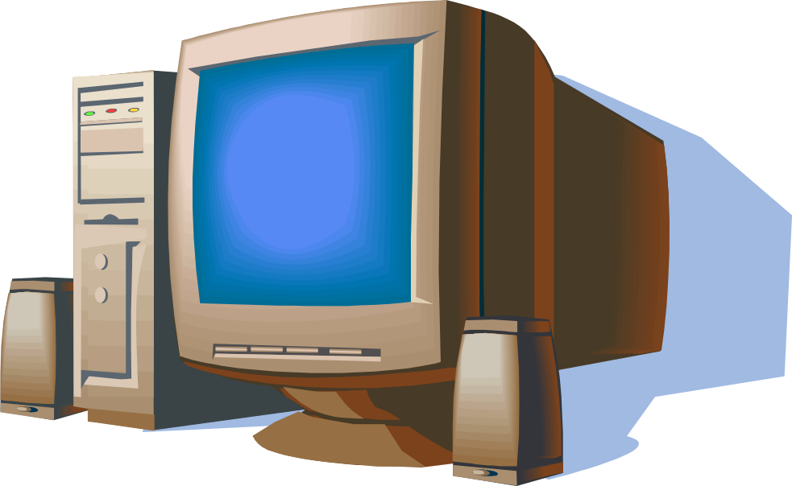
Configuring the Client
Configuration files
Personality Script
Connecting to Server

Slide 4
Configuration files
  XML based configuration files
  Engine config:
    Configure the (C++) client engine
    <resources_folder>/engine_config.xml
  Script config:
    Used to configure scripts on startup
    <resources_folder>/scripts_config.xml
  User Preferences:
    Configure graphics, display and game specific settings
    <working_folder>/preferences.xml

Slide 5
Configuration files
  Entities:
    List all the entities to be used
    <resources_folder>/entities.xml
  Resources:
    Specify resources to be used in the game
      e.g. the loading screen
    Override these for your own purposes
    <resources_folder>/resources.xml

Slide 6
Debug Key
Many debugging features are accessed via the DEBUG key.
  e.g. Python console, watchers, and performance monitor.
Defaults to tilde.
  Can be reconfigured in engine configuration XML.
Notes:
There can actually be multiple debug keys defined, as well as key combinations.

Slide 7
Personality Script
  Global script used to start up the client
  Load and Update settings
  Initialise the game
  Handles the global Logic
    In game menus
    Connection to Server
  There are personality scripts for the base and cell apps as well
  Location:
    <resources_folder>/scripts/client/<script_name>.py
  example.py

Slide 8
Personality Script
  Interaction is handled via Notification Methods or Callbacks
Method | Description
init(…) | Called when BigWorld is ready to initialise. (engine, script and perference config files are passed as parameters)
start(…) | Called after BigWorld has initialised, and is ready to run***
fini(…) | Called when BigWorld shuts down
handleKeyEvent(…) | Called when the user presses a key…
handleMouseEvent(…) | … or moves the mouse
handleAxisEvent(…) | … or moves the joystick
onChangeEnvironments(…) | Called when the player goes from outside to inside or vice versa
onRecreateDevice(…) | Called when the screen resolution changes

Slide 9
Connecting to Server
  Connecting to Server is done via a BigWorld python module method
  BigWorld.connect(hostName, args, connectionCallback)
    hostName: String with the IP or domain address of the login server
    args: Optional Python object with
      username: Name of player will display and be represented by
      password: Password to ensure player authenticity
      inactivityTimeout: Seconds before player is disconnected if no updates are received
    connectionCallback: Optional Python method that will be called with the various stages of the login process

Slide 10
Connection Callback function
  def connectionCallback(self, stage, status, msg)
    stage: Defines the current phase of connection
      0 Client could not initiate login
      1 Client has connected to Login Server
      2 Client has received data from Login Server (connection is complete)
      6 Client has been disconnected from Login Server
    status: Indicates outcome of that phase
      'NOT_SET‘ : Not set
      'LOGGED_ON' : Account Login succeeded
      'CONNECTION_FAILED‘ : Login failed: Unable to contact login server
      etc
    msg: Text message describing the response

Slide 11
Connection Information
  BigWorld.LatencyInfo().value
    A read only Vector4 of this clients network latency information
    isOnline, minLatency, maxLentency, avgLatency
  BigWorld.serverDiscovery
    servers: List of available servers as serverDiscovery::Detail objects
    searching: 1-Initiates search of BigWorld servers on LAN
      0-Stops current search and clears server attributes
    changeNotifier: Python function to be called every time a Details object is created or updated in the servers attribute list

Slide 12
Connection Information
  serverDiscovery::Details (read-only)
    hostName: Name of host machine
    ip: IP address of host machine, as integer. 1st byte is most significant
    port: Access port that the host machine is listening to for connections
    uid: User ID of host to uniquely identify multiple servers on a machine
    ownerName: Name of the user who launched server
    usersCount: Total connection attempts made by any client to this host
    universeName: Name of universe currently playing on server
    spaceName: Name of space currently playing on server

Slide 13
Demo Time
  Presented:
    Configuration XML Files
    Personality Script
    Server Connection
    Demo App:

Slide 14
Entities
Entity Architecture
Client Entity
Entity Script
Client – Server Communication
Physics
Movement Filters
Player Entity

Slide 15
Entity Architecture
The Entity
Cell
Base
Client

Slide 16
Client Entity
Entity
1
1
0-1
0-*
smoothes movement
Filter
PyModel
represents visually
1
0-*
Motor
moves & animates

Slide 17
Entity Script
  Recall Distributed Entity Model from Server Training
  Entities can exist on Cell, Base and Client
  Interface (definition), Python (implementation)
  The script implements:
    <ClientMethods>, as described in the definition file
    Property notification methods: set_propertyName()
    General notification methods
    Any other client-side behaviour

Slide 18
Entity Notification Methods
Method | Description
onEnterWorld(…) | Called when BigWorld has inserted the Entity into the game world
onLeaveWorld(…) | Called when the Entity is about to leave the game world
targetFocus(…) | We have acquired a new target
targetBlur(…) | We have lost our target
targetModelChanged(…) | The target’s model has changed
Reload(…) | Called when scripts are reloaded. Here we can reset our state as required
Controlled(…) | Lets us know our controlled state has changed

Slide 19
Client – Server Communication
  Client entities have base and cell mailboxes to communicate to the server
  Entity.base.methodName()
    Calls method on the base component of entity
    Only valid for the player entity
  Entity.cell.methodName()
    Calls method on the cell component of entity
    Valid for all entities on the client with a cell component

Slide 20
Physics
  Entity physics is used to manipulate the movement of the entity
  Only controlled entities are allowed to use physics
  Each entity mush initialise its physics attribute with a physics type
  Example:
    self.physics.type = 0
      Set physics to standard player-style physics
    self.physics.collide = 1
      Activates collision detection
Type | Description
0 – Standard | Falls, collides with scenery
1 - Ripper | Hovering Vehicle
2 - Limpet | Use physics.chase to stick to an entity

Slide 21
Using Physics
Method | Description
seek() | Make the player travel to a position in the world
stop() | Stop seeking
Attribute | Description
velocity | Set the velocity of the player
userDirected | Cause Entity yaw to be affected by the DirectionCursor, i.e. the mouse
dcLocked | Temporarily detach Entity yaw from mouse control
gravity | Set the amount of gravity, i.e 9.8
fall | Set to true to allow the entity to fall
collide | Allow collisions with scenery

Slide 22
Movement Filters
  Filters allow for smooth movement in the game
  Position updates from the server may be infrequent
  Use an Entity Filter to provide a real-time position
  Example:
    Entity.filter = BigWorld.AvatarFilter()
    Creates a simple filter and attaches it to the entity
    Linearly Interpolates the positions received from the server

Slide 23
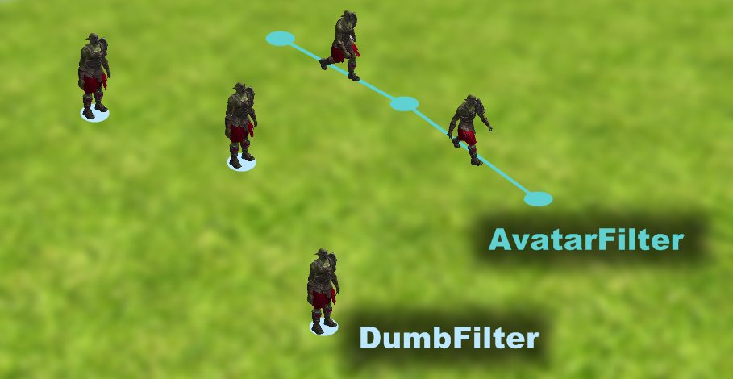
Movement Filters

Slide 24
Movement Filters
Filter | Description
DumbFilter | Does nothing
AvatarFilter | Linearly interpolate the last 8 position updates
AvatarDropFilter | As above, but also drops the entity onto the ground
PlayerAvatarFilter | Use the player’s input, but accept server overrides
BoidsFilter | Control many models using a flocking algorithm

Slide 25
Player Entity
Entity
Avatar
NPC
PlayerAvatar
Input Handling
Player Controlled

Slide 26
Player Entity
  The player entity’s Python object must:
  Be a class that inherits from an actual Entity class
  Be called Player<ParentClassName>
    Example: PlayerAvatar
  BigWorld.player()
    Returns current player entity
  BigWorld.player(entity)
    Sets new player entity
    No effect if no Player<entity> class exists
    onBecomeNonPlayer() called on the old player entity
    onBecomePlayer() called on the new player entity
    There can only be one player entity at any one time

Slide 27
Controlled Entities
  A Controlled Entity is directed by a client, and sends position updates to the server (e.g. Player)
  A Non-controlled entity receive server updates
  Any number of entities can be controlled, i.e., affected by user input
    Player in big boat
    A “Redeemer” weapon
    A “Lost Vikings” game

Slide 28
Controlled Entities
  Example:
    BigWorld.controlEntity(entity, controlState)
      If controlState is true, then entity will act as a player (input impacts movement, uses direction cursor, etc...)
      Notification method informs entity that it is now controlled
        def controlled(self, bool)

Slide 29
Demo Time
  Presented:
    Entities
    Physics
    Filters
    Player
    Controlled Entities
    Demo App:

Slide 30
Models
Model Overview
Model Creation
PyModel
PyModelNode
PyAttachment
PyFashion
Model LOD
Motors
Trackers

Slide 31
Model Overview
  The Model represents a 3D Object
  Entities may have 0 or more models, usually 1
  They have one primary model, and n secondary models
  They can be attached to other models too, more about that later…
  Examples :
    pyModel = BigWorld.Model(modelFile,…)
      modelFile takes .model paths and returns a PyModel object
      Can pass any number of .model paths, which are joined to produce a single PyModel according to node structures
    pyModel = BigWorld.PyModelObstacle(modelFile,…)
      Create a model that exists in the collision scene

Slide 32
Models Overview
    entity.model = pyModel
      Sets the main model for the entity
    entity.addModel(pyModel)
      Adds secondary models to the entity (e.g., a spell effect)
    entity.delModel(pyModel)
      Removes secondary models from the entity
    entity.models
      Python list of secondary models
    model.position = (x,y,z)
      Set the position of the model

Slide 33
Model Creation
  Models and animations are created in 3ds Max and exported with the BigWorld exporter
    .primitives Raw mesh data
    .animation Raw key frame animation data
    .visual Node hierarchy, rendering info,
    bounding box.
    If a node name starts with HP_, then it is a
    hard point attribute that returns a PyModelNode. See example file.
    .model Refers to the .visual file, and includes
    animations, actions, dyes.
    See example file.

Slide 34
PyModel
Model
Node
Node
Node
Node
Attachment
Node
Node
Node
Attachment
Node
Node

Slide 35
PyModelNode
  Use nodes to make attachments to your model
  Two ways to access a PyModelNode:
    model.HardPointName attributes
    Returns the node called HP_HardPointName
  model.node("nodeName") method
    Returns the node called nodeName
  model.myHardPoint = pyModel
    Attaches a secondary model to a node on main model (e.g., a gun)
  node.attach(PyAttachment)
  node.detach(PyAttachment)
  node.attachments

Slide 36
PyAttachment
  Any number of PyAttachment objects can be attached to any PyModelNode
    …but a PyAttachment can be attached to only one PyModelNode at any one time
  PyAttachments include:
    PyModel Any PyModel can be attached to another
    ParticleSystem Describes particle behaviour
    PySplodge A generic shadow cast by the sun
      Width, height and LOD can be customised
      Shadow texture configured in engine_config.xml
    GuiAttachment Allows attachment of GUI components

Slide 37
PyFashion
  PyFashion objects alter the look of a PyModel
  PyDye(matter, tint)
    Changes the material of parts of a PyModel as specified in the .model file. See python_client.chm.

Slide 38
Model LOD
  Model Level of Detail can be used to increase performance.
  Models can define simplified versions of complex models.
  BigWorld automatically swaps the models based on the cameras position.
  Controlling LOD by:
    Material: define fewer shaders.
    Mesh: create models with fewer polygons.
    Node: remove node influences in skeletons.

Slide 39
Motors
  Motors are used to move, orient and animate models
  Entity Models by default are drawn at the origin
  When a PyModel is assigned to Entity.model, it has an ActionMatcher motor added to it automatically
  The action matcher moves a model to where the entity is
  It also performs animations – we’ll talk about this later

Slide 40
Motors
  Examples:
    motor = BigWorld.Propellor(parameters)
      Creates a propellor motor
    self.model.addMotor(motor)
      Adds motor to the model
      Multiple motors will each get a turn to impact the PyModel, which may cause clashes
    self.model.delMotor(motor)
      Removes motor from the model

Slide 41
Motor Types
Motor | Description
ActionMatcher | Moves PyModel to to where the Entity is, and shows an appropriate animation
Propellor | Moves PyModel by applying a point of force
Oscillator | Rotate model back-and-forth (security camera)
Oscillator2 | Oscillate around world origin
LinearHomer | Travel directly to target
Homer | Homes with given turn rate and speed
Bouncer | Use physics to bounce model (grenade)
Servo | Sets PyModel position based on a signal

Slide 42
Trackers
  Trackers override the animation for a node
  Changes yaw and pitch of a pointingNode based on a direction provider
  Blends nodes connected to the pointingNode to in-between positions. Blending determined by TrackerNodeInfo
    Example: Turning head to face another entity, partially turning
    neck and shoulders
  They point a node(s) in a direction, after the animation has been applied

Slide 43
Trackers
  Example:
    tracker = BigWorld.Tracker()
    tracker.directionProvider =
    BigWorld.DiffDirProvider(sourceMatrix,
    targetMatrix)
    tracker.nodeInfo =
    BigWorld.TrackerNodeInfo(self.model,
    "Head", [( "Neck", 0.5 )],
    "None", -100, 100, -100, 100, 100 )
  Attach and remove Tracker:
    self.model.tracker = tracker
    del self.model.tracker

Slide 44
Demo Time
  Presented:
    Model Creation
    PyModel and PyModelNode
    Attachments
    Fashions
    LOD
    Motors
    Trackers
    Demo App:

Slide 45
Animations and Actions
Animations and Actions Overview
Playing Actions
Actions Architecture
ActionQueuer
ActionMatcher

Slide 46
Animations and Actions Overview
  Animations perform the movements on the 3D model using skeletal animation or morphing
  Actions are used to play animations on models but have additional properties

Slide 47
Playing Actions
  ActionQueuers are used to control animations from Python
  Play an action immediately:
    Model.Jump()
  Play an action in 1 second:
    Model.Jump(1.0)
  Play an action in 1 second, then call back the script when complete:
    Model.Jump(1.0, self.onJumpComplete)
  Play an action, then play another action when that is finished.
    Model.Jump().Land()

Slide 48
Actions Architecture
ActionMatcher
Action Queue
ActionQueuer
Walk
Breath Heavily
ActionQueuer
Hold Object Lefthand
Wave Righthand
ActionQueuer
…

Slide 49
ActionQueuer
  Store an Action to call at anytime:
    myJumpAction = Model.action("Jump")
    myJumpAction = Model.Jump
  myJumpAction(afterTime, callBack, promoteMotion)
    Adds the ActionQueuer to the ActionQueue
    All arguments are optional
      afterTime Delay before queuing the action
      callBack Method to call when action completes
      promoteMotion Boolean defining whether animation will move the entity
  All Actions are blended
    No popping of animations
    Blend in / Blend out
    Blend between other actions that are playing
    All on a per-node basis

Slide 50
ActionQueuer Attributes
Attribute | Description
track | Integer. Actions will replace any action playing on the same track. -1 means ‘no track’
blendInTime | Time in seconds for an action to fully affect the model
blendOutTime | Time in seconds for an action to completely stop affecting the model
duration | Time in seconds for the complete action to play out
displacement | Distance in metres the action moves the model
rotation | Angle in radians the action turns the model

Slide 51
ActionMatcher
  Chooses and displays animations, given only the basic movement updates from the server
    Added as a default motor when a PyModel is assigned to Entity.model
  Every action can have a <match> section, which can contain a <trigger> and a <cancel> section
    Note matches like minSpeed, maxSpeed
    See example here : base.model
    This is setup in ModelViewer
  See the ActionMatcher at work:
    BigWorld.debugAQ(BigWorld.player())

Slide 52
ActionMatcher Attributes
  matcherCoupled
    Defaults to 1. Set to 0 to turn off
  inheritOnRecouple
    Defaults to 1. Player Entity will be moved to PyModel position to prevent visual jarring
  lastMatch
    Name of the last action taken
  matchCaps
    List of numbers between 0 and 31 that represent the a user-defined state of the ActionMatcher
    Actions can specify certain states in order to be selected for matching

Slide 53
ActionMatcher Attributes
  turnModelToEntity
    Determines if ActionMatcher should adjust PyModel yaw to match direction of entity
      If set to 0, ActionMatcher will not change yaw at all
  footTwistSpeed
    Rate at which the entire PyModel can twist yaw to face the current direction of its entity owner

Slide 54
Demo Time
  Presented:
    Animations
    Actions
    ActionQueuer
    ActionMatcher
    Demo App:

Slide 55
Cameras and Viewing the World
Camera Types
Creating and Using Cameras
Setting up views

Slide 56
Camera Types
  CursorCamera
    Uses DirectionCursor to follow line of sight at a desired distance from the entity
  FreeCamera
    No limits, no collision, freely flys around the world, controlled by arrow keys and mouse
    freeCamera.fixed = 1 will stop any movement

Slide 57
Creating and Using Cameras
  BigWorld.CursorCamera()
    Creates a CursorCamera
  camera.target = BigWorld.PlayerMatrix()
    BigWorld.PlayerMatrix() returns MatrixProvider
    target is updated as player position is updated
  BigWorld.camera(camera)
    Only one camera can be in use at any one time
  BigWorld.firstPerson(true)
    Cursor camera operate in 1st or 3rd person mode

Slide 58
Creating and Using Cameras
  camera.set(transformMatrix)
    Sets the world transform of the camera
  camera.position
    Current position of the camera
  camera.direction
    Current orientation of the camera
  camera.matrix
    Current world → camera transform
  camera.invViewMatrix
    Current camera → world transform

Slide 59
Setting up view
  BigWorld.projection()
  Returns the singleton projection object
  Contains:
    nearPlane
      Distance to the near clipping plane for the current camera
    farPlane
      Distance to the far clipping plane for the current camera
    fov
      Field of view of the current camera, between 0 and pi
    rampFov(newFOV, timeAllowed)
      Changes to the given field of view over the specified time period

Slide 60
3D Engine
Engine Overview
Visuals
EffectMaterials
Lighting
Textures
Height-Mapped Terrain

Slide 61
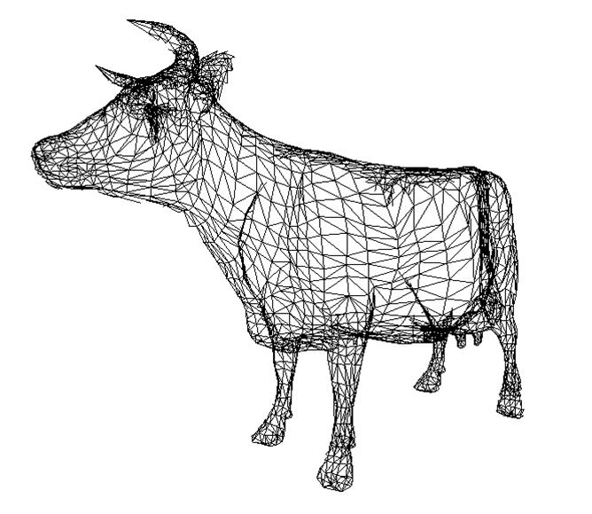
Engine Overview
  DirectX9 engine
  Left-handed coordinate system
    X–right, Y–up, Z–into the screen
  Extensive use of .fx files
  Height-mapped terrain
  Skeletal animation
  Skinning (3-bones per vertex)
  Render channels for delayed
  rendering
  Called Moo because quick to type

Slide 62
Visual
  Low-level renderable object, exported from content creation application
    3ds Max, Maya
  Most in-game objects rendered with visual
    Characters, scenery objects, shells, etc...
  Contains:
    Primitives Vertices and indices
    Skeleton Nodes hierarchy
    Materials EffectMaterial
    Collision data BSP tree

Slide 63
Effect Material
  Uses ID3DXEffect
  Variables
    Artist-editable variables
    Auto variables (using variable semantics)
  Technique annotations
    Informs the renderer about skinning, normal mapping, render channels and graphics settings.

Slide 64
Lighting
  8 Dynamic lights
    2 Directional lights
    4 Point lights
    2 Spot lights
    Culled to objects
  Static vertex lighting
    Shells and indoor objects
Property
Directional
Point
Spot
Colour
✓
✓
✓
Direction
✓
✗
✓
Position
✗
✓
✓
Inner radius
✗
✓
✓
Outer radius
✗
✓
✓
Cone angle
✗
✗
✓

Slide 65
Textures
  The engine compresses and scales textures based on rules defined by TextureDetailLevel or a .texformat file
  TextureDetailLevel matches the resource name – or part of it – to a rule, in order to decide:
    Texture format
    Texture format when compressed
    Whether the texture needs to be rescaled
  Behivour in relation to texture quality settings.texformat is an XML file that can be used to determine the format of a texture.
    If a .texformat file exists with the same name as a texture, then the file will decide the format of the texture.

Slide 66
Textures
  Compressed and scaled textures are cached to .dds (or .c.dds if compressed) files with the same name as the source texture Mip-map chain generation rules

Slide 67
Height-Mapped Terrain
  100x100 metre blocks
    Same size as chunks
  Height pole frequency defined per space
  Arbitrary number of texture layers
    4 layers per pass
    Layer mask detail set per space
    Independent of height pole frequency
  Alpha component contains specular luminance

Slide 68
Demo Time
  Presented:
    Effect Files
    Lighting
    Textures
    Demo App:

Slide 69
Gaming Aspects
Direction Cursor
Targeting
Traps
Matrix and Vector4 Providers
Profiling & Engine Statistics

Slide 70
Direction Cursor
  The Direction Cursor is a vector that extends from the Player's head
  Mouse input affects the angle of this vector to produce a potential line of sight
  Provides a full, dynamic matrix (position and orientation)
Mouse position
Direction Cursor
Player’s Head

Slide 71
Direction Cursor
  dc = BigWorld.dcursor()
    Get the Direction Cursor object
  BigWorld.dcursor(dc)
    Activates the direction cursos (activated by default)
  Many BigWorld objects can use the Direction Cursor
    Trackers can animate body parts to face along line of sight
    ActionMatcher animates PyModel to match pitch/yaw
    Cursor Camera sits behind head, looking along line of sight

Slide 72
Targeting
  BigWorld.target
    Access the BigWorld Targeting System
  BigWorld.target()
    Retrieves the Entity closest to the center of the screen
    Or you can use your own view vector for targetting
  Use Bit Fields to allow selective targetting
    BigWorld.target.caps( [NPCs, Monsters] )

Slide 73
Traps
  Triggers a callback whenever the player entity on a given client enters or leaves the trap
  BigWorld.addPot(centre, radius, callback)
    Returns a trap ID that can be saved
    Creates a spherical, player-only trap denoted by the given MatrixProvider and radius, invoking callback when triggered
  def trapCallback(entered, trapID)
    entered will be 1 if player has entered the trap, 0 if left it
  BigWorld.delPot(trapID)
    Destroys trap

Slide 74
Matrix and Vector4 Providers
  A “provider” is an abstract interface that is queried for a value of some type
    Since a provider is a class object, and the query method is virtual, the concrete provider class can be as dynamic as it wishes
    This paradigm is used by BigWorld to allow continually changing values to be fed from one object to another these objects needing to know about concrete provider types
    Allows Python to setup controllers without requiring any Python code to be ticked per-frame
Notes:
In other words, an input can be given a value without knowing or caring where the value comes from

Slide 75
Matrix and Vector4 Providers
  Vector4 providers
    Some examples:
      Vector4Animation – interpolates between two or more Vector4’s over time
      Vector4LFO – provides a waveform over time
      Vector4Morph – morphs between two values over time
  Matrix providers
    Some examples:
      MatrixAnimation – interpolates between two or more matrices over time
      PyModelNode – a matrix provider that represents a joint’s transform in world space
      MouseTargetingMatrix – provides a world space direction matrix representation of the mouse cursor (i.e. for picking)

Slide 76
Example Vector4Provider Usage
Animating exposed shader parameters
  e.g. Vector4LFO to create a pulsating effect on a model:
  lfo = Math.Vector4LFO()
  lfo.period = 0.5
  lfo.waveform = ‘SINE’
  $p.model.Single_material_skinned = ‘Merchant’
  $p.model.Single_material_skinned.clothesColour3 = lfo

Slide 77
Example MatrixProvider Usage
Moving a model using a motor
  e.g. make a box that floats 2 metres above the player
  model = BigWorld.Model(“sets/town/props/axe.model”)
  t = Math.Matrix()
  t.setTranslate( (0,2,0) )
  product = Math.MatrixProduct()
  product.a = $p.matrix
  product.b = t
  model.addMotor( BigWorld.Servo(product) )
  $p.addModel( model )
Entity.matrix
Constant Matrix
MatrixProduct
Servo

Slide 78
Profiling and Engine Statistics
  Real-time Profiling Console
    Accessed in-game via DEBUG+F5
    Displays various statistics, averaged over the last few frames
      Frame rate
      Primitive counts
      Breakdown of Dog Watcher hierarchy
  Dog Watchers
    Named sections of code marked for timing
    Allows for hierarchical profiling of different parts of the code

Slide 79
Profiling and Engine Statistics
  Profiler
    Camera follows a specific path for a fixed number of frames
    Outputs per-frame details into an CSV spreadsheet for analysis
    Can run in “Profiler History” mode
      Similar to standard profiler, but the game remains interactive
      Useful for testing specific cases that cannot be automated
  Soak testing
    Runs a camera fly-through for a certain amount of time
    Frame rate is not limited – provides average frame rate at the end
    Used to test whether the game will run for long periods of time
    Outputs MemTracker stats every 6 seconds
    Outputs CSV file as in the profiler test, but includes memory totals
Notes:
Profiler CSV output
Total time to execute entire frame
Time spent in a particular section of code
Number of times a particular section of code was executed
“Profiler History” mode
The frame rate is not limited
Writes CSV file every 60 seconds
Soak testing
Long term testing - usually run for hours at a time

Slide 80
Demo Time
Presented:
  Direction Cursor
  Targeting
  Traps
  Matrix and Vector Providers
  Profiling
  Demo App:

Slide 81
Particle Systems and Effects
Particle Systems
Flora
Weather
Water

Slide 82
Particle Systems
  SpriteParticleRenderer()
    Renders each particle as a single sprite
  PointSpriteParticleRenderer()
    Renders each particle as a pointsprite (maximum size of 64 pixels)
  AmpParticleRenderer()
    Draws a series of wiggly lines back to the source to simulate, for example, electricity
  BlurParticleRenderer()
    Draws particle trails (cheap)
  TrailParticleRenderer()
    Draws particle trails (more expensive)
  MeshParticleRenderer()
    Renders each particle as a mesh object

Slide 83
Particle System Actions
Action | Description
Source | Creates particles over time, on demand or on move
Sink | Destroys particles over time or under speed
Barrier | Forms an invisible shape to reflect or stop particles
Force | Applies a constant acceleration to particles
Stream | Converges the velocity of particles to a stream
Jitter | Adds random motion to the particles
Scaler | Scales a spawned particle over time
TintShader | Tints a particle according to its age
NodeClamp | Links particles to the PyModel Node to which the
Orbiter | Causes particles to orbit around a point
Flare | Draws a lens flare from one or more particles
Collide | Collides particles with the 3D collision scene
Splat | Similar to Collide, but calls into script per-collision
MatrixSwarm | Causes particles to swarm around targets
Magnet | Accelerates particles towards a particular point

Slide 84
Using Particle Systems
  Pixie.create(fileName)
    Returns a ParticleSystem or MetaParticleSystem
    Loads definition from XML file fileName
  Pixie.ParticleSystem(capacity)
    Creates an empty ParticleSystem
    Initial capacity is capacity particles (default is 100)
  Pixie.MetaParticleSystem()
    Creates an empty MetaParticleSystem
  model.rightHand = ps
    Attaches ParticleSystem ps to the rightHand node

Slide 85
Weather
Weather API exposed to python:
  BigWorld.addSkyBox – fade in/out additional sky box models
  BigWorld.weatherController – control rain streaks
  BigWorld.sunlightController – sunlight colour multiplier
  BigWorld.ambientController – ambient lighting colour multiplier
  BigWorld.fogController – fog colour and density multiplier
  These all take a Vector4Provider to allow dynamically controlled values
Additional particle effects can be attached to the player via usual mechanisms
  Systems such as snow use the ‘outdoors only’ flag to avoid appearing inside
Clients are kept in sync via the environment sync
Create localised weather systems by creating a weather entity
Notes:
* Environment sync:
* Server simply sends a weather pattern name (e.g. ‘STORMY’)
* Python scripts are notified when this is changed by the server and are responsible for updating the current weather as appropriate
* Localised weather effects can be achieved by creating an entity that overrides the space’s default weather pattern when the player is nearby

Slide 86
Flora
A system that allows lots of small detail objects to be rendered efficiently within a radius around the player
  e.g. grasses, ferns, pebbles, debris
    The shape of individual flora objects are defined by .visual files.
  Non-interactive (i.e. no collision between player and flora)
  Can be animated over time using a Perlin noise generator
Fades in/out in distance as the player moves
Placement is automatic, driven by the underlying texture on the terrain
  e.g. a grass texture would create grass floras
  Texture -> flora mappings defined in the flora XML file

Slide 87
Water
Individual water bodies placed in the WorldEditor
Tweakable shader parameters
  e.g. colour, fresnel exponent, texture scale, ripple size/speed/direction
Reflection/refraction
Normal map based ripple physics simulation that responds to objects moving across the surface
Uses MRT depth buffer to create soft edge and foam effects
  High-end feature

Slide 88
Demo Time
  Presented:
    Particle Systems
    Weather
    Flora
    Water
    Demo App:

Slide 89
BigWorld GUI
GUI components
  Provides a hierarchy of 2D quads which render to the screen in correct order, and which detect input events
  Can be serialised to/from an XML file
Component scripts
  A Python class instance that is attached to a particular component in order to handle logic
  e.g. button, slider, action bar
Input handling
  Component posts keyboard and mouse events to the attached script object
Mouse cursor

Slide 90
Component Types
  Simple(texture)
    texture can be a path to a texture, or a PyTextureProvider
    All other component types derive from this type.
  Window(texture)
    Children inherit the position of the Window
    Clips children to the region of the Window
    Can be used to scroll the children within the Window
  Frame2(texture)
    A resizable frame that avoids texture stretching
  BoundingBox(texture)
    Renders texture at the corners of an entity's bounding box (projected to screen).
Notes:
Frame2:
* old Frame used 8 draw calls,
* uses subregions of the one texture
* tiles the background

Slide 91
Component Types
  Text(text)
    Renders a line of text using a bitmap font
    The currently used bitmap font can be changed at runtime
  MeshAdaptor()
    Contains a PyModelAttachment to be included in the GUI tree

Slide 92
Component Layout
By default, components are defined in clip space (position and size)
  So 0, 0 is the centre of the screen and +Y is up and +X is to the right
  The clip space ranges from -1.0 to +1.0 on both axis, so the screen is 2.0 units wide and 2.0 units high
  Allows a GUI to be designed to be resolution independent
  Also allows a component position to be anchored at different locations
    e.g. a component can have its horizontal clip space position set to 1.0, with its horizontal anchor set to RIGHT in order to have a component float on the right hand side of the screen.

Slide 93
Component Layout
A Simple GUI component does not inherit position from its parent…
…unless the parent is a Window component
  If a child is defined in clip space, then the clip space is contained within the window
  So 0,0 is the centre of the window, -1.0 is the left side of the window, +1.0 is the right side of the window, etc.
If desired, you can define a component’s position or size in pixels, relative to the top left of the screen (or Window, if it is a child of a Window component)

Slide 94
Component Layout
Clip space position and anchors
+1.0
position.x = -1.0
horizontalAnchor = “LEFT”
position.y = 1.0
verticalAnchor = “TOP”
position.x = 0.0
horizontalAnchor = “CENTER”
position.y = 1.0
verticalAnchor = “TOP”
position.x = 1.0
horizontalAnchor = “RIGHT”
position.y = 1.0
verticalAnchor = “TOP”
position.x = -1.0
horizontalAnchor = “LEFT”
position.y = 0.0
verticalAnchor = “CENTER”
position.x = 0.0
horizontalAnchor = “CENTER”
position.y = 0.0
verticalAnchor = “CENTER”
position.x = 1.0
horizontalAnchor = “RIGHT”
position.y = 0.0
verticalAnchor = “CENTER”
-1.0
+1.0
position.x = -1.0
horizontalAnchor = “LEFT”
position.y = -1.0
verticalAnchor = “BOTTOM”
position.x = 0.0
horizontalAnchor = “CENTER”
position.y = -1.0
verticalAnchor = “BOTTOM”
position.x = 1.0
horizontalAnchor = “RIGHT”
position.y = -1.0
verticalAnchor = “BOTTOM”
-1.0

Slide 95
Component Layout
Window transform inheritance
+1.0
+1.0
position.x = -1.0
horizontalAnchor=“LEFT”
position.y = 1.0
verticalAnchor = “TOP”
-1.0
+1.0
-1.0
+1.0
position.x = 1.0
horizontalAnchor=“RIGHT”
position.y = -1.0
verticalAnchor = “BOTTOM”
-1.0
-1.0
Notes:
Larger dark blue box is the WindowGUIComponent, and is defined in screen clip space
Light blue boxes are children of the Window, and are defined in the clip space defined by the window
When the window is moved, children will maintain their relative position and size (if size is defined in CLIP)
NOTE: Position mode for new components default to “LEGACY”, above behaviour will only occur when position mode is set to “CLIP”

Slide 96
GUI Shaders
  Modifies the appearance of a GUI component
    Not to be confused with vertex/pixel shaders
    Can attach multiple shaders to a single component
  AlphaShader()
    Controls the alpha blending of a GUI component
  ClipShader()
    Clips a component. Example: a progress bar
  ColourShader()
    Dynamically changes or adjusts colour of a GUI component
  MatrixShader()
    Moves and resizes GUI components

Slide 97
Example
  Create and configure the Components
    guiBG = GUI.Simple("bg.bmp")
    guiBG.position = (-1, -1, 0.5)
    guiText = GUI.Text("blah")
    guiText.position = (-1, -1, 0.4)
    guiText.font = "default_small.font"
  Add the components to the GUI tree
    guiBG.addChild(guiText)
    GUI.addRoot(guiBG)
  Apply shaders to GUI
    alphaBlend = GUI.AlphaShader()
    guiBG.addShader(alphaBlend)

Slide 98
Attaching GUI to Models
  GuiAttachment inherits from PyAttachment
    Can be attached to a PyModelNode
    A GUI component can then be attached to the GuiAttachment
  Example
    guiBG = GUI.Simple("bg.bmp")
    guiAttach = GUI.Attachment()
    guiAttach.component = guiBG
    model.rightHand = guiAttach

Slide 99
Input Handling
  A GUI component script can handle input events by setting the appropriate flags on the component and implementing callbacks as required.
  Input Callbacks:
    handleKeyEvent( … )
    handleCharEvent( … )
    handleMouseEvent( … )
    handleAxisEvent( … )
    handleMouseClickEvent( … )
    etc.
Notes:
Etc includes drag+drop related events:
handleDragStartEvent
handleDragStopEvent
handleDragEnterEvent
handleDragLeaveEvent

Slide 100
International Keyboard Support
The input system generates character events based on the user’s active keyboard layout.
  Implemented using WM_CHAR
  Supports “dead” keys
    E.g. on a Spanish keyboard you can enter the character “é” pressing the apostrophe key followed by the e key.
  handleCharEvent is called multiple times based on the user’s auto-repeat settings.
  Characters are passed into Python as Unicode strings.
Notes:
No support yet for IME
Dead keys: The apostrophe does not itself generate a character event and is known as a “dead key”.
Auto-repeat: in 1.9.3+ only charEvent auto-repeats. keyEvent does not, however this can be easily changed if desired (trivial C++ change).
In 2.0 keyEvent will also auto-repeat (e.g. to get repeats on arrow keys).

Slide 101
Mouse Cursor
  The MouseCursor object encapsulates all cursor behaviour
  Cursor shapes are defined via the mouse cursors definition file…
    default file: gui/mouse_cursors.xml or
    specify file in resources.xml under gui/cursorsDefinitions
  …or you can define a mouse cursor shape from a PyTextureProvider.
    for example, you can combine this with a PyModelRenderer to have a dynamically rendered 3D mouse cursor.

Slide 102
Demo Time
  Presented:
    GUI Components
    Input Handling
    Mouse Cursor
    Demo App:

Slide 103

Conclusion
This completes the Client training
Detailed information can be found in the Python documentation
Thanks for attending

