Slide 1


HACK THE BEGINNING 2026
I N F O R A M T I O N
TEAM IncuFlow
TEAM NAME :
PROBLEM STATEMENT :
AI-Powered Incubation Document Automation
AI-Powered Incubation Document Automation
MEMBERS :
Aryan, Love Chauhan, Farhan Farooque
AI-Powered Incubation Document Automation
AI-Powered Incubation Document Automation

Slide 2




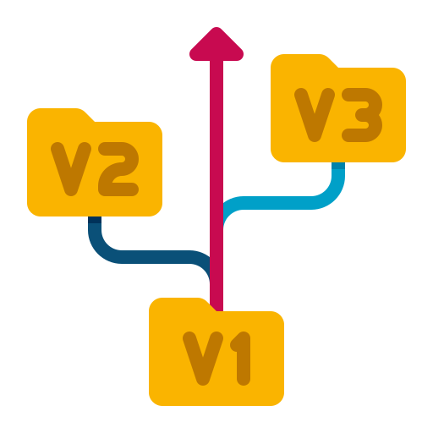





INTRODUCING KairoDocs
KairoDocs Web App Workflow
USER UPLOADS RANDOM FORMATTED DOCUMENT
GENERATE DOCS
AI POWERED
PERSONAL DASHBORD
DOCUMENT DATA ANALYASED VIA LLM MODEL
STANDARD FORMAT DOCUMENT GENERATED
SAFE DAYTABASE
VERSION CONTROL
EASY RE-EDIT
FILE SUBMITTED TO THE SPECIFIC MENTOR
MENTOR CHECK AND APPROVE THE BILL
TEMPLATES
AUTHENTICATION
24/7 HELPLINE

Slide 3




TECHNICAL APPROACH
P R O C E S S F L O W A R C H I T R E C T U R E
Algorithm Development
Next.Js Routing, Telegram WebHook for File Hosting
Mentor Dashboard
User Dashboard
Admin Dashboard
Website Development
HTML , CSS , JS, HeroUI V3 , Next,js, Figma, Stitch
SEND SUCCESSFUL
QUERY
SEND FOR APPROVAL
Encryption and Security
File Upload
File Approved
Firebase Authentication , Google Account Login
Cloud Services
Firebase- Database , API Key – Google Flash 3 , RAG Database – Pinecone, Deploy- Vercel
SEND ALL FETCHED
NPUTS
Template Upload
AI Model Analyze
Standard Doc
RAG Trained

Slide 4
DASHBOARD DETAILS
USER DASHBOARD
MENTOR DASHBOARD
ADMIN PANEL
NEGATIVE IMPACTS
Generate new Mentor ID
Track Overall Projects
Add / Edit Templates
Authenticate Users
Configure Backends
Add Sections
Edit Document Layouts
Add / Delete Histories
Review Mentor Approvals
Add / Delete Rules
Submit New Files ( Work Orders, Builds, MOU’s, Invoice
Edit the Generated Files
Requests for Project Approval
In-App Chat and Queries
See Previous Documents
View New Opened Projects
Approve the Project / Documents From User
Suggest for Changes
Hold the Project and Review
See Previous version of Documents.
SOLUTION BENIFITS

Slide 5
MARKETING SCOPE
Incubation Centers & Accelerators:
Organizations looking to streamline the submission and approval process for startup work orders and MOUs.
Early-Stage Startups:
Founders who require automated, standard-format document generation (Invoices, MOUs) to maintain professionalism with minimal effort
Corporate R&D Wings:
Departments managing multiple sub-projects that require rigorous documentation and multi-level approval workflows.
Educational Institutions:
Universities needing a standardized platform for student project submissions, mentor reviews, and version control.

Slide 6






FEASIBILITY AND VIABILITY
Platform & Software Used
Github
Firebase
Antigravity
Telegram
ImgBB API
Vercel
Gemini API
Pinecone

Slide 7
RESEARCH AND REFERENCES
TOOLS USED
REFER LINKS USED
ATTRIBUTION :
ICONS USED FROM FLATICON.COM
https://flaticon.com/
https://firebase.com/console
https://flaticon/.com/
https://pinecone.com
© COPYRIGHT : AS STUDIOS
NO PLAGARISM HAS BEEN PROMOTED

