Slide 1
KAIRODOCS
Institutional Document Intelligence Platform
Comprehensive Mechanism & Feature Deep Dive

Slide 2
CORE MECHANISM: RAG WORKFLOW
Step 1: Ingestion
PDF policies are processed into embeddings via Hugging Face MiniLM and stored in Pinecone Vector DB.
Step 2: Retrieval
Semantic search finds institutional precedents and legal clauses relevant to the user request.
Step 3: Extraction
Groq (Llama 3.3) parses unstructured PDF text and maps it to specific template variables.
Step 4: Hydration
The system injects extracted JSON data into HTML templates with real-time UI previews.

Slide 3

INTELLIGENT DOCUMENT GENERATION
Mechanism: Native PDF Parsing
Uses 'unpdf' to extract text from Uint8Array buffers directly in the server process, avoiding external dependencies.
Feature: Variable Analysis Engine
Regex-based identification of {{PLACEHOLDERS}} in admin templates. AI then maps raw data to these keys intelligently.
Feature: DOCX Engine
Backend translation of HTML to Office XML, preserving Garamond typography and standard legal formatting.

Slide 4
ADMIN DASHBOARD OVERVIEW
Template Builder
Dept. Management
Global Ticker
Knowledge Base
Jodit-powered editor for designing document boilerplates with variables.
Create departments, manage roles, and track global document metrics.
Real-time ticker tape marquee system for app-wide announcements.
Control RAG ingestion by uploading valid institutional precedents.

Slide 5
HEAD & USER WORKFLOWS
DEPARTMENT HEAD (Review Task)
REGULAR USER (Creation Task)
• Submission Queue: Real-time list of pending documents from their department.
• Approval System: Verify AI-generated content; Approve or Reject with feedback.
• Head Invites: Secure token generation specifically for department growth.
• Project Folders: Group documents by client, project, or case file.
• AI Doc Builder: Step-by-step PDF upload and template matching flow.
• Editor Workspace: Review AI extractions in a premium rich text environment.

Slide 6
PLATFORMS & SERVICES UTILIZED
CATEGORY | SERVICE | CRITICAL ROLE IN PROJECT
Framework | Next.js 15 / React 19 | Unified App Router & Server Actions
AI Engine | Groq (Llama 3.3 70B) | Sub-second PDF analysis and JSON extraction
Vector DB | Pinecone | Semantic storage of policy & legal rules
Database | Firebase Realtime DB | Stateful sync between User and Head dashboards
Identity | Firebase Auth | Role-Based Access Control (RBAC) tiers
Styling | Tailwind CSS v4 | High-performance utility-first UI architecture
Deploy | Vercel | Edge hosting and global API scaling

Slide 7
WHAT DEFINES KAIRODOCS?
AI Provider Failover
No-Template Parsing
Recursive cascading from Groq to Gemini ensuring 100% uptime.
AI interprets any PDF content without requiring strict source formatting.
Real-time Ticker
Enterprise Security
Instant global synchronization for announcements and project statuses.
Encrypted submission flows with isolated department silos.

Slide 8
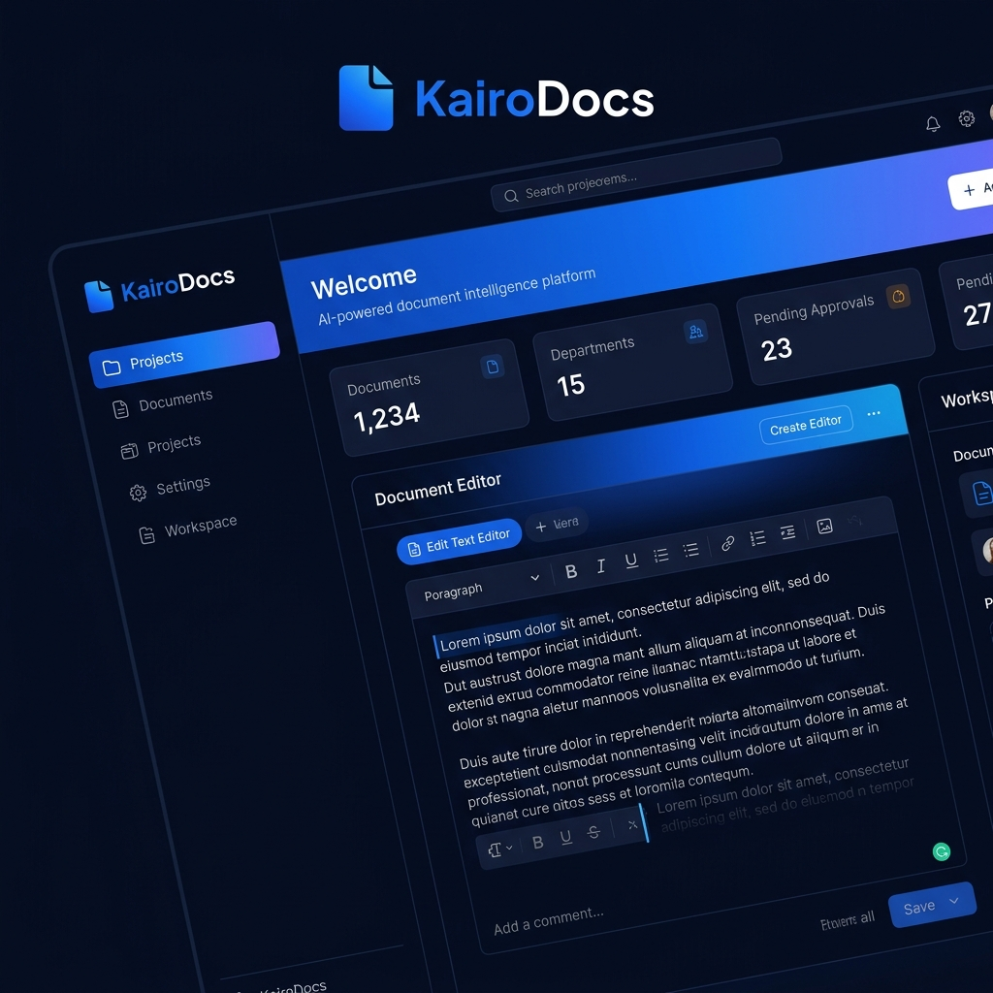
PREMIUM UI & UX SHOWCASE

Slide 9
KAIRODOCS
Scaling Intelligence. Streamlining Compliance.
© 2026 KairoDocs Inc. | Confidential Strategic Briefing

