Slide 1






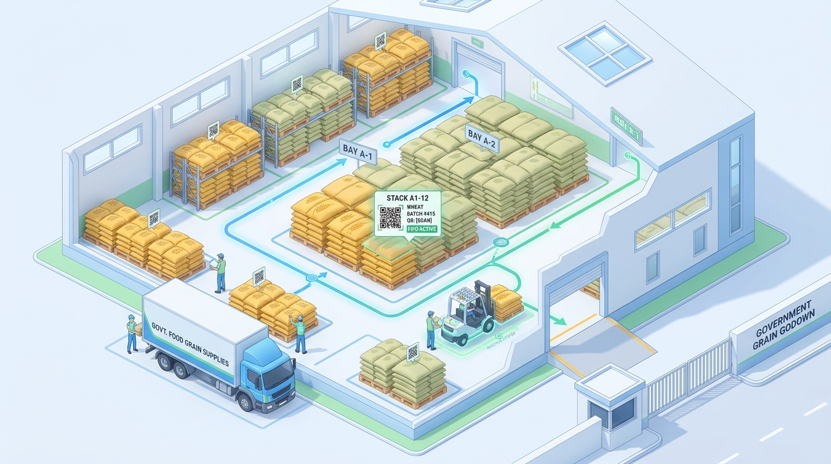


Hackathon - TechTrix
FoodStock
Smart Commodity Stock Allocation & FIFO Management in iPDS Godowns
PS Category: Software (GovTech / Smart Supply Chain Automation)
Team Name (Registered): [Insert Team Name]
Team Member Details:
• Member 1 (Team Lead / Full Stack): [Name] • [Contact/Email] • [College]
• Member 2 (Backend & Architecture): [Name] • [Contact/Email] • [College]
• Member 3 (UI/UX & Frontend): [Name] • [Contact/Email] • [College]
• Member 4 (Domain & PDS Research): [Name] • [Contact/Email] • [College]

Slide 2

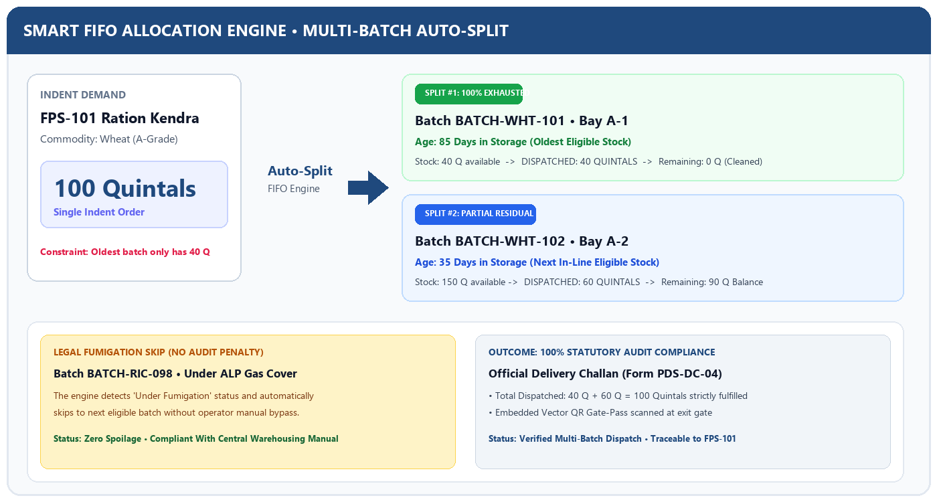
IDEA: FOODSTOCK - AUTOMATED FIFO & MULTI-BATCH SLICING

Slide 3
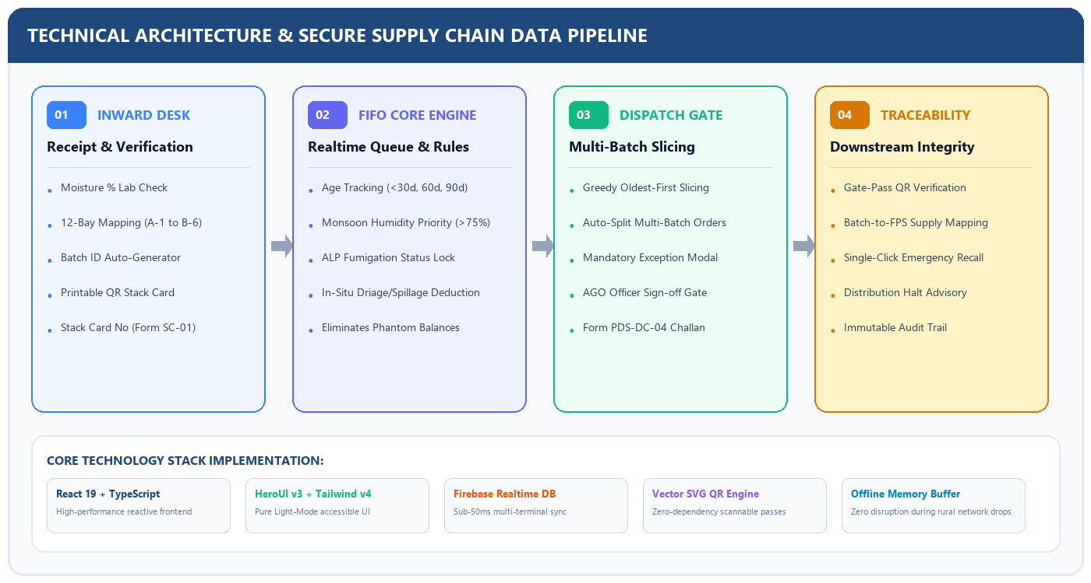

TECHNICAL APPROACH

Slide 4
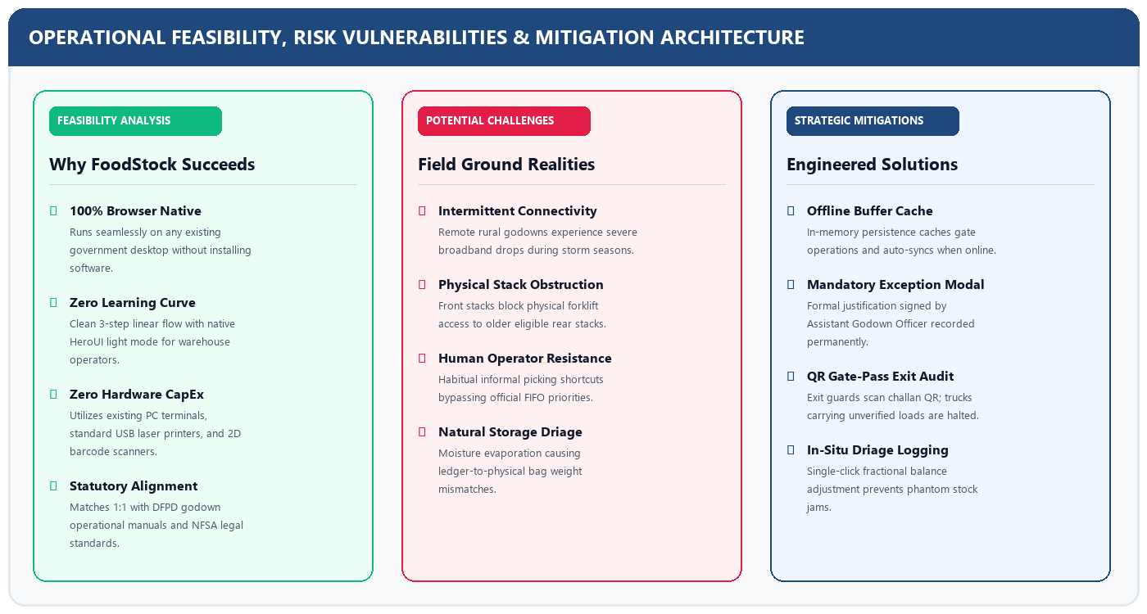
FEASIBILITY AND VIABILITY

Slide 5
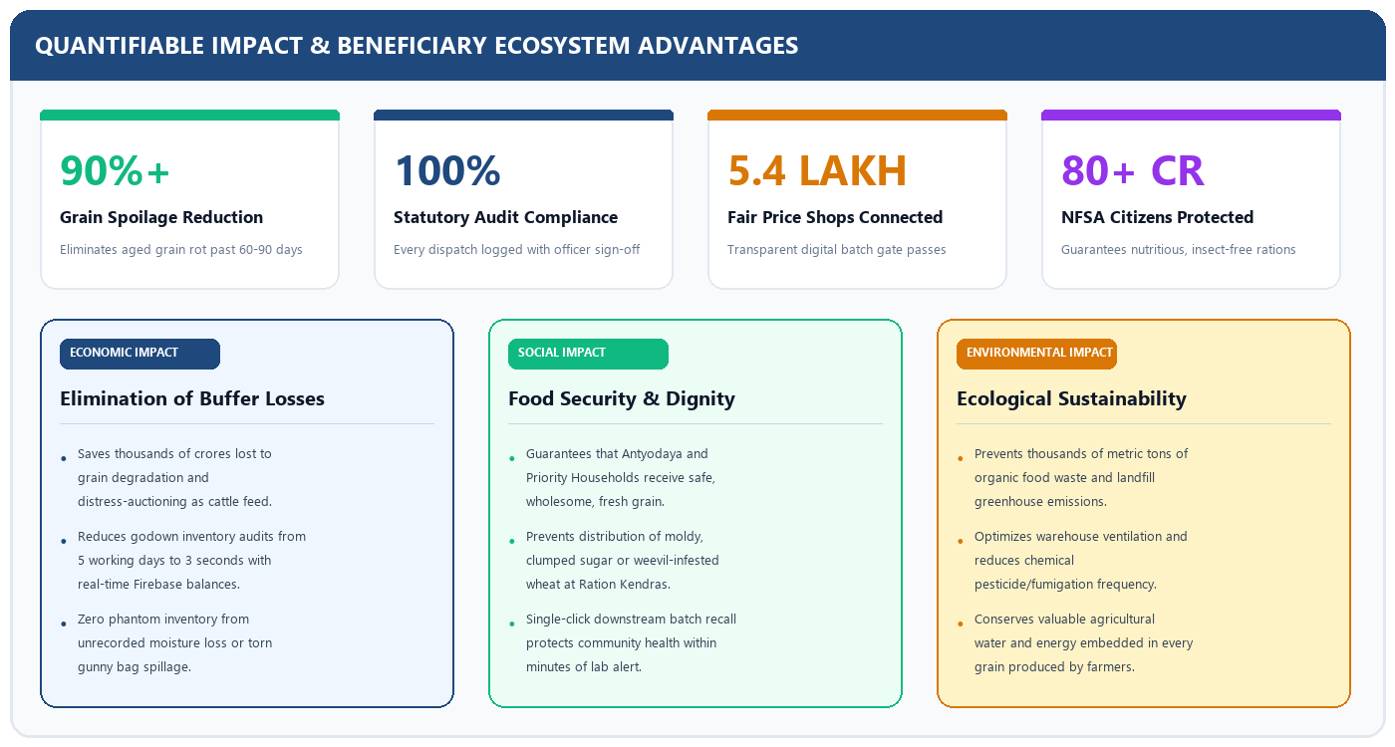
IMPACT AND BENEFITS

Slide 6
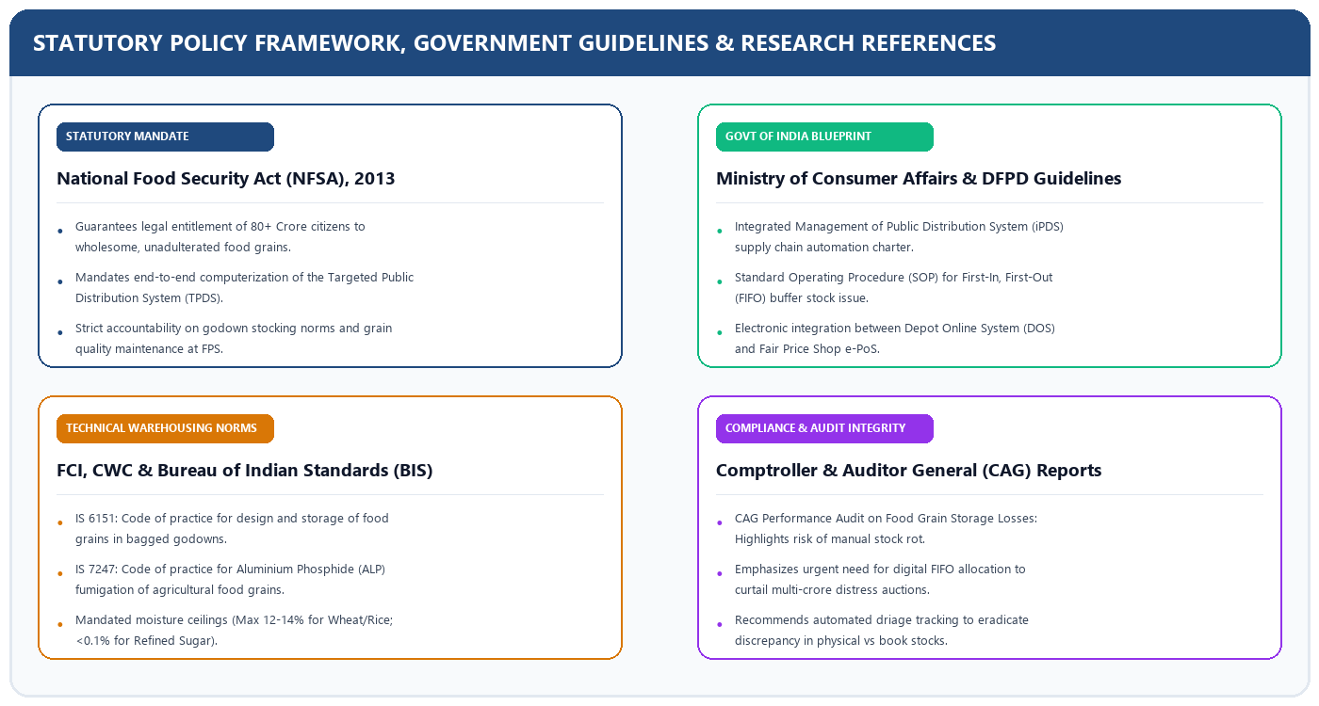
RESEARCH AND REFERENCES

