Slide 1


SMART INDIA HACKATHON 2026
TITLE PAGE
Problem Statement ID – SIH26184
Problem Statement Title- Predictive Analytics Framework for Cybercrime Complaints to Forecast Likely Cash Withdrawal Locations (MHA)
Theme- Software, Blockchain & Cybersecurity
PS Category- Software
Team ID- [YOUR TEAM ID]
Team Name (Registered on portal)- TEAM CYPHORA

Slide 2
NIRAKSHAN — SEE. PREDICT. INTERCEPT.
TEAM CYPHORA
Proposed Solution (Describe your Idea/Solution/Prototype)
◎ PREDICT
Hawkes engine forecasts cash-out hotspots before they happen
+2h · +6h · +24h lead windows
▣ INTERCEPT
Real ATM/bank layer (OpenStreetMap) for pre-positioning forces
Live geospatial data
⚠ PREVENT
QR fraud sensor stops scams at the payment entry point
NPCI rule engine + camera
SHIFT: Reactive — freeze after money is gone (HOURS) → Proactive — intercept before cash-out (MINUTES)
“We watch, so you’re safe.” — working prototype live 24/7

Slide 3
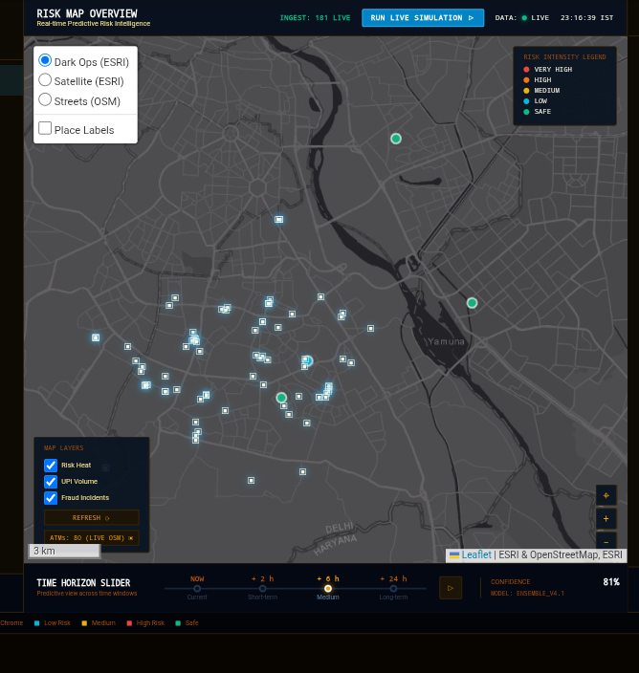
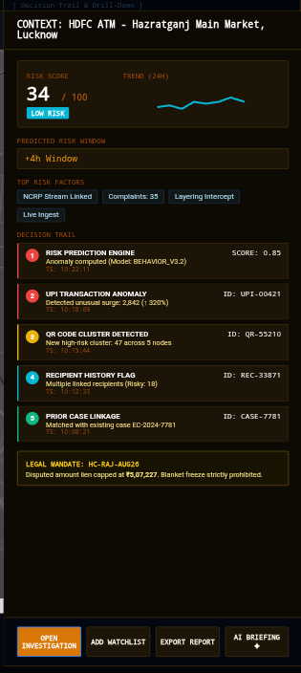
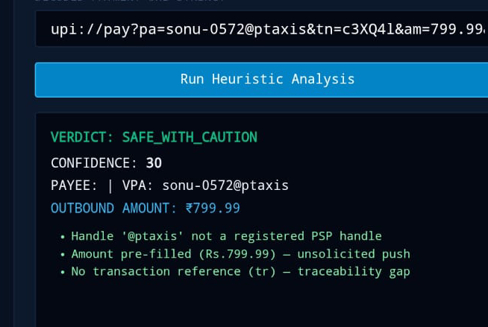
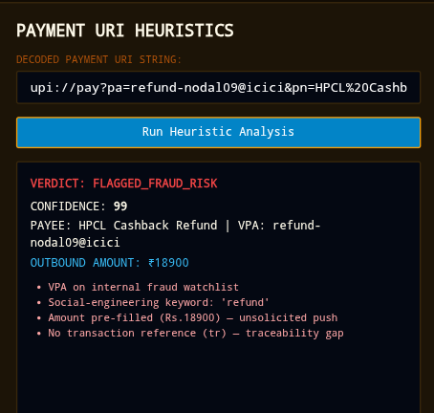
TECHNICAL APPROACH
TEAM CYPHORA
DATA → DECISION → ACTION
LIVE INGEST
SSE + SQLite
PREDICT
Hawkes process
VISUALIZE
Satellite + OSM ATMs
DETECT
QR rules + EWMA AI
ACT
Sec.102 dossier
Python stdlib · SSE · SQLite · Leaflet + ESRI/OSM · BarcodeDetector · Gemini LLM (optional)
Risk map: default view with other available style. On one click shows the ATM locations in data. Shows risk score for each location on tap with downloadable report pdf and ai briefing .One click LIVE DEMO shows how it works.
How to scan:QR Analytics tab → Open Camera → hold until edges flash green → verdict

Slide 4
FEASIBILITY AND VIABILITY
TEAM CYPHORA
RISK
MITIGATION
✓ FEASIBLE NOW
• Prototype live 24/7 on cloud
• Zero dependencies — stdlib only
• Deployable on-prem / air-gapped
• Full demo replays in < 1 min
No public NCRP / CFCFRMS API
Adapter ingest + live SMS-forwarder path
Victim PII sensitivity
On-prem deployment — PII never leaves
Free-tier uptime / cold starts
Keep-alive monitor + 1-command port
PROTOTYPE LIVE NOW → nirikshanv2.onrender.com

Slide 5
IMPACT AND BENEFITS
TEAM CYPHORA
MINUTES
interception lead time, not hours —
pre-position before cash-out
ZERO
blanket freezes — every lien capped to
disputed value (Sec.102 BNSS)
HOUR 1
the critical recovery window —
KPIs instrumented live on dashboard
I4C & CYBER CELLS
minutes-level proactive interception
BANK NODAL OFFICERS
precise, legally-capped lien advisories
CITIZENS
protection at the scam entry point itself
SOCIAL: faster recovery, trust in digital payments · ECONOMIC: near-zero infra cost, scales nationally · MEASURED: live KPIs

Slide 6
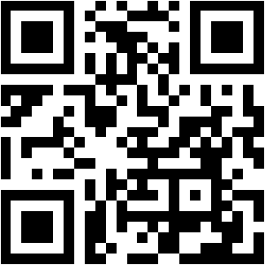
RESEARCH AND REFERENCES
TEAM CYPHORA
DATA & MAPS
I4C · cybercrime.gov.in (NCRP)
OpenStreetMap Overpass API — live ATM layer
ESRI World Imagery basemaps
MODEL & RULES
Hawkes (1971) — self-exciting point processes
Mohler et al. (2011) — predictive crime mapping
NPCI UPI technical documentation (upi:// spec)
Rajasthan HC (Aug 2026) — Sec.102 proportionality
RBI Annual Report — payment-fraud trends
SMS-forwarder live ingest — genuinely live complaint path
THIS PROTOTYPE — LIVE
github.com/Yosa-Shiawase/Nirikshanv2
Website: Nirikshan
scan → open live demo

