Slide 1


Elastic
Pavan Navule

Slide 2
Contents
Introduction
Terminology
Index, Type, Document, Field
Comparison with Relational Database
Architecture
Clusters, Nodes, Shards & Replicas
Installation & Configuration
Setup & Run Elastic Server
Elastic in Action
Indexing, Querying & Deleting

Slide 3




Introduction
Distributed

Slide 4
Terminology
Index
Is means of storing different types of data.
Can span across one primary shard or multiple shards.
Identified by metadata field _index
An Index can contain multiple types

Slide 5
Terminology
Type
A type is a convenient way to store a specific type of data within an index
Identified by metadata field _type

Slide 6
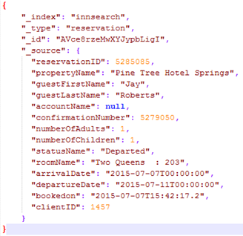
Terminology
Document
A document is JSON object (set of ‘key-value’ pairs aka fields)
_type
_id
_source

Slide 7
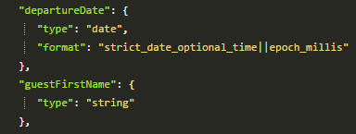
Terminology
Field
Key
type (data type)
Format
Value
Can hold scalar data (int, string values) or Nested structures like array or object

Slide 8
Terminology (Comparison with RDBMS)
Database
Index
Id | Status
1 | Reserved
2 | In House
3 | Departed
Type
1 | Reserved
Document

Slide 9
Installation
Download from www.elastic.co/downloads/elasticsearch
Extract to your desired location
Configuration
Default port 9200
Configure
Config file location “~/elasticsearch-2.4.0/config/elasticsearch.yml“
node name
port
path for log files etc.,

Slide 10
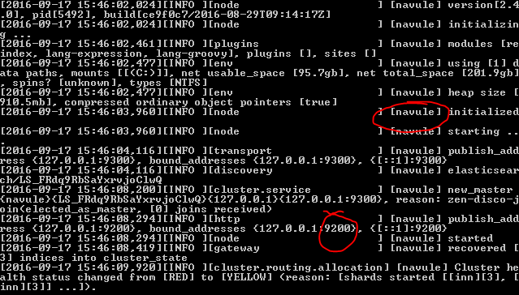
Run Elastic Server
Go to “~/elasticsearch-2.4.0/bin/“
Double click “elasticsearch.bat”

Slide 11
Indexing
Syntax
POST /{index}/{type}/{id}
{
“key-1": "value",
"key-2": "value",
...
"key-n": "value",
}
Example
POST /demo/reservation/1
{
"guestname": "Mr.J",
"arrivaldate": "2016/12/12",
"departuredate": "2016/12/14"
}

Slide 12
Querying
Syntax | Example
Search
GET /{index}/_search | GET demo/reservation/1
Search by type & id
GET /{index}/{type}/{id}
Search by property
GET /{index}/_search?q={propName}=“value" | GET /demo/_search?q=guestname="Mr.J"
Free search across index
GET /{index}/_search?q=‘value' | GET demo/reservation/1

Slide 13
Deleting a Document
DELETE /{Index}/{Type}/{Id}
Eg:
DELETE demo/reservation/1

Slide 14
Review
Introduction
Terminology
Index, Type, Document, Field
Comparison with Relational Database
Architecture
Clusters, Nodes, Shards & Replicas
Installation & Configuration
Setup & Run Elastic Server
Elastic in Action
Indexing, Querying & Deleting

Slide 15
Q&A

Slide 16
Thank You!

