Slide 1
ASR
Whisper 2022
SenseVoice Tongyi 2024.7
Qwen2-Audio 7B 2024.7
VibeVoice 7B microsoft 2025
VibeVoiceASR 2026.3
Step-Audio 2025.8
Mimo-Audio 7B. 2025.12
Moss-Transcribe-Diarize 0.9B 2026.7
Cohere-transcribe-03-2026
Qwen3-ASR-1.7B. 2026.1

Slide 2
 | Time | Organization | Paper
Whisper Whisper-turbo 1550M | 2022.Sep 2022.Dec | OpenAI | Robust Speech Recognition via Large-Scale Weak Supervision | https://arxiv.org/pdf/2212.04356
SenseVoice 7B | 2024.7 | Alibaba Group Tongyi SpeechTeam | FunAudioLLM: Voice Understanding and Generation Foundation Models for Natural Interaction Between Humans and LLMs | https://arxiv.org/pdf/2407.04051
Qwen2-Audio 7B | 2024.7 | Alibaba | Qwen2-Audio Technical Report | https://arxiv.org/pdf/2407.10759
VibeVoice 7B VibeVoiceASR 7B | 2025 2026 3 | Microsoft | VibeVoice Technical Report VIBEVOICE-ASR Technical Report | https://arxiv.org/pdf/2508.19205 https://arxiv.org/pdf/2601.18184
Step-Audio | 2025.8 | StepFun Audio Team | Step-Audio 2 Technical Repor | https://arxiv.org/pdf/2507.16632
Mimo-Audio 7B | 2025.12 | XiaoMi | MiMo-Audio: Audio Language Models are Few-Shot Learners | https://arxiv.org/pdf/2512.23808
Moss-Transcribe-diarize 0.9B | 2026. 7 | MOSI.AI | MOSS Transcribe Diarize Technical Report | https://arxiv.org/pdf/2601.01554
Qwen3-ASR 1.7B | 2026.1 | Qwen | Qwen3-ASR Technical Report | https://arxiv.org/pdf/2601.21337

Slide 3
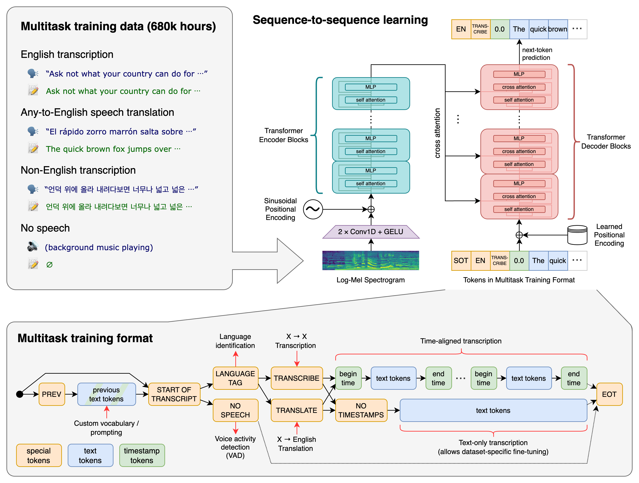
Robust Speech Recognition via Large-Scale Weak Supervision -2022

Slide 4
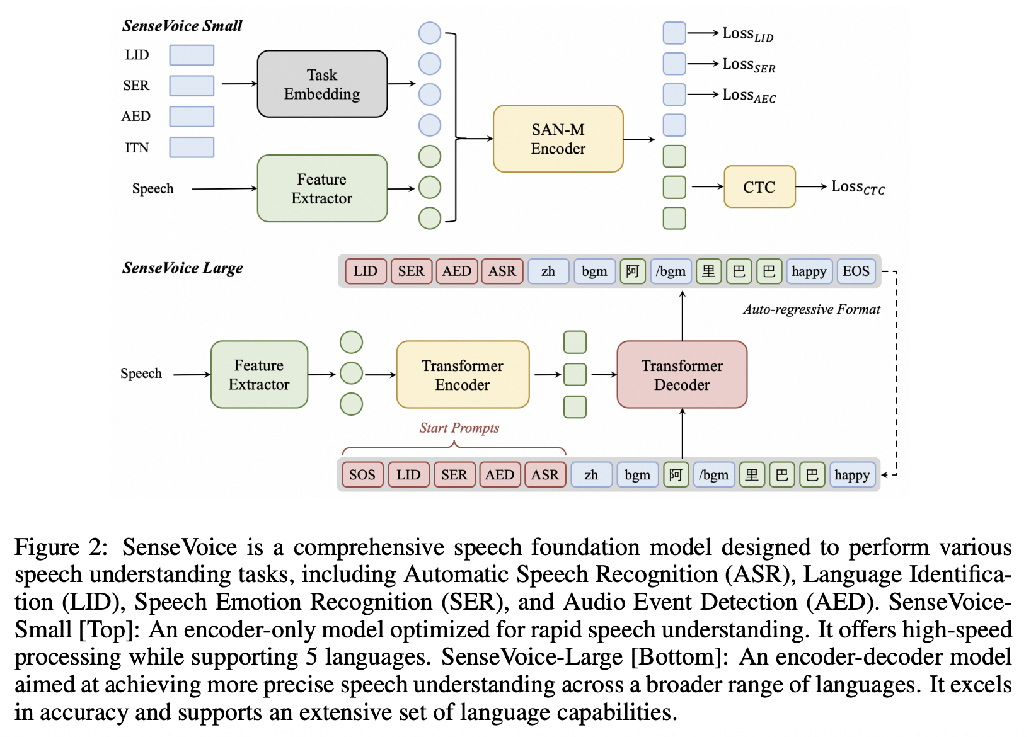
FunAudioLLM: Voice Understanding and Generation Foundation Models for Natural Interaction Between Humans and LLMs Alibaba Group -07-2024

Slide 5
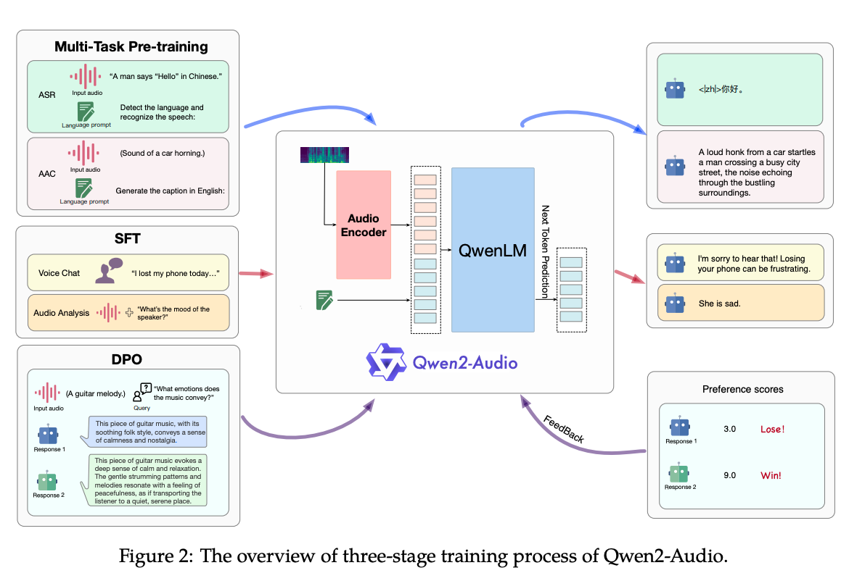
Qwen2-Audio Technical Report 2024-02-02
Qwen2-Audio-7B
Generalization LALM
SLU(Spoken language understanding)
SER(Speech Emotion Recognition)
ASR(Audio Speech Recognition)
S2TT(Speech-to-Text Translation)
VSC(Vocal Sound Classification)

Slide 6
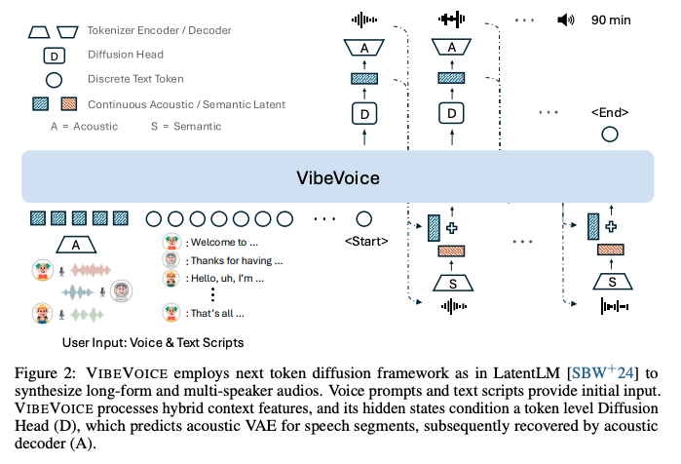
VIBEVOICE Technical Report -2025

Slide 7
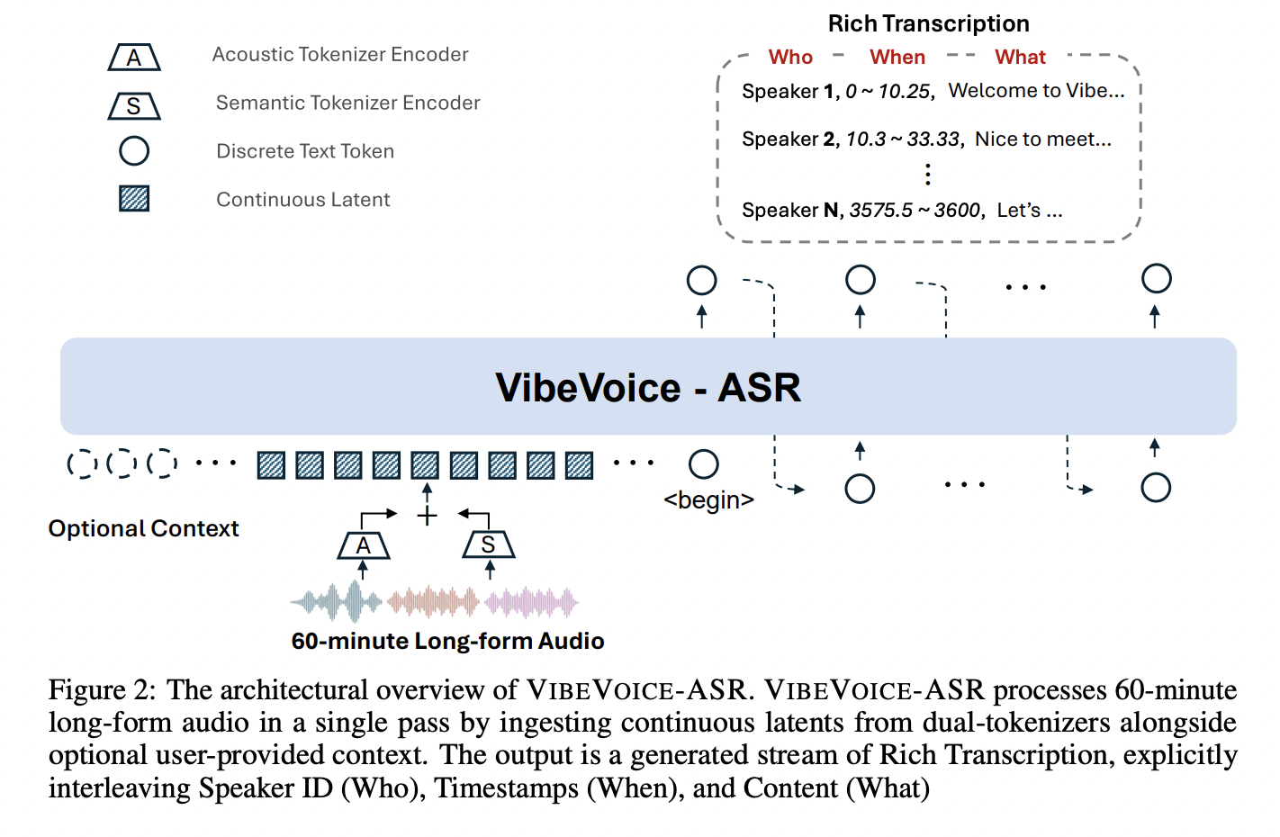
VIBEVOICE-ASR Technical Report -14 March 2026

Slide 8
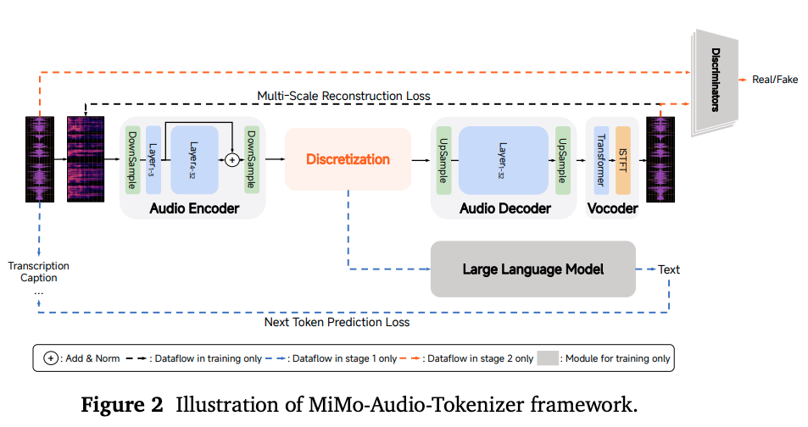
MiMo-Audio: Audio Language Models are Few-Shot Learners-2025

Slide 9
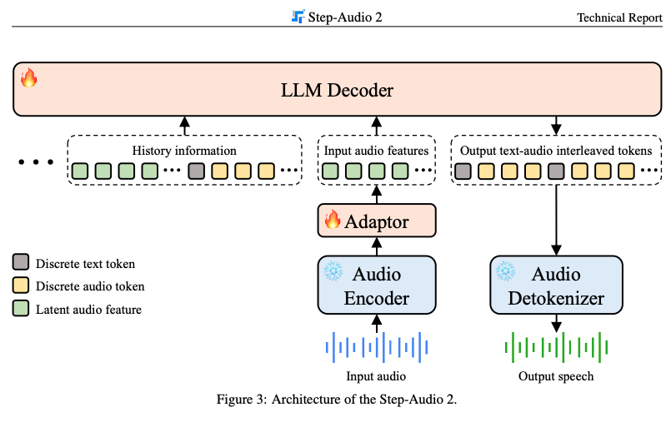
Step-Audio 2 Technical Report 27 Aug 2025

Slide 10
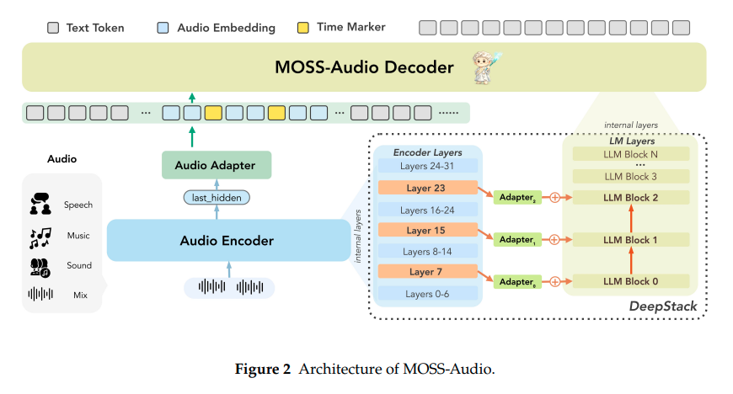
MOSS-Audio Technical Report

Slide 11
Step-Audio 2 Technical Report 27 Aug 2025

Slide 12
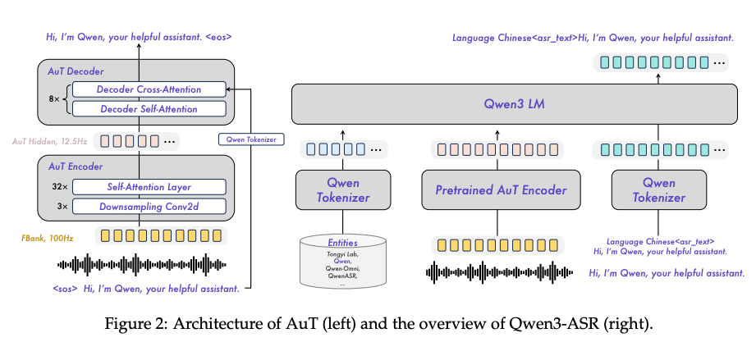
Qwen3-ASR Technical Report 2026-02-02

