Slide 1
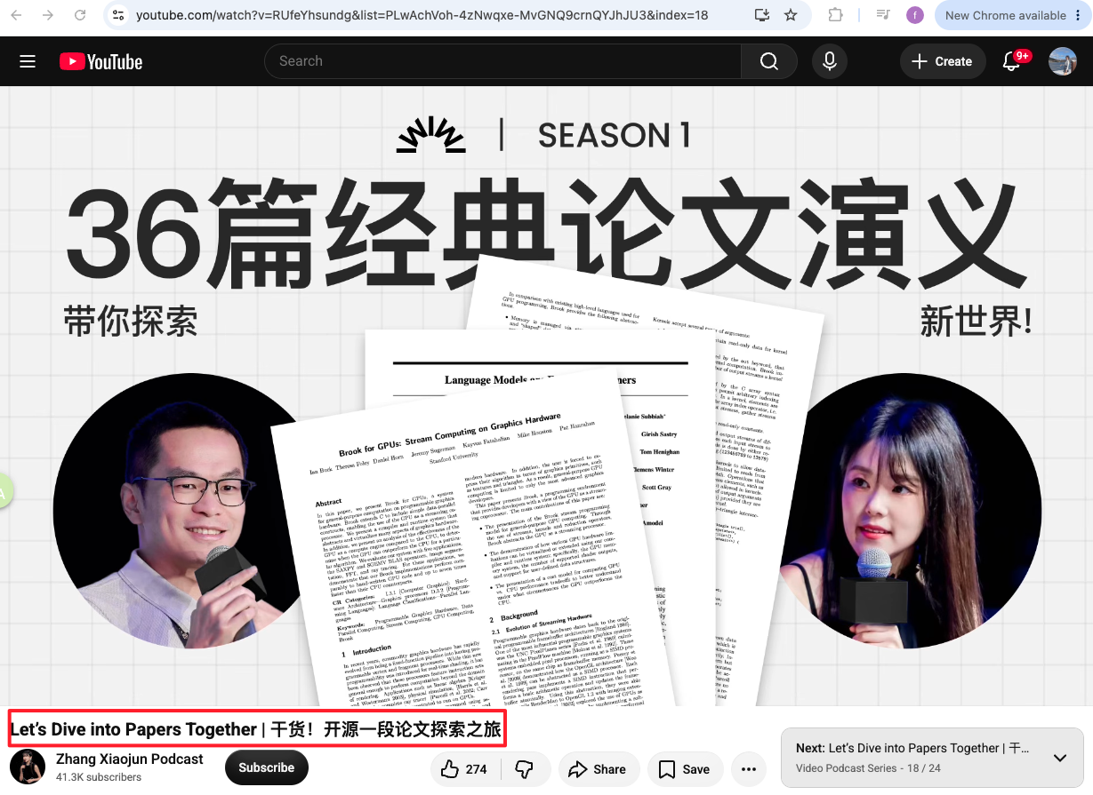

Slide 2
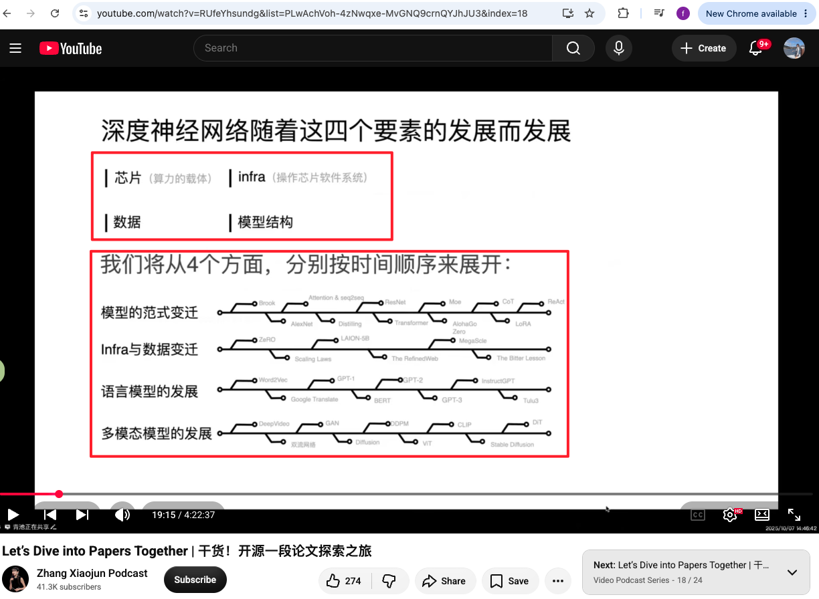

Slide 3
1. A mathematical theory of communication 1948 Claude Shannon
2. Computing machinery and intelligence 1950
3. The Perceptron: A Probabilistic Model for Information Storage and Organization in the Brain 1986
4. 1986 Learning Representations by back-propagating errors
5. LeNet (1998 Gradient-based learning applied to document recognition)
6. lmageNet (2009 a large-scale hierarchical image database )
7. AlexNet(2012 lmageNet classification with deep convolutional neural networks)
8. Word2Vec(2013 Efficient Estimation of Word Representations in Vector Space)
9. GAN(2014 Generative Adversarial Networks).
10. Gaussian Splatting(2014)
11. Seq2Seq(2014 Sequence to Sequence Learning with Neural Networks)
12. Attention Mechanism (2014 for machine translation)
13. R-CNN(2014 Rich feature hierarchies for accurate object detection and semantic segmentation
14. ADAM(2014): A METHOD FOR STOCHASTIC OPTIMIZATION
15. Faster R-CNN (2015 towards real-time obiect detection with region proposal networks).
16. ResNet (2015 Deep Residual Learning for lmage Recognition).
17. Deep Learning(2015)
17. Transformer(2017 "Attention is All You Need )
18. MoE (2017 Outrageously Large Neural Networks: The Sparsely-Gated Mixture-of-Experts Layer)
19. 《Proximal Policy Optimization》2017
20. BERT (2018 Pre-training of Deep Bidirectional Transformers for Language Understanding)
20. GPT-3 (2020 Language Models are Few-Shot Learners),
21. ViT(2020 vision transformer)
22.DDPM(2020 Denoising Diffusion Probabilistic Models)
23.NeRF( 2020 Representing Scenes as Neural Radiance Fields for View Synthesis)
24. CLIP( 2021 Learning Transferable Visual Models From Natural Language Supervision
25. LoRA(2021 Low-Rank Adaptation of Large Language Models
26. CoT(2022 Chain-of-Thought Prompting Elicits Reasoning in Large Language Models)
27. ReAct(2023 Synergizing Reasoning and Acting in Language Models)
28. The bitter Lesson 2019
29. AlphaGo Zero(2017 Mastering Chess and Shogi by Self-Play with a General Reinforcement Learning Algorithm)
30. DeepSeek-R1: Incentivizing Reasoning Capability in LLMs via Reinforcement Learning

Slide 4
Pre-neural (before 2010s)
Language model to measure the entropy of English[Shannon 1950]
Lots of work on n-gram language models (for machine translation, speech recognition) [Brants+ 2007]
Neural ingredients (2010s)
First neural language model [Bengio+ 2003]
Sequence-to-sequence modeling (for machine translation)[Sutskever+ 2014]
Adam optimizer[Kingma+ 2014]
Attention mechanism (for machine translation) [Bahdanau+ 2014]
Transformer architecture (for machine translation) [Vaswani+ 2017]
Mixture of experts[Shazeer+ 2017]
Model parallelism[Huang+ 2018] [Rajbhandari+ 2019][Shoeybi+ 2019]
Early foundation models (late 2010s)
ELMo: pretraining with LSTMs, fine-tuning helps tasks[Peters+ 2018]
BERT: pretraining with Transformer, fine-tuning helps tasks [Devlin+ 2018]
Google's T5 (11B): cast everything as text-to-text[Raffel+ 2019]
Embracing scaling, more closed
OpenAI's GPT-2 (1.5B): fluent text, first signs of zero-shot, staged release[Radford+ 2019]
Scaling laws: provide hope / predictability for scaling[Kaplan+ 2020]
OpenAI's GPT-3 (175B): in-context learning, closed[Brown+ 2020]
Google's PaLM (540B): massive scale, undertrained [Chowdhery+ 2022]
DeepMind's Chinchilla (70B): compute-optimal scaling laws[Hoffmann+ 2022]
Open models
EleutherAI's open datasets (The Pile) and models (GPT-J) [Gao+ 2020][Wang+ 2021]
Meta's OPT (175B): GPT-3 replication, lots of hardware issues[Zhang+ 2022]
Hugging Face / BigScience's BLOOM: focused on data sourcing[Workshop+ 2022]
Meta's Llama models[Touvron+ 2023][Touvron+ 2023][Grattafiori+ 2024]
Alibaba's Qwen models[Qwen+ 2024]
DeepSeek's models[DeepSeek-AI+ 2024][DeepSeek-AI+ 2024][DeepSeek-AI+ 2024]
AI2's OLMo 2[Groeneveld+ 2024][OLMo+ 2024]

Slide 5
Levels of openness
Closed models (e.g., GPT-4o): API access only [OpenAI+ 2023]
Open-weight models (e.g., DeepSeek): weights available, paper with architecture details, some training details, no data details [DeepSeek-AI+ 2024]
Open-source models (e.g., OLMo): weights and data available, paper with most details (but not necessarily the rationale, failed experiments)[Groeneveld+ 2024]
Today's frontier models
OpenAI's GPT-5.6 Series Sol
Anthropic's Claude Fable5/Opus 5
Kimi K3 https://www.kimi.com/en/blog/kimi-k3
xAI's Grok-4.5
Google’s Gemini-3.7-Flash & Gemini-3.1-Pro
DeepSeek's DeepSeek-V4-Pro
Alibaba's Qwen3.8-Max

