Slide 1
React VS React-Native

Slide 2
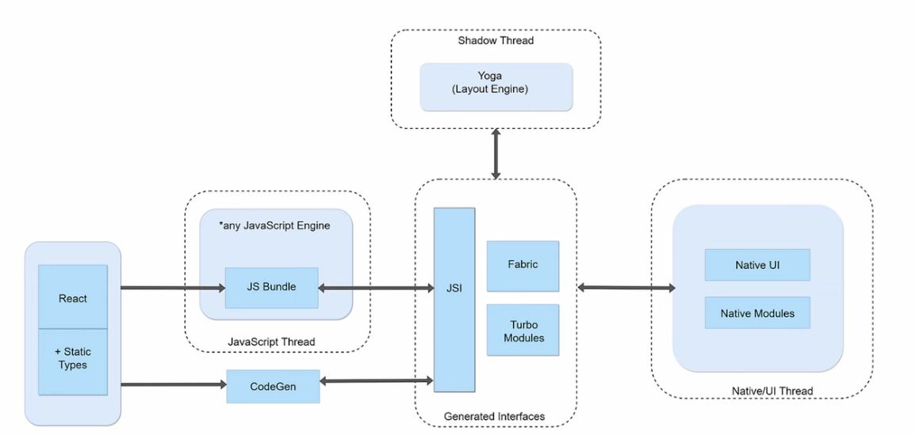

Slide 3
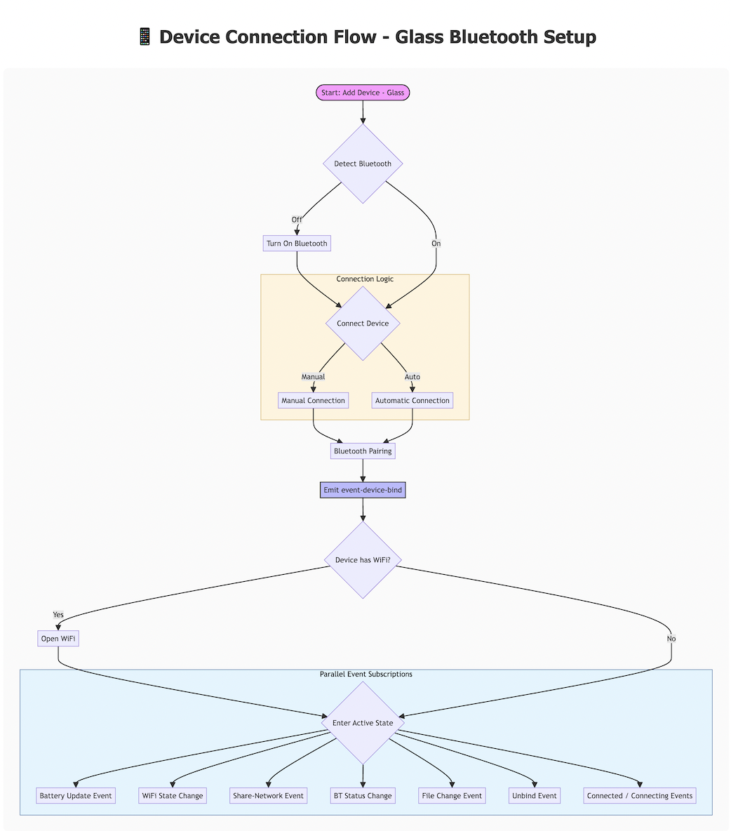

Slide 4
New vs Old Architecutre Comparion(Fabric is React Native's new rendering system, React Native 0.68, Version 0.76 default)
The Rendering: DOM VS Native Views
Threading Architecture
Styling: Yoga vs Css
View Flattening
Navigation
Lifecycle
Engine
Timer(Web VS React-Native VS Node)
Build and Deployment

Slide 5
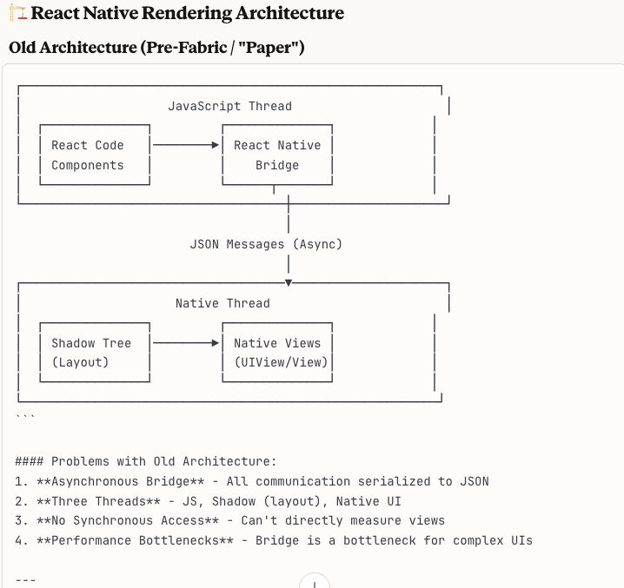
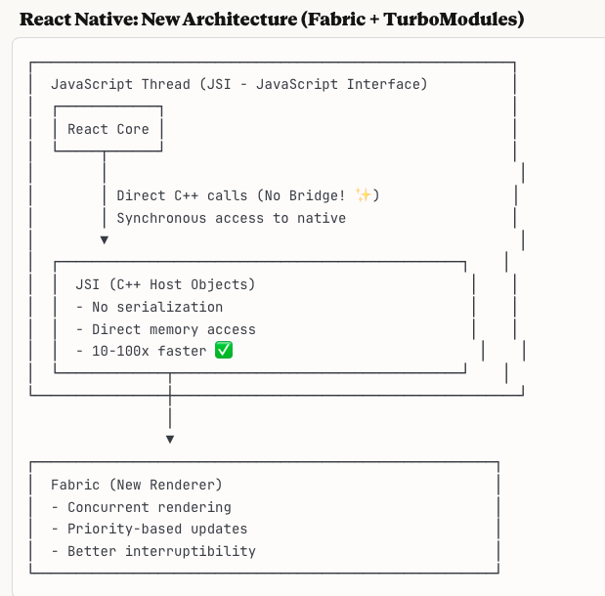
Synchronous Layout and Effects

Slide 6
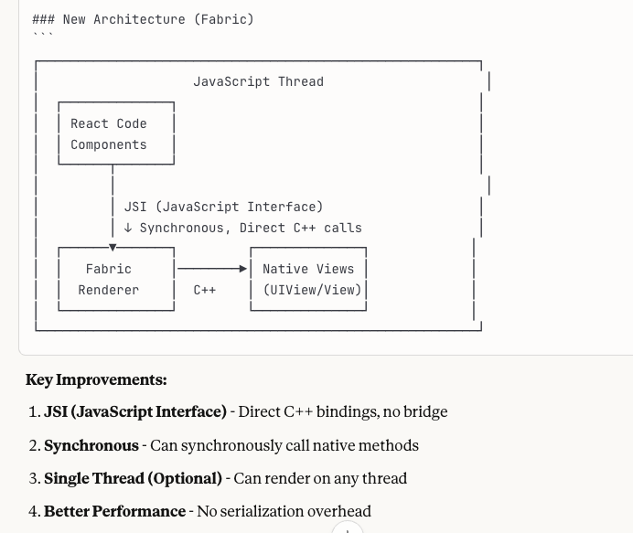
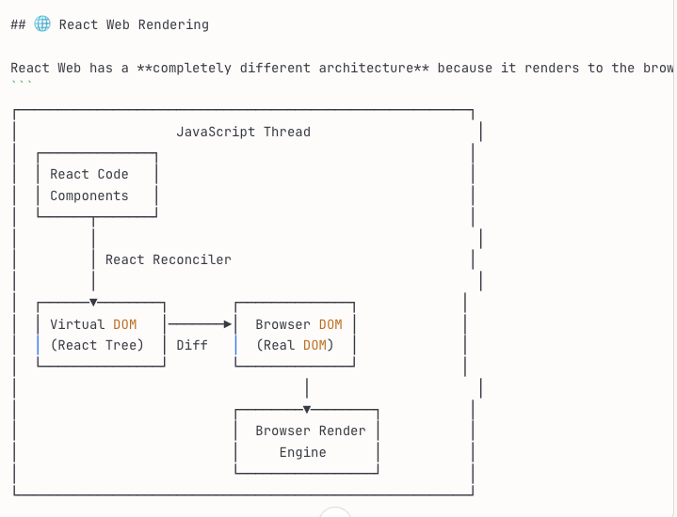
Web Rendering vs. React-Native Fabric

Slide 7
The Rendering: DOM VS Native Views
Rendering Target | Browser DOM Virtual DOM diffs are reconciled into real DOM nodes — <div> <span> <img>. The browser's rendering engine (Blink, WebKit, Gecko) handles layout, paint, and compositing. JSX→VDOM→DOM Nodes→Browser Paint | Platform Native Views Renders to actual native UI components — UIView (iOS) / android.view.View (Android). No WebView, no HTML. The OS composites the views directly via GPU. JSX → React Element Tree→ React shadow Tree → Host View Tree(Native View)

Slide 8
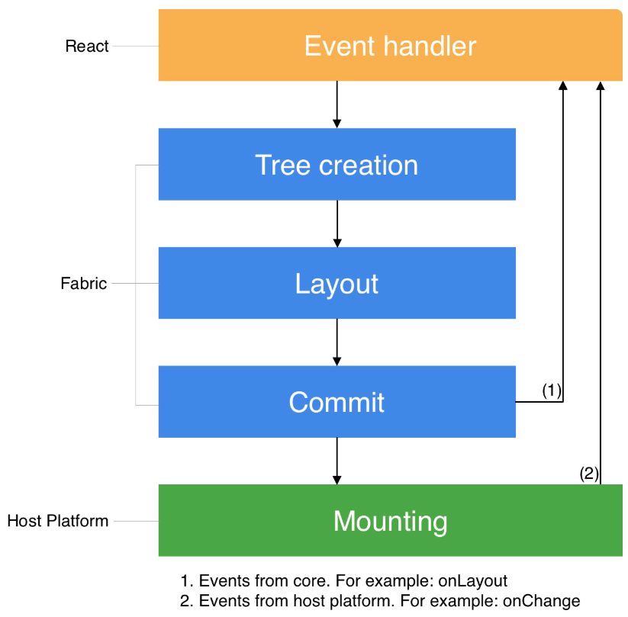

Slide 9
Initial Render Pipeline
Render Phase Main Thread Execute Component → Virtual DOM function MyComponent() executes in V8/SpiderMonkey/JSC. Returns React Elements → builds the Virtual DOM (JS objects in memory). Also called the "Fiber Tree" internally. Reconciliation Main Thread Diff Virtual DOM (no-op on first render) On initial render: no previous tree to diff. React marks all Fiber nodes as needing placement. Builds the "effect list" of DOM operations to perform. Commit Phase Main Thread Create DOM Nodes & Append React calls document.createElement(), sets attributes/properties, calls appendChild() to build the real DOM tree. Browser Paint Main Thread + GPU Layout → Paint → Composite Browser CSS engine calculates layout (reflow), paints pixels to layers, and the GPU compositor assembles the final frame. DOM element on screen | Render Phase JS Thread Execute Component → Create React Shadow Node(React Host Components) function MyComponent() executes on the JS thread via Hermes. Creates React Element tree (JS objects), then builds the Shadow Tree (C++) via JSI. The Shadow Tree lives in C++ memory. Commit Phase UI Thread Layout calculation(React Shadow Node) + Tree Promotion(New Tree -> Next Tree) Yoga Layout Calculation Yoga (C++ Flexbox engine) traverses the Shadow Tree, calculates layout: positions (x, y), sizes (width, height), via Flexbox algorithm. Produces absolute pixel coordinates for every node. Mount Phase UI Thread Transforms the React Shadow Tree(contains data from layout calculation) into a Host View Tree with rendered pixels on the screen Tree Diffing(view Flattening) + Tree Promotion(Next Tree -> Render Tree) + View Mounting Platform native views are instantiated: UIView / ViewGroup. Properties applied, views inserted into the native view hierarchy. Native View on screen

Slide 10
React State Updates Pipeline
Trigger Main Thread setState() / Hooks Update setState or useState setter called. React 18 automatically batches updates (even in async code). Render Phase Main Thread Re-execute Component → New Virtual DOM Component re-renders, producing a new VDOM tree (Fiber nodes). This is the "work-in-progress" tree. Reconciliation Main Thread VDOM Diff → Minimal DOM Operations React's fiber reconciler diffs old vs new VDOM. Produces a list of DOM mutations: setAttribute, insertBefore, removeChild. Batches DOM operations for efficiency. Browser Repaint Main Thread + GPU Reflow → Repaint → Composite Browser recalculates affected layout regions, repaints dirty areas, composites layers on GPU. useLayoutEffect runs synchronously before paint. Updated DOM Element | Trigger JS Thread setState() / Hooks Update setState or useState setter called. React schedules a re-render on the JS thread. Batching may combine multiple state updates. Render Phase JS Thread Re-execute Component → New React Shadow Tree Component function re-executes. A new Shadow Tree is created in C++ memory. This tree represents the desired state of the UI. Commit Phase Layout calculation Tree Promotion(new tree -> next tree) Mount UI Thread Tree Promotion(Next Tree -> Rendered Tree) Tree Diffing View Mounting Update Native View

Slide 11
React Native Render State Updates (C++ state updates)
No C++ State Update Path on Web The web has no concept of a "C++ shadow tree" that can be mutated independently of JavaScript. All React state changes must go through the JS main thread. However, the browser does offer some mechanisms to offload work from JS: CSS Transitions / Animations — GPU-composited, don't touch JS or layout. transform + opacity — compositor-only properties, skip layout & paint entirely. scroll — native browser scrolling is off-main-thread by default (compositor thread). Web Animations API — declarative animations that run on the compositor. OffscreenCanvas — WebGL/Canvas rendering in a Worker thread. | When C++ State is used only when the platform knows something React doesn’t need to control . Eg ScrollView User scrolls → iOS/Android reports offset (x: 0, y: 347) ↓ C++ State updated directly ↓ Used by measure() API internally ↓ React Element Tree is NOT affected C++ state updates skip the “render phase” since React is not involved. Native → C++ (JS never touched) 2. The updates can originate and happen on any thread, including the main thread. Commit Phase Read latest committed version of ShadowNode N Clone N → N' with new state S Attempt to commit N' to the tree If commit succeeds → done If commit fails (tree changed underneath) → retry from step 1 Mount phase Tree Diff (old ↔ new) → Apply to Native Views Same as normal state updates: diff old vs new Shadow Tree, produce mutations, apply to native views on UI thread. Updated Native View(JS Thread never touched)

Slide 12
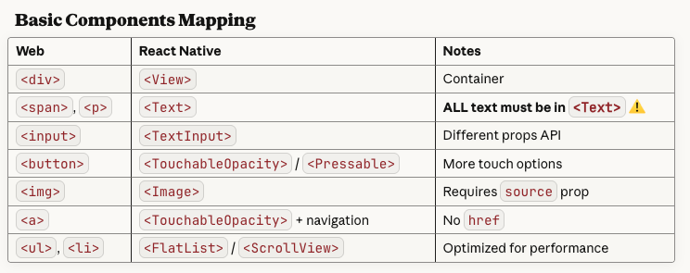
RN always uses border-box , no property needed
Total width = width + padding left + padding right + border left + border right

Slide 13
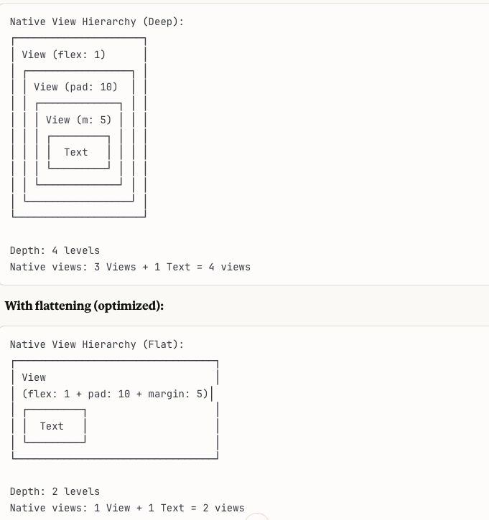
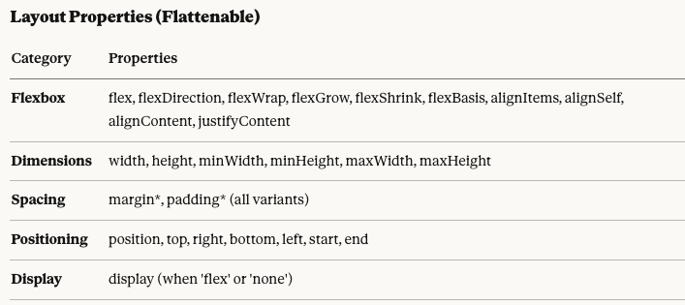
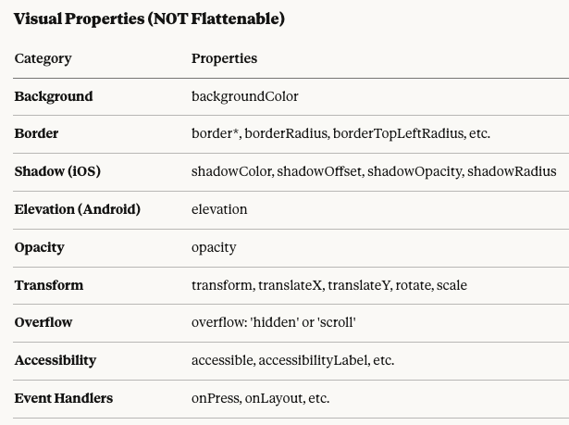
View Flattening
Layout-only nodes:

Slide 14
Threading Architecture
Threading Architecture | Single-Threaded (Main Thread) JS execution, DOM manipulation, layout, and paint all share the Main Thread. Heavy computation blocks rendering. Web Workers provide off-thread JS but cannot access the DOM. Offloading Web Workers, requestIdleCallback, OffscreenCanvas | Multi-Threaded (3+ Threads) JS Thread runs Hermes/JSC — executes your React code. UI Thread (Main) — renders native views, handles touch. Shadow Thread — Yoga layout calculation (New Arch merges this into background work). New Arch (Fabric) JSI enables synchronous cross-thread calls, replacing the async Bridge.

Slide 15
Styling: Css Vs Yoga
Styling System | CSS (Full Spec) Full CSS cascade, selectors, media queries, pseudo-elements, Grid, Flexbox, animations, transitions. Styles are parsed by the browser's CSS engine and applied during layout/paint. Tooling: CSS Modules , Tailwind, styled-components, CSS-in-JS | Yoga (Flexbox Subset in C++) JS objects passed to the Yoga layout engine. Flexbox-only — no cascade, no selectors, no CSS Grid, no pseudo-elements. All values are unitless (dp). StyleSheet.create() for optimization. Limitations: No inheritance No cascade No media queries (use Dimensions API)

Slide 16
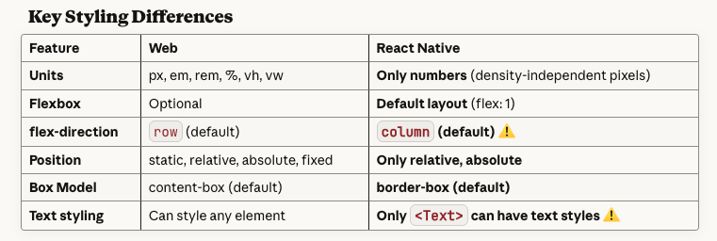

Slide 17
Navigation
Navigation & Routing | URL-Based Routing Browser history stack via History API. Routes map to URL paths. Deep linking is native to the web. Back/forward managed by the browser. Libraries: React Router , Next.js Router TanStack Router | Native Stack-Based Navigation(a stack of screens) No URL bar. Navigation mimics native app patterns — Stack, Tab, Drawer navigators. Each screen is a native view controller with platform transitions and gestures. Libraries: React Navigation Expo Router (file-based, adds URL support)

Slide 18
Lifecycle
Component Lifecycle | Standard React Lifecycle useEffect useLayoutEffect useMemo — runs in a single environment. Page visibility via visibilitychange event. Cleanup on unmount is straightforward. | React Lifecycle + App State Same hooks, but with added AppState (active / background / inactive). Must handle: OS killing background processes, memory warnings, and native module lifecycle. useFocusEffect for screen visibility.

Slide 19
Engine
JavaScript Engine | Browser JS Engine V8 (Chrome/Edge), SpiderMonkey (Firefox), JavaScriptCore (Safari). Full JIT compilation, mature garbage collection, Web APIs built in. | Hermes (Default since RN 0.70) Hermes — bytecode-compiled AOT(ahead of time) for fast startup and low memory. Optimized for mobile constraints. No full JIT on Android. Alternatively JSC on iOS (legacy). Key advantage Hermes precompiles JS → bytecode at build time, slashing cold start time.

Slide 20
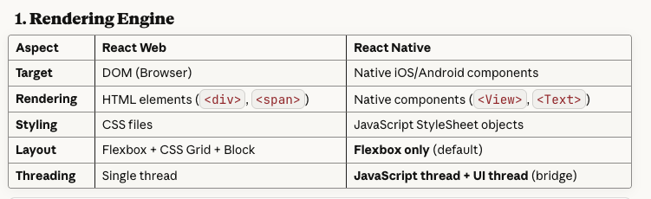

Slide 21
JS ↔ Native Communication
JS ↔ Native Communication | Direct — No Bridge Needed JS and DOM are in the same runtime. Calling document.createElement() is a synchronous engine API call. Web APIs (fetch, canvas, WebGL) are built into the browser. | JSI / Bridge Old Arch Async JSON Bridge — serializes all data between JS ↔ Native (bottleneck). New Arch JSI — C++ interface allowing synchronous, direct calls between JS and native. TurboModules + Fabric eliminate the bridge. JS (Hermes)⟷ JSI ⟷C++ / Native

Slide 22
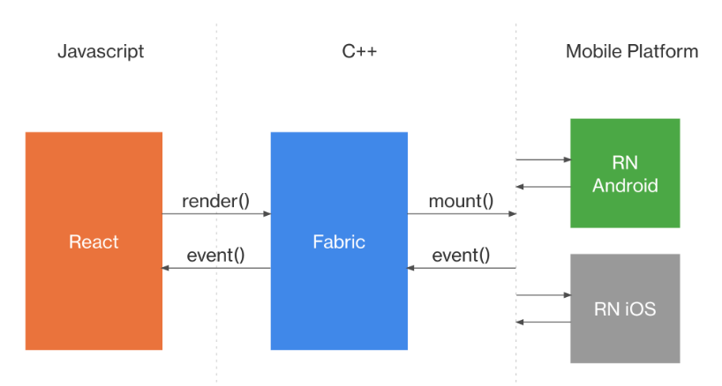

Slide 23
Timer(Web VS React-Native VS Node)
## 1. Web Timer
// ┌───────────────────────────┐
// │ Call Stack │
// │ (Synchronous Code) │
// └─────────────┬─────────────┘
// │
// ┌─────────────▼─────────────┐
// │ Microtask Queue │
// │ - Promise.then() │
// │ - queueMicrotask() │
// │ - MutationObserver │
// └─────────────┬─────────────┘
// │
// ┌─────────────▼─────────────┐
// │ Render Pipeline │
// │ - Style calculation │
// │ - Layout │
// │ - Paint │
// └─────────────┬─────────────┘
// │
// ┌─────────────▼─────────────┐
// │ Macrotask Queue │
// │ - setTimeout │
// │ - setInterval │
// │ - I/O │
// └─────────────┬─────────────┘
// │
// ┌─────────────▼─────────────┐
// │ requestAnimationFrame │
// │ (before next paint) │
// └─────────────┬─────────────┘
// │
// ┌─────────────▼─────────────┐
// │ requestIdleCallback │
// │ (when browser is idle) │
// └───────────────────────────┘
// ## 2. React Native Timers
// ### Event Loop Architecture
// ```
// JavaScript Thread Bridge Native Thread
// ───────────────── ────────
// ┌───────────────────────┐
// │ Synchronous Code │
// └──────────┬────────────┘
// │
// ┌──────────▼────────────┐
// │ Microtask Queue │
// │ (Promise - uses │
// │ setImmediate) │
// └──────────┬────────────┘
// │
// ┌──────────▼────────────┐
// │ setImmediate Queue │
// └──────────┬────────────┘
// │
// └───────────────────> [Bridge Crossing]
// │
// ┌──────────▼──────────┐
// │ Native Processing │
// │ - Layout │
// │ - Render │
// └──────────┬──────────┘
// │
// ┌────────────────────────────┘
// │
// ┌──────────▼────────────┐
// │ requestAnimationFrame │
// │ (after frame ready) │
// └──────────┬────────────┘
// │
// ┌──────────▼────────────┐
// │ setTimeout/setInterval│
// └───────────────────────┘
// ## 3. Node.js Timers
// ### Event Loop Architecture
// ```
// ┌───────────────────────────┐
// ┌─>│ timers │ ← setTimeout, setInterval
// │ └─────────────┬─────────────┘
// │ ┌─────────────▼─────────────┐
// │ │ pending callbacks │ ← I/O callbacks (deferred)
// │ └─────────────┬─────────────┘
// │ ┌─────────────▼─────────────┐
// │ │ idle, prepare │ ← Internal use
// │ └─────────────┬─────────────┘
// │ ┌─────────────▼─────────────┐
// │ │ poll │ ← I/O operations
// │ └─────────────┬─────────────┘
// │ ┌─────────────▼─────────────┐
// │ │ check │ ← setImmediate callbacks
// │ └─────────────┬─────────────┘
// │ ┌─────────────▼─────────────┐
// │ │ close callbacks │ ← socket.on('close', ...)
// │ └───────────────────────────┘
// │
// │ ┌───────────────────────────┐
// │ │ process.nextTick │ ← Highest priority!
// │ │ (after each phase) │
// │ └───────────────────────────┘
// │
// │ ┌───────────────────────────┐
// │ │ Promise Microtasks │ ← After nextTick
// │ └───────────────────────────┘
// │
// └──────────────────────────────────┘

Slide 24
Build & Deployment
Build & Deployment | Bundle → CDN Vite, Webpack, esbuild bundle JS/CSS/assets into static files. Deploy to any CDN or server. Instant updates — no app store review. | Native Binary + JS Bundle Gradle (Android) / Xcode (iOS) compile native code into an app binary containing the Hermes bytecode bundle. App Store / Play Store submission required. OTA Updates CodePush / Expo Updates can push JS-only changes without store review.

Slide 26
