Slide 1
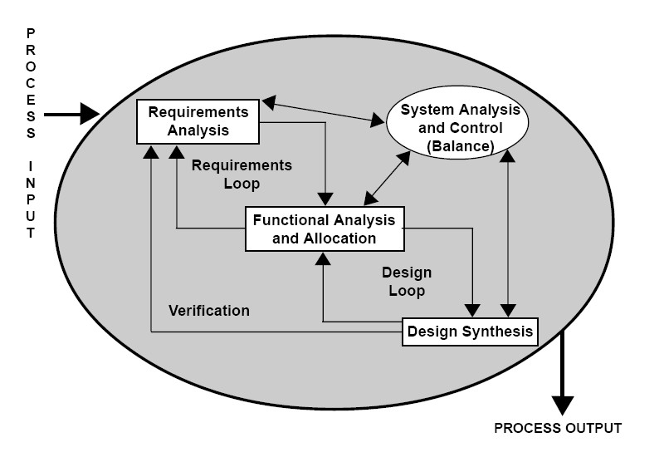
1) Which particular activities in SDLC can be related with ‘Requirement Engineering’? Requirement Analysis In both SDLC and Requirement Engineering there's requirement analysis 2) Major activities involve in Requirement Engineering. a) Requirement Elicitation b) Requirement Analysis c) Requirement Validation 3) What we do during requirement elicitation? Here we specify the software functions 4)Discuss each type of fact-finding techniques. Interview Background Reading Document Sampling Questionnaire/Survey Observation Research |  | 5) Discuss the task done in requirement analysis and management. 6)Discuss about requirement validation. Requirements validation is the process of checking that requirements defined for development, define the system that the customer really wants. To check issues related to requirements, we perform requirements validation.

