Slide 1


Chapter 1
Stable Matching
Slides by Kevin Wayne.
Copyright © 2005 Pearson-Addison Wesley.
All rights reserved.
Notes:
Please report any errors to Kevin Wayne (wayne@cs.princeton.edu). Thanks!

Slide 2
1.1 A First Problem: Stable Matching

Slide 3
Matching Residents to Hospitals
Goal. Given a set of preferences among hospitals and medical school students, design a self-reinforcing admissions process.
Unstable pair: applicant x and hospital y are unstable if:
  x prefers y to its assigned hospital.
  y prefers x to one of its admitted students.
Stable assignment. Assignment with no unstable pairs.

Slide 4
Stable Matching Problem
Goal. Given n men and n women, find a "suitable" matching.
  Participants rate members of opposite sex.
  Each man lists women in order of preference from best to worst.
  Each woman lists men in order of preference from best to worst.
favorite
least favorite
favorite
least favorite
1st
2nd
3rd
1st
2nd
3rd
Xavier
Amy
Bertha
Clare
Amy
Yancey
Xavier
Zeus
Yancey
Bertha
Amy
Clare
Bertha
Xavier
Yancey
Zeus
Zeus
Amy
Bertha
Clare
Clare
Xavier
Yancey
Zeus
Men’s Preference Profile
Women’s Preference Profile
Notes:
med school admissions has some distracting asymmetries: each college looking for several applicants, but each student looking for one college; there may be more (fewer) applicants than available slots for colleges; each student does not apply to every college
"bare-bones" version of the problem; also a change of scenery
preserves essential nature of problem; in particular our solution to this simplified version extends to more general case

Slide 5
Stable Matching Problem
Perfect matching: everyone is matched.
  Each man gets exactly one woman.
  Each woman gets exactly one man.
Stability: no incentive for some pair of participants to undermine assignment by joint action.
  In matching M, an unmatched pair m-w is unstable if man m and woman w prefer each other to current partners.
  Unstable pair m-w could each improve by joint action.
Stable matching: perfect matching with no unstable pairs.
Stable matching problem. Given the preference lists of n men and n women, find a stable matching if one exists.

Slide 6
Stable Matching Problem
Q. Is assignment X-C, Y-B, Z-A stable?
favorite
least favorite
favorite
least favorite
1st
2nd
3rd
1st
2nd
3rd
Xavier
Amy
Bertha
Clare
Amy
Yancey
Xavier
Zeus
Yancey
Bertha
Amy
Clare
Bertha
Xavier
Yancey
Zeus
Zeus
Amy
Bertha
Clare
Clare
Xavier
Yancey
Zeus
Men’s Preference Profile
Women’s Preference Profile

Slide 7
Stable Matching Problem
Q. Is assignment X-C, Y-B, Z-A stable?
A. No. Bertha and Xavier are unstable pair.
favorite
least favorite
favorite
least favorite
1st
2nd
3rd
1st
2nd
3rd
Xavier
Amy
Bertha
Clare
Amy
Yancey
Xavier
Zeus
Yancey
Bertha
Amy
Clare
Bertha
Xavier
Yancey
Zeus
Zeus
Amy
Bertha
Clare
Clare
Xavier
Yancey
Zeus
Men’s Preference Profile
Women’s Preference Profile

Slide 8
Stable Matching Problem
Q. Is assignment X-A, Y-B, Z-C stable?
A. Yes.
favorite
least favorite
favorite
least favorite
1st
2nd
3rd
1st
2nd
3rd
Xavier
Amy
Bertha
Clare
Amy
Yancey
Xavier
Zeus
Yancey
Bertha
Amy
Clare
Bertha
Xavier
Yancey
Zeus
Zeus
Amy
Bertha
Clare
Clare
Xavier
Yancey
Zeus
Men’s Preference Profile
Women’s Preference Profile

Slide 9
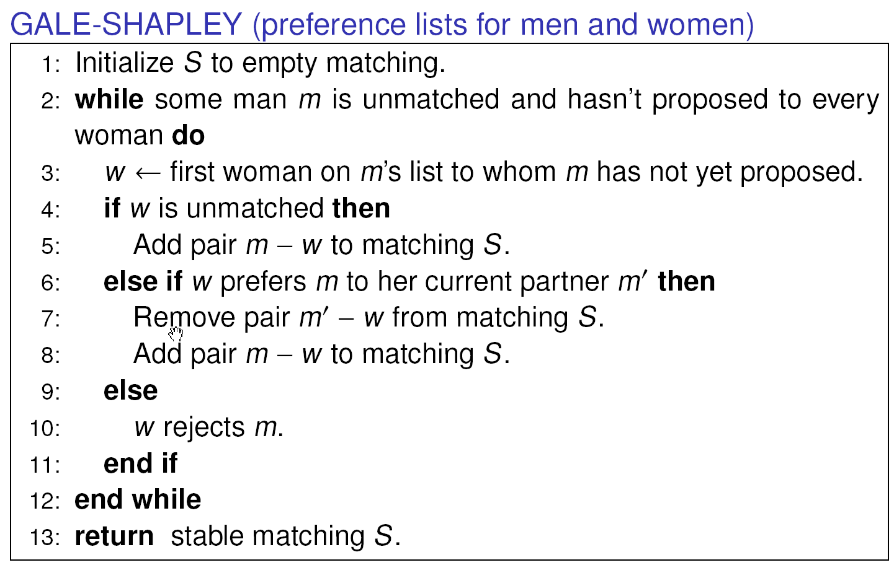
Propose-And-Reject Algorithm
Propose-and-reject algorithm. [Gale-Shapley 1962] Intuitive method that guarantees to find a stable matching.

Slide 10
Proof of Correctness: Termination
Observation 1. Men propose to women in decreasing order of preference.
Observation 2. Once a woman is matched, she never becomes unmatched; she only "trades up."
Claim. Algorithm terminates after at most n² iterations of while loop.
Pf. Each time through the while loop a man proposes to a new woman. There are only n² possible proposals. ▪
Notes:
stable matching is unique for worst-case instance

Slide 11
Proof of Correctness: Perfection
Claim. All men and women get matched.
Pf. (by contradiction)
  Suppose, for sake of contradiction, that Zeus is not matched upon termination of algorithm.
  Then some woman, say Amy, is not matched upon termination.
  By Observation 2, Amy was never proposed to.
  But, Zeus proposes to everyone, since he ends up unmatched. ▪

Slide 12
Proof of Correctness: Stability
Claim. No unstable pairs.
Pf. (by contradiction)
  Suppose A-Z is an unstable pair: each prefers each other to partner in Gale-Shapley matching S*.
  Case 1: Z never proposed to A.
  ⇒ Z prefers his GS partner to A.
  ⇒ A-Z is stable.
  Case 2: Z proposed to A.
  ⇒ A rejected Z (right away or later)
  ⇒ A prefers her GS partner to Z.
  ⇒ A-Z is stable.
  In either case A-Z is stable, a contradiction. ▪
men propose in decreasing
order of preference
S*
Amy-Yancey
Bertha-Zeus
. . .
women only trade up

Slide 13
Understanding the Solution
Q. For a given problem instance, there may be several stable matchings. Do all executions of Gale-Shapley yield the same stable matching? If so, which one?
An instance with two stable matchings.
  A-X, B-Y, C-Z.
  A-Y, B-X, C-Z.
1st
2nd
3rd
1st
2nd
3rd
Xavier
A
B
C
Amy
Y
X
Z
Yancey
B
A
C
Bertha
X
Y
Z
Zeus
A
B
C
Clare
X
Y
Z

Slide 14
Understanding the Solution
Def. Woman w is a valid partner of man m if there exists some stable matching in which they are matched.
Man-optimal assignment. Each man receives best valid partner.
Claim. All executions of GS yield man-optimal assignment, which is a stable matching!
Notes:
"genre of questions that arise in many areas of cs: algorithm runs asynchronously, with different independent components performing actions that can be interleaved in complex ways, and we want to know how much variability this asynchrony can cause in final outcome (e.g., if independent components are engines on different wings of airplane, it might be a big deal)"
man-optimality: guarantees that all possible executions of Gale-Shapley (with men as proposers) yields same stable marriage
this is a remarkable result: if each man is independently given his best stable partner, then the result is a stable marriage; yet a priori there is no reason to believe that this is even a perfect matching, let alone stable!
characterize matching found - number of possible ways to prove, many lead to complicated proofs

Slide 15
Man Optimality
Claim. GS matching S* is man-optimal.
Pf. (by contradiction)
  Suppose some man is paired with someone other than best partner. Men propose in decreasing order of preference ⇒ some man is rejected by valid partner.
  Let Y be first such man, and let A be first valid
  woman that rejects him.
  Let S be a stable matching where A and Y are matched.
  When Y is rejected, A forms engagement with a man,
  say Z, whom she prefers to Y.
  Let B be Z's partner in S.
  Z not rejected by any valid partner at the point when Y is rejected by A. Thus, Z prefers A to B.
  But A prefers Z to Y.
  Thus A-Z is unstable in S. ▪
S
Amy-Yancey
Bertha-Zeus
. . .
since this is first rejection
by a valid partner

Slide 16
Stable Matching Summary
Stable matching problem. Given preference profiles of n men and n women, find a stable matching.
Gale-Shapley algorithm. Finds a stable matching in O(n²) time.
Man-optimality. In version of GS where men propose, each man receives best valid partner.
Q. Does man-optimality come at the expense of the women?

Slide 17
Woman Pessimality
Woman-pessimal assignment. Each woman receives worst valid partner.
Claim. GS finds woman-pessimal stable matching S*.
Pf.
  Suppose A-Z matched in S*, but Z is not worst valid partner for A.
  There exists stable matching S in which A is paired with a man, say Y, whom she likes less than Z.
  Let B be Z's partner in S.
  Z prefers A to B.
  Thus, A-Z is an unstable in S. ▪
S
man-optimality
Amy-Yancey
Bertha-Zeus
. . .

Slide 18
Deceit?
Q. Can there be an incentive to misrepresent your preference list?
Assume you know men's propose-and-reject algorithm.
Assume preference lists of all other participants are known.
Fact. No, for any man; yes, for some women.
If Amy lies ``I prefer Zeus to Xavier", GS will return {A-Y,B-X,C-Z}!
1st
2nd
3rd
1st
2nd
3rd
Xavier
Amy
Bertha
Clare
Amy
Yancey
Xavier
Zeus
Yancey
Bertha
Amy
Clare
Bertha
Xavier
Yancey
Zeus
Zeus
Amy
Bertha
Clare
Clare
Xavier
Yancey
Zeus
Men’s Preference Profile
Women’s Preference Profile

Slide 19
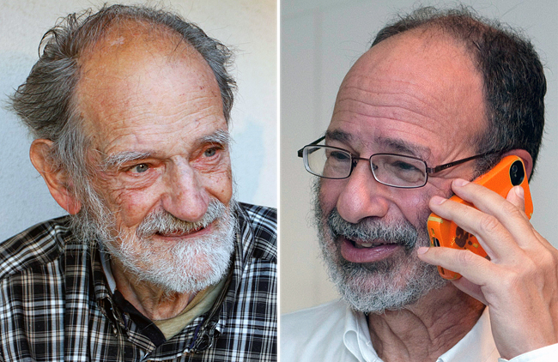
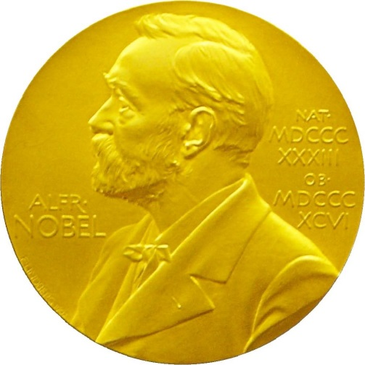
2012 Nobel Prize in Economics
Lloyd Shapley. Stable matching theory and Gale-Shapley algorithm.
Alvin Roth. Applied Gale-Shapley to matching new doctors with hospitals, students with schools, and organ donors with patients.

Slide 20
Homework
Read Chapter 1 of the textbook.
Exercises 1, 2, 4 & 5 in Chapter 1.

