Slide 1

User Generated Content Analytics
Lovekesh Bansal
Roshni Das
Tomer Peled
Thomas Stamatopoulos

Slide 2

OUR FOCUS
CHALLENGE STATEMENT:
Create a wining strategy for your charity
Using the correct image, description, caption and title set an achievable goal aiming at a good charitable cause.
IMPORTANCE:
People that create charities are often in dire straits and need assistance in raising funds for medical / disaster relief purposes and their success is crucial.
SOME KEY QUESTIONS:
What is the most impactful setting of a post that can increase a charity’s probability of achieving it’s target amount?
Image topics, captions , sentiments …..
How does these settings change between large scale and small scale projects
Are there any time patterns in fundraising projects that should be considered

Slide 3
What is GOFUNDME ?
Crowdfunding service
No deadline or Goal requirement
Topics – Medical, Emergency, Memorial, Education, Charity etc…
Posts include – topic, Images, caption
Post can be – Liked, shared, commented
Funding can be done in multiple currencies and multiple modes
Keep any amount of fund that you receive

Slide 4
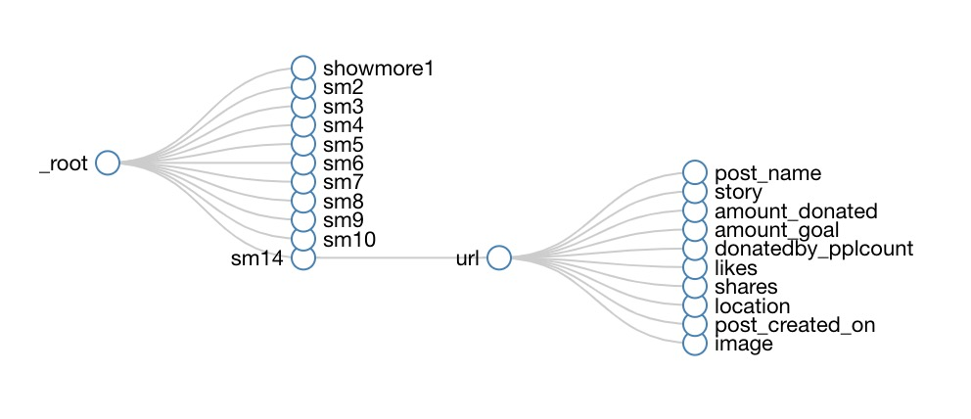
Data Collection & Analysis
Focus on a specific charity cause: “California Wildfires”
Use of online scrapping tool for the collection of data
Use of LDA (Latent Dirichlet Allocation) for the grouping and analysis of images
Use of VADER for Sentiment analysis of the charity descriptions
Use of statistic modeling for the analysis of feature importance
Separation of projects in small (<$10,000) and large (>$10,000) ones

Slide 5
Donation Time Analysis
Idea –
Spot donation peak times/decline times
Fundraiser could realize time periods in which more effort should be put in place
Each page contains a scrollable section that shows the donations made and when
Analysis method -
Selecting 10 successful projects, plotting number of donations by time, identifying mutual patterns
Scraping –
Consecutive HTTP requests with 2 parameters – fundraise ID and current index (10 donations each request)
Data –

Slide 6
Donation Time Analysis - Results

Slide 7
Donation Time Analysis - Results
Most impactful period – Initial project phase
Reasons might be
Gofundme “Trending” promotion
Most efforts spent at the beginning of the project
Exhaustion of closer circles of potential donors
Fundraisers should keep track of their fundraising project performance over time, identify the point of decline and compensate for it by
Project updates
Further promotion through shares on social media platforms
Altering captions/images

Slide 8
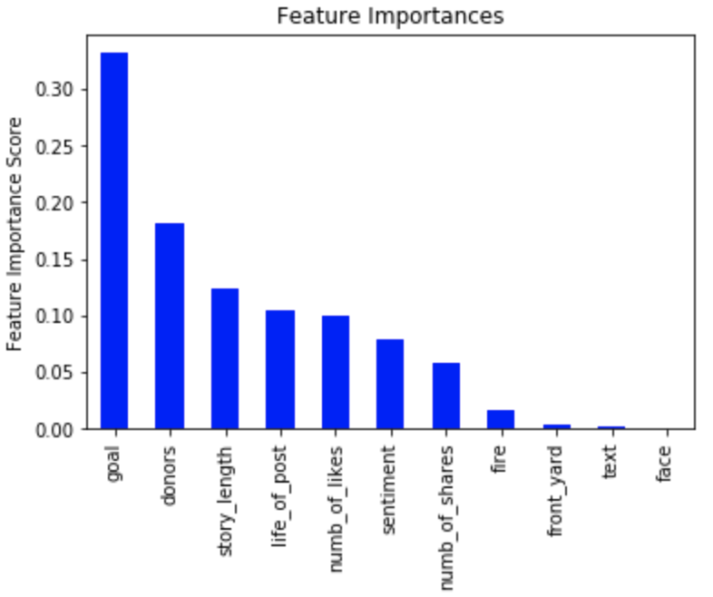
Wining Strategy
Set a realistic goal:
Most successful large scale charities (above $10,000) had set goals within the $30,000 range
Get the word out:
Successful projects had approximately 3x the engagement (likes and shares) compared to unsuccessful ones leading to 4x the donors
Provide concrete context:
Successful projects had consistent stories complementing the charity conveying the purpose and goals, charities with generic stories performed poorly irrespective of the images

Slide 9
Small vs Large Charity
Mean Values | Small Charity (<$10,000) |  | Large Charity (>$10,000)
 | Win | Fail | Win | Fail
Set Goal | $3,200 | $4,700 | $29,000 | $1,472,412
Shares | 130 | 76 | 3,400 | 1,000
Likes | 42 | 12 | 270 | 110
Sentiment | 0.71 | 0.48 | 0.65 | 0.50
Story length | 1070 | 1000 | 1500 | 1400
Fire (image) | 0.02 | 0.04 | 0.02 | 0.05
The above table presents the differences among the mean values of high and low achieving charities of each category.

Slide 10
Moving forward
Clustering of charities and creation of clear subcategories
Correlation of successful charities in regards to the effects of social media (network effect) and popularity of the topic
Fake charity classifier, identifying sincere causes and filtering out scams

