Slide 1
Minimal APIs vs Controller-based APIs
By Louëlla Creemers

Slide 2
Welcome!
Controller-based APIs
Minimal APIs
Routing
Dependency Injection
Performance
Support
Conclusion

Slide 3
Should I convert my controller-based API?
Should I give Minimal APIs a try?
Is a controller-based API the best solution?

Slide 4
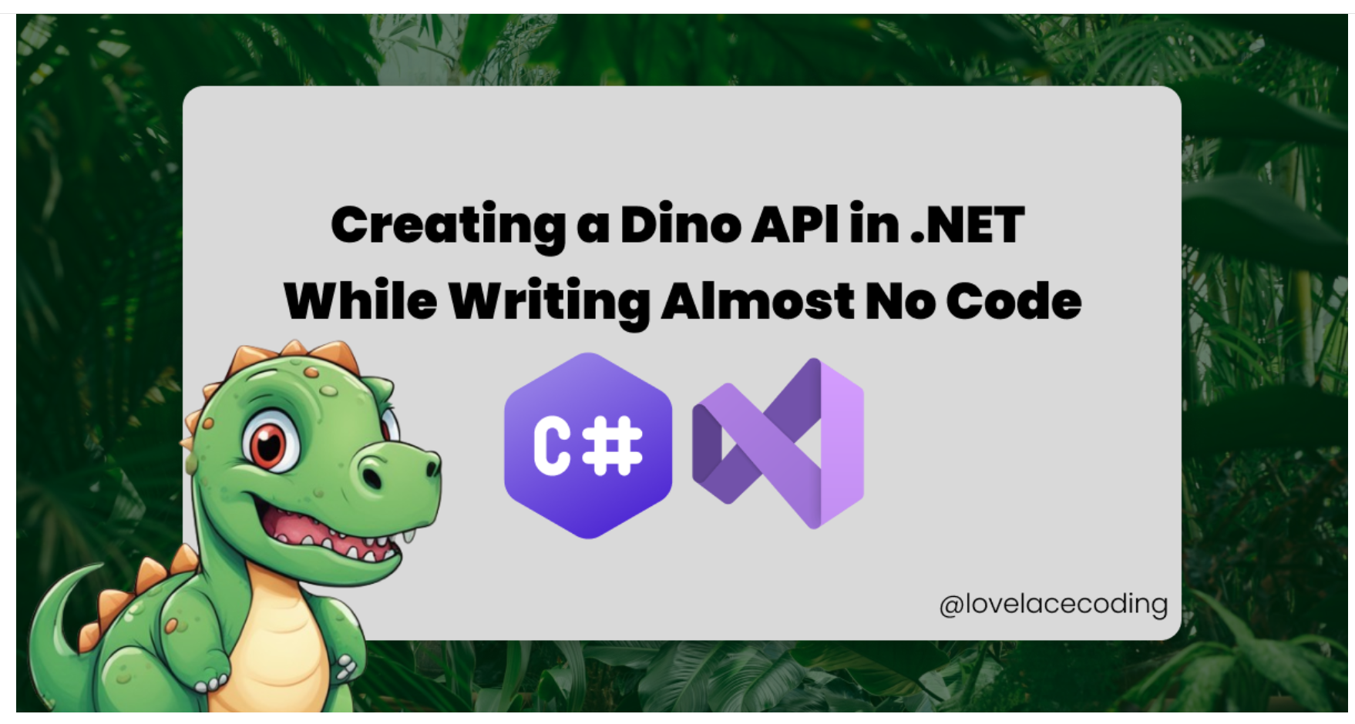
January 20th, 2024

Slide 5



Louëlla Creemers
Microsoft MVP
JetBrains Community Contributor
.NET Foundation Board Member
.NET developer (freelance)
University teacher

Slide 6

Controller-based API?

Slide 7
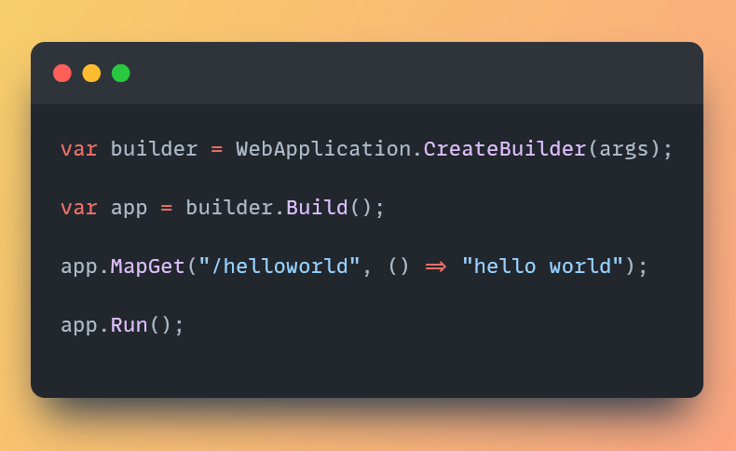
Minimal API?

Slide 8
Timeline
2002
ASP.NET WebForms
2007–2009
ASP.NET MVC and Web API
2016
ASP.NET Core
2021
Minimal APIs in .NET 6

Slide 9
Why?
Minimizing complexity
Minimizing boilerplate code
Better performance
Great for micro services

Slide 10


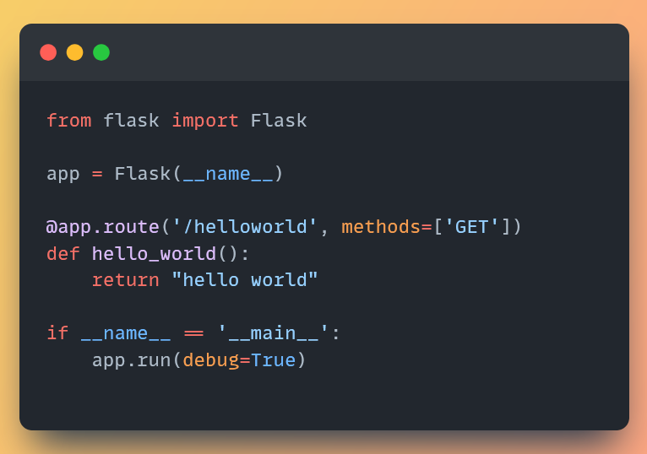
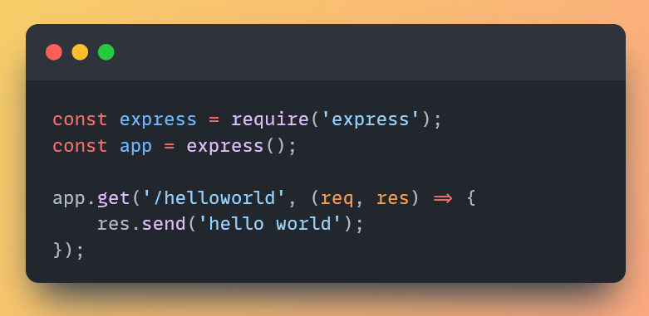

Slide 11
This did not happen overnight

Slide 12
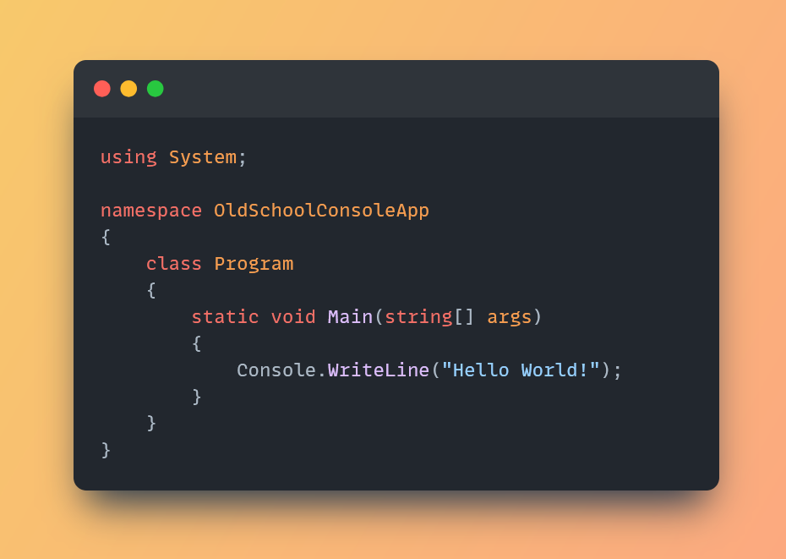
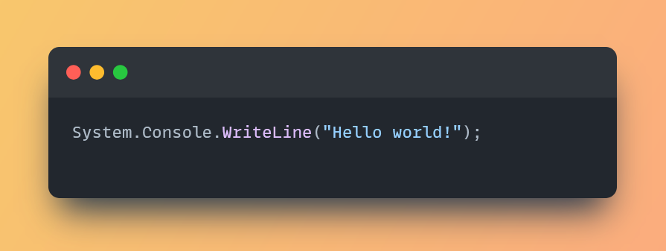
Top level statements

Slide 13
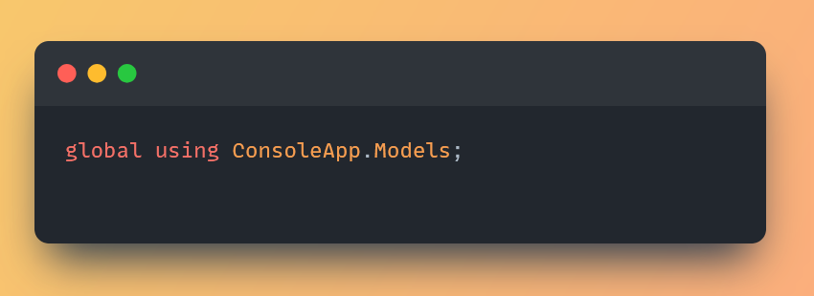
Global usings

Slide 14
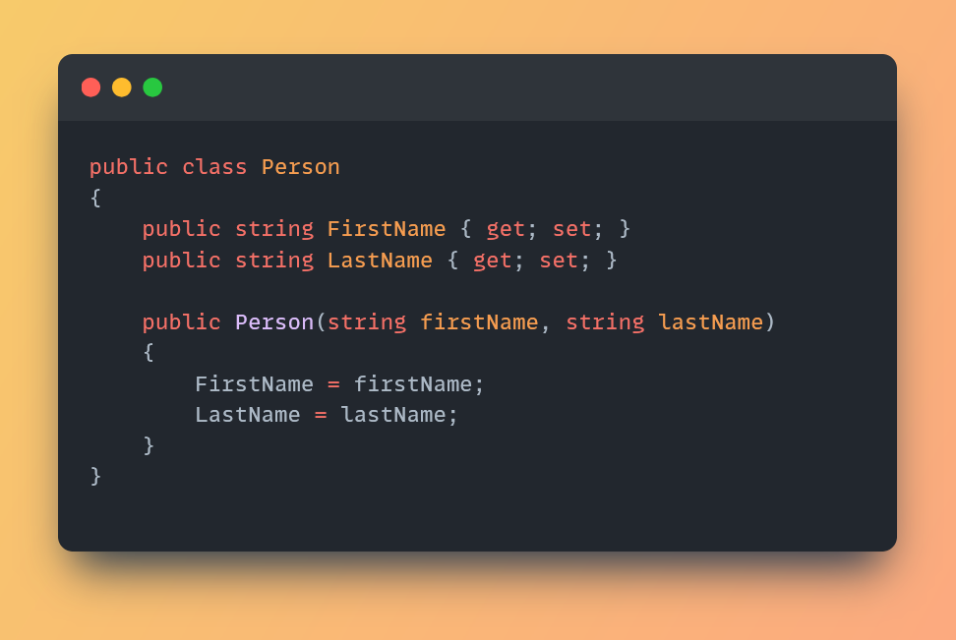
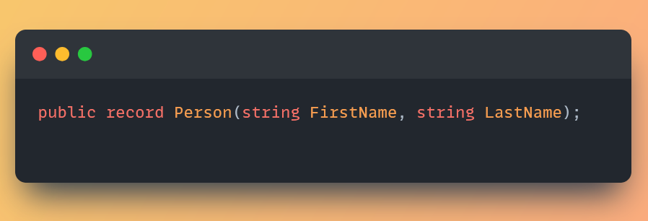
Records

Slide 15
So now we’re here

Slide 16
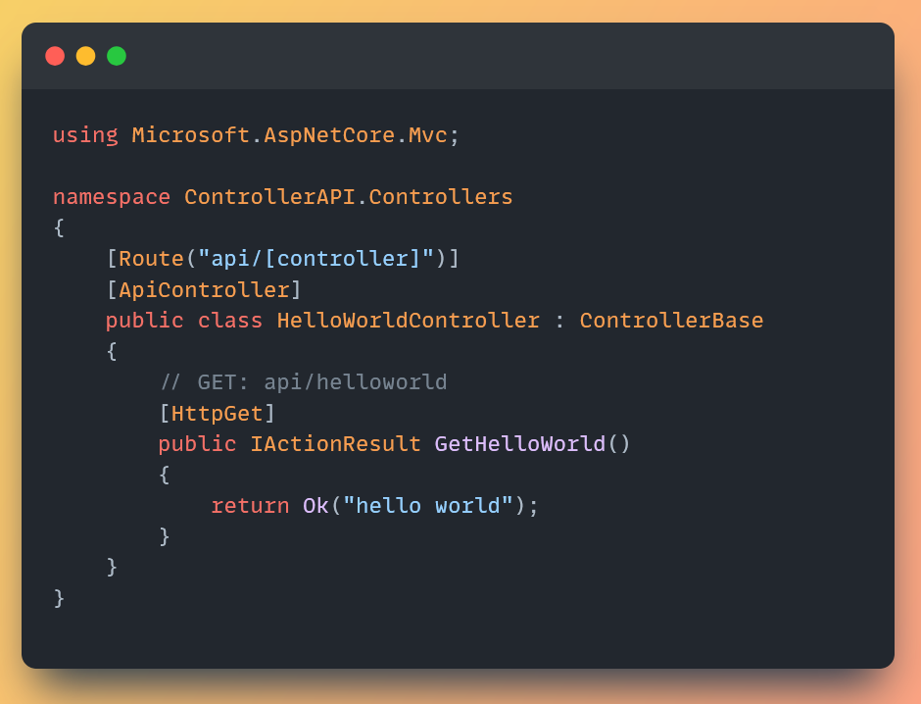
Routing

Slide 17
Demo

Slide 18
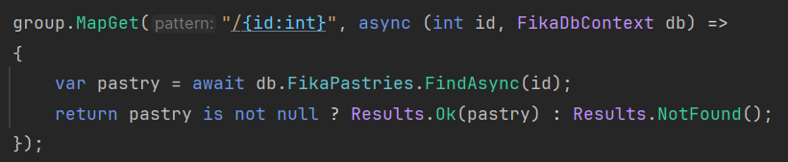
Dependency Injection
Notes:
Consider adding a service layer inbetween

Slide 19
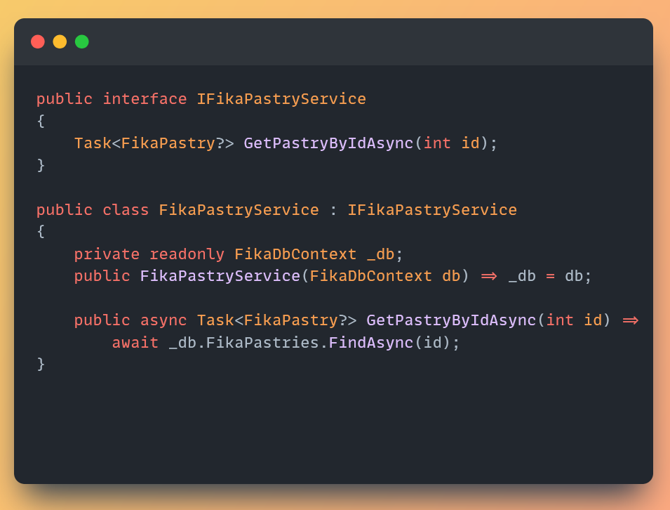
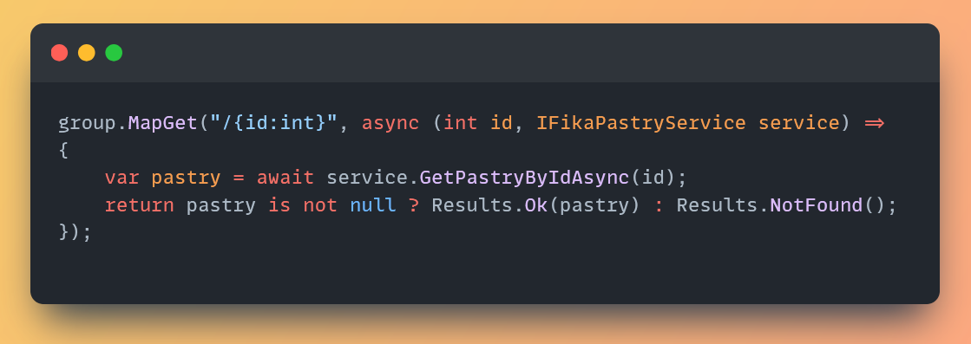
Service layers

Slide 20
Performance

Slide 21
Performance – Simple API
Minimal API: 500 ms.
Controller-based API: 650 ms.

Slide 22
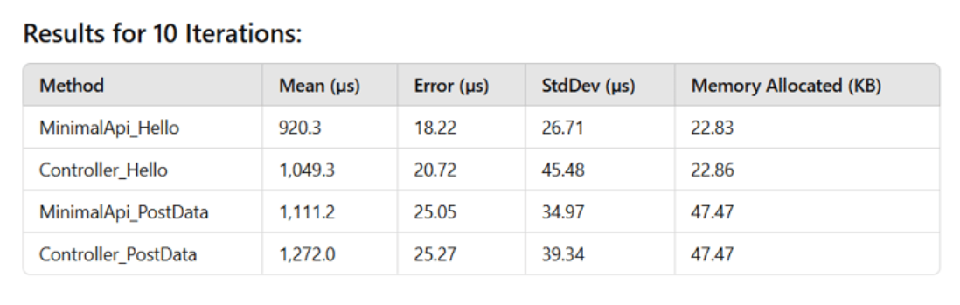
Extended performance
Source: Spyros Ponaris on dev.to

Slide 23
Not supported
Model binding
JsonPatch
OData

Slide 24
Model binding
Feature | Minimal APIs | Controller APIs
Complex Model Binding | 🚫 Not available | ✅ Available
Custom Model Binders | 🚫 Not available | ✅ Available
Validation via Data Annotations ([Required]) | ✅ Partly supported | ✅ Available
Binding Multiple Sources ([FromBody], [FromQuery] Together) | 🚫 Not available | ✅ Available

Slide 25
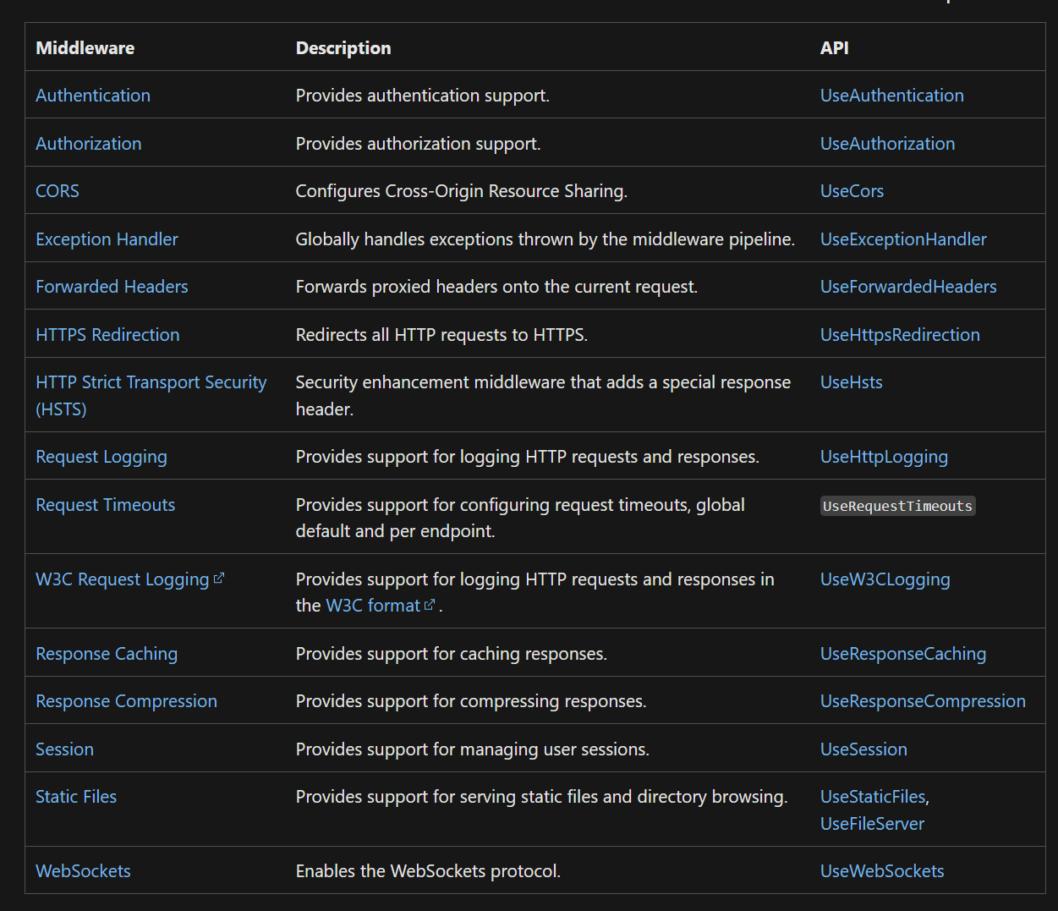
Middleware

Slide 26
The decision
Performance and simplicity.
Custom code and advanced topics.

Slide 27
Best use cases for Minimal APIs
Smaller APIs
Microservices
Demo’s

Slide 28
Not so great use cases for Minimal APIs
Large scale APIs
Model binding heavy APIs
‘Thick controllers’

Slide 29
Questions?

Slide 30
Resources
Microsoft Docs – Minimal API reference (https://tinyurl.com/4esjyr4u)
FreeCodeCamp video course (https://tinyurl.com/4rtxr7v8)
Benchmark of Spyros Ponaris (https://tinyurl.com/359mnbvc)
FastEndpoints (https://fast-endpoints.com/)

Slide 31
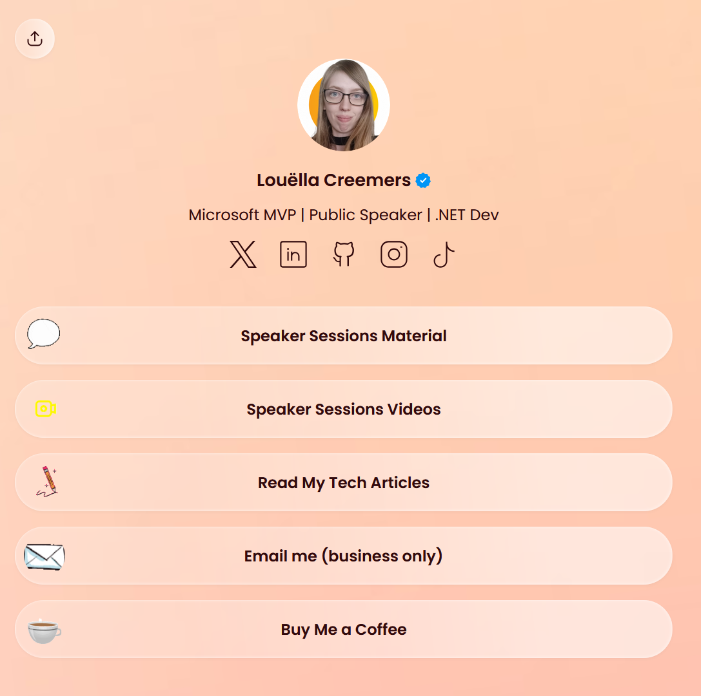
Thank you! Please visit louella.dev/socials

