Slide 1

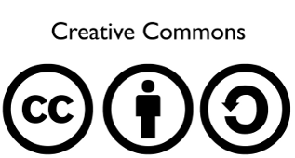
Arduino 101
Presented by Daniel Packard - 2013/12/14
With Maurice Woods III, Casey Kuhns, and Stephen Warren

Slide 2
A Maker Space for Loveland.

Slide 3
A Maker Space for Loveland.
Special thanks to SparkFun, Ferguson Highschool, and E3 Learning

Slide 4

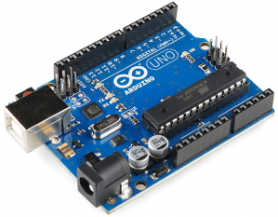
Arduino

Slide 5
Arduino
You've been lied to!

Slide 6
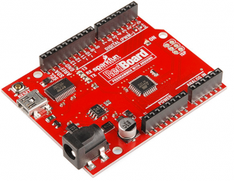

Arduino
RedBoard
You've been lied to!
This class will use the RedBoard platform from

Slide 7

http://dlnmh9ip6v2uc.cloudfront.net/datasheets/Kits/SFE-SIK-RedBoard-Guide-Version3.0-Online.pdf

Slide 8
Arduino (Redboard) is...

Slide 9
Arduino (Redboard) is...
A programmable micro-controller.

Slide 10
Arduino (Redboard) is...
Atmega Processor
A programmable micro-controller.

Slide 11
Arduino (Redboard) is...
Input/Output pins
(power)
A programmable micro-controller.

Slide 12
Arduino (Redboard) is...
USB Serial Interface
(and power)
A programmable micro-controller.

Slide 13
Arduino (Redboard) is...
Power
A programmable micro-controller.

Slide 14
Arduino (Redboard) is...
USB Serial Interface
(and power)
Atmega Processor
Power
IO pins
A programmable micro-controller.

Slide 15
Arduino (Redboard) is...
USB Serial Interface
(and power)
Atmega Processor
Power
Input/Output pins
A programmable micro-controller.
A programmable micro-controller.
But the best way to explain the Arduino is with some examples:
https://www.youtube.com/watch?v=6mXM-oGggrM
http://www.youtube.com/watch?v=yuKcLG1tqks
http://www.instructables.com/id/20-Unbelievable-Arduino-Projects/

Slide 16
Programmable Circuits

Slide 17
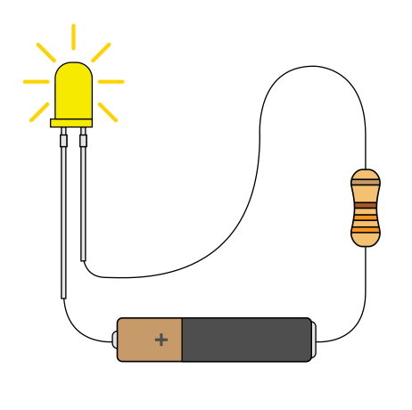
Programmable Circuits
Build a simple circuit
(electronics)
Image attributed to SparkFun Electronics

Slide 18
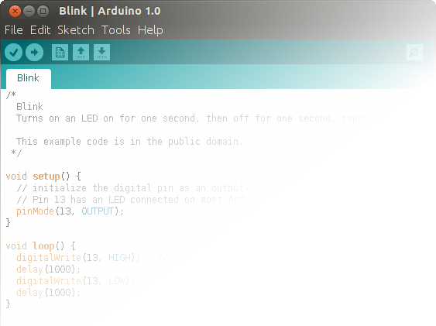
Programmable Circuits
Build a simple circuit
(electronics)
Image attributed to SparkFun Electronics
Write a control program
(software)

Slide 19
Arduino 101
Installation:
Windows and Mac users:
Download the installer from:
      http://arduino.cc
Linux users(specifically Debian):
In a terminal:
      sudo apt-get install arduino
      sudo usermod -aG dialout <user>
      Logout, and log back in for changes to take effect.

Slide 20
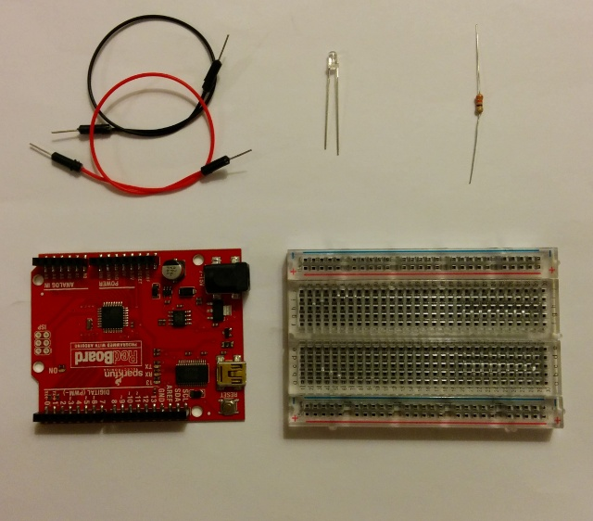
Building the Circuit
Inside your kit, you'll find:
1 LED
2 Jumper cables
1 resistor
1 RedBoard
1 Breadboard

Slide 21
Building the Circuit

Slide 22
Building the Circuit

Slide 23
Building the Circuit

Slide 24
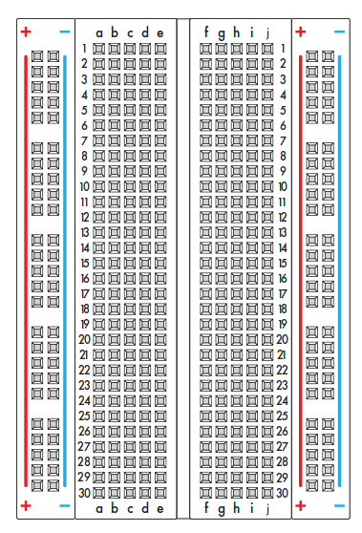
Building the Circuit
Bread board to the rescue!

Slide 25
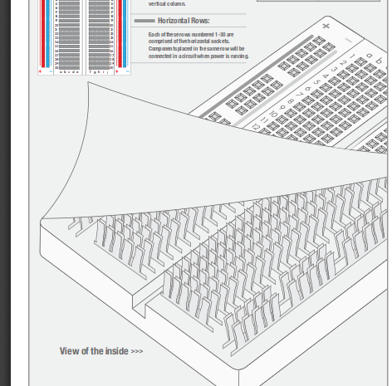
Building the Circuit

Slide 26
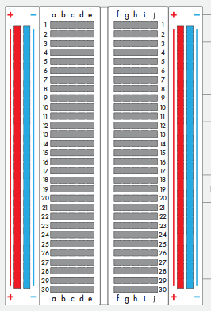
Building the Circuit
Bread board to the rescue!

Slide 27
Building the Circuit
Bread board to the rescue!

Slide 28
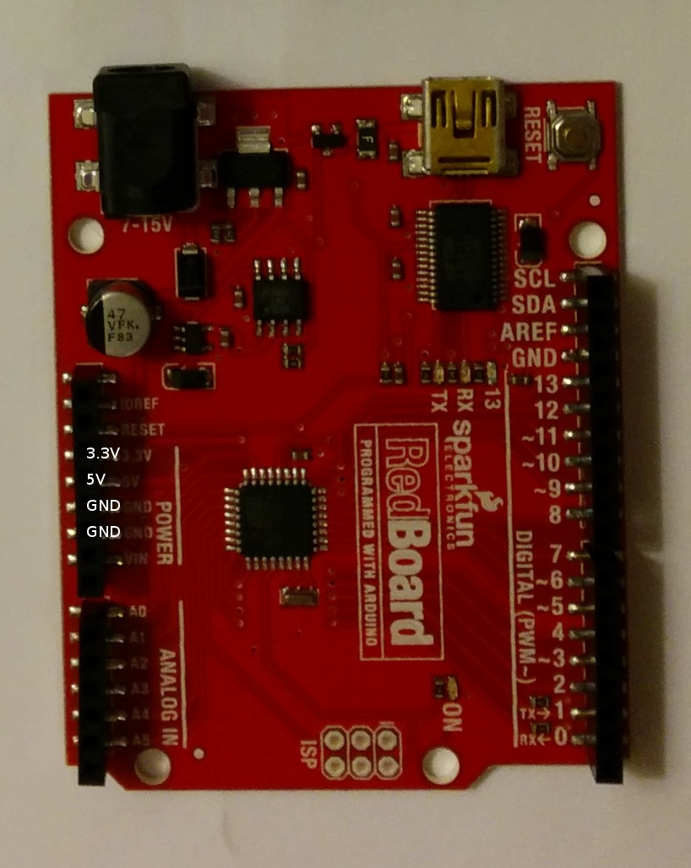
Building the Circuit
Bread board to the rescue!
+
-

Slide 29
Building the Circuit
Bread board to the rescue!
+
-

Slide 30
Building the Circuit
Bread board to the rescue!
+
-
Short Leg

Slide 31
Building the Circuit
Bread board to the rescue!
+
-
Short Leg

Slide 32
Building the Circuit
Bread board to the rescue!
+
-

Slide 33
Programming the Circuit
First, we have to connect to a pin we can control
+
-
9
Short Leg

