Slide 1
Principal Component Analysis
Presented by:
Loveleen Amar

Slide 2
PCA
What is PCA
Principal Component Analysis (PCA) is one of the most fundamental unsupervised algorithms for dimension reduction and is a foundation stone in Machine Learning. It has found use in a wide range of fields ranging from Neuroscience to Quantitative Finance.
Unsupervised Learning Method
Dimensionality Reduction
Feature Elimination
Feature Extraction

Slide 3
Feature elimination is what it sounds like: we reduce the feature space by eliminating features.
Advantages: Simplicity, Interpretability
Disadvantages: gain no information from those variables you’ve dropped.
Feature extraction
Principal component analysis : extracts important feature, it combines our input variables in a specific way, then we can drop the “least important” variables. It tries to find a meaningful way to flatten the data by focusing on the things that are different between cells.

Slide 4
When should I use PCA?
Why & When to use PCA?
Use PCA when you want to reduce the number of variables to help reduce the overfitting.
2. Use it when you want to ensure your variables are independent of one another?
3. When you are comfortable making your independent variables less interpretable?

Slide 5
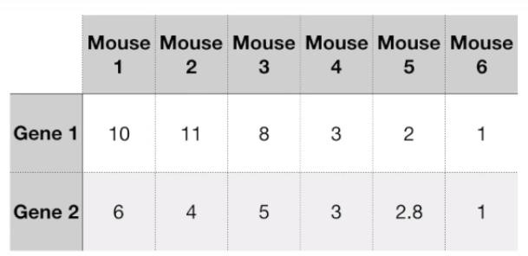
Understand PCA’s Use with Example
Mouse 1…n = Records
Gene1 and Gene2 =Features

Slide 6
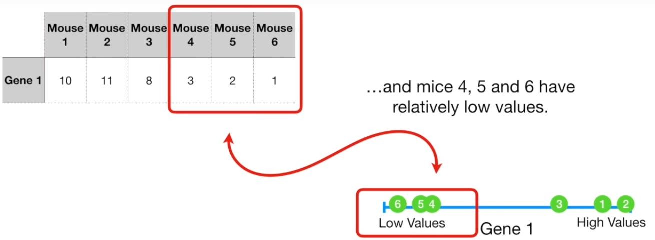
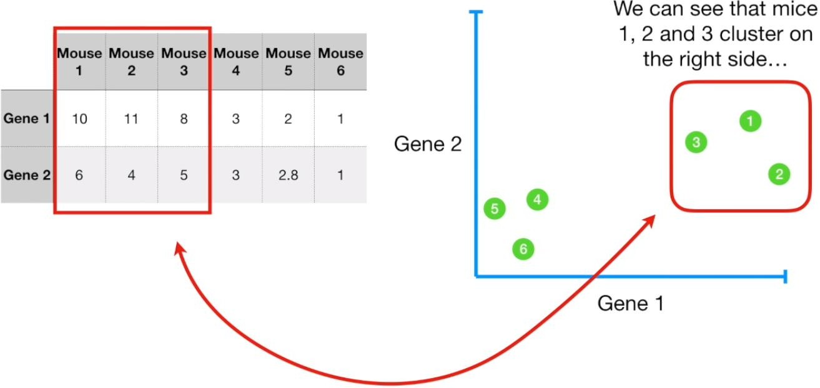
For one dimension
For two dimension

Slide 7
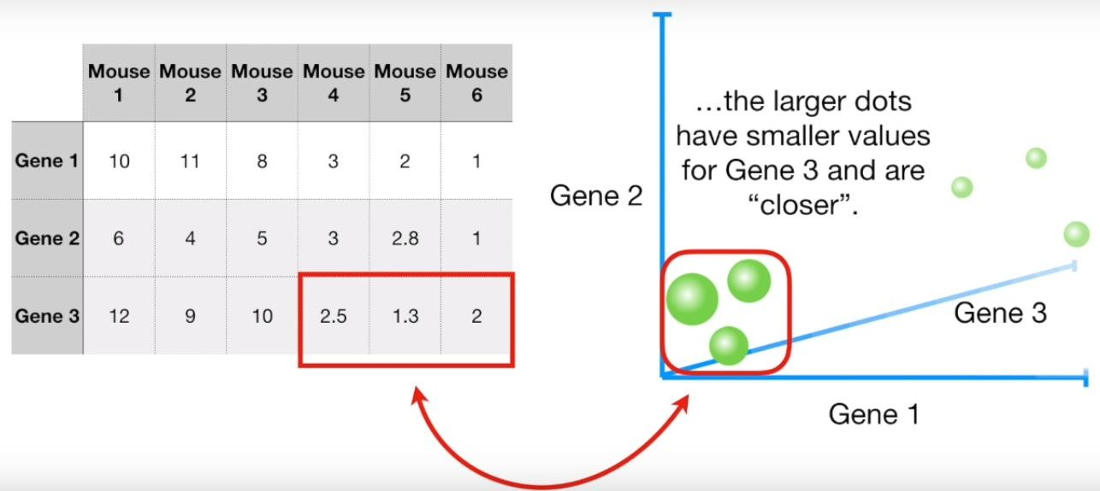
For three dimension
If we measured 4- Genes and it requires 4- dimension, no longer able to plot.
So, we are going to solve this problem with PCA that can take 4 or mores Gene measurements (features) and make a 2-D (not fixed) PCA plot…

Slide 8
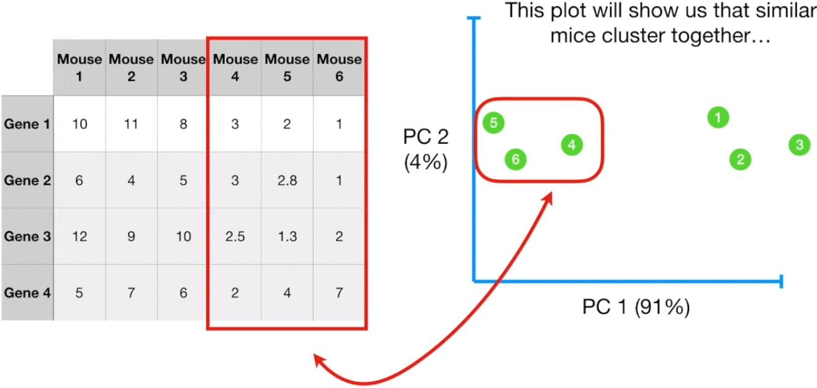
X-axis explain 91% variation and y-axis 4% of data.

Slide 9
How does PCA work?
We are going to calculate a matrix that summarizes how our variables all relate to one another.
Calculating the mean of each feature.
Covariance Matric calculation
We’ll then break this matrix down into two separate components: direction and magnitude.
Calculating the Eighen values and corresponding Eighen vectors.
The principle component with greater Eighen value is more important

Slide 10
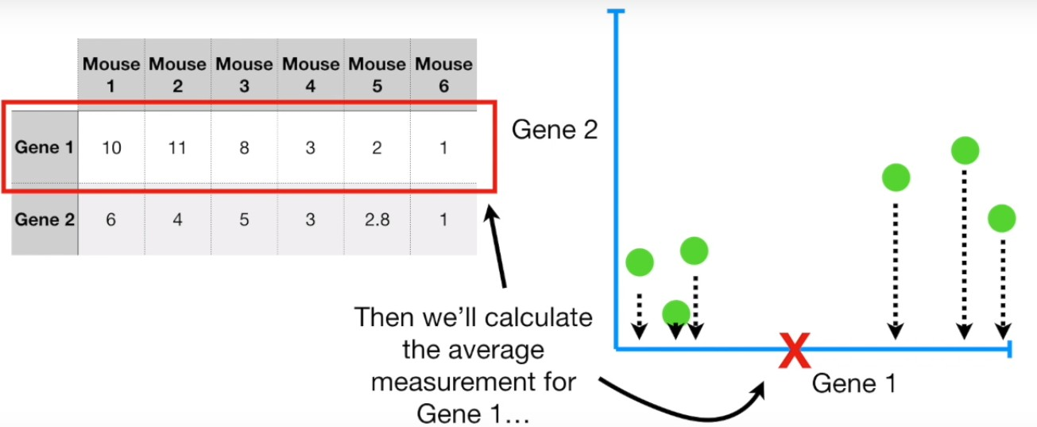
Working of PCA (for 2-D data with example)
Step 1: Calculate mean feature 1

Slide 11
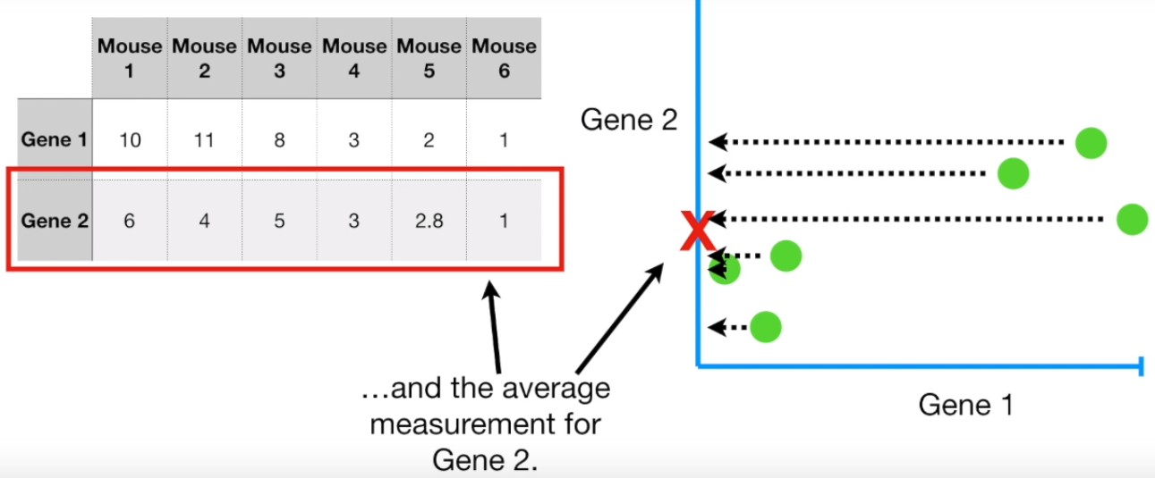
Step 2: Calculate mean for feature 2

Slide 12
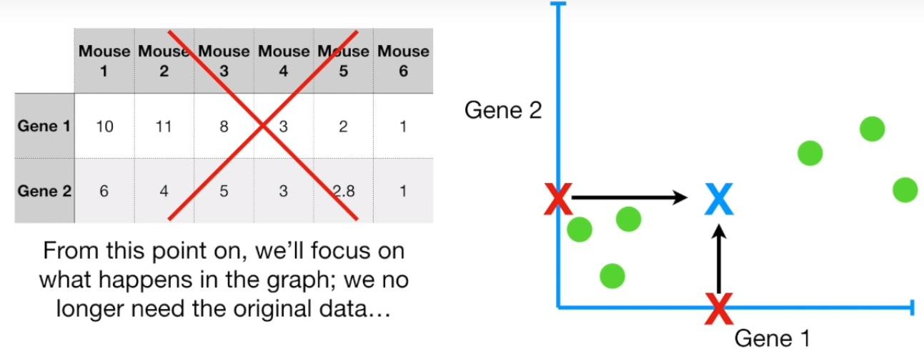
Step 3: Calculate the centre of the data
With the average value, we can calculate the centre of the data.

Slide 13
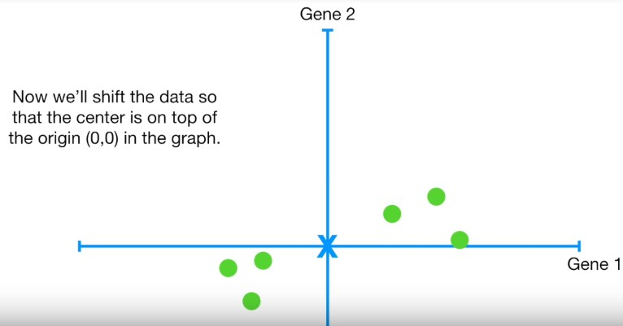
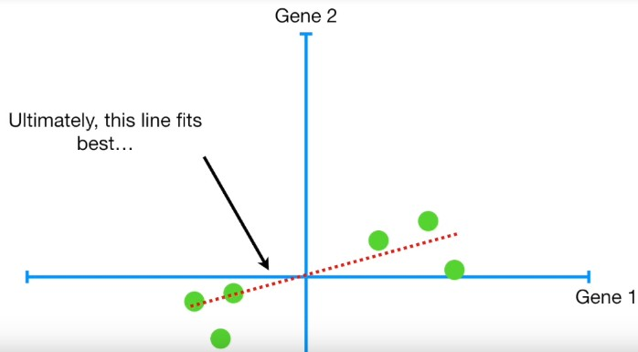
Step 4: Move the centre to origin
Note: Shifting the data did not change how the data points are positioned relative to each other.
Step 5: Find the best fit line (principle components)

Slide 14
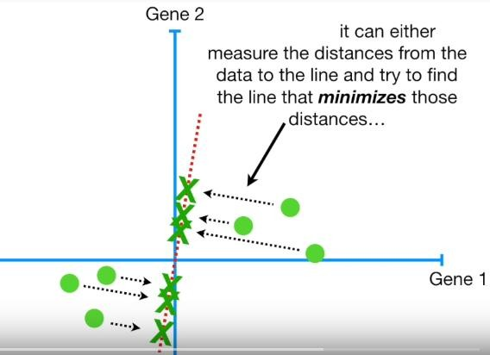
How PCA decides if a fit is good or not?
1st Way to find a best fit line

Slide 15
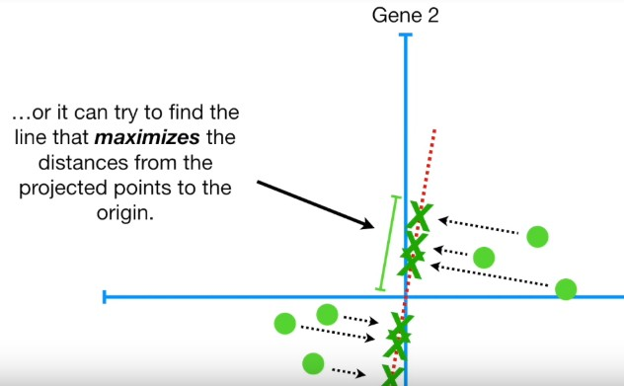
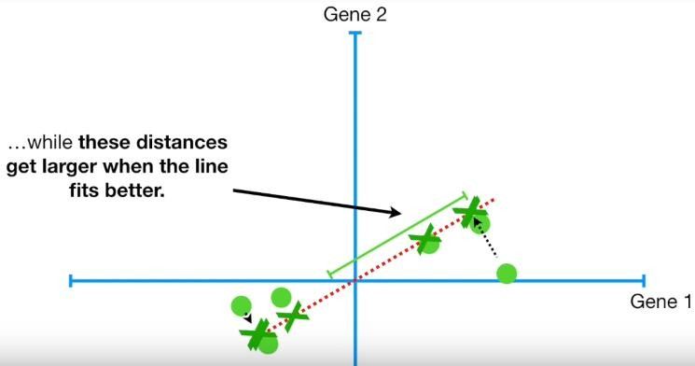
2nd Way to find a best fit line

Slide 16
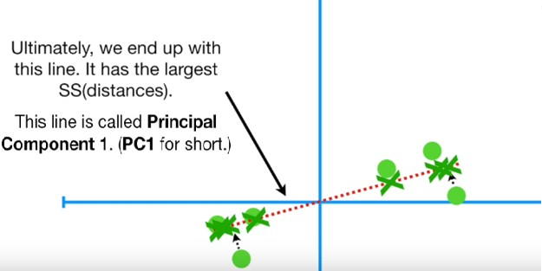
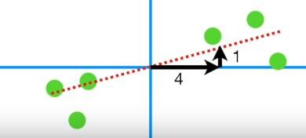
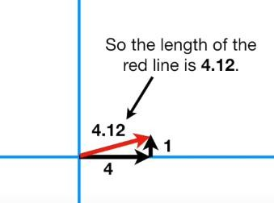
Step 6: Find Eighen vector for PC1
Once we get the best fit line (PC1), the next step is to calculate eighen vectors corresponding to PC1.
To make PC-1
Mix 4-part of gene-1 With 1-part of Gene-2
For SVD (making unit vector)

Slide 17
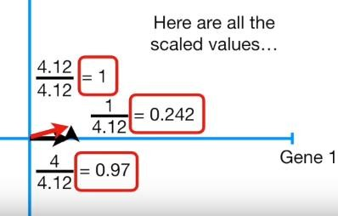
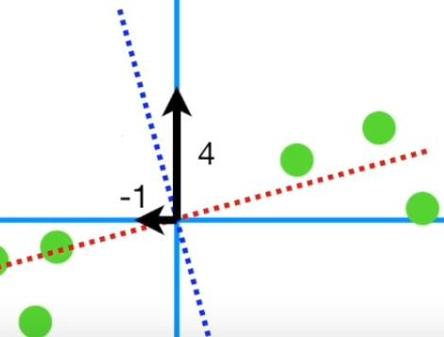
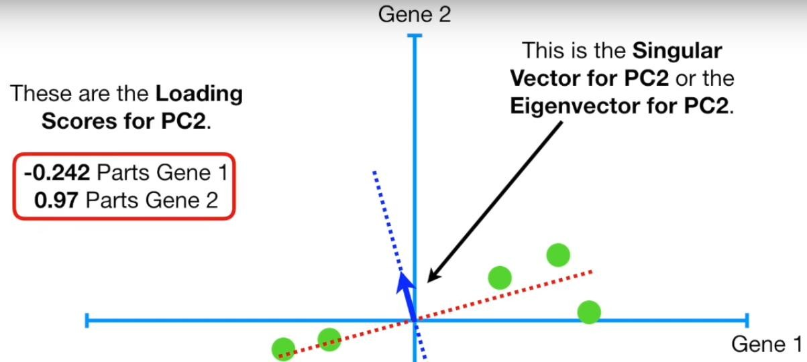
To make PC-1
Mix 0.97-part of gene-1 With 0.242-part of Gene-2
This one-unit long vector, consisting of 0.97 parts of gene-1 and
0.242 parts of Gene-2, is called the SINGULAR VECTOR or EIGENVECTOR for PC1. The proportion of each gene are called LOADING SCORES.
Lets work on PC2 : PC2 is simply the line through the origin that is perpendicular to PC1
To make PC-2
-1 part of gene-1 4 part of Gene-2

Slide 18
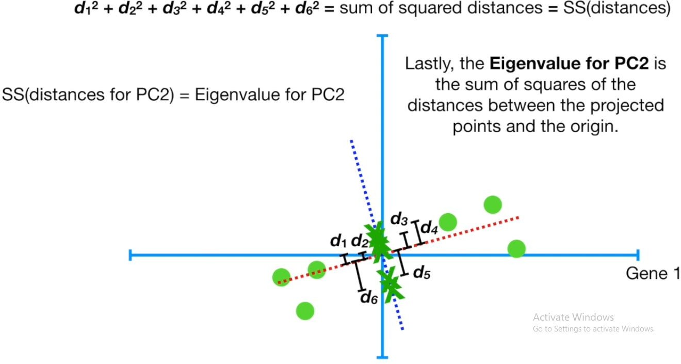
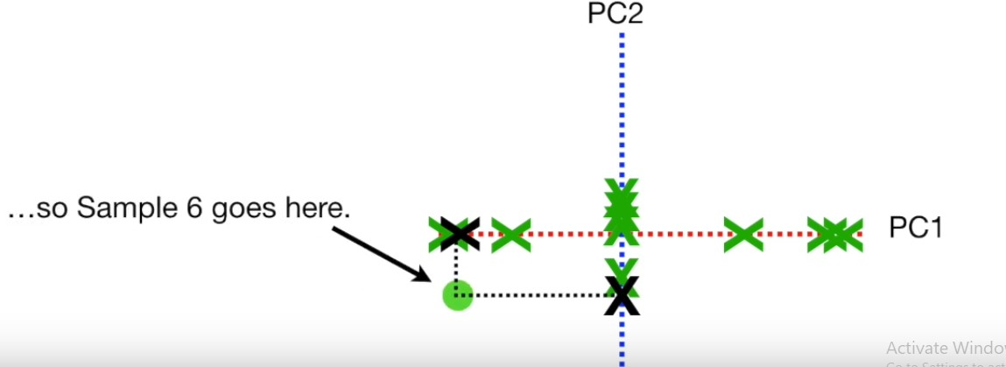
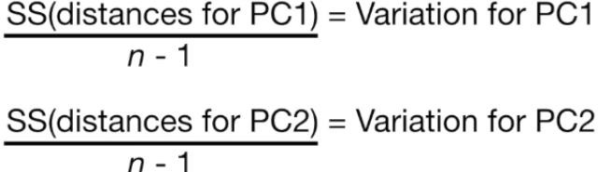
Suppose, The variation of PC-1 is = 15 The variation of PC-2 is = 3
Total variations around both PCs=18
PC-1 account 15/18 (83%) of total variations around the PCs Similarly, PC-2, 17%

Slide 19
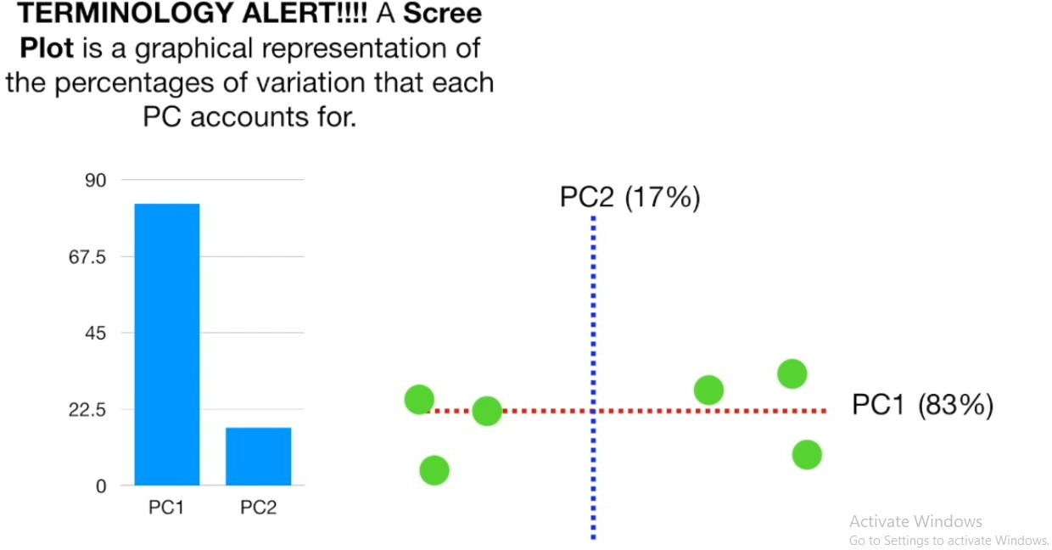
Scree Plot
Graphical representation of the variation each PC accounts

Slide 20
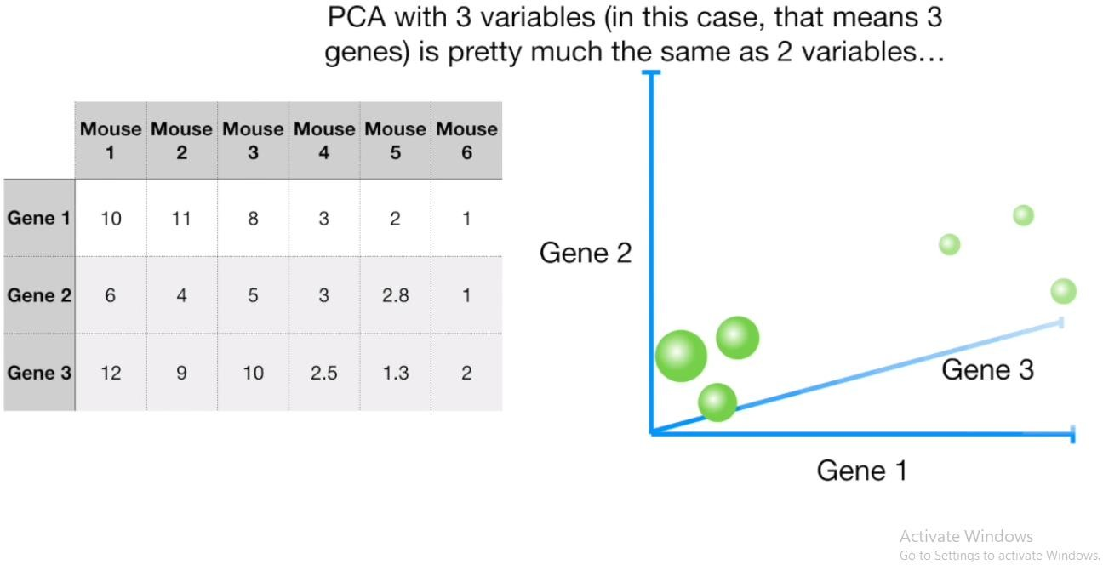
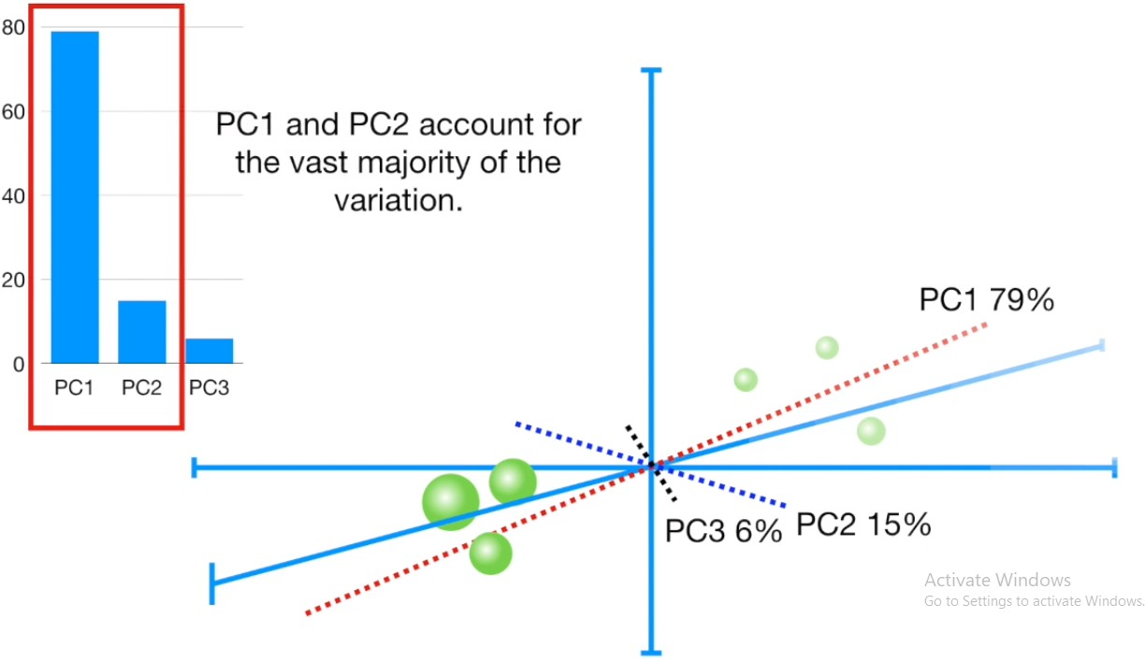
Consider little more complex example (3-D)

Slide 21
Applications of PCA
Quantitative Finance: PCA is a methodology to reduce the dimensionality of a complex problem. Say, a fund manager has 200 stocks in his portfolio. To analyze these stocks quantitatively a stock manager will require a co-relational matrix of the size 200 * 200, which makes the problem very complex. With PCA the task would become much easier.
PCA has been used on Medical Data to show correlation of Cholesterol with low density lipo-protein.
PCA has been used in the Detection and Visualization of Computer Network Attacks.

Slide 22
Thank You!!!

