Slide 1
Containers from Scratch using GO Language
Courtesy Liz Rice

Slide 2
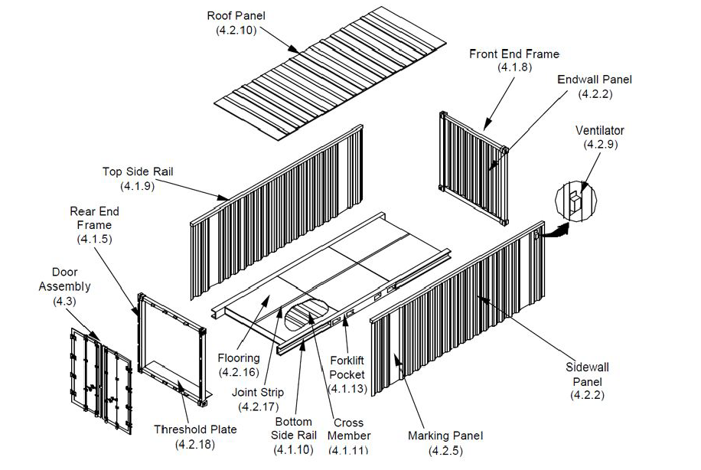
Build your own Container in Go
Namespaces
Chroot
CGroups

Slide 4
Linux Kernel
Namespaces are a fundamental aspect of containers in Linux.
The kernel has a set of tables to manage the system
Namespaces allow duplication of these tables for container isolation.
Mount (mnt), Process ID (pid), Network (net), Inter-process Communication (ipc), UTS, User ID (user), Control group (cgroup) Namespace, Time Namespace
Kernel
Host
Container 1
Container 2
https://en.wikipedia.org/wiki/Linux_namespaces

Slide 5
Namespaces
What you can see
Created with syscalls
Unix Timesharing System
Process IDs
Mounts
Network
User IDs
InterProcess Comms

Slide 7
CGroups
What you can use
Filesystem interface
Memory
CPU
I/O
Process numbers
…

Slide 8
Live Demonstration Build
https://github.com/lovellbrian/dockerdemo
git clone --recurse-submodules https://github.com/lovellbrian/dockerdemo
Use branches to step through the building process
Step 1, Step 2, …

