Slide 1
FRICTION

Slide 2
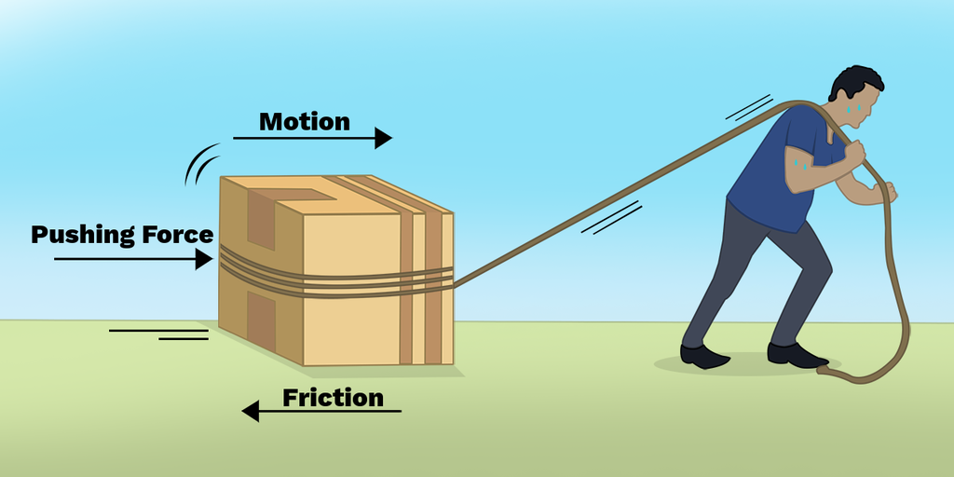
What is friction?
What is Friction?
Friction is a force that opposes the motion between two surfaces in contact.
It acts tangential to the surfaces and always opposes motion.

Slide 3
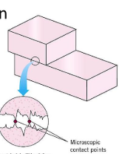
Why does Friction occur?
Due to interlocking of tiny irregularities on surfaces.
Called the force of contact.

Slide 4
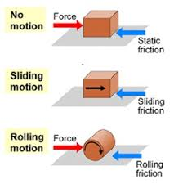
Types of Friction
(A) Static Friction
Acts when the object is at rest.
Prevents the object from starting to move.
(B) Limiting Friction
Maximum static friction just before the object starts moving.
Increases with external force up to a point.
(C) Kinetic or Sliding Friction
Acts when the object is sliding over the surface.
Less than limiting friction.
Also called dynamic friction.
(D) Rolling Friction
Acts when an object rolls over a surface.
Smallest among all types of friction.
Rolling objects get slightly deformed at the point of contact.

Slide 5
Remember
Limiting > Kinetic > Rolling friction
Friction is necessary for walking, holding objects, vehicles moving, etc.
Reducing friction: Lubricants, polishing surfaces.
Increasing friction: Rough surfaces, special soles on shoes.

Slide 6
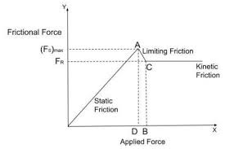
Variation of Frictional Force with Applied Force
OA: Static friction increases with applied force.
A: Maximum static friction (Limiting friction).
After A: Object moves with kinetic friction (constant and slightly less).
Rolling friction < Sliding friction < Limiting friction

Slide 7
Factors Affecting Friction
Material of surfaces in contact
Smoothness or roughness of surfaces
Area of contact (not a major factor usually)
Normal force (greater normal force → greater friction)

Slide 8
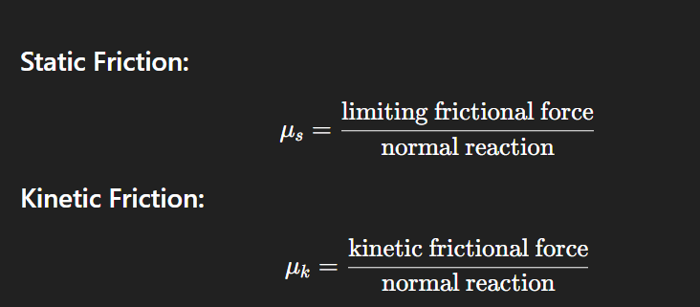
Coefficient of Friction (μu)
Coefficient tells how rough or smooth a surface is.

Slide 9
example
Problem:
Mass = 2 kg
Force applied = 2.5 N
Coefficient of static friction = 0.4
g=9.8m/s2
Find maximum static friction!

Slide 10
Solution:
Normal reaction, R=m×g=2×9.8=19.6 N
Maximum static friction = 0.4×19.6=7.84
✅ Since 2.5 N<7.84 , block does not move. 👉 Frictional force = Applied force = 2.5 N

Slide 11
Q1. Which type of friction is the least in magnitude? (A) Static friction (B) Limiting friction (C) Kinetic friction (D) Rolling friction

Slide 12
Problem:
Mass = 20 kg
Force applied = 98 N
Coefficient of kinetic friction = 0.25
Find acceleration.

Slide 13
Solution:
Normal reaction, R=20×9.8=196 N
Kinetic friction force = 0.25×196=49 N
Net force = 98−49=49 N
Acceleration = Net Force/Mass=49/20=2.45 m/s2
✅ Acceleration = 2.45 m/s²

Slide 14
Q2. What happens to friction when the normal force between two surfaces increases? (A) Friction decreases (B) Friction remains constant (C) Friction increases (D) Friction becomes zero

Slide 15
Q3. The force responsible for stopping a moving vehicle is: (A) Magnetic force (B) Frictional force (C) Electrostatic force (D) Gravitational force

Slide 16
Q4. Which method will NOT help in reducing friction? (A) Lubrication (B) Using wheels (C) Making the surfaces rougher (D) Streamlining the shape

Slide 17
Q1. (D) Rolling friction
Q2. (C) Friction increases
Q3. (B) Frictional force
Q4. (C) Making the surfaces rougher

Slide 18
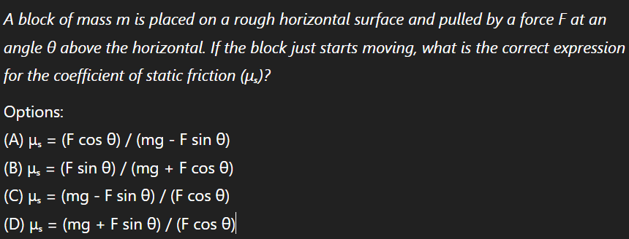

Slide 20
Hence, the correct answer is (A).

