Slide 1
Chemical Effects of Electric Current
Olympiad Preparation | Grade 8 (Target: Grade 10 Level)

Slide 2
Energy and Electricity
Energy is required for all activities. It comes in various forms like heat, light, mechanical, and electrical energy.
Electricity is a versatile and clean form of energy.
We often need to convert one form of energy into another.
Electric energy can cause chemical changes in substances.

Slide 3
What is Electric Current?
Electric current is the flow of electric charge (usually electrons) through a conductor.
Measured in Amperes (A)
Requires a voltage source (like a battery) and a closed circuit.

Slide 4
Chemical Effects of Electric Current
When an electric current passes through a liquid (electrolyte), it can cause chemical reactions. These are called chemical effects of current.
Can lead to decomposition of compounds.
Used in industries for electrolysis, refining, and electroplating.

Slide 5
What is Electrolysis?
Electrolysis is the process of using electric current to break down a compound in liquid form.
Requires electrodes (anode and cathode) and an electrolyte.
Commonly used in decomposition of water, electroplating, etc.

Slide 6
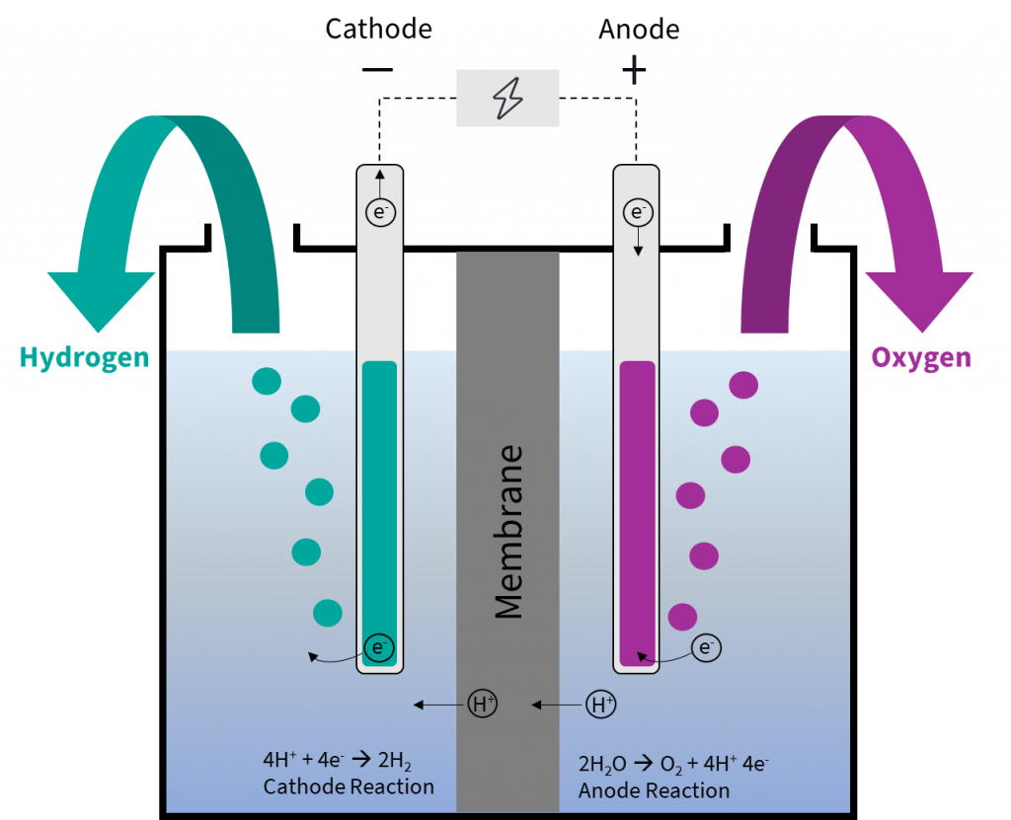
Electrolysis – Basic Diagram
Electrolysis of water: Electric current decomposes water into hydrogen and oxygen gas.

Slide 7
Applications of Electrolysis
Electrolysis is used in several practical applications:
Manufacturing chemicals (e.g., NaOH, Cl₂, H₂)
Extraction of metals from ores (electrometallurgy)
Refining of impure metals
Electroplating

Slide 8
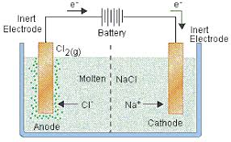
Extraction of Metals – Electrometallurgy
Reactive metals like Na, K, Ca, Mg are extracted using electrolysis.
Example: NaCl molten → Na + Cl₂
Aluminum is extracted from Al₂O₃ using electrolysis.

Slide 9
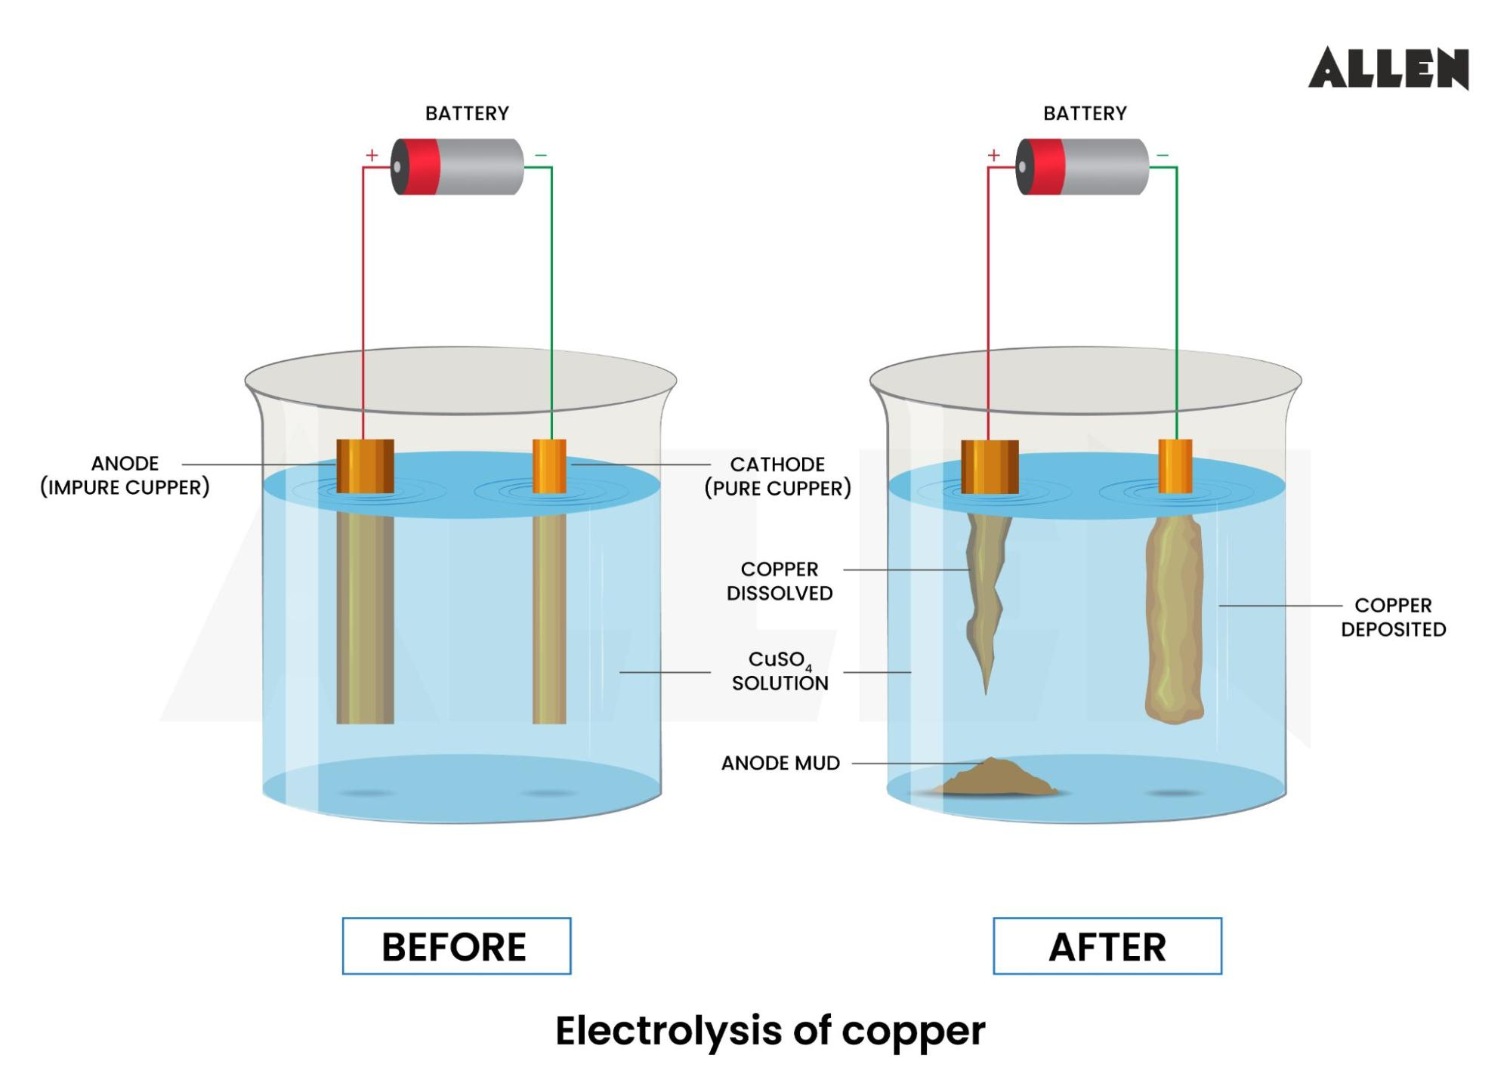
Refining of Metals
Impure metals are purified using electrolysis.
Example: Impure copper is made anode, pure copper is cathode.

Slide 10
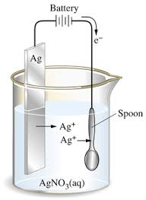
What is Electroplating?
Electroplating is the process of depositing a thin layer of one metal over another using electricity.
Used for protection, appearance, and corrosion resistance.
Common metals: Silver, gold, nickel, chromium.

Slide 11
Steps in Electroplating
The basic steps include:
Clean the object thoroughly.
Make the object cathode (–ve) and metal plate anode (+ve).
Immerse in electrolyte solution of metal salt.
Pass current to deposit metal layer.

Slide 12
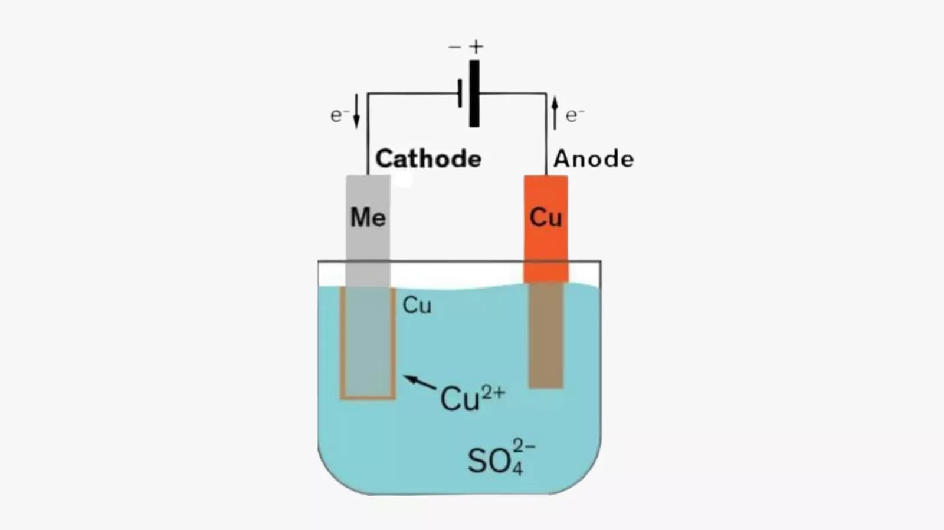
Example: Electroplating Copper
Copper is deposited on an iron object using copper sulphate solution as electrolyte.

Slide 13
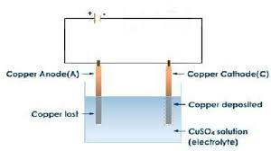
Reactions at Electrodes
In CuSO₄ solution:
At Cathode: Cu²⁺ + 2e⁻ → Cu (deposited on object)
At Anode: Cu → Cu²⁺ + 2e⁻ (copper dissolves into solution)

Slide 14
Summary
Key points to remember:
Electric current can cause chemical changes.
Electrolysis splits compounds using electric current.
Electroplating is a practical application of electrolysis.
Used in metal extraction, refining, and decoration.

Slide 15
Olympiad Tips
Some tips for cracking Olympiad questions:
Understand all diagrams thoroughly.
Practice reactions and electrode identification.
Revise real-world applications.
Solve previous year questions.

Slide 16
Quick Quiz
Test your knowledge!
1. What is electrolysis?
2. What is the electrolyte used in copper electroplating?
3. What is formed at the cathode during electrolysis of water?
4. Name one metal extracted using electrolysis.
5. Why is electroplating done?

Slide 17
Quiz Answers
Here are the answers:
1. Breakdown of compound using electric current.
2. Copper sulphate solution.
3. Hydrogen gas.
4. Sodium / Aluminum / Magnesium.
5. For protection, appearance, or corrosion resistance.

Slide 18
Thank You!
Any Questions?

