Slide 1
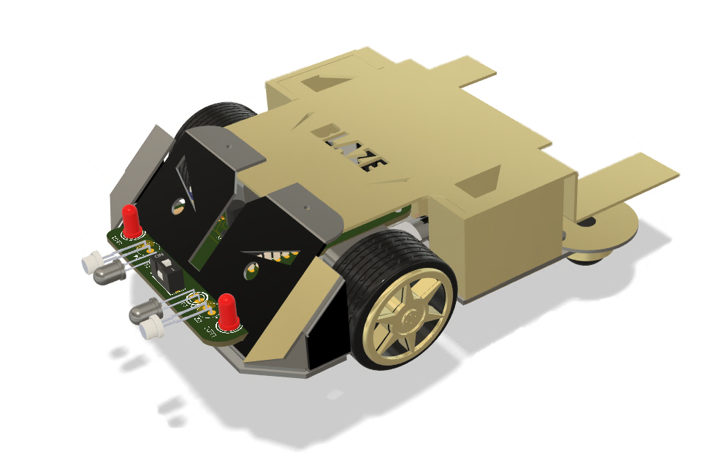
Obstacle Avoiding Car without Arduino or Microcontroller

Slide 2
Importance
It allows users to gain hands-on experience with a wide range of electronic components and learn how to design and build a functional robot using only discrete components.
This project can serve as a foundation for more complex robotics projects in the future.

Slide 3
List of Components:
- LM358 Op-Amp IC (2)
- 4x4 IC base (2)
- Motor driver IC
- Motor driver IC base
- Hex Inverter IC
- Hex Inverter IC base
- Transmitter LED (2)
- Receiver Photodiode (2)
- LED (2)
- 330-ohm resistor (2)
- 100-ohm resistor (4)
- 103 VR 10k ohm (2)
- Male header (2)
- 5V voltage regulator IC
- 10 microfarad capacitor (2)
- Wire connector
- Ball caster wheel (2)
- DC gear motors (2)
- Wheels (2)
- Battery
- Wires
- PCB
- Switch

Slide 4
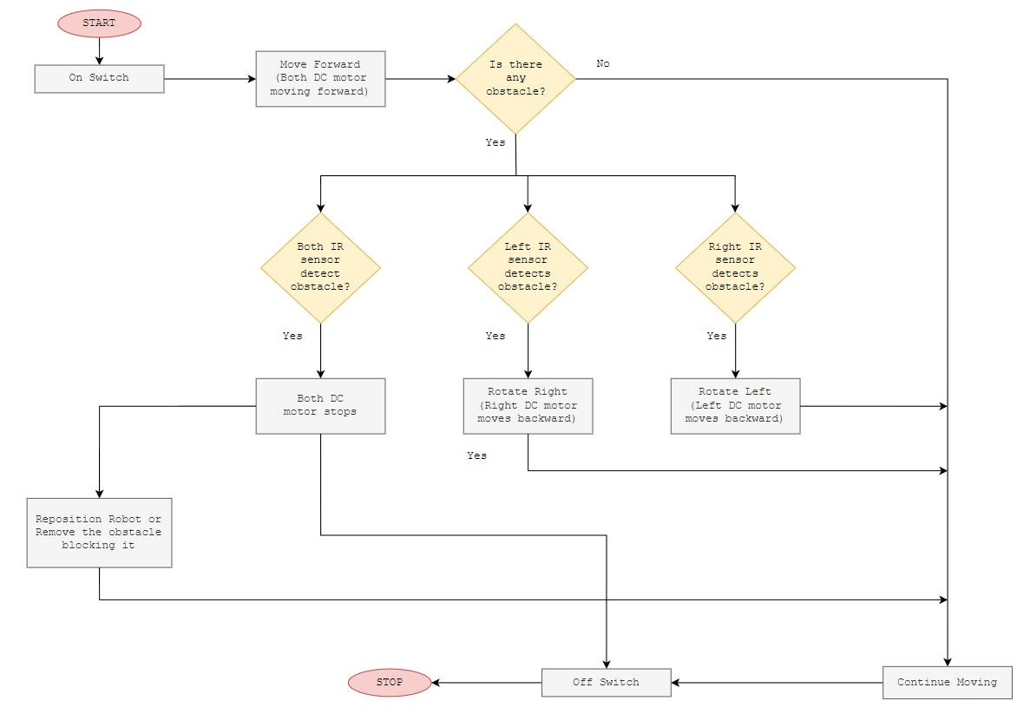
FLOWCHART

Slide 5
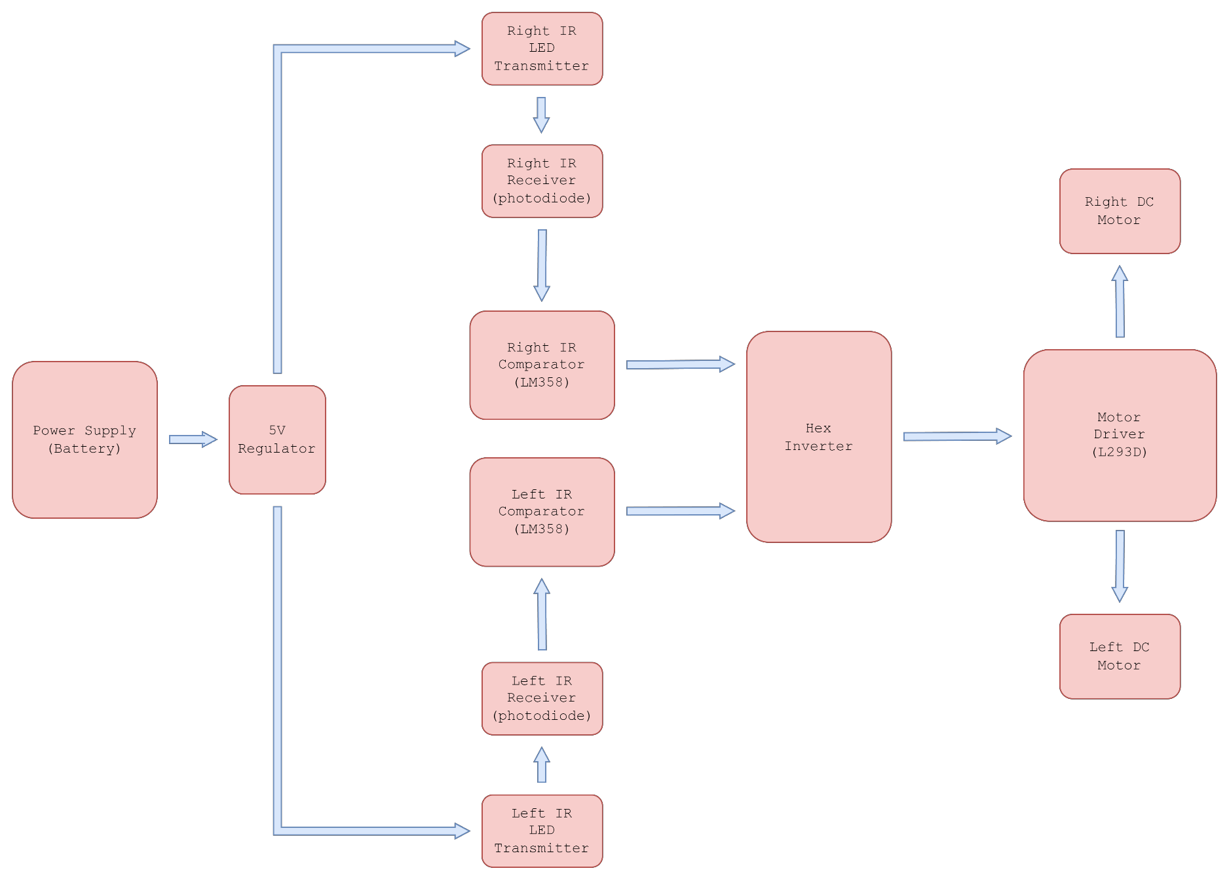
BLOCK DIAGRAM

Slide 6
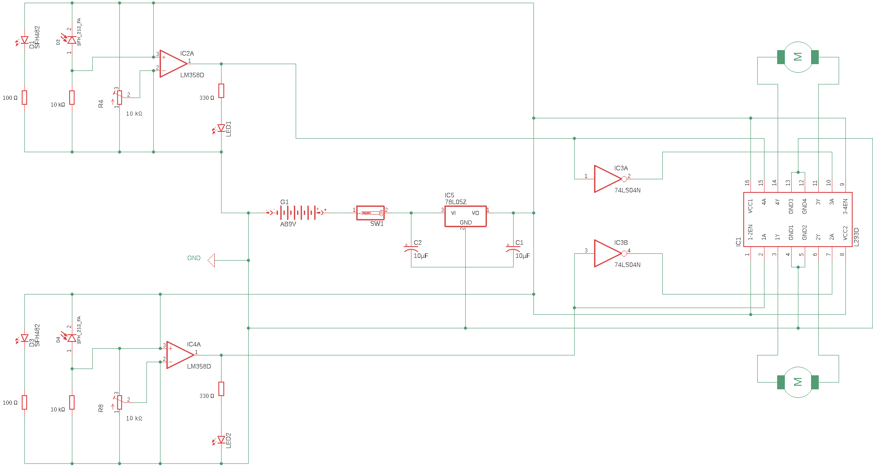
SCHEMATIC DIAGRAM

Slide 7
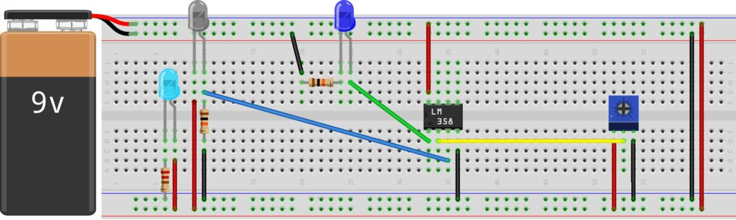
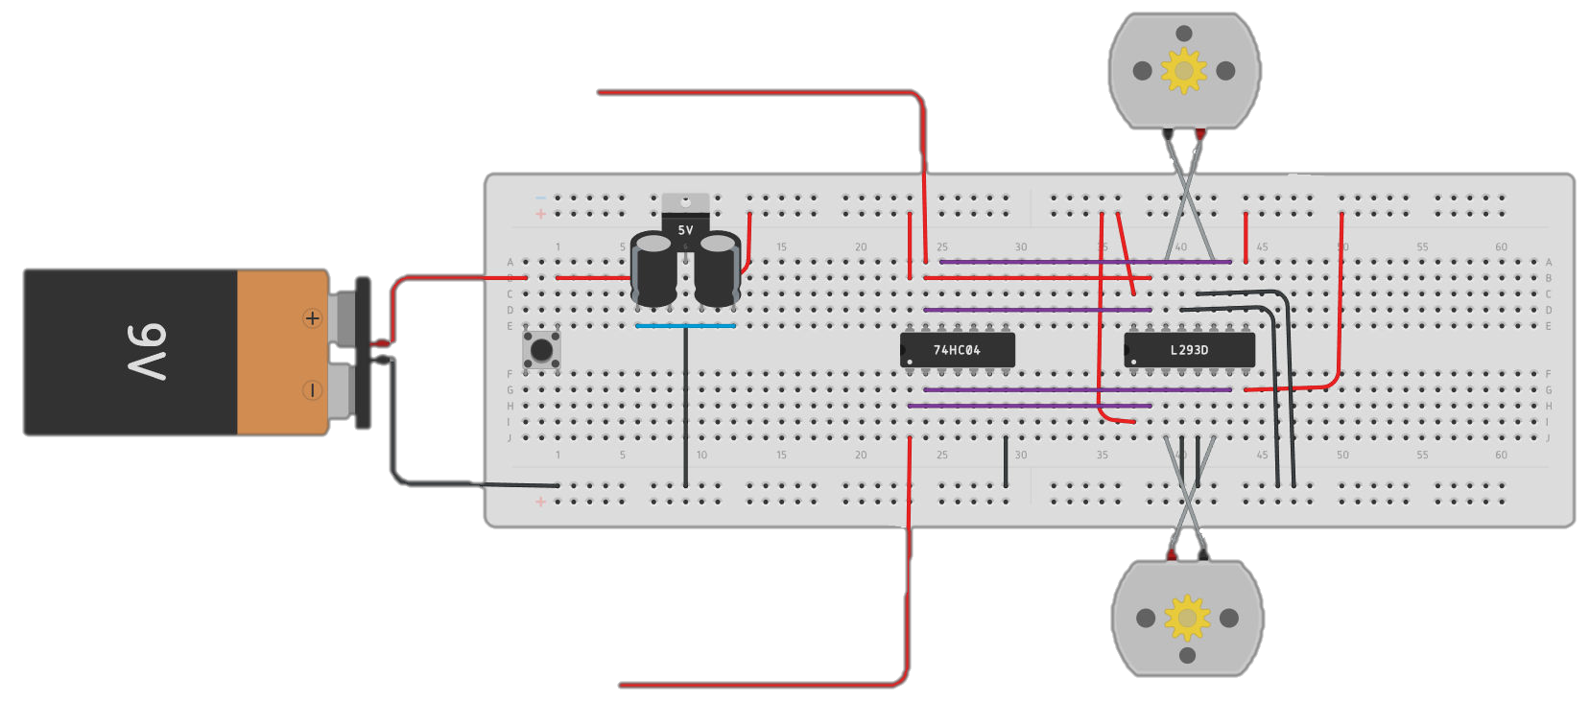
BREAD BOARD LAYOUT
IR Sensor layout (right and left module)
LEFT IR
MODULE
Main Circuit
RIGHT IR
MODULE

Slide 8
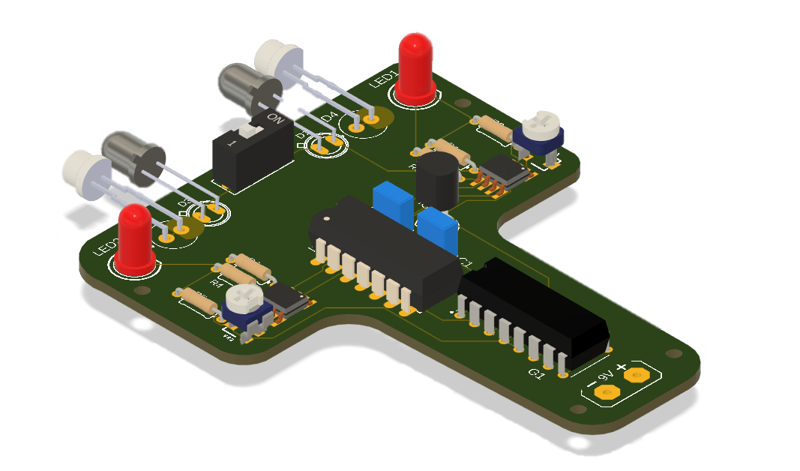
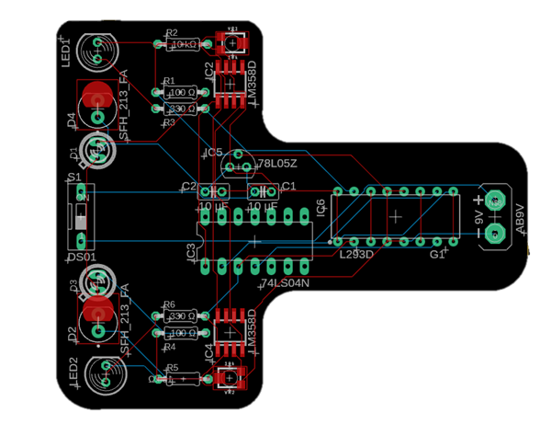
PCB LAYOUT
TWO-DIMENSIONAL (2D)
THREE-DIMENSIONAL (3D)

Slide 9
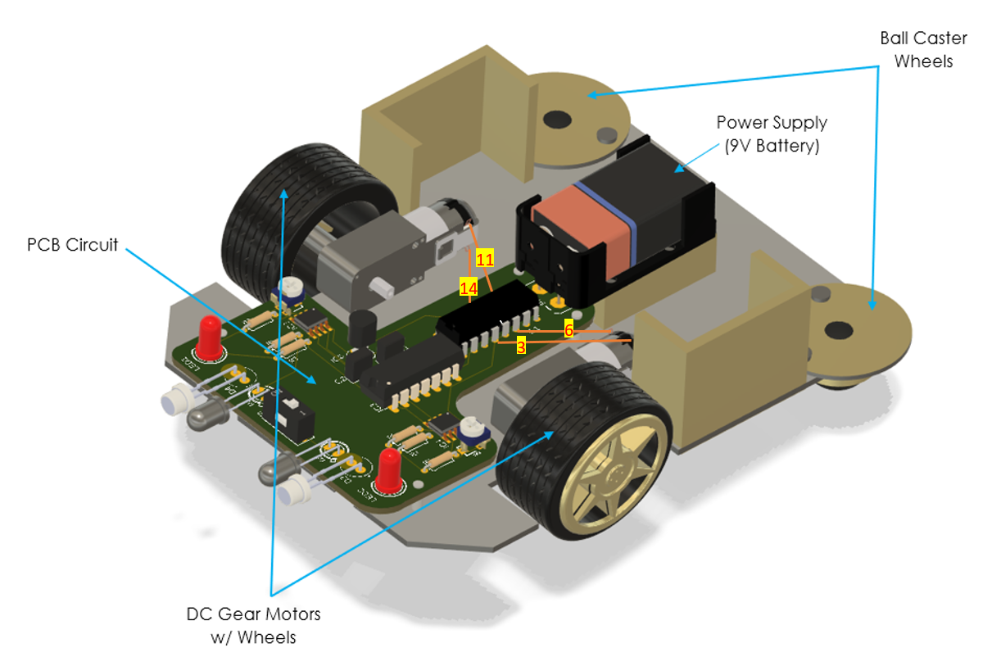
OUTPUT (3D MODEL)
INSIDE THE PACKAGING

Slide 10
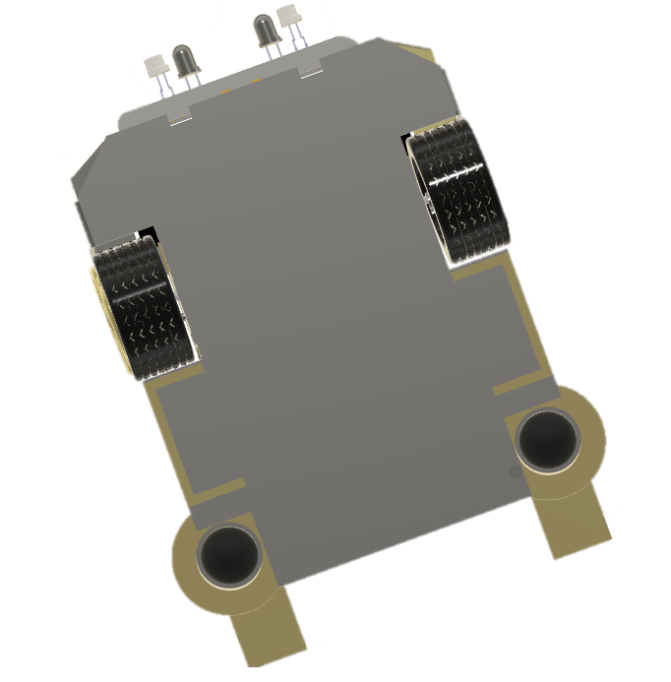
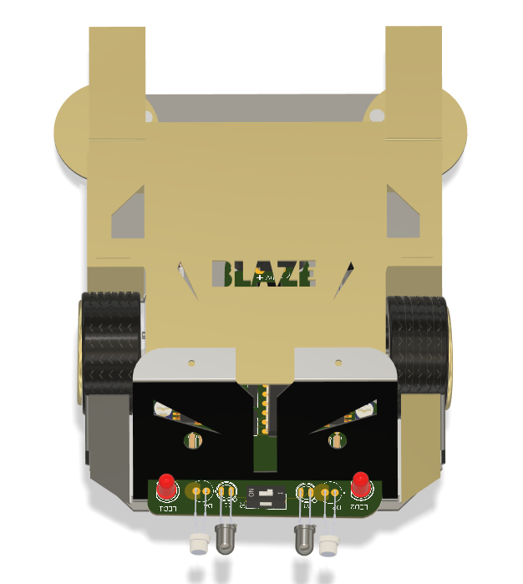
OUTPUT (3D MODEL)
TOP VIEW
BOTTOM VIEW

Slide 11
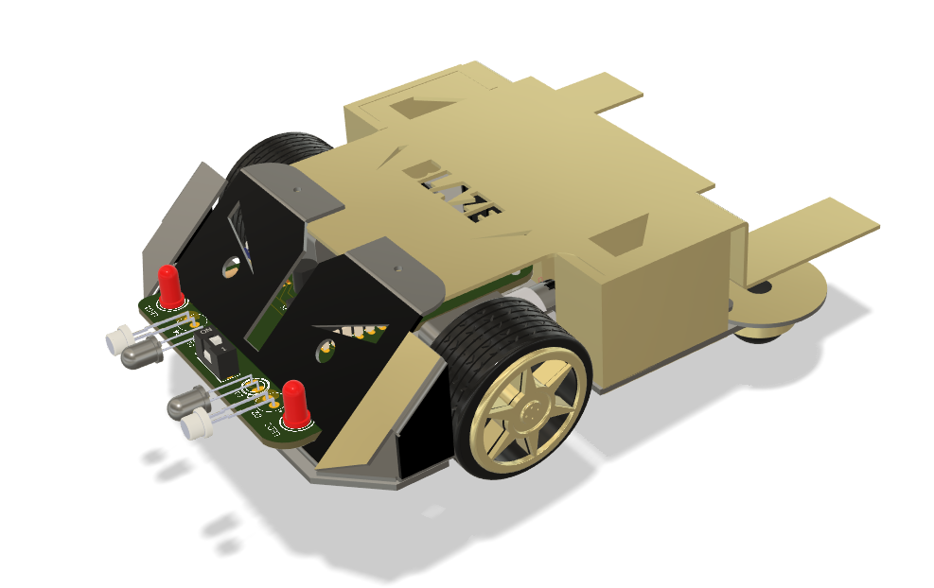
OUTPUT (3D MODEL)

Slide 12

End of
Presentation

