Slide 1


Customer Segmentation

Slide 2

Hello Everyone!
I am Akon Usoh and I'll be discussing customer segmentation.
It is an essential aspect of any business strategy that helps you understand your target audience better.
I'll be sharing insights on its importance and how it can help businesses create effective marketing strategies.
Let's get started!

Slide 3
Table of Content
Introduction
Problem Statement
Objectives
Project Scope
Methodology
Deliverables
Stakeholders
Risks and Challenges
Evaluation and Measurement
Timeline
Conclusion

Slide 4
Introduction
The purpose of this project is to develop a customer segmentation model for a company in order to better understand their customers and tailor their marketing and sales strategies to specific customer segments.
By analysing customer data, we aim to identify groups of customers with similar characteristics and behaviour, and create targeted marketing campaigns to increase customer retention and acquisition.

Slide 5
Problem Statement
Companies are facing a challenge in effectively identifying and reaching out to their customers with personalized marketing messages.
Without a clear understanding of their customers' needs, preferences, and behaviour, companies will be unable to design targeted marketing campaigns that resonate with their customers.
As a result, they are losing potential sales opportunities and failing to retain their customers.

Slide 6
Objectives
Develop a customer segmentation model that categorizes customers into meaningful groups based on their behaviour, demographics, and preferences.
Identify key characteristics of each customer segment, such as purchasing behavior, brand loyalty, and customer lifetime value.
Design targeted marketing campaigns that are tailored to each customer segment, with the aim of increasing customer retention and acquisition.
Measure the effectiveness of the customer segmentation model and the impact of the targeted marketing campaigns on customer behaviour and sales.

Slide 7
Project Scope
The scope of this project is to develop a model that segments customers based on their purchasing behavior and demographic characteristics.
The model will be trained on a dataset of customer transaction and demographic data.
The goal is to identify patterns and commonalities among different groups of customers, which can then be used to develop targeted marketing campaigns and improve customer experience.
The project timeline is set to be six weeks.

Slide 8
Methodology
Develop a customer segmentation model that categorizes customers into meaningful groups based on their behaviour, demographics, and preferences.
Identify key characteristics of each customer segment, such as purchasing behaviour, brand loyalty, and customer lifetime value.
Design targeted marketing campaigns that are tailored to each customer segment, with the aim of increasing customer retention and acquisition.
Measure the effectiveness of the customer segmentation model and the impact of the targeted marketing campaigns on customer behaviour and sales.

Slide 9
Deliverables
The project will deliver the following outputs:
Customer segmentation model that categorizes customers into distinct groups based on their characteristics and behavior.
Customer profiles that describe the key characteristics of each customer segment.
Targeted marketing campaigns that are tailored to each customer segment.
Performance metrics that measure the effectiveness of the customer segmentation model and the impact of the targeted marketing campaigns.

Slide 10
Stakeholders
The key stakeholders involved in the project are:
The company's management team, who will provide guidance and support for the project and ensure its alignment with the company's overall strategy.
The data analyst, data scientist, and marketing team, who will be responsible for executing the project tasks and delivering the outputs.
The customers, who will benefit from more personalized and relevant marketing messages.

Slide 11
Risk and Challenges
Some potential risks and challenges that may arise during the project include:
Lack of data quality or availability, which may affect the accuracy and reliability of the customer segmentation model.
Resistance to change from customers or the marketing team, who may be skeptical of the new approach.
Technical difficulties in implementing the marketing campaigns, such as integration issues with existing marketing platforms.
Budget constraints that may limit the scope or quality of the project.
To mitigate these risks, we will conduct regular quality checks on the data, involve key stakeholders in the project planning and execution, provide training and support for the marketing team, and closely monitor the project budget.

Slide 12
Evaluation and Measurement
The success of the project will be evaluated based on the following criteria:
Accuracy and reliability of the customer segmentation model.
Relevance and effectiveness of the targeted marketing campaigns, as measured by key performance indicators such as conversion rates, customer retention rates and customer lifetime value.
Increase in customer satisfaction and loyalty, as reflected in customer feedback and surveys.
We will use a combination of quantitative and qualitative methods to measure the impact of the project, including statistical analysis, surveys, and focus groups.

Slide 13
Project Timeline
The project timeline will be as follows:
Week 1-2: Data collection and preprocessing
Week 3: Customer segmentation model development
Week 4: Customer profile creation and targeted marketing campaign design
Week 5: Marketing campaign implementation and performance monitoring
Week 6: Evaluation and measurement, final report preparation

Slide 14
Conclusion
The customer segmentation model project aims to help the company better understand its customers and design targeted marketing campaigns to increase customer retention and acquisition.
By identifying customer groups with similar characteristics and behavior, the company can tailor its marketing messages to each group's needs and preferences, resulting in more effective and efficient marketing efforts.
The project has the potential to increase customer satisfaction and loyalty, leading to increased sales and revenue for the company.

Slide 15
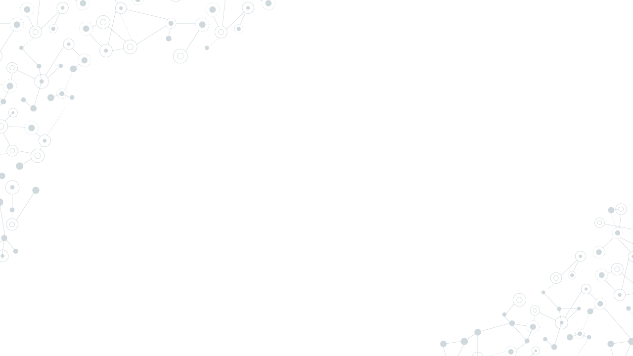
Thanks
Any questions?
You can reach me via:
Website
LinkedIn
GitHub

