Slide 1

ACADEMIC PROJECT PRESENTATION
Pulse Monitor
ESP32-based heart-rate & SpO₂ monitoring with cloud logging and AI-assisted measurement review
Wokwi simulation · ThingSpeak cloud · Python bridge · AI service · SQLite · web dashboard
Presented by: ______________________
Guide: ______________________
Department of ______________________ · Oct 2026
Notes:
Greeting + one-line hook: this project is a complete monitoring pipeline — from a simulator, through the cloud, to an AI-assisted review dashboard. Fill in your name, guide and department before presenting.

Slide 2
Agenda
1. Problem & objectives
2. System architecture at a glance
3. Components — role, objective & how each works
4. Cloud path: ThingSpeak → bridge → local API
5. What the AI service does — and what it returned
6. Dashboard & end-to-end walkthrough of one reading
7. Verification results
8. Limitations, safety & future work
At a glance
1 simulation source · 1 cloud log
3 local services · 1 database
2-stage AI review layer
every claim verified on the running system
Pulse Monitor · ESP32 heart-rate & SpO₂ pipeline with AI-assisted review
2 / 18
Notes:
Walk through the agenda quickly: architecture first, then each component with its objective and working, then the AI results, then results and limits.

Slide 3
Why this project: problem & objectives
The problem
Objectives
Continuous vitals logging is easy to start but hard to finish — data ends up stranded in one cloud dashboard.
No local record, no review layer, and no context for what the numbers mean.
Early prototypes often imply medical accuracy they do not have.
Acquire pulse + SpO₂ estimates optically (MAX30102 on an ESP32).
Reject invalid measurement windows before anything is uploaded.
Persist every valid reading locally (SQLite) and visualise it live.
Let the user log symptoms so readings have context.
Publish to ThingSpeak for cloud storage and MATLAB analysis.
Add an honest AI layer: transparent rules + unsupervised anomaly scoring.
Research prototype — not a medical device. It does not diagnose anything, and it is not a substitute for professional care.
Pulse Monitor · ESP32 heart-rate & SpO₂ pipeline with AI-assisted review
3 / 18
Notes:
Emphasise the gap this addresses and set honest expectations right at the start. The objective list doubles as the project scope.

Slide 4
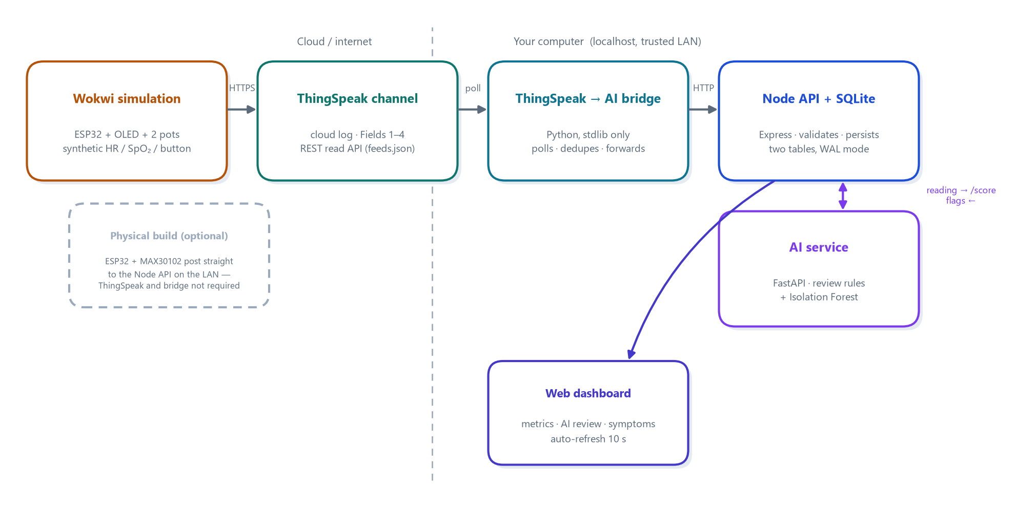
System architecture
Two ingestion paths converge on one local API: the cloud path (simulation → ThingSpeak → bridge) and a direct LAN path (physical board). Every stored reading is scored by the AI service, and the dashboard reads only from the local API — one source of truth.
Pulse Monitor · ESP32 heart-rate & SpO₂ pipeline with AI-assisted review
4 / 18
Notes:
Trace the flow left to right. Mention the second, direct path for the physical board, covered by the dashed note under the Wokwi block.

Slide 5
Components at a glance — each has one clear job
MAX30102 sensor
Optical PPG: red + IR LEDs and a photodiode yield pulse and SpO₂ estimates.
ESP32 DevKit
Reads the sensor over I²C, validates windows, uploads over Wi-Fi.
Wokwi simulation
ESP32 + OLED + pots reproduce the firmware without hardware.
ThingSpeak channel
Cloud log (Fields 1–4) + REST read API for the PC.
Bridge (Python)
Polls the channel, dedupes entries, forwards to the local API.
Node API + SQLite
Validation, persistence, AI calls, REST for the dashboard.
AI service (FastAPI)
Review rules + Isolation Forest anomaly scoring.
Dashboard (web)
Metrics, latest AI review, flags table, symptom journal.
Pulse Monitor · ESP32 heart-rate & SpO₂ pipeline with AI-assisted review
5 / 18
Notes:
One sentence per tile; the next slides explain the important ones in depth.

Slide 6
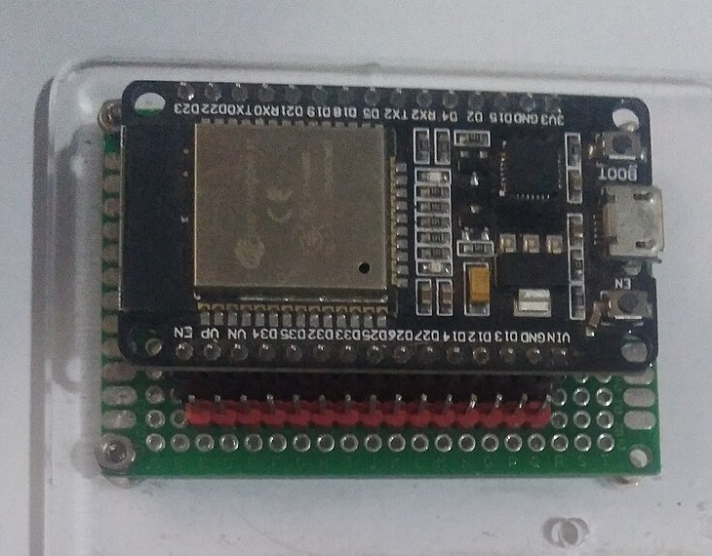
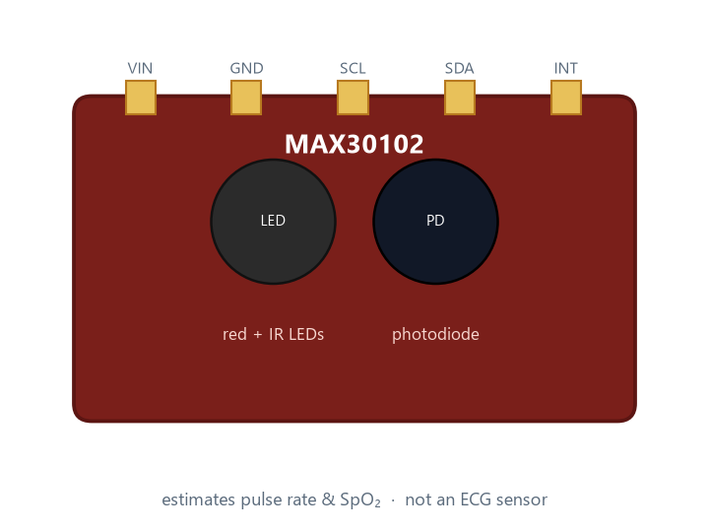
Core hardware — MAX30102 sensor & ESP32
MAX30102 — objective: acquire the pulse waveform optically.
Red + IR LEDs shine into the skin; a photodiode measures the reflected light.
Pulse rate and SpO₂ are estimated from the light ratios (PPG).
It is not an ECG — beat shape / electrical activity are not captured.
ESP32 — objective: turn raw samples into trustworthy readings.
Reads the sensor over I²C in 100-sample windows (SparkFun MAX3010x library).
Uploads only when a window is valid: pulse and SpO₂ found, ranges plausible.
Adds a signal-quality heuristic and a beat-interval variability flag — explicitly not arrhythmia detection.
ESP32 DevKit (photo: Wikimedia Commons, CC BY-SA 4.0)
MAX30102 module — red + IR LEDs and photodiode (illustration)
Pulse Monitor · ESP32 heart-rate & SpO₂ pipeline with AI-assisted review
6 / 18
Notes:
Hold the sensor gently against the fingertip. Stress the difference between PPG and ECG, and that the firmware's variability flag is a coarse heuristic, not a diagnosis.

Slide 7
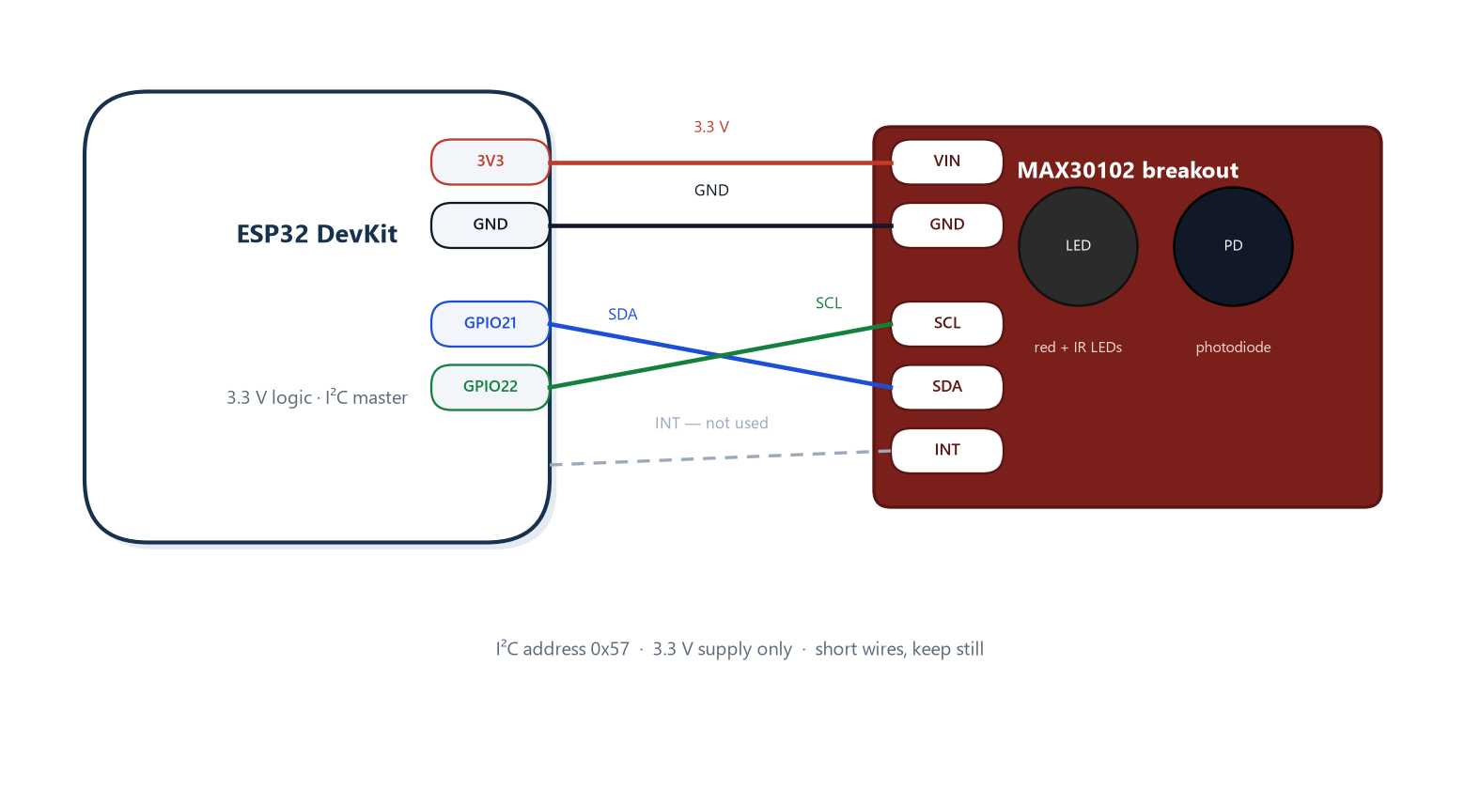
Interface — wiring the sensor to the board
I²C at 3.3 V: SDA → GPIO21, SCL → GPIO22; sensor address 0x57.
The same wiring is mirrored one-to-one inside the Wokwi simulation.
INT pin exists but is not used in this prototype.
Practical quality note: short wires, gentle contact with the fingertip, keep still during measurement.
Powering the module from 5 V or swapping SDA/SCL are the two most common wiring mistakes — the sensor simply returns zeros when it is unhappy.
Pulse Monitor · ESP32 heart-rate & SpO₂ pipeline with AI-assisted review
7 / 18
Notes:
Offer to show the physical wiring. Three points: 3.3 V only, address 0x57, keep still.

Slide 8
The Wokwi simulation — developing without hardware
Objective: exercise the complete cloud + AI + dashboard pipeline before real hardware exists.
Contains: ESP32 + SSD1306 OLED + two potentiometers + one push button.
Posts to ThingSpeak every ~20 s, respecting the free-tier limit (≥ 15 s).
The OLED shows live HR, SpO₂, quality and Wi-Fi status during the run.
Control | Effect
HR potentiometer | heart rate 45–150 bpm → Field 1
SpO₂ potentiometer | 85–100 % → Field 2
Push button | manual / test flag → Field 4
OLED display | live status on the virtual device
Honest note: the simulation validates the software pipeline — not sensor accuracy. Its values are synthetic by design.
Pulse Monitor · ESP32 heart-rate & SpO₂ pipeline with AI-assisted review
8 / 18
Notes:
Explain how the simulator replaced hardware during development and what it does and does not prove. Mention the 20 s cadence and why (free-tier rate limit).

Slide 9
Cloud logging — ThingSpeak channel
Field | Meaning | Values
Field 1 | heart rate | bpm
Field 2 | SpO₂ | %
Field 3 | signal quality | 0–100 %
Field 4 | manual / test flag | 0 or 1
Objective: durable cloud storage, MATLAB visualisations, and a pull point the PC can read.
Working: every accepted reading becomes one timestamped entry; the read API (feeds.json) returns them as JSON.
Only the newest entries matter for live use — the bridge reads the last 100 and picks up where it left off.
The write key lives only in the firmware; the channel is public for this project.
Pulse Monitor · ESP32 heart-rate & SpO₂ pipeline with AI-assisted review
9 / 18
Notes:
ThingSpeak provides the storage layer and MATLAB plotting. The read API is what the bridge consumes — this decouples the cloud from the local network.

Slide 10
ThingSpeak → local API bridge (Python)
Polls feeds.json every 10 s and sorts entries by ID.
Skips everything already processed — the state file remembers the last entry ID, so no duplicates and no silent replays.
Validates numeric fields; a broken entry is retried, never skipped.
Forwards each new entry to POST /api/readings and prints the AI result to the console.
Why this exists: Wokwi runs in the cloud and cannot reach 127.0.0.1 on your PC. So instead of the device pushing to the laptop, the laptop pulls from the cloud.
Poll the channel (≤ 100 entries).
Keep only IDs newer than the state file.
Forward to the local API and check saved=True.
Advance the state file only after a successful save.
ThingSpeak entry 3 forwarded | HR=45 bpm SpO2=100%
API saved=True | AI flags=['heart_rate_outside_configured_review_band']
Config: THINGSPEAK_CHANNEL_ID (+ optional READ_API_KEY) · first run processes only the latest entry; full history replay is opt-in via REPLAY_HISTORY_ON_FIRST_RUN.
Pulse Monitor · ESP32 heart-rate & SpO₂ pipeline with AI-assisted review
10 / 18
Notes:
Explain the localhost problem in one sentence, then the state file as the exactly-once mechanism. The code box shows real console output from the live run with the user's channel.

Slide 11
Local server — Node API + SQLite
Endpoint | Job
POST /api/readings | validate → store → AI score → save flags
GET /api/readings | recent readings with their AI flags
POST/GET /api/symptoms | symptom journal entries
GET /api/health | service status
Range validation (HR 25–240, SpO₂ 70–100, quality 0–100) — bad data never reaches the database.
If AI_SERVICE_URL is configured, every reading is scored and its flags stored alongside.
SQLite in WAL mode with two tables (readings, symptoms); the database is created automatically and older files upgrade in place.
Bound to the local network only — nothing is exposed to the internet.
Pulse Monitor · ESP32 heart-rate & SpO₂ pipeline with AI-assisted review
11 / 18
Notes:
Point at validation as the first line of data hygiene. Mention SQLite WAL and automatic schema setup — zero manual database work.

Slide 12
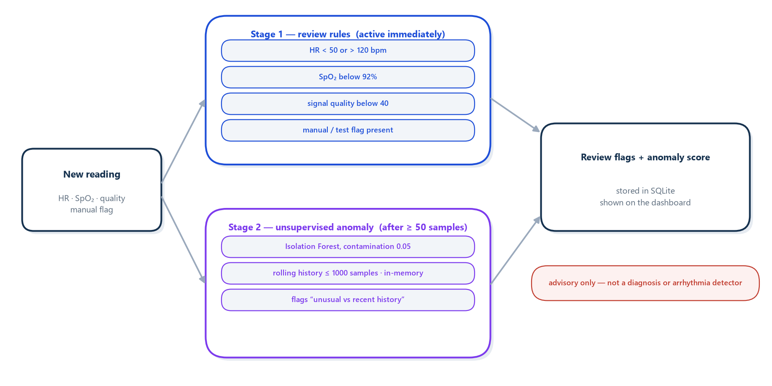
What the AI service does
A local FastAPI microservice (POST /score) — no health data leaves the computer.
Stage 1 rules are deterministic and explainable; Stage 2 learns what is normal for this device only, in memory, and needs ≥ 50 samples before it says anything.
The response itself carries the disclaimer: experimental screening aid, not validated for diagnosis or arrhythmia detection.
Pulse Monitor · ESP32 heart-rate & SpO₂ pipeline with AI-assisted review
12 / 18
Notes:
Explain the two stages in one breath each: rules anyone can audit; a model that learns your device's normal. Emphasise the model needs history and resets on restart.

Slide 13
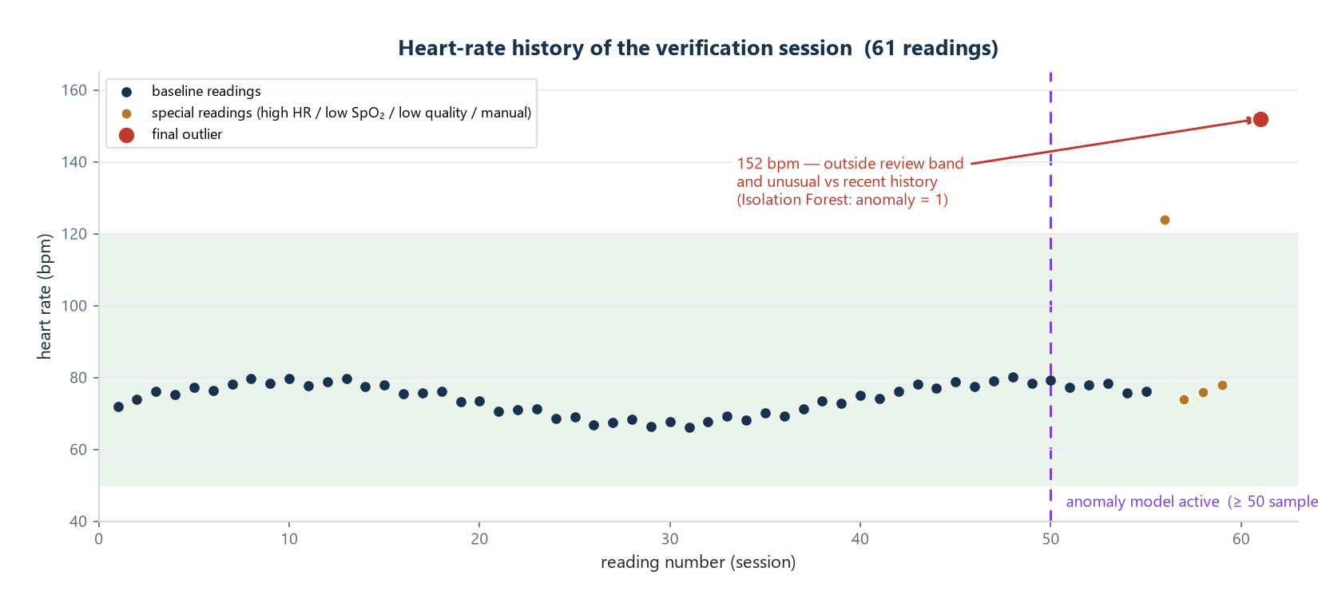
What the AI returned — real results
Live example — ThingSpeak entry 3: HR 45 bpm → flag: “heart rate outside configured review band”; stored and shown on the dashboard.
Verification session (61 readings): one HR 152 bpm outlier received 5 flags, including “unusual relative to recent device history” (Isolation Forest, anomaly = 1).
Every flag is a prompt to review context — never a conclusion.
“reviewFlags”: [
“low_signal_quality”,
“heart_rate_outside_configured_review_band”,
“spo2_below_configured_review_threshold”,
“pulse_interval_variability_flag_from_firmware”,
“unusual_relative_to_recent_device_history”
], “unsupervisedAnomaly”: 1
Verification run: baseline, planned special readings and the flagged outlier.
The stored AI response for the outlier — verbatim.
Pulse Monitor · ESP32 heart-rate & SpO₂ pipeline with AI-assisted review
13 / 18
Notes:
Show the real numbers: HR 45 flagged live; the 152 outlier after 61 samples. Reiterate that flags are advisory only.

Slide 14
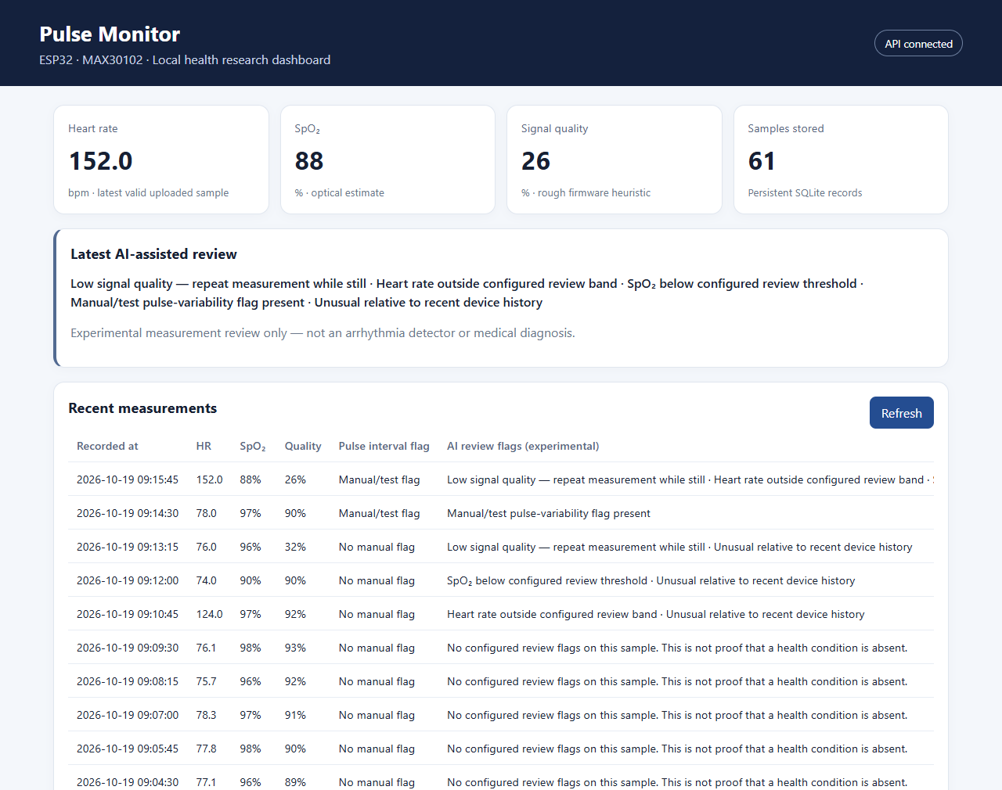
The dashboard — where the user meets the data
Metric cards: latest heart rate, SpO₂, signal quality, sample count.
“Latest AI-assisted review” panel: plain-language flags for the newest reading.
Measurements table: every reading with its AI flags — plus the symptom journal below.
Auto-refreshes every 10 s; open it from any device on the LAN.
Disclaimers are visible in the interface itself, not buried in documentation.
Pulse Monitor · ESP32 heart-rate & SpO₂ pipeline with AI-assisted review
14 / 18
Notes:
Open the live dashboard if possible. Point at the metric cards, the AI review panel, and the flags column in the table.

Slide 15
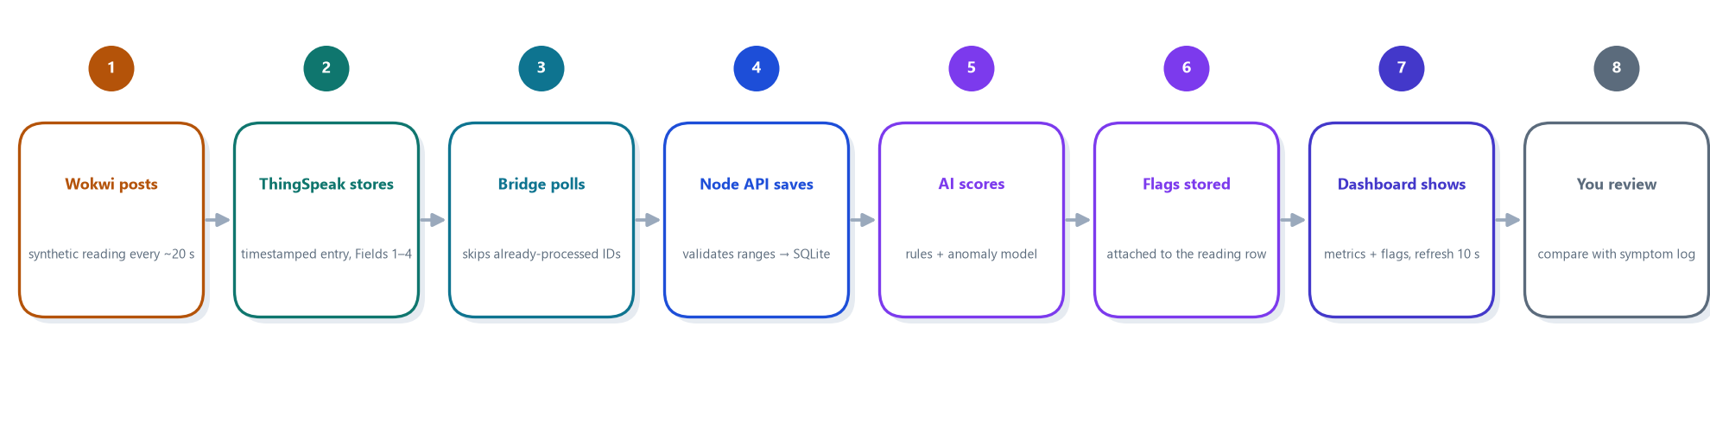
One reading, end to end
entry 3 · HR 45.0 bpm · SpO₂ 100 % · quality 95 → forwarded by the bridge → saved by the API → AI flag: heart_rate_outside_configured_review_band → dashboard shows the row with the flag in plain language.
If the API call fails, the bridge retries — the entry is never marked processed until the save succeeds.
The AI model's history is kept in memory, so a service restart simply starts learning again.
Pulse Monitor · ESP32 heart-rate & SpO₂ pipeline with AI-assisted review
15 / 18
Notes:
Follow one real reading end-to-end and land on the dashboard row. This proves the chain with a real ThingSpeak entry.

Slide 16
Verification results — observed on the running system
Test | Result
Live chain: ThingSpeak entry → dashboard | one real reading stored, scored and displayed — end to end in under one poll cycle ✓
Bridge duplicate safety | restarts and re-polls produced no duplicate rows ✓
Broken-entry handling | corrupt entries were retried; the state file never advanced past unsaved data ✓
First-run policy | only the latest existing entry processed by default; replay is opt-in ✓
AI anomaly stage | outlier flagged after 61 in-service samples (anomaly = 1) ✓
Dashboard QA | 0 console errors, 0 failed network requests during the full session ✓
Integration defects found & fixed | AI service startup, console encoding, SpO₂/quality unit display ✓
Every row above was observed on the actual pipeline against the project's real ThingSpeak channel — not estimated.
Pulse Monitor · ESP32 heart-rate & SpO₂ pipeline with AI-assisted review
16 / 18
Notes:
Summarise the verification matrix. Every claim here was observed on the running system; the last row shows engineering hygiene — defects were found and fixed during testing.

Slide 17
Limitations, safety & what comes next
Limitations — stated honestly
Safety rules & next steps
Sensor data in the simulation is synthetic by design.
An optical PPG sensor is not an ECG and cannot see beat morphology.
The anomaly model is unsupervised and in-memory (it resets on restart).
Thresholds are prototype choices, not clinical values; symptoms are self-reported.
Local use only: no accounts, no encryption at rest.
Frame it as a logging and review aid — never as a diagnosis; keep disclaimers visible.
Keep API keys private; rotate any key that is ever shared in a screenshot.
Next: collect real labelled data with an ECG reference.
Then: validated metrics (sensitivity / specificity) and a supervised model trained on that data.
Later: persistent training, alerts, multi-user access, documented protocol.
Pulse Monitor · ESP32 heart-rate & SpO₂ pipeline with AI-assisted review
17 / 18
Notes:
Be candid about limitations; frame next steps as the path to research-grade evidence.

Slide 18
Conclusion
A complete pipeline was built and verified end to end: simulation → cloud → bridge → API → AI review → SQLite → dashboard.
Each component has one clear job, and every failure mode found during testing was fixed and re-verified.
The AI layer adds transparent review flags plus an experimental anomaly signal — framed as an aid, not a diagnosis.
The system is ready for its next phase: real sensor data and formal validation.
Thank you — questions?
Pulse Monitor · ESP32 heart-rate & SpO₂ pipeline with AI-assisted review
18 / 18
Notes:
Close with the one-liner: the pipeline works end to end and is honest about what it is. Invite questions.

