Slide 1


Analyzing Spotify listening habits
Understanding playlists, popularity, and artist preferences
Alexandra Lawler – cmp-262 – 12/14/25
Notes:
This project analyzes my Spotify playlist data to understand my listening habits using data analytics.

Slide 2
Purpose:
Analyze personal Spotify data
Identify listening patterns
Understand popularity and preferences
Notes:
The purpose was to explore patterns in what I listen to, how popular the music is, and how my playlists are structured.

Slide 3
Who benefits
Spotify and streaming services
Recommendation teams
Individual listeners
Data analysts
Notes:
Spotify could use this type of analysis to improve recommendations and better understand user behavior.

Slide 4
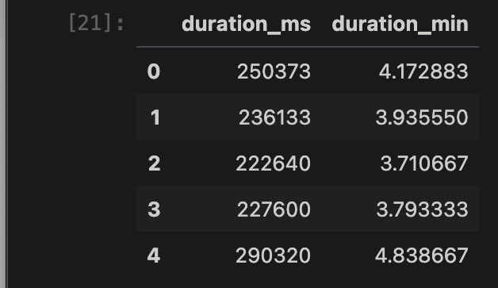
Dataset and collection
Spotify web api
Playlist and track metadata
One row = one song
Cleaned dataset
Notes:
I collected the data using the Spotify Web API. Each row represents one track with its playlist, artist, and popularity score.

Slide 5




Tools used
Python
jupyter notebook
Pandas and NumPy
Matplotlib and seaborn
GitHub
Notes:
I used Python in Jupyter notebook, pandas for cleaning, and Matplotlib and Seaborn for visualizations.

Slide 6
Questions asked
How does song popularity vary?
Which artists appear most?
How many songs per playlist?
What defines my listening habits?
Notes:
These four questions guided the analysis and focused on patterns measurable with the available data.

Slide 7
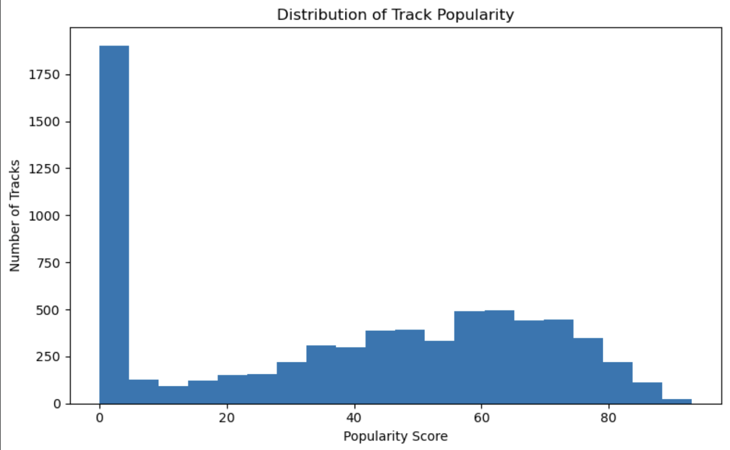
popularity
Mix of popular and niche songs
No single range dominates
Balanced listening habits
Notes:
This shows I listen to both mainstream and less popular songs, not just chart-toppers.

Slide 8
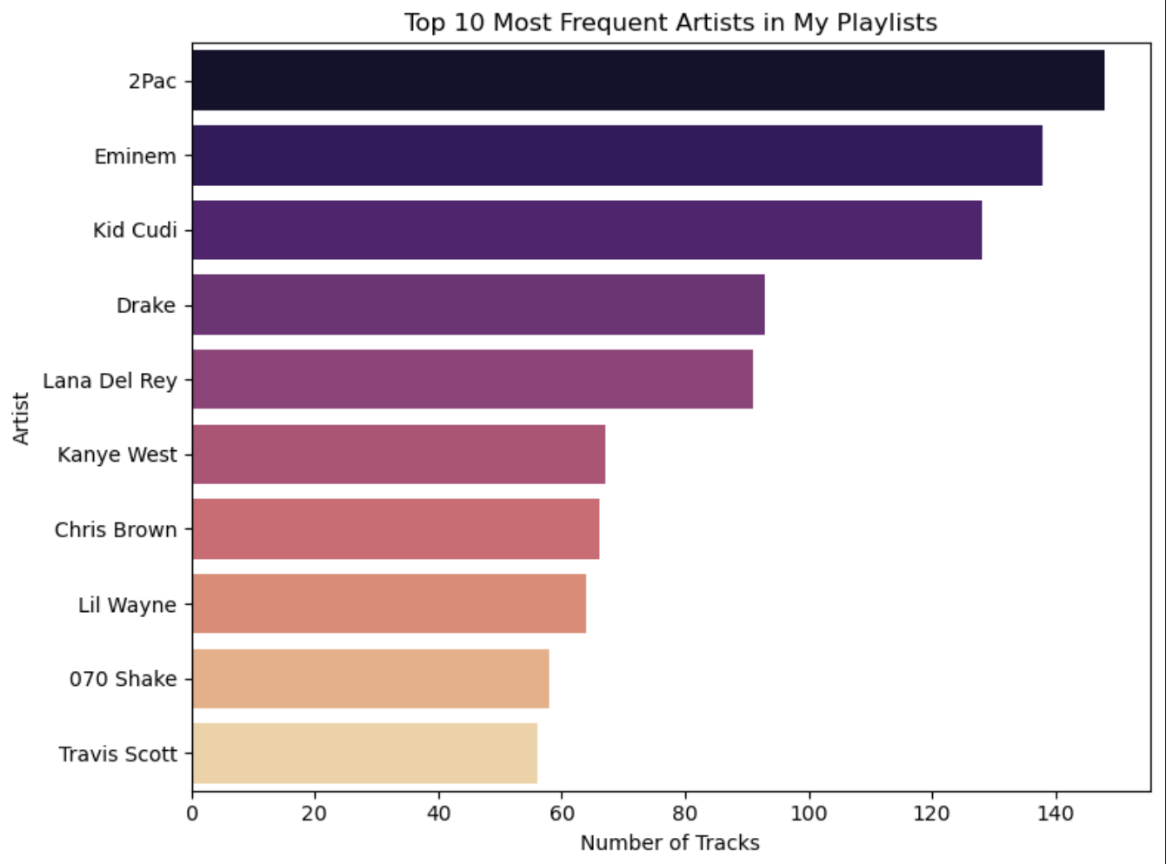
Top artists
Small group of repeat artists
Appear across playlists
Strong personal preferences
Notes:
A small number of artists appear frequently, showing consistent preferences.

Slide 9
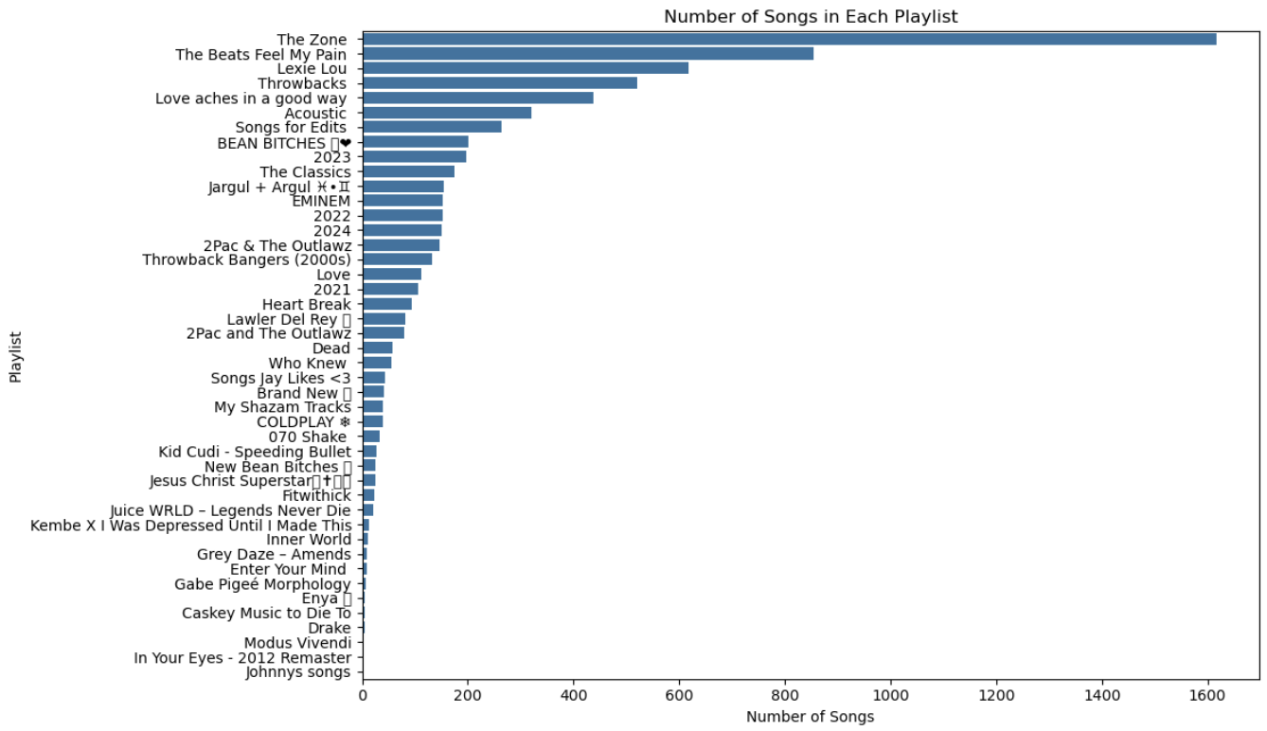
Results: playlist sizes
Some playlists are much larger
Different listening purposes
Curated vs. casual playlists
Notes:
Some playlists are clearly used more often, suggesting different moods or use cases

Slide 10
Key insights
Listening habits are consistent
Strong artist loyalty
Playlists serve different roles
Popularity is balanced
Notes:
Overall, the analysis answered my questions and revealed clear patterns in my listening behavior.

Slide 11
recommendations
Improve personalized recommendations
Suggest similar artists
Balance popular and new songs
Notes:
Spotify could use these patterns to fine-tune recommendations and discovery features.

Slide 12
Future work
Add audio features
Mood clustering
Listening history and skips
Notes:
With more data, this analysis could explore moods and deeper behavior patterns.

