Slide 1
Bridges
DFS tree
DFS starts from a node u visits a descendants of u on the DFS tree
Maintain data structures:
num[v]: time point node v is visited
low[v]: đỉnh con có số thứ tự Num[] thấp nhất khi bắt đầu định chiều từ v
Start from node 6
6
1
4
3
num[6] = 1, low[6] = 1
num[1] = 2, low[1] = 1
num[3] = 3, low[3] = 1
num[2] = 4, low[2] = 4
num[8] = 5, low[8] = 4
num[5] = 6, low[5] = 4
num[9] = 7, low[9] = 4
num[7] = 8, low[7] = 4
num[4] = 9, low[4] = 9
2
8
5
9
7

Slide 2
Bridges
DFS tree
DFS starts from a node u visits a descendants of u on the DFS tree
Maintain data structures:
num[v]: time point node v is visited
low[v]: minimal num of some node x such that v is equal to x or there is a back end (u,x) in which u is the node v or some descendant of v
Start from node 6
6
1
4
3
v
When we have a back edge (u,v) 🡪 update: low[u] = min(low[u], num[v])
8
5
u

Slide 3
Bridges
DFS tree
DFS starts from a node u visits a descendants of u on the DFS tree
Maintain data structures:
num[v]: time point node v is visited
low[v]: minimal num of some node x such that v is equal to x or there is a back end (u,x) in which u is the node v or some descendant of v
Start from node 6
6
1
4
3
2
When a node v is finished-exploration (u is the parent of v) 🡪 update: low[u] = min(low[u], low[v])
8
u
v
7

Slide 4
Bridges
Bridge:
Forward edge (u,v) having low[v] > num[u] is a bridge
Articulation point:
If u is not a root of the DFS tree and forward edge (u,v) having low[v] ≥ num[u] then u is an articulation point
If u is the root of a DFS tree, then u is an articulation point if it has more than 1 child
Start from node 6
6
1
4
3
num[6] = 1, low[6] = 1
num[1] = 2, low[1] = 1
num[3] = 3, low[3] = 1
num[2] = 4, low[2] = 4
num[8] = 5, low[8] = 4
num[5] = 6, low[5] = 4
num[9] = 7, low[9] = 4
num[7] = 8, low[7] = 4
num[4] = 9, low[4] = 9
2
8
5
9
7

Slide 5
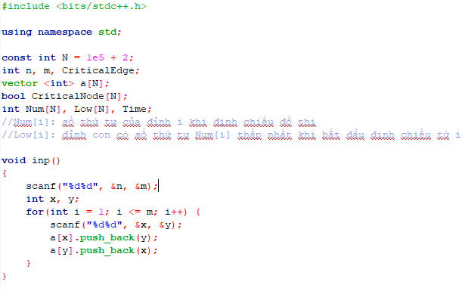
Bridges

Slide 6
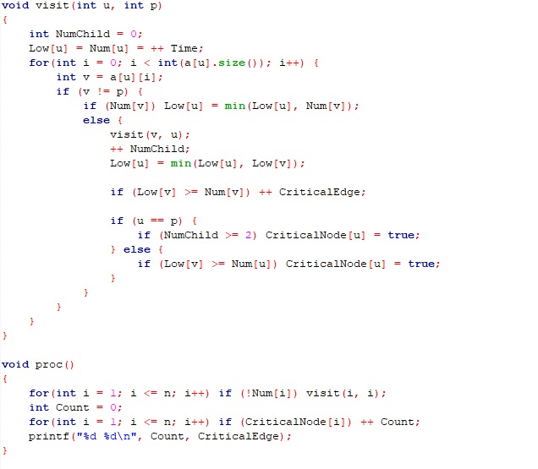
Bridges

Slide 7
Inter-City Bus
Algorithm
Run BFS for computing the cost for traveling with one bus from a city i to another reachable city j → Cost graph G
Apply the Dijkstra algorithm for finding the shortest path from city 1 to city n in G

Slide 8
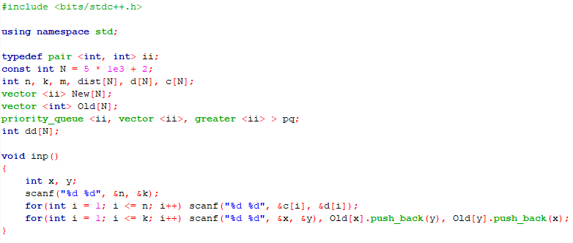
Intercity_bus

Slide 9
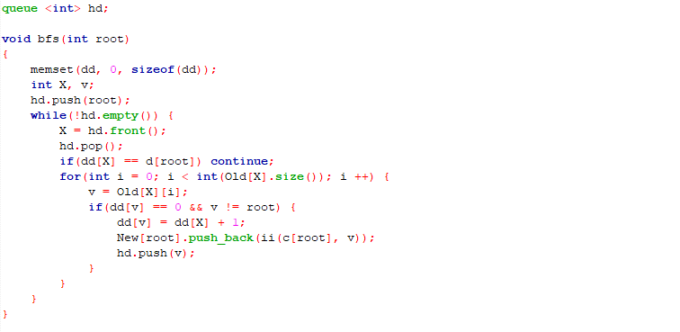
Intercity_bus

Slide 10
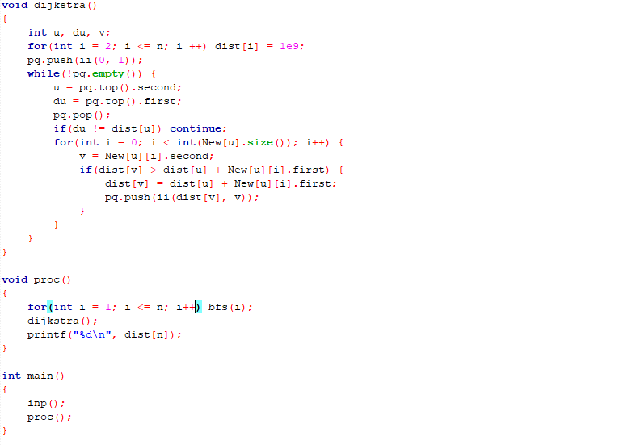
Intercity_bus

Slide 11
Make Span Schedule
Algorithm
L is the TOPO list of nodes of G
F[u]: earlest time point the task u can start
Explore L from left to right, for each node u:
makespan = max(makespan, F[u] + d[u])
For each arc (u,v), update F[v] = max(F[v], F[u] + d[u])
4
2
7
2
6
2
3
3
5
2
1
9
5
4
4
3
5
5
6
8
3
1

Slide 12
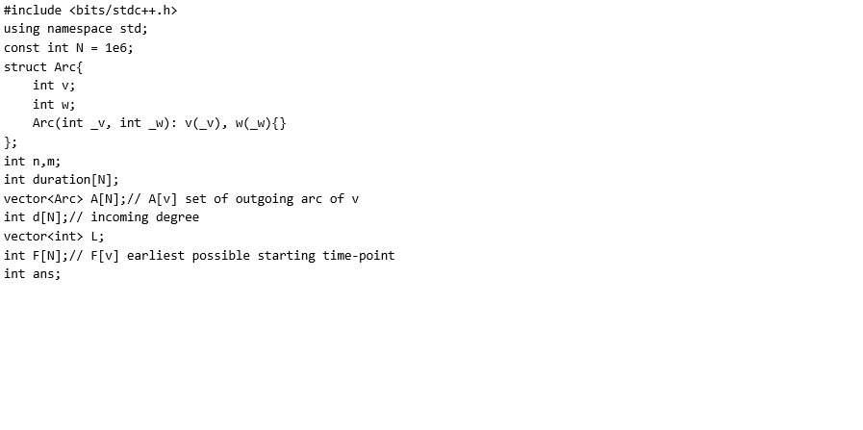
Make Span Schedule

Slide 13
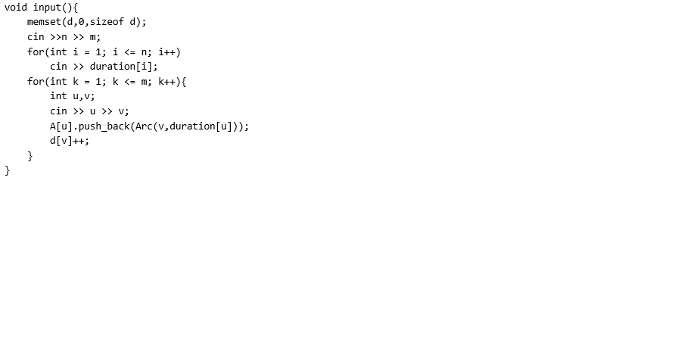
Make Span Schedule

Slide 14
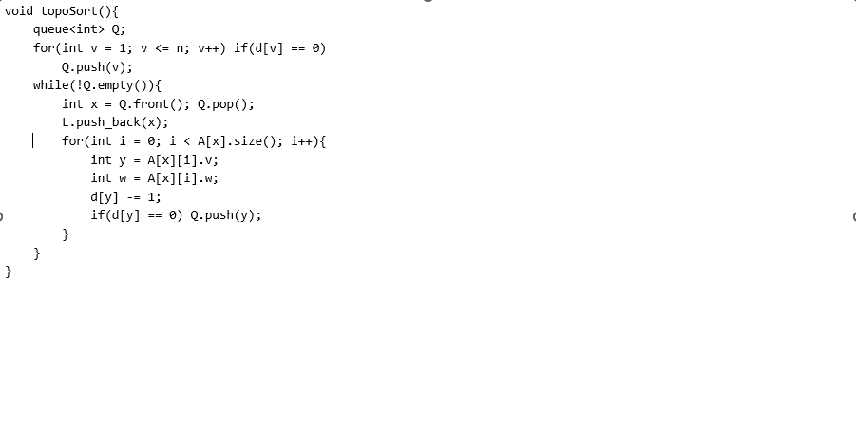
Make Span Schedule

Slide 15
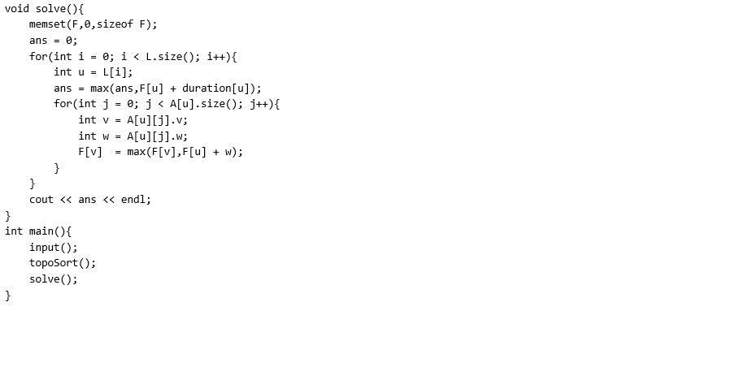
Make Span Schedule

Slide 16
Strongly Connected Component
Algorithm
Run DFS on G → compute the finishing time f(v) of each node v of G
Build residual graph G^{T} of G
Run DFS on G^{T}: the nodes are considered in a decreasing order of f
Each run DFS(u) will visit all nodes of the strongly connected component containing u

Slide 17
Implementation – Strongly Connected Component
#include <stdio.h>
#include <bits/stdc++.h>
#include <vector>
#include <iostream>
using namespace std;
#define MAX_N 100001
int n;
vector<int> A[MAX_N];
vector<int> A1[MAX_N];// residual graph
// data structure for DFS
int f[MAX_N];// finishing time
char color[MAX_N];
int t;
int icc[MAX_N];// icc[v] index of the strongly connected component containing v
int ncc;// number of connected components in the second DFS
int x[MAX_N];// sorted-list (decreasing of finishing time) of nodes visited by DFS
int idx;

Slide 18
Implementation – Strongly Connected Component
void buildResidualGraph(){// xay dung do thi bu
for(int u = 1; u <= n; u++){
for(int j = 0; j < A[u].size(); j++){
int v = A[u][j];
A1[v].push_back(u);
}
}
}
void init(){
for(int v = 1; v <= n; v++){
color[v] = 'W';
}
t = 0;
}

Slide 19
Implementation – Strongly Connected Component
// DFS on the original graph
void dfsA(int s){
t++; color[s] = 'G';
for(int j = 0; j < A[s].size(); j++){
int v = A[s][j];
if(color[v] == 'W'){ dfsA(v); }
}
t++;
f[s] = t;
color[s] = 'B';
idx++;
x[idx] = s;
}
void dfsA(){
init();
idx = 0;
for(int v = 1; v <= n; v++){
if(color[v] == 'W'){
dfsA(v);
}
}
}

Slide 20
Implementation – Strongly Connected Component
// DFS on the residual graph
void dfsA1(int s){
t++; color[s] = 'G'; icc[s] = ncc;
//for(set<int>::iterator it = A1[s].begin(); it != A1[s].end(); it++){
for(int j = 0; j < A1[s].size(); j++){
int v= A1[s][j];
if(color[v] == 'W'){ dfsA1(v); }
}
color[s] = 'B';
}
void dfsA1(){
init();
ncc = 0;
for(int i = n; i >= 1; i--){
int v = x[i];
if(color[v] == 'W'){
ncc++;
dfsA1(v);
}
}
}

Slide 21
Implementation – Strongly Connected Component
void solve(){
dfsA();
buildResidualGraph();
dfsA1();
cout << ncc;
}
void input(){
int m;
cin >> n >> m;
for(int k = 1; k <= m; k++){
int u,v;
cin >> u >> v;
A[u].push_back(v);
}
}
int main(){
input();
solve();
}

