Slide 1
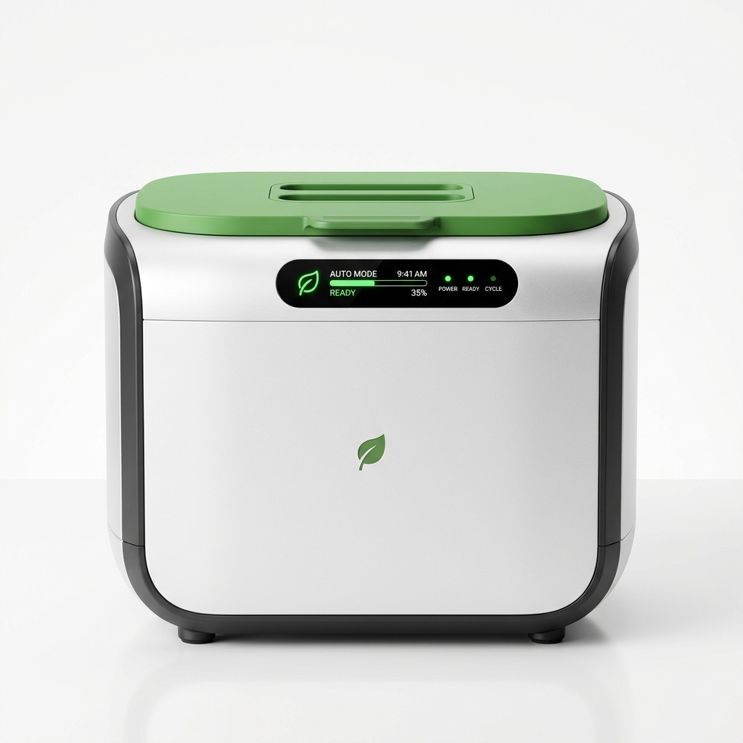
DECENTRALIZED CLEAN ENERGY INFRASTRUCTURE
EcoBin
"Throw Waste. Create Energy."
AI waste sorting + on-site biogas for campuses & societies
25-30
>98%
Rs.1L+
LPG cylinders
saved/month
AI sorting
accuracy
saved monthly
per campus
echobin.vercel.app | contact@ecobin.tech | Autonomous Bio-Utility
EcoBin Autonomous Segregation Node

Slide 2
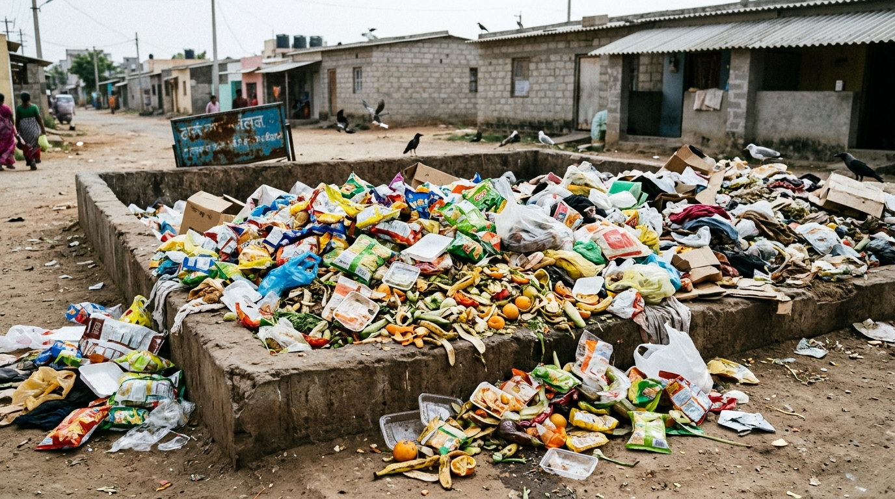
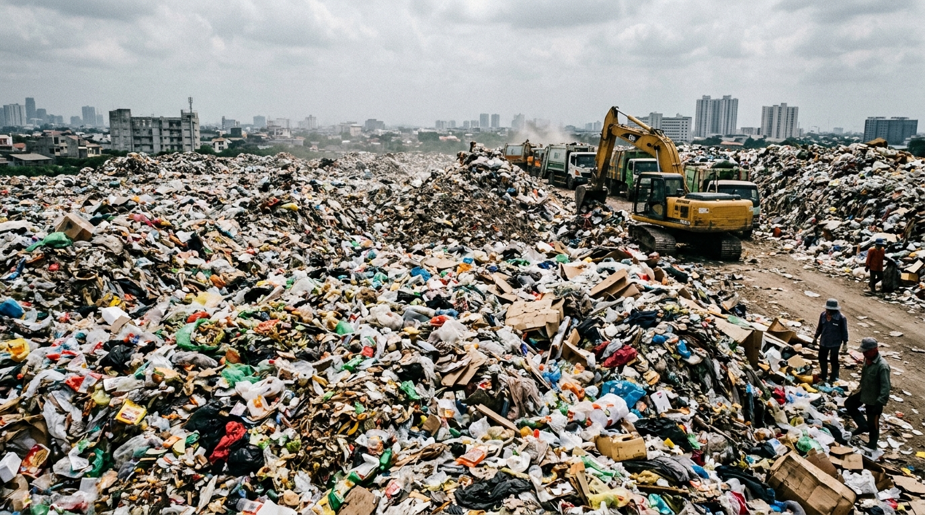
THE PROBLEM
Institutions Pay Lakhs Monthly for a Broken Waste System
Mixed waste. Failed sorting. Diesel trucks. Landfill fines.
1.5 Lakh MT
>40%
Rs. 1.5L/mo
municipal solid waste
generated daily in India
human sorting
error rate at source
average haulage bill
paid by campuses
HOW THE BROKEN SYSTEM WORKS TODAY
Mixed
Disposal
Manual
Bins Fail
Diesel
Haulage
Landfill
+ Fines
Zero sorting
at source
->
>40% error,
dirty loads
->
Rs. 80k/mo to haul
70% water
->
Rs. 50k NGT
fines

Slide 3
MARKET TIMING
Why Now? Four Tailwinds Make This the Right Moment
Regulations. Cost spikes. Cheap AI sensors. ESG pressure — all converging.
Regulation
Mandates Action
Diesel & LPG
Costs Surged 40%
SWM 2016 legally requires on-site treatment
for all bulk generators >100 kg/day.
Rs. 50,000 NGT fines now actively enforced.
Haulage costs up 40% in 3 years.
LPG cylinder prices at all-time high.
Institutions urgently seeking alternatives.
AI Sensors Now
Cost <Rs. 800
ESG & NAAC
Now Mandatory
ESP32-S3 AI camera modules: <Rs. 800.
Edge inference viable in Rs. 3L hardware.
Moore's Law finally reached waste-tech.
Universities need NAAC Green credentials.
Corporates face SEBI BRSR net-zero mandates.
Green infra is a procurement priority.

Slide 4
THE SOLUTION
Drop Any Waste. Get Free Cooking Gas.
Fully autonomous 4-step closed loop. Zero manual sorting. Zero diesel trucks.
01
02
03
04
Drop Waste
AI Vision Sort
Bio-Digestion
Free Cooking Gas
User drops anything.
No sorting needed.
->
<150ms edge AI
sorts dry vs wet
->
Organic food waste
becomes clean biogas
->
Piped directly to
kitchen stoves
BEFORE vs. AFTER
BEFORE
AFTER (EcoBin)
Mixed Waste -> 40% Error -> Rs.80k Hauling -> Landfill + Rs.50k Fine
Single Drop -> AI Sorts -> Biogas to Kitchen -> Rs.1L+ Saved Monthly

Slide 5
THE PRODUCT
EcoBin Hardware: Plug-and-Play Smart Waste Node
Installs in 3-5 days. No civil work. Modular for 100-500 kg/day.
AI Vision Sort
Bio-Digestion
ESP32-S3 + YOLOv8
<150ms | >98% accuracy
Mesophilic 37C dome
Auto pH anti-souring
Free Cooking Gas
Clean Recyclables
65% CH4 purity
Piped to kitchen stoves
Dry bales: PET, paper
Sold to industrial mills
EcoBin Autonomous Hardware Node | 100–500 kg/day Modular Capacity

Slide 6
MARKET OPPORTUNITY
Rs. 14,200 Cr Market — 1.2 Lakh Generators Legally Mandated to Act
Bottom-up sizing. Every bulk waste generator >100 kg/day must comply with SWM 2016.
TAM
Rs. 14,200 Cr
SAM
Rs. 3,200 Cr
SOM
Rs. 95 Cr
1,20,000 bulk waste generators
across urban India
25,000 universities & gated societies
in Tier-1 cities
800 beachhead deployments
Delhi-NCR & Bengaluru (3-yr)
120k x Rs.1.18L avg
25k x Rs.1.28L avg
800 hubs x Rs.12L ARR
GO-TO-MARKET EXECUTION ROADMAP
Stage 1
Month 0-6
Stage 2
Month 6-12
Stage 3
Month 12-24
Stage 4
Year 2+
Prototype Build
& Pilot Deployment
20 university
campuses (NCR)
150 gated societies
JLL/CBRE channel
800 nodes
Series A ready
->
->
->

Slide 7
ARCHITECTURE & PILOT TARGETS
Engineered Unit Capacity & Projected Savings
Target operational specifications designed for standard higher-ed campuses:
250 kg
28 LPG
>95%
Rs. 1L+
food waste
daily capacity target
cylinders replaced
projected per month
machine vision
sorting precision target
net savings per
campus per month (est.)
KEY ENGINEERING & PILOT TARGETS
Dual-stream automated diverter: dry recyclables to baler, food scraps to macerator
Mesophilic 37°C anaerobic reactor with automated pH buffering against acid souring
Direct methane piping (65% CH4) designed to replace commercial 19kg mess LPG cylinders
Sub-150ms sensor fusion (Sony IMX vision, dielectric moisture, inductive metal)
100% compliant with Ministry of Environment SWM 2016 bulk generator mandate
Source: EcoBin Systems Architecture & Pilot Engineering Benchmarks

Slide 8
BUSINESS MODEL & UNIT ECONOMICS
Hardware Sale + Sticky Monthly Retainer = 16-20 Month Payback
Customer recovers full capital cost in <20 months purely from operational savings.
HOW ECOBIN MAKES MONEY
Campus / RWA
Pays EcoBin
Hardware CapEx
Rs. 3L - 8L
Monthly AMC
Rs. 5k-10k | 65% margin
Recyclable
Offtake +Rs. 15k/mo
->
->
->
CAMPUS UNIT ECONOMICS (250 kg/day)
Hauling Contracts Eliminated
Rs. 45,000 / mo
38-42%
LPG Cylinders Replaced (28 nos)
Rs. 56,000 / mo
Hardware Margin
Recyclable Sales
+ Rs. 6,500 / mo
65-70%
EcoBin AMC Fee
- Rs. 7,500 / mo
AMC Margin
NET MONTHLY SAVING
Rs. 1,00,000 / mo
>6.8x
Capital Payback Period
16-20 months
LTV / CAC

Slide 9
COMPETITION & MOAT
No One Combines AI Sorting + On-Site Biogas. EcoBin Owns This.
Competitors solve one piece. EcoBin solves the complete system.
Feature
EcoBin
Manual 2-Bin
Compost Pit
Old Biogas
AI Auto-Sorting
YES <150ms
NO Manual
NO None
NO None
On-Site Biogas
YES
NO
NO
RISK Unstable
Zero Human Sorting
YES
NO 40% fail
NO Manual
NO Manual
SWM 2016 Compliant
YES Full
PART
PART
PART
Rs.1L+/mo Saving
YES
NO
NO
NO
Anti-Souring Control
YES Auto
NO
NO
NO Manual
OUR 4 COMPETITIVE MOATS
Proprietary
AI Dataset
Anti-Souring
Bioprocess IP
Utility
Lock-In
Regulatory
Alignment
20k+ real waste images,
growing with every node
Auto pH dosing loop —
no competitor has this
Gas pipes = sticky.
<1.5% annual churn
100% SWM 2016 compliant
on-site bio-utility design

Slide 10
THE TEAM & INVESTMENT ASK
Raising Rs. 1.5 Cr Seed to Deploy Across 20 Target Campuses
Domain-first team. Clear milestones. Every rupee de-risks a specific technical risk.
TEAM CAPABILITIES
MILESTONE LADDER — USE OF FUNDS
Embedded Systems & Firmware
RAISING: Rs. 1.5 Cr SEED ROUND
ESP32-S3 | FreeRTOS | OTA | Edge AI
12-month runway | 20 campuses | Rs. 1.2 Cr ARR
Computer Vision & ML
M1
Rs. 35L
Month 0-3
YOLOv8 | TFLite | Custom 20k Dataset
Gen-2 hardware finalized
BIS certifications done
Risk: scaling proven
Anaerobic Bio-Process Eng.
v
Biogas | VFA Monitoring | pH Control
M2
Rs. 70L
Month 3-9
Institutional B2B Sales
20 campus hubs deployed
3-person sales team hired
Target: Rs. 12L ARR
Campus Admin | SWM Compliance | GTM
v
M3
Rs. 45L
Month 9-18
Hardware & Manufacturing
NCR assembly hub opened
JLL/CBRE channel signed
Target: 100 nodes, Series A
Fabrication | Modular Design | BoM

Slide 11
DECENTRALIZED URBAN BIO-UTILITY | SEED STAGE
Thank You
EcoBin — "Throw Waste. Create Energy."
echobin.vercel.app
contact@ecobin.tech
Open for institutional pilots, municipal partnerships & strategic collaborations

