Slide 1
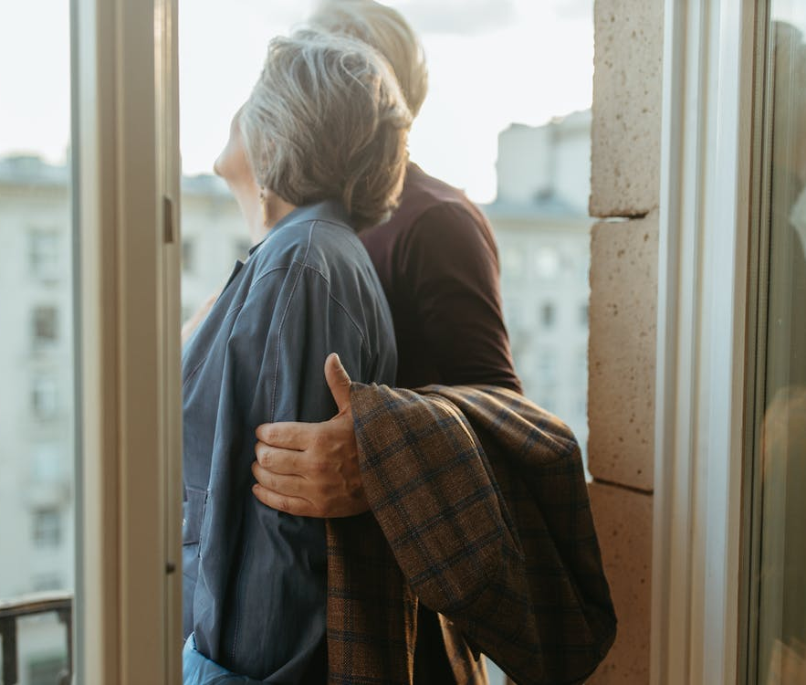
Provide for the aged
社区智慧养老
养老院社区智慧养老解决方案PPT
It could be the part of the presentation where you can introduce your company or agency. It could be the part of the presentation where you can introduce your company or agency.
START →

Slide 2
01
智慧养老的发展
Here you could describe the topic of the section.
目录
养老政策支持
02
Here you could describe the topic of the section.
CONTENTS
03
智慧养老措施
Here you could describe the topic of the section.
It could be the part of the presentation where you can introduce your company or agency.
04
未来养老模式
Here you could describe the topic of the section.

Slide 3
Part 01
智慧养老的发展
Development of smart pension
It could be the part of the presentation where you can introduce your company or agency. It could be the part of the presentation where you can introduce your company or agency.

Slide 4
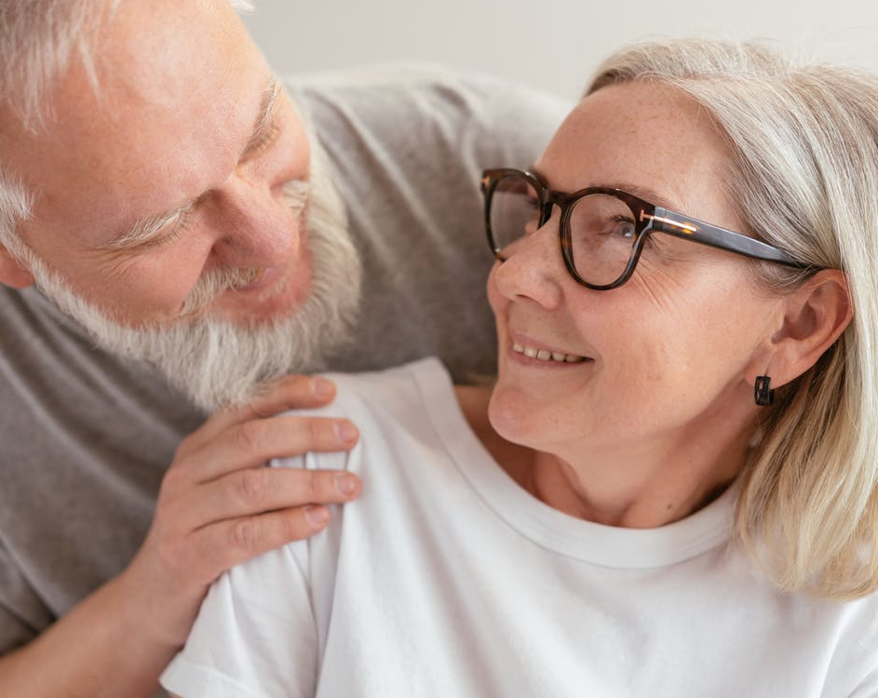
智慧养老的发展
Development of smart pension
智慧养老的发展
Venus has a beautiful name and is the second planet from the Sun. It’s terribly hot—even hotter than Mercury—and its atmosphere is extremely poisonous. Venus has a beautiful name and is the second planet from the Sun. It’s terribly hot—even hotter than Mercury—and its atmosphere is extremely poisonous.
关键词
关键词
关键词

Slide 5
智慧养老的发展
Development of smart pension
未来养老模式
未来养老模式
Venus has a beautiful name and is the second planet from the Sun. It’s terribly hot—even hotter than Mercury
Venus has a beautiful name and is the second planet from the Sun. It’s terribly hot—even hotter than Mercury
01
03
未来养老模式
02
04
未来养老模式
Venus has a beautiful name and is the second planet from the Sun. It’s terribly hot—even hotter than Mercury
Venus has a beautiful name and is the second planet from the Sun. It’s terribly hot—even hotter than Mercury

Slide 6
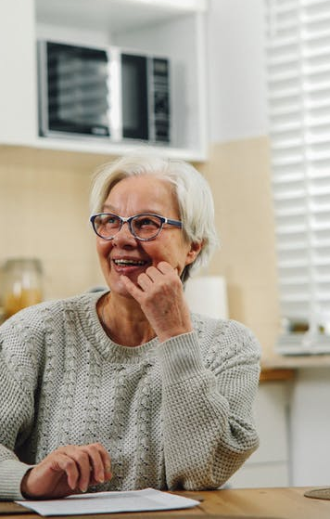
智慧养老的发展
Development of smart pension
智慧养老
01
03
智慧养老
Venus has a beautiful name and is the second planet from the Sun. It’s terribly hot—even hotter than Mercury—and its atmosphere
Venus has a beautiful name and is the second planet from the Sun. It’s terribly hot—even hotter than Mercury—and its atmosphere
智慧养老
02
04
智慧养老
Venus has a beautiful name and is the second planet from the Sun. It’s terribly hot—even hotter than Mercury—and its atmosphere
Venus has a beautiful name and is the second planet from the Sun. It’s terribly hot—even hotter than Mercury—and its atmosphere

Slide 7
Part 02
养老政策支持
Pension policy support
It could be the part of the presentation where you can introduce your company or agency. It could be the part of the presentation where you can introduce your company or agency.

Slide 8
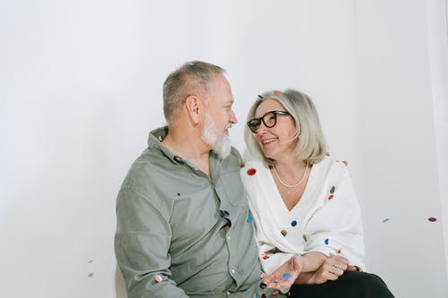
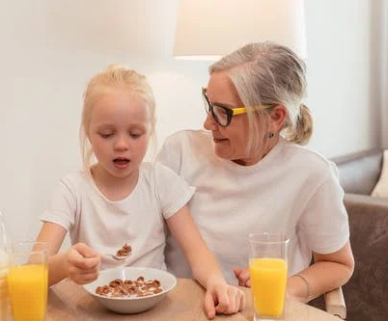
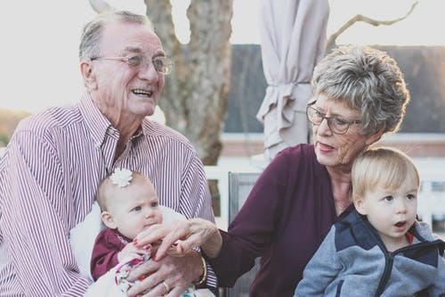
养老政策支持
Pension policy support
养老政策
养老政策
养老政策
养老政策
Venus has a beautiful name and is the second planet from the Sun. It’s terribly hot—even hotter than Mercury
Venus has a beautiful name and is the second planet from the Sun. It’s terribly hot—even hotter than Mercury
Venus has a beautiful name and is the second planet from the Sun. It’s terribly hot—even hotter than Mercury
Venus has a beautiful name and is the second planet from the Sun. It’s terribly hot—even hotter than Mercury

Slide 9
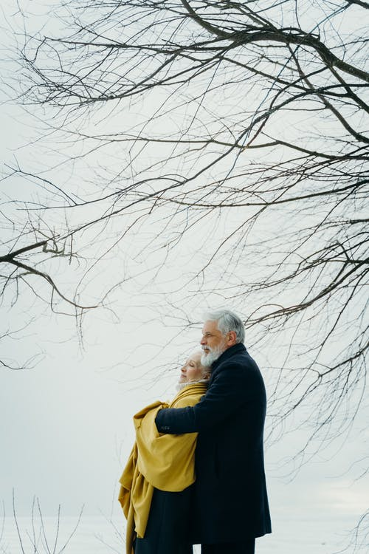
养老政策支持
Pension policy support
养老政策
01
Venus has a beautiful name and is the second planet from the Sun. It’s terribly hot—even hotter than Mercury—and its atmosphere
养老政策
02
Venus has a beautiful name and is the second planet from the Sun. It’s terribly hot—even hotter than Mercury—and its atmosphere
养老政策
03
Venus has a beautiful name and is the second planet from the Sun. It’s terribly hot—even hotter than Mercury—and its atmosphere

Slide 10
Part 03
智慧养老措施
Smart pension measures
It could be the part of the presentation where you can introduce your company or agency. It could be the part of the presentation where you can introduce your company or agency.

Slide 11
智慧养老措施
Smart pension measures
智慧养老
02
智慧养老
04
Venus has a beautiful name and is the second planet from the Sun.
Venus has a beautiful name and is the second planet from the Sun.
Venus has a beautiful name and is the second planet from the Sun.
Venus has a beautiful name and is the second planet from the Sun.
01
智慧养老
03
智慧养老

Slide 12




智慧养老措施
Smart pension measures
智慧养老措施
智慧养老措施
Venus has a beautiful name and is the second planet from the Sun. It’s terribly hot—even hotter than Mercury
Venus has a beautiful name and is the second planet from the Sun. It’s terribly hot—even hotter than Mercury
智慧养老措施
智慧养老措施
Venus has a beautiful name and is the second planet from the Sun. It’s terribly hot—even hotter than Mercury
Venus has a beautiful name and is the second planet from the Sun. It’s terribly hot—even hotter than Mercury

Slide 13
智慧养老措施
Smart pension measures
智慧养老
01
03
智慧养老
Venus has a beautiful name and is the second planet from the Sun. It’s terribly hot—even hotter than Mercury—and its atmosphere
Venus has a beautiful name and is the second planet from the Sun. It’s terribly hot—even hotter than Mercury—and its atmosphere
智慧养老
02
04
智慧养老
Venus has a beautiful name and is the second planet from the Sun. It’s terribly hot—even hotter than Mercury—and its atmosphere
Venus has a beautiful name and is the second planet from the Sun. It’s terribly hot—even hotter than Mercury—and its atmosphere

Slide 14
Part 04
未来养老模式
Future pension model
It could be the part of the presentation where you can introduce your company or agency. It could be the part of the presentation where you can introduce your company or agency.

Slide 15
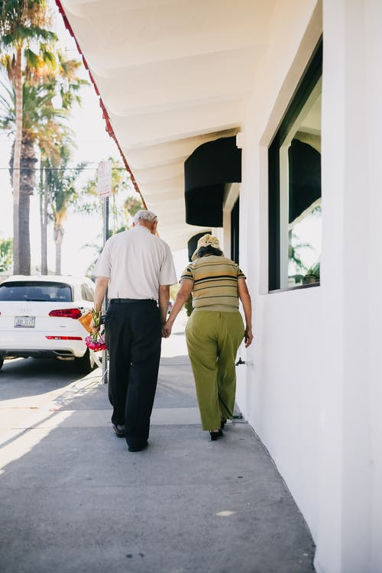
未来养老模式
Future pension model
Venus has a beautiful name and is the second planet from the Sun. It’s terribly hot—even hotter than Mercury—and its atmosphere is extremely poisonous. Venus has a beautiful
01
02
03
未来养老模式
未来养老模式
未来养老模式
Venus has a beautiful name and is the second planet from the Sun.
Venus has a beautiful name and is the second planet from the Sun.
Venus has a beautiful name and is the second planet from the Sun.

Slide 16
未来养老模式
Future pension model
未来养老模式
未来养老模式
Venus has a beautiful name and is the second planet from the Sun. It’s terribly hot—even hotter than Mercury
Venus has a beautiful name and is the second planet from the Sun. It’s terribly hot—even hotter than Mercury
01
03
未来养老模式
02
04
未来养老模式
Venus has a beautiful name and is the second planet from the Sun. It’s terribly hot—even hotter than Mercury
Venus has a beautiful name and is the second planet from the Sun. It’s terribly hot—even hotter than Mercury

Slide 17
未来养老模式
Future pension model
智慧养老的发展
Venus has a beautiful name and is the second planet from the Sun. It’s terribly hot—even hotter than Mercury—and its atmosphere is extremely poisonous. Venus has a beautiful name and is the second planet from the Sun. It’s terribly hot—even hotter than Mercury—and its atmosphere is extremely poisonous.
关键词
关键词
关键词

Slide 18
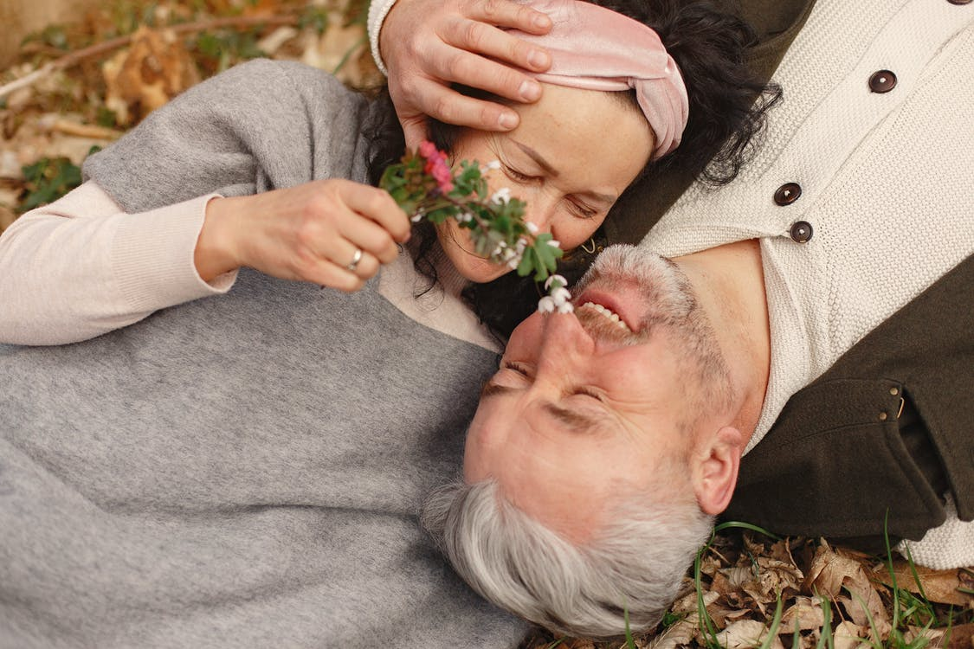
行业PPT模板http://www.1ppt.com/hangye/
未来养老模式
Future pension model
未来养老模式
Venus has a beautiful name and is the second planet from the Sun. It’s terribly hot—even hotter than Mercury—and its atmosphere is extremely poisonous. Venus has a beautiful name and is the second planet from the Sun. It’s terribly hot
养老模式
养老模式
养老模式
养老模式
Venus has a beautiful name and is the second planet
Venus has a beautiful name and is the second planet
Venus has a beautiful name and is the second planet
Venus has a beautiful name and is the second planet
Notes:
模板来自于： 第一PPT https://www.1ppt.com/

Slide 19
Provide for the aged
社区智慧养老
养老院社区智慧养老解决方案PPT
It could be the part of the presentation where you can introduce your company or agency. It could be the part of the presentation where you can introduce your company or agency.
START →

Slide 20

可以在下列情况使用
个人学习、研究。
拷贝模板中的内容用于其它幻灯片母版中使用。
不可以在以下情况使用
任何形式的在线付费下载。
网络转载、线上线下传播。
PPT模板： www.1ppt.com/moban/ 行业PPT模板：www.1ppt.com/hangye/
节日PPT模板：www.1ppt.com/jieri/ PPT素材： www.1ppt.com/sucai/
PPT背景图片：www.1ppt.com/beijing/ PPT图表： www.1ppt.com/tubiao/
优秀PPT下载：www.1ppt.com/xiazai/ PPT教程： www.1ppt.com/powerpoint/
Word模板： www.1ppt.com/word/ Excel模板： www.1ppt.com/excel/
个人简历： www.1ppt.com/jianli/ PPT课件： www.1ppt.com/kejian/
手抄报： www.1ppt.com/shouchaobao/ 试题下载： www.1ppt.com/shiti/
教案下载： www.1ppt.com/jiaoan/ 字体下载： www.1ppt.com/ziti/

