Slide 1
Object-Oriented Systems Development: survey of structured methods by A G Sutcliffe
Presented by: Nestor Rivera
EEL6883 UCF Spring 07

Slide 2
Introduction
OOD more than OOP.
Written in 1991.
Object Oriented Development was not widely accepted.

Slide 3
Outline
Object Oriented Concepts.
Evaluation of Modeling Components.
Evaluation Procedure.
Object Oriented Methods.
Review of Object Orientedness of Traditional Software Development Methods.
Conclusions.

Slide 4
Object Oriented Concepts
Three OOD principles that improve software design for reliability, maintainability, and reusability.
Abstraction: Objects are an abstraction of part of the real-world. More maintainable and reusable.
Encapsulation: Objects hide their internal contents from other components to improve maintainability. (information hiding)
Inheritance: Organizing objects in class hierarchies to promote reuse. (subclass, superclass, hierarchical, multiple, polymorphism)

Slide 5
Object Oriented Model of Systems
The Object Oriented Model of Systems is composed of a network of objects communicating by messages.
Each object specifies data and activity and may share properties according to a classification hierarchy.

Slide 6
Evaluation of Modeling Components
Objects vs. Traditional Concepts of Entities and Functions.
ISO TC97: entity, propositions and events.
Entity: Any concrete or abstract thing of interest including association among things.
Entities on three levels: Entity instance, entity type and entity class.
Propositions, rules, constraints which specify the behavior of entities.
Events: The fact that something has happened in either the universe of discourse, or the environment, or the information system.

Slide 7
Evaluation of Modeling Components – Cont.
Events are modeled as messages passed within a network of objects.
Objects record state change resulting from events.
Distinction between ISO TC97 and OOD: separation of data structure and rules, entities do not possess attributes, relationships are different.
Object Orientation shares many of the ISO concepts but by no means all. Main divergence point: separation of activity and data specification.

Slide 8
Evaluation of Modeling Components – Cont.
Objects could be classified as data-oriented and task-oriented objects.
Booch divides objects into actors (real-time systems), servers (data retrieval systems), and agents.

Slide 9
Evaluation Procedure – Conceptual Modeling
Evaluation framework: a meta-model of OO development.
The data and processing control parts of a system are modeled in unit rather than separately.
The method produces a network system model of objects communicating by messages.
The method explicitly models object types and instances.
Classification of objects is supported with property inheritance.

Slide 10
Evaluation Procedure – Procedural Guidelines
The method should guide the analyst towards identifying and describing objects.
Guidance should be available for analysis, specification and design phases.

Slide 11
Evaluation Procedure – Transformations and Products
Design transformations should support change of OO specifications into designs implementable in OOP languages.

Slide 12
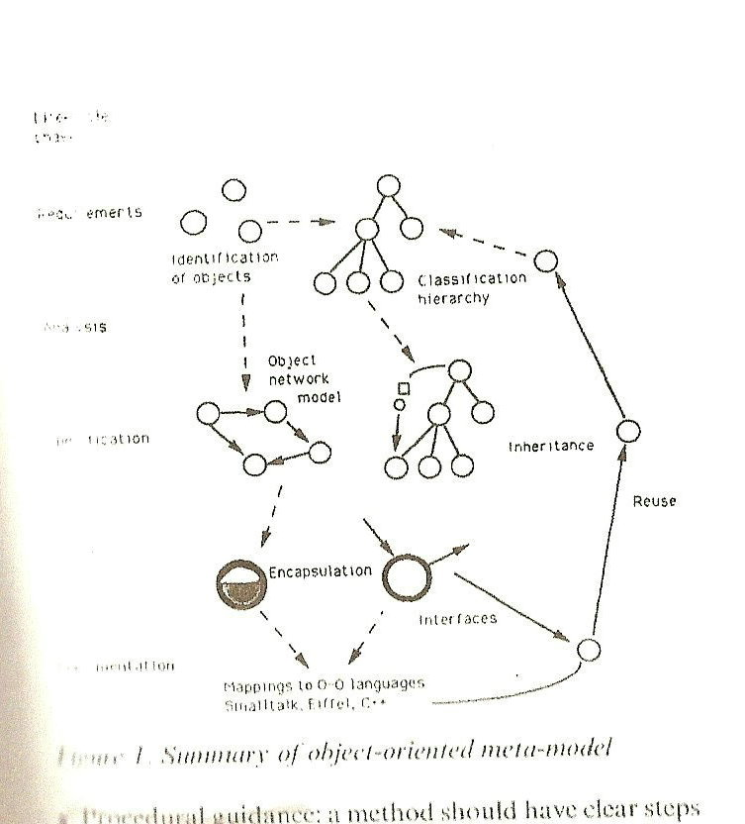
Evaluation Procedure – OO Meta-model

Slide 13
Review of Object Oriented and Traditional Methods
Goal: Highlight differences between OO and non OO methods.
Case study: Video renting system for hotels. Snapshots of artifacts only.

Slide 14
Object Oriented Methods
Hierarchical Object Oriented Design (HOOD)
Object Oriented System Design (OOSD)
Object Oriented System Analysis (OOSA)
Object Oriented Analysis (OOA)
ObjectOry

Slide 15
Object Oriented Methods – Hierarchical Object-Oriented Design (HOOD)
Scores well on OO properties.
Encourages modeling of objects explicitly.
Objects are modeled in a hierarchical manner.
Strong emphasis on the object interface specification and encapsulation.
The OO model of systems is supported. Overall, incorporates many OO properties.
Uses Booch’s concepts (actors and servers)
Supports object classes, but inheritance and reuse are not made explicit.
Real time-method -> data specification and associated inheritance receive less attention.

Slide 16
Object Oriented Methods – Object-Oriented Systems Design (OOSD)
Assumes analysis phase has been completed.
Provides detailed notation for object classes and management of inheritance.
Inter-object communications (event/message types)
Detailed notation for interface description and encapsulation.
No analysis advice is given.

Slide 17
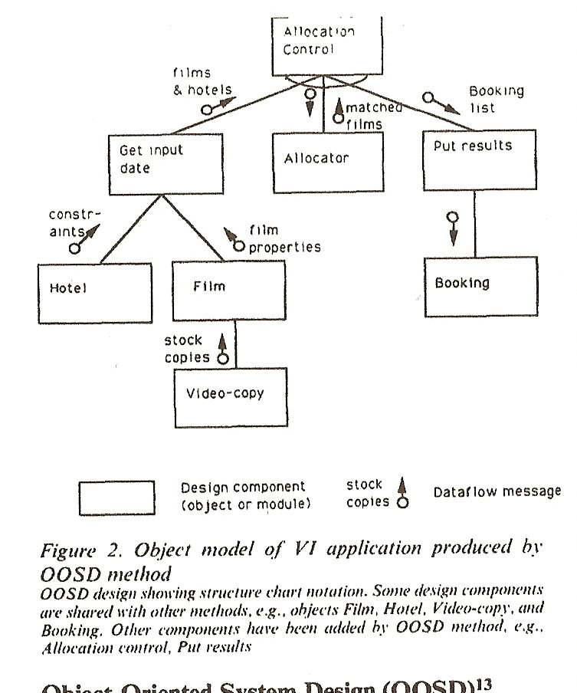
Object-Oriented Systems Design (OOSD) – Object Model Structure Chart

Slide 18
Object Oriented Methods – Object-Oriented Systems Analysis (OOSA)
Many heuristics for object identification and analysis, which help with initial abstraction and object modeling.
Data modeling approach (ER modeling)
Models an object relationship network with subclasses.
State-transition specifications are constructed for each object and functions are modeled with data-flow diagrams.
Produces a composite activity-data model (synthesis not clearly specified)
Lack of support for inheritance.
Underspecified in the design phase.

Slide 19
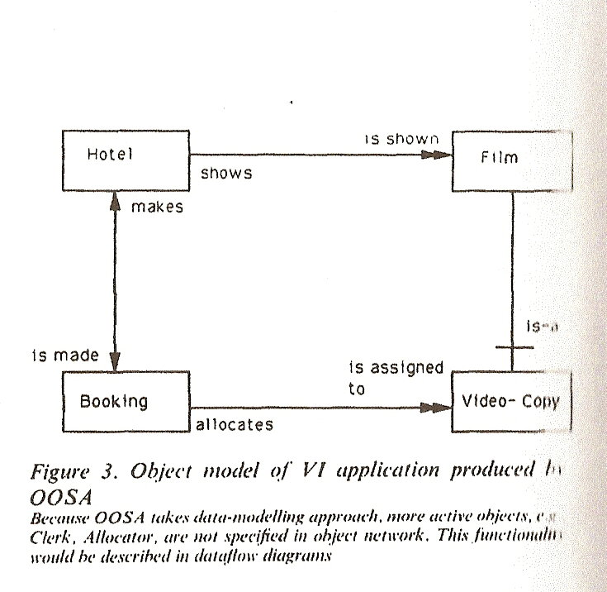
Object-Oriented Systems Analysis (OOSA) – Object Relationship Model

Slide 20
Object Oriented Methods – Object-Oriented Analysis (OOA)
Covers all OO concepts, although analysis method only.
Classification and inheritance are modeled and abstraction is helped by the structure layer (Subject, Structure, Attribute, Service)
Uses hierarchical inheritance.
Specification of encapsulation and object interfaces is not as detailed as OOSD, or HOOD.
Overall, it does meet many OO criteria.

Slide 21
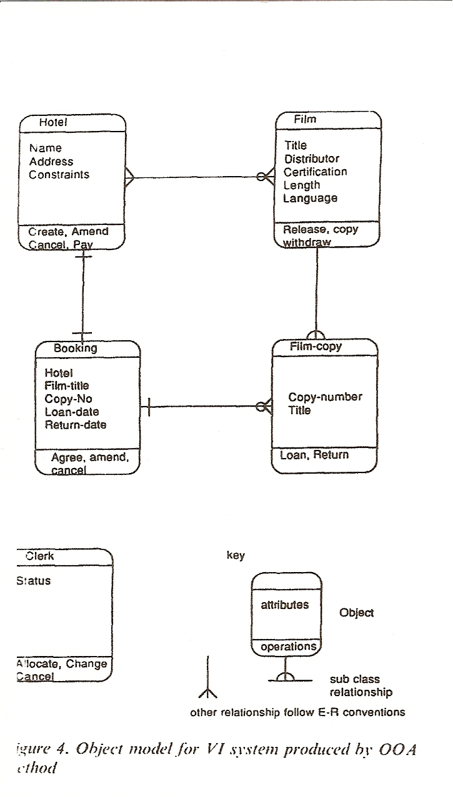
Object-Oriented Analysis (OOA) – Object Model in the Service Layer

Slide 22
Object Oriented Methods – ObjectOry
Developed by Jacobson.
Supports OO concepts of classification, encapsulation and inheritance.
Abstraction is promoted by levels.
Adds “use cases” to the OO approach.
Composite data and activity definition is not strongly enforced and services are also regarded as objects.
Reuse is supported by component libraries.
Guidance for analysis is less comprehensive.
Target applications: like HOOD real-time systems and engineering systems.

Slide 23
Summary of Object Oriented Methods
Variable and not all methods meet the necessary range of criteria.
HOOD and OOSD give comprehensive design notation but weak on prescriptive guidance (analysis)
HOOD supports most OO criteria, except property inheritance.
OOSA produces an object model with fewer components as a consequence of its data base modeling heritage.
OOA is more likely to identify actor and server objects.
No complete object oriented method exists.

Slide 24
Traditional Methods
Information Engineering (IE)
Information systems activity and change analysis (ISAC)
Structured Analysis/Structured Design (SASD)
Structured Systems Analysis and Design Methods (SSADM)
Structured Analysis and Design Technique (SADT)
Jackson System Development (JSD)
Nijssen’s Information Analysis Method (NIAM)
Mascot-3

Slide 25
Traditional Methods – Information Engineering (IE)
Uses data modeling.
Functional specification uses process dependency and action diagrams.
Concepts of type-instance are supported.
Encourages conceptual modeling of business processes -> object orientation.
Cannot be regarded as truly object-oriented (separation of processing from data and emphasis on functional decomposition)

Slide 26
Traditional Methods – Information Systems Activity and change analysis (ISAC)
Advocates top-down functional decomposition in separated specifications as activity and data diagrams.
Emphasis is placed on analysis phase.
Type-instance and classification concepts are not supported.
More functionally oriented than object-oriented.

Slide 27
Traditional Methods – Structured Analysis/Structured Design (SASD)
Top-down functional decomposition.
Analyses system in terms of a network of processes connected by data flow messages.
Functional cohesion and low coupling.
Does not support any OO concepts (separates data and process specification)
More recent versions have added state-transition diagrams and bottom-up analysis driven by event identification (more potential for OO specifications)

Slide 28
Traditional Methods – Structured Systems Analysis and Design Method (SSADM)
Composite method derived from structured analysis, structured design and data analysis.
Process analysis is separated from data analysis -> functionally related processing structures.
Most of the views expressed about IE also apply to SSADM.

Slide 29
Traditional Methods – Structured Analysis and Design Techniques (SADT)
Uses top-down decomposition to analyze systems.
Specification uses network diagrams of processes connected by data flows, control messages, and mechanisms.
Encourages modeling of real world problems, but constructs separate activity and data models.
Does not support type-instance concepts.
Separation of process specification from data makes it unsuitable for an OO approach.

Slide 30
Traditional Methods – Jackson System Development (JSD)
System models based on networks of concurrent communication processes.
Type-instance concept.
Classification and property inheritance are not supported.
System control is modeled in terms of time-ordering of actions associated with entities.
More recent versions have placed more emphasis on data modeling -> object model that combines data and operations.
Much in common with OO methods.
No object classification, instead entity roles.

Slide 31
Nijssen’s Information Analysis Method (NIAM)
Conceptual modeling method that concentrates on data specification during early part of the analysis life-cycle.
Support data abstraction with conceptual modeling -> encouraging OO.
Type-instance concepts are supported.
Possess some OO properties, not inheritance.

Slide 32
Traditional Methods – Mascot-3
Advocates functional decomposition of systems.
Recent versions have introduced encapsulation and clearly defined interfaces for system components.
Type-instance concept.
No classification of objects
Little guidance during early analysis.
Encourages a functionally oriented specification.
Implementation does incorporate OO features.

Slide 33
Summary of Traditional methods evaluation
Methods using functional decomposition encourage identification of goal related components in systems.
OO approach promotes system components more compatible with data models.
Functionally oriented analyst will identify different modules from OO analyst.
Current structured methods using an entity-modeling and/or entity life history have potential to evolve towards OO.

Slide 34
Conclusions
Use of a particular system development method will bias implementation of OO systems. OO designs may not be derived from any specification.
Data model and OO specification show considerable convergence. It is feasible to migrate from structured methods such as JSD, IE and SSADM to OO method.
OO methods have yet to be proven in practice: they have little CASE tool support, and lack of modeling techniques for reuse system development.
Rentsch’s prediction “object oriented systems development will be in the 1990’s what structured design was in the 1970’s”

Slide 35
Final Thoughts
Overwhelming at times, but yet well organized.
Good picture of the history and evolution of OOD (complement to previous paper)
Outdated >15 years
Poor coverage of interface design.
1995 (Booch, Jacobson and Rumbaugh proposed the Unified Process and UML)

Slide 36
Additional References
http://www.wikipedia.com
Sommerville, Software Engineering Vol. 7, Chapter 14.
Structured System Analysis and design method (SSADM) by Caroline Ashworth, 1998 Information and Software Technology.

Slide 37
Questions
What are the new alternatives to OO development?
?

