Slide 1
Unacast case presentation
Lovisa Brandrud

Slide 2
New York Citibike
– Insights about areas and usage

Slide 3
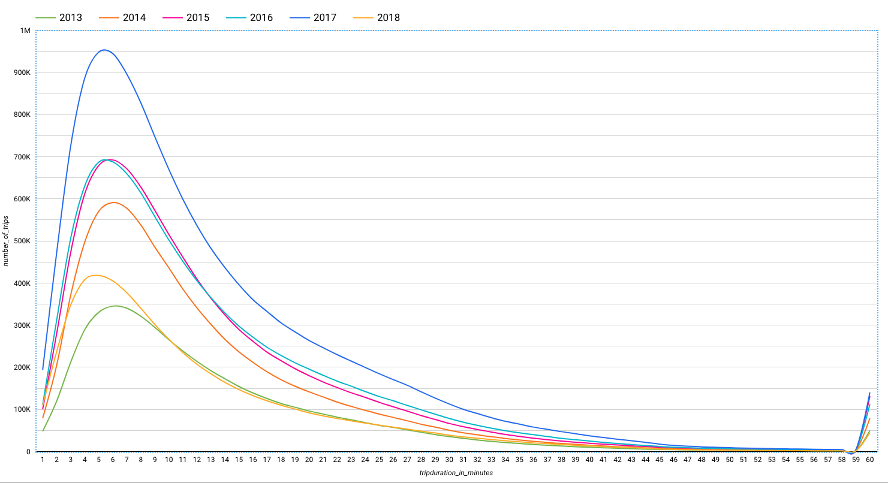
We have the same tendency across all years

Slide 4
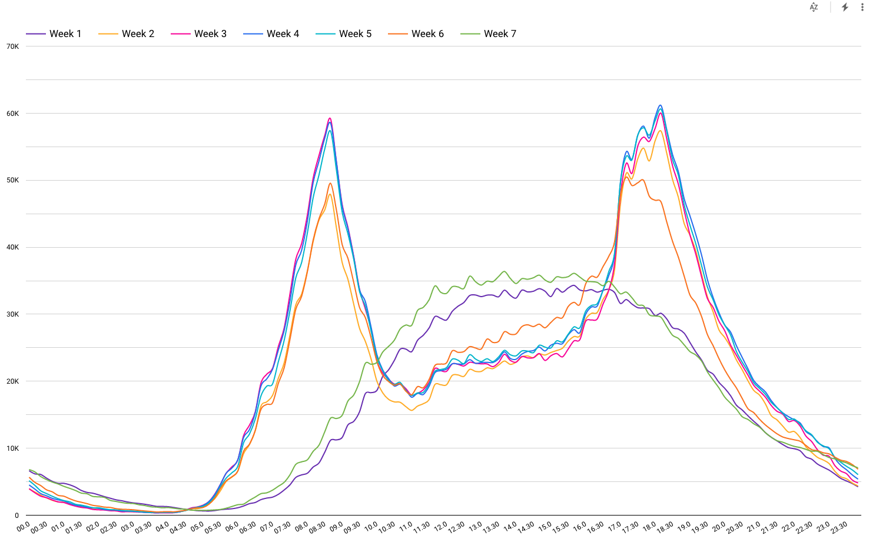
Weekdays show two peaks – one around 08.30 and a broader one around 18.00
Based on trips in 2017 and 2018

Slide 5
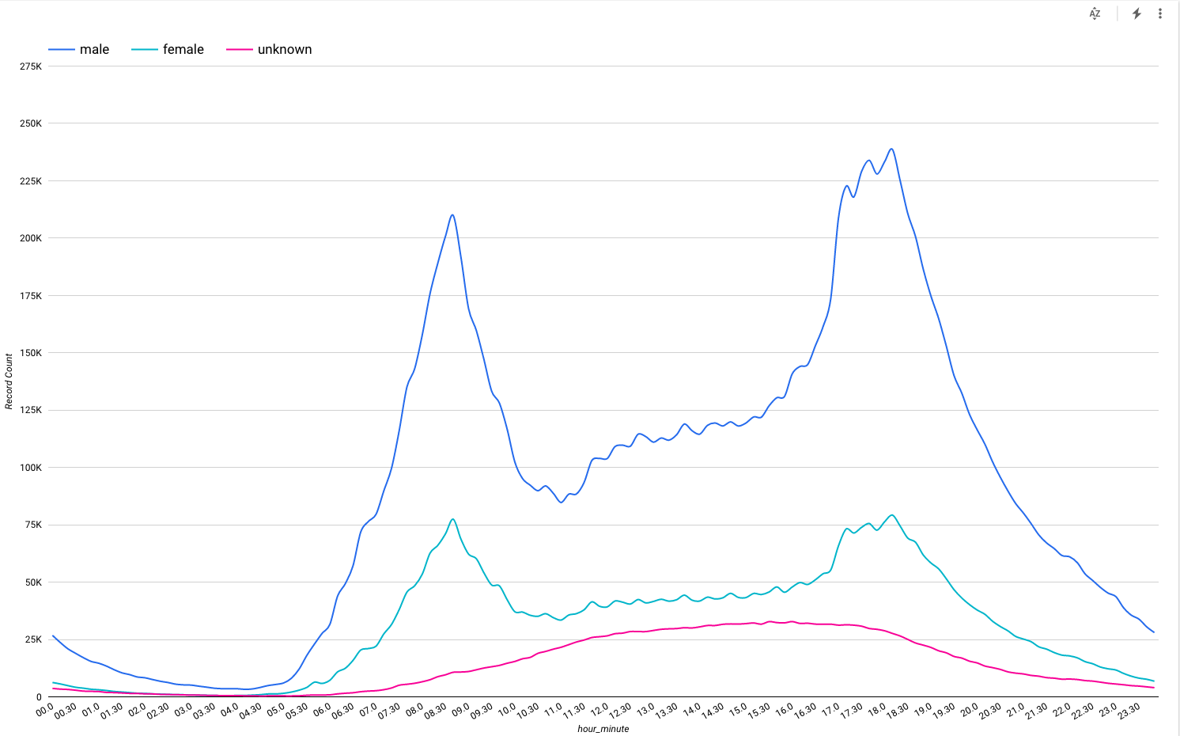
Males account for around 2/3 of all trips
Based on trips in 2017 and 2018

Slide 6
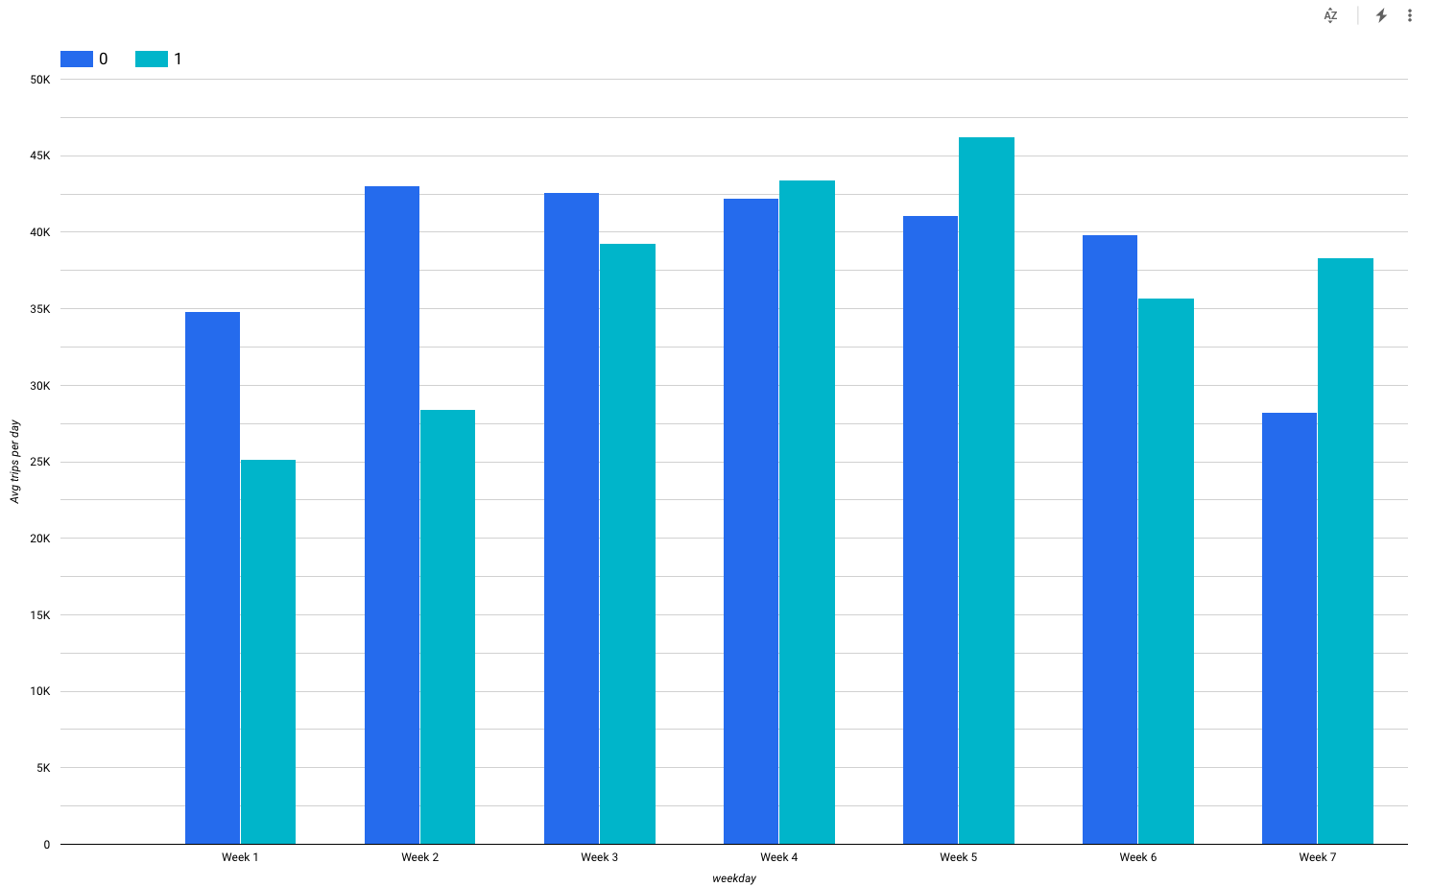
Rain does not have a great impact on demand
Based on trips in 2016

Slide 7
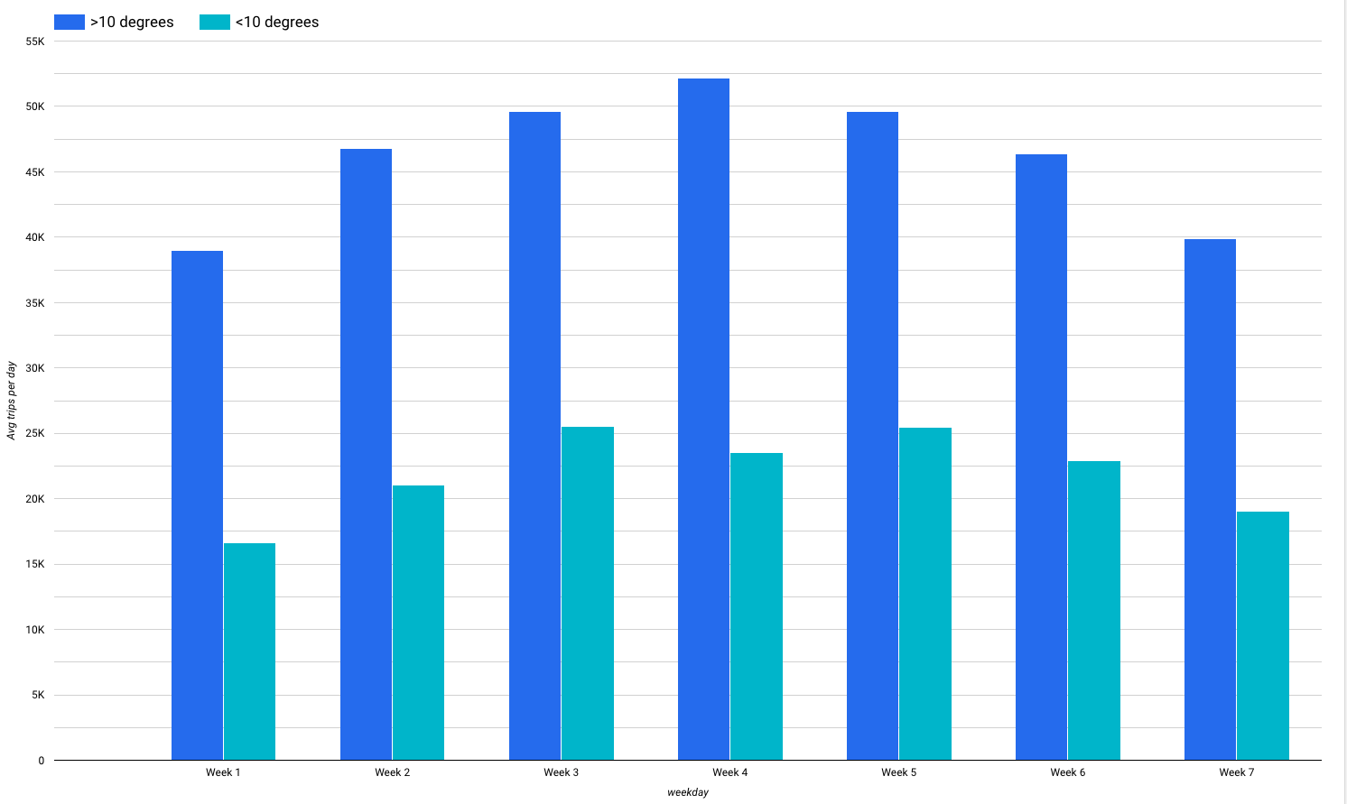
Temperature affect usage
Based on trips in 2016
Notes:
Disse temperaturene ser vi hovedsaklig I desember

Slide 8
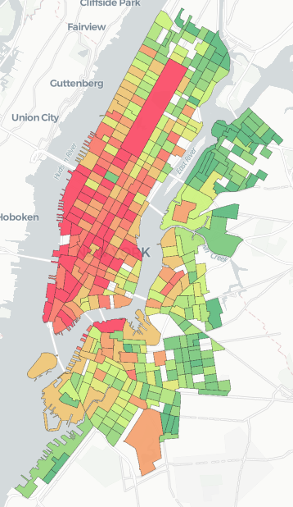
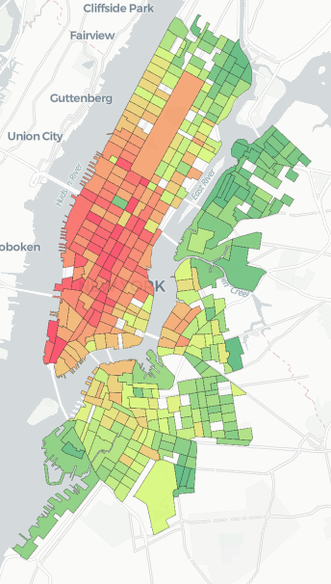
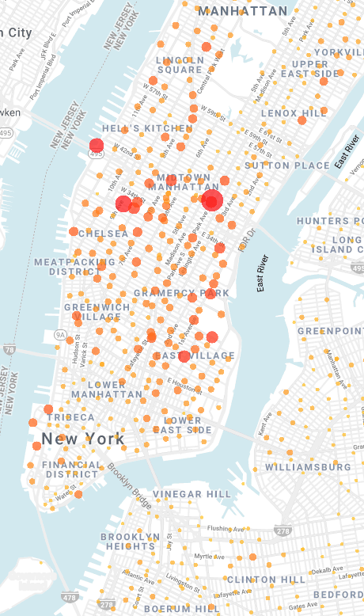
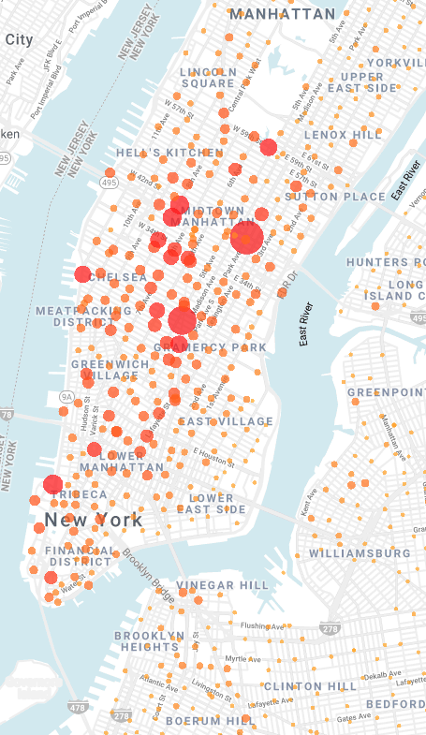
Average number of trips per day originating in the census tract
Absolute
Normalized per station
Notes:
Based on data from 2017

Slide 9
What now?

Slide 10
A tool for estimating demand for bikes
Wednesday
08-09
Wednesday
18-19
< 10 degrees
→ 50% demand
Notes:
Based on data from 2017

Slide 11
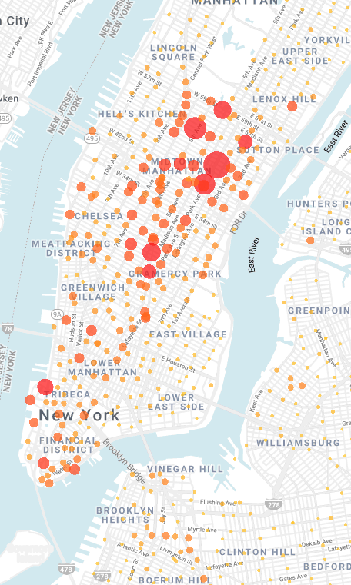
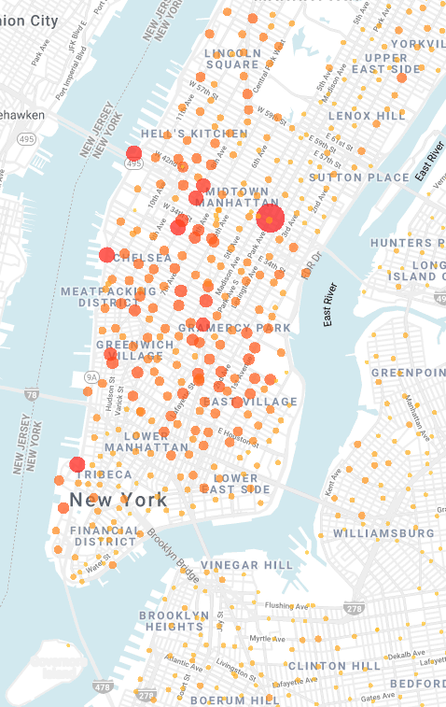
A tool for estimating demand for docks
Wednesday
08-09
Wednesday
18-19
Notes:
Based on data from 2017

Slide 12
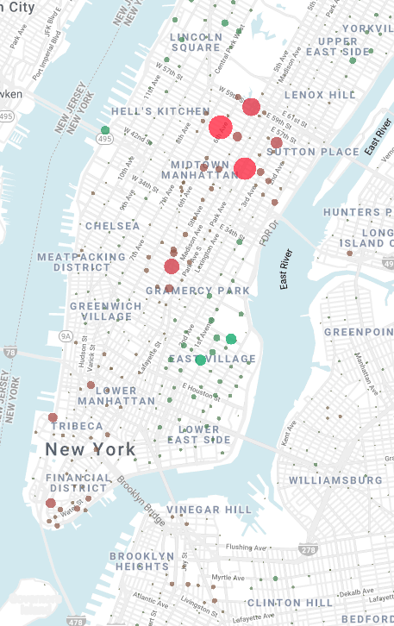
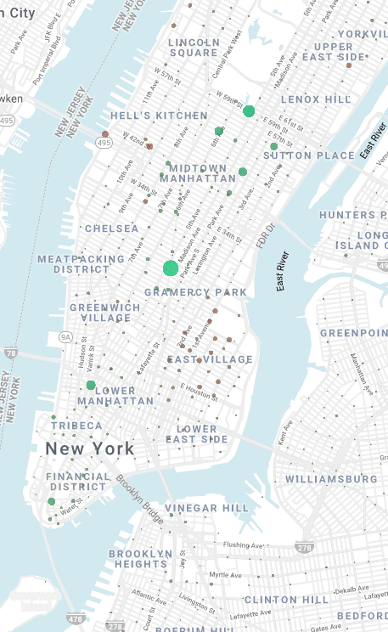
A tool for estimating net demand
Wednesday
08-09
Wednesday
18-19
Red = Too many bikes
Green = Need more bikes
Notes:
Additional information:
Add current number of bikes into the equation
Add temperature (categorical, linear, more advanced distribution)
Add wind
Holidays
Festivals, etc
One of the greatest challenges is still the fact that we here assume unlimited supply of bikes and docks, this is not the case in reality and can give a shifted picture

Slide 13
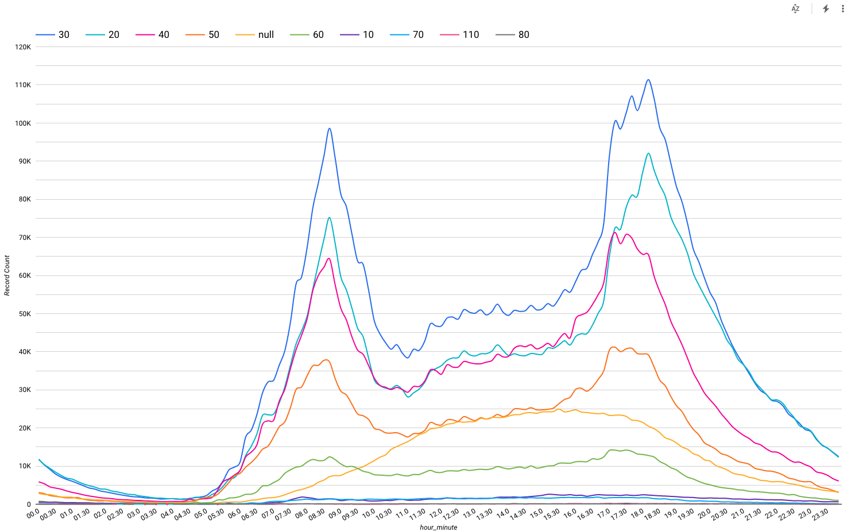
Most trips are taken by people in their 30's
Based on trips in 2017 and 2018

Slide 14
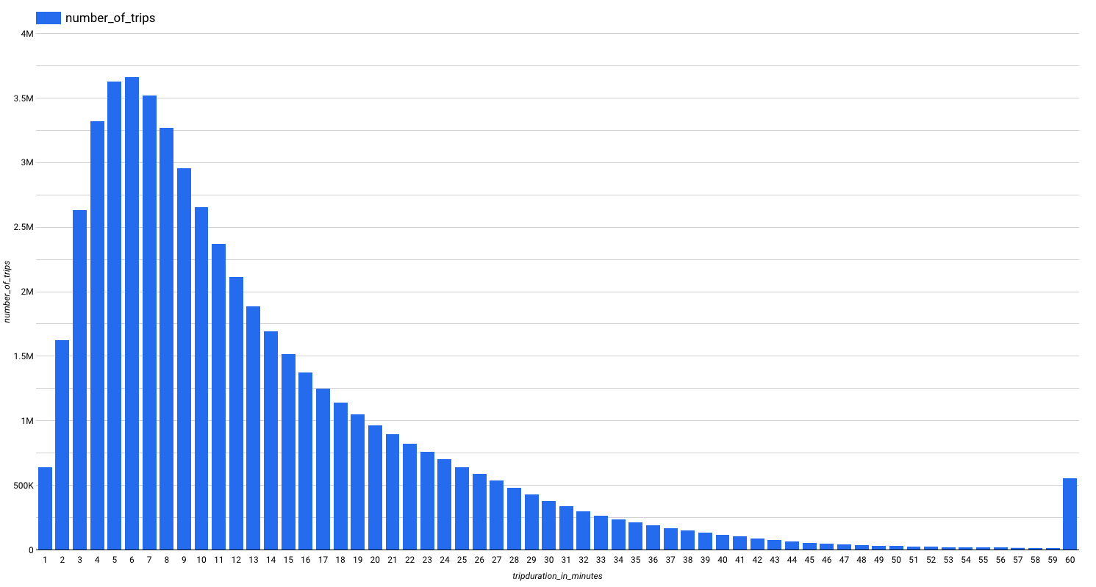
Most trips last around 6 minutes

Slide 15
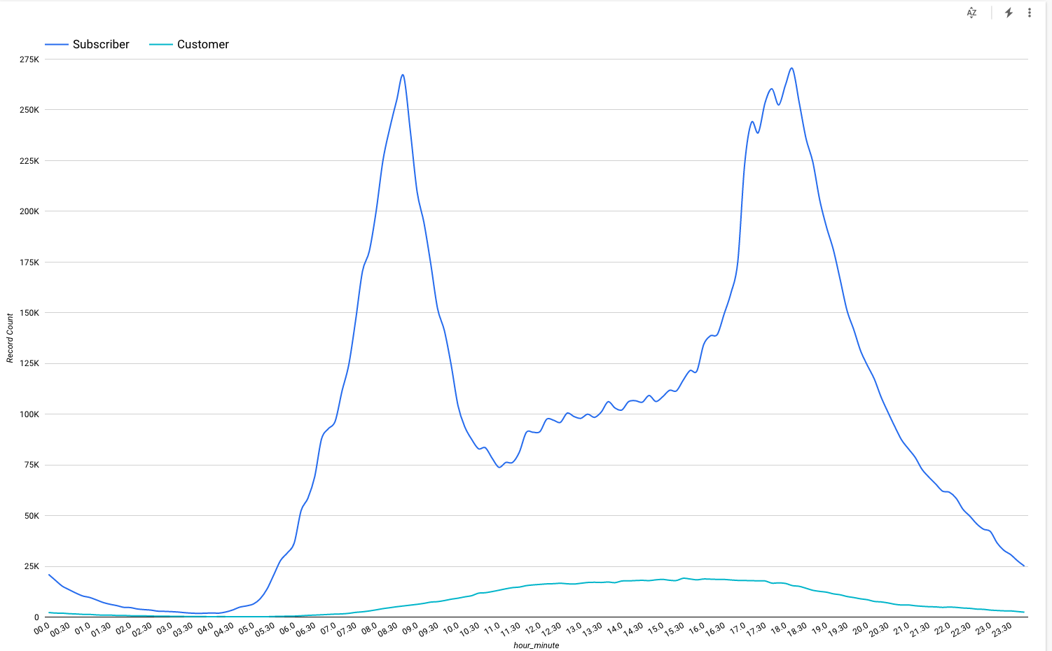
Weekdays show two peaks – one around 08.30 and a broader one around 18.00
Based on trips in 2017 and 2018

Slide 16
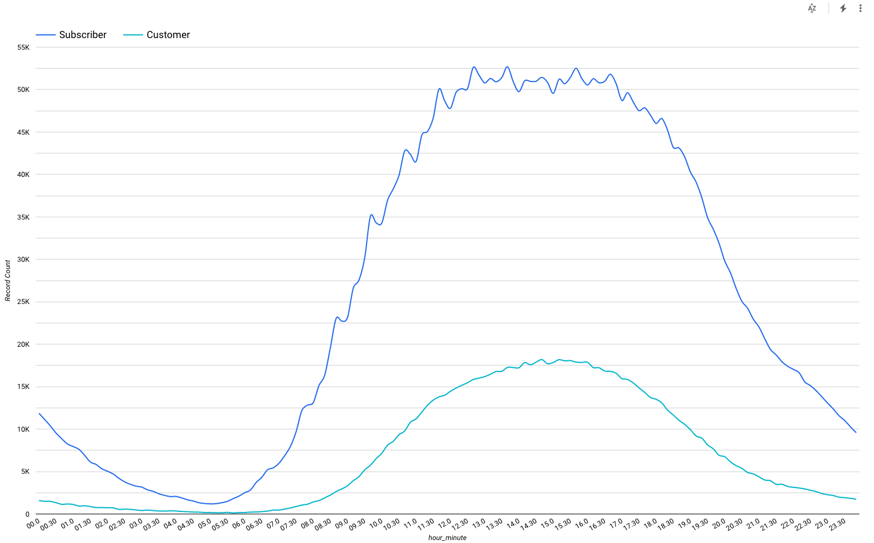
Weekends show a different pattern then weekdays
Based on trips in 2017

Slide 17
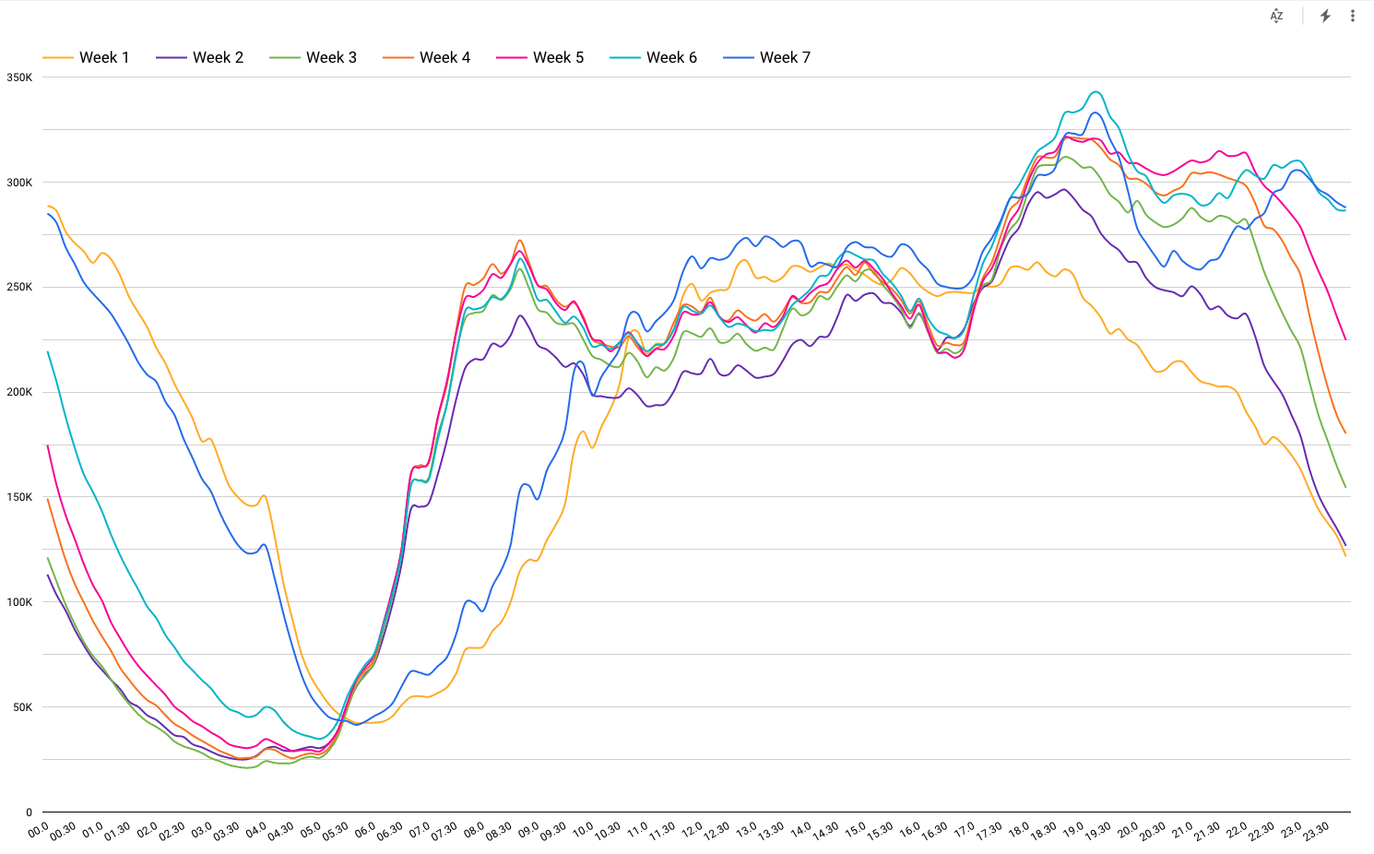
Taxi: Weekends show a different pattern then weekdays
Based on trips in 2017

Slide 18
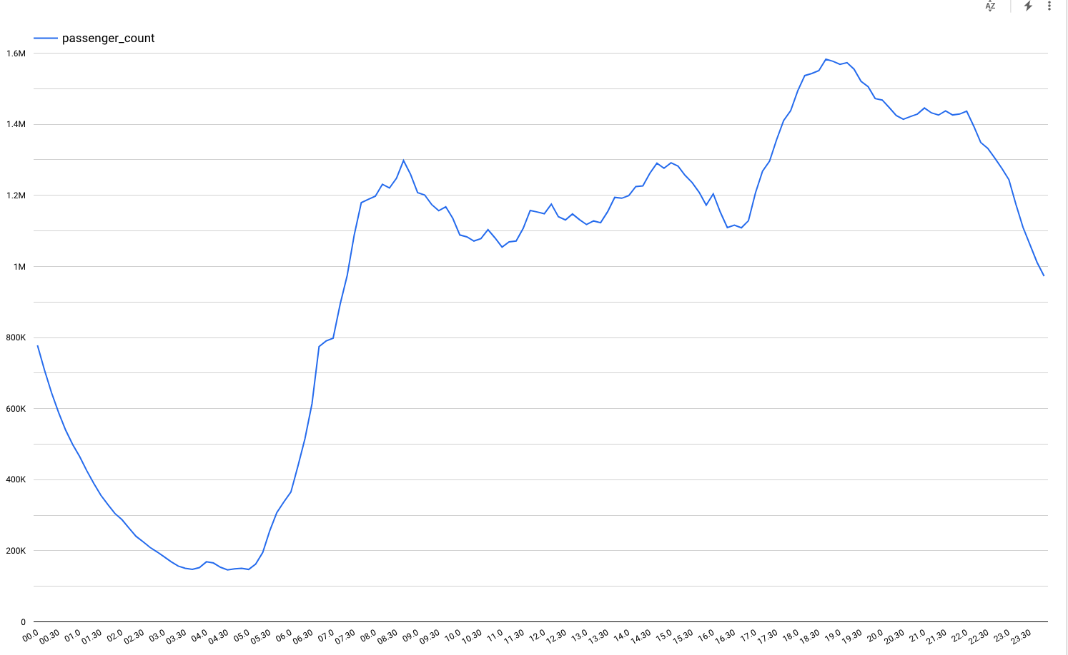
Taxi: Weekdays
Based on trips in 2017 and 2018

Slide 19
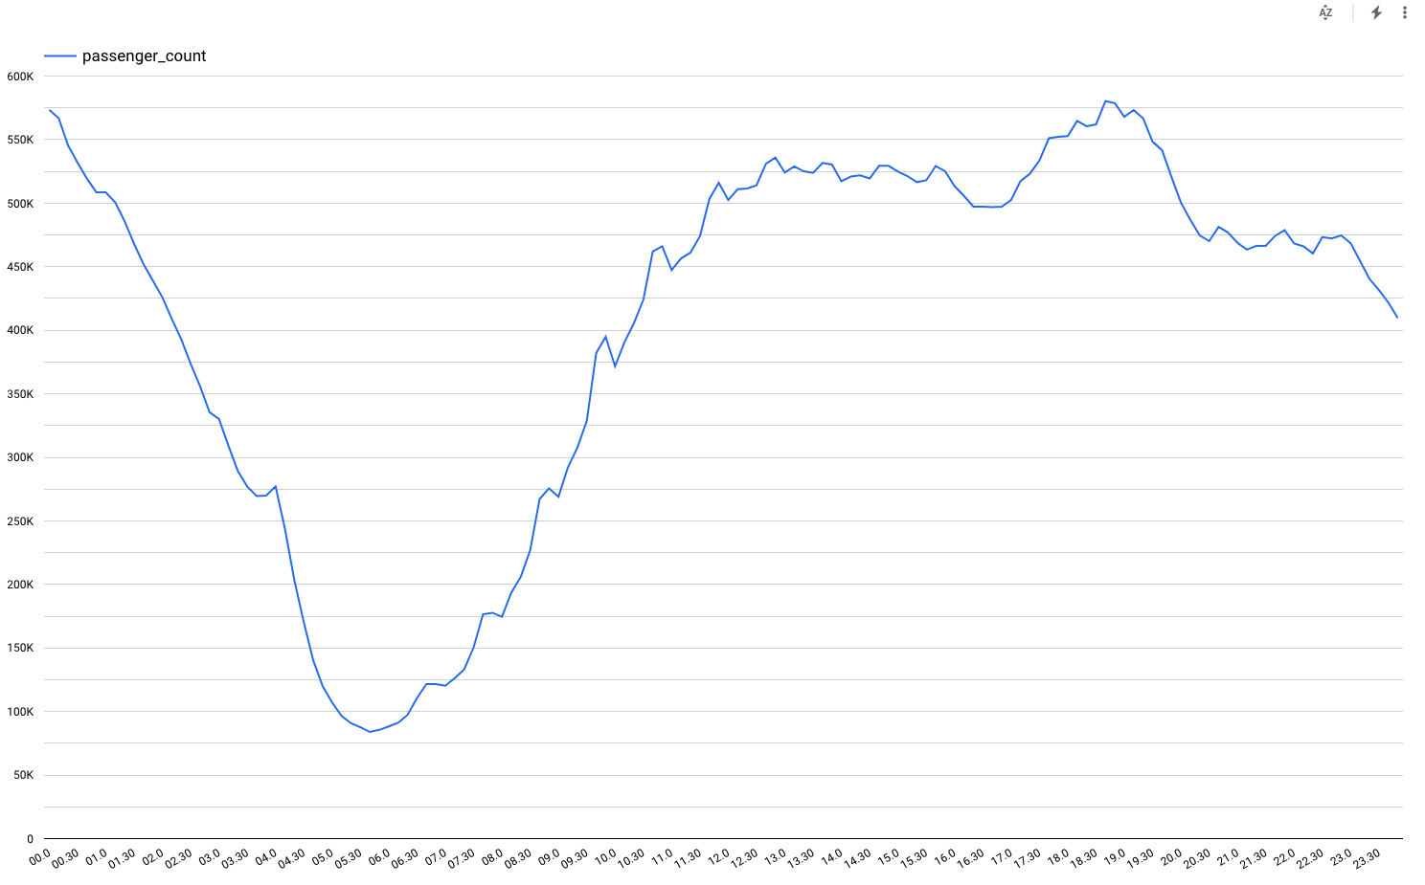
Weekends taxi
Based on trips in 2017

