Slide 1
THE ADORNED INTERNATIONAL
Enterprise & Innovation Acceleration Initiative
Tier-1 Strategic Business Case & Masterplan | Target Showcase: December 2026
McKinsey Standard | Prepared for Senior Pastoral Leadership & Board of Trustees

Slide 2
THE ADORNED INTERNATIONAL
Executive Brief: Catalyst for Economic Elevation & Kingdom Impact
01. THE VISION
Bridging the Gap from Idea to Scalable Enterprise
AIVA transforms raw business concepts into sustainable enterprises via structured training, capital, and 6-month incubation. • Target Showcase: December 2026 • 80% Church Members / 20% External • Pastoral Governance Board
02. THE CAPITAL MODEL
₦6.5M Seed Grant Pool (December 2026)
Graduating founders pitch before Pastoral Leadership and 'Kingdom Angels' to win seed grants. • 1st Place: ₦5,000,000 Grant • 2nd Place: ₦1,000,000 Grant • 3rd Place: ₦500,000 Grant
03. THE INCUBATION
6-Month Top 5 Post-Pitch Acceleration
Top 5 emerging ventures transition into an intensive 6-month incubation cohort starting Jan 2027. • Executive C-Suite Mentorship • Legal & Tax (CAC) Formalization • Shared Workspace & Tool Credits • Quarterly Audit Tranches

Slide 3

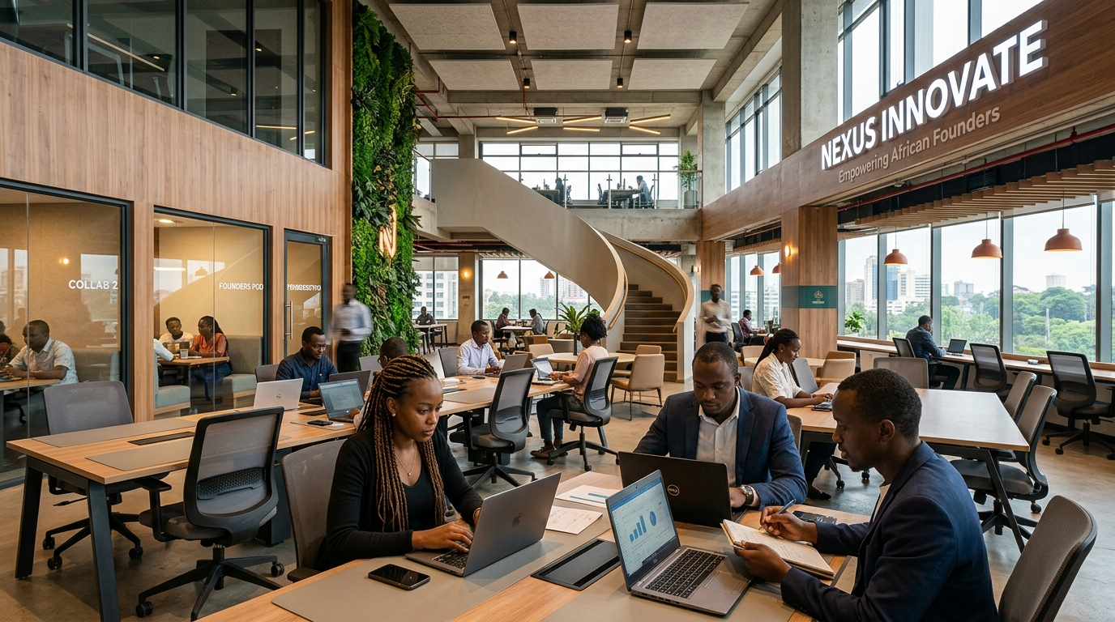

THE ADORNED INTERNATIONAL
Strategic Framework: McKinsey 3-Horizon Growth Strategy
HORIZON 1 (2026)
Seed & Formalization
• Launch Cohort 1 Intake (Sep 2026) • Execute 6-Week Enterprise Bootcamp • Host December 2026 Demo Day • CAC & Legal Formalization for Top 5
HORIZON 2 (2027)
Commercial Integration
• Integrate Top 5 into Church Business Chains • Activate 10% Profit Payback into Seed Fund • Expand Mentorship Network to 20+ Leaders • Launch Cohort 2 Intake
HORIZON 3 (2028+)
Kingdom Venture Fund
• Scale Capital Pool to ₦50M+ with Impact Partners • Establish Evergreen Revolving Capital Model • Regional Replication in Partner Churches • Self-Sustaining Venture Ecosystem

Slide 4
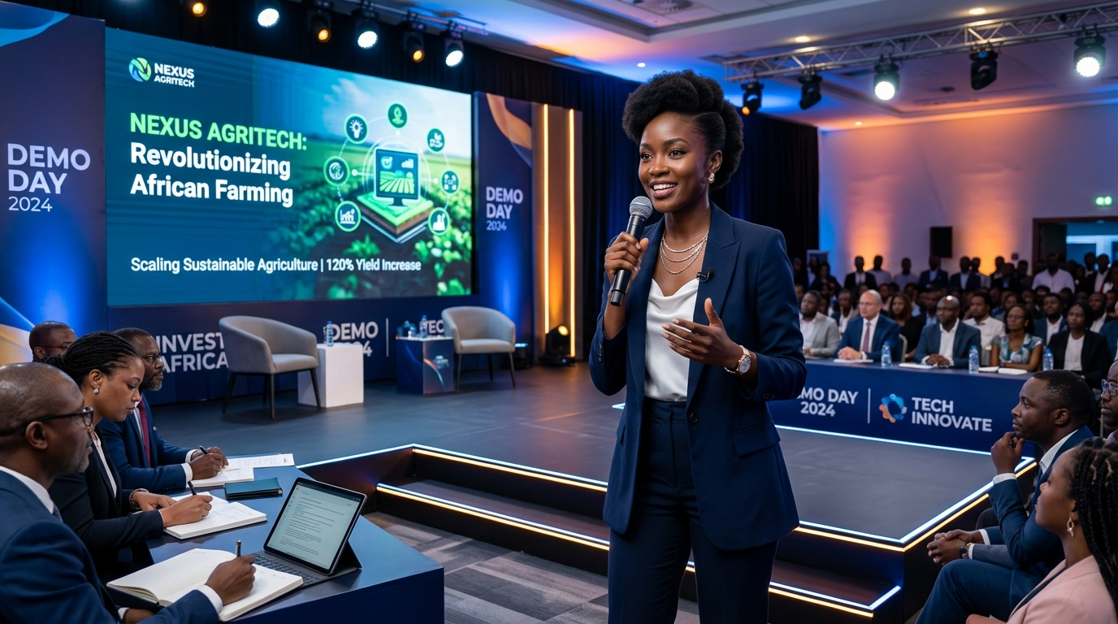
THE ADORNED INTERNATIONAL
Program Architecture: The 4-Stage Accelerator Pipeline
STAGE 1
Application Intake
Timeline: September 2026
• Online Application Portal • 80% Church / 20% External • 100-Pt Vetting Matrix • Desktop Due Diligence
STAGE 2
Enterprise Bootcamp
Timeline: Oct - Nov 2026
• Business Model Canvas • Unit Economics & Pricing • CAC & Tax Formalization • Pitch Masterclasses
STAGE 3
Demo Day Showcase
Timeline: December 2026
• Executive Live Showcase • 1st Place: ₦5,000,000 • 2nd Place: ₦1,000,000 • 3rd Place: ₦500,000
STAGE 4
Top 5 Incubation
Timeline: Jan - Jun 2027
• C-Suite Mentor Matching • CAC Corporate Setup • Shared Workspace Credits • Milestone Tranches

Slide 5
THE ADORNED INTERNATIONAL
Annual Cohort Budget: ₦14,000,000 Capital Allocation
CAPITAL ALLOCATION BRIEF
TOTAL ANNUAL BUDGET
₦14,000,000
SEED GRANT POOL
₦6,500,000 (46.4%)
OPS & INCUBATION
₦7,500,000 (53.6%)
TARGET APPLICANTS
50+ Businesses
DEMO DAY DATE
December 2026
TOP INCUBATED COHORT
Top 5 Ventures
Itemized Expense Allocation (NGN)
1. Seed Funding Grants Pool — ₦6,500,000 (46.4%)
1st Place: ₦5M | 2nd Place: ₦1M | 3rd Place: ₦500K
2. Bootcamp & Facilitators — ₦2,200,000 (15.7%)
Weekend masterclass facilitators & workbooks
3. December Demo Day Production — ₦2,500,000 (17.9%)
Venue production, media coverage, livestreaming
4. Incubation (6 Months) — ₦1,800,000 (12.9%)
Legal CAC setup, tax IDs, accounting tools
5. Admin & Reserve — ₦1,000,000 (7.1%)
Branding, portal hosting, contingency reserve

Slide 6
THE ADORNED INTERNATIONAL
Capital Sourcing Strategy: 4-Pillar Funding Architecture
PILLAR 1: CHURCH EMPOWERMENT FUND
₦3,500,000 (25% of Total)
Institutional anchor commitment from church benevolence and empowerment budget.
PILLAR 2: 'KINGDOM ANGELS' NETWORK
₦5,000,000 (36% of Total)
Subscriptions from high-net-worth congregation members committing ₦500k–₦1M each.
PILLAR 3: CORPORATE CSR & SPONSORSHIPS
₦4,500,000 (32% of Total)
Headline and Gold sponsorship packages pitched to commercial banks, fintechs, and telecoms.
PILLAR 4: COMMITMENT TOKENS
₦1,000,000 (7% of Total)
Nominal application fee (₦10,000 per application) ensuring high founder commitment.

Slide 7
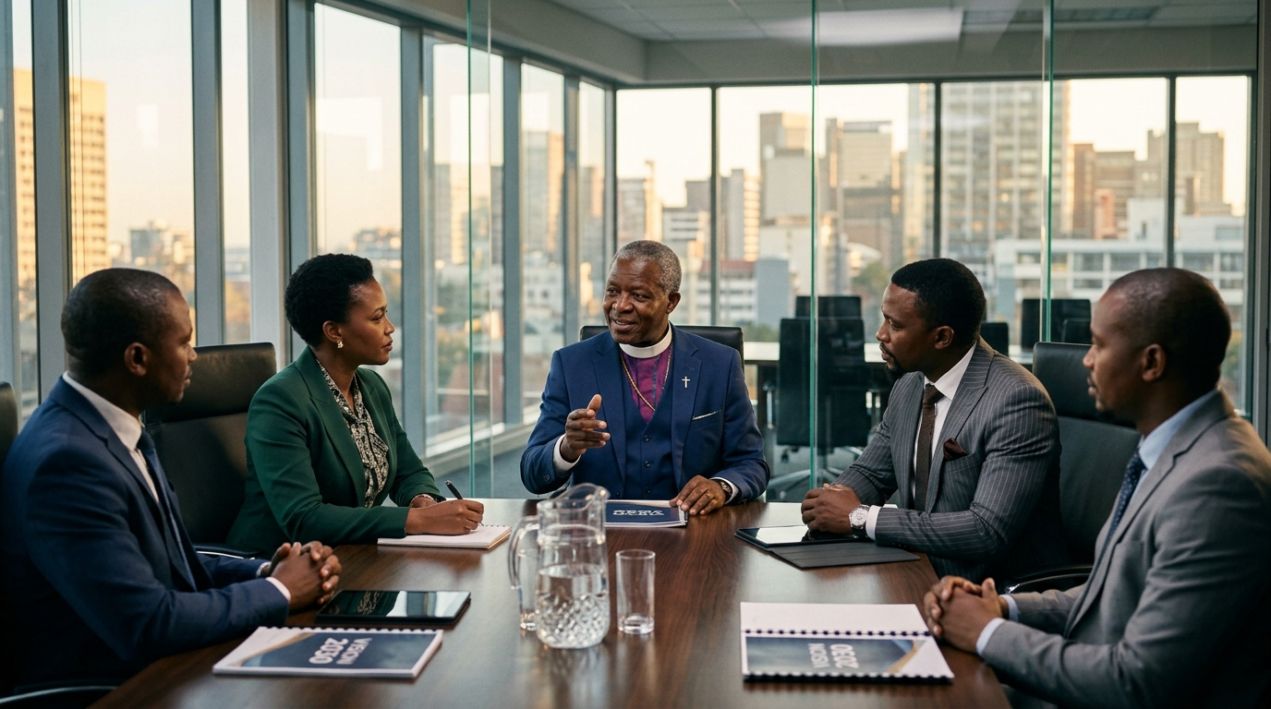
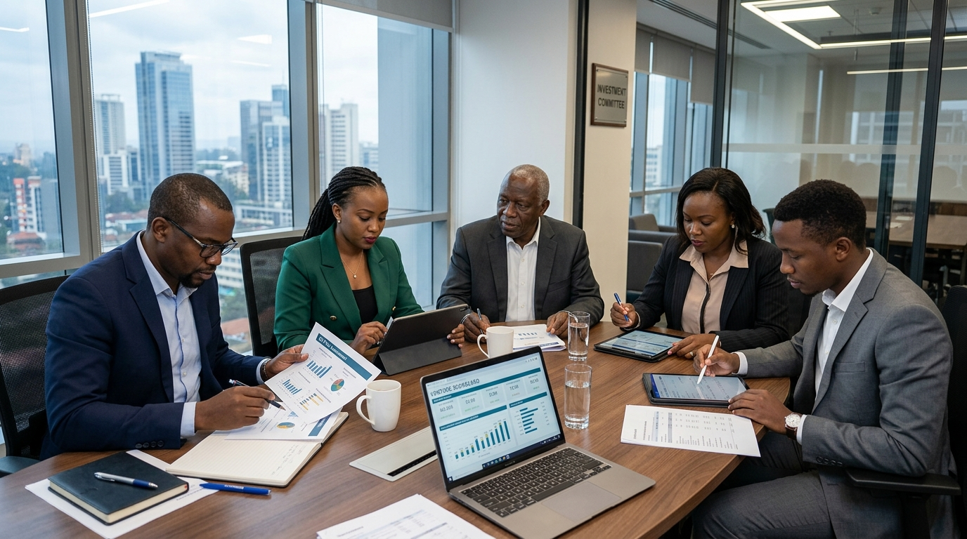
THE ADORNED INTERNATIONAL
Governance Structure: Senior Pastoral Advisory Board & FIC
1. SENIOR PASTORAL ADVISORY BOARD
Ultimate Governance & Stewardship
• Ultimate vision alignment & stewardship • Final fund disbursement approval • Ethical leadership governance • Strategic policy direction
2. FUND INVESTMENT COMMITTEE (FIC)
Vetting, Scoring & Capital Allocation
• Senior corporate & finance executives • Pitch evaluation at December Demo Day • Milestone tranche disbursement • Portfolio compliance audits
3. AIVA INCUBATION OPERATIONS TEAM
Program Delivery & Founder Coaching
• Program Director & Lead Mentors • 6-week bootcamp delivery • CAC corporate registration & tax setup • Quarterly milestone reporting

Slide 8

THE ADORNED INTERNATIONAL
Balanced Scorecard: 4-Pillar Impact & ROI Matrix
1. FINANCIAL ROI
Tithe Growth & Fund Payback
• Projected ₦6M/yr tithes by Year 3. • 10% profit payback into Seed Fund starting Month 18.
2. SOCIAL ROI
Job Creation & Elevation
• 15–30 direct jobs in Cohort 1; 40+ indirect jobs. • Household income elevation.
3. BRAND ROI
Institutional Leadership
• Positions church as socio-economic hub. • Unlocks corporate partnerships.
4. KINGDOM ROI
Marketplace Ethics
• Ethical Christian business leaders. • 20% external slot outreach engine.

Slide 9
ACTION PLAN FOR PASTORAL LEADERSHIP
Leadership Implementation Roadmap (Target: December 2026 Demo Day)
1. FORMAL PASTORAL BOARD RATIFICATION (August 2026)
Adopt AIVA as an official economic empowerment initiative of The Adorned International.
2. APPOINTMENT OF AIVA STEERING COMMITTEE (Early September 2026)
Establish a 5-member committee of senior business leaders to oversee program execution.
3. 'KINGDOM ANGELS' EXECUTIVE BREAKFAST (Mid-September 2026)
Gather high-net-worth church members to raise ₦5,000,000 in anchor seed commitments.
4. APPLICATION PORTAL LAUNCH (Late September 2026)
Open online application intake for 80% church members / 20% external candidates.
5. ENTERPRISE BOOTCAMP & MENTOR MATCHING (October – November 2026)
Conduct 6-week intensive training and C-suite mentor pairings.
6. INAUGURAL DEMO DAY SHOWCASE (December 2026)
Host flagship competition showcase in December 2026 and award ₦6.5M in seed capital grants.

