Slide 1

Walchand College of Engineering
(Government Aided Autonomous Institution)
Vishrambag, Sangli, 416415
Department of Computer Science & Engineering
Presentation on
1947
“Plant Disease Prediction System”
AY:2021-22
Under the guidance of
Prof. Miss P D Mundada
Team Members:
2019BTECS00109 : Mr. Lovish T Agrawal
2019BTECS00114 : Mr. Swapnil S Kanade
Date: 20/05/2022

Slide 2
Agenda
Abstract
Problem statement
Objectives
Methodology
Flow chart
Outcomes/Applications
Technology stack
Conclusion
References

Slide 3
Abstract
Now, a day’s financial impact of agriculture is increasing day by day with economic growth of our country, still agriculture is one wide sectors and that is playing very important role for our county. While tracking diseases in plants with the help of an expert can be very expensive in agricultural areas. There is a need for a system which can automatically detect the diseases as it can bring revolution in monitoring large fields of crop and then plant leaves can be taken cure as soon as possible after detection of disease.

Slide 4
Problem statement
To create a plant disease prediction system which will detect the diseases in selected plants by analyzing its images provided through the dataset.

Slide 5
Objectives
To study fundamentals of image processing, deep learning and web development technology.
To implement a plant disease recognition system using convolutional neural networks.
To implement web based GUI, based on the given problem statement.
To test and deploy the web application.

Slide 6
Methodology
Phase I: Research and Strategy
It refers to collecting all information related to the project.
Phase II: Preparation of project outline.
Phase III: Webapp Designing.
Phase IV: Construction
Backend: It is the core structure of product. The images of the plant leaves will be processed and then analyzed and finally we will diagnoze the disease the plant is infected with.
Frontend: This is what makes HTML, CSS visible to the user. It also helps to manage whole system through the web app.
Phase V: Testing, Integration and Deployment
Testing, integration of software and deployment of final product in real time environment.

Slide 7
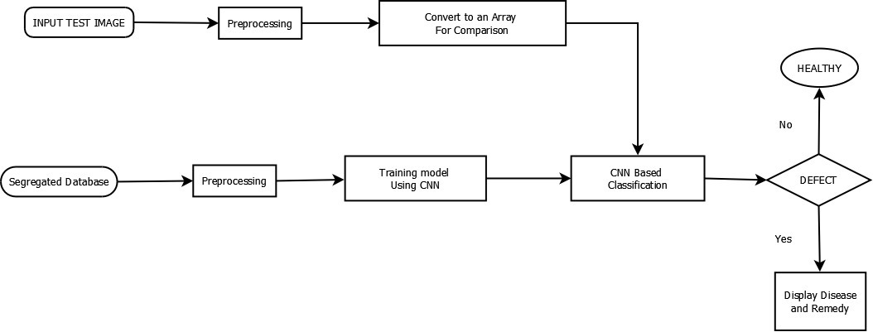
Flow chart

Slide 8
Outcomes/Applications
The plant disease recognition system will help us in recognition of diseases of the selected plants.
We will able to treat the infected plant with proper nutrients after the timely recognition of the disease.
Tracking of diseases in plants with the help of experts will prove to be quite expensive, so this will eventually help in cost reduction.
As the plants diseases will be tracked beforehand the wastage will be low and that will reduce the losses.

Slide 9
Technology Stack
SOFTWARE SPECIFICATION
TensorFlow (OpenCV) Dataset: https://drive.google.com/drive/folders/1vdr9CC9ChYVW2iXp6PlfyMOGD-4Um1ue Front End: React Js Back End: Django

Slide 10
Conclusion
In Plant disease recognition system the application will identify the type of infection the plant is suffering without expert intervention thus saving a lost of cost and time. The disease can be beforehand digonised thus proper steps can be taken to ensure that the disease doesn’t spread further thus lots of losses can be avoided.
Developments of such automated systems are used to assist the farmers and experts to identify plant disease and pests by leaf visual symptoms. Obtained results evidence that the designed system for the farmers are much helpful in order to reduce the complexity, time, and cost of diagnosing the leaves from any diseases.

Slide 11
references
Research Paper : P. Sonal, P. Patil, M. Rupali, and S. Zambre, “Classification of cotton leaf spot disease using support vector machine,” International Journal of Engineering Research and Applications, vol. 4, no. 5, pp. 92-93, 2014
https://www.academia.edu/download/34209819/P45019297.pdf
OpenCV Doc: https://docs.opencv.org/4.x/
Tensorflow Documentation: https://www.tensorflow.org/tutorials
Deep Learning : https://en.wikipedia.org/wiki/Deep_learning
Image Processing : https://en.wikipedia.org/wiki/Digital_image_processing
https://towardsdatascience.com/a-comprehensive-guide-to-convolutional-neural-networks-the-eli5-way-3bd2b1164a53

Slide 12
Thank You

