Slide 1
MultiThreading

Slide 2
Java Thread Basics
1. Thread Priority
Java assigns a thread priority that determines how that thread should be treated with respect to other threads
Thread priorities are integers ( 1 to 10) MIN_PRIORITY =1, MAX_ PRIORITY = 10, NORM_ PRIORITY =5
3. Thread priorities are used by the thread scheduler to decide when each thread should be allowed to run
4. Higher priorities threads gets more CPU time than the lower one

Slide 3
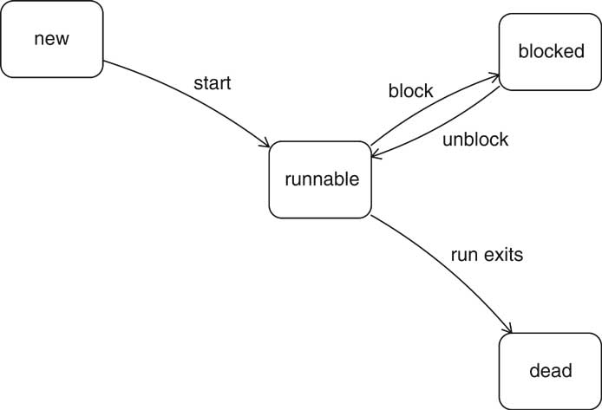
Thread Basics……
2. Thread States :
New
Runnable
Blocked
Dead

Slide 4
How To Create a Thread
Two Ways of Creating a Thread
1. By Extending a Thread class
2. By Implementing a Runnable interface

Slide 5
Thread Class In Java
Defined in java.lang package
Constructors :
1. Thread()
2. Thread(String name)
3. Thread(Runnable r)
4. Thread(Runnable r, String name)
Important Methods : (Next Slide)

Slide 6
    public string getName() → returns name of the thread
    public int getPriority() →returns priority of the thread
    public Boolean isAlive() → checks if thread is alive or not
    public void run() → entry point for the thread
    static void sleep(long millis) → causes the current thread to sleep for mentioned no of milliseconds
    6. static void sleep(long millis, long nano)
    7. public void start() → to start a thread
    8. public stop() → to stop a thread (deprecated method)
    9. interrupt() → interrupt a thread
    10. boolean isInterrupted() → checks whether the thread is
    interrupted or not.

Slide 7
Runnable interface
public interface Runnable
{
public void run();
}

Slide 8
Various Method of Thread Class
class MainThread {
public static void main(String[] args) {
long id = Thread.currentThread().getId();
String name = Thread.currentThread().getName();
int priority = Thread.currentThread().getPriority();
Thread.State state = Thread.currentThread().getState();
String threadGroupName = Thread.currentThread().getThreadGroup().getName();
System.out.println("id="+id+"; name="+name+"; priority="+priority);
System.out.println("state="+state+"; threadGroupName="+threadGroupName);
System.out.println(Thread.currentThread().isAlive());
} }
id=1; name=main; priority=5
state=RUNNABLE; threadGroupName=main
true

Slide 9
Sleep Method
static void sleep(long millis)
static void sleep(long millis, int nanos)
Throws Interrupt exception

Slide 10
Main Thread
class thread1
{
public static void main(String args[])
{ for(int i=0;i<5;i++)
{ try
{
Thread.sleep(1000);
System.out.println(i);
}
catch(InterruptedException e)
{}
System.out.println();
}
Thread t = new Thread();
System.out.println(t.getPriority());
System.out.println(t.isAlive());
System.out.println(t.isInterrupted());
}
}
Output:-
0
1
2
3
4
Priority 5
Alive=false
Interrupted= false
Notes:
Why thread is alive is false. Because we have created thread but not started.

Slide 11
To create a new thread either
Your class should extend Thread class OR
Your class should implement Runnable interface
class MyThread extends Thread
{
public void run()
{
…………
…………
}
}
class MyThread implements Runnable
{
public void run()
{
…………
…………
}
}

Slide 12
Using Thread class
class thread2 extends Thread
{ int k;
public void run()
{ for(int i=0;i<5;i++)
System.out.println(this.getName()+" " +k++);
}
public static void main(String args[])
{ thread2 obj1 = new thread2();
thread2 obj2 = new thread2();
obj1.start();
obj2.start();
}
}
Notes:
Here obj1 and obj2 are type of thread class.

Slide 13
Output
Sample Output:
Thread-0 0
Thread-1 0
Thread-0 1
Thread-1 1
Thread-1 2
Thread-1 3
Thread-1 4
Thread-0 2
Thread-0 3
Thread-0 4
Notes:
Here output cannot be predicate. Because of thread scheduling

Slide 14
class ThreadTest implements Runnable
{
Thread t;
ThreadTest(String t1)
{
t= new Thread(this);
t.start();
//System.out.println(t.getState() + " " + t.getName());
}
public void run()
{
for(int i=0;i<2;i++)
System.out.println(t.getState() + " " + t.getName());
} // end of run
public static void main(String args[])
{
ThreadTest obj = new ThreadTest("Test");
for(int i=0;i<2;i++)
System.out.println(Thread.currentThread().getState() + " " + Thread.currentThread().getName());
}
}
Notes:
Here, we are not using sleep. Output depends on thread scheduling policy. Thread considers the following aspect for scheduling
Priority of thread
2. Waiting time of thread
3. Nature of thread(daemon thread)
We can not determine which thread will get chance because it also depends on operating system scheduling. That is generally round robin scheduling.

Slide 15
Using Runnable interface
class thread3 implements Runnable
{ int k;
Thread t;
String name;
thread3(String s)
{
t= new Thread(this); // passing the reference of runnable
name=s;
t.start();
}
public void run()
{
for(int i=0;i<5;i++)
System.out.println(this.name+" " +k++);
}
public static void main(String args[])
{
thread3 obj = new thread3("th1");
thread3 obj1 = new thread3("th2");
for(int i=0;i<5;i++)
{
System.out.println("Main"+i);
} //thread3 obj2 = new thread3("ss2");
} }
Notes:
If you are not extending the Thread class, your class object would not be treated as a thread object. So you need to explicitly create Thread class object. We are passing the object of your class that implements Runnable so that your class run() method may execute.

Slide 16
Sample output:
th1 0
th1 1
th1 2
Main0
th1 3
Main1
Main2
th2 0
Main3
th1 4
Main4

Slide 17
Which is better ??
Thread or runnable
Notes:
We extends the class on Runnable is better because our class can extends the other class and implement as many interface as required.

Slide 18
Example
class TH1 extends Thread
{
public void run()
{
try
{
for(int i=101;i<120;i=i+2)
{
System.out.println(i+"By Thread TH1");
Thread.sleep(10);
}
}// End of try
catch(InterruptedException e){}
}// End of run
} //end of TH1
Thread printing Three digit
Odd Numbers

Slide 19
class TH2 extends Thread
{
public void run()
{
int i,j;
try
{
for(i=100;i<=120;i++)
{
for(j=2;j<i/2;j++)
{
if(i % j != 0) continue;
else
break;
}
if( j >= i/2)
{
System.out.println(i+"By Thread TH2");
Thread.sleep(100);
}
} // end of for
}// end of try
catch(InterruptedException e){}
}// End of run
} //end of TH1
Thread printing Three Digit
prime Numbers

Slide 20
class THtest
{
public static void main(String args[])
{
Thread t1 = new TH1();
Thread t2 = new TH1();
Thread t3 = new TH2();
Thread t4 = new TH2();
t1.start();
t4.start();
System.out.println(“Main Method Exited”);
}
}

Slide 21
Sample output
101By Thread TH1
Main Method Exited
101By Thread TH2
103By Thread TH1
105By Thread TH1
107By Thread TH1
109By Thread TH1
111By Thread TH1
113By Thread TH1
115By Thread TH1
117By Thread TH1
119By Thread TH1
103By Thread TH2
107By Thread TH2
109By Thread TH2
113By Thread TH2
Notes:
Here main method existed before the child thread. In order to prevent this we can use join method.

Slide 22
Join methods
void join()
void Join(ms)
This method waits for child thread to die. ( a thread for which it's been called ).
It is useful to manage co-related / inter-dependant tasks and functionalities implementation with multiple threads.
Notes:
If we wish a thread should wait for the termination of other thread then join method is used. Join method wait for child thread.
Yield can only make a thread from Running State to Runnable State, not in wait or blocked state.
Sleep can only make a thread from running state to wait state not runnable state.
Join make a thread from running to wait state until the other thread wake up.
When we create a Thread in java, by default it’s a user thread and if it’s running JVM will not terminate the program. When a thread is marked as daemon thread, JVM doesn’t wait it to finish and as soon as all the user threads are finished, it terminates the program as well as all the associated daemon threads.
Wait vs Sleep vs Yield in Java
Difference between Wait and Sleep in Java
Main difference between wait and sleep is that wait() method release the acquired monitor when thread is waiting while Thread.sleep() method keeps the lock or monitor even if thread is waiting. Also wait method in java should be called from synchronized method or block while there is no such requirement for sleep() method. Another difference is Thread.sleep() method is a static method and applies on current thread, while wait() is an instance specific method and only got wake up if some other thread calls notify method on same object. also in case of sleep, sleeping thread immediately goes to Runnable state after waking up while in case of wait, waiting thread first acquires the lock and then goes into Runnable state. So based upon your need if you require a specified second of pause use sleep() method or if you want to implement inter-thread communication use wait method.
here is list of difference between wait and sleep in Java :
1) wait is called from synchronized context only while sleep can be called without synchronized block. see Why wait and notify needs to call from synchronized method for more detail.
2) wait is called on Object while sleep is called on Thread. see Why wait and notify are defined in object class instead of Thread.
3) waiting thread can be awake by calling notify and notifyAll while sleeping thread can not be awaken by calling notify method.
4) wait is normally done on condition, Thread wait until a condition is true while sleep is just to put your thread on sleep.
5) wait release lock on object while waiting while sleep doesn’t release lock while waiting.
Difference between yield and sleep in java
Major difference between yield and sleep in Java is that yield() method pauses the currently executing thread temporarily for giving a chance to the remaining waiting threads of the same priority to execute. If there is no waiting thread or all the waiting threads have a lower priority then the same thread will continue its execution. The yielded thread when it will get the chance for execution is decided by the thread scheduler whose behavior is vendor dependent. Yield method doesn’t guarantee that current thread will pause or stop but it guarantee that CPU will be relinquish by current Thread as a result of call to Thread.yield() method in java.
Sleep method in Java has two variants one which takes millisecond as sleeping time while other which takes both mill and nano second for sleeping duration.
Read more: http://javarevisited.blogspot.com/2011/12/difference-between-wait-sleep-yield.html#ixzz3pawdSg36

Slide 23
Join method
class TestJoinMethod1 extends Thread{
public void run(){
for(int i=1;i<=5;i++){
try{
Thread.sleep(500);
}catch(Exception e){System.out.println(e);}
System.out.println(this.getName()+ “ ” +i);
}
}
public static void main(String args[]){
TestJoinMethod1 t1=new TestJoinMethod1();
TestJoinMethod1 t2=new TestJoinMethod1();
TestJoinMethod1 t3=new TestJoinMethod1();
System.out.println("Thread 1 is started");
t1.start();
try{
t1.join();
}catch(Exception e){System.out.println(e);}
System.out.println("Thread 2 is started");
t2.start();
System.out.println("Thread 3 is started");
t3.start();
System.out.println(“Main thread is existed”);
}
}
Notes:
Here main thread that is parent thread wait for child thread t1. wait for it completeness.

Slide 24
Join method
Thread 1 is started
Thread-0 1
Thread-0 2
Thread-0 3
Thread-0 4
Thread-0 5
Thread 2 is started
Thread 3 is started
Main thread is existed
Thread-2 1
Thread-1 1
Thread-2 2
Thread-1 2
Thread-2 3
Thread-1 3
Thread-2 4
Thread-1 4
Thread-2 5
Thread-1 5
Notes:
As you can see in the above example,when t1 completes its task then t2 and t3 starts executing.

Slide 25
Join Example
class TestJoinMethod2 extends Thread{
public void run(){
for(int i=1;i<=5;i++){
try{
Thread.sleep(500);
}catch(Exception e){System.out.println(e);}
System.out.println(this.getName()+ " " + i);
}
}
public static void main(String args[]){
TestJoinMethod2 t1=new TestJoinMethod2();
TestJoinMethod2 t2=new TestJoinMethod2();
TestJoinMethod2 t3=new TestJoinMethod2();
t1.start();
try{
t1.join(1500);
}catch(Exception e){System.out.println(e);}
t2.start();
t3.start();
}
}
Thread-0 1
Thread-0 2
Thread-0 3
Thread-1 1
Thread-0 4
Thread-2 1
Thread-1 2
Thread-2 2
Thread-0 5
Thread-1 3
Thread-2 3
Thread-1 4
Thread-2 4
Thread-1 5
Thread-2 5
Notes:
In the above example main thread wait for specified time period. If time period is exceed then main thread will start and will not wait for termination of child thread.
For example if I write Thread.sleep(1500). What will be output can predicate.
In the above example,when t1 is completes its task for 1500 miliseconds(3 times) then t2 and t3 starts executing.

Slide 26
Daemon Method
public void setDaemon(boolean status)
//is used to mark the current thread as daemon thread or user thread.
public boolean isDaemon()
//is used to check that current is daemon.

Slide 27
Demon Example
class JavaDaemonThread {
public static void main(String[] args) throws InterruptedException {
Thread dt = new Thread(new DaemonThread(), "dt");
dt.setDaemon(true);
dt.start();
Thread.sleep(30000);
System.out.println("Finishing program"); } }
class DaemonThread implements Runnable
{
public void run() {
while(true){ processSomething(); } }
private void processSomething() {
try {
System.out.println("Processing daemon thread");
Thread.sleep(5000);
}
catch (InterruptedException e) {
e.printStackTrace() } } }

Slide 28
Yield Method
static void Yield()
This method causes the currently executing thread object to temporarily pause and allow other threads to execute. It does not guaranteed to have any effect at all.

Slide 29
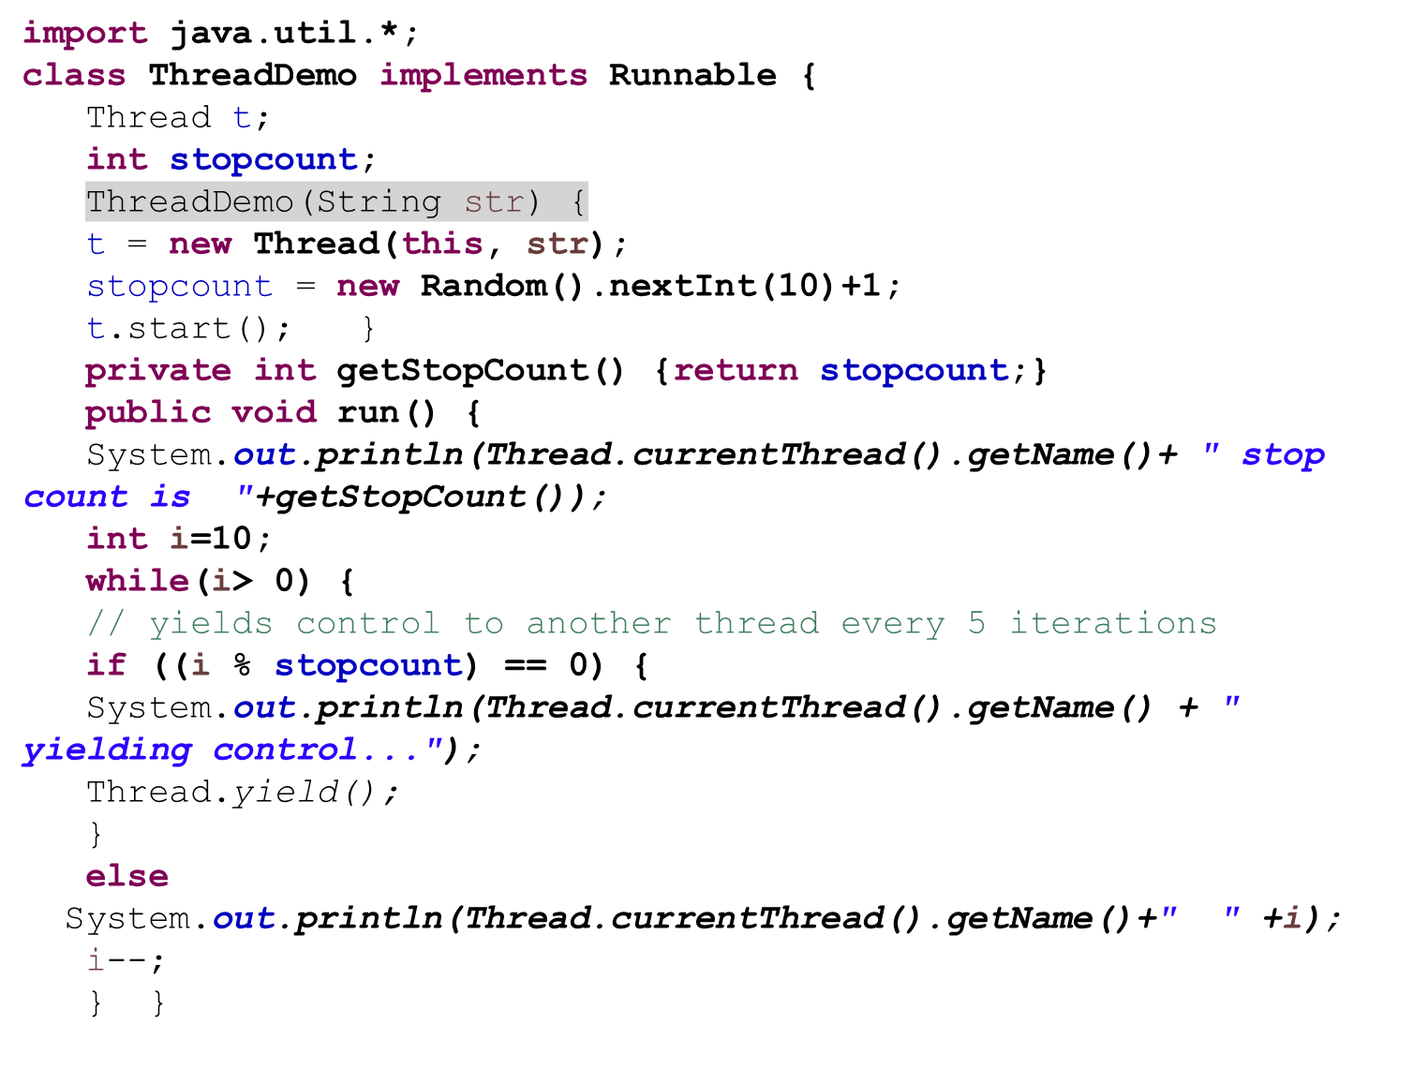

Slide 30
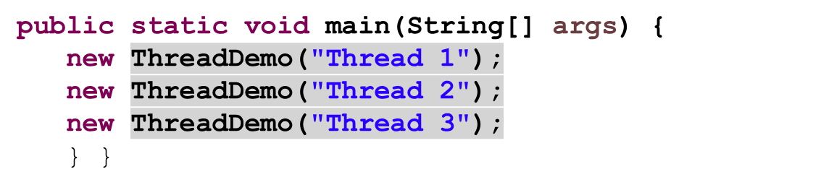

Slide 31
Synchronization
Process for sharing shared resources
Key for synchronization is monitor or semaphore.
Monitor is an object that is used as mutually exclusive lock
Only one thread can own a monitor at a given time.
Acquiring a lock or monitor is said to have entered the monitor.
All other threads attempting to acquire the lock or enter the monitor are blocked.
Java implements synchronization thru
Synchronized methods (Object Locks)
Synchronize Statement

Slide 32
Corrupting a Shared Data Structure
Threads share access to common objects and hence can conflict with each other and corrupt data structure.
Race Condition may occur
“Race Condition occurs if the effect of multiple threads on shared data depends on the order in which threads are scheduled.”

Slide 33
Synchronized Method Example
public void run()
{
target.call(msg);
}
}
class callMe
{
Synchronized public void call(String msg)
{ System.out.println("[" + msg);
try{
Thread.sleep(1000);
}
catch(Exception e) {}
System.out.println("]");
}
}
class caller implements Runnable
{ String msg;
callMe target; //shared object
Thread th;
caller(String s, callMe t)
{ msg=s;
target=t;
th = new Thread();
th.start();
}
class Sync
{
public static void main(String args[])
{ callMe obj = new callMe();
caller th1 = new caller("one",obj);
caller th2 = new caller("two",obj);
caller th3 = new caller("three",obj);
System.out.println(“main Thread”);
}
}

Slide 34
Synchronized Block Example
public void run()
{ synchronized(target)
target.call(msg);
}
}
class callMe
{
public void call(String msg)
{ System.out.println("[" + msg);
try{
Thread.sleep(1000);
}
catch(Exception e) {}
System.out.println("]");
}
}
class caller implements Runnable
{ String msg;
callMe target;
Thread th;
caller(String s, callMe t)
{ msg=s;
target=t;
th = new Thread();
th.start();
}
class Sync
{
public static void main(String args[])
{ callMe obj = new callMe();
caller th1 = new caller("one",obj);
caller th2 = new caller("two",obj);
caller th3 = new caller("three",obj);
System.out.println(“main Thread”);
}
}
Notes:
.

Slide 35
Synchronized method using Annonymous class
Thread t2=new Thread(){
public void run(){
obj.printTable(100);
}
};
t1.start();
t2.start();
}
}
class Table{
synchronized void printTable(int n){
//synchronized method
for(int i=1;i<=5;i++){
System.out.println(n*i);
try{
Thread.sleep(400);
}catch(Exception e){System.out.println(e);}
}
}
}
class TestSynchronization3{
public static void main(String args[]){
final Table obj = new Table();//only one object
Thread t1=new Thread(){
public void run(){
obj.printTable(5);
}
};

Slide 36
Single buffer Producer Consumer

Slide 37
class Q
{
int n;
synchronized int get()
{
return n;
}
synchronized void put(int n)
{
this.n=n;
}
} // end of class Q
class producer implements Runnable
{ Q q;
Thread t;
producer(String name, Q q)
{
this.q = q;
t= new Thread(this,name);
t.start();
}
public void run()
{
int i=0;
while(i<10)
{
q.put(i++);
System.out.println("producer " + i);
}
} // end of run
} // end of producer

Slide 38
class consumer implements Runnable
{
Q q;
Thread t;
consumer(String name, Q q)
{
this.q = q;
t= new Thread(this,name);
t.start();
}
public void run()
{
int i=0;
while(i<9)
{
i= q.get();
System.out.println("consumer "+ i);
}
} // end of run
} // end of consumer
class PandC
{
public static void main(String args[])
{
Q q= new Q();
producer p = new producer("producer",q);
consumer c= new consumer("consumer",q);
//try{
// p.t.join();
// c.t.join();
// }
// catch(InterruptedException e){}
System.out.println(Thread.currentThread().getName());
}
}

Slide 39
Output
producer 1
producer 2
producer 3
producer 4
producer 5
producer 6
producer 7
producer 8
producer 9
producer 10
main
consumer 5
consumer 9

Slide 40
Single buffer Using Thread Sleep

Slide 41
class Q
{ int n;
synchronized int get()
{
try
{
Thread.sleep(1000);
}
catch(InterruptedException e) {}
return n;
}
synchronized void put(int n)
{
this.n=n;
try
{
Thread.sleep(1000);
}
catch(InterruptedException e){}
}
} // end of class Q
class producer implements Runnable
{ Q q;
Thread t;
producer(String name, Q q)
{ this.q = q;
t= new Thread(this,name);
t.start();
}
public void run()
{ int i=0;
while(i<10)
{ q.put(i);
System.out.println(this.getName() +” “+ i);
i++;
}
}
}
Notes:
On execution of sleep method, It makes the thread to wait / halt for specified milli-seconds by keeping the hold of monitor / lock of the shared object.

Slide 42
class consumer implements Runnable
{ Q q;
Thread t;
consumer(String name, Q q)
{ this.q = q;
t= new Thread(this,name);
t.start();
}
public void run()
{ int i=0;
while(i<9)
{
i= q.get();
System.out.println("consumer "+ i);
}
}
} // end of consumer
class PandC
{
public static void main(String args[])
{Q q= new Q();
producer p1 = new producer("producer-1",q);
//producer p2 = new producer("producer-2",q);
consumer c= new consumer("consumer",q);
}
}

Slide 43
Single producer
producer 0
consumer 0
producer 1
consumer 1
producer 2
consumer 2
producer 3
consumer 3
producer 4
consumer 4
producer 5
consumer 5
producer 6
consumer 6
producer 7
consumer 7
producer 8
consumer 8
producer 9
consumer 9
Notes:
Due to sleep it prints alternatively.

Slide 44
Two Producers
producer-1 0
consumer 0
producer-2 0
consumer 0
producer-1 1
consumer 1
producer-2 1
consumer 1
producer-1 2
consumer 2
producer-2 2
consumer 2
producer-1 3
consumer 3
producer-2 3
producer-2 4
consumer 4
producer-1 4
consumer 4
producer-2 5
producer-2 6
consumer 6
producer-1 5
consumer 5
producer-2 7
consumer 7
producer-1 6
consumer 6
producer-2 8
consumer 8
producer-1 7
consumer 7
producer-2 9
consumer 9
producer-1 8
producer-1 9
Notes:
Producer will overwrite if it gets the cpu and consumer will not get chance.

Slide 45
Inter Thread Communication/
Co-operation
Three methods used for inter Thread communication and co-operation
final void wait() throws InterruptedException
final void notify();
final void notifyAll();
A. wait()
Tells the calling thread to give up monitor/lock and go to sleep until some other thread calls notify.
B. Notify()
Wakes up the thread that call called wait() on the same object. Calling object does not live the lock. It lives the lock after completion of synchronized block/ method. Thus it is called notify and continue.
C. notifyAll()
Wakes up the all the threads that call called wait() on the same object. One of the threads will be granted the access.

Slide 46
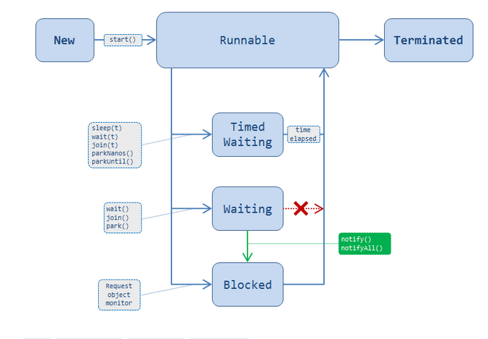

Inter Thread Communication/
Co-operation
Notes:
http://stackoverflow.com/questions/28378592/java-thread-state-transition-waiting-to-blocked-or-runnable

Slide 47
Single buffer Wait() & notify()

Slide 48
class Q
{
int n;
boolean valueset=false;
synchronized int get()
{
try{
while(valueset==false) // busy waiting
wait(); // leave the lock
}
catch(InterruptedException e) {}
valueset=false;
notify();
// it will not leave the lock but inform the other thread
// other thread will join the waiting queue
return n;
}
synchronized void put(int n)
{
try
{
while(valueset == true) // busy waiting
wait(); // leave the lock
this.n=n;
valueset=true;
notify();
}
catch(InterruptedException e){}
}
} // end of class Q
class producer implements Runnable
{
int n;
Q q;
Thread t;
producer(String name, Q q,int n)
{
this.n=n;
this.q = q;
t= new Thread(this,name);
t.start();
}
public void run()
{
while(true)
{
q.put(n);
System.out.println(t.getName() + " "+ n);
n++;
}
}
}
Notes:
Busy waiting means once thread get notify it will again start from while. To remove this we can use if statement

Slide 49
class consumer implements Runnable
{
Q q;
Thread t;
consumer(String name, Q q)
{
this.q = q;
t= new Thread(this,name);
t.start();
}
public void run()
{
while(true)
{
i= q.get();
System.out.println(t.getName()+" "+ i);
}
}
} // end of consumer
class PandC
{
public static void main(String args[])
{
Q q= new Q();
producer p1 = new producer("producer-1",q,100);
consumer c= new consumer("consumer",q);
}
}

Slide 50
Sample Output
producer-1 100
producer-1 101
consumer 100
consumer 101
producer-1 102
consumer 102
Notes:
This output due to internal working of instruction in CPU.

Slide 51
Bounded Buffer

Slide 52
class BoundedQueue<E>
{
public BoundedQueue(int capacity)
{
elements = new Object[capacity];
head = 0;
tail = 0;
size = 0;
}
public synchronized E remove()
throws InterruptedException
{
while (size == 0) wait();
E r = (E) elements[head];
head++;
size--;
if (head == elements.length)
head = 0;
notifyAll();
return r;
}
public synchronized void add(E newValue)
throws InterruptedException
{
while (size == elements.length) wait();
elements[tail] = newValue;
tail++;
size++;
if (tail == elements.length)
tail = 0;
notifyAll();
}
private Object[] elements;
private int head;
private int tail;
private int size;
}

Slide 53
class Consumer implements Runnable
{
private BoundedQueue<String> queue;
private int greetingCount;
private static final int DELAY = 10;
public Consumer(BoundedQueue<String> aQueue, int count)
{
queue = aQueue;
greetingCount = count;
}
public void run()
{
try
{
int i = 1;
while (i <= greetingCount)
{
String greeting = queue.remove();
System.out.println(greeting);
i++;
Thread.sleep((int) (Math.random() * DELAY));
}
}
catch (InterruptedException exception)
{ } } // end of run
}

Slide 54
class Producer implements Runnable
{private String greeting;
private BoundedQueue<String> queue;
private int greetingCount;
private static final int DELAY = 10;
}
public Producer(String aGreeting, BoundedQueue<String> aQueue, int count)
{
greeting = aGreeting;
queue = aQueue;
greetingCount = count;
}
public void run()
{
try
{
int i = 1;
while (i <= greetingCount)
{
queue.add(i + ": " + greeting);
i++;
Thread.sleep((int) (Math.random() * DELAY));
} } // end of run
catch (InterruptedException exception)
{ } } // end of producer
Notes:
Why resume method is written in synchronized block. Because notify is written in synchronized block.

Slide 55
class ThreadTester
{
public static void main(String[] args)
{
BoundedQueue<String> queue = new BoundedQueue<String>(10);
final int GREETING_COUNT = 10;
Runnable run1 = new Producer("Hello, World!", queue, GREETING_COUNT);
Runnable run2 = new Producer("Goodbye, World!", queue, GREETING_COUNT);
Runnable run3 = new Consumer(queue, 2 * GREETING_COUNT);
Thread thread1 = new Thread(run1);
Thread thread2 = new Thread(run2);
Thread thread3 = new Thread(run3);
thread1.start();
thread2.start();
thread3.start();
}
}

Slide 56
Deadlock
When two threads have a circular dependence on a pair of synchronized objects.
Declaring methods synchronized ensures that threads executes them fully not partially. { Not Enough to ensure that program runs correctly}
Notes:
http://www.journaldev.com/1058/java-deadlock-example-and-how-to-analyze-deadlock-situation

Slide 57
class ThreadDeadlock {
public static void main(String[] args) throws InterruptedException {
Object obj1 = new Object();
Object obj2 = new Object();
Object obj3 = new Object();
Thread t1 = new Thread(new SyncThread(obj1, obj2), "t1");
Thread t2 = new Thread(new SyncThread(obj2, obj3), "t2");
Thread t3 = new Thread(new SyncThread(obj3, obj1), "t3");
t1.start();
Thread.sleep(5000);
t2.start();
Thread.sleep(5000);
t3.start();
}
}

Slide 58
class SyncThread implements Runnable{
private Object obj1;
private Object obj2;
public SyncThread(Object o1, Object o2)
{
this.obj1=o1;
this.obj2=o2;
}
public void run()
{
String name = Thread.currentThread().getName();
System.out.println(name + "acquiring lock on "+obj1);
synchronized (obj1) {
System.out.println(name + "acquired lock on "+obj1);
work();
System.out.println(name + " acquiring lock on "+obj2);
synchronized (obj2) {
System.out.println(name + " acquired lock on "+obj2);
work();
}
System.out.println(name + " released lock on " +obj2);
}
System.out.println(name + " released lock on " +obj1);
System.out.println(name + " finished execution.");
}
private void work() {
try
{
Thread.sleep(30000);
}
catch (InterruptedException e)
{
e.printStackTrace();
}
}
}
Notes:
Here we aquire a lock on object 1 and then tries to take lock on object. That is why dead lock. Inside a one synchronized block other synchronized block is written

Slide 59
t1acquiring lock on java.lang.Object@25d35bf2
t1acquired lock on java.lang.Object@25d35bf2
t2acquiring lock on java.lang.Object@28825459
t2acquired lock on java.lang.Object@28825459
t3acquiring lock on java.lang.Object@31602bbc
t3acquired lock on java.lang.Object@31602bbc
t1 acquiring lock on java.lang.Object@28825459
t2 acquiring lock on java.lang.Object@31602bbc
t3 acquiring lock on java.lang.Object@25d35bf2
Notes:
Here we aquire a lock on object 1 and then tries to take lock on object. That is why dead lock. Inside a one synchronized block other synchronized block is written

Slide 60
Solution of DeadLock
Avoid Nested Locks
Lock Only What is Required
Avoid waiting indefinitely
Notes:
http://www.journaldev.com/1058/java-deadlock-example-and-how-to-analyze-deadlock-situation.

Slide 61
public void run()
{
String name = Thread.currentThread().getName();
System.out.println(name + "acquiring lock on "+obj1);
synchronized (obj1)
{
System.out.println(name + "acquired lock on "+obj1);
work();
}
System.out.println(name + " acquiring lock on "+obj2);
synchronized (obj2)
{
System.out.println(name + " acquired lock on "+obj2);
work();
}
System.out.println(name + " released lock on " +obj2);
System.out.println(name + " released lock on " +obj1);
System.out.println(name + " finished execution.");
}
Notes:
Two synchronized blocks are independent. So no dead lock Although they execute serially in run method.

Slide 62
t1acquiring lock on java.lang.Object@25d35bf2
t1acquired lock on java.lang.Object@25d35bf2
t2acquiring lock on java.lang.Object@28825459
t2acquired lock on java.lang.Object@28825459
t3acquiring lock on java.lang.Object@31602bbc
t3acquired lock on java.lang.Object@31602bbc
t1 acquiring lock on java.lang.Object@28825459
t2 acquiring lock on java.lang.Object@31602bbc
t1 acquired lock on java.lang.Object@28825459
t2 acquired lock on java.lang.Object@31602bbc
t3 acquiring lock on java.lang.Object@25d35bf2
t3 acquired lock on java.lang.Object@25d35bf2
t1 released lock on java.lang.Object@28825459
t1 released lock on java.lang.Object@25d35bf2
t1 finished execution.
t2 released lock on java.lang.Object@31602bbc
t2 released lock on java.lang.Object@28825459
t2 finished execution.
t3 released lock on java.lang.Object@25d35bf2
t3 released lock on java.lang.Object@31602bbc
t3 finished execution.
BUILD SUCCESSFUL (total time: 1 minute 12 seconds)

