Slide 1

Backend Engineering-1(23CS006)
Registration Form
Lovisha, 2310990726
Sneha , 2310991296
Sarthak, 2310992521
Class Group: G25
Supervised by: Vikas Patel

Slide 2
Project Overview
Objective:
Create a user-friendly registration form to capture user data.
Develop backend functionality to securely transmit and store this data.
Key Components:
Frontend: User interface for data entry.
Backend: Server-side processing and storage of data.

Slide 3
Technology Stack
Frontend:
HTML
CSS
JavaScript
Backend:
Node.js
Tools:
Visual Studio Code

Slide 4
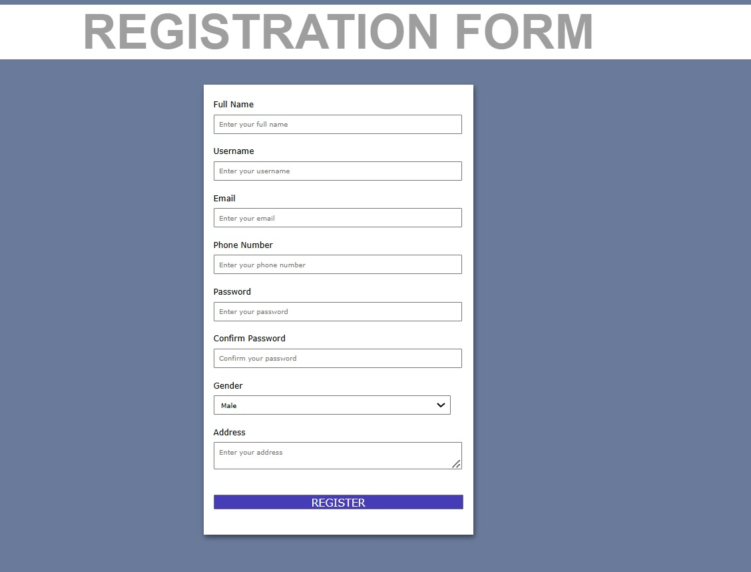
Technical Details
1. Frontend Design (HTML & CSS)
Create a registration form with HTML.
Style the form with CSS for a responsive and appealing design.

Slide 5
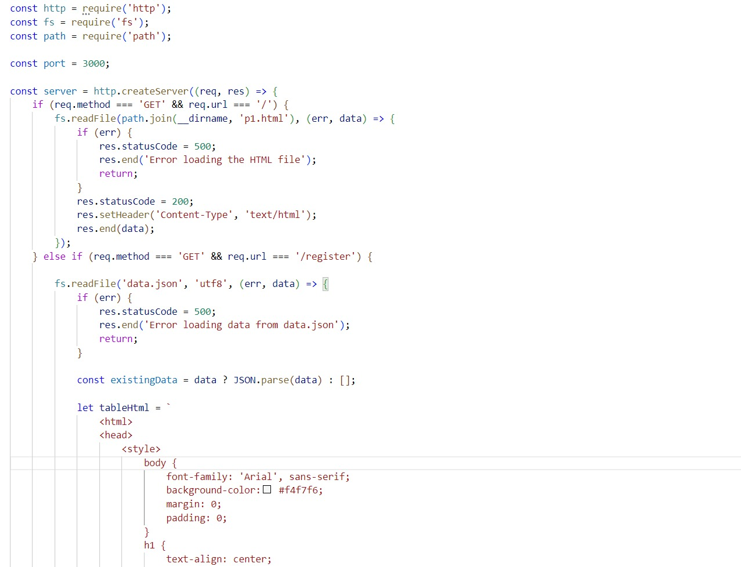
Technical Details
2. Backend Implementation (Node.js)
Set up a Node.js server.

Slide 6
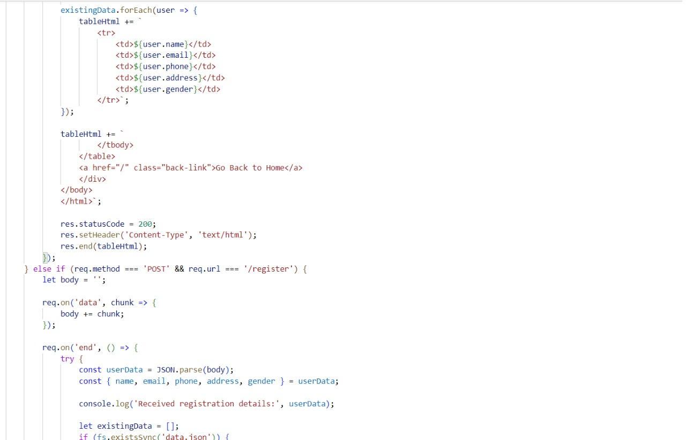

Slide 7
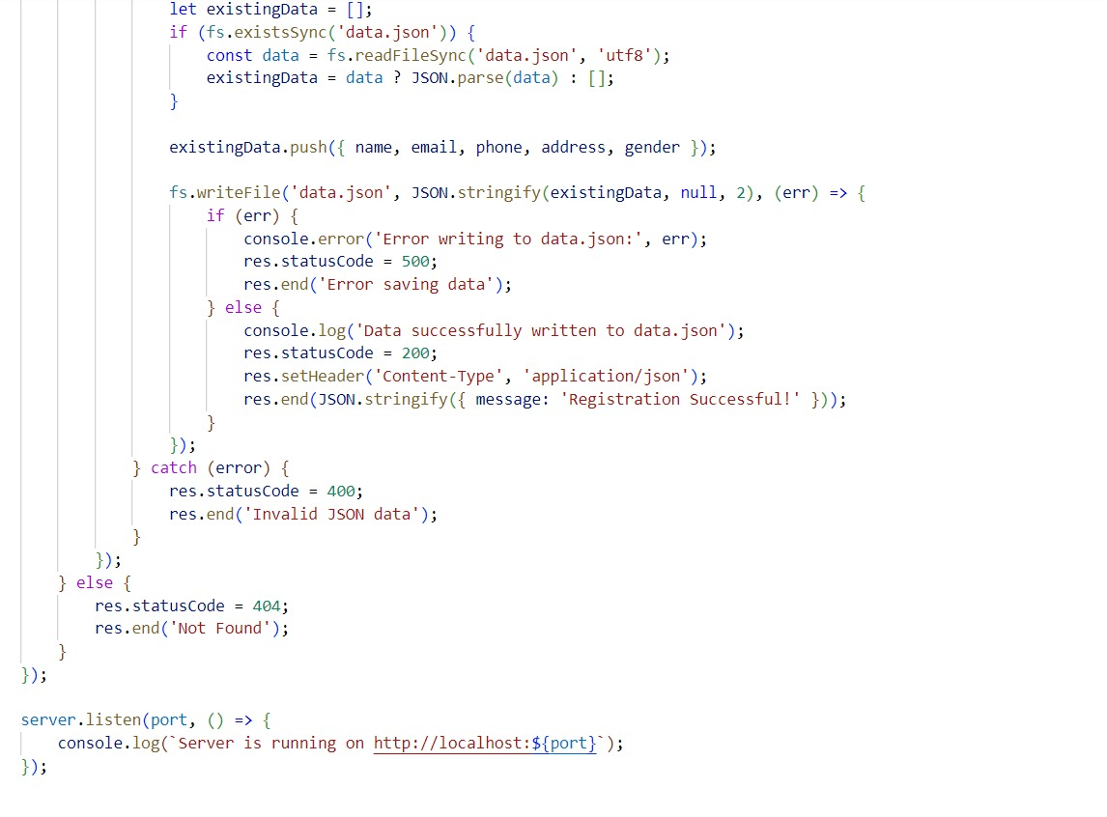

Slide 8
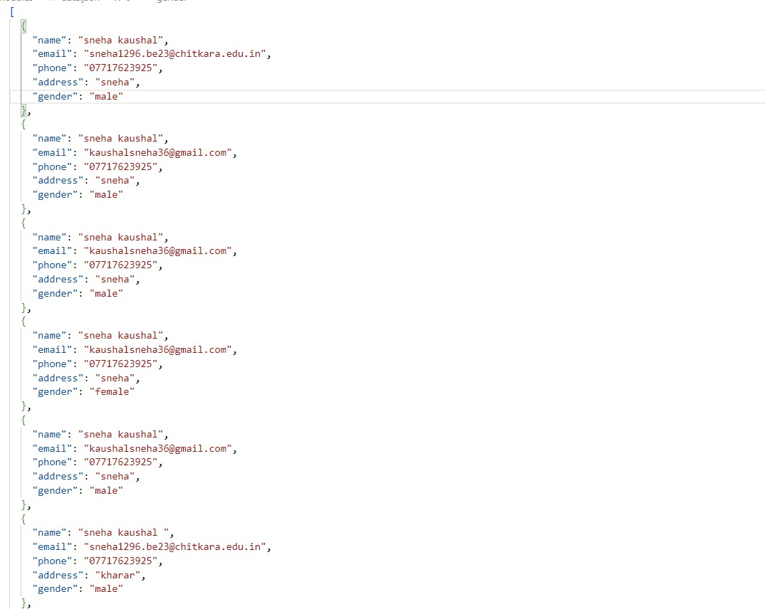
Technical Details
3 .Data.json
Data will be stored here

Slide 9
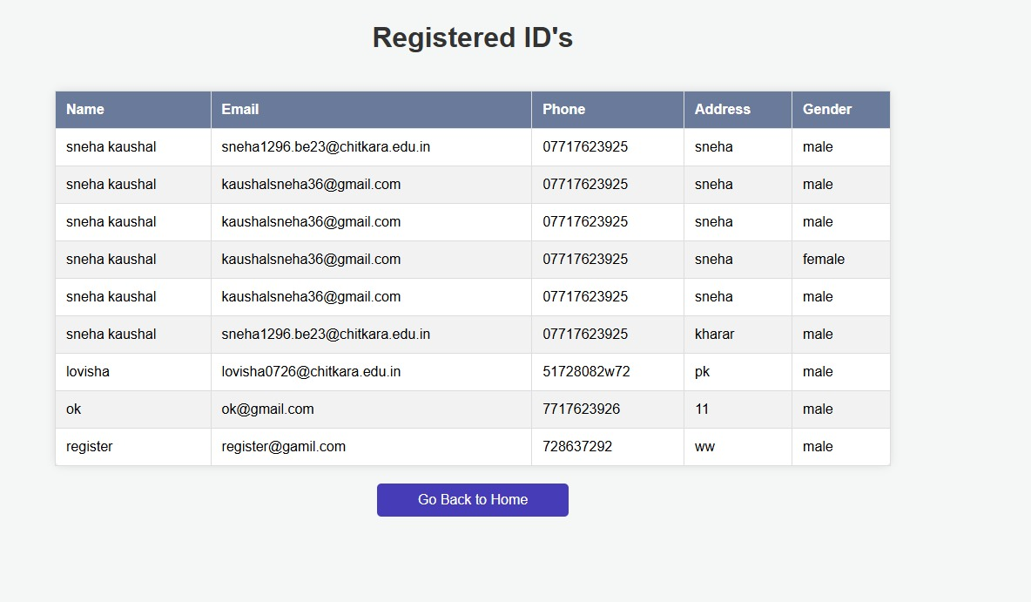
4. Routing

Slide 10
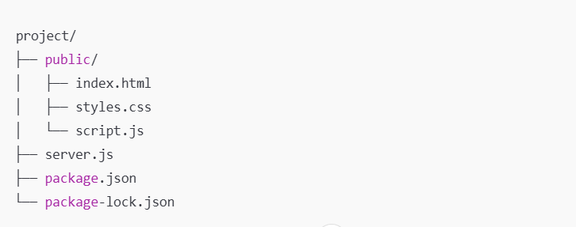
Technical Details
5. Directory Structure

Slide 11
Thank You

