Slide 1
CSIS 4495 002 Applied Research Project Ecotots
Submitted to – Prof. Padmapriya Arasanipalai Kandhadai
Submitted by – Lovish Dhanda
(300377652)
Gurkanwal Singh
(300375339)

Slide 2

agenda
About our Project
Feature overview
Live Demonstration

Slide 3

About OUR PROJECT
EcoTots: A Sustainable Clothing Exchange for Families
The Challenge Children outgrow clothes rapidly, leading to underused garments and recurring costs for families—especially those with limited finances. Meanwhile, gently used clothes often go to waste.
Our Mission Create a dedicated digital platform to simplify the exchange of children’s clothing—making it accessible, affordable, and sustainable.

Slide 4
About OUR PROJECT
Research Questions
How can we make reusing kids’ clothing practical for families?
Can a child-focused marketplace promote sustainable clothing habits?
Why It Matters
Tackles financial strain on parents, reduces textile waste
Fosters community support, promotes circular fashion

Slide 5
Feature overview
🛠 Technology Stack
Frontend: React.js – Dynamic, interactive UI
Backend: Node.js + Express.js – Handles server logic & APIs
Database: MongoDB – Flexible data management
Firebase: Image storage & Google sign-in
Chatbot: Ollama-powered keyword search assistant

Slide 6
Feature overview
🔑 Key Features
🔐 User Authentication (Buyers & Sellers)
📦 Product Listings with images & details
🔍 Search & Filters (by gender, price)
🤖 Chatbot Support for quick keyword searches
👤 Profile Management for personalized use
📧 Email-Based Communication between users
☁️ Secure Image Storage via Firebase

Slide 7
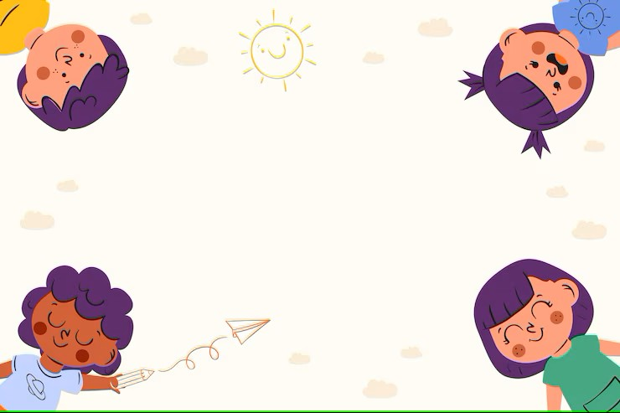
Live Demonstration

Slide 8

Thank you

