Slide 1
Image Preprocessing

Slide 2
INDEX
Introduction
Importance of Image Preprocessing
Common Image Preprocessing Techniques
Use Case
Conclusion

Slide 3
1.Introduction
Welcome to the world of image preprocessing! Ever wondered how photos become clearer or how facial recognition works?
Image pre-processing is an improvement of the image data that suppresses unwilling distortions or enhances some image features important for further processing
Image preprocessing is like giving the photos a makeover, making them look their best so that recognition works even better!
In this presentation, we'll explore the basics of image preprocessing – a magic touch that makes images look better and helps computers understand them more easily

Slide 4
2.Importance of Image Preprocessing
Clearer Vision: Image preprocessing helps computers "see" images more clearly by removing unwanted elements and enhancing important features.
Improved Understanding: It makes pictures easier for computers to understand, like making sure the lighting is just right before taking a photo.
Enhanced Accuracy: Preprocessing is like giving images a touch-up, ensuring that computer tasks such as facial recognition work with greater precision.
Noise Reduction: It acts as a noise-canceling filter, getting rid of unnecessary distractions in images.
Standardization: Like setting the stage for a photo shoot, preprocessing standardizes image quality, making it easier for computers to work consistently with different pictures.

Slide 5
3.Common Image Preprocessing Techniques
Lets see some of the Image preprocessing techniques
Image augmentation
Noise reduction

Slide 8
Noise reduction
Noise reduction is like clearing static from a radio signal, but for images. It's a process that cleans up unwanted 'noise' or disturbances, making pictures look smoother and more polished
In images, "noise" refers to random variations in brightness or color that don't represent the actual scene.
The goal of noise reduction is to clean up the image, making it clearer and more focused by smoothing out these unwanted irregularities.
This process is particularly important in improving the performance of computer vision algorithms and enhancing overall image quality.
Technique For Noise Reduction In Images
Blur filter
Gaussian Filter
Median Filter
Bilateral filter
The origial image

Slide 9
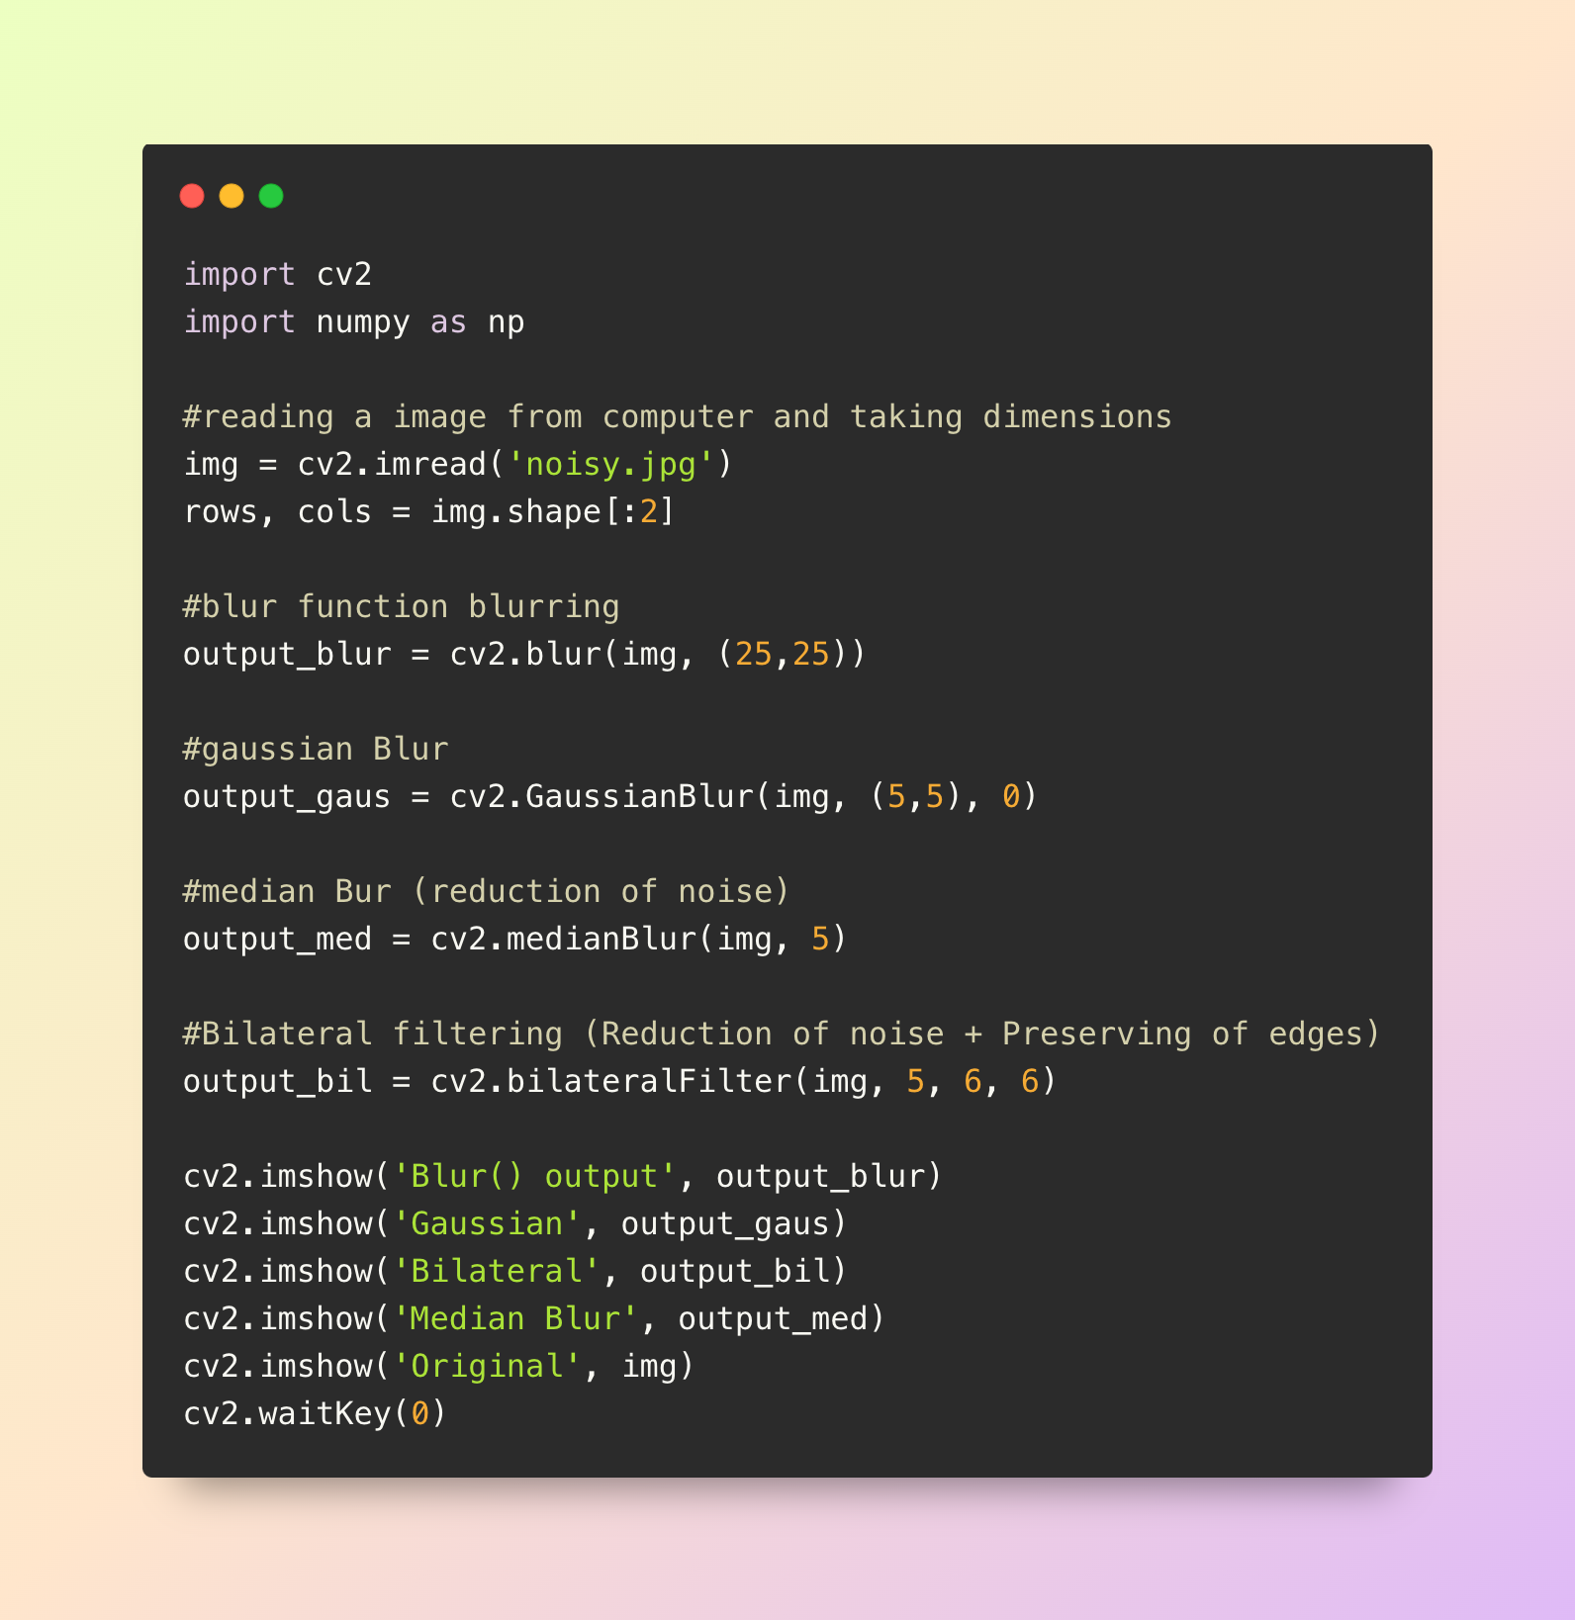
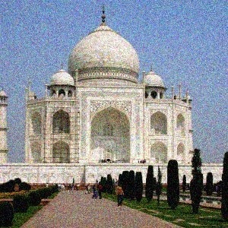
CODE
ORIGINAL IMAGE

Slide 10
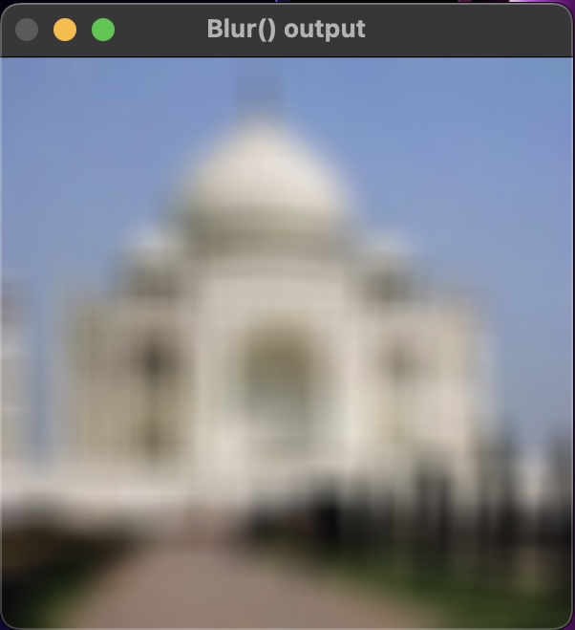
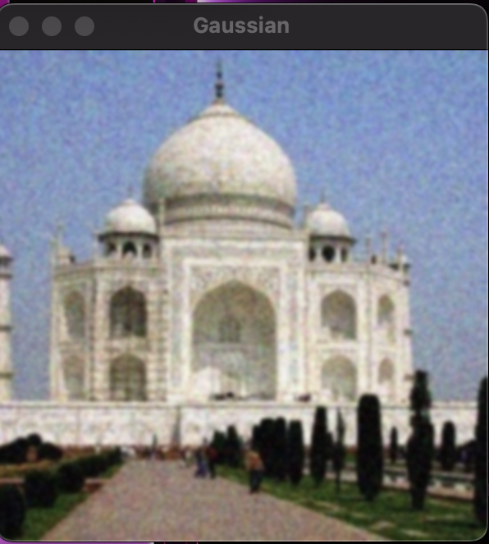
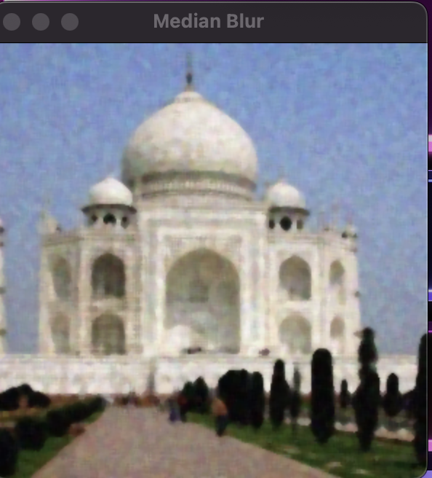
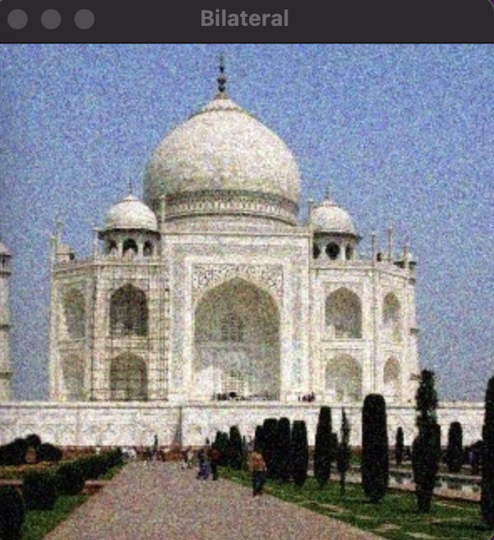
A blur filter, or simply a blur, is a technique used in image processing to reduce the level of detail in an image
Blur filter
Gaussian Filter
A Gaussian filter is like a gentle blur for images, smoothing out details and reducing noise to create a softer and more polished look
Median Filter
A median filter is like a smart cleaner for images, replacing each pixel's value with the middle value in its surroundings
Bilateral filter
A bilateral filter is like a smart blur that smoothens an image while preserving important edges and details, but is not better than Gaussian.

