Slide 1
Image Preprocessing

Slide 2
INDEX
Introduction
Importance of Image Preprocessing
Common Image Preprocessing Techniques
Use Case
Conclusion

Slide 3
1. Introduction
Welcome to the world of image preprocessing! Ever wondered how photos become clearer or how facial recognition works?
Image pre-processing is an improvement of the image data that suppresses unwilling distortions or enhances some image features important for further processing
Image preprocessing is like giving the photos a makeover, making them look their best so that recognition works even better!
In this presentation, we'll explore the basics of image preprocessing – a magic touch that makes images look better and helps computers understand them more easily

Slide 4
2. Importance of Image Preprocessing
Clearer Vision: Image preprocessing helps computers "see" images more clearly by removing unwanted elements and enhancing important features.
Improved Understanding: It makes pictures easier for computers to understand, like making sure the lighting is just right before taking a photo.
Enhanced Accuracy: Preprocessing is like giving images a touch-up, ensuring that computer tasks such as facial recognition work with greater precision.
Noise Reduction: It acts as a noise-canceling filter, getting rid of unnecessary distractions in images.
Standardization: Like setting the stage for a photo shoot, preprocessing standardizes image quality, making it easier for computers to work consistently with different pictures.

Slide 5
3. Common Image Preprocessing Techniques
Lets see some of the Image preprocessing techniques
Image augmentation
Noise reduction

Slide 6
Image augmentation
Image augmentation is a technique widely used in deep learning to artificially increase the diversity of the training dataset. It involves applying various transformations to the original images, creating new training samples with variations
The primary goals of image augmentation in the context of training machine learning models are:
Increased Dataset Size: By applying various transformations, you can artificially increase the size of your dataset, providing more diverse examples for the model to learn from.
Robustness: Augmentation helps improve the model's robustness by exposing it to variations in input data.
Invariance: Augmentation can introduce invariance to certain transformations, making the model less sensitive to changes in lighting, orientation, or other factors.
common image augmentation techniques:
Rotation: Randomly rotate the image by a certain degree.
Width and Height Shifts: Shift the image horizontally or vertically by a fraction of the total width or height.
Zoom: Zoom into or out of the image.
Horizontal and Vertical Flips: Can flip the image horizontally or vertically.
Shear: Apply shear transformation to the image.

Slide 7
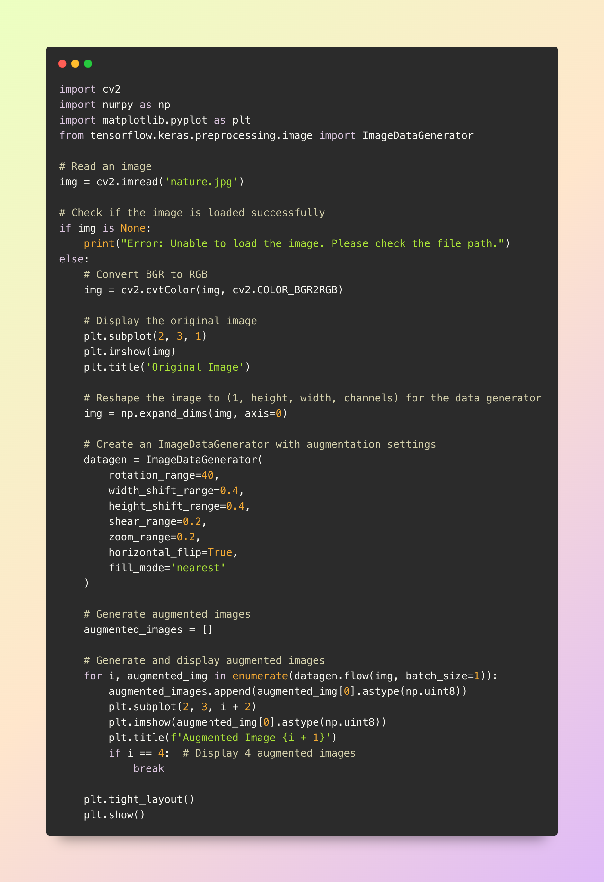

Code
Original image

Slide 8
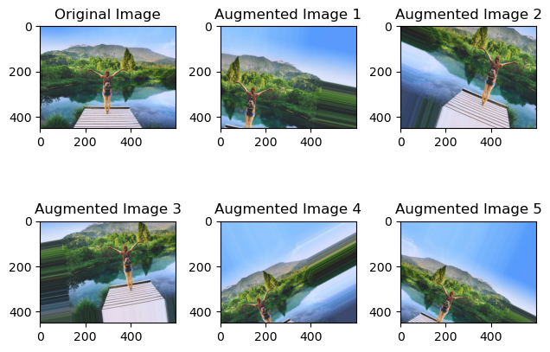
This is the augmented images

Slide 9
Noise reduction
Noise reduction is like clearing static from a radio signal, but for images. It's a process that cleans up unwanted 'noise' or disturbances, making pictures look smoother and more polished
In images, "noise" refers to random variations in brightness or color that don't represent the actual scene.
The goal of noise reduction is to clean up the image, making it clearer and more focused by smoothing out these unwanted irregularities.
This process is particularly important in improving the performance of computer vision algorithms and enhancing overall image quality.
Technique For Noise Reduction In Images
Blur filter
Gaussian Filter
Median Filter
Bilateral filter
The origial image

Slide 10
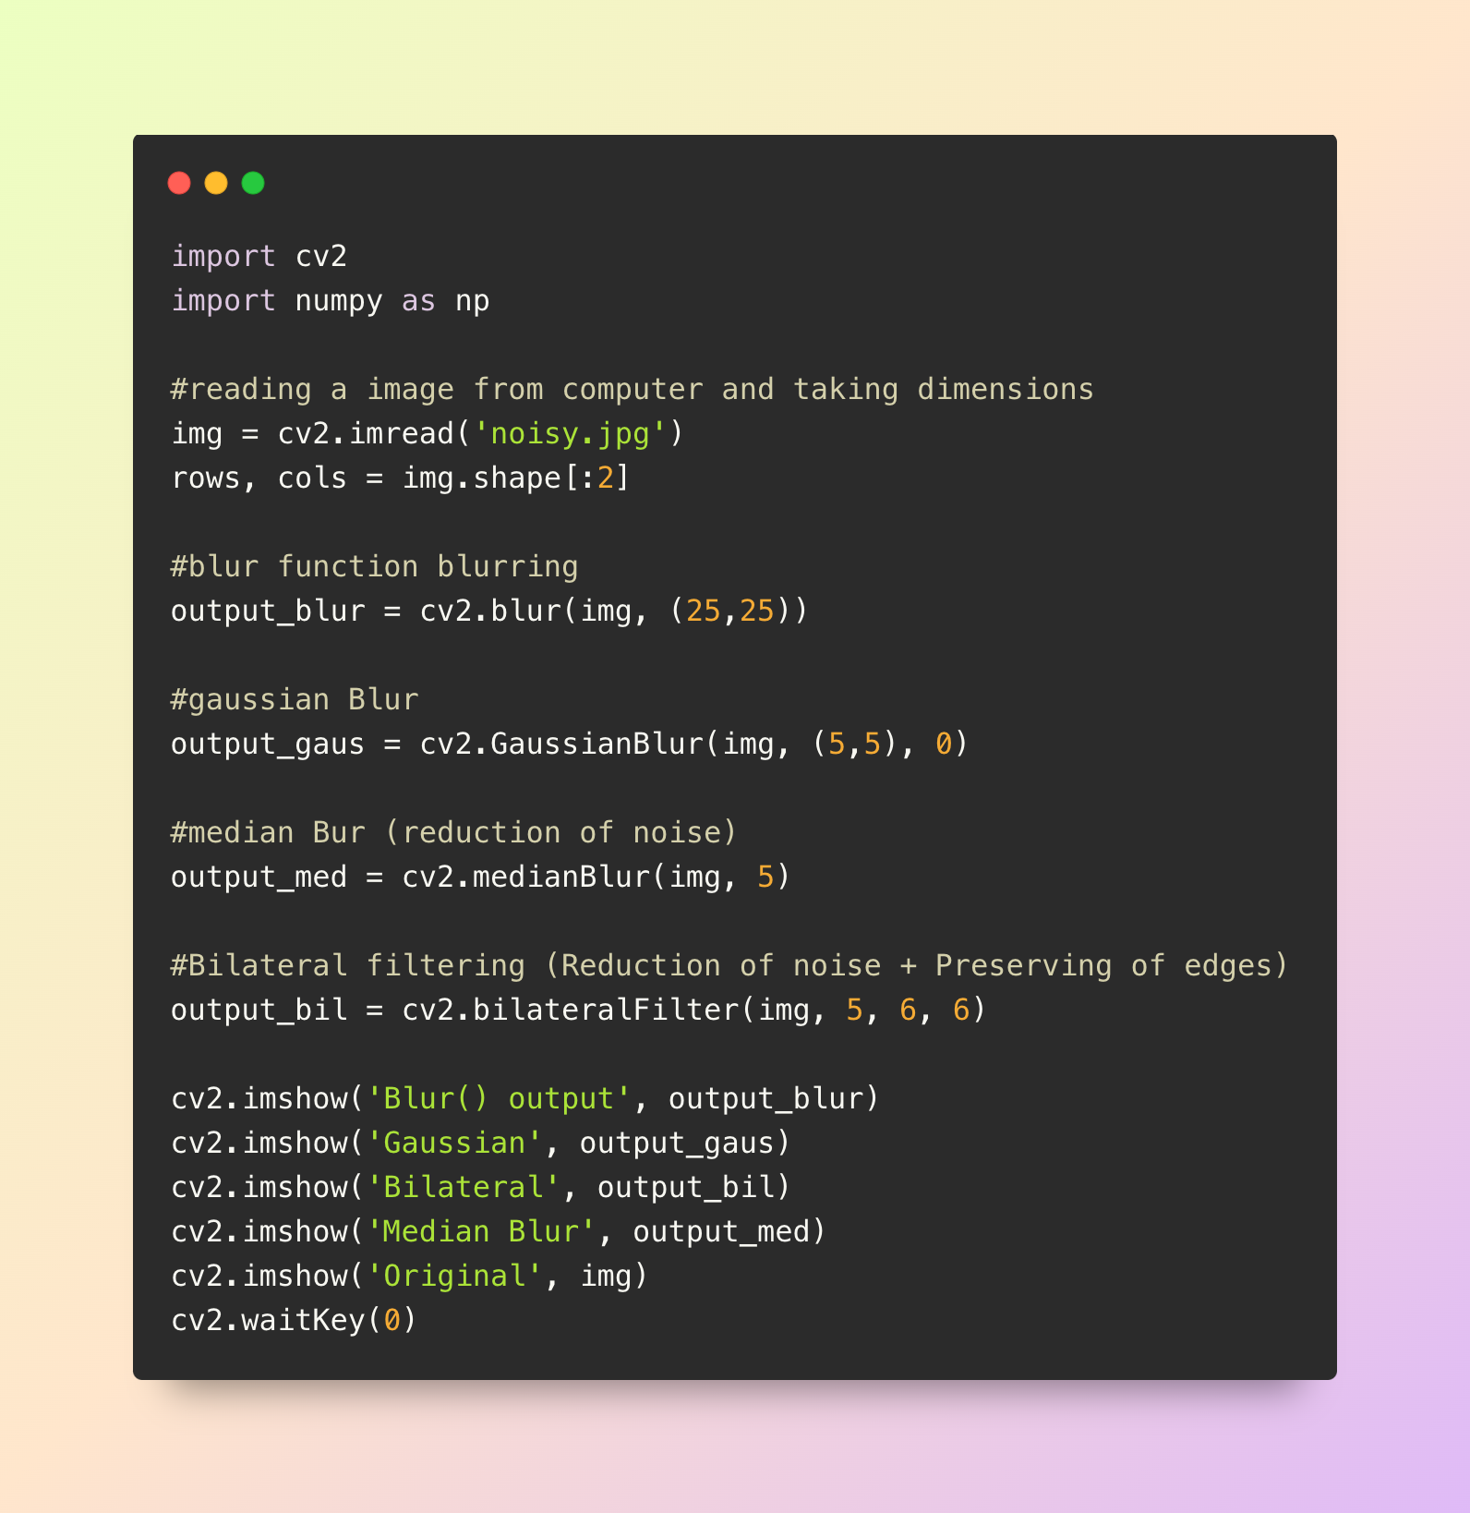
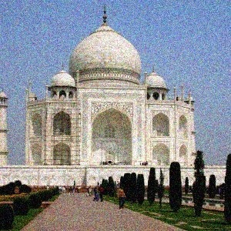
CODE
ORIGINAL IMAGE

Slide 11
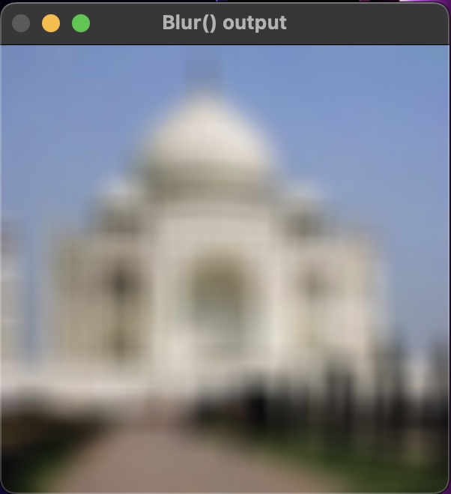
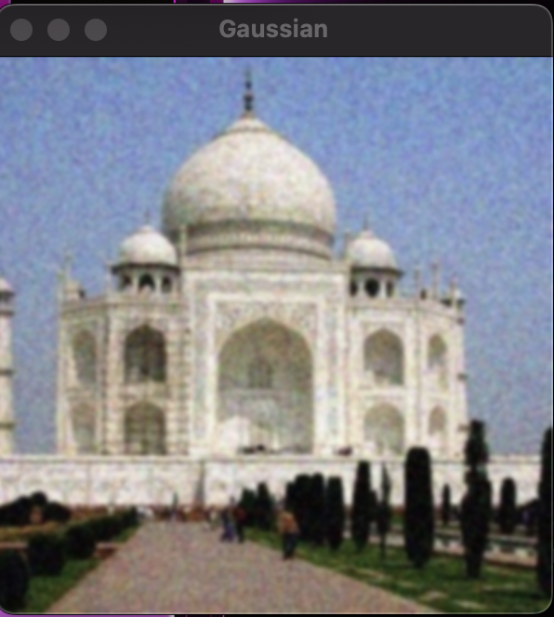
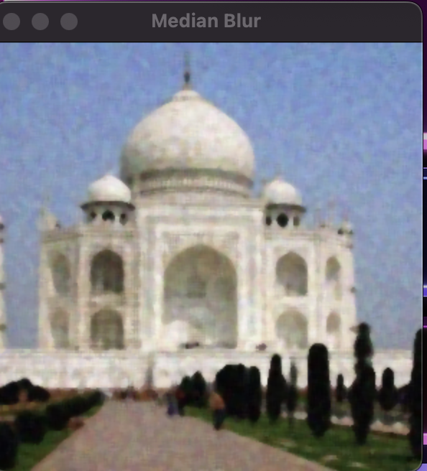
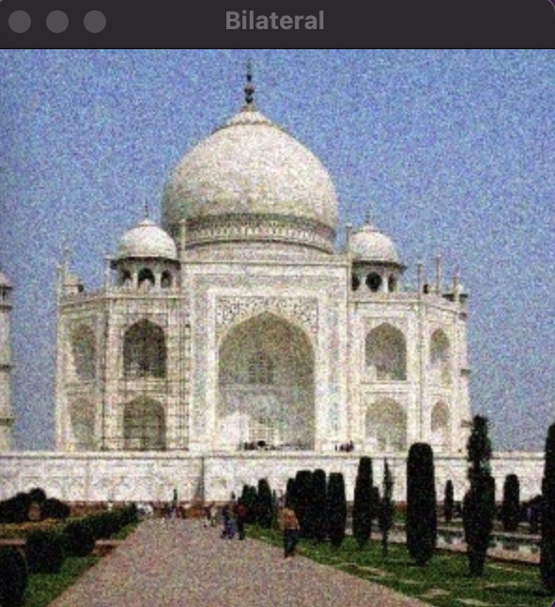
A blur filter, or simply a blur, is a technique used in image processing to reduce the level of detail in an image
Blur filter
Gaussian Filter
A Gaussian filter is like a gentle blur for images, smoothing out details and reducing noise to create a softer and more polished look
Median Filter
A median filter is like a smart cleaner for images, replacing each pixel's value with the middle value in its surroundings
Bilateral filter
A bilateral filter is like a smart blur that smoothens an image while preserving important edges and details, but is not better than Gaussian.

Slide 12
4. Use Cases
E-commerce Product Recognition:
Use Case: Preprocessing images of products to improve their quality and standardize appearance, enhancing the accuracy of product recognition systems for better cataloging and search functionalities.
Medical Imaging Diagnosis:
Use Case: Applying image preprocessing to medical scans to reduce noise and enhance critical details, aiding healthcare professionals in accurate diagnosis and improving the reliability of automated diagnostic systems.
Quality Control in Manufacturing:
Use Case: Employing image preprocessing techniques to enhance clarity and remove distortions in manufacturing inspection images, ensuring accurate quality control and minimizing errors in the production process.
Facial Recognition for Security:
Use Case: Enhancing facial images through preprocessing to improve the accuracy of facial recognition systems, increasing security in access control, surveillance, and identity verification applications.
Automated Document Processing:
Use Case: Preprocessing images of documents to optimize text extraction and improve character recognition, streamlining document digitization processes and increasing the efficiency of data entry and retrieval systems.

Slide 13
5. Conclusion
In conclusion, image preprocessing acts as the unsung hero in the world of visual data analysis. By employing various techniques to clean, enhance, and standardize images, we pave the way for more accurate and efficient performance in applications such as facial recognition, medical imaging, e-commerce, manufacturing, and document processing. It's the behind-the-scenes magic that transforms raw images into data-ready gems, opening doors to improved decision-making, enhanced automation, and a clearer vision of the visual world.

Slide 14
THANK YOU

