Slide 1
MRI Brain Tumor Image Classification
.

Slide 2
Abstract
Medical imaging plays a pivotal role in the early detection and diagnosis of brain tumors. Magnetic Resonance Imaging (MRI) is a widely used modality for capturing detailed images of the brain, enabling healthcare professionals to identify abnormalities. In this study, we propose a novel approach for the automated classification of brain tumor images obtained through MRI scans, utilizing state-of-the-art deep learning techniques.
Our methodology involves the development and training of a convolutional neural network (CNN) on a comprehensive dataset of labeled MRI brain tumor images. The CNN is designed to extract intricate features from the images, enabling the model to discern subtle patterns indicative of various tumor types. We employ transfer learning techniques to leverage pre-trained models and optimize the learning process with limited labeled medical data.

Slide 3
Abstract
To evaluate the performance of our proposed model, extensive experiments are conducted using a diverse set of MRI images from different sources and populations. The results demonstrate high accuracy, sensitivity, and specificity in classifying brain tumor images, showcasing the potential of our approach for reliable and efficient diagnosis.
The proposed automated classification system has the potential to significantly enhance the speed and accuracy of brain tumor diagnosis, aiding healthcare professionals in making timely and informed decisions. This research contributes to the ongoing efforts in leveraging advanced technologies for improving the effectiveness of medical image analysis in the field of neurology.

Slide 4
TABLE OF CONTENTS
Introduction
Motivation
Literature Review
Challenges and limitations in existing system
Objectives
Scope and It’s application
Architecture
Their algorithm description
UML Diagram
Model Used

Slide 5
Introduction
The general health of the people and livestock and nature, in general, is considered the foremost wealth component of any nation. Thus, improving health and controlling diseases are crucial factors in the sustenance and progress of the world. Early identification of diseases is crucial in disease control. Therefore, the rapid and accurate diagnosis is of foremost significance. There has been a steady growth in the medical instrumentation field in the past and present centuries. With the advent of computers, accurate interpretation of data analysis and measurements has led to vast improvement. Computer-aided analytical tools have become a great help to medical experts in decision-making. Computer-aided diagnosis is a fast-growing research area. Medical image processing (MIP) is one of the important techniques in diagnosis, where classification is a very important process to classify the disease, whether benign or malignant.

Slide 6
Motivation
Medical imaging, especially through MRI scans, has revolutionized the field of neurology by providing detailed insights into the structure and abnormalities of the brain. However, the sheer volume of data generated by these scans poses a significant challenge for healthcare professionals in terms of time and accuracy.
The motivation behind developing an automated classification system lies in addressing these challenges. By harnessing the power of deep learning and artificial intelligence, we aim to streamline the diagnosis process for brain tumors. The manual interpretation of MRI images is time-consuming and relies heavily on the expertise of radiologists. An automated classification system can assist and augment the capabilities of healthcare professionals by quickly and accurately categorizing brain tumor images.
In summary, the motivation for MRI Brain Tumor Image Classification stems from the need to enhance the speed and accuracy of diagnosis, reduce the burden on healthcare professionals, and ultimately improve patient care in the realm of neurology.

Slide 7
LITERATURE REVIEW
S No. | Name | Author | Year
1 | A Survey of Brain Tumor Segmentation and Classification Algorithms | Erena Siyoum Biratu | 2021
2 | Classification of Brain Tumor Images Using CNN | Manali Gupta, Sanjay Kumar Sharma | 2023
3 | Magnetic resonance imaging-based brain tumor image classification performance enhancement | Belayneh Sisay Alemu, Sultan Feisso | 2023
4 | Brain Tumor Detection and Segmentation | Aditya Miglani , Hrithik | 2021

Slide 8
Challenges and limitations in existing system
Limited Data Availability: The availability of labeled and diverse datasets for training deep learning models is a persistent challenge. The scarcity of comprehensive datasets hampers the ability of models to generalize well across different patient populations and imaging protocols.
Interpretability and Explainability: Deep learning models, particularly complex neural networks, are often considered "black-box" systems, making it challenging to interpret the decisions they make. Understanding and explaining why a particular classification was made is crucial for gaining trust from healthcare professionals and ensuring the reliability of the system.
Class Imbalance: Imbalances in the distribution of different tumor types within datasets can lead to biased models. Some rare tumor types may not be adequately represented, impacting the model's ability to accurately classify them .

Slide 9
Challenges and limitations in existing system
Robustness to Variability: MRI scans can vary in terms of image quality, resolution, and acquisition protocols. Existing systems may struggle to maintain robust performance across these variabilities, limiting their real-world applicability.
Ethical Concerns and Bias: Issues related to patient privacy, data security, and potential biases within the training data can pose ethical challenges. Ensuring fairness and avoiding biases, especially concerning different demographic groups, is crucial for responsible deployment in diverse healthcare settings.

Slide 10
Objectives
Enhance Diagnostic Accuracy: Develop a system that can accurately classify MRI brain tumor images, reducing the chances of misdiagnosis and improving overall diagnostic accuracy compared to traditional methods.
Early Detection: Aim to detect brain tumors at an early stage, facilitating timely interventions and improving patient outcomes. Early detection is crucial for effective treatment and can significantly impact survival rates.
Streamline Workflow: Develop a system that seamlessly integrates into the existing clinical workflow, providing efficient and timely support to healthcare professionals. The objective is to enhance rather than disrupt the diagnostic process.
Handle Diverse Tumor Types: Create a system capable of classifying various types of brain tumors, including common and rare forms. The objective is to provide a comprehensive solution that covers the spectrum of brain abnormalities.

Slide 11
Scope and it’s application
Early Diagnosis:
Scope: Early detection of brain tumors is crucial for effective treatment and improved outcomes.
Application: Implementing MRI Brain Tumor Image Classification for routine screening can lead to early identification of tumors, allowing for timely intervention and personalized treatment plans.
Treatment Planning:
Scope: Understanding the type and location of a brain tumor is vital for devising an appropriate treatment strategy.
Application: MRI classification can assist oncologists and surgeons in planning precise surgical procedures, radiation therapy, or targeted drug therapies based on the characteristics of the tumor.

Slide 12
Scope and it’s application
Monitoring Disease Progression:
Scope: Continuous monitoring is essential to track changes in tumor size and characteristics over time.
Application: Implementing regular MRI scans with automated classification enables healthcare professionals to monitor disease progression and adjust treatment plans accordingly.
Research and Clinical Trials:
Scope: Contributing to the advancement of medical knowledge and the development of novel treatments.
Application: MRI Brain Tumor Image Classification can be used to analyze imaging data in research studies and clinical trials, aiding in the identification of patterns and biomarkers associated with specific tumor types.

Slide 13
Scope and it’s application
Telemedicine:
Scope: Extending access to specialized diagnostic expertise beyond geographical constraints.
Application: Integrating automated classification into telemedicine platforms allows remote healthcare professionals to assess MRI brain scans and provide timely consultations, especially in underserved areas.
Education and Training:
Scope: Enhancing the training of medical professionals in neurology and radiology.
Application: Using MRI Brain Tumor Image Classification tools as educational aids for medical students, residents, and healthcare professionals to develop their expertise in brain tumor diagnosis.

Slide 14
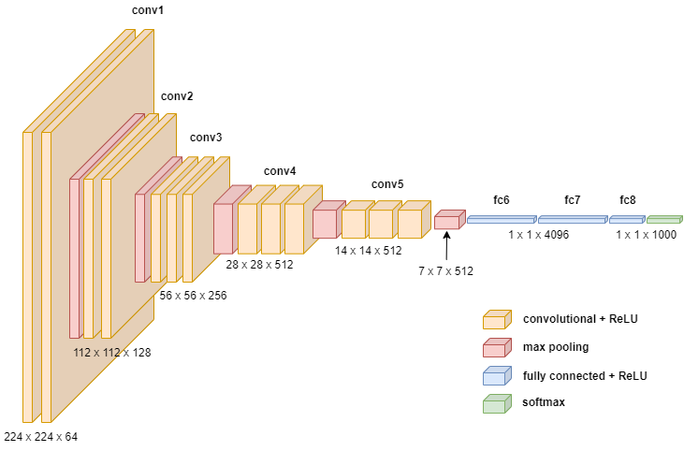
ARCHITECTURE DIAGRAM

Slide 15
Algorithm Description
Input Layer: Responsible for receiving the input images, typically in the form of RGB images with a fixed size.
Convolutional Blocks: Consists of several convolutional layers with small 3x3 filters, followed by rectified linear unit (ReLU) activations. These blocks form the core feature extraction part of the model.
MaxPooling Layers: Interspersed between convolutional blocks to reduce spatial dimensions and retain important features.
Fully Connected (Dense) Layers: After the convolutional and pooling layers, one or more fully connected layers are employed for high-level reasoning and classification. Typically followed by ReLU activations and dropout layers for regularization.

Slide 16
Algorithm Description
Output Layer: The final layer responsible for producing the model's output. Often uses a softmax activation function for multi-class classification tasks.
Batch Normalization: In some variations of VGG, batch normalization layers may be added to normalize and stabilize activations, aiding in faster convergence during training.
Dropout: Dropout layers may be added for regularization, helping to prevent overfitting by randomly dropping a certain percentage of neurons during training.
Flattening Layer: Precedes the fully connected layers and transforms the multi-dimensional feature maps into a one-dimensional vector.
Global Average Pooling: Instead of flattening, some variations use global average pooling to reduce the spatial dimensions of the feature maps before the fully connected layers.

Slide 17
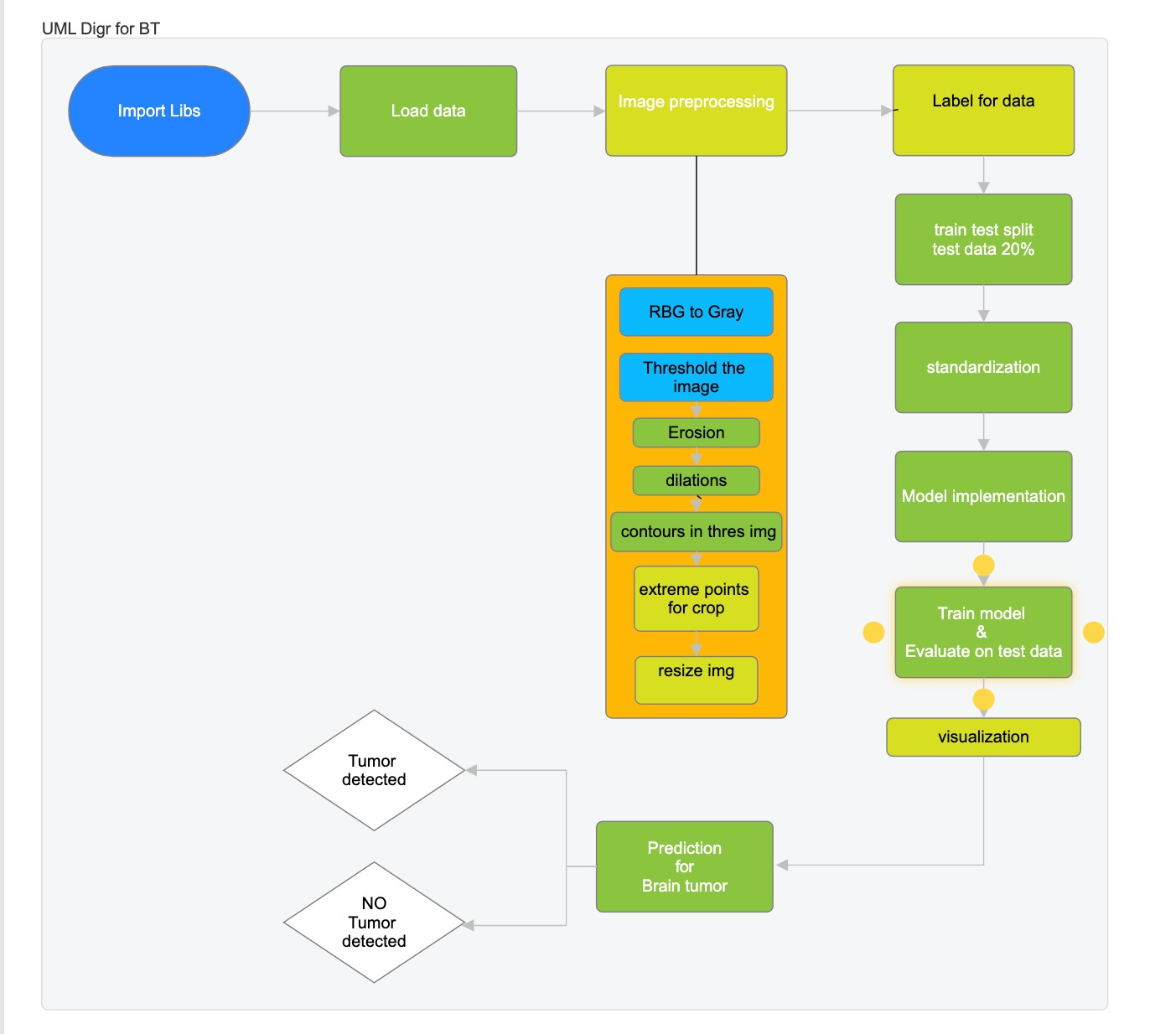
UML Diagrams

Slide 18
Model Used
CNN Sequential
VGG16
VGG19

Slide 19
CNN Sequential
The pixels from the image are fed to the convolutional layer that performs the convolution operation. It results in a convolved map. The convolved map is applied to a ReLU function to generate a rectified feature map.
The image is processed with multiple convolutions and ReLU layers for locating the features

Slide 20
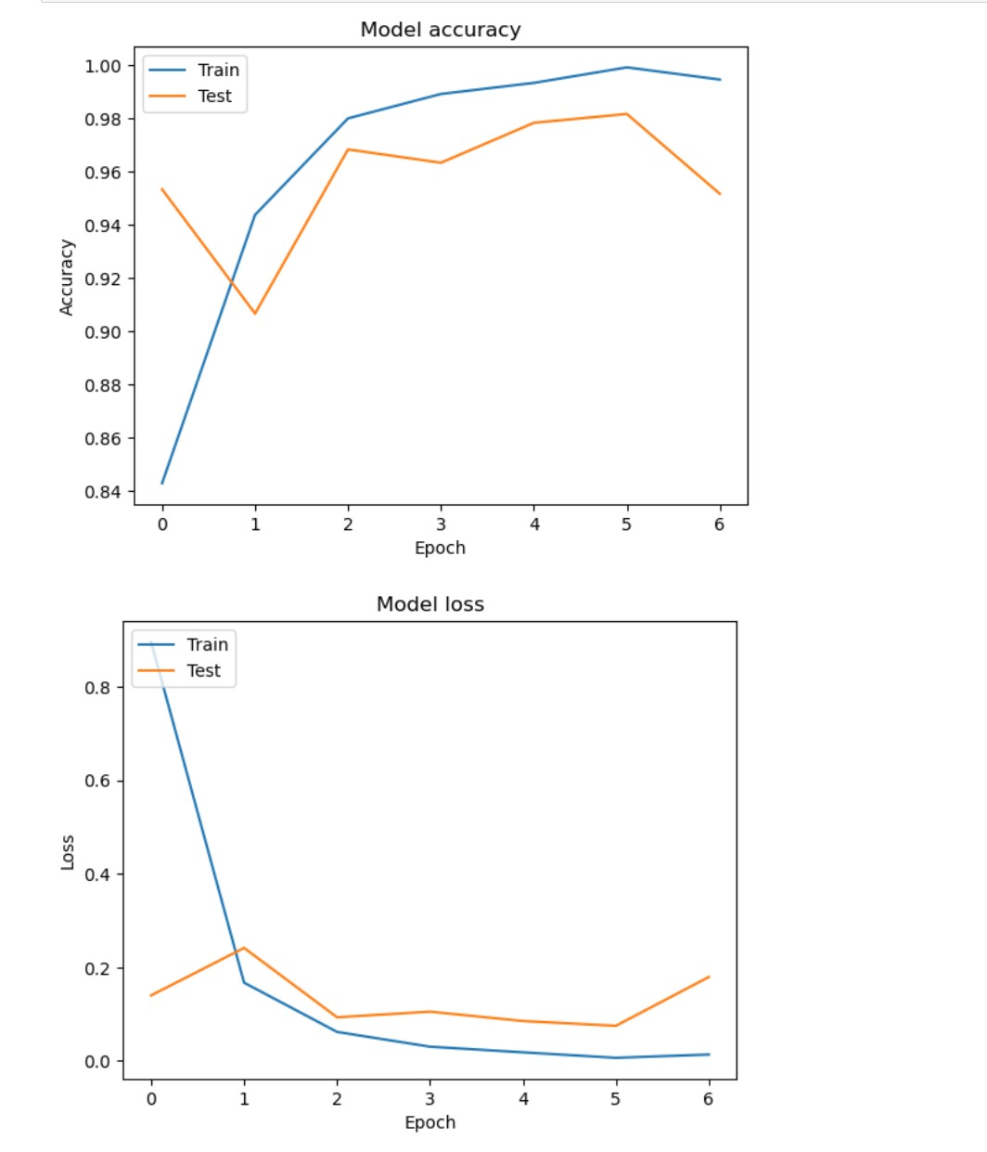
CNN Sequential

Slide 21
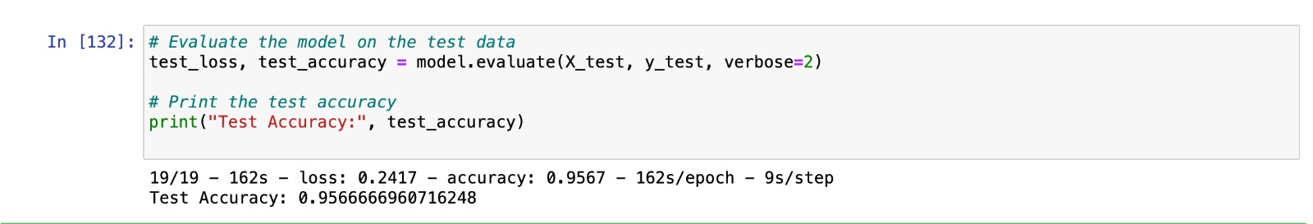
VGG16
VGG-16 is a convolutional neural network that is 16 layers deep. You can load a pretrained version of the network trained on more than a million images from the ImageNet database.
The pretrained network can classify images into 1000 object categories, such as keyboard, mouse, pencil, and many animals.

Slide 22
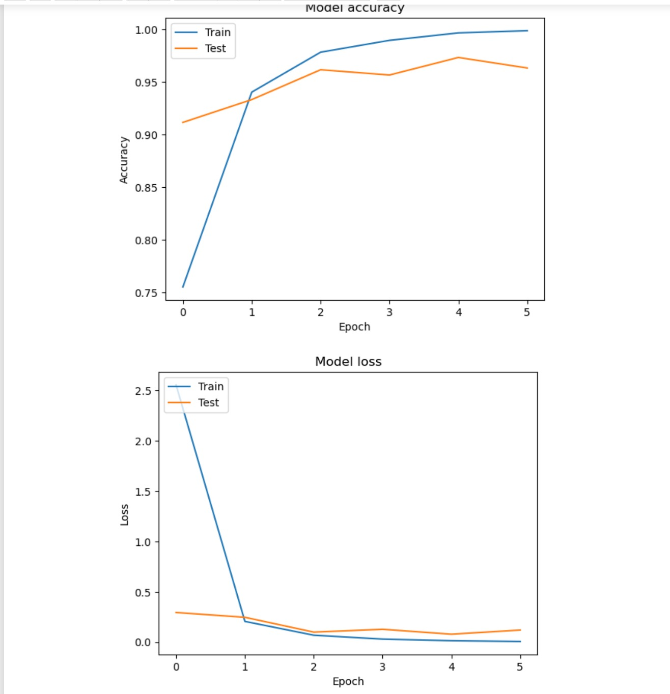
VGG16

Slide 23
THANK YOU

