Slide 1
PROJECTS
TILL NOW

Slide 2
PROJECTS
Image - Classification
Brain-Tumor Detection
Brain-Tumor Classification

Slide 3
Image - Classification
Objective:
The project aims to perform image classification using a pre-trained VGG16 model on the ImageNet dataset.
Workflow:
Users upload an image, and the system reads and preprocesses it using OpenCV and TensorFlow.
The VGG16 model, pre-trained on ImageNet, is used to classify the image into one of a thousand categories.
Technology Stack:
Utilizes Python with libraries such as NumPy, TensorFlow, OpenCV, and Matplotlib.
Leverages the VGG16 model from Keras for image classification.
Key Functions:
read_image: Converts uploaded images to an OpenCV-compatible format.
classify_image: Loads the VGG16 model, processes the input image, predicts the top classes, and displays the result using OpenCV and Matplotlib.

Slide 4
2. Brain-Tumor Detection
Objective:
The project aims to perform Binary image classification using a CNN Models like sequential, pre-trained VGG16, VGG19 model on the ImageNet dataset.
Workflow:
Users upload an image, and the system reads and preprocesses it using OpenCV and TensorFlow.
These CNN model , are used to classify the image into two categories i.e Tumor-Detected, No Tumor.
Technology Stack:
Utilizes Python with libraries such as NumPy, TensorFlow, OpenCV, Keras, Scikit learn and Matplotlib.
Leverages the CNN sequential, VGG16, VGG19 model from Keras for image classification.
Key Functions:
crop_brain_contour: Converts uploaded images to an Preprocessed Image format.

Slide 5
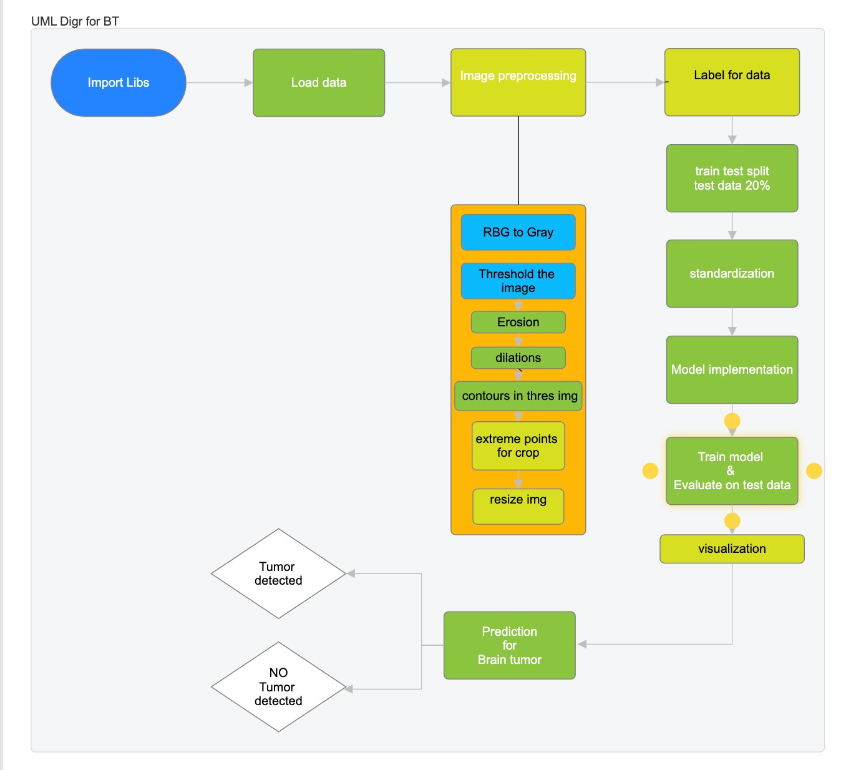
2. Brain-Tumor Detection
.

Slide 6
3. Brain-Tumor Classification
Objective:
The project aims to perform image classification using a CNN Models like sequential, pre-trained VGG16, VGG19, and Xceptionv2 model on the ImageNet dataset.
Workflow:
Users upload an image, and the system reads and preprocesses it using OpenCV and TensorFlow.
These CNN model , are used to classify the image into four categories i.e the three are the types of Tumor and one is no tumor.
Technology Stack:
Utilizes Python with libraries such as NumPy, TensorFlow, OpenCV, Keras, Scikit learn and Matplotlib.
Leverages the CNN sequential, VGG16, VGG19 model from Keras for image classification.

