Slide 1



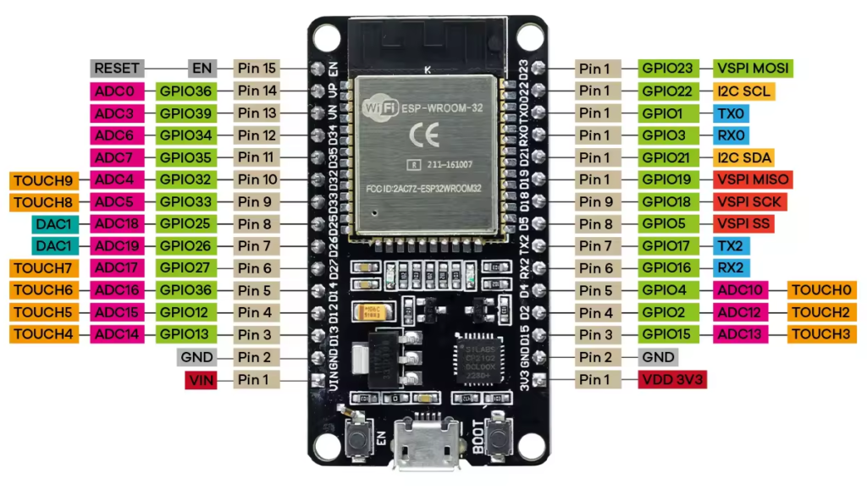
Mission Raftaar
ESP32 & IoT
Hands-on Training for Educators
Dual-core 240 MHz
Wi-Fi + Bluetooth LE
34 GPIO pins
I2C | SPI | UART
EMBEDDED SYSTEMS | ARDUINO PROGRAMMING | WI-FI & MQTT | ESP32-CAM | TINYML
NIELIT CHANDIGARH / ROPAR

Slide 2
Module 1
Embedded Systems & IoT
01
FOUNDATIONS BEFORE THE FIRST LINE OF CODE
EMBEDDED SYSTEMS | MICROCONTROLLER VS MICROPROCESSOR | IOT ARCHITECTURE | APPLICATIONS

Slide 3
Learning Outcomes and Training Roadmap
UNDERSTAND
BUILD
TEACH
ESP32 architecture, memory and peripherals
Microcontroller vs microprocessor
IoT layers and data flow
Edge AI and TinyML basics
Program the ESP32 in Arduino C/C++
Use GPIO, PWM, ADC, DAC, I2C, SPI, UART
Interface sensors, displays, servos
Web server, MQTT and cloud dashboards
Design practicals and live demos
Run interdisciplinary mini-projects
Assess with MCQs, rubrics, challenges
Troubleshoot common student errors
Training roadmap | suggested 2-3 day programme, about 16 contact hours
M1
Embedded & IoT basics
M2
ESP32 hardware
M3
Arduino programming
M4
Sensors & actuators
M5
Wi-Fi, web, MQTT
M6
Camera, AI, apps
M7
Teaching & projects
Each module: concept > circuit > code > expected output > classroom activity > knowledge check

Slide 4
What Are Embedded Systems?
WHAT IS IT?
How does it work? Sense > Decide > Act
A computer built into a product to do one dedicated job
Hardware + firmware, usually real-time and low-power
Sensor
temperature, light, motion
Microcontroller
firmware decides
Actuator
LED, motor, relay
WHY DO WE NEED IT?
Power + clock
Automates sensing and control cheaply and reliably
Small, always-on, runs for years on little energy
Billions of devices: phones, cars, meters, toys
Everyday examples
Washing machine
Car ABS
Smart meter
Pacemaker
Drones
Smart watch
TIP
Analogy: an embedded system is like a thermostat with a brain: it keeps sensing the room, compares with a target, and switches the heater on or off, forever.
Ask: name three embedded devices in this room and what each one senses.

Slide 5
Microcontroller vs Microprocessor
Feature | Microcontroller (e.g. ESP32) | Microprocessor (e.g. Core i5, Cortex-A)
What is inside | CPU + RAM + flash + I/O peripherals on ONE chip | CPU only; RAM, storage, I/O are external chips
Typical clock | 16 MHz - 240 MHz | 1 GHz - 5 GHz
Memory | KB to a few MB (ESP32: 520 KB SRAM) | GB of external RAM
Software | Firmware, bare-metal or RTOS | Full OS: Linux, Windows, Android
Power | Milliwatts; deep sleep in microamps | Watts to tens of watts
Boot time | Instant (milliseconds) | Seconds to minutes
Best for | Dedicated control: sensors, motors, IoT nodes | General computing, GUI, heavy AI, servers
Cost | Rs 300 - 800 for an ESP32 board | Higher; needs a motherboard
TIP
CHECK
Analogy: a microprocessor is a powerful chef who needs a whole kitchen (RAM, storage, I/O). A microcontroller is a food truck: small, self-contained, does one menu very well.
Is a Raspberry Pi a microcontroller? Its SoC runs Linux, so it is a microprocessor-class board. (Pi Pico is a microcontroller.)

Slide 6
Introduction to the Internet of Things
WHAT IS IT?
IoT data loop
A network of physical objects with sensors, software and connectivity that collect and exchange data over the Internet.
Things
sensors + ESP32
WHY IS IT REQUIRED?
Action
app, alert, control
Network
Wi-Fi, MQTT, HTTP
Remote monitoring without a person on site
Data-driven decisions and automation
Early fault detection saves cost and lives
IoT
Cloud
store + analyse
HOW DOES IT WORK?
Device senses > sends over Wi-Fi/LTE/LoRa > cloud stores and analyses > user sees dashboard or app triggers an action back.
TIP
Scale: tens of billions of connected devices worldwide. ESP32 is a popular, low-cost entry point for learning IoT end to end.

Slide 7
IoT Architecture: Four Layers
4 Application layer
Dashboards, mobile apps, alerts, analytics, automation rules
e.g. Grafana, ThingSpeak, Node-RED, Blynk
Data flows UP
Commands flow DOWN
3 Processing layer
Storage, rules, cloud and edge analytics, machine learning
e.g. cloud server, MQTT broker, edge AI on ESP32
ESP32 spans layers 1 and 2
and can run layer 3 logic at the edge
2 Network layer
Moves data reliably and securely between device and cloud
e.g. Wi-Fi, Bluetooth LE, LoRa, LTE; MQTT, HTTP
1 Perception layer
Sensors read the world; actuators change it
e.g. DHT22, PIR, LDR, relay, servo + ESP32
Activity: map a smart street-light project onto the four layers (which device sits in which layer?)

Slide 8
Real-World IoT Applications
E
Education
A
Agriculture
H
Healthcare
Smart attendance, lab monitoring, remote experiments
Soil moisture, auto irrigation, greenhouse climate
Wearable vitals, remote patient monitoring, cold chain
I
Industry (IIoT)
S
Smart cities
S
Smart home
Predictive maintenance, energy meters, asset tracking
Street lights, parking, waste bins, air quality
Lighting, security, energy saving, voice control
TEACHING TIP
Classroom idea: every student group picks one domain and sketches sensors, ESP32 role, cloud and user action on one page.

Slide 9
Module 2
ESP32 Hardware & Architecture
02
Know the chip before you wire it
ESP32 family | Block diagram | CPU and memory | GPIO pinout | ADC, DAC, PWM | UART, SPI, I2C | Wi-Fi and Bluetooth

Slide 10
Introduction to the ESP32
WHAT IS IT?
240 MHz
dual-core Xtensa LX6
520 KB
SRAM on chip
34
GPIO pins
A low-cost, low-power system-on-chip from Espressif with a dual-core CPU, Wi-Fi and Bluetooth, designed for IoT.
WHY USE IT IN TEACHING?
2.4 GHz
Wi-Fi 802.11 b/g/n
BLE 4.2
plus Bluetooth Classic
3.3 V
logic level
Wi-Fi + Bluetooth built in: IoT in one board
Programmable with Arduino IDE, MicroPython, ESP-IDF
Rich peripherals; costs about the price of a textbook
Huge community, libraries and tutorials
TIP
Teaching tip: hold up the board and name the three things students can see: the silver module (CPU + radio + flash), the USB-UART chip, and the pin headers.
HOW DOES IT WORK?
Firmware in flash runs on the Xtensa cores; peripherals are configured through registers and driven by the Arduino API.
REAL-WORLD USE
Smart plugs, sensor nodes, BLE beacons, cameras, wearables and classroom lab kits.

Slide 11
ESP32 Family and Development Boards
Chip | CPU | Wireless | Highlights | Use it for
ESP32 | Xtensa LX6, 2 cores, 240 MHz | Wi-Fi 4 + BT Classic + BLE 4.2 | Most boards and tutorials; DAC, touch | This course
ESP32-S2 | Xtensa LX7, 1 core | Wi-Fi 4 only | Native USB, more GPIO | Wi-Fi only, USB devices
ESP32-S3 | Xtensa LX7, 2 cores | Wi-Fi 4 + BLE 5 | AI vector instructions, USB, camera | Edge AI, cameras
ESP32-C3 | RISC-V, 1 core, 160 MHz | Wi-Fi 4 + BLE 5 | Low cost, open RISC-V | Cheap IoT nodes
ESP32-C6 | RISC-V, 160 MHz | Wi-Fi 6 + BLE 5 + 802.15.4 | Thread / Zigbee / Matter | Smart-home
ESP32-H2 | RISC-V, 96 MHz | BLE 5 + 802.15.4 (no Wi-Fi) | Very low power | Thread / Zigbee nodes
Common development boards
ESP32 DevKit V1 (30/38-pin)
Our lab board: ESP32-WROOM-32, USB-UART, breadboard friendly
ESP32-CAM (AI-Thinker)
OV2640 camera + microSD, needs FTDI programmer
ESP32-S3-DevKitC
AI-capable, native USB, camera support
LILYGO / Heltec boards
Built-in OLED, LoRa or TFT display variants
Pick for class: original ESP32 DevKit V1. Every pin number in this deck refers to it; check your board silkscreen first.

Slide 12
ESP32 Internal Architecture
ESP32 SoC (single chip)
Dual-core CPU
Xtensa LX6: PRO_CPU (core 0) + APP_CPU (core 1), up to 240 MHz, FreeRTOS
Memory
ROM 448 KB | SRAM 520 KB, RTC memory 16 KB (keeps data in deep sleep)
Radio
Wi-Fi 802.11 b/g/n (2.4 GHz), Bluetooth Classic + BLE 4.2
Internal bus (AHB / APB)
GPIO x34
ADC 12-bit x18
DAC 8-bit x2
Touch x10
PWM (LEDC) x16
I2C x2
SPI x4
UART x3
I2S x2
CAN (TWAI)
SDIO
Ethernet MAC
Support blocks
Security
AES, SHA, RSA, RNG: secure boot, flash encryption
Clock & power
40 MHz crystal, PLL: sleep modes, ~10 uA deep sleep
ULP co-processor
runs while the CPUs sleep, wakes on sensor threshold
Off-chip (on module)
SPI flash 4 MB (firmware), optional PSRAM, antenna

Slide 13
CPU, Memory and Processing Capability
Where your program lives
PROCESSING
Flash (4 MB typical)
program code, constants, SPIFFS / LittleFS files
Two 32-bit cores; Arduino code runs on core 1 by default
Up to ~600 DMIPS; hardware floating point unit
Run tasks on both cores with FreeRTOS xTaskCreatePinnedToCore()
SRAM (520 KB)
variables, stack, heap; Wi-Fi buffers use ~40-60 KB
LIMITS TO REMEMBER
SRAM is small: avoid huge String concatenations
Do not block loop() with long delay() when serving Wi-Fi
Watchdog resets a program that never yields
RTC memory (16 KB)
survives deep sleep (RTC_DATA_ATTR variables)
TRY IT: PRINT CHIP INFO
Serial.println(ESP.getChipModel());
Serial.println(ESP.getFreeHeap());
Serial.println(ESP.getFlashChipSize());
ROM (448 KB)
boot loader and core functions (read only)
TIP
Activity: run the three lines above on every board. Compare free heap before and after connecting Wi-Fi. Why did it drop?

Slide 14
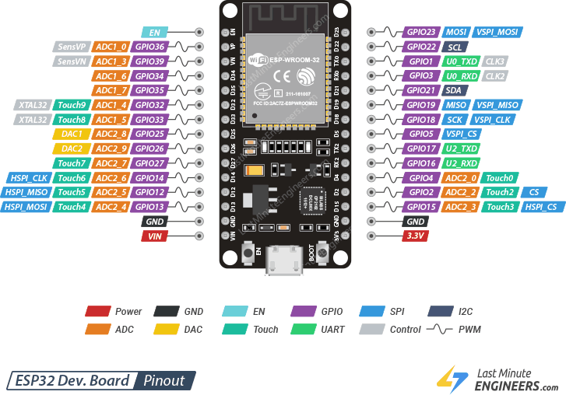
GPIO Pinout and Pin Functions

Slide 15
ADC, DAC, PWM, Touch and Interrupts
ADC: ANALOG IN
DAC: ANALOG OUT
PWM (LEDC)
12-bit (0-4095), about 0-3.3 V
Use ADC1 pins (GPIO32-39) when Wi-Fi is on
ADC2 pins are blocked by Wi-Fi
Two true 8-bit DACs: GPIO25, GPIO26
Output 0-3.3 V in 256 steps
Waveforms, audio, reference voltage
16 channels on any output pin
Frequency and resolution are set by you
Dim LEDs, drive servos, control motor speed
analogRead(34);
dacWrite(25, 128); // 1.65 V
ledcAttach(18, 5000, 8);
ledcWrite(18, 128);
TOUCH SENSING
INTERRUPTS
REMEMBER
10 capacitive pins: T0=GPIO4, T2=2, T3=15, T4=13, T5=12, T6=14, T7=27, T8=33, T9=32
Reading falls when touched
Nearly every GPIO can trigger one
Event-driven: no polling, instant reaction
ISR must be short; mark with IRAM_ATTR
ESP32 ADC is non-linear near 0 V and 3.3 V; calibrate for accuracy
GPIO34-39: input only, no pull-ups
Max 3.3 V on every pin
Core 3.x: ledcAttach(pin, freq, bits); core 2.x used ledcSetup + ledcAttachPin
touchRead(T0);
attachInterrupt(digitalPinToInterrupt(4),
isr, FALLING);

Slide 16
Communication: UART, SPI and I2C
 | UART | SPI | I2C
Wires | 2 (TX, RX) + GND | 4 (SCK, MOSI, MISO, CS) | 2 (SDA, SCL) + pull-ups
Style | Asynchronous, point to point | Synchronous, full duplex | Synchronous, shared bus, addressed
Speed | 9600 - 115200 baud typical | Up to 80 MHz; fastest | 100 kHz / 400 kHz
Devices | GPS, GSM, serial PC link | TFT, SD card, ADC, LoRa | OLED, LCD, MPU6050, RTC
ESP32 default pins | UART0: 1/3 | UART2: 17/16 | VSPI: 18, 19, 23, CS 5 | SDA 21, SCL 22
UART2 in code
SPI (VSPI) in code
I2C in code
Serial2.begin(9600, SERIAL_8N1,
16, 17); // RX, TX
SPI.begin(18, 19, 23, 5);
// SCK, MISO, MOSI, SS
Wire.begin(21, 22);
// SDA, SCL (any pins work)
TIP
Analogy: UART = a phone call between two people. SPI = a teacher with a dedicated cable to each student (fast, more wires). I2C = a class where each student answers to their own name over one shared line.

Slide 17
Wi-Fi and Bluetooth Capabilities
Wi-Fi operating modes
Station (STA)
ESP32 joins your router as a client; used for IoT, MQTT, HTTP
WiFi.mode(WIFI_STA)
Access Point (AP)
ESP32 creates its own hotspot; phone connects directly, no router
WiFi.softAP("ESP32-Lab")
STA + AP
Both at once: configuration portal while connected
WiFi.mode(WIFI_AP_STA)
ESP-NOW
Fast router-less peer-to-peer packets between ESP32s
#include <esp_now.h>
WI-FI FACTS
BLUETOOTH
IEEE 802.11 b/g/n, 2.4 GHz only (no 5 GHz)
Up to 150 Mbps raw; practical 10-20 Mbps
WPA2 / WPA3 security; hidden SSIDs supported
Classic (BR/EDR): audio, serial (SPP)
BLE: tiny, low-power packets for beacons, sensors, phone apps
Library: BLEDevice.h; Serial: BluetoothSerial.h
TIP
Classroom note: campus networks often block devices or use captive portals. Bring a phone hotspot or a router as a guaranteed 2.4 GHz network for the lab.

Slide 18
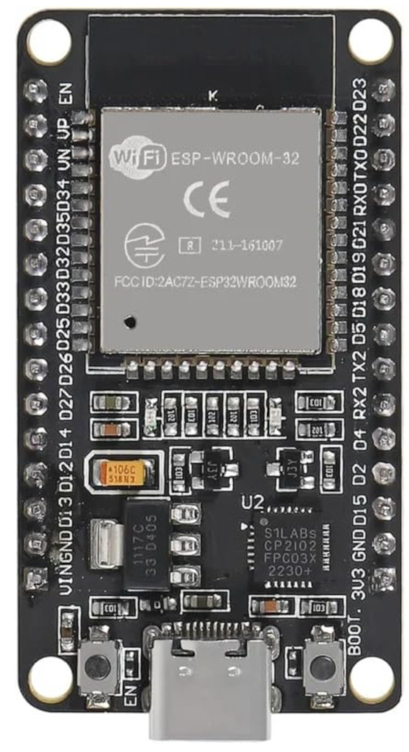
Dev Board Components and Safe Connections
DO
Power from USB (5 V) or VIN; logic is 3.3 V
Join all grounds (ESP32, sensor, external supply)
Use a 220 ohm resistor in series with every LED
Use a driver (transistor / relay board) for motors and lamps
Use a divider or level shifter for 5 V signals
Antenna + radio module
Pin headers (GPIO)
DON'T
Never connect a 5 V signal directly to a GPIO pin
Never draw more than 12 mA per pin (40 mA abs. max)
Never use GPIO6-11 (internal flash)
Never touch mains wiring in class: use 5-12 V loads only
Avoid pulling strapping pins GPIO0, 2, 12, 15 during boot
Voltage Regulator
CP2102
EN / BOOT buttons
USB port: 5 V + serial

Slide 19
Knowledge Check: Modules 1 and 2
Q1. Which statement best describes a microcontroller?
Q2. In the four-layer IoT architecture, sensors belong to the
Q3. Which ESP32 pin is INPUT ONLY?
A) CPU only; RAM and I/O are external
B) CPU, memory and peripherals on a single chip
C) Needs Linux to run any program
D) Used only inside desktop computers
A) Application layer
B) Processing layer
C) Network layer
D) Perception layer
A) GPIO2
B) GPIO21
C) GPIO34
D) GPIO25
DISCUSSION QUESTION
QUICK PRACTICAL TASK
How would you explain to a first-year student why an ESP32 is not "a small Raspberry Pi"?
Label 3V3, GND, VIN, EN, BOOT and the on-board LED pin on your board. Find two input-only pins and one DAC pin.

