Slide 1
Style analysis of Car Design by pipeline
Degree program: Laurea magistrale informatica Universita di Bologna
Student name:
Peng Lu

Slide 2
Menu
Introduction
Proposed Method
01
02
Experimental Results
Discussion and Conclusions
03
04

Slide 3
Introduction
PART 01

Slide 4
Problem Description
Generate a pipeline that will be able to distinguish the vehicle style based on the feature extracted from the image about vehicle.
Dataset: Stanford Cars
Model: CLIP, DINOv2, ResNet50
Method Clustering: KMeans, DBSCAN
Visualization: Grad-cam, UMAP

Slide 5
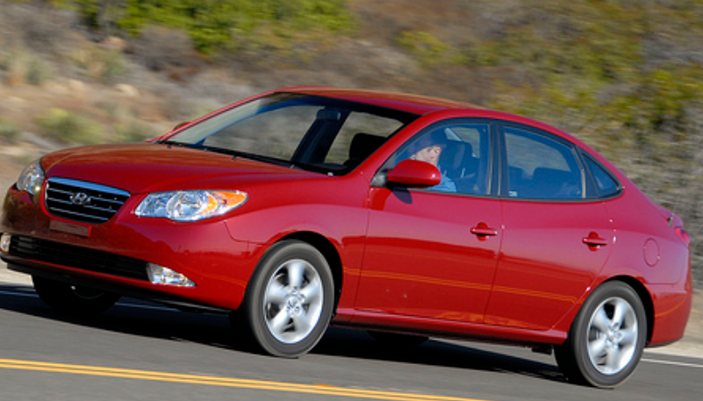
Why?
How to distinguish the car styles?
Maggiority: can’ distinguish the car styles.
Expert: can dinstinguish the car style easily, but how many images they can detect for a day?

Slide 6
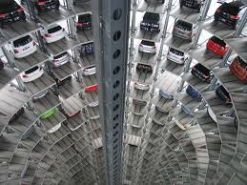


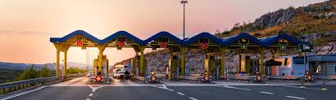
Target audience interested in the problem.
Smart Parking management
Based on the car styles dinamicly modify the price of parking.
Target marketing
Evaluate the target’s spending power by localize the target’s car style.
Forencis search
For witness, memorize the color and format of vehicle is easier than whole lisence plate.

Slide 7
Benefits of a proposed solution.
Why replace car style instead of car model
1) The style of car are less than car model.
2) The car model will increase day by day, but the variation of number of style is rare.

Slide 8
Proposed Method
PART 02

Slide 9
Approach to the solution - part 1
Obatain the useful dataset : standford cars,=
Find the correspond model:
1) CLIP: Learns by matching images to captions (Vision-Language).
used in: generate soft label(based on user prompts), feature extraction (512 dimension)
2)DINOv2: Self-Supervised: Learns by looking at images alone and finding internal patterns.
used in: feature extraction (768 dimension)
3)ResNet50: Supervised: Learns from images with strict human labels
used in: feature extraction (2048 dimension)
Clustering:
Kmeans: tries to find the "center" of a group
DBSCA: looks for "crowds." It connects points that are close to many other points and ignores the loners.

Slide 10
Approach to the solution - part 2
Visualization:
Grad-cam: use to see which region our model is concern about.
UMAP visualizzation: project the feature vectors on the 2D map to see
Cluster validity: If the cluster generated is good enough or not
Compare models: by looking the umap
Prototype analysis

Slide 11
Computational challenges faced - part 1
Clustering phase:
Q1: The feature vector is too big
A1: Use dimension reduction before clustering (PCA and UMAP)
Princile component analysis -> fast reduction
Uniform Manifold Approximation and Projection -> reduction but preserve local structure
Q2: For Kmeans, the N. of cluster(k) should be preset, how to decide the k?
A2: Use elbow law
Q3: For DBSCAN need find a Epsilon which the distance of point within cluster is near, and the distance between noise point is far away
A3:K-Distance Graph: compute the k-neast distance for all point, them sort them and find the knee point.

Slide 12
Computational challenges faced - part 2
Comparison between model cluster with prompt generated cluster:
Simply calculate the mean style probabilities of images within same cluster, then set a threshold, for those higher than threshold will be considere the style of the cluster.
Save the set for further comparison of prompt engeneering.
Visualization phase:
UMAP visualization: dimension reduction of feature vector to 2D
Prototype analysis: find centroid then extract the three centroid-nearst images from cluster for grad-cam analysis and comparison.
Grad-cam: a variation, use feature activations of penultimate layer of each model, then for every image compute the cosine-similarity score(as importance Weights) between feature map value with centroid of image, finally project this on the image.

Slide 13
Experimental Results
PART 03

Slide 14
Results - part 1
Before the results discussion, Technologies and versions used :
CLIP: open_clip with model ViT-B-32 and dataset laion2b_s34b_b79k
where ViT-B-32: Vision Transformer, Base size, with 32x32 pixel patches.
DINOv2: used version 'dinov2_vitb14', which is the "standard" balanced choice for most tasks. (Vits14 Fast,Vitl14 High accuracy, vitg14 stand for giant most powerful and consume more resourse)
ResNet50: Standard version
In the feature extraction phase, for each model produce a dataframe which contains metadata, feature vector for every image, with CLIP model will also generate a soft label dataframe.

Slide 15
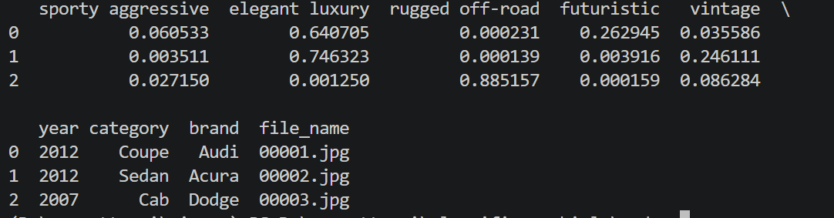
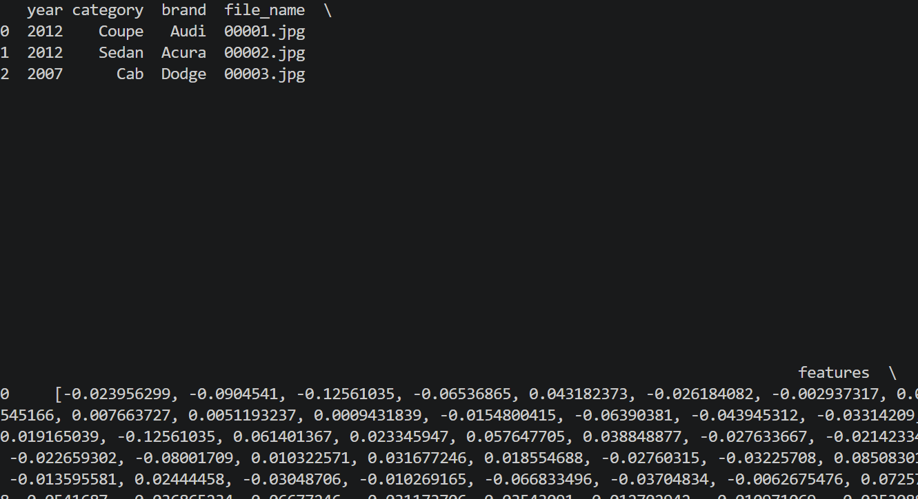
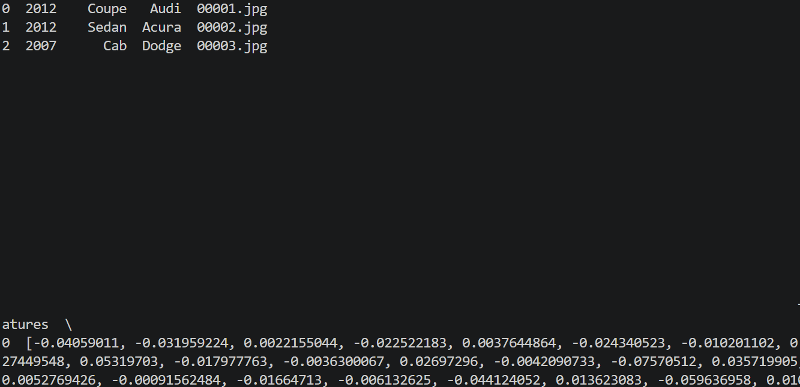
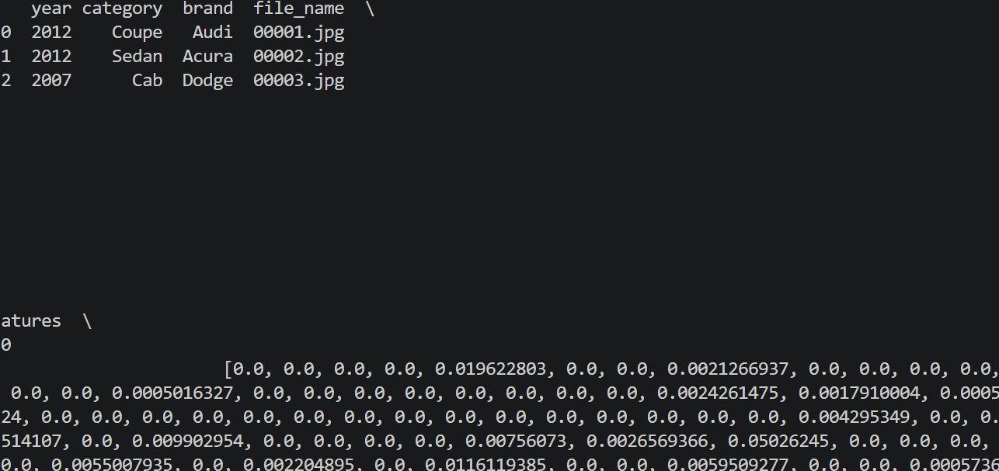
Results - part 2
Softlabel
CLIP (512 dimension for feature vector)
单击此处添加文本
DINOv2 (768 dimensions for feature vector)
ResNet (2048 dimension for feature vector)

Slide 16
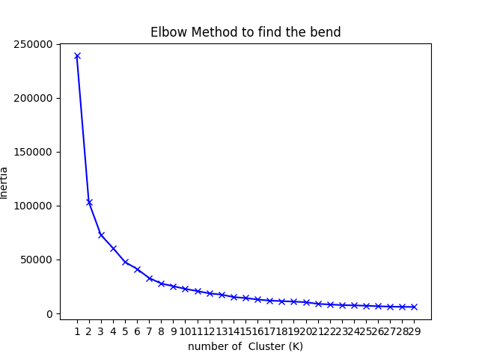
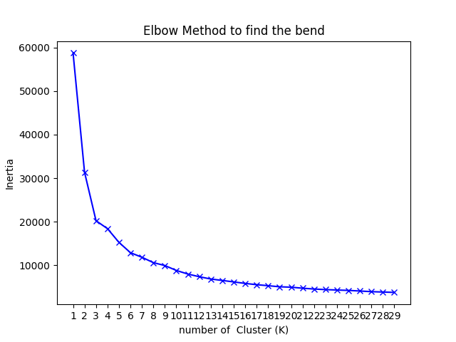
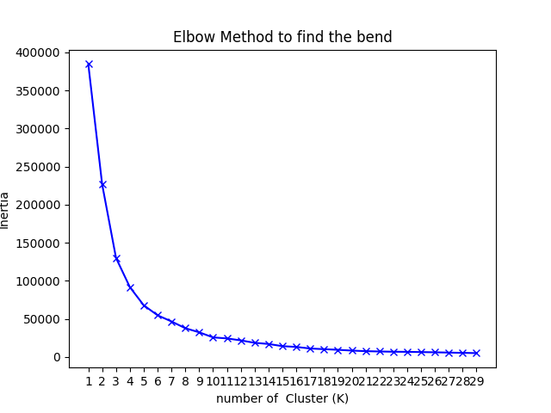
Results - part 3
Clustering phase:
The dimension of feature vector is too bigger, to process the clustering the dimention reduction is required, using PCA for fast reduction to 50 dimension, then use UMAP reduction to reduce the feature vector to 10.
For Kmeans find the knee point in elbow law, used kneelocator of library knee to find the knee point automatically.
CLIP
ResNet50
DINOv2

Slide 17
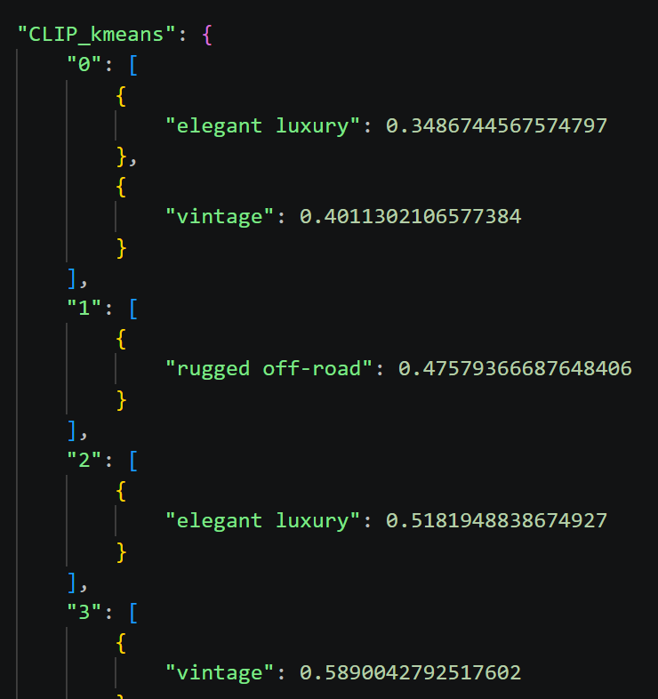
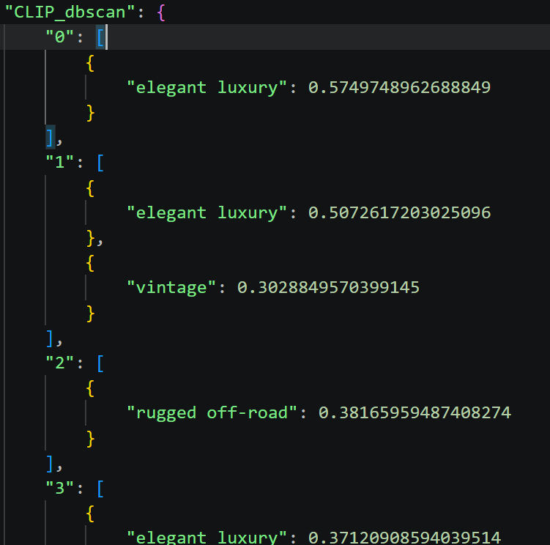
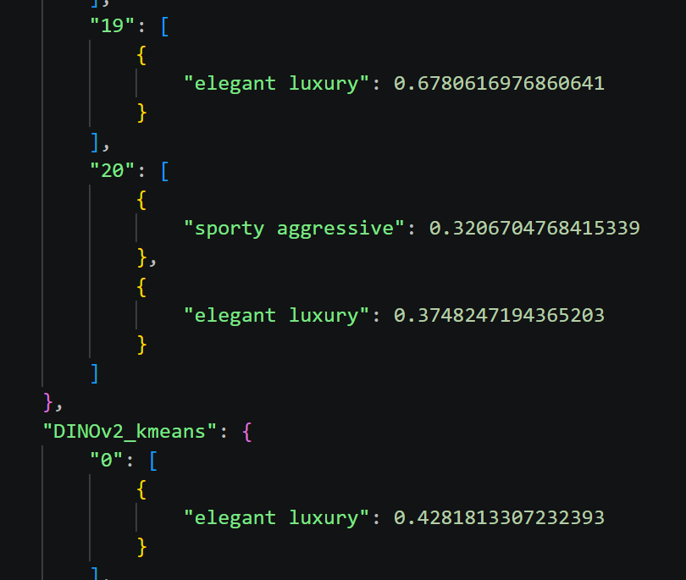
Results - part 4
Comparison phase
Idea:
After got the cluster compute the probability of soft label for the images within cluster, then the value higher then threshold(customized) will be considere as soft label for whole cluster

Slide 18
Results - part 5
Visualization phase
UMAP visualization: use the dimension reduction that reduce the feature vector to 2D then use them as axis of UMAP map, for every methods of cluster of each model create two UMAP map, one for cluster(to compare the models) another one for image’s metadata(years, to see the temporal evolution) also generated a file which contain some statistic data about the metadata of every cluster.
Prototype extraction: just compute the centroid for every cluster(mean of all feature vector of cluster), then based centroid find the k-nearst images as prototype

Slide 19
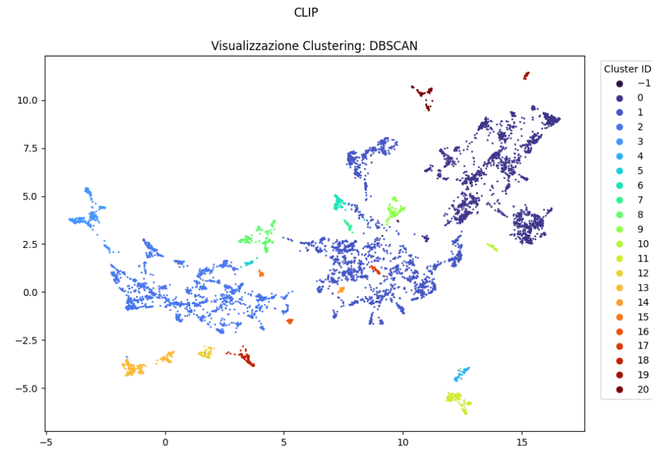
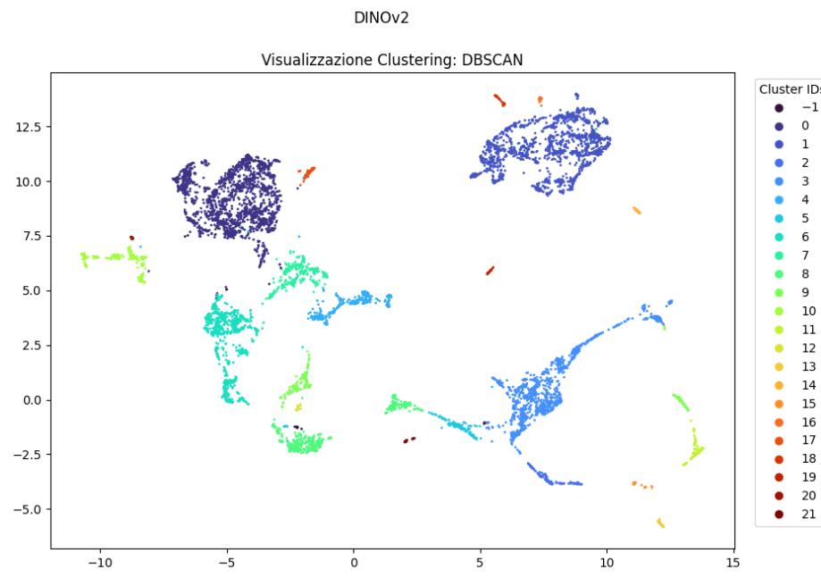
Results - part 6
单击此处添加文本

Slide 20
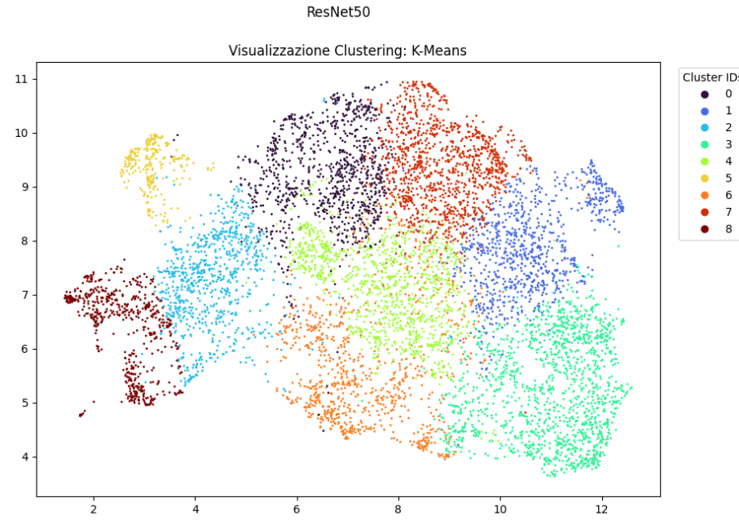
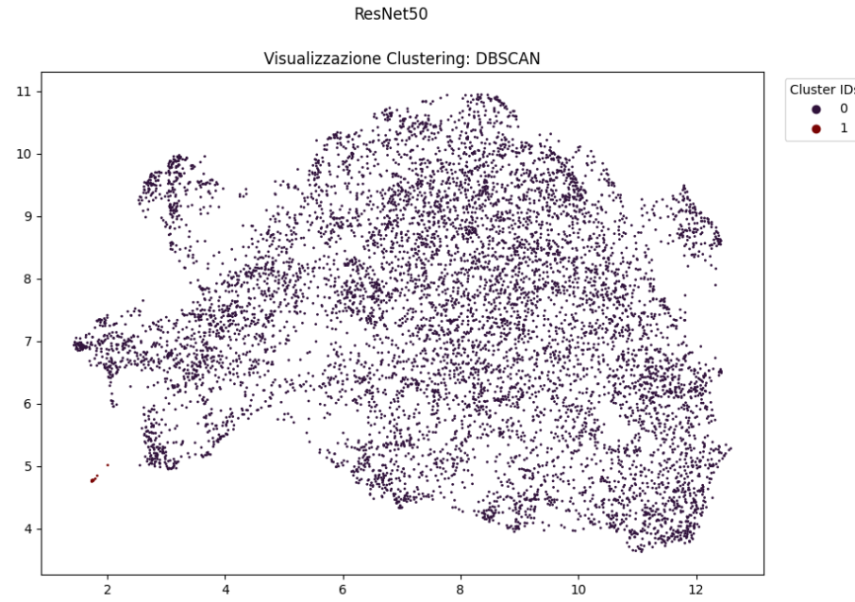
Results - part 7
单击此处添加文本

Slide 21
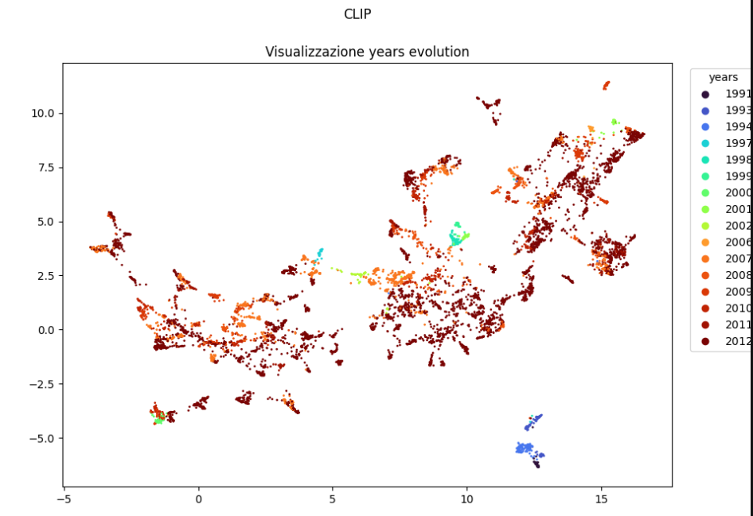
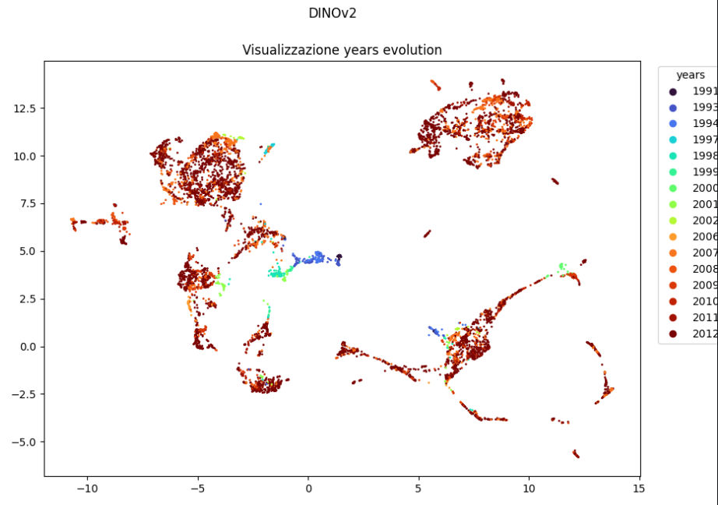
Results - part 8
单击此处添加文本

Slide 22
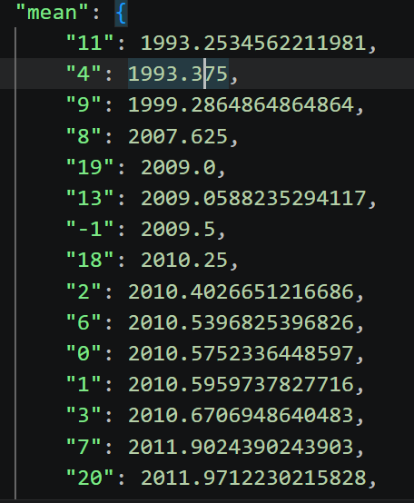
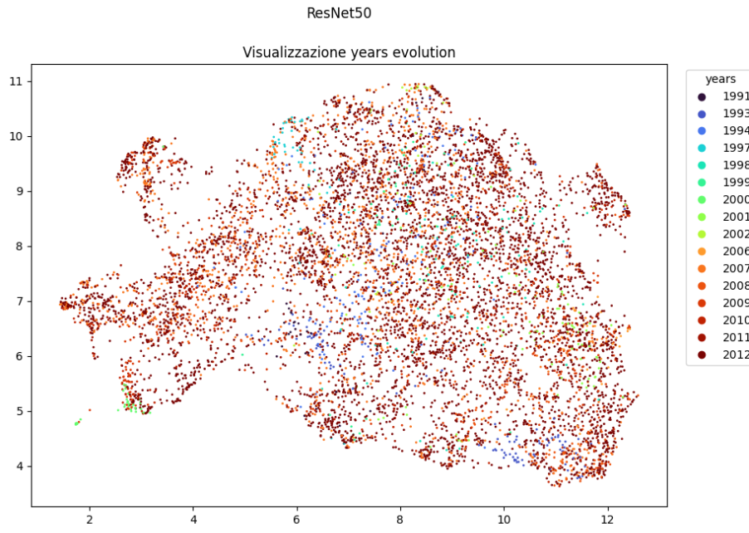
Results - part 9
单击此处添加文本

Slide 23
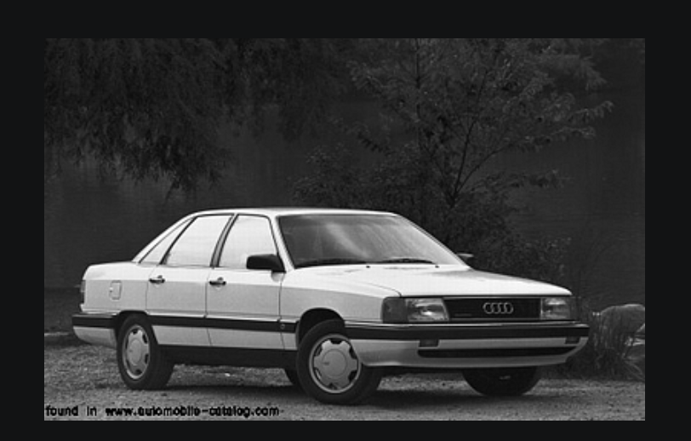
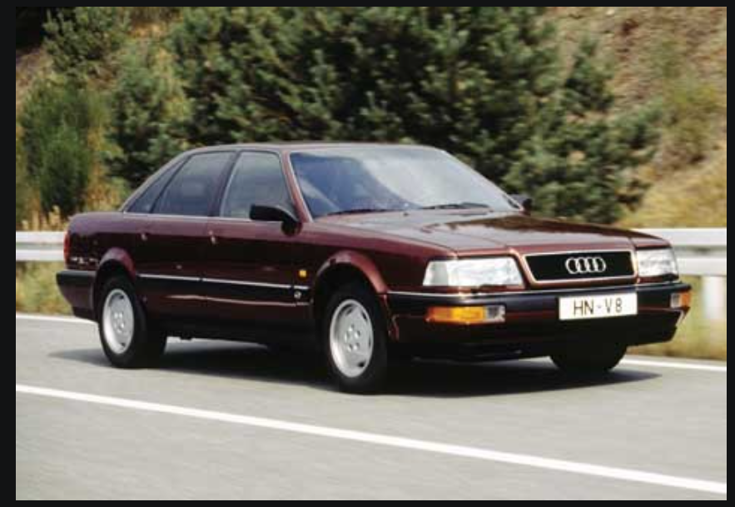
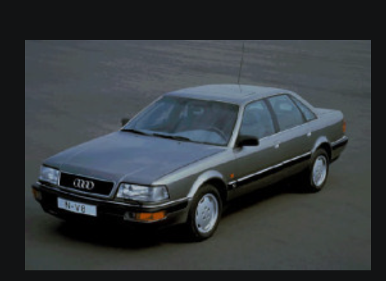
Results - part 10
I will show an example of prototype extracted from a cluster (cluster 11 of CLIP-DBSCAN)

Slide 24
Results - part 11
Grad-cam phase:
As the CLIP and DINOv2 don’t uses the CNN, the standard grad-cam won’t work on them, but can still apply similar logic to generate the heat map.
Idea is: use feature activations of penultimate layer of each model, then for every image compute the cosine-similarity score(as importance Weights) between feature map value with centroid of image, finally project this on the image.

Slide 25
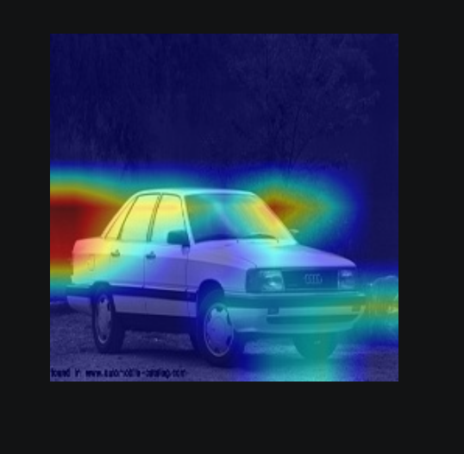
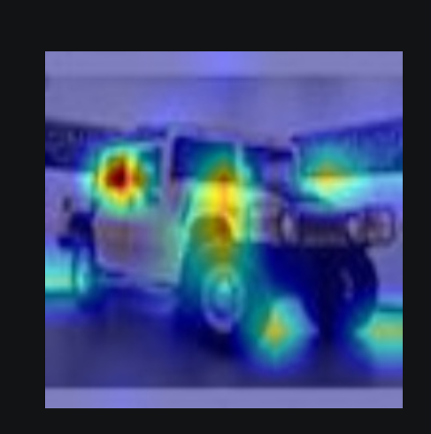
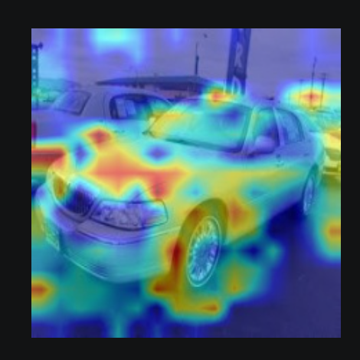
Results - part 12
some examples
CLIP
ResNet50
DINOv2

Slide 26
Results - part 13
Prompt engineering
Tested with two different prompt to see the change of probabilities
prompt1=["sporty aggressive", "elegant luxury", "rugged off-road", "futuristic", "vintage"]
prompt2=["a photo of a sporty aggressive style car", "a photo of a elegant luxury style car", "a photo of a rugged off-road style car", "a photo of a futuristic style car", "a photo of a vintage style car"]
Result after the comparison, the prompt2’s cluster soft label probability is better than first one. (Identicate by the prototype that they are same cluster, but with prompt2 same cluster has discovered more style than prompt1. )

Slide 27
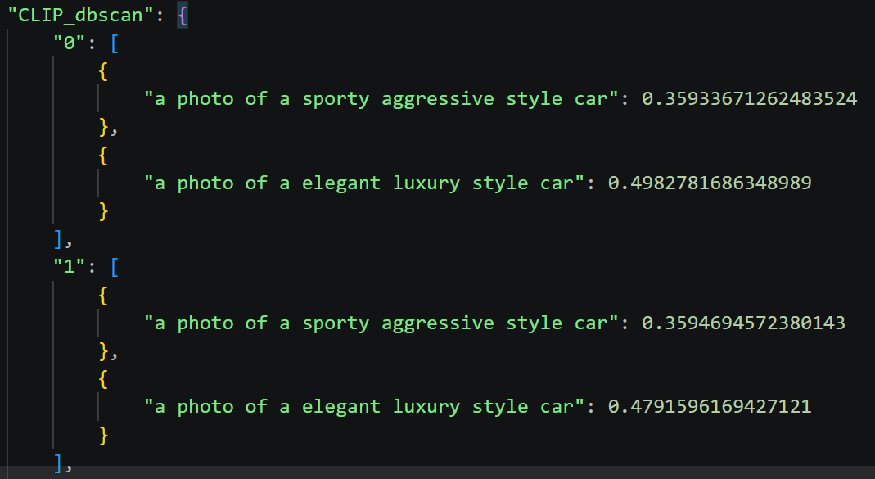
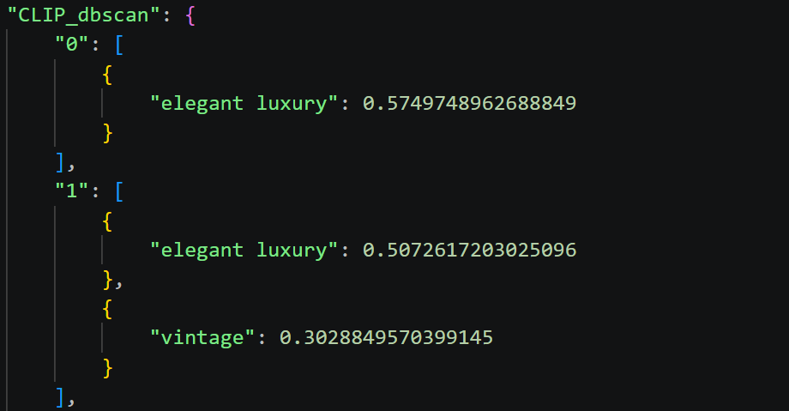
Results - part 5
单击此处添加文本
prompt1
prompt2

Slide 28
Conclusion
PART 04

Slide 29
Results Discussion - part 1
Between the clustering method, maybe DBSCAN is better than Kmeans
Between model, the ResNet seems worst, then DINOv2 is better than Kmeans.
From impact of prompt engineering may the more specific prompt able to achieve good results.
Through the year evolution UMAP we can clearly see some cluster has a limited number color about the year, that means the evolution of that car is be stopped for a long period. (example CLIP year UMAP and CLIP DBSCAN UMAP)

Slide 30
Results Discussion - part 2
Future work
Refine code, let code more accessible, remove the redundant part.
Add more possible comparison with other metadata
May exist other clustering method
Try the different version of models

Slide 31
Reference
Dataset:
https://www.kaggle.com/datasets/eduardo4jesus/stanford-cars-dataset
Image:
https://www.yourparkingspace.co.uk/insights/designing-the-car-parks-of-the-future
https://magellaninvestmentpartners.com/insights/investing-in-toll-roads/

Slide 32
Thanks for attention !
单击此处添加副标题内容

