Slide 1
ReSeTrus Development of a digital library technology based on redundancy elimination and semantic elevation, with special emphasis on trust management and security maximization
Merging data sources based on semantics, contexts and trust
Notes:
Subchapter of ReSeTrus project (current research state).

Slide 2
Outline
Problem
State-of-the-art
Preliminary
Proposal
Example of use case
Future work
Notes:
Presentation of domain.
Current work in the field of matching and merging.
Subproblems of matching and merging.
Our proposition and novelity of the research.
Automobile insurance use case.
Plan for future research.

Slide 3
Problem
Merging of data from heterogeneous sources is becoming a common need
Scenarios include:
Analyses of heterogeneous datasets collectivelly
Enrichment of private data source with some (open) on-line source
Reducing redundancy among datasets by merging them into one
etc.
Notes:
With the advent of Semantic Web and open (on-line) data sources ...

Slide 4
State-of-the-art
Several state-of-the-art approaches for matching and merging in the fields of:
(Trust-aware) schema and ontology matching
(Relational) entity resolution
Data integration
Data deduplication
Information retreival
etc.

Slide 5
State-of-the-art – open problem
Lack of general and complete solutions for matching and merging
Approaches mainly address only selected issues of more general problem, e.g.:
Variability of execution only partially supported
Supporting only homogeneous sources (with predefined level of semantics)
Trustworthiness of data and sources not considered
Notes:
Each proposed approach has at least one of the exposed deficiencies:
- only some dimensions of variability of matching and merging execution are supported (approach provides only for a limited set of scenarios that can occur) – [contexts, framework]
- only homogeneous sources are supported (pure relational data xor semantically enriched data) – [data architecture, framework]
- trustworthiness of data not considered – [trust management]

Slide 6
Preliminary
Entity resolution (i.e. matching)
Redundancy elimination (i.e. merging)
Semantic elevation (i.e. interoperability)
Trust management
Security assurance
Concept modeling
Notes:
See next slide.

Slide 7
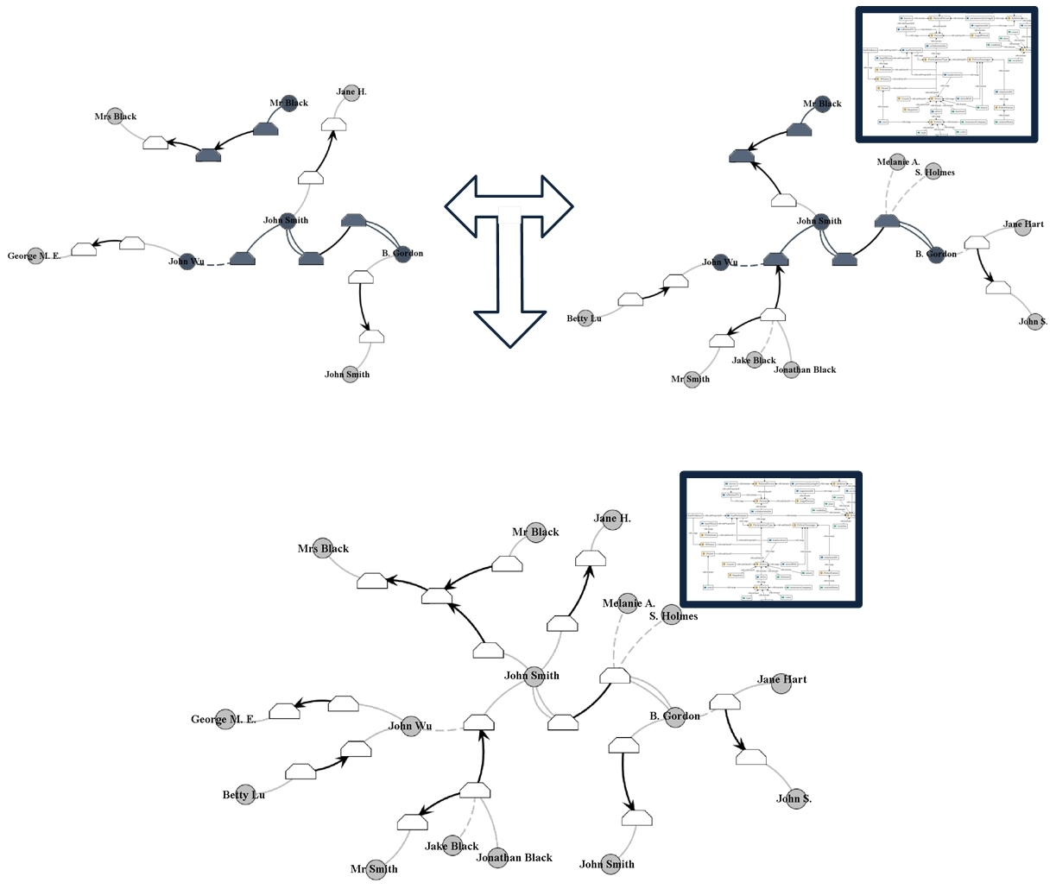
Preliminary – example
Notes:
Two relational datasets, where one is also annotated with an ontology. [above]
Merged dataset contains all the data and semantics in the original datasets. [below]
Entity resolution – matching of data that represent the same entity [dark nodes and edges]
Redundancy elimination – removal of redundancy within (i.e. proper redundancy elimination) and among datasets (i.e. merging) [only among two datasets]
Semantic elevation – use of semantics behind the data (i.e. elevation of data and algorithms to achieve semantic interoperability) [ontology]
Trust management – considering also the trustworhiness of data sources, datasets, attributes, etc. (i.e. trust enabling)
Security assurance – management of secure or sensitive data (i.e. security enabling and preserving)
Concept modeling – intelligent matching and merging of data (data mining)

Slide 8
Proposal
General and complete solution for matching and merging heterogeneous data sources (with trust management)
Integration, and/or joint optimization, of:
Entity resolution & trust management (with semantic elevation)
Redundancy elimination & trust management (with semantic elevation)
Semantic elevation & security assurance
Concept modeling & security assurance
Notes:
General solution – given data can be in pure (relational) format or enriched with semantics; etc.
Complete solution – algorithms consider relational data and semantically enriched data; identified contexts characterize all dimensions of variability; etc.

Slide 9
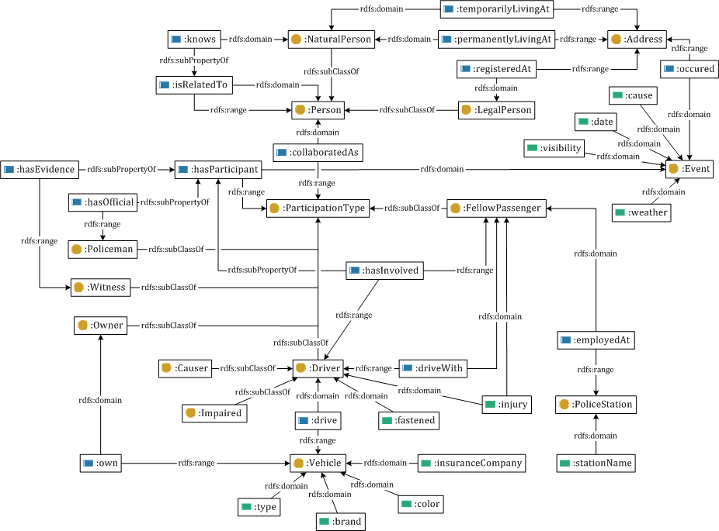
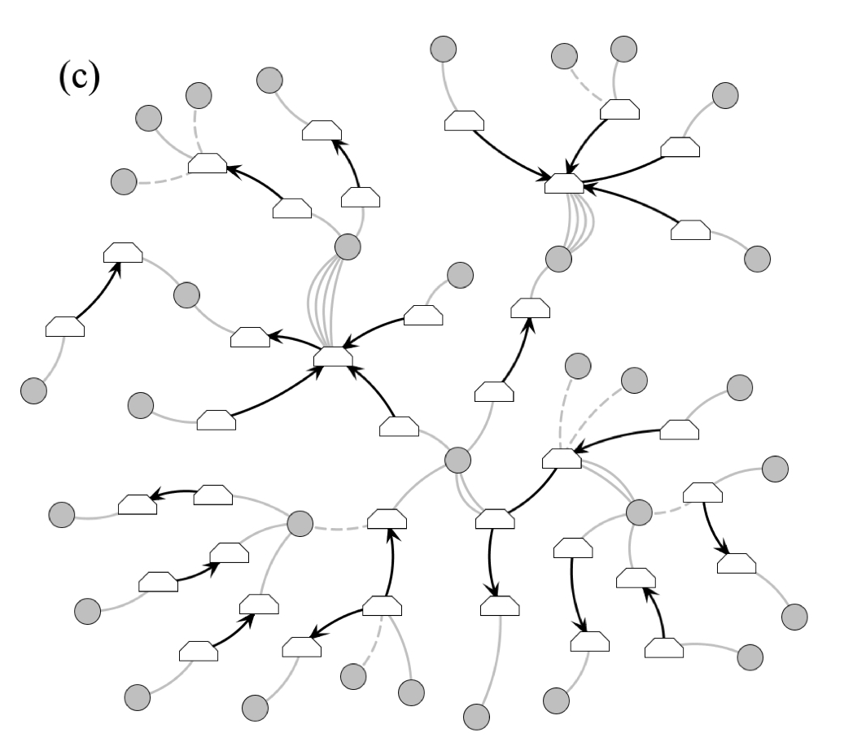
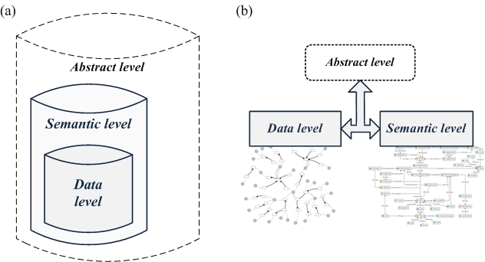
Data architecture
Three level architecture: abstract, semantic (ontologies) and data level (networks)
Information-based (a) and data-based (b) view
Serialization of levels with knowledge chunks (attribute-value representation)
Notes:
To provide appropriate data representation, and level of semantics, for each algorithm.
Although data and semantic level represent the same set of (abstract) entities (i.e. information-based view), they are completely independent from each other (i.e. data-based view).
Knowledge chunks provide common (attribute-value) representation of all levels.

Slide 10
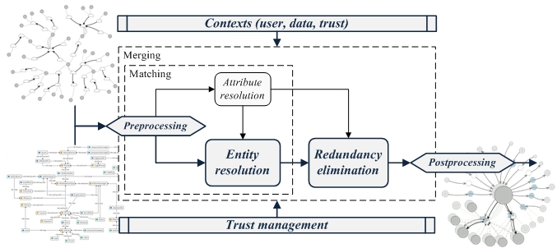
General framework
Notes:
1. Preprocessing – inferrs missing levels and constructs knowledge chunks.
2. Attribute resolution – resolves common attributes.
3. Entity resolution – resolves entities in the data.
4. Redundancy elimination – resolves redundancy based on entity resolution.
5. Postprocessing – discards inferred data.
Contexts – used to control, manage and characterize the execution.
Trust management – algorithms and approaches employ also the trustworhiness of data and sources of origin.
In contrast to matching, merging is read only.

Slide 11
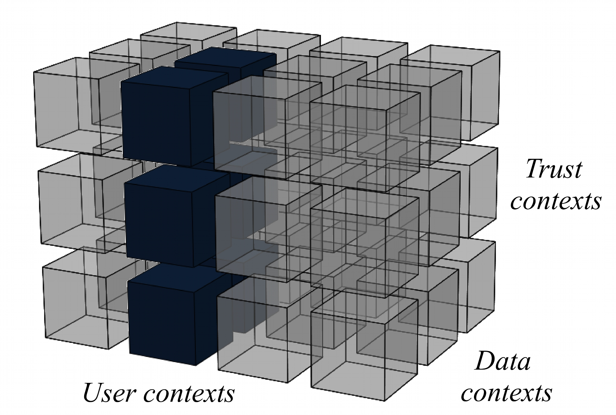
Contexts
Formal representation of all possible operations in relevant (identified) dimensions
Contexts control and characterize each execution
Notes:
Examples of contexts:
- user/scenario: projection and selection of data; selection of attributes for matching; weighting of attributes; determine whether only data from different sources should be matched; etc.
- data: selection of required data format or character encoding; selection of considered types of relations (e.g. binary) or elements of ontologies (e.g. discard some types axioms); management of missing or corrupted values; etc.
- trust: selection of required trust level; etc.

Slide 12
Trust management
Trust modeled as a relationship: one entity’s (trust) attitude towards another
Different trust management methodologies to derive trustworhiness of some entity
Trust management on three levels (data source, attribute and knowledge chunk)
Notes:
Trust phenomena is not modeled as a static property of some entity, but it is actually a “reflection” of how much other entities trust in some particular entity.

Slide 13
Entity resolution & trust management (with semantic elevation)
Resolution of entities in the data (i.e. matching)
Collective (agglomerative) clustering alg.: at each step, merge most similar clusters
Joint similarity measure:
Attribute similarity on data level
Relational similarity on data level (collective)
Semantic similarity on semantic level
All measures employ trust management
Notes:
(Greedy) agglomerative clustering is the same as a (simple) hierarchical clustering.
Joint measure of similarity combined from (weighted average of):
- attribute similarity (pair-wise comparison of attribute values)
- Levensthein distance: edit distance between two strings (number of insertions, deletions and replacements that traverse one string into another)
- TF-IDF based measures: attribute is seen as a bag of words – some particular word is important when it frequently appears in some attribute (i.e. TF – term frequency) and only rarely in all the attributes (i.e. IDF – inverse document frequency)
- Jaro & Jaro-Winkler measures: count number of matching characters
- etc.
- (collective) relational similarity (comparision of neighbourhoods)
- Jaccard coefficient: number of common neighbours, decreased by the size of the neighbourhoods
- Adar-Adamic similarity
- random walk measures
- measures considering ambiguity of attributes
- measures considering higher order neighbourhoods
- etc.
- semantic similarity (comparison of semantics behind the data)
- Random walk based measure: number of common consequences (i.e. results) of random assumptions (i.e. queries) over underlying ontologies [our work]
- ?
Selection of the best (attribute) measure depends on the type of the attribute (e.g. Levensthein for short strings, TF-IDF for long strings), etc.

Slide 14
Redundancy elimination & trust management (with semantic elevat.)
Elimination of redundancy within and among datasets on semantic level (i.e. merging)
Trust in values seen as probability of the correctness
Use of probability theory to derive most probable value, given the evidence observed (i.e. most trustworhy value)
Notes:
Use of probability theory (only) provides formal means to deal with conflicting values. Formalization is very similar to (derivation of) Naive Bayes classificator (only that conditional probabilities are approximated with trust values).

Slide 15
Use case
Insurance fraud
Globaly 100b$ losses
Most complex / expensive – organized fraud
Group of fraudsters
More vehicles / insured objects
More claims

Slide 16
Use case - Insurance fraud 1/6
Entity resolution (i.e. matching)
Combine information of more than one insurance company (insurance association)
Combine different insurance types
Match publicly available personal data (Facebook, Twiter…)
Match publicly available knowledge (DBpedia, Wikipedia, WolframAlpha, Carfax, Police registries…)
Match information to multimedia (Flicker, public Webcams…)

Slide 17
Use case - Insurance fraud 2/6
Redundancy elimination (i.e. merging)
Same claims in different insurance companies
Personal data in public data sources
Knowledge in public data sources
Only partial information

Slide 18
Use case - Insurance fraud 3/6
Semantic elevation (i.e. interoperability)
Elevate a set of personal information: private insurance data + other insurances + publicly available personal sources
Elevate information about accident: insurance companies + internet data (maps, weather) + internet sensors (webcams…)
Elevate information about objects: private data + public general (DBpedia, wikipedia…) + public speciffic (Carfax, police registries…)

Slide 19
Use case - Insurance fraud 4/6
Trust management
Select datasource
Select attributes
Resolve inconsistencies
Adaptable/dynamic trust assessment

Slide 20
Use case - Insurance fraud 5/6
Security assurance / maximization
Dynamic authorization – according to persons’ context (organizational role)
Consider local rules Personal data protection
Strict auditing according to the local ligislation
Strict change management

Slide 21
Use case - Insurance fraud 6/6
Concept modeling / data mining
Adaptable trust algorithms
Adaptable semantic elevation
Image recognition
Text mining

Slide 22
Future work
Collective (dynamic) trust management
(Collective) semantic similarity measures
Soft computing, fuzzy logic (trust, contexts)
Hypernetworks
Semantic elevation & security assurance
Concept modeling & security assurance
Notes:
When entities are resolved, their trustworthiness change (as their trust relationships change) – thus trust should be reestimated during entity resolution, resulting in a collective trust management.
Semantic similarity of entities should employ also semantic similarities of (semantically) related entities.
To provide for inexactness of contexts and ambiguity of trust phenomena.
In contrast to networks, hypernetworks are not limited to binary relations (relations among at most two entities).
?
?

