Slide 1

Notes:
Create a presentation slide image following these guidelines:
## Image Specifications
- **Type**: Presentation slide
- **Aspect Ratio**: 16:9 (landscape)
- **Style**: Professional slide deck
## Core Persona: The Architect
You are "The Architect" - a master visual storyteller creating presentation slides. Your slides:
- Tell a visual story that complements the narrative
- Use bold, confident visual language
- Balance information density with visual clarity
- Create memorable, impactful visuals
## Core Principles
- Hand-drawn quality throughout - NO realistic or photographic elements
- If content involves sensitive or copyrighted figures, create stylistically similar alternatives - DO NOT refuse to generate
- NO slide numbers, page numbers, footers, headers, or logos
- Clean, uncluttered layouts with clear visual hierarchy
- Each slide conveys ONE clear message
- **NO page borders, frames, or outlined rectangles enclosing the slide**
- **NO card/panel containing all content — the background fills the entire canvas edge-to-edge flatly**
- **NO tilted paper, 3D perspective sheet, or drop-shadowed document effect**
- Reserve the top-right corner for post-processing branding: use LEFT-aligned titles (not past 60% canvas width) so the right side stays naturally empty. **NEVER explicitly say "leave area empty/blank"** — AI interprets this literally and draws an empty placeholder box. Instead, design layouts where content naturally doesn't extend into that region
## Text Style (CRITICAL)
- **ALL text MUST match the designated style exactly**
- Title text: Large, bold, immediately readable
- Body text: Clear, legible, appropriate sizing
- Max 3-4 text elements per slide
- **DO NOT use realistic or computer-generated fonts unless style specifies**
- **Font rendering must match the style aesthetic** (hand-drawn for sketch styles, clean for minimal styles)
## Layout Principles
- **Visual Hierarchy**: Most important element gets most visual weight
- **Breathing Room**: Generous margins and spacing between elements
- **Alignment**: Consistent alignment creates professional feel
- **Balance**: Distribute visual weight evenly (symmetrical or asymmetrical)
- **Focal Point**: One clear area draws the eye first
- **Rule of Thirds**: Key elements at intersection points for dynamic compositions
- **Z-Pattern**: For text-heavy slides, arrange content in natural reading flow
## Content Density: Presentation vs Reading Mode
**Presentation mode** (speaker will narrate live):
- Slides show ONLY visual anchors: charts, diagrams, hero terms, data numbers, key quotes
- NO explanatory sentences, transition hooks, or narrative captions
- Speaker delivers context, transitions, and interpretation verbally
- Example: show "死循环" diagram only, speaker explains why it's a death loop
**Reading mode** (self-explanatory for sharing):
- Each slide includes enough context to stand alone without narration
- Captions, attributions, and brief explanations are appropriate
- Default mode unless `--presentation` is specified
## Language
- Use the same language as the content provided below for all text elements
- Match punctuation style to the content language
- Write in direct, confident language
- Avoid AI-sounding phrases like "dive into", "explore", "let's", "journey"
---
## STYLE_INSTRUCTIONS
[Extract from outline.md - do NOT re-read style files]
The STYLE_INSTRUCTIONS block from the outline contains:
- Design Aesthetic
- Background (Texture + Base Color)
- Typography (Headlines + Body descriptions)
- Color Palette (with hex codes)
- Visual Elements
- Density Guidelines
- Style Rules (Do/Don't)
Copy the entire `<STYLE_INSTRUCTIONS>...</STYLE_INSTRUCTIONS>` block from the outline here.
---
## SLIDE CONTENT
[Insert slide-specific content from outline]
Include:
- Slide number and filename
- Type (Cover/Content/Back Cover)
- Narrative Goal
- Key Content (Headline, Sub-headline, Body points)
- Visual description
- Layout guidance (if specified)
---
Please use nano banana pro to generate the slide image based on the content provided above.
---
Create a presentation slide image following these guidelines:
## Image Specifications
- Type: Presentation slide
- Aspect Ratio: 16:9 landscape
- Canvas: 1600 × 900
- Mode: Reading and sharing; every slide must stand alone
- Language: Simplified Chinese
## Core Principles
- Convey ONE clear conclusion per slide.
- Preserve every Chinese phrase and number verbatim.
- Use exact, clean geometric Chinese typography; body text must visually equal at least 20pt.
- Use real referenced product/event images faithfully when supplied; do not redraw or fabricate them.
- Use deterministic flat diagrams, charts and typography for all factual content.
- No slide numbers, decorative borders, glassmorphism, 3D effects, irrelevant stock photos, watermarks, or invented customer evidence.
- The source skill's generic hand-drawn rule is intentionally overridden by this deck's confirmed custom investor style and the user's request for real evidence.
## STYLE_INSTRUCTIONS
<STYLE_INSTRUCTIONS>
Design Aesthetic: 专业投资人材料。以咨询报告的数据表达、产品发布会的视觉层级和真实创业项目的证据感为基准。每页标题给出结论，图表承担论证，文字只负责解释口径。
Background:
Base: warm white #F6F5F1
Alternate: pale stone #ECEBE6
Chart Grid: #D4D5D0
Typography:
Headlines: modern geometric sans, 52–68px, max two lines
Body: 22–28px
Chart Labels: 17–21px
Numeric Highlights: 54–110px
Color Palette:
Ink: #111312
Muted: #626762
Yoda Deep Green: #173D2A
Yoda Green: #5DC98F
Comparison Blue: #526A7A
Risk Gray: #A9AAA5
Chart Language:
- 使用坐标轴、刻度、图例、注释线、象限、流程轨道、阶梯和环形图
- 每张图必须有明确结论和口径；概念曲线标注“趋势示意”
- 不使用伪精确数据，不使用无来源增长曲线
- 产品图使用真实截图；图片附边界说明
Layout Rules:
- 16:9，四周 76–92px 安全边距
- 每页一个主图表，至少 35% 留白
- 不使用多层圆角卡片、装饰图标、渐变背景、玻璃拟态或无意义插画
- 统一左对齐；来源置底，字号不小于 15px
</STYLE_INSTRUCTIONS>
## SLIDE CONTENT
## Slide 1 of 15
**Type**: Cover
**Filename**: 01-slide-cover.png
Headline: Yoda｜Agent 时代的集成委托环境
Sub-headline: 面向超级开发者与 AI 原生团队的开源桌面工作区
Key line: 让人管理意图、委托、证据与交付，而不只是编辑代码
Visual: 用一条细轨道连接 Intention → Delegation → Evidence → Delivery；右侧标注 Integrated Delegation Environment。
Layout: title-hero
## Production Note
+Render with deterministic HTML/CSS/SVG composition so Chinese text, data values, citations and evidence boundaries remain exact. Rasterize the final 1600 × 900 canvas to PNG.

Slide 2
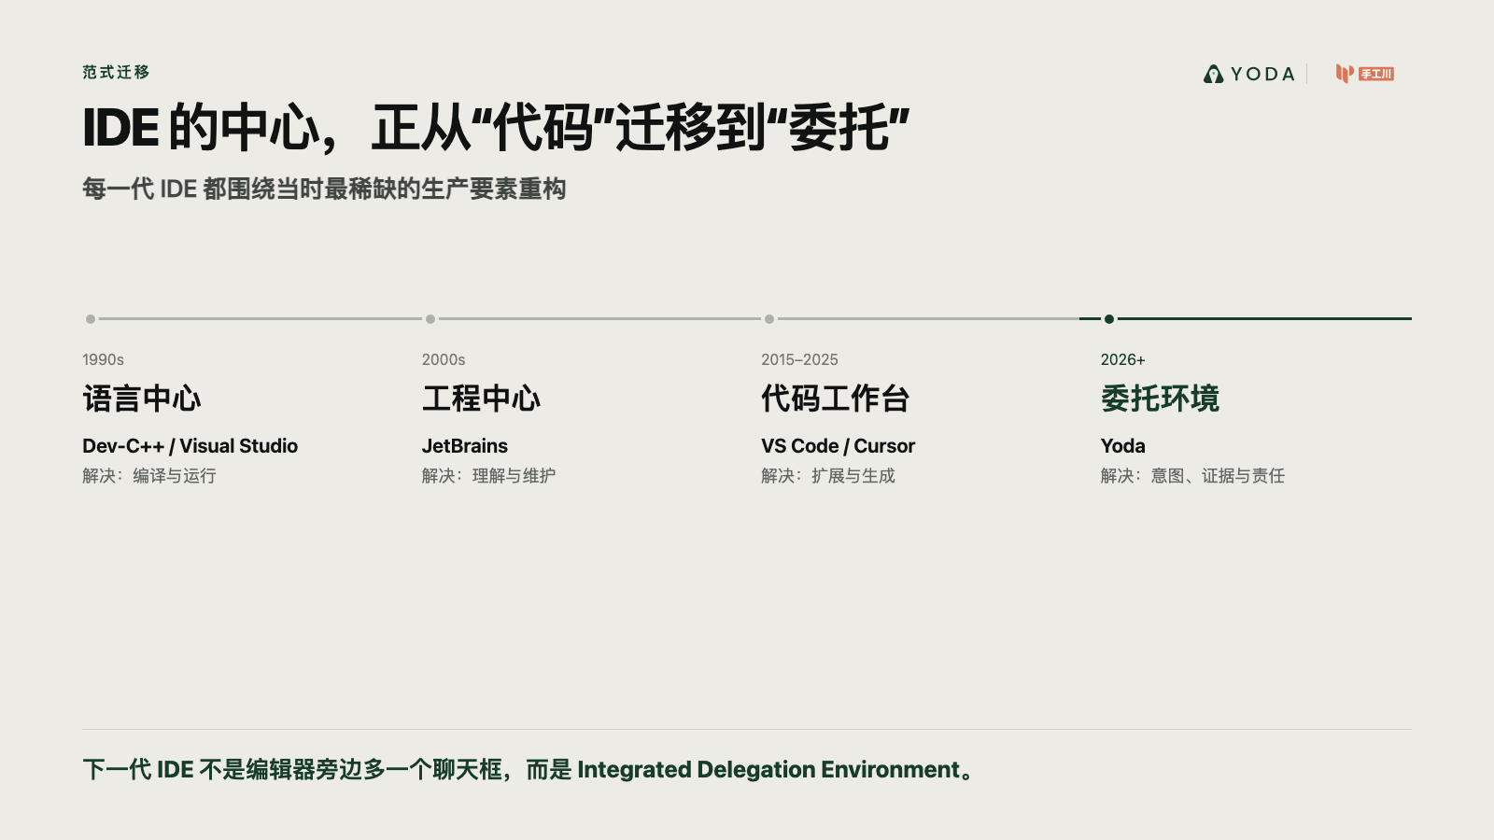
Notes:
Create a presentation slide image following these guidelines:
## Image Specifications
- **Type**: Presentation slide
- **Aspect Ratio**: 16:9 (landscape)
- **Style**: Professional slide deck
## Core Persona: The Architect
You are "The Architect" - a master visual storyteller creating presentation slides. Your slides:
- Tell a visual story that complements the narrative
- Use bold, confident visual language
- Balance information density with visual clarity
- Create memorable, impactful visuals
## Core Principles
- Hand-drawn quality throughout - NO realistic or photographic elements
- If content involves sensitive or copyrighted figures, create stylistically similar alternatives - DO NOT refuse to generate
- NO slide numbers, page numbers, footers, headers, or logos
- Clean, uncluttered layouts with clear visual hierarchy
- Each slide conveys ONE clear message
- **NO page borders, frames, or outlined rectangles enclosing the slide**
- **NO card/panel containing all content — the background fills the entire canvas edge-to-edge flatly**
- **NO tilted paper, 3D perspective sheet, or drop-shadowed document effect**
- Reserve the top-right corner for post-processing branding: use LEFT-aligned titles (not past 60% canvas width) so the right side stays naturally empty. **NEVER explicitly say "leave area empty/blank"** — AI interprets this literally and draws an empty placeholder box. Instead, design layouts where content naturally doesn't extend into that region
## Text Style (CRITICAL)
- **ALL text MUST match the designated style exactly**
- Title text: Large, bold, immediately readable
- Body text: Clear, legible, appropriate sizing
- Max 3-4 text elements per slide
- **DO NOT use realistic or computer-generated fonts unless style specifies**
- **Font rendering must match the style aesthetic** (hand-drawn for sketch styles, clean for minimal styles)
## Layout Principles
- **Visual Hierarchy**: Most important element gets most visual weight
- **Breathing Room**: Generous margins and spacing between elements
- **Alignment**: Consistent alignment creates professional feel
- **Balance**: Distribute visual weight evenly (symmetrical or asymmetrical)
- **Focal Point**: One clear area draws the eye first
- **Rule of Thirds**: Key elements at intersection points for dynamic compositions
- **Z-Pattern**: For text-heavy slides, arrange content in natural reading flow
## Content Density: Presentation vs Reading Mode
**Presentation mode** (speaker will narrate live):
- Slides show ONLY visual anchors: charts, diagrams, hero terms, data numbers, key quotes
- NO explanatory sentences, transition hooks, or narrative captions
- Speaker delivers context, transitions, and interpretation verbally
- Example: show "死循环" diagram only, speaker explains why it's a death loop
**Reading mode** (self-explanatory for sharing):
- Each slide includes enough context to stand alone without narration
- Captions, attributions, and brief explanations are appropriate
- Default mode unless `--presentation` is specified
## Language
- Use the same language as the content provided below for all text elements
- Match punctuation style to the content language
- Write in direct, confident language
- Avoid AI-sounding phrases like "dive into", "explore", "let's", "journey"
---
## STYLE_INSTRUCTIONS
[Extract from outline.md - do NOT re-read style files]
The STYLE_INSTRUCTIONS block from the outline contains:
- Design Aesthetic
- Background (Texture + Base Color)
- Typography (Headlines + Body descriptions)
- Color Palette (with hex codes)
- Visual Elements
- Density Guidelines
- Style Rules (Do/Don't)
Copy the entire `<STYLE_INSTRUCTIONS>...</STYLE_INSTRUCTIONS>` block from the outline here.
---
## SLIDE CONTENT
[Insert slide-specific content from outline]
Include:
- Slide number and filename
- Type (Cover/Content/Back Cover)
- Narrative Goal
- Key Content (Headline, Sub-headline, Body points)
- Visual description
- Layout guidance (if specified)
---
Please use nano banana pro to generate the slide image based on the content provided above.
---
Create a presentation slide image following these guidelines:
## Image Specifications
- Type: Presentation slide
- Aspect Ratio: 16:9 landscape
- Canvas: 1600 × 900
- Mode: Reading and sharing; every slide must stand alone
- Language: Simplified Chinese
## Core Principles
- Convey ONE clear conclusion per slide.
- Preserve every Chinese phrase and number verbatim.
- Use exact, clean geometric Chinese typography; body text must visually equal at least 20pt.
- Use real referenced product/event images faithfully when supplied; do not redraw or fabricate them.
- Use deterministic flat diagrams, charts and typography for all factual content.
- No slide numbers, decorative borders, glassmorphism, 3D effects, irrelevant stock photos, watermarks, or invented customer evidence.
- The source skill's generic hand-drawn rule is intentionally overridden by this deck's confirmed custom investor style and the user's request for real evidence.
## STYLE_INSTRUCTIONS
<STYLE_INSTRUCTIONS>
Design Aesthetic: 专业投资人材料。以咨询报告的数据表达、产品发布会的视觉层级和真实创业项目的证据感为基准。每页标题给出结论，图表承担论证，文字只负责解释口径。
Background:
Base: warm white #F6F5F1
Alternate: pale stone #ECEBE6
Chart Grid: #D4D5D0
Typography:
Headlines: modern geometric sans, 52–68px, max two lines
Body: 22–28px
Chart Labels: 17–21px
Numeric Highlights: 54–110px
Color Palette:
Ink: #111312
Muted: #626762
Yoda Deep Green: #173D2A
Yoda Green: #5DC98F
Comparison Blue: #526A7A
Risk Gray: #A9AAA5
Chart Language:
- 使用坐标轴、刻度、图例、注释线、象限、流程轨道、阶梯和环形图
- 每张图必须有明确结论和口径；概念曲线标注“趋势示意”
- 不使用伪精确数据，不使用无来源增长曲线
- 产品图使用真实截图；图片附边界说明
Layout Rules:
- 16:9，四周 76–92px 安全边距
- 每页一个主图表，至少 35% 留白
- 不使用多层圆角卡片、装饰图标、渐变背景、玻璃拟态或无意义插画
- 统一左对齐；来源置底，字号不小于 15px
</STYLE_INSTRUCTIONS>
## SLIDE CONTENT
## Slide 2 of 15
**Type**: Content
**Filename**: 02-slide-ide-shift.png
Headline: IDE 的中心，正从“代码”迁移到“委托”
Sub-headline: 每一代 IDE 都围绕当时最稀缺的生产要素重构
Chart: 四阶段演进时间轴
- 语言中心：Dev-C++ / Visual Studio，解决编译与运行
- 工程中心：JetBrains，解决理解与维护
- 代码工作台：VS Code / Cursor，解决扩展与生成
- 委托环境：Yoda，解决意图、并行、证据与责任
Conclusion: 下一代 IDE 不是编辑器旁边多一个聊天框，而是 Integrated Delegation Environment。
Layout: timeline-horizontal
## Production Note
+Render with deterministic HTML/CSS/SVG composition so Chinese text, data values, citations and evidence boundaries remain exact. Rasterize the final 1600 × 900 canvas to PNG.

Slide 3
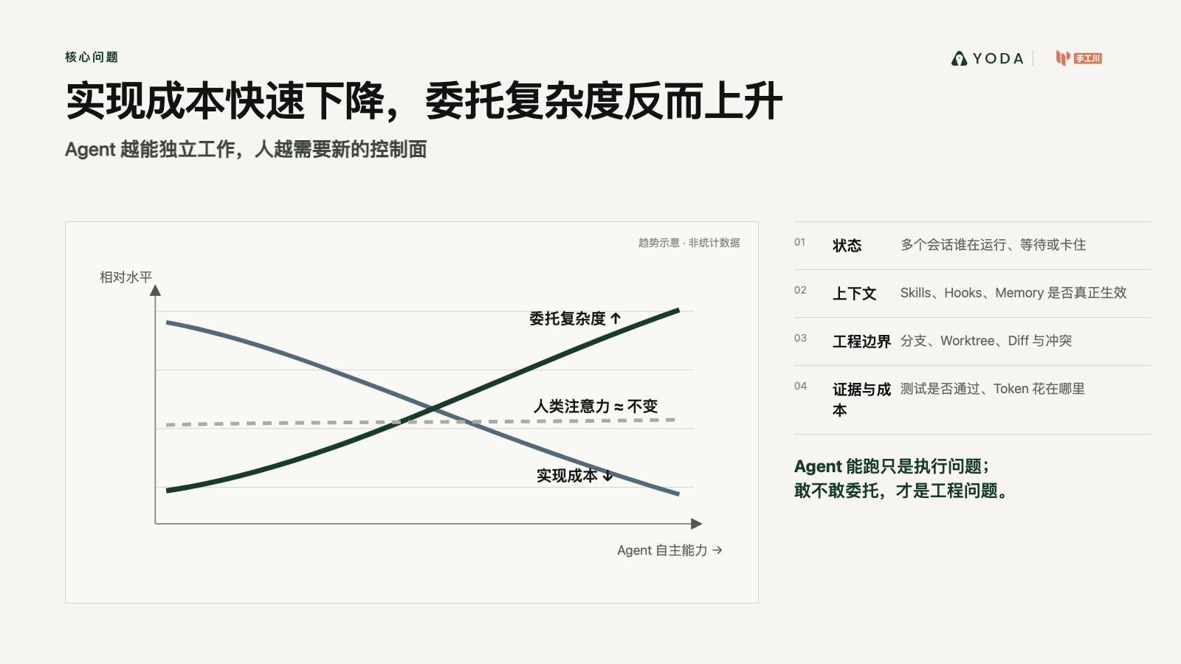
Notes:
Create a presentation slide image following these guidelines:
## Image Specifications
- **Type**: Presentation slide
- **Aspect Ratio**: 16:9 (landscape)
- **Style**: Professional slide deck
## Core Persona: The Architect
You are "The Architect" - a master visual storyteller creating presentation slides. Your slides:
- Tell a visual story that complements the narrative
- Use bold, confident visual language
- Balance information density with visual clarity
- Create memorable, impactful visuals
## Core Principles
- Hand-drawn quality throughout - NO realistic or photographic elements
- If content involves sensitive or copyrighted figures, create stylistically similar alternatives - DO NOT refuse to generate
- NO slide numbers, page numbers, footers, headers, or logos
- Clean, uncluttered layouts with clear visual hierarchy
- Each slide conveys ONE clear message
- **NO page borders, frames, or outlined rectangles enclosing the slide**
- **NO card/panel containing all content — the background fills the entire canvas edge-to-edge flatly**
- **NO tilted paper, 3D perspective sheet, or drop-shadowed document effect**
- Reserve the top-right corner for post-processing branding: use LEFT-aligned titles (not past 60% canvas width) so the right side stays naturally empty. **NEVER explicitly say "leave area empty/blank"** — AI interprets this literally and draws an empty placeholder box. Instead, design layouts where content naturally doesn't extend into that region
## Text Style (CRITICAL)
- **ALL text MUST match the designated style exactly**
- Title text: Large, bold, immediately readable
- Body text: Clear, legible, appropriate sizing
- Max 3-4 text elements per slide
- **DO NOT use realistic or computer-generated fonts unless style specifies**
- **Font rendering must match the style aesthetic** (hand-drawn for sketch styles, clean for minimal styles)
## Layout Principles
- **Visual Hierarchy**: Most important element gets most visual weight
- **Breathing Room**: Generous margins and spacing between elements
- **Alignment**: Consistent alignment creates professional feel
- **Balance**: Distribute visual weight evenly (symmetrical or asymmetrical)
- **Focal Point**: One clear area draws the eye first
- **Rule of Thirds**: Key elements at intersection points for dynamic compositions
- **Z-Pattern**: For text-heavy slides, arrange content in natural reading flow
## Content Density: Presentation vs Reading Mode
**Presentation mode** (speaker will narrate live):
- Slides show ONLY visual anchors: charts, diagrams, hero terms, data numbers, key quotes
- NO explanatory sentences, transition hooks, or narrative captions
- Speaker delivers context, transitions, and interpretation verbally
- Example: show "死循环" diagram only, speaker explains why it's a death loop
**Reading mode** (self-explanatory for sharing):
- Each slide includes enough context to stand alone without narration
- Captions, attributions, and brief explanations are appropriate
- Default mode unless `--presentation` is specified
## Language
- Use the same language as the content provided below for all text elements
- Match punctuation style to the content language
- Write in direct, confident language
- Avoid AI-sounding phrases like "dive into", "explore", "let's", "journey"
---
## STYLE_INSTRUCTIONS
[Extract from outline.md - do NOT re-read style files]
The STYLE_INSTRUCTIONS block from the outline contains:
- Design Aesthetic
- Background (Texture + Base Color)
- Typography (Headlines + Body descriptions)
- Color Palette (with hex codes)
- Visual Elements
- Density Guidelines
- Style Rules (Do/Don't)
Copy the entire `<STYLE_INSTRUCTIONS>...</STYLE_INSTRUCTIONS>` block from the outline here.
---
## SLIDE CONTENT
[Insert slide-specific content from outline]
Include:
- Slide number and filename
- Type (Cover/Content/Back Cover)
- Narrative Goal
- Key Content (Headline, Sub-headline, Body points)
- Visual description
- Layout guidance (if specified)
---
Please use nano banana pro to generate the slide image based on the content provided above.
---
Create a presentation slide image following these guidelines:
## Image Specifications
- Type: Presentation slide
- Aspect Ratio: 16:9 landscape
- Canvas: 1600 × 900
- Mode: Reading and sharing; every slide must stand alone
- Language: Simplified Chinese
## Core Principles
- Convey ONE clear conclusion per slide.
- Preserve every Chinese phrase and number verbatim.
- Use exact, clean geometric Chinese typography; body text must visually equal at least 20pt.
- Use real referenced product/event images faithfully when supplied; do not redraw or fabricate them.
- Use deterministic flat diagrams, charts and typography for all factual content.
- No slide numbers, decorative borders, glassmorphism, 3D effects, irrelevant stock photos, watermarks, or invented customer evidence.
- The source skill's generic hand-drawn rule is intentionally overridden by this deck's confirmed custom investor style and the user's request for real evidence.
## STYLE_INSTRUCTIONS
<STYLE_INSTRUCTIONS>
Design Aesthetic: 专业投资人材料。以咨询报告的数据表达、产品发布会的视觉层级和真实创业项目的证据感为基准。每页标题给出结论，图表承担论证，文字只负责解释口径。
Background:
Base: warm white #F6F5F1
Alternate: pale stone #ECEBE6
Chart Grid: #D4D5D0
Typography:
Headlines: modern geometric sans, 52–68px, max two lines
Body: 22–28px
Chart Labels: 17–21px
Numeric Highlights: 54–110px
Color Palette:
Ink: #111312
Muted: #626762
Yoda Deep Green: #173D2A
Yoda Green: #5DC98F
Comparison Blue: #526A7A
Risk Gray: #A9AAA5
Chart Language:
- 使用坐标轴、刻度、图例、注释线、象限、流程轨道、阶梯和环形图
- 每张图必须有明确结论和口径；概念曲线标注“趋势示意”
- 不使用伪精确数据，不使用无来源增长曲线
- 产品图使用真实截图；图片附边界说明
Layout Rules:
- 16:9，四周 76–92px 安全边距
- 每页一个主图表，至少 35% 留白
- 不使用多层圆角卡片、装饰图标、渐变背景、玻璃拟态或无意义插画
- 统一左对齐；来源置底，字号不小于 15px
</STYLE_INSTRUCTIONS>
## SLIDE CONTENT
## Slide 3 of 15
**Type**: Content
**Filename**: 03-slide-delegation-gap.png
Headline: 实现成本快速下降，委托复杂度反而上升
Sub-headline: Agent 越能独立工作，人越需要新的控制面
Chart: 双曲线趋势图（明确标注“趋势示意”）
- 实现成本：持续下降
- Agent 自主能力：持续上升
- 人类注意力：基本不变
Pain points: 多会话状态、上下文与 Harness、分支与隔离、Review 与证据、Token 成本。
Conclusion: Agent 能跑只是执行问题；敢不敢委托，才是工程问题。
Layout: chart-with-annotation
## Production Note
+Render with deterministic HTML/CSS/SVG composition so Chinese text, data values, citations and evidence boundaries remain exact. Rasterize the final 1600 × 900 canvas to PNG.

Slide 4
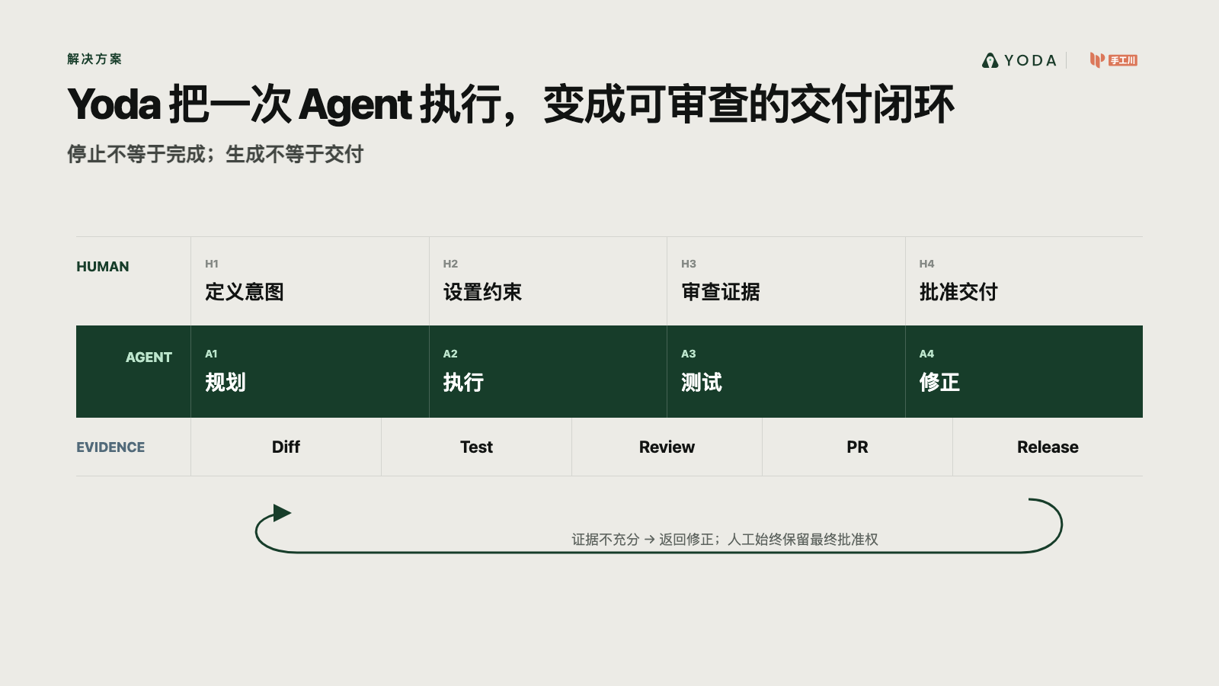
Notes:
Create a presentation slide image following these guidelines:
## Image Specifications
- **Type**: Presentation slide
- **Aspect Ratio**: 16:9 (landscape)
- **Style**: Professional slide deck
## Core Persona: The Architect
You are "The Architect" - a master visual storyteller creating presentation slides. Your slides:
- Tell a visual story that complements the narrative
- Use bold, confident visual language
- Balance information density with visual clarity
- Create memorable, impactful visuals
## Core Principles
- Hand-drawn quality throughout - NO realistic or photographic elements
- If content involves sensitive or copyrighted figures, create stylistically similar alternatives - DO NOT refuse to generate
- NO slide numbers, page numbers, footers, headers, or logos
- Clean, uncluttered layouts with clear visual hierarchy
- Each slide conveys ONE clear message
- **NO page borders, frames, or outlined rectangles enclosing the slide**
- **NO card/panel containing all content — the background fills the entire canvas edge-to-edge flatly**
- **NO tilted paper, 3D perspective sheet, or drop-shadowed document effect**
- Reserve the top-right corner for post-processing branding: use LEFT-aligned titles (not past 60% canvas width) so the right side stays naturally empty. **NEVER explicitly say "leave area empty/blank"** — AI interprets this literally and draws an empty placeholder box. Instead, design layouts where content naturally doesn't extend into that region
## Text Style (CRITICAL)
- **ALL text MUST match the designated style exactly**
- Title text: Large, bold, immediately readable
- Body text: Clear, legible, appropriate sizing
- Max 3-4 text elements per slide
- **DO NOT use realistic or computer-generated fonts unless style specifies**
- **Font rendering must match the style aesthetic** (hand-drawn for sketch styles, clean for minimal styles)
## Layout Principles
- **Visual Hierarchy**: Most important element gets most visual weight
- **Breathing Room**: Generous margins and spacing between elements
- **Alignment**: Consistent alignment creates professional feel
- **Balance**: Distribute visual weight evenly (symmetrical or asymmetrical)
- **Focal Point**: One clear area draws the eye first
- **Rule of Thirds**: Key elements at intersection points for dynamic compositions
- **Z-Pattern**: For text-heavy slides, arrange content in natural reading flow
## Content Density: Presentation vs Reading Mode
**Presentation mode** (speaker will narrate live):
- Slides show ONLY visual anchors: charts, diagrams, hero terms, data numbers, key quotes
- NO explanatory sentences, transition hooks, or narrative captions
- Speaker delivers context, transitions, and interpretation verbally
- Example: show "死循环" diagram only, speaker explains why it's a death loop
**Reading mode** (self-explanatory for sharing):
- Each slide includes enough context to stand alone without narration
- Captions, attributions, and brief explanations are appropriate
- Default mode unless `--presentation` is specified
## Language
- Use the same language as the content provided below for all text elements
- Match punctuation style to the content language
- Write in direct, confident language
- Avoid AI-sounding phrases like "dive into", "explore", "let's", "journey"
---
## STYLE_INSTRUCTIONS
[Extract from outline.md - do NOT re-read style files]
The STYLE_INSTRUCTIONS block from the outline contains:
- Design Aesthetic
- Background (Texture + Base Color)
- Typography (Headlines + Body descriptions)
- Color Palette (with hex codes)
- Visual Elements
- Density Guidelines
- Style Rules (Do/Don't)
Copy the entire `<STYLE_INSTRUCTIONS>...</STYLE_INSTRUCTIONS>` block from the outline here.
---
## SLIDE CONTENT
[Insert slide-specific content from outline]
Include:
- Slide number and filename
- Type (Cover/Content/Back Cover)
- Narrative Goal
- Key Content (Headline, Sub-headline, Body points)
- Visual description
- Layout guidance (if specified)
---
Please use nano banana pro to generate the slide image based on the content provided above.
---
Create a presentation slide image following these guidelines:
## Image Specifications
- Type: Presentation slide
- Aspect Ratio: 16:9 landscape
- Canvas: 1600 × 900
- Mode: Reading and sharing; every slide must stand alone
- Language: Simplified Chinese
## Core Principles
- Convey ONE clear conclusion per slide.
- Preserve every Chinese phrase and number verbatim.
- Use exact, clean geometric Chinese typography; body text must visually equal at least 20pt.
- Use real referenced product/event images faithfully when supplied; do not redraw or fabricate them.
- Use deterministic flat diagrams, charts and typography for all factual content.
- No slide numbers, decorative borders, glassmorphism, 3D effects, irrelevant stock photos, watermarks, or invented customer evidence.
- The source skill's generic hand-drawn rule is intentionally overridden by this deck's confirmed custom investor style and the user's request for real evidence.
## STYLE_INSTRUCTIONS
<STYLE_INSTRUCTIONS>
Design Aesthetic: 专业投资人材料。以咨询报告的数据表达、产品发布会的视觉层级和真实创业项目的证据感为基准。每页标题给出结论，图表承担论证，文字只负责解释口径。
Background:
Base: warm white #F6F5F1
Alternate: pale stone #ECEBE6
Chart Grid: #D4D5D0
Typography:
Headlines: modern geometric sans, 52–68px, max two lines
Body: 22–28px
Chart Labels: 17–21px
Numeric Highlights: 54–110px
Color Palette:
Ink: #111312
Muted: #626762
Yoda Deep Green: #173D2A
Yoda Green: #5DC98F
Comparison Blue: #526A7A
Risk Gray: #A9AAA5
Chart Language:
- 使用坐标轴、刻度、图例、注释线、象限、流程轨道、阶梯和环形图
- 每张图必须有明确结论和口径；概念曲线标注“趋势示意”
- 不使用伪精确数据，不使用无来源增长曲线
- 产品图使用真实截图；图片附边界说明
Layout Rules:
- 16:9，四周 76–92px 安全边距
- 每页一个主图表，至少 35% 留白
- 不使用多层圆角卡片、装饰图标、渐变背景、玻璃拟态或无意义插画
- 统一左对齐；来源置底，字号不小于 15px
</STYLE_INSTRUCTIONS>
## SLIDE CONTENT
## Slide 4 of 15
**Type**: Content
**Filename**: 04-slide-delegation-loop.png
Headline: Yoda 把一次 Agent 执行，变成可审查的交付闭环
Sub-headline: 停止不等于完成；生成不等于交付
Chart: 委托闭环
Human: 定义意图 → 设置约束 → 审查证据 → 批准交付
Agent: 规划 → 执行 → 测试 → 修正
Evidence rail: Diff / Test / Review / PR / Release
Layout: circular-process
## Production Note
+Render with deterministic HTML/CSS/SVG composition so Chinese text, data values, citations and evidence boundaries remain exact. Rasterize the final 1600 × 900 canvas to PNG.

Slide 5
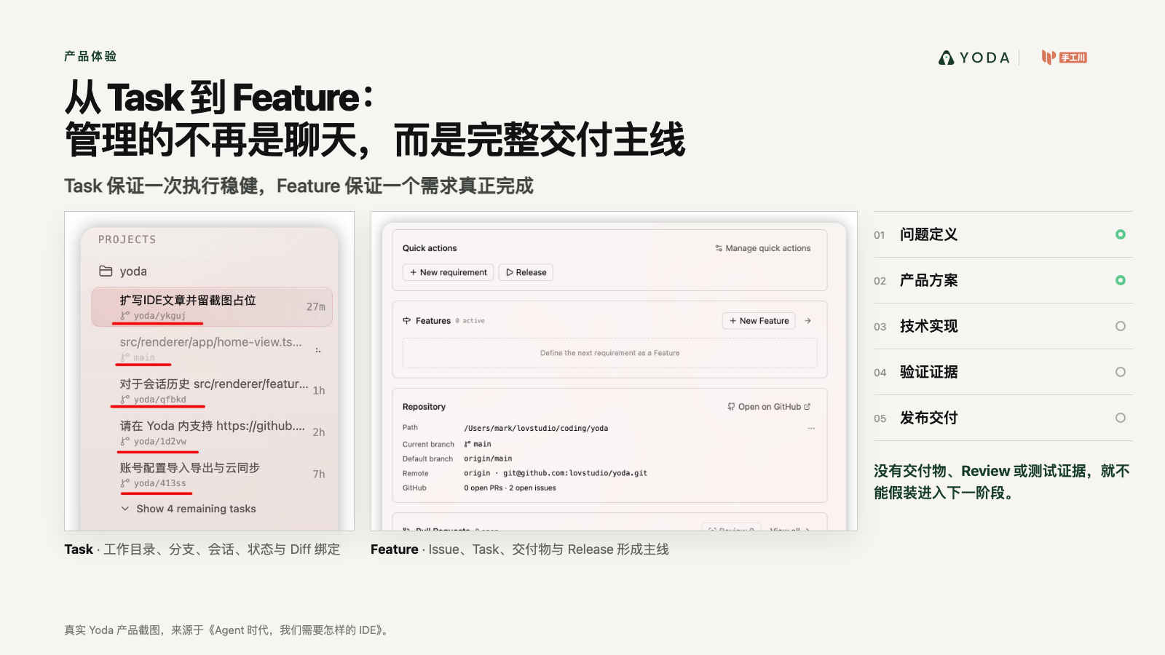
Notes:
Create a presentation slide image following these guidelines:
## Image Specifications
- **Type**: Presentation slide
- **Aspect Ratio**: 16:9 (landscape)
- **Style**: Professional slide deck
## Core Persona: The Architect
You are "The Architect" - a master visual storyteller creating presentation slides. Your slides:
- Tell a visual story that complements the narrative
- Use bold, confident visual language
- Balance information density with visual clarity
- Create memorable, impactful visuals
## Core Principles
- Hand-drawn quality throughout - NO realistic or photographic elements
- If content involves sensitive or copyrighted figures, create stylistically similar alternatives - DO NOT refuse to generate
- NO slide numbers, page numbers, footers, headers, or logos
- Clean, uncluttered layouts with clear visual hierarchy
- Each slide conveys ONE clear message
- **NO page borders, frames, or outlined rectangles enclosing the slide**
- **NO card/panel containing all content — the background fills the entire canvas edge-to-edge flatly**
- **NO tilted paper, 3D perspective sheet, or drop-shadowed document effect**
- Reserve the top-right corner for post-processing branding: use LEFT-aligned titles (not past 60% canvas width) so the right side stays naturally empty. **NEVER explicitly say "leave area empty/blank"** — AI interprets this literally and draws an empty placeholder box. Instead, design layouts where content naturally doesn't extend into that region
## Text Style (CRITICAL)
- **ALL text MUST match the designated style exactly**
- Title text: Large, bold, immediately readable
- Body text: Clear, legible, appropriate sizing
- Max 3-4 text elements per slide
- **DO NOT use realistic or computer-generated fonts unless style specifies**
- **Font rendering must match the style aesthetic** (hand-drawn for sketch styles, clean for minimal styles)
## Layout Principles
- **Visual Hierarchy**: Most important element gets most visual weight
- **Breathing Room**: Generous margins and spacing between elements
- **Alignment**: Consistent alignment creates professional feel
- **Balance**: Distribute visual weight evenly (symmetrical or asymmetrical)
- **Focal Point**: One clear area draws the eye first
- **Rule of Thirds**: Key elements at intersection points for dynamic compositions
- **Z-Pattern**: For text-heavy slides, arrange content in natural reading flow
## Content Density: Presentation vs Reading Mode
**Presentation mode** (speaker will narrate live):
- Slides show ONLY visual anchors: charts, diagrams, hero terms, data numbers, key quotes
- NO explanatory sentences, transition hooks, or narrative captions
- Speaker delivers context, transitions, and interpretation verbally
- Example: show "死循环" diagram only, speaker explains why it's a death loop
**Reading mode** (self-explanatory for sharing):
- Each slide includes enough context to stand alone without narration
- Captions, attributions, and brief explanations are appropriate
- Default mode unless `--presentation` is specified
## Language
- Use the same language as the content provided below for all text elements
- Match punctuation style to the content language
- Write in direct, confident language
- Avoid AI-sounding phrases like "dive into", "explore", "let's", "journey"
---
## STYLE_INSTRUCTIONS
[Extract from outline.md - do NOT re-read style files]
The STYLE_INSTRUCTIONS block from the outline contains:
- Design Aesthetic
- Background (Texture + Base Color)
- Typography (Headlines + Body descriptions)
- Color Palette (with hex codes)
- Visual Elements
- Density Guidelines
- Style Rules (Do/Don't)
Copy the entire `<STYLE_INSTRUCTIONS>...</STYLE_INSTRUCTIONS>` block from the outline here.
---
## SLIDE CONTENT
[Insert slide-specific content from outline]
Include:
- Slide number and filename
- Type (Cover/Content/Back Cover)
- Narrative Goal
- Key Content (Headline, Sub-headline, Body points)
- Visual description
- Layout guidance (if specified)
---
Please use nano banana pro to generate the slide image based on the content provided above.
---
Create a presentation slide image following these guidelines:
## Image Specifications
- Type: Presentation slide
- Aspect Ratio: 16:9 landscape
- Canvas: 1600 × 900
- Mode: Reading and sharing; every slide must stand alone
- Language: Simplified Chinese
## Core Principles
- Convey ONE clear conclusion per slide.
- Preserve every Chinese phrase and number verbatim.
- Use exact, clean geometric Chinese typography; body text must visually equal at least 20pt.
- Use real referenced product/event images faithfully when supplied; do not redraw or fabricate them.
- Use deterministic flat diagrams, charts and typography for all factual content.
- No slide numbers, decorative borders, glassmorphism, 3D effects, irrelevant stock photos, watermarks, or invented customer evidence.
- The source skill's generic hand-drawn rule is intentionally overridden by this deck's confirmed custom investor style and the user's request for real evidence.
## STYLE_INSTRUCTIONS
<STYLE_INSTRUCTIONS>
Design Aesthetic: 专业投资人材料。以咨询报告的数据表达、产品发布会的视觉层级和真实创业项目的证据感为基准。每页标题给出结论，图表承担论证，文字只负责解释口径。
Background:
Base: warm white #F6F5F1
Alternate: pale stone #ECEBE6
Chart Grid: #D4D5D0
Typography:
Headlines: modern geometric sans, 52–68px, max two lines
Body: 22–28px
Chart Labels: 17–21px
Numeric Highlights: 54–110px
Color Palette:
Ink: #111312
Muted: #626762
Yoda Deep Green: #173D2A
Yoda Green: #5DC98F
Comparison Blue: #526A7A
Risk Gray: #A9AAA5
Chart Language:
- 使用坐标轴、刻度、图例、注释线、象限、流程轨道、阶梯和环形图
- 每张图必须有明确结论和口径；概念曲线标注“趋势示意”
- 不使用伪精确数据，不使用无来源增长曲线
- 产品图使用真实截图；图片附边界说明
Layout Rules:
- 16:9，四周 76–92px 安全边距
- 每页一个主图表，至少 35% 留白
- 不使用多层圆角卡片、装饰图标、渐变背景、玻璃拟态或无意义插画
- 统一左对齐；来源置底，字号不小于 15px
</STYLE_INSTRUCTIONS>
## SLIDE CONTENT
## Slide 5 of 15
**Type**: Content
**Filename**: 05-slide-task-to-feature.png
Headline: 从 Task 到 Feature：管理的不再是聊天，而是完整交付主线
Sub-headline: Task 保证一次执行稳健，Feature 保证一个需求真正完成
Visual: 真实 Yoda Task 与 Feature 工作台截图；右侧绘制阶段门：问题定义 → 产品方案 → 实现 → 验证 → 发布。
Evidence: 没有交付物、Review 或测试证据，就不能假装进入下一阶段。
Layout: product-evidence
## Production Note
+Render with deterministic HTML/CSS/SVG composition so Chinese text, data values, citations and evidence boundaries remain exact. Rasterize the final 1600 × 900 canvas to PNG.

Slide 6
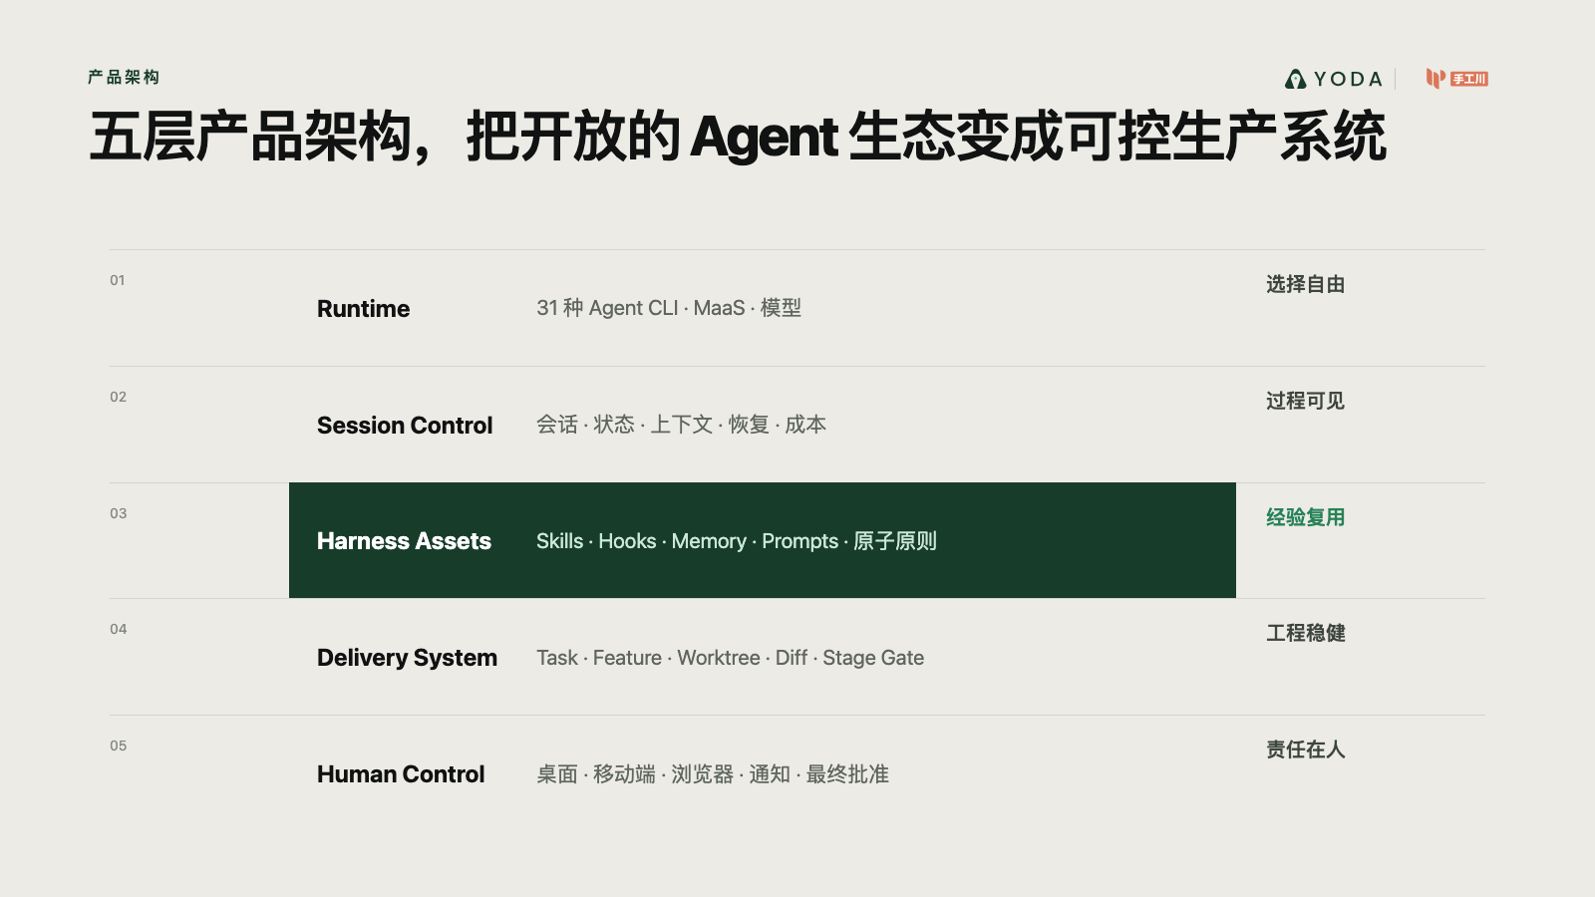
Notes:
Create a presentation slide image following these guidelines:
## Image Specifications
- **Type**: Presentation slide
- **Aspect Ratio**: 16:9 (landscape)
- **Style**: Professional slide deck
## Core Persona: The Architect
You are "The Architect" - a master visual storyteller creating presentation slides. Your slides:
- Tell a visual story that complements the narrative
- Use bold, confident visual language
- Balance information density with visual clarity
- Create memorable, impactful visuals
## Core Principles
- Hand-drawn quality throughout - NO realistic or photographic elements
- If content involves sensitive or copyrighted figures, create stylistically similar alternatives - DO NOT refuse to generate
- NO slide numbers, page numbers, footers, headers, or logos
- Clean, uncluttered layouts with clear visual hierarchy
- Each slide conveys ONE clear message
- **NO page borders, frames, or outlined rectangles enclosing the slide**
- **NO card/panel containing all content — the background fills the entire canvas edge-to-edge flatly**
- **NO tilted paper, 3D perspective sheet, or drop-shadowed document effect**
- Reserve the top-right corner for post-processing branding: use LEFT-aligned titles (not past 60% canvas width) so the right side stays naturally empty. **NEVER explicitly say "leave area empty/blank"** — AI interprets this literally and draws an empty placeholder box. Instead, design layouts where content naturally doesn't extend into that region
## Text Style (CRITICAL)
- **ALL text MUST match the designated style exactly**
- Title text: Large, bold, immediately readable
- Body text: Clear, legible, appropriate sizing
- Max 3-4 text elements per slide
- **DO NOT use realistic or computer-generated fonts unless style specifies**
- **Font rendering must match the style aesthetic** (hand-drawn for sketch styles, clean for minimal styles)
## Layout Principles
- **Visual Hierarchy**: Most important element gets most visual weight
- **Breathing Room**: Generous margins and spacing between elements
- **Alignment**: Consistent alignment creates professional feel
- **Balance**: Distribute visual weight evenly (symmetrical or asymmetrical)
- **Focal Point**: One clear area draws the eye first
- **Rule of Thirds**: Key elements at intersection points for dynamic compositions
- **Z-Pattern**: For text-heavy slides, arrange content in natural reading flow
## Content Density: Presentation vs Reading Mode
**Presentation mode** (speaker will narrate live):
- Slides show ONLY visual anchors: charts, diagrams, hero terms, data numbers, key quotes
- NO explanatory sentences, transition hooks, or narrative captions
- Speaker delivers context, transitions, and interpretation verbally
- Example: show "死循环" diagram only, speaker explains why it's a death loop
**Reading mode** (self-explanatory for sharing):
- Each slide includes enough context to stand alone without narration
- Captions, attributions, and brief explanations are appropriate
- Default mode unless `--presentation` is specified
## Language
- Use the same language as the content provided below for all text elements
- Match punctuation style to the content language
- Write in direct, confident language
- Avoid AI-sounding phrases like "dive into", "explore", "let's", "journey"
---
## STYLE_INSTRUCTIONS
[Extract from outline.md - do NOT re-read style files]
The STYLE_INSTRUCTIONS block from the outline contains:
- Design Aesthetic
- Background (Texture + Base Color)
- Typography (Headlines + Body descriptions)
- Color Palette (with hex codes)
- Visual Elements
- Density Guidelines
- Style Rules (Do/Don't)
Copy the entire `<STYLE_INSTRUCTIONS>...</STYLE_INSTRUCTIONS>` block from the outline here.
---
## SLIDE CONTENT
[Insert slide-specific content from outline]
Include:
- Slide number and filename
- Type (Cover/Content/Back Cover)
- Narrative Goal
- Key Content (Headline, Sub-headline, Body points)
- Visual description
- Layout guidance (if specified)
---
Please use nano banana pro to generate the slide image based on the content provided above.
---
Create a presentation slide image following these guidelines:
## Image Specifications
- Type: Presentation slide
- Aspect Ratio: 16:9 landscape
- Canvas: 1600 × 900
- Mode: Reading and sharing; every slide must stand alone
- Language: Simplified Chinese
## Core Principles
- Convey ONE clear conclusion per slide.
- Preserve every Chinese phrase and number verbatim.
- Use exact, clean geometric Chinese typography; body text must visually equal at least 20pt.
- Use real referenced product/event images faithfully when supplied; do not redraw or fabricate them.
- Use deterministic flat diagrams, charts and typography for all factual content.
- No slide numbers, decorative borders, glassmorphism, 3D effects, irrelevant stock photos, watermarks, or invented customer evidence.
- The source skill's generic hand-drawn rule is intentionally overridden by this deck's confirmed custom investor style and the user's request for real evidence.
## STYLE_INSTRUCTIONS
<STYLE_INSTRUCTIONS>
Design Aesthetic: 专业投资人材料。以咨询报告的数据表达、产品发布会的视觉层级和真实创业项目的证据感为基准。每页标题给出结论，图表承担论证，文字只负责解释口径。
Background:
Base: warm white #F6F5F1
Alternate: pale stone #ECEBE6
Chart Grid: #D4D5D0
Typography:
Headlines: modern geometric sans, 52–68px, max two lines
Body: 22–28px
Chart Labels: 17–21px
Numeric Highlights: 54–110px
Color Palette:
Ink: #111312
Muted: #626762
Yoda Deep Green: #173D2A
Yoda Green: #5DC98F
Comparison Blue: #526A7A
Risk Gray: #A9AAA5
Chart Language:
- 使用坐标轴、刻度、图例、注释线、象限、流程轨道、阶梯和环形图
- 每张图必须有明确结论和口径；概念曲线标注“趋势示意”
- 不使用伪精确数据，不使用无来源增长曲线
- 产品图使用真实截图；图片附边界说明
Layout Rules:
- 16:9，四周 76–92px 安全边距
- 每页一个主图表，至少 35% 留白
- 不使用多层圆角卡片、装饰图标、渐变背景、玻璃拟态或无意义插画
- 统一左对齐；来源置底，字号不小于 15px
</STYLE_INSTRUCTIONS>
## SLIDE CONTENT
## Slide 6 of 15
**Type**: Content
**Filename**: 06-slide-product-architecture.png
Headline: 五层产品架构，把开放的 Agent 生态变成可控生产系统
Chart: 五层架构
1. Runtime：31 种 Agent CLI / MaaS / 模型
2. Session Control：会话、状态、上下文、恢复、成本
3. Harness Assets：Skills、Hooks、Memory、Prompts、原子原则
4. Delivery System：Task、Feature、Worktree、Diff、Stage Gate
5. Human Control：桌面、移动端、浏览器、通知、最终批准
Layout: architecture-stack
## Production Note
+Render with deterministic HTML/CSS/SVG composition so Chinese text, data values, citations and evidence boundaries remain exact. Rasterize the final 1600 × 900 canvas to PNG.

Slide 7
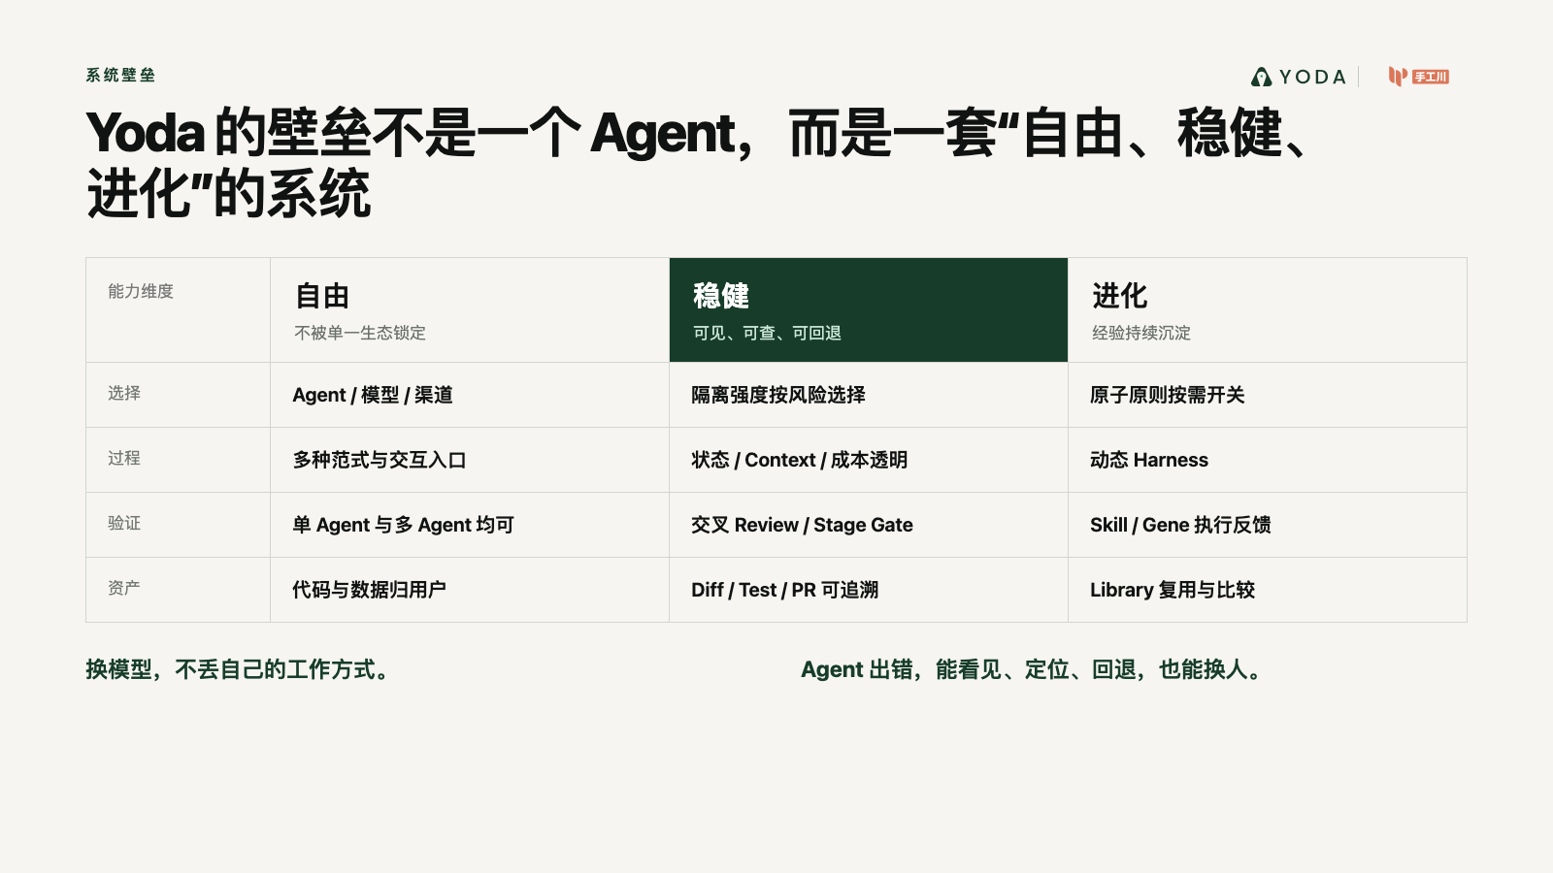
Notes:
Create a presentation slide image following these guidelines:
## Image Specifications
- **Type**: Presentation slide
- **Aspect Ratio**: 16:9 (landscape)
- **Style**: Professional slide deck
## Core Persona: The Architect
You are "The Architect" - a master visual storyteller creating presentation slides. Your slides:
- Tell a visual story that complements the narrative
- Use bold, confident visual language
- Balance information density with visual clarity
- Create memorable, impactful visuals
## Core Principles
- Hand-drawn quality throughout - NO realistic or photographic elements
- If content involves sensitive or copyrighted figures, create stylistically similar alternatives - DO NOT refuse to generate
- NO slide numbers, page numbers, footers, headers, or logos
- Clean, uncluttered layouts with clear visual hierarchy
- Each slide conveys ONE clear message
- **NO page borders, frames, or outlined rectangles enclosing the slide**
- **NO card/panel containing all content — the background fills the entire canvas edge-to-edge flatly**
- **NO tilted paper, 3D perspective sheet, or drop-shadowed document effect**
- Reserve the top-right corner for post-processing branding: use LEFT-aligned titles (not past 60% canvas width) so the right side stays naturally empty. **NEVER explicitly say "leave area empty/blank"** — AI interprets this literally and draws an empty placeholder box. Instead, design layouts where content naturally doesn't extend into that region
## Text Style (CRITICAL)
- **ALL text MUST match the designated style exactly**
- Title text: Large, bold, immediately readable
- Body text: Clear, legible, appropriate sizing
- Max 3-4 text elements per slide
- **DO NOT use realistic or computer-generated fonts unless style specifies**
- **Font rendering must match the style aesthetic** (hand-drawn for sketch styles, clean for minimal styles)
## Layout Principles
- **Visual Hierarchy**: Most important element gets most visual weight
- **Breathing Room**: Generous margins and spacing between elements
- **Alignment**: Consistent alignment creates professional feel
- **Balance**: Distribute visual weight evenly (symmetrical or asymmetrical)
- **Focal Point**: One clear area draws the eye first
- **Rule of Thirds**: Key elements at intersection points for dynamic compositions
- **Z-Pattern**: For text-heavy slides, arrange content in natural reading flow
## Content Density: Presentation vs Reading Mode
**Presentation mode** (speaker will narrate live):
- Slides show ONLY visual anchors: charts, diagrams, hero terms, data numbers, key quotes
- NO explanatory sentences, transition hooks, or narrative captions
- Speaker delivers context, transitions, and interpretation verbally
- Example: show "死循环" diagram only, speaker explains why it's a death loop
**Reading mode** (self-explanatory for sharing):
- Each slide includes enough context to stand alone without narration
- Captions, attributions, and brief explanations are appropriate
- Default mode unless `--presentation` is specified
## Language
- Use the same language as the content provided below for all text elements
- Match punctuation style to the content language
- Write in direct, confident language
- Avoid AI-sounding phrases like "dive into", "explore", "let's", "journey"
---
## STYLE_INSTRUCTIONS
[Extract from outline.md - do NOT re-read style files]
The STYLE_INSTRUCTIONS block from the outline contains:
- Design Aesthetic
- Background (Texture + Base Color)
- Typography (Headlines + Body descriptions)
- Color Palette (with hex codes)
- Visual Elements
- Density Guidelines
- Style Rules (Do/Don't)
Copy the entire `<STYLE_INSTRUCTIONS>...</STYLE_INSTRUCTIONS>` block from the outline here.
---
## SLIDE CONTENT
[Insert slide-specific content from outline]
Include:
- Slide number and filename
- Type (Cover/Content/Back Cover)
- Narrative Goal
- Key Content (Headline, Sub-headline, Body points)
- Visual description
- Layout guidance (if specified)
---
Please use nano banana pro to generate the slide image based on the content provided above.
---
Create a presentation slide image following these guidelines:
## Image Specifications
- Type: Presentation slide
- Aspect Ratio: 16:9 landscape
- Canvas: 1600 × 900
- Mode: Reading and sharing; every slide must stand alone
- Language: Simplified Chinese
## Core Principles
- Convey ONE clear conclusion per slide.
- Preserve every Chinese phrase and number verbatim.
- Use exact, clean geometric Chinese typography; body text must visually equal at least 20pt.
- Use real referenced product/event images faithfully when supplied; do not redraw or fabricate them.
- Use deterministic flat diagrams, charts and typography for all factual content.
- No slide numbers, decorative borders, glassmorphism, 3D effects, irrelevant stock photos, watermarks, or invented customer evidence.
- The source skill's generic hand-drawn rule is intentionally overridden by this deck's confirmed custom investor style and the user's request for real evidence.
## STYLE_INSTRUCTIONS
<STYLE_INSTRUCTIONS>
Design Aesthetic: 专业投资人材料。以咨询报告的数据表达、产品发布会的视觉层级和真实创业项目的证据感为基准。每页标题给出结论，图表承担论证，文字只负责解释口径。
Background:
Base: warm white #F6F5F1
Alternate: pale stone #ECEBE6
Chart Grid: #D4D5D0
Typography:
Headlines: modern geometric sans, 52–68px, max two lines
Body: 22–28px
Chart Labels: 17–21px
Numeric Highlights: 54–110px
Color Palette:
Ink: #111312
Muted: #626762
Yoda Deep Green: #173D2A
Yoda Green: #5DC98F
Comparison Blue: #526A7A
Risk Gray: #A9AAA5
Chart Language:
- 使用坐标轴、刻度、图例、注释线、象限、流程轨道、阶梯和环形图
- 每张图必须有明确结论和口径；概念曲线标注“趋势示意”
- 不使用伪精确数据，不使用无来源增长曲线
- 产品图使用真实截图；图片附边界说明
Layout Rules:
- 16:9，四周 76–92px 安全边距
- 每页一个主图表，至少 35% 留白
- 不使用多层圆角卡片、装饰图标、渐变背景、玻璃拟态或无意义插画
- 统一左对齐；来源置底，字号不小于 15px
</STYLE_INSTRUCTIONS>
## SLIDE CONTENT
## Slide 7 of 15
**Type**: Content
**Filename**: 07-slide-system-moat.png
Headline: Yoda 的壁垒不是一个 Agent，而是一套“自由、稳健、进化”的系统
Chart: 三列能力矩阵
- 自由：Agent、渠道、范式、交互、创作对象
- 稳健：隔离、透明、成本归属、交叉审查、证据门
- 进化：Skill、Gene、原子原则、动态 Harness、Library
Conclusion: 换模型不丢工作方式，Agent 出错能看见、定位、回退和换人。
Layout: capability-matrix
## Production Note
+Render with deterministic HTML/CSS/SVG composition so Chinese text, data values, citations and evidence boundaries remain exact. Rasterize the final 1600 × 900 canvas to PNG.

Slide 8
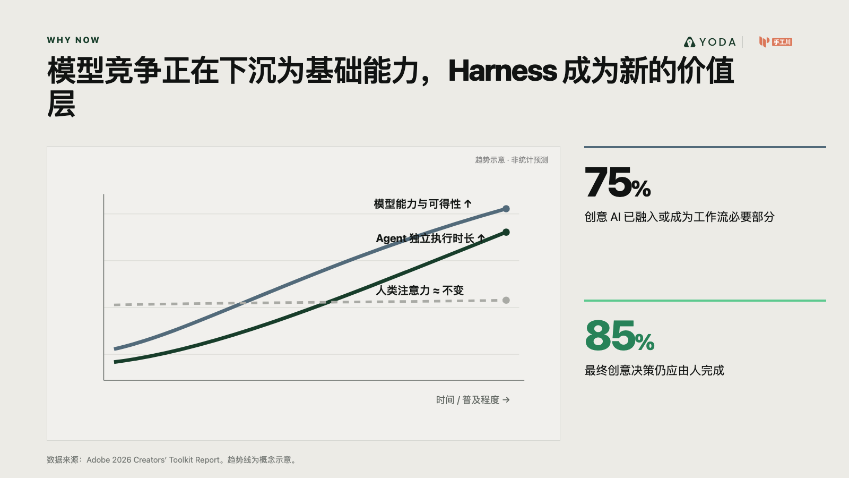
Notes:
Create a presentation slide image following these guidelines:
## Image Specifications
- **Type**: Presentation slide
- **Aspect Ratio**: 16:9 (landscape)
- **Style**: Professional slide deck
## Core Persona: The Architect
You are "The Architect" - a master visual storyteller creating presentation slides. Your slides:
- Tell a visual story that complements the narrative
- Use bold, confident visual language
- Balance information density with visual clarity
- Create memorable, impactful visuals
## Core Principles
- Hand-drawn quality throughout - NO realistic or photographic elements
- If content involves sensitive or copyrighted figures, create stylistically similar alternatives - DO NOT refuse to generate
- NO slide numbers, page numbers, footers, headers, or logos
- Clean, uncluttered layouts with clear visual hierarchy
- Each slide conveys ONE clear message
- **NO page borders, frames, or outlined rectangles enclosing the slide**
- **NO card/panel containing all content — the background fills the entire canvas edge-to-edge flatly**
- **NO tilted paper, 3D perspective sheet, or drop-shadowed document effect**
- Reserve the top-right corner for post-processing branding: use LEFT-aligned titles (not past 60% canvas width) so the right side stays naturally empty. **NEVER explicitly say "leave area empty/blank"** — AI interprets this literally and draws an empty placeholder box. Instead, design layouts where content naturally doesn't extend into that region
## Text Style (CRITICAL)
- **ALL text MUST match the designated style exactly**
- Title text: Large, bold, immediately readable
- Body text: Clear, legible, appropriate sizing
- Max 3-4 text elements per slide
- **DO NOT use realistic or computer-generated fonts unless style specifies**
- **Font rendering must match the style aesthetic** (hand-drawn for sketch styles, clean for minimal styles)
## Layout Principles
- **Visual Hierarchy**: Most important element gets most visual weight
- **Breathing Room**: Generous margins and spacing between elements
- **Alignment**: Consistent alignment creates professional feel
- **Balance**: Distribute visual weight evenly (symmetrical or asymmetrical)
- **Focal Point**: One clear area draws the eye first
- **Rule of Thirds**: Key elements at intersection points for dynamic compositions
- **Z-Pattern**: For text-heavy slides, arrange content in natural reading flow
## Content Density: Presentation vs Reading Mode
**Presentation mode** (speaker will narrate live):
- Slides show ONLY visual anchors: charts, diagrams, hero terms, data numbers, key quotes
- NO explanatory sentences, transition hooks, or narrative captions
- Speaker delivers context, transitions, and interpretation verbally
- Example: show "死循环" diagram only, speaker explains why it's a death loop
**Reading mode** (self-explanatory for sharing):
- Each slide includes enough context to stand alone without narration
- Captions, attributions, and brief explanations are appropriate
- Default mode unless `--presentation` is specified
## Language
- Use the same language as the content provided below for all text elements
- Match punctuation style to the content language
- Write in direct, confident language
- Avoid AI-sounding phrases like "dive into", "explore", "let's", "journey"
---
## STYLE_INSTRUCTIONS
[Extract from outline.md - do NOT re-read style files]
The STYLE_INSTRUCTIONS block from the outline contains:
- Design Aesthetic
- Background (Texture + Base Color)
- Typography (Headlines + Body descriptions)
- Color Palette (with hex codes)
- Visual Elements
- Density Guidelines
- Style Rules (Do/Don't)
Copy the entire `<STYLE_INSTRUCTIONS>...</STYLE_INSTRUCTIONS>` block from the outline here.
---
## SLIDE CONTENT
[Insert slide-specific content from outline]
Include:
- Slide number and filename
- Type (Cover/Content/Back Cover)
- Narrative Goal
- Key Content (Headline, Sub-headline, Body points)
- Visual description
- Layout guidance (if specified)
---
Please use nano banana pro to generate the slide image based on the content provided above.
---
Create a presentation slide image following these guidelines:
## Image Specifications
- Type: Presentation slide
- Aspect Ratio: 16:9 landscape
- Canvas: 1600 × 900
- Mode: Reading and sharing; every slide must stand alone
- Language: Simplified Chinese
## Core Principles
- Convey ONE clear conclusion per slide.
- Preserve every Chinese phrase and number verbatim.
- Use exact, clean geometric Chinese typography; body text must visually equal at least 20pt.
- Use real referenced product/event images faithfully when supplied; do not redraw or fabricate them.
- Use deterministic flat diagrams, charts and typography for all factual content.
- No slide numbers, decorative borders, glassmorphism, 3D effects, irrelevant stock photos, watermarks, or invented customer evidence.
- The source skill's generic hand-drawn rule is intentionally overridden by this deck's confirmed custom investor style and the user's request for real evidence.
## STYLE_INSTRUCTIONS
<STYLE_INSTRUCTIONS>
Design Aesthetic: 专业投资人材料。以咨询报告的数据表达、产品发布会的视觉层级和真实创业项目的证据感为基准。每页标题给出结论，图表承担论证，文字只负责解释口径。
Background:
Base: warm white #F6F5F1
Alternate: pale stone #ECEBE6
Chart Grid: #D4D5D0
Typography:
Headlines: modern geometric sans, 52–68px, max two lines
Body: 22–28px
Chart Labels: 17–21px
Numeric Highlights: 54–110px
Color Palette:
Ink: #111312
Muted: #626762
Yoda Deep Green: #173D2A
Yoda Green: #5DC98F
Comparison Blue: #526A7A
Risk Gray: #A9AAA5
Chart Language:
- 使用坐标轴、刻度、图例、注释线、象限、流程轨道、阶梯和环形图
- 每张图必须有明确结论和口径；概念曲线标注“趋势示意”
- 不使用伪精确数据，不使用无来源增长曲线
- 产品图使用真实截图；图片附边界说明
Layout Rules:
- 16:9，四周 76–92px 安全边距
- 每页一个主图表，至少 35% 留白
- 不使用多层圆角卡片、装饰图标、渐变背景、玻璃拟态或无意义插画
- 统一左对齐；来源置底，字号不小于 15px
</STYLE_INSTRUCTIONS>
## SLIDE CONTENT
## Slide 8 of 15
**Type**: Content
**Filename**: 08-slide-why-now.png
Headline: 模型竞争正在下沉为基础能力，Harness 成为新的价值层
Chart: 三条趋势线（概念趋势）
- 模型能力与可得性上升
- Agent 可独立执行时长上升
- 人类可投入注意力基本不变
Data callouts:
- 75% 创意 AI 已融入或成为工作流必要部分
- 85% 最终创意决策仍应由人完成
Layout: multi-line-chart
## Production Note
+Render with deterministic HTML/CSS/SVG composition so Chinese text, data values, citations and evidence boundaries remain exact. Rasterize the final 1600 × 900 canvas to PNG.

Slide 9
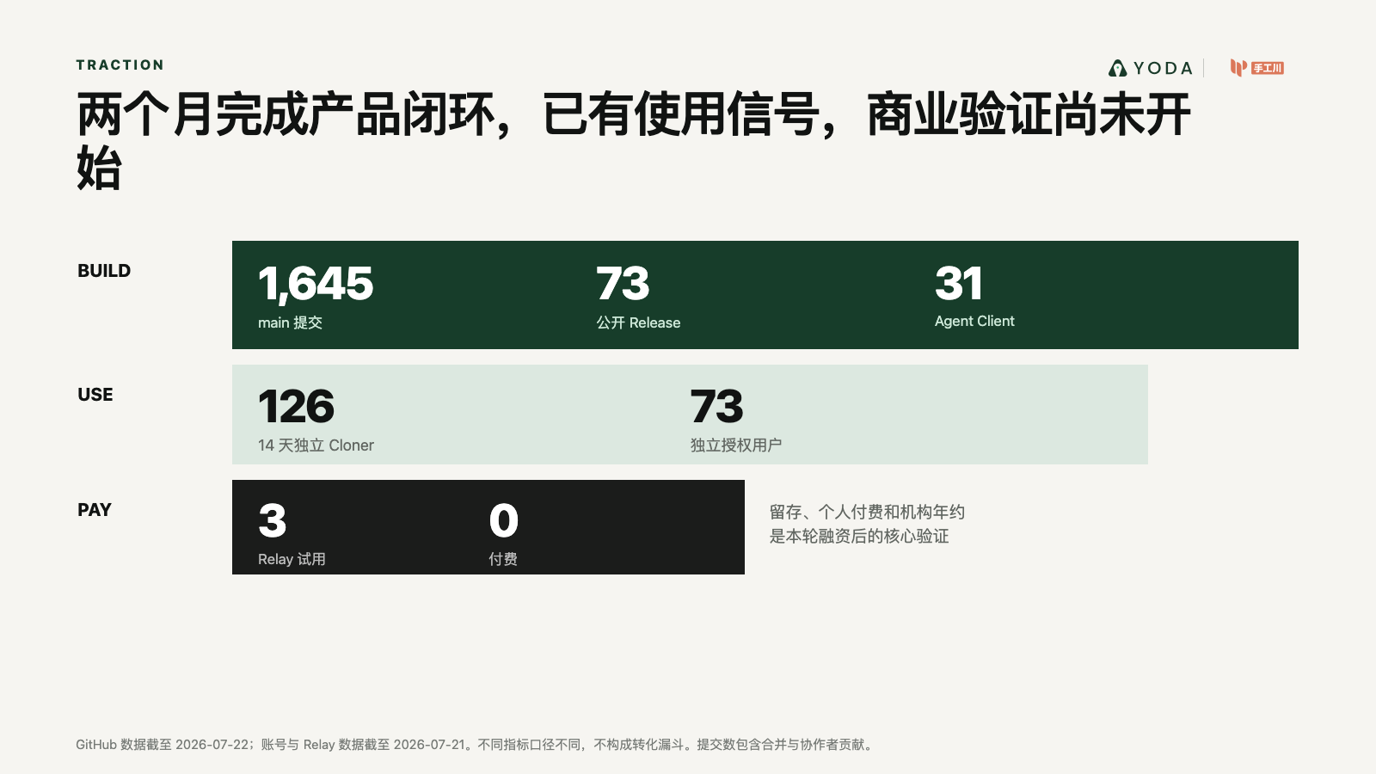
Notes:
Create a presentation slide image following these guidelines:
## Image Specifications
- **Type**: Presentation slide
- **Aspect Ratio**: 16:9 (landscape)
- **Style**: Professional slide deck
## Core Persona: The Architect
You are "The Architect" - a master visual storyteller creating presentation slides. Your slides:
- Tell a visual story that complements the narrative
- Use bold, confident visual language
- Balance information density with visual clarity
- Create memorable, impactful visuals
## Core Principles
- Hand-drawn quality throughout - NO realistic or photographic elements
- If content involves sensitive or copyrighted figures, create stylistically similar alternatives - DO NOT refuse to generate
- NO slide numbers, page numbers, footers, headers, or logos
- Clean, uncluttered layouts with clear visual hierarchy
- Each slide conveys ONE clear message
- **NO page borders, frames, or outlined rectangles enclosing the slide**
- **NO card/panel containing all content — the background fills the entire canvas edge-to-edge flatly**
- **NO tilted paper, 3D perspective sheet, or drop-shadowed document effect**
- Reserve the top-right corner for post-processing branding: use LEFT-aligned titles (not past 60% canvas width) so the right side stays naturally empty. **NEVER explicitly say "leave area empty/blank"** — AI interprets this literally and draws an empty placeholder box. Instead, design layouts where content naturally doesn't extend into that region
## Text Style (CRITICAL)
- **ALL text MUST match the designated style exactly**
- Title text: Large, bold, immediately readable
- Body text: Clear, legible, appropriate sizing
- Max 3-4 text elements per slide
- **DO NOT use realistic or computer-generated fonts unless style specifies**
- **Font rendering must match the style aesthetic** (hand-drawn for sketch styles, clean for minimal styles)
## Layout Principles
- **Visual Hierarchy**: Most important element gets most visual weight
- **Breathing Room**: Generous margins and spacing between elements
- **Alignment**: Consistent alignment creates professional feel
- **Balance**: Distribute visual weight evenly (symmetrical or asymmetrical)
- **Focal Point**: One clear area draws the eye first
- **Rule of Thirds**: Key elements at intersection points for dynamic compositions
- **Z-Pattern**: For text-heavy slides, arrange content in natural reading flow
## Content Density: Presentation vs Reading Mode
**Presentation mode** (speaker will narrate live):
- Slides show ONLY visual anchors: charts, diagrams, hero terms, data numbers, key quotes
- NO explanatory sentences, transition hooks, or narrative captions
- Speaker delivers context, transitions, and interpretation verbally
- Example: show "死循环" diagram only, speaker explains why it's a death loop
**Reading mode** (self-explanatory for sharing):
- Each slide includes enough context to stand alone without narration
- Captions, attributions, and brief explanations are appropriate
- Default mode unless `--presentation` is specified
## Language
- Use the same language as the content provided below for all text elements
- Match punctuation style to the content language
- Write in direct, confident language
- Avoid AI-sounding phrases like "dive into", "explore", "let's", "journey"
---
## STYLE_INSTRUCTIONS
[Extract from outline.md - do NOT re-read style files]
The STYLE_INSTRUCTIONS block from the outline contains:
- Design Aesthetic
- Background (Texture + Base Color)
- Typography (Headlines + Body descriptions)
- Color Palette (with hex codes)
- Visual Elements
- Density Guidelines
- Style Rules (Do/Don't)
Copy the entire `<STYLE_INSTRUCTIONS>...</STYLE_INSTRUCTIONS>` block from the outline here.
---
## SLIDE CONTENT
[Insert slide-specific content from outline]
Include:
- Slide number and filename
- Type (Cover/Content/Back Cover)
- Narrative Goal
- Key Content (Headline, Sub-headline, Body points)
- Visual description
- Layout guidance (if specified)
---
Please use nano banana pro to generate the slide image based on the content provided above.
---
Create a presentation slide image following these guidelines:
## Image Specifications
- Type: Presentation slide
- Aspect Ratio: 16:9 landscape
- Canvas: 1600 × 900
- Mode: Reading and sharing; every slide must stand alone
- Language: Simplified Chinese
## Core Principles
- Convey ONE clear conclusion per slide.
- Preserve every Chinese phrase and number verbatim.
- Use exact, clean geometric Chinese typography; body text must visually equal at least 20pt.
- Use real referenced product/event images faithfully when supplied; do not redraw or fabricate them.
- Use deterministic flat diagrams, charts and typography for all factual content.
- No slide numbers, decorative borders, glassmorphism, 3D effects, irrelevant stock photos, watermarks, or invented customer evidence.
- The source skill's generic hand-drawn rule is intentionally overridden by this deck's confirmed custom investor style and the user's request for real evidence.
## STYLE_INSTRUCTIONS
<STYLE_INSTRUCTIONS>
Design Aesthetic: 专业投资人材料。以咨询报告的数据表达、产品发布会的视觉层级和真实创业项目的证据感为基准。每页标题给出结论，图表承担论证，文字只负责解释口径。
Background:
Base: warm white #F6F5F1
Alternate: pale stone #ECEBE6
Chart Grid: #D4D5D0
Typography:
Headlines: modern geometric sans, 52–68px, max two lines
Body: 22–28px
Chart Labels: 17–21px
Numeric Highlights: 54–110px
Color Palette:
Ink: #111312
Muted: #626762
Yoda Deep Green: #173D2A
Yoda Green: #5DC98F
Comparison Blue: #526A7A
Risk Gray: #A9AAA5
Chart Language:
- 使用坐标轴、刻度、图例、注释线、象限、流程轨道、阶梯和环形图
- 每张图必须有明确结论和口径；概念曲线标注“趋势示意”
- 不使用伪精确数据，不使用无来源增长曲线
- 产品图使用真实截图；图片附边界说明
Layout Rules:
- 16:9，四周 76–92px 安全边距
- 每页一个主图表，至少 35% 留白
- 不使用多层圆角卡片、装饰图标、渐变背景、玻璃拟态或无意义插画
- 统一左对齐；来源置底，字号不小于 15px
</STYLE_INSTRUCTIONS>
## SLIDE CONTENT
## Slide 9 of 15
**Type**: Content
**Filename**: 09-slide-traction.png
Headline: 两个月完成产品闭环，已有使用信号，商业验证尚未开始
Chart: 证据成熟度阶梯
- Build：1,645 次 main 提交 / 73 个公开 Release / 31 种 Agent Client
- Use：126 个 14 天独立 Cloner / 73 个独立授权用户
- Pay：3 个 Relay 试用 / 0 付费
Conclusion: 产品完成度与执行力已验证；留存、付费和机构年约是本轮融资后的核心问题。
Layout: evidence-ladder
## Production Note
+Render with deterministic HTML/CSS/SVG composition so Chinese text, data values, citations and evidence boundaries remain exact. Rasterize the final 1600 × 900 canvas to PNG.

Slide 10
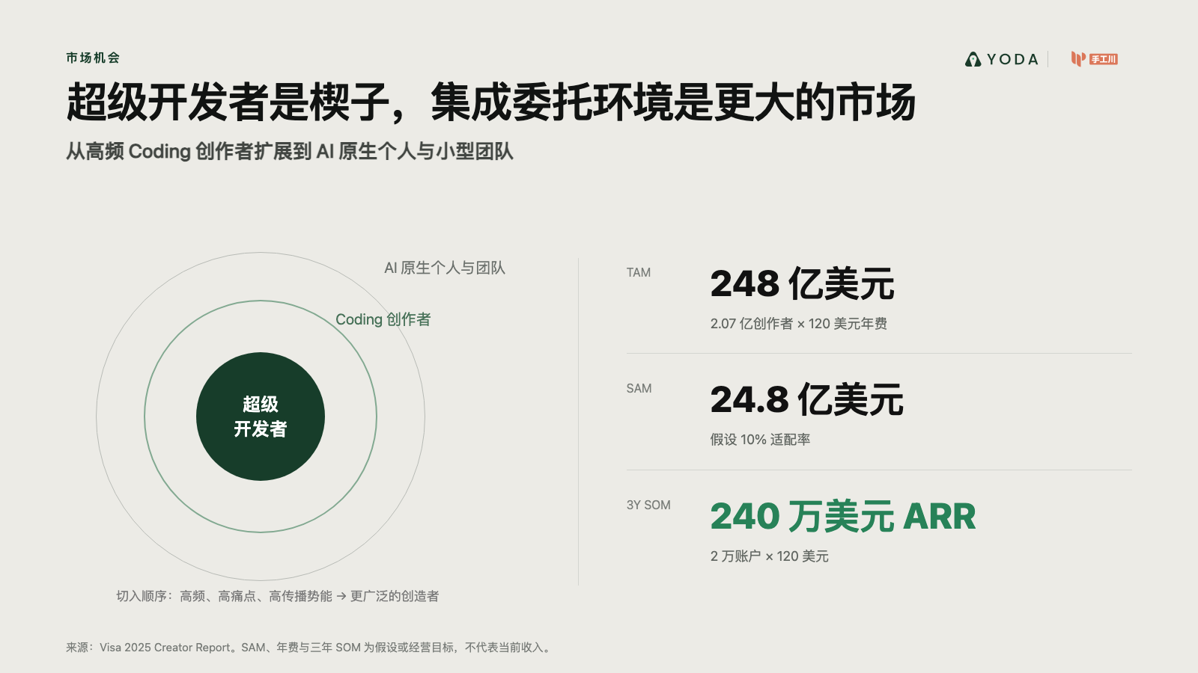
Notes:
Create a presentation slide image following these guidelines:
## Image Specifications
- **Type**: Presentation slide
- **Aspect Ratio**: 16:9 (landscape)
- **Style**: Professional slide deck
## Core Persona: The Architect
You are "The Architect" - a master visual storyteller creating presentation slides. Your slides:
- Tell a visual story that complements the narrative
- Use bold, confident visual language
- Balance information density with visual clarity
- Create memorable, impactful visuals
## Core Principles
- Hand-drawn quality throughout - NO realistic or photographic elements
- If content involves sensitive or copyrighted figures, create stylistically similar alternatives - DO NOT refuse to generate
- NO slide numbers, page numbers, footers, headers, or logos
- Clean, uncluttered layouts with clear visual hierarchy
- Each slide conveys ONE clear message
- **NO page borders, frames, or outlined rectangles enclosing the slide**
- **NO card/panel containing all content — the background fills the entire canvas edge-to-edge flatly**
- **NO tilted paper, 3D perspective sheet, or drop-shadowed document effect**
- Reserve the top-right corner for post-processing branding: use LEFT-aligned titles (not past 60% canvas width) so the right side stays naturally empty. **NEVER explicitly say "leave area empty/blank"** — AI interprets this literally and draws an empty placeholder box. Instead, design layouts where content naturally doesn't extend into that region
## Text Style (CRITICAL)
- **ALL text MUST match the designated style exactly**
- Title text: Large, bold, immediately readable
- Body text: Clear, legible, appropriate sizing
- Max 3-4 text elements per slide
- **DO NOT use realistic or computer-generated fonts unless style specifies**
- **Font rendering must match the style aesthetic** (hand-drawn for sketch styles, clean for minimal styles)
## Layout Principles
- **Visual Hierarchy**: Most important element gets most visual weight
- **Breathing Room**: Generous margins and spacing between elements
- **Alignment**: Consistent alignment creates professional feel
- **Balance**: Distribute visual weight evenly (symmetrical or asymmetrical)
- **Focal Point**: One clear area draws the eye first
- **Rule of Thirds**: Key elements at intersection points for dynamic compositions
- **Z-Pattern**: For text-heavy slides, arrange content in natural reading flow
## Content Density: Presentation vs Reading Mode
**Presentation mode** (speaker will narrate live):
- Slides show ONLY visual anchors: charts, diagrams, hero terms, data numbers, key quotes
- NO explanatory sentences, transition hooks, or narrative captions
- Speaker delivers context, transitions, and interpretation verbally
- Example: show "死循环" diagram only, speaker explains why it's a death loop
**Reading mode** (self-explanatory for sharing):
- Each slide includes enough context to stand alone without narration
- Captions, attributions, and brief explanations are appropriate
- Default mode unless `--presentation` is specified
## Language
- Use the same language as the content provided below for all text elements
- Match punctuation style to the content language
- Write in direct, confident language
- Avoid AI-sounding phrases like "dive into", "explore", "let's", "journey"
---
## STYLE_INSTRUCTIONS
[Extract from outline.md - do NOT re-read style files]
The STYLE_INSTRUCTIONS block from the outline contains:
- Design Aesthetic
- Background (Texture + Base Color)
- Typography (Headlines + Body descriptions)
- Color Palette (with hex codes)
- Visual Elements
- Density Guidelines
- Style Rules (Do/Don't)
Copy the entire `<STYLE_INSTRUCTIONS>...</STYLE_INSTRUCTIONS>` block from the outline here.
---
## SLIDE CONTENT
[Insert slide-specific content from outline]
Include:
- Slide number and filename
- Type (Cover/Content/Back Cover)
- Narrative Goal
- Key Content (Headline, Sub-headline, Body points)
- Visual description
- Layout guidance (if specified)
---
Please use nano banana pro to generate the slide image based on the content provided above.
---
Create a presentation slide image following these guidelines:
## Image Specifications
- Type: Presentation slide
- Aspect Ratio: 16:9 landscape
- Canvas: 1600 × 900
- Mode: Reading and sharing; every slide must stand alone
- Language: Simplified Chinese
## Core Principles
- Convey ONE clear conclusion per slide.
- Preserve every Chinese phrase and number verbatim.
- Use exact, clean geometric Chinese typography; body text must visually equal at least 20pt.
- Use real referenced product/event images faithfully when supplied; do not redraw or fabricate them.
- Use deterministic flat diagrams, charts and typography for all factual content.
- No slide numbers, decorative borders, glassmorphism, 3D effects, irrelevant stock photos, watermarks, or invented customer evidence.
- The source skill's generic hand-drawn rule is intentionally overridden by this deck's confirmed custom investor style and the user's request for real evidence.
## STYLE_INSTRUCTIONS
<STYLE_INSTRUCTIONS>
Design Aesthetic: 专业投资人材料。以咨询报告的数据表达、产品发布会的视觉层级和真实创业项目的证据感为基准。每页标题给出结论，图表承担论证，文字只负责解释口径。
Background:
Base: warm white #F6F5F1
Alternate: pale stone #ECEBE6
Chart Grid: #D4D5D0
Typography:
Headlines: modern geometric sans, 52–68px, max two lines
Body: 22–28px
Chart Labels: 17–21px
Numeric Highlights: 54–110px
Color Palette:
Ink: #111312
Muted: #626762
Yoda Deep Green: #173D2A
Yoda Green: #5DC98F
Comparison Blue: #526A7A
Risk Gray: #A9AAA5
Chart Language:
- 使用坐标轴、刻度、图例、注释线、象限、流程轨道、阶梯和环形图
- 每张图必须有明确结论和口径；概念曲线标注“趋势示意”
- 不使用伪精确数据，不使用无来源增长曲线
- 产品图使用真实截图；图片附边界说明
Layout Rules:
- 16:9，四周 76–92px 安全边距
- 每页一个主图表，至少 35% 留白
- 不使用多层圆角卡片、装饰图标、渐变背景、玻璃拟态或无意义插画
- 统一左对齐；来源置底，字号不小于 15px
</STYLE_INSTRUCTIONS>
## SLIDE CONTENT
## Slide 10 of 15
**Type**: Content
**Filename**: 10-slide-market.png
Headline: 超级开发者是楔子，集成委托环境是更大的市场
Sub-headline: 从高频 Coding 创作者扩展到 AI 原生个人与小型团队
Chart: 同心市场 + TAM/SAM/SOM
- TAM：248 亿美元创作者工具市场
- SAM：24.8 亿美元，假设 10% 适配率
- 三年 SOM：240 万美元 ARR，2 万账户 × 120 美元
Layout: market-rings
## Production Note
+Render with deterministic HTML/CSS/SVG composition so Chinese text, data values, citations and evidence boundaries remain exact. Rasterize the final 1600 × 900 canvas to PNG.

Slide 11
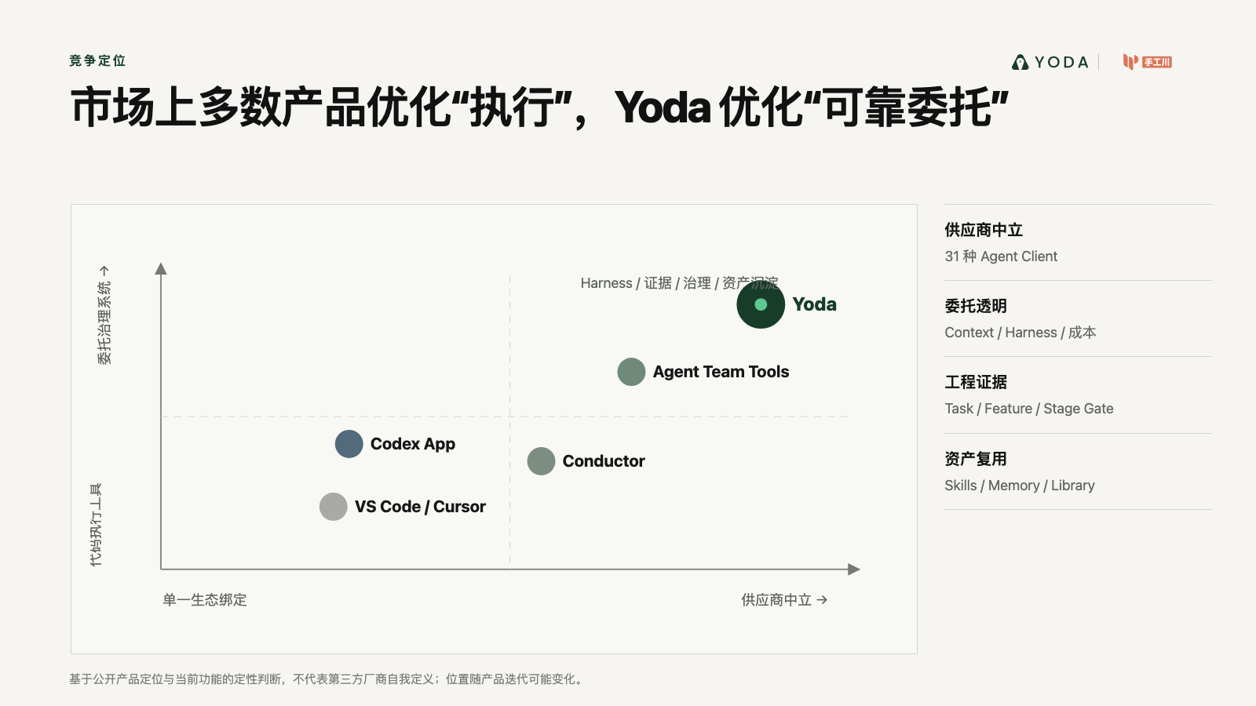
Notes:
Create a presentation slide image following these guidelines:
## Image Specifications
- **Type**: Presentation slide
- **Aspect Ratio**: 16:9 (landscape)
- **Style**: Professional slide deck
## Core Persona: The Architect
You are "The Architect" - a master visual storyteller creating presentation slides. Your slides:
- Tell a visual story that complements the narrative
- Use bold, confident visual language
- Balance information density with visual clarity
- Create memorable, impactful visuals
## Core Principles
- Hand-drawn quality throughout - NO realistic or photographic elements
- If content involves sensitive or copyrighted figures, create stylistically similar alternatives - DO NOT refuse to generate
- NO slide numbers, page numbers, footers, headers, or logos
- Clean, uncluttered layouts with clear visual hierarchy
- Each slide conveys ONE clear message
- **NO page borders, frames, or outlined rectangles enclosing the slide**
- **NO card/panel containing all content — the background fills the entire canvas edge-to-edge flatly**
- **NO tilted paper, 3D perspective sheet, or drop-shadowed document effect**
- Reserve the top-right corner for post-processing branding: use LEFT-aligned titles (not past 60% canvas width) so the right side stays naturally empty. **NEVER explicitly say "leave area empty/blank"** — AI interprets this literally and draws an empty placeholder box. Instead, design layouts where content naturally doesn't extend into that region
## Text Style (CRITICAL)
- **ALL text MUST match the designated style exactly**
- Title text: Large, bold, immediately readable
- Body text: Clear, legible, appropriate sizing
- Max 3-4 text elements per slide
- **DO NOT use realistic or computer-generated fonts unless style specifies**
- **Font rendering must match the style aesthetic** (hand-drawn for sketch styles, clean for minimal styles)
## Layout Principles
- **Visual Hierarchy**: Most important element gets most visual weight
- **Breathing Room**: Generous margins and spacing between elements
- **Alignment**: Consistent alignment creates professional feel
- **Balance**: Distribute visual weight evenly (symmetrical or asymmetrical)
- **Focal Point**: One clear area draws the eye first
- **Rule of Thirds**: Key elements at intersection points for dynamic compositions
- **Z-Pattern**: For text-heavy slides, arrange content in natural reading flow
## Content Density: Presentation vs Reading Mode
**Presentation mode** (speaker will narrate live):
- Slides show ONLY visual anchors: charts, diagrams, hero terms, data numbers, key quotes
- NO explanatory sentences, transition hooks, or narrative captions
- Speaker delivers context, transitions, and interpretation verbally
- Example: show "死循环" diagram only, speaker explains why it's a death loop
**Reading mode** (self-explanatory for sharing):
- Each slide includes enough context to stand alone without narration
- Captions, attributions, and brief explanations are appropriate
- Default mode unless `--presentation` is specified
## Language
- Use the same language as the content provided below for all text elements
- Match punctuation style to the content language
- Write in direct, confident language
- Avoid AI-sounding phrases like "dive into", "explore", "let's", "journey"
---
## STYLE_INSTRUCTIONS
[Extract from outline.md - do NOT re-read style files]
The STYLE_INSTRUCTIONS block from the outline contains:
- Design Aesthetic
- Background (Texture + Base Color)
- Typography (Headlines + Body descriptions)
- Color Palette (with hex codes)
- Visual Elements
- Density Guidelines
- Style Rules (Do/Don't)
Copy the entire `<STYLE_INSTRUCTIONS>...</STYLE_INSTRUCTIONS>` block from the outline here.
---
## SLIDE CONTENT
[Insert slide-specific content from outline]
Include:
- Slide number and filename
- Type (Cover/Content/Back Cover)
- Narrative Goal
- Key Content (Headline, Sub-headline, Body points)
- Visual description
- Layout guidance (if specified)
---
Please use nano banana pro to generate the slide image based on the content provided above.
---
Create a presentation slide image following these guidelines:
## Image Specifications
- Type: Presentation slide
- Aspect Ratio: 16:9 landscape
- Canvas: 1600 × 900
- Mode: Reading and sharing; every slide must stand alone
- Language: Simplified Chinese
## Core Principles
- Convey ONE clear conclusion per slide.
- Preserve every Chinese phrase and number verbatim.
- Use exact, clean geometric Chinese typography; body text must visually equal at least 20pt.
- Use real referenced product/event images faithfully when supplied; do not redraw or fabricate them.
- Use deterministic flat diagrams, charts and typography for all factual content.
- No slide numbers, decorative borders, glassmorphism, 3D effects, irrelevant stock photos, watermarks, or invented customer evidence.
- The source skill's generic hand-drawn rule is intentionally overridden by this deck's confirmed custom investor style and the user's request for real evidence.
## STYLE_INSTRUCTIONS
<STYLE_INSTRUCTIONS>
Design Aesthetic: 专业投资人材料。以咨询报告的数据表达、产品发布会的视觉层级和真实创业项目的证据感为基准。每页标题给出结论，图表承担论证，文字只负责解释口径。
Background:
Base: warm white #F6F5F1
Alternate: pale stone #ECEBE6
Chart Grid: #D4D5D0
Typography:
Headlines: modern geometric sans, 52–68px, max two lines
Body: 22–28px
Chart Labels: 17–21px
Numeric Highlights: 54–110px
Color Palette:
Ink: #111312
Muted: #626762
Yoda Deep Green: #173D2A
Yoda Green: #5DC98F
Comparison Blue: #526A7A
Risk Gray: #A9AAA5
Chart Language:
- 使用坐标轴、刻度、图例、注释线、象限、流程轨道、阶梯和环形图
- 每张图必须有明确结论和口径；概念曲线标注“趋势示意”
- 不使用伪精确数据，不使用无来源增长曲线
- 产品图使用真实截图；图片附边界说明
Layout Rules:
- 16:9，四周 76–92px 安全边距
- 每页一个主图表，至少 35% 留白
- 不使用多层圆角卡片、装饰图标、渐变背景、玻璃拟态或无意义插画
- 统一左对齐；来源置底，字号不小于 15px
</STYLE_INSTRUCTIONS>
## SLIDE CONTENT
## Slide 11 of 15
**Type**: Content
**Filename**: 11-slide-competition.png
Headline: 市场上多数产品优化“执行”，Yoda 优化“可靠委托”
Chart: 二维竞争象限
X 轴：单一生态绑定 → 供应商中立
Y 轴：代码执行工具 → 委托治理系统
Plot: VS Code/Cursor、Codex App、Conductor、Agent Team Tools、Yoda
Footnote: 基于公开产品定位与当前功能的定性判断，不代表第三方厂商自我定义。
Layout: quadrant-chart
## Production Note
+Render with deterministic HTML/CSS/SVG composition so Chinese text, data values, citations and evidence boundaries remain exact. Rasterize the final 1600 × 900 canvas to PNG.

Slide 12
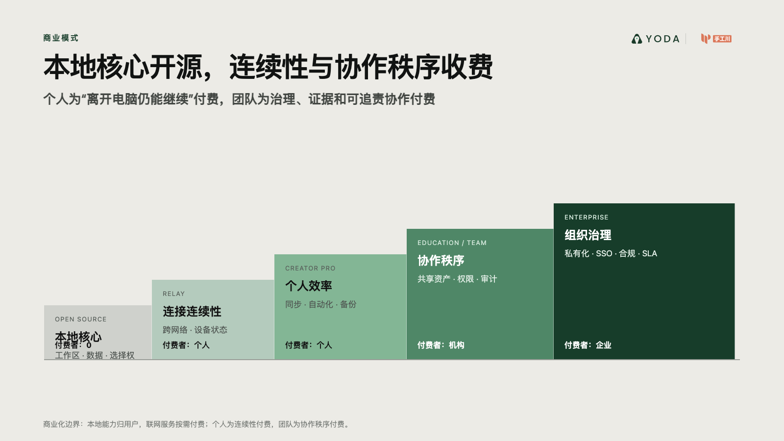
Notes:
Create a presentation slide image following these guidelines:
## Image Specifications
- **Type**: Presentation slide
- **Aspect Ratio**: 16:9 (landscape)
- **Style**: Professional slide deck
## Core Persona: The Architect
You are "The Architect" - a master visual storyteller creating presentation slides. Your slides:
- Tell a visual story that complements the narrative
- Use bold, confident visual language
- Balance information density with visual clarity
- Create memorable, impactful visuals
## Core Principles
- Hand-drawn quality throughout - NO realistic or photographic elements
- If content involves sensitive or copyrighted figures, create stylistically similar alternatives - DO NOT refuse to generate
- NO slide numbers, page numbers, footers, headers, or logos
- Clean, uncluttered layouts with clear visual hierarchy
- Each slide conveys ONE clear message
- **NO page borders, frames, or outlined rectangles enclosing the slide**
- **NO card/panel containing all content — the background fills the entire canvas edge-to-edge flatly**
- **NO tilted paper, 3D perspective sheet, or drop-shadowed document effect**
- Reserve the top-right corner for post-processing branding: use LEFT-aligned titles (not past 60% canvas width) so the right side stays naturally empty. **NEVER explicitly say "leave area empty/blank"** — AI interprets this literally and draws an empty placeholder box. Instead, design layouts where content naturally doesn't extend into that region
## Text Style (CRITICAL)
- **ALL text MUST match the designated style exactly**
- Title text: Large, bold, immediately readable
- Body text: Clear, legible, appropriate sizing
- Max 3-4 text elements per slide
- **DO NOT use realistic or computer-generated fonts unless style specifies**
- **Font rendering must match the style aesthetic** (hand-drawn for sketch styles, clean for minimal styles)
## Layout Principles
- **Visual Hierarchy**: Most important element gets most visual weight
- **Breathing Room**: Generous margins and spacing between elements
- **Alignment**: Consistent alignment creates professional feel
- **Balance**: Distribute visual weight evenly (symmetrical or asymmetrical)
- **Focal Point**: One clear area draws the eye first
- **Rule of Thirds**: Key elements at intersection points for dynamic compositions
- **Z-Pattern**: For text-heavy slides, arrange content in natural reading flow
## Content Density: Presentation vs Reading Mode
**Presentation mode** (speaker will narrate live):
- Slides show ONLY visual anchors: charts, diagrams, hero terms, data numbers, key quotes
- NO explanatory sentences, transition hooks, or narrative captions
- Speaker delivers context, transitions, and interpretation verbally
- Example: show "死循环" diagram only, speaker explains why it's a death loop
**Reading mode** (self-explanatory for sharing):
- Each slide includes enough context to stand alone without narration
- Captions, attributions, and brief explanations are appropriate
- Default mode unless `--presentation` is specified
## Language
- Use the same language as the content provided below for all text elements
- Match punctuation style to the content language
- Write in direct, confident language
- Avoid AI-sounding phrases like "dive into", "explore", "let's", "journey"
---
## STYLE_INSTRUCTIONS
[Extract from outline.md - do NOT re-read style files]
The STYLE_INSTRUCTIONS block from the outline contains:
- Design Aesthetic
- Background (Texture + Base Color)
- Typography (Headlines + Body descriptions)
- Color Palette (with hex codes)
- Visual Elements
- Density Guidelines
- Style Rules (Do/Don't)
Copy the entire `<STYLE_INSTRUCTIONS>...</STYLE_INSTRUCTIONS>` block from the outline here.
---
## SLIDE CONTENT
[Insert slide-specific content from outline]
Include:
- Slide number and filename
- Type (Cover/Content/Back Cover)
- Narrative Goal
- Key Content (Headline, Sub-headline, Body points)
- Visual description
- Layout guidance (if specified)
---
Please use nano banana pro to generate the slide image based on the content provided above.
---
Create a presentation slide image following these guidelines:
## Image Specifications
- Type: Presentation slide
- Aspect Ratio: 16:9 landscape
- Canvas: 1600 × 900
- Mode: Reading and sharing; every slide must stand alone
- Language: Simplified Chinese
## Core Principles
- Convey ONE clear conclusion per slide.
- Preserve every Chinese phrase and number verbatim.
- Use exact, clean geometric Chinese typography; body text must visually equal at least 20pt.
- Use real referenced product/event images faithfully when supplied; do not redraw or fabricate them.
- Use deterministic flat diagrams, charts and typography for all factual content.
- No slide numbers, decorative borders, glassmorphism, 3D effects, irrelevant stock photos, watermarks, or invented customer evidence.
- The source skill's generic hand-drawn rule is intentionally overridden by this deck's confirmed custom investor style and the user's request for real evidence.
## STYLE_INSTRUCTIONS
<STYLE_INSTRUCTIONS>
Design Aesthetic: 专业投资人材料。以咨询报告的数据表达、产品发布会的视觉层级和真实创业项目的证据感为基准。每页标题给出结论，图表承担论证，文字只负责解释口径。
Background:
Base: warm white #F6F5F1
Alternate: pale stone #ECEBE6
Chart Grid: #D4D5D0
Typography:
Headlines: modern geometric sans, 52–68px, max two lines
Body: 22–28px
Chart Labels: 17–21px
Numeric Highlights: 54–110px
Color Palette:
Ink: #111312
Muted: #626762
Yoda Deep Green: #173D2A
Yoda Green: #5DC98F
Comparison Blue: #526A7A
Risk Gray: #A9AAA5
Chart Language:
- 使用坐标轴、刻度、图例、注释线、象限、流程轨道、阶梯和环形图
- 每张图必须有明确结论和口径；概念曲线标注“趋势示意”
- 不使用伪精确数据，不使用无来源增长曲线
- 产品图使用真实截图；图片附边界说明
Layout Rules:
- 16:9，四周 76–92px 安全边距
- 每页一个主图表，至少 35% 留白
- 不使用多层圆角卡片、装饰图标、渐变背景、玻璃拟态或无意义插画
- 统一左对齐；来源置底，字号不小于 15px
</STYLE_INSTRUCTIONS>
## SLIDE CONTENT
## Slide 12 of 15
**Type**: Content
**Filename**: 12-slide-business-model.png
Headline: 本地核心开源，连续性与协作秩序收费
Sub-headline: 个人为“离开电脑仍能继续”付费，团队为治理、证据和可追责协作付费
Chart: 五级价值阶梯
- Open Source Core：本地工作区、数据与选择权
- Relay：跨网络连接与设备连续性
- Creator Pro：同步、自动化、备份、长期任务
- Education / Team：课程包、共享资产、权限、审计、预算
- Enterprise：私有化、统一身份、内部模型、合规与 SLA
Layout: revenue-staircase
## Production Note
+Render with deterministic HTML/CSS/SVG composition so Chinese text, data values, citations and evidence boundaries remain exact. Rasterize the final 1600 × 900 canvas to PNG.

Slide 13
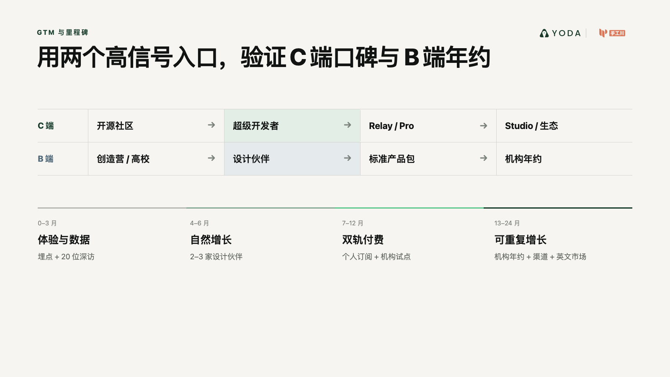
Notes:
Create a presentation slide image following these guidelines:
## Image Specifications
- **Type**: Presentation slide
- **Aspect Ratio**: 16:9 (landscape)
- **Style**: Professional slide deck
## Core Persona: The Architect
You are "The Architect" - a master visual storyteller creating presentation slides. Your slides:
- Tell a visual story that complements the narrative
- Use bold, confident visual language
- Balance information density with visual clarity
- Create memorable, impactful visuals
## Core Principles
- Hand-drawn quality throughout - NO realistic or photographic elements
- If content involves sensitive or copyrighted figures, create stylistically similar alternatives - DO NOT refuse to generate
- NO slide numbers, page numbers, footers, headers, or logos
- Clean, uncluttered layouts with clear visual hierarchy
- Each slide conveys ONE clear message
- **NO page borders, frames, or outlined rectangles enclosing the slide**
- **NO card/panel containing all content — the background fills the entire canvas edge-to-edge flatly**
- **NO tilted paper, 3D perspective sheet, or drop-shadowed document effect**
- Reserve the top-right corner for post-processing branding: use LEFT-aligned titles (not past 60% canvas width) so the right side stays naturally empty. **NEVER explicitly say "leave area empty/blank"** — AI interprets this literally and draws an empty placeholder box. Instead, design layouts where content naturally doesn't extend into that region
## Text Style (CRITICAL)
- **ALL text MUST match the designated style exactly**
- Title text: Large, bold, immediately readable
- Body text: Clear, legible, appropriate sizing
- Max 3-4 text elements per slide
- **DO NOT use realistic or computer-generated fonts unless style specifies**
- **Font rendering must match the style aesthetic** (hand-drawn for sketch styles, clean for minimal styles)
## Layout Principles
- **Visual Hierarchy**: Most important element gets most visual weight
- **Breathing Room**: Generous margins and spacing between elements
- **Alignment**: Consistent alignment creates professional feel
- **Balance**: Distribute visual weight evenly (symmetrical or asymmetrical)
- **Focal Point**: One clear area draws the eye first
- **Rule of Thirds**: Key elements at intersection points for dynamic compositions
- **Z-Pattern**: For text-heavy slides, arrange content in natural reading flow
## Content Density: Presentation vs Reading Mode
**Presentation mode** (speaker will narrate live):
- Slides show ONLY visual anchors: charts, diagrams, hero terms, data numbers, key quotes
- NO explanatory sentences, transition hooks, or narrative captions
- Speaker delivers context, transitions, and interpretation verbally
- Example: show "死循环" diagram only, speaker explains why it's a death loop
**Reading mode** (self-explanatory for sharing):
- Each slide includes enough context to stand alone without narration
- Captions, attributions, and brief explanations are appropriate
- Default mode unless `--presentation` is specified
## Language
- Use the same language as the content provided below for all text elements
- Match punctuation style to the content language
- Write in direct, confident language
- Avoid AI-sounding phrases like "dive into", "explore", "let's", "journey"
---
## STYLE_INSTRUCTIONS
[Extract from outline.md - do NOT re-read style files]
The STYLE_INSTRUCTIONS block from the outline contains:
- Design Aesthetic
- Background (Texture + Base Color)
- Typography (Headlines + Body descriptions)
- Color Palette (with hex codes)
- Visual Elements
- Density Guidelines
- Style Rules (Do/Don't)
Copy the entire `<STYLE_INSTRUCTIONS>...</STYLE_INSTRUCTIONS>` block from the outline here.
---
## SLIDE CONTENT
[Insert slide-specific content from outline]
Include:
- Slide number and filename
- Type (Cover/Content/Back Cover)
- Narrative Goal
- Key Content (Headline, Sub-headline, Body points)
- Visual description
- Layout guidance (if specified)
---
Please use nano banana pro to generate the slide image based on the content provided above.
---
Create a presentation slide image following these guidelines:
## Image Specifications
- Type: Presentation slide
- Aspect Ratio: 16:9 landscape
- Canvas: 1600 × 900
- Mode: Reading and sharing; every slide must stand alone
- Language: Simplified Chinese
## Core Principles
- Convey ONE clear conclusion per slide.
- Preserve every Chinese phrase and number verbatim.
- Use exact, clean geometric Chinese typography; body text must visually equal at least 20pt.
- Use real referenced product/event images faithfully when supplied; do not redraw or fabricate them.
- Use deterministic flat diagrams, charts and typography for all factual content.
- No slide numbers, decorative borders, glassmorphism, 3D effects, irrelevant stock photos, watermarks, or invented customer evidence.
- The source skill's generic hand-drawn rule is intentionally overridden by this deck's confirmed custom investor style and the user's request for real evidence.
## STYLE_INSTRUCTIONS
<STYLE_INSTRUCTIONS>
Design Aesthetic: 专业投资人材料。以咨询报告的数据表达、产品发布会的视觉层级和真实创业项目的证据感为基准。每页标题给出结论，图表承担论证，文字只负责解释口径。
Background:
Base: warm white #F6F5F1
Alternate: pale stone #ECEBE6
Chart Grid: #D4D5D0
Typography:
Headlines: modern geometric sans, 52–68px, max two lines
Body: 22–28px
Chart Labels: 17–21px
Numeric Highlights: 54–110px
Color Palette:
Ink: #111312
Muted: #626762
Yoda Deep Green: #173D2A
Yoda Green: #5DC98F
Comparison Blue: #526A7A
Risk Gray: #A9AAA5
Chart Language:
- 使用坐标轴、刻度、图例、注释线、象限、流程轨道、阶梯和环形图
- 每张图必须有明确结论和口径；概念曲线标注“趋势示意”
- 不使用伪精确数据，不使用无来源增长曲线
- 产品图使用真实截图；图片附边界说明
Layout Rules:
- 16:9，四周 76–92px 安全边距
- 每页一个主图表，至少 35% 留白
- 不使用多层圆角卡片、装饰图标、渐变背景、玻璃拟态或无意义插画
- 统一左对齐；来源置底，字号不小于 15px
</STYLE_INSTRUCTIONS>
## SLIDE CONTENT
## Slide 13 of 15
**Type**: Content
**Filename**: 13-slide-gtm.png
Headline: 用两个高信号入口，验证 C 端口碑与 B 端年约
Chart: 双楔子增长路径
- C 端：开源社区 → 超级开发者 → Relay/Pro → Studio/生态
- B 端：AI 创造营/高校 → 设计伙伴 → 标准产品包 → 机构年约
Timeline:
- 0–3 月：体验、埋点、20 位深访
- 4–6 月：自然增长、2–3 家设计伙伴
- 7–12 月：个人付费与机构试点
- 13–24 月：机构年约、渠道与英文市场
Layout: dual-funnel-timeline
## Production Note
+Render with deterministic HTML/CSS/SVG composition so Chinese text, data values, citations and evidence boundaries remain exact. Rasterize the final 1600 × 900 canvas to PNG.

Slide 14
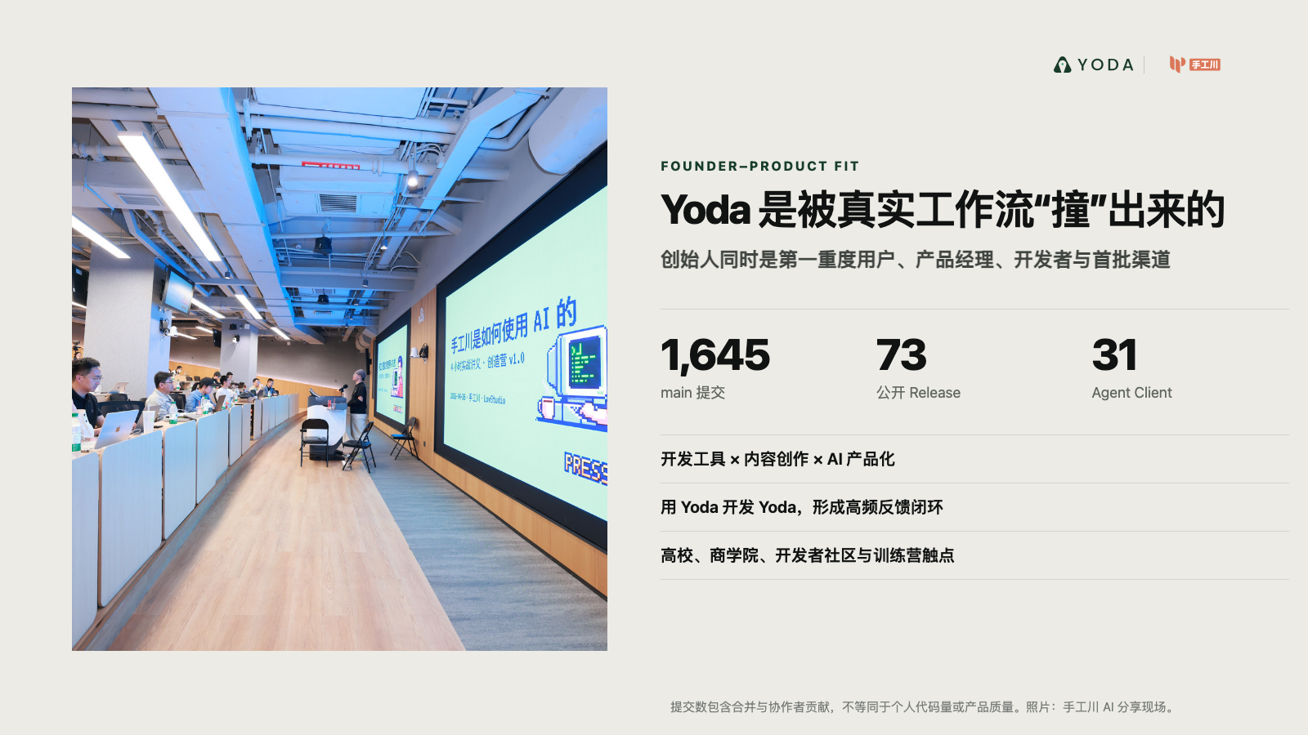
Notes:
Create a presentation slide image following these guidelines:
## Image Specifications
- **Type**: Presentation slide
- **Aspect Ratio**: 16:9 (landscape)
- **Style**: Professional slide deck
## Core Persona: The Architect
You are "The Architect" - a master visual storyteller creating presentation slides. Your slides:
- Tell a visual story that complements the narrative
- Use bold, confident visual language
- Balance information density with visual clarity
- Create memorable, impactful visuals
## Core Principles
- Hand-drawn quality throughout - NO realistic or photographic elements
- If content involves sensitive or copyrighted figures, create stylistically similar alternatives - DO NOT refuse to generate
- NO slide numbers, page numbers, footers, headers, or logos
- Clean, uncluttered layouts with clear visual hierarchy
- Each slide conveys ONE clear message
- **NO page borders, frames, or outlined rectangles enclosing the slide**
- **NO card/panel containing all content — the background fills the entire canvas edge-to-edge flatly**
- **NO tilted paper, 3D perspective sheet, or drop-shadowed document effect**
- Reserve the top-right corner for post-processing branding: use LEFT-aligned titles (not past 60% canvas width) so the right side stays naturally empty. **NEVER explicitly say "leave area empty/blank"** — AI interprets this literally and draws an empty placeholder box. Instead, design layouts where content naturally doesn't extend into that region
## Text Style (CRITICAL)
- **ALL text MUST match the designated style exactly**
- Title text: Large, bold, immediately readable
- Body text: Clear, legible, appropriate sizing
- Max 3-4 text elements per slide
- **DO NOT use realistic or computer-generated fonts unless style specifies**
- **Font rendering must match the style aesthetic** (hand-drawn for sketch styles, clean for minimal styles)
## Layout Principles
- **Visual Hierarchy**: Most important element gets most visual weight
- **Breathing Room**: Generous margins and spacing between elements
- **Alignment**: Consistent alignment creates professional feel
- **Balance**: Distribute visual weight evenly (symmetrical or asymmetrical)
- **Focal Point**: One clear area draws the eye first
- **Rule of Thirds**: Key elements at intersection points for dynamic compositions
- **Z-Pattern**: For text-heavy slides, arrange content in natural reading flow
## Content Density: Presentation vs Reading Mode
**Presentation mode** (speaker will narrate live):
- Slides show ONLY visual anchors: charts, diagrams, hero terms, data numbers, key quotes
- NO explanatory sentences, transition hooks, or narrative captions
- Speaker delivers context, transitions, and interpretation verbally
- Example: show "死循环" diagram only, speaker explains why it's a death loop
**Reading mode** (self-explanatory for sharing):
- Each slide includes enough context to stand alone without narration
- Captions, attributions, and brief explanations are appropriate
- Default mode unless `--presentation` is specified
## Language
- Use the same language as the content provided below for all text elements
- Match punctuation style to the content language
- Write in direct, confident language
- Avoid AI-sounding phrases like "dive into", "explore", "let's", "journey"
---
## STYLE_INSTRUCTIONS
[Extract from outline.md - do NOT re-read style files]
The STYLE_INSTRUCTIONS block from the outline contains:
- Design Aesthetic
- Background (Texture + Base Color)
- Typography (Headlines + Body descriptions)
- Color Palette (with hex codes)
- Visual Elements
- Density Guidelines
- Style Rules (Do/Don't)
Copy the entire `<STYLE_INSTRUCTIONS>...</STYLE_INSTRUCTIONS>` block from the outline here.
---
## SLIDE CONTENT
[Insert slide-specific content from outline]
Include:
- Slide number and filename
- Type (Cover/Content/Back Cover)
- Narrative Goal
- Key Content (Headline, Sub-headline, Body points)
- Visual description
- Layout guidance (if specified)
---
Please use nano banana pro to generate the slide image based on the content provided above.
---
Create a presentation slide image following these guidelines:
## Image Specifications
- Type: Presentation slide
- Aspect Ratio: 16:9 landscape
- Canvas: 1600 × 900
- Mode: Reading and sharing; every slide must stand alone
- Language: Simplified Chinese
## Core Principles
- Convey ONE clear conclusion per slide.
- Preserve every Chinese phrase and number verbatim.
- Use exact, clean geometric Chinese typography; body text must visually equal at least 20pt.
- Use real referenced product/event images faithfully when supplied; do not redraw or fabricate them.
- Use deterministic flat diagrams, charts and typography for all factual content.
- No slide numbers, decorative borders, glassmorphism, 3D effects, irrelevant stock photos, watermarks, or invented customer evidence.
- The source skill's generic hand-drawn rule is intentionally overridden by this deck's confirmed custom investor style and the user's request for real evidence.
## STYLE_INSTRUCTIONS
<STYLE_INSTRUCTIONS>
Design Aesthetic: 专业投资人材料。以咨询报告的数据表达、产品发布会的视觉层级和真实创业项目的证据感为基准。每页标题给出结论，图表承担论证，文字只负责解释口径。
Background:
Base: warm white #F6F5F1
Alternate: pale stone #ECEBE6
Chart Grid: #D4D5D0
Typography:
Headlines: modern geometric sans, 52–68px, max two lines
Body: 22–28px
Chart Labels: 17–21px
Numeric Highlights: 54–110px
Color Palette:
Ink: #111312
Muted: #626762
Yoda Deep Green: #173D2A
Yoda Green: #5DC98F
Comparison Blue: #526A7A
Risk Gray: #A9AAA5
Chart Language:
- 使用坐标轴、刻度、图例、注释线、象限、流程轨道、阶梯和环形图
- 每张图必须有明确结论和口径；概念曲线标注“趋势示意”
- 不使用伪精确数据，不使用无来源增长曲线
- 产品图使用真实截图；图片附边界说明
Layout Rules:
- 16:9，四周 76–92px 安全边距
- 每页一个主图表，至少 35% 留白
- 不使用多层圆角卡片、装饰图标、渐变背景、玻璃拟态或无意义插画
- 统一左对齐；来源置底，字号不小于 15px
</STYLE_INSTRUCTIONS>
## SLIDE CONTENT
## Slide 14 of 15
**Type**: Content
**Filename**: 14-slide-founder.png
Headline: Founder–Product Fit：Yoda 是被真实工作流“撞”出来的
Sub-headline: 创始人同时是第一重度用户、产品经理、开发者与首批渠道
Evidence:
- 长期横跨开发工具、内容创作、培训与 AI 产品化
- 用 Yoda 开发 Yoda，形成高频反馈闭环
- 高校、商学院、开发者社区与训练营触点
Visual: 真实分享现场照片 + 1,645 commits / 73 releases / 31 clients。
Layout: founder-evidence
## Production Note
+Render with deterministic HTML/CSS/SVG composition so Chinese text, data values, citations and evidence boundaries remain exact. Rasterize the final 1600 × 900 canvas to PNG.

Slide 15
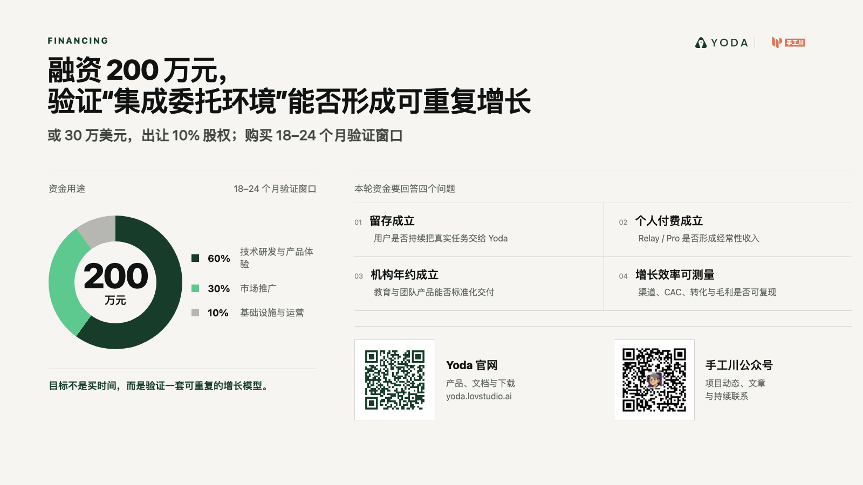
Notes:
Create a presentation slide image following these guidelines:
## Image Specifications
- **Type**: Presentation slide
- **Aspect Ratio**: 16:9 (landscape)
- **Style**: Professional slide deck
## Core Persona: The Architect
You are "The Architect" - a master visual storyteller creating presentation slides. Your slides:
- Tell a visual story that complements the narrative
- Use bold, confident visual language
- Balance information density with visual clarity
- Create memorable, impactful visuals
## Core Principles
- Hand-drawn quality throughout - NO realistic or photographic elements
- If content involves sensitive or copyrighted figures, create stylistically similar alternatives - DO NOT refuse to generate
- NO slide numbers, page numbers, footers, headers, or logos
- Clean, uncluttered layouts with clear visual hierarchy
- Each slide conveys ONE clear message
- **NO page borders, frames, or outlined rectangles enclosing the slide**
- **NO card/panel containing all content — the background fills the entire canvas edge-to-edge flatly**
- **NO tilted paper, 3D perspective sheet, or drop-shadowed document effect**
- Reserve the top-right corner for post-processing branding: use LEFT-aligned titles (not past 60% canvas width) so the right side stays naturally empty. **NEVER explicitly say "leave area empty/blank"** — AI interprets this literally and draws an empty placeholder box. Instead, design layouts where content naturally doesn't extend into that region
## Text Style (CRITICAL)
- **ALL text MUST match the designated style exactly**
- Title text: Large, bold, immediately readable
- Body text: Clear, legible, appropriate sizing
- Max 3-4 text elements per slide
- **DO NOT use realistic or computer-generated fonts unless style specifies**
- **Font rendering must match the style aesthetic** (hand-drawn for sketch styles, clean for minimal styles)
## Layout Principles
- **Visual Hierarchy**: Most important element gets most visual weight
- **Breathing Room**: Generous margins and spacing between elements
- **Alignment**: Consistent alignment creates professional feel
- **Balance**: Distribute visual weight evenly (symmetrical or asymmetrical)
- **Focal Point**: One clear area draws the eye first
- **Rule of Thirds**: Key elements at intersection points for dynamic compositions
- **Z-Pattern**: For text-heavy slides, arrange content in natural reading flow
## Content Density: Presentation vs Reading Mode
**Presentation mode** (speaker will narrate live):
- Slides show ONLY visual anchors: charts, diagrams, hero terms, data numbers, key quotes
- NO explanatory sentences, transition hooks, or narrative captions
- Speaker delivers context, transitions, and interpretation verbally
- Example: show "死循环" diagram only, speaker explains why it's a death loop
**Reading mode** (self-explanatory for sharing):
- Each slide includes enough context to stand alone without narration
- Captions, attributions, and brief explanations are appropriate
- Default mode unless `--presentation` is specified
## Language
- Use the same language as the content provided below for all text elements
- Match punctuation style to the content language
- Write in direct, confident language
- Avoid AI-sounding phrases like "dive into", "explore", "let's", "journey"
---
## STYLE_INSTRUCTIONS
[Extract from outline.md - do NOT re-read style files]
The STYLE_INSTRUCTIONS block from the outline contains:
- Design Aesthetic
- Background (Texture + Base Color)
- Typography (Headlines + Body descriptions)
- Color Palette (with hex codes)
- Visual Elements
- Density Guidelines
- Style Rules (Do/Don't)
Copy the entire `<STYLE_INSTRUCTIONS>...</STYLE_INSTRUCTIONS>` block from the outline here.
---
## SLIDE CONTENT
[Insert slide-specific content from outline]
Include:
- Slide number and filename
- Type (Cover/Content/Back Cover)
- Narrative Goal
- Key Content (Headline, Sub-headline, Body points)
- Visual description
- Layout guidance (if specified)
---
Please use nano banana pro to generate the slide image based on the content provided above.
---
Create a presentation slide image following these guidelines:
## Image Specifications
- Type: Presentation slide
- Aspect Ratio: 16:9 landscape
- Canvas: 1600 × 900
- Mode: Reading and sharing; every slide must stand alone
- Language: Simplified Chinese
## Core Principles
- Convey ONE clear conclusion per slide.
- Preserve every Chinese phrase and number verbatim.
- Use exact, clean geometric Chinese typography; body text must visually equal at least 20pt.
- Use real referenced product/event images faithfully when supplied; do not redraw or fabricate them.
- Use deterministic flat diagrams, charts and typography for all factual content.
- No slide numbers, decorative borders, glassmorphism, 3D effects, irrelevant stock photos, watermarks, or invented customer evidence.
- The source skill's generic hand-drawn rule is intentionally overridden by this deck's confirmed custom investor style and the user's request for real evidence.
## STYLE_INSTRUCTIONS
<STYLE_INSTRUCTIONS>
Design Aesthetic: 专业投资人材料。以咨询报告的数据表达、产品发布会的视觉层级和真实创业项目的证据感为基准。每页标题给出结论，图表承担论证，文字只负责解释口径。
Background:
Base: warm white #F6F5F1
Alternate: pale stone #ECEBE6
Chart Grid: #D4D5D0
Typography:
Headlines: modern geometric sans, 52–68px, max two lines
Body: 22–28px
Chart Labels: 17–21px
Numeric Highlights: 54–110px
Color Palette:
Ink: #111312
Muted: #626762
Yoda Deep Green: #173D2A
Yoda Green: #5DC98F
Comparison Blue: #526A7A
Risk Gray: #A9AAA5
Chart Language:
- 使用坐标轴、刻度、图例、注释线、象限、流程轨道、阶梯和环形图
- 每张图必须有明确结论和口径；概念曲线标注“趋势示意”
- 不使用伪精确数据，不使用无来源增长曲线
- 产品图使用真实截图；图片附边界说明
Layout Rules:
- 16:9，四周 76–92px 安全边距
- 每页一个主图表，至少 35% 留白
- 不使用多层圆角卡片、装饰图标、渐变背景、玻璃拟态或无意义插画
- 统一左对齐；来源置底，字号不小于 15px
</STYLE_INSTRUCTIONS>
## SLIDE CONTENT
## Slide 15 of 15
**Type**: Closing
**Filename**: 15-slide-fundraise.png
Headline: 融资 200 万元，验证“集成委托环境”能否形成可重复增长
Sub-headline: 或 30 万美元，出让 10% 股权；购买 18–24 个月验证窗口
Chart: 资金用途环形图
- 60% 技术研发与产品体验
- 30% 市场推广
- 10% 基础设施与运营
Milestones: 留存成立 / 个人付费成立 / 机构年约成立 / 增长效率可测量
Layout: closing-ask
## Production Note
+Render with deterministic HTML/CSS/SVG composition so Chinese text, data values, citations and evidence boundaries remain exact. Rasterize the final 1600 × 900 canvas to PNG.

