Slide 1
~/ project-report MCA · 2nd Semester · 2025–26
A PROJECT REPORT ON
Terminal Based
Chat Application
A real-time, asynchronous messaging platform engineered entirely for the command-line environment.
Submitted By
Submitted To
Ghanshyam · 25138
Mr. Anshul Kalia
Divya Jyoti · 25135
Assistant Professor
Manya Ranchan · 25153
Department of Computer Science
Himachal Pradesh University, Shimla

Slide 2
01 — CONTENTS
02 / 13
Table of Contents
01 Project Overview 03
02 Technology Stack 04
03 System Architecture 05
04 Database Schema 06
05 Backend Implementation 07
06 Source Modules 08
07 User Authentication 09
08 Real-Time Communication 10
09 Testing & Diagnostics 11
10 Key Features 12
11 Future Scope & Conclusion 13

Slide 3
SECTION 01
03 / 12
Project Overview
A terminal-based chat application that provides the responsiveness of modern messaging applications while operating entirely within the user's command-line environment.
OBJECTIVES
01 Secure login via mobile number and OTP verification.
02 Instant message exchange using WebSockets.
It is built as a lightweight alternative to resource-intensive graphical clients, the system serves developers and command-line enthusiasts who prefers simplicity and an uninterrupted workflow.
03 Persistent storage of accounts and chat history.
04 A simple, native-feeling terminal user interface.

Slide 4
SECTION 02
04 / 12
Technology Stack
BACKEND
FRONTEND (TUI)
FastAPI · Uvicorn
Textual · Rich
Asynchronous Python framework over the ASGI gateway, handling both stateless REST endpoints and stateful WebSocket sessions.
Reactive terminal UI engine that renders a CSS-styled layout, paired with Rich for refined typography and colour.
DATABASE
NETWORKING
PostgreSQL · SQLModel
WebSockets · httpx
Relational persistence driven by asyncpg for non-blocking I/O, with SQLModel bridging SQLAlchemy mapping and Pydantic validation.
Full-duplex sockets sustain real-time message streams, while httpx handles the asynchronous HTTP handshake for authentication.
Runtime · Python 3.10 / 3.11 / 3.12 | Platform · Linux · macOS · Windows

Slide 5
SECTION 03
05 / 12
System Architecture
An asynchronous client–server architecture in which data flows over two distinct channels: stateless REST for authentication and history, and persistent WebSockets for live message delivery.
CLIENT
SERVER — FASTAPI
PERSISTENCE
Textual TUI
Async Backend Hub
PostgreSQL
HTTP
Reactive terminal interface running an asynchronous listener loop on the user's local machine.
→
POST /request-otp
Stores user records and full message history; modelled via SQLModel for type-safe access.
asyncpg
POST /verify-otp
↔
WS
GET /messages/{a}/{b}
↔
WS /ws/{phone_number}
Maintains an in-memory map of active sockets for instantaneous routing.
DATA FLOW
The client first issues an HTTP request to obtain an OTP and verify the user. Upon successful authentication, it upgrades to a WebSocket session identified by the user's phone number. Outbound messages are transmitted through this socket; the server persists them to PostgreSQL and forwards them to the recipient's active connection in the same operation.

Slide 6
SECTION 04
06 / 12
Database Schema
messages
id (pk) | int
sender_id | int
receiver_id | int
content | text
created_at | timestamp
users
id (pk) | Int
phone_number (uq) | varchar (n)
is_verified | boolean
1 : N
sends / receives
The schema is defined through SQLModel, which unifies SQLAlchemy's relational mapping with Pydantic's validation. A single User may participate in many Messages, related through the sender_id and receiver_id foreign keys.

Slide 7
SECTION 05
07 / 12
Backend Implementation
01 — REST ENDPOINTS
Stateless HTTP routes handle authentication handshakes and the retrieval of historical conversations between two users.
02 — WEBSOCKET GATEWAY
A persistent socket at /ws/{phone_number} maintains a dictionary of active connections for direct routing.
server.log
INFO: Started server process
INFO: Waiting for application startup.
03 — PERSISTENCE LAYER
INFO: Application startup complete.
SQLModel definitions are executed through the asyncpg driver to ensure non-blocking reads and writes against PostgreSQL.
INFO: Uvicorn running on 0.0.0.0:8000
04 — CONCURRENCY MODEL
The entire server operates on Python's asyncio event loop, served by Uvicorn over the ASGI gateway interface.

Slide 8
SECTION 06
08 / 13
Source Modules
The codebase is organised into four focused Python modules, each with a single, well-defined responsibility under the separation-of-concerns principle.
MODULE | ROLE | RESPONSIBILITY
main.py | System Brain & Traffic Controller | Hosts the central FastAPI application. Exposes REST endpoints for OTP issuance and history retrieval, and maintains the persistent WebSocket pipeline that forwards messages between users.
client.py | User Interface & Terminal Experience | Runs locally with the Textual framework to render a flicker-free terminal window. Handles keystrokes, calls the backend API for login, and listens asynchronously for inbound messages.
models.py | Blueprint & Rulebook | Defines the User and Message data structures via SQLModel and enforces validation through Pydantic, preventing malformed records from entering the system.
database.py | Storage Pipe | Configures the asynchronous asyncpg engine, initialises database tables on startup, and yields transactional sessions to any module that needs to read or write data.

Slide 9
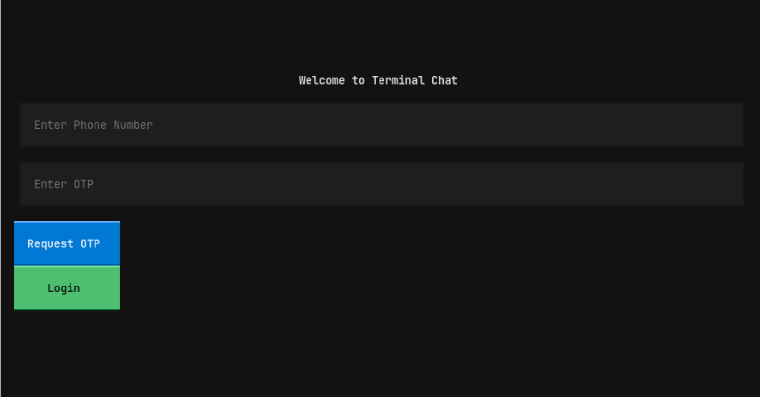
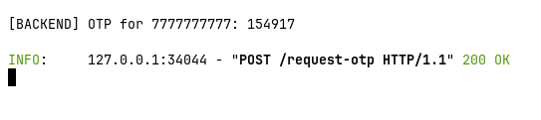
SECTION 07
09 / 13
User Authentication
Authentication is performed through a two-step One-Time Password mechanism keyed against the user's mobile number, eliminating any need for stored passwords.
01
Request OTP
The client submits a phone number; the server generates a code, stores it in an in-memory cache, and returns acknowledgement.
02
Verify OTP
The submitted code is validated against the cache; on success the user record is marked is_verified = True.
Fig. — Welcome screen rendered by the Textual TUI client.
03
Establish Session
The client transitions from the login view to the chat interface and opens its persistent WebSocket connection.
Fig. — Backend logs when OTP requested.

Slide 10
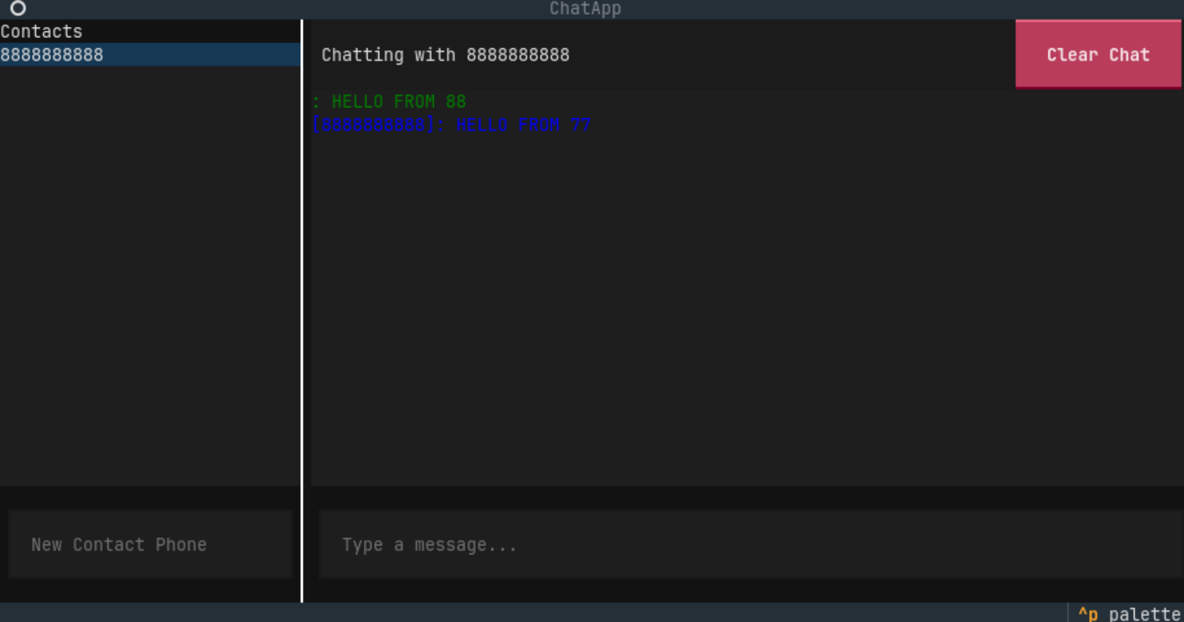
SECTION 08
10 / 13
Real-Time Communication
Real-time exchange is sustained by a full-duplex WebSocket channel established once authentication completes, allowing the server to push messages without client polling.
Connection registered in active_connections dictionary, keyed by phone number.
Outbound payload is persisted to PostgreSQL, then forwarded to the recipient's live socket in a single asynchronous operation.
The reactive Textual loop receives the payload and re-renders the conversation pane without blocking input.
Fig. — Live conversation rendered between two authenticated users.
Disconnection events purge the socket from memory, preventing stale references.

Slide 11
SECTION 09
11 / 13
Testing
The system was validated by running the backend and multiple client instances side-by-side, then verifying each functional path against a structured set of test cases.
ID | FUNCTIONAL SCOPE | EXPECTED RESULT | STATUS
TC-001 | Request OTP via /request-otp endpoint. | Token stored in memory cache and printed to server logs. | PASS
TC-002 | Submit valid OTP matching cached identity. | Session established; client loads primary workspace view. | PASS
TC-003 | Submit invalid or expired OTP payload. | API returns HTTP 400 and the client surfaces an error. | PASS
TC-004 | Dispatch real-time text message between users. | Row persisted to PostgreSQL and delivered to the recipient. | PASS
TC-005 | Disconnect and re-login to verify history sync. | Client recalls historical endpoints and repopulates the view. | PASS

Slide 12
SECTION 10
12 / 13
Key Features
01
02
03
OTP Authentication
Real-Time Messaging
Persistent History
Password-less login through a mobile-number and one-time-code verification handshake.
Instant one-to-one exchange over persistent WebSocket connections without polling.
Conversations are stored in PostgreSQL and replayed on demand between any two participants.
04
05
06
Contact Management
Reactive TUI
Lightweight
A sidebar interface for adding new contacts via phone number and selecting an active conversation.
A CSS-styled Textual interface that re-renders asynchronously as messages arrive over the socket.
Operates entirely within the terminal, consuming a fraction of the resources required by graphical clients.

Slide 13
SECTION 11
13 / 13
Future Scope & Conclusion
FUTURE ENHANCEMENTS
CONCLUSION
→ Group conversations with multi-recipient routing.
The Terminal Based Chat Application demonstrates that a modern, responsive messaging experience can be delivered without departing from the command-line environment.
→ End-to-end encryption of message payloads.
→ File transfer and inline multimedia previews.
→ Cloud deployment with horizontal scaling.
By combining FastAPI's asynchronous features, PostgreSQL's reliability, and Textual's reactive rendering, the project achieves a lightweight, and upgradable base for further development.
→ Read receipts and presence indicators.
Thank You
Department of Computer Science
Himachal Pradesh University, Shimla

