Slide 1
Week 1: Basics
Reading: Jensen 1.6,1.8,1.9

Slide 2
Two things we focus on
DFT = quick way to do QM
200 atoms, gases and solids, hard matter, treats electrons
MD = molecular dynamics
Classical nuclei, no electrons, used for bio, soft systems, liquids, 10⁷ atoms

Slide 3
Essential approximations
Nuclei=points
Interactions are EM
c→∞, so non-relativistic (can add back in as perturbation)
Natural units for electrons are atomic units (app C of Jensen)

Slide 4
Conversions
1 Hartree = 27.2 eV – total electron energies
1 eV = 23 kcal/mol – bond energies
1 kcal/mol = 4.1 kJ/mol – activation energies
1 kJ/mol = 83.6 cm⁻¹ - biochemistry
1 cm⁻¹ = 1.44 K – vibrations, rotations
1 Hartree = 315,773 K

Slide 5
Review of quantum
Most problems have 1 particle.
Given some potential function v(r), find eigenvalues of H = T + V
Label ε_{j} for eigenvalues, φ_{j}(r) for eigenfunctions, j=1,2,3,…
Lowest is ground state, next is first excited state, etc.

Slide 6
Particle in box
v(x)=0 for 0 < x < L, ∞ otherwise
ε_{j}= ħ² π² j² /2m_{e}L², j=1,2,3…
Atomic units: ε_{j}= π² j² /2L²

Slide 7
Harmonic oscillator
v(x)= ½ k x²
ε_{n}= ħω (n+ ½), n=0,1,2,3…
Atomic units: ε_{n}= ω (n+ ½)

Slide 8
Hydrogen atom
v(r)= -1/r, no dependence on angle, Coulomb attraction
Ψ_{nlm} (r) = R_{nl} (r) Y_{lm} (θ,ϕ)
ε_{n}= - E_{H}/(2n²), n=1,2,3…; g_{n}=2n²
Atomic units: ε_{n}= - 1/(2n²)
Hydrogenic (1 el, Z protons): ε_{n}= - Z²/(2n²)

Slide 9
More than 1 particle
Need to know if Fermions or Bosons.
Electrons are fermions, so wavefunction is ANTISYMMETRIC under swapping of two particles.
N = number of electrons.
Ψ(r₁,…,r_{j},…,r_{i},…,r_{N})= - Ψ(r₁,…,r_{i},…,r_{j},…,r_{N})
Also have spin indices for each.

Slide 10
Great Born-Oppenheimer approximation: Electrons
m_{e} << M_{a}, for all nuclei a
Total wavefn is approximately product of electronic wavefn times nuclear wavefn.
Electrons remain always in the same state
Find E_{j}(R) = energy of j-th electronic eigenstate for fixed nuclear positions R
Called a PES = potential energy surface

Slide 11
Great Born-Oppenheimer approximation: Nuclei
H = T_{n} + V_{nn} + E₀(R)
Assumed electrons in their ground state
Total potential: E_{tot}(R) = V_{nn}(R) + E₀(R)
V_{nn}(R) = Σ Z_{a} Z_{b} / | R_{a}-R_{b}| = Coulomb repulsion
Can treat nuclei either quantum mechanically or classically (MD).
Vibrations usually quantum mechanical.

Slide 12
H₂: the simplest case
H_{e} = t₁+t₂+v(r₁)+v(r₂)-1/r-1/|r-Rz| + 1/|r₁-r₂|
t₁ = kinetic energy of electron 1
v(r) = -1/r-1/|r-Rz| = one-body potential = attraction to the two nuclei, R apart on z-axis
E₀(R) = < Ψ₀(r_{1,}r₂)| H_{e} | Ψ₀(r_{1,}r₂) >
Note: All matter bound by Coulomb potentials, so V->0 as separation -> ∞, so all bound systems have E < 0.

Slide 13
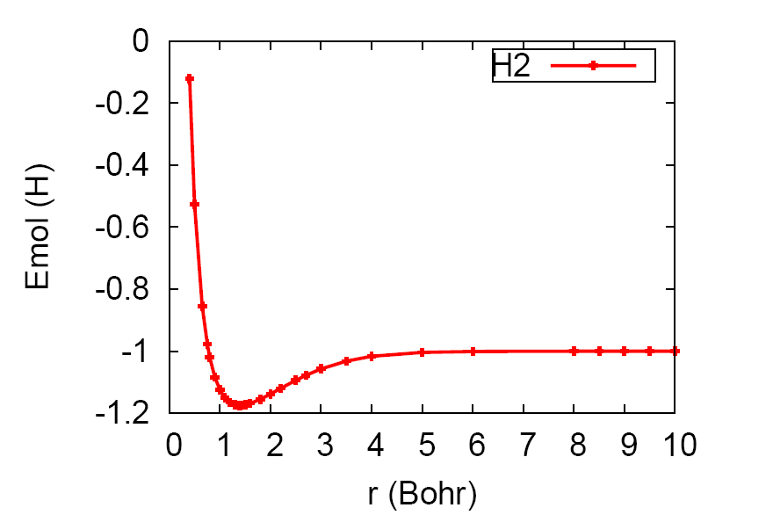
Exact molecular energy for H₂
R₀
D_{e}

Slide 14
More generally..
3N_{n}-6 internal coordinates
Eg methane has 9
Large molecule=>vast conformational space

Slide 15
Common phases of matter
Gas => molecules barely interact => most info from finite isolated molecule
Xal solid => perfect ordered array => solve with periodic boundary conditions
Liquids => need finite T,P for nuclei => MD
Small molecules and ordered solids => well-separated global minima => structure at 300K well-approximated by minimum
Bigger, softer molecules => many minima within 0.1 eV of each other => need to simulate at finite T

Slide 16
Notation for all matter
H=T_{n}+T_{e}+V_{nn}+V_{ne}+V_{ee}
T_{e} is kinetic energy of electrons, j=1,…,N
T_{n} is kinetic energy of nuclei
A labels nuclei, a=1,…,N_{n}
Z_{a} is the charge on a-th nucleus, of mass M_{a}

