Slide 1
Unsupervised and supervised learning on the Singapore housing dataset IE4102 Sem 1 2023 Low Eeron

Slide 2
TABLE OF CONTENTS
01
02
03
Introduction
Literature Review
Methodology
05
06
07
Results
Conclusion
Recommendation
Describing problem statement and scope
Review on available models and methods
Process of the project
04
Assumptions
Assumptions made in the model
Results obtained from the project
Learning points from the project
Things to do in the future

Slide 3
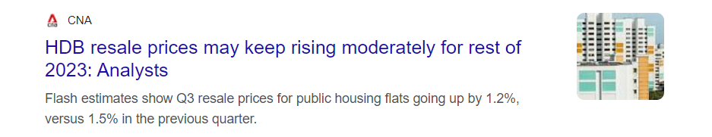
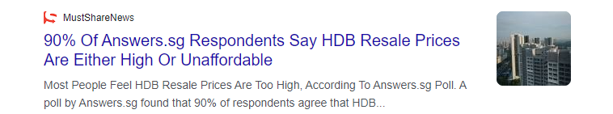


Introduction
Problems:
1. Limited filtering features on PropertyGuru
2. Wide price range
Solutions:
1. Unsupervised recommendation system
2. Supervised resale price prediction system
Notes:
- As we all know HDB resale prices has been increasing … -while I read another article…
-went on property..realise there is two problems when it comes to websites like this
-introduce problems and so what are the implications of the problems ?
Buyers may not be able to truly find the properties they want
For the second problem , buyers may over pay while sellers may under sell their property
- So to resolve these problems, this project offers two solutions

Slide 4
Literature review
Unsupervised technique:
- Kmeans clustering ( natural groups, allow property navigation )
- Hierarchical clustering (insides into different property tiers )
- Dbscan (identify unique or outlier properties)
Supervised technique:
- Random Forest (combines multiple decision trees for prediction accuracy )
- Xgboost & Gradient boosting machine (uses adaptive, trend-responsive predictions )
- Support vector machines (addresses non-linear complexicity )
- Lasso and Ridge regression (focus on key variables for precise outcomes )
distVincentySphere
(accurately measures distance by comparing coordinates)
Evaluation metrics:
- Root mean square error ( closeness of prediction to actual prices )
- Mean absolute percentage error ( percentage-based accuracy metric )

Slide 5
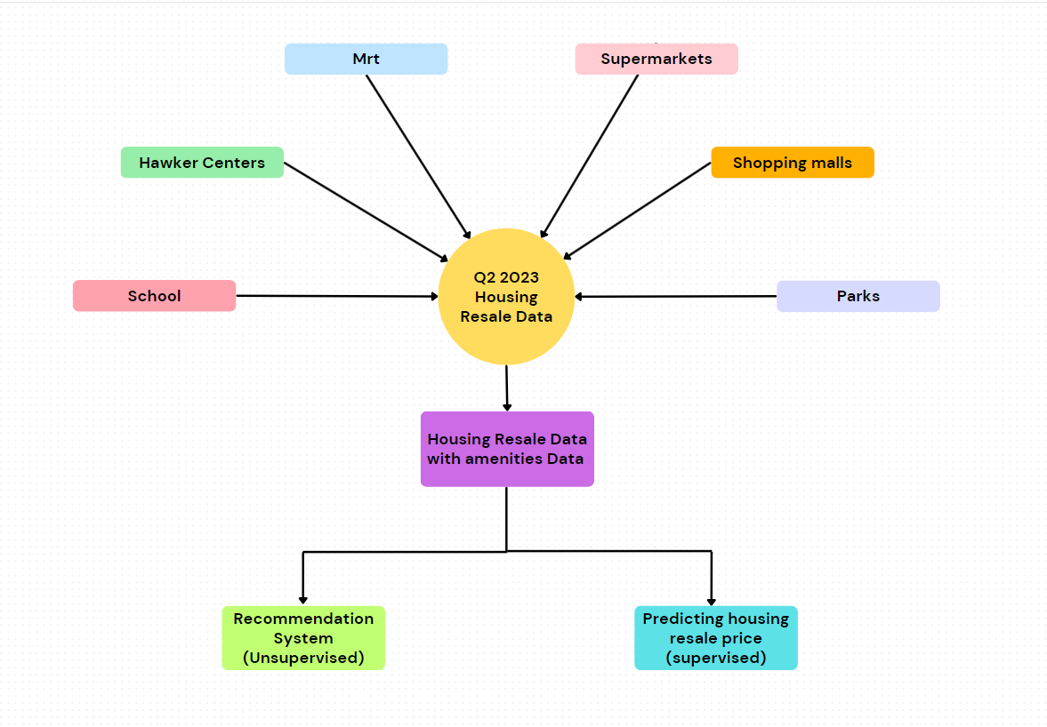
Methodology (overview)

Slide 6
Methodology (process)
Get the closest distance of amenities and the number of amenities within specific radii
Get Longitude and Latitude
Using distVincentySphere and compare the respective coordinates to get the proximity and density of amenities (1km radii for all amenities except 2km for school)
Filter Housing resale Data
Filtered the data in Q2 of 2023 from April to June
Geocode the addresses (housing resale data) and postal codes (School and Supermarket) to get their respective coordinates
(Combine data rmd file)

Slide 7
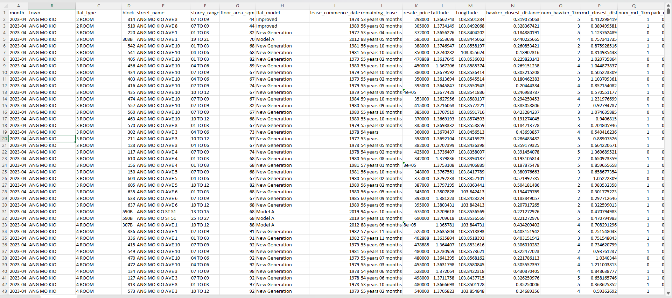
Methodology (process)

Slide 8
Methodology (process)
Data cleaning on the final combined dataset
1. Drop non-essential columns such as block,street_name,month,lease_commence_date, Latitude,Longitude
2. Remove rows where flat_model is "2-room“
( outlier values )
3. Remove rows where distances are greater than 4km for all towns ( outlier values )
Preliminary analysis
Analyse the average distances and number of facilities for each town
Summary statistic of the amenities
(Final rmd file)

Slide 9
Methodology (process)
Develop unsupervised recommendation system
Develop supervised housing resale price prediction system
Using shiny app and unsupervised clustering technic to develop a unsupervised recommendation system
Using shiny app and supervised technics to develop a resale price prediction system
(Final rmd file)

Slide 10
Assumptions
#3
#2
#1
Combining datasets from different years was considered not to cause crucial disparities in model performance.
External monetary conditions between quarters were assumed remain relatively the same therefore have no significant effect on resale prices.
The popularity of amenities was deemed not to have a significant impact on resale prices.

Slide 11
Results ( Overview )
Preliminary analysis of data
Feature importance
Gathering insides into the factors that most influence resale prices of housing units
Provide insights into the spatial distribution of amenities
Shiny app
Showcasing the unsupervised and supervised shiny app
Performance metrics
RMSE and MAPE performance

Slide 12
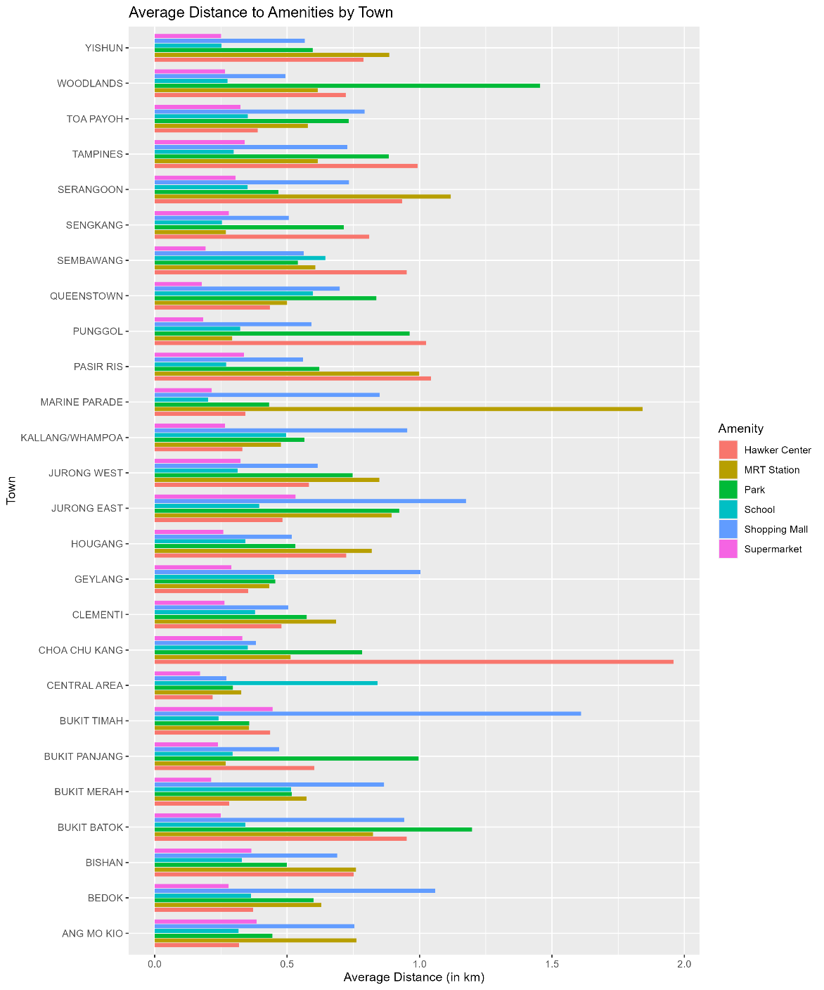
Results ( Preliminary analysis of data )
Amenity Accessibility Overview across towns
- Majority of towns have amenities within 1km on average.
- Notable exceptions:
Woodlands: 1.5km to nearest park.
Marine Parade: 1.75km to closest MRT station.
Choa Chu Kang: 2km to nearest hawker center.
Bukit Timah: 1.6km to shopping malls.
.

Slide 13
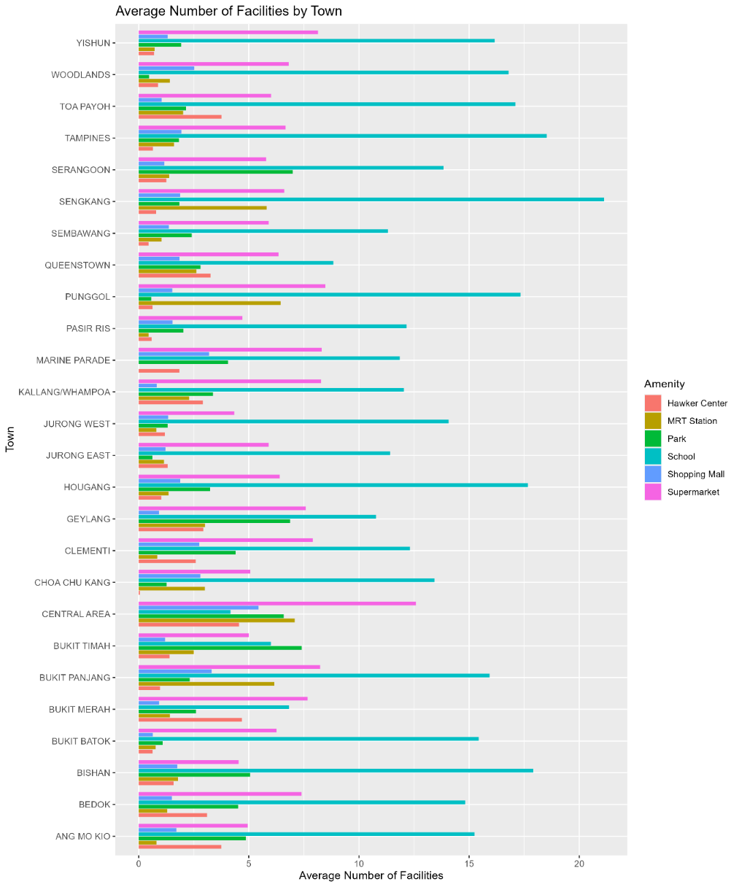
Results ( Preliminary analysis of data )
Amenity Density Overview Across Towns
- Generally balanced distribution of facilities in most towns.
Some characteristic:
- Central Area has fewer schools but has the highest supermarket density.
- Sengkang features the highest school density, appealing to families.
-Jurong West has a lower supermarket density.

Slide 14
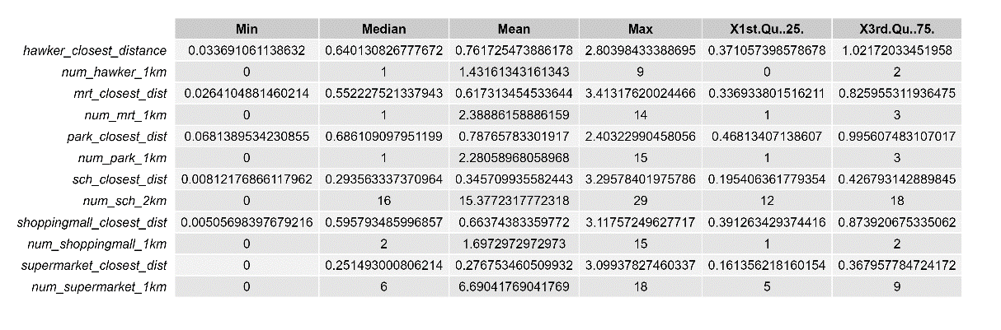
Results ( Preliminary analysis of data )
Insights on Amenity Proximity and Density
- Supermarkets are closest to housing, indicating high accessibility.
- Parks are the furthest on average, suggesting more spaced distribution.
- All amenities are within 1km on average, showcasing efficient urban design.
- Supermarkets have the highest count within 1km, reflecting their prevalence.
- Hawker centers have a lower density within 1km, despite cultural significance.

Slide 15
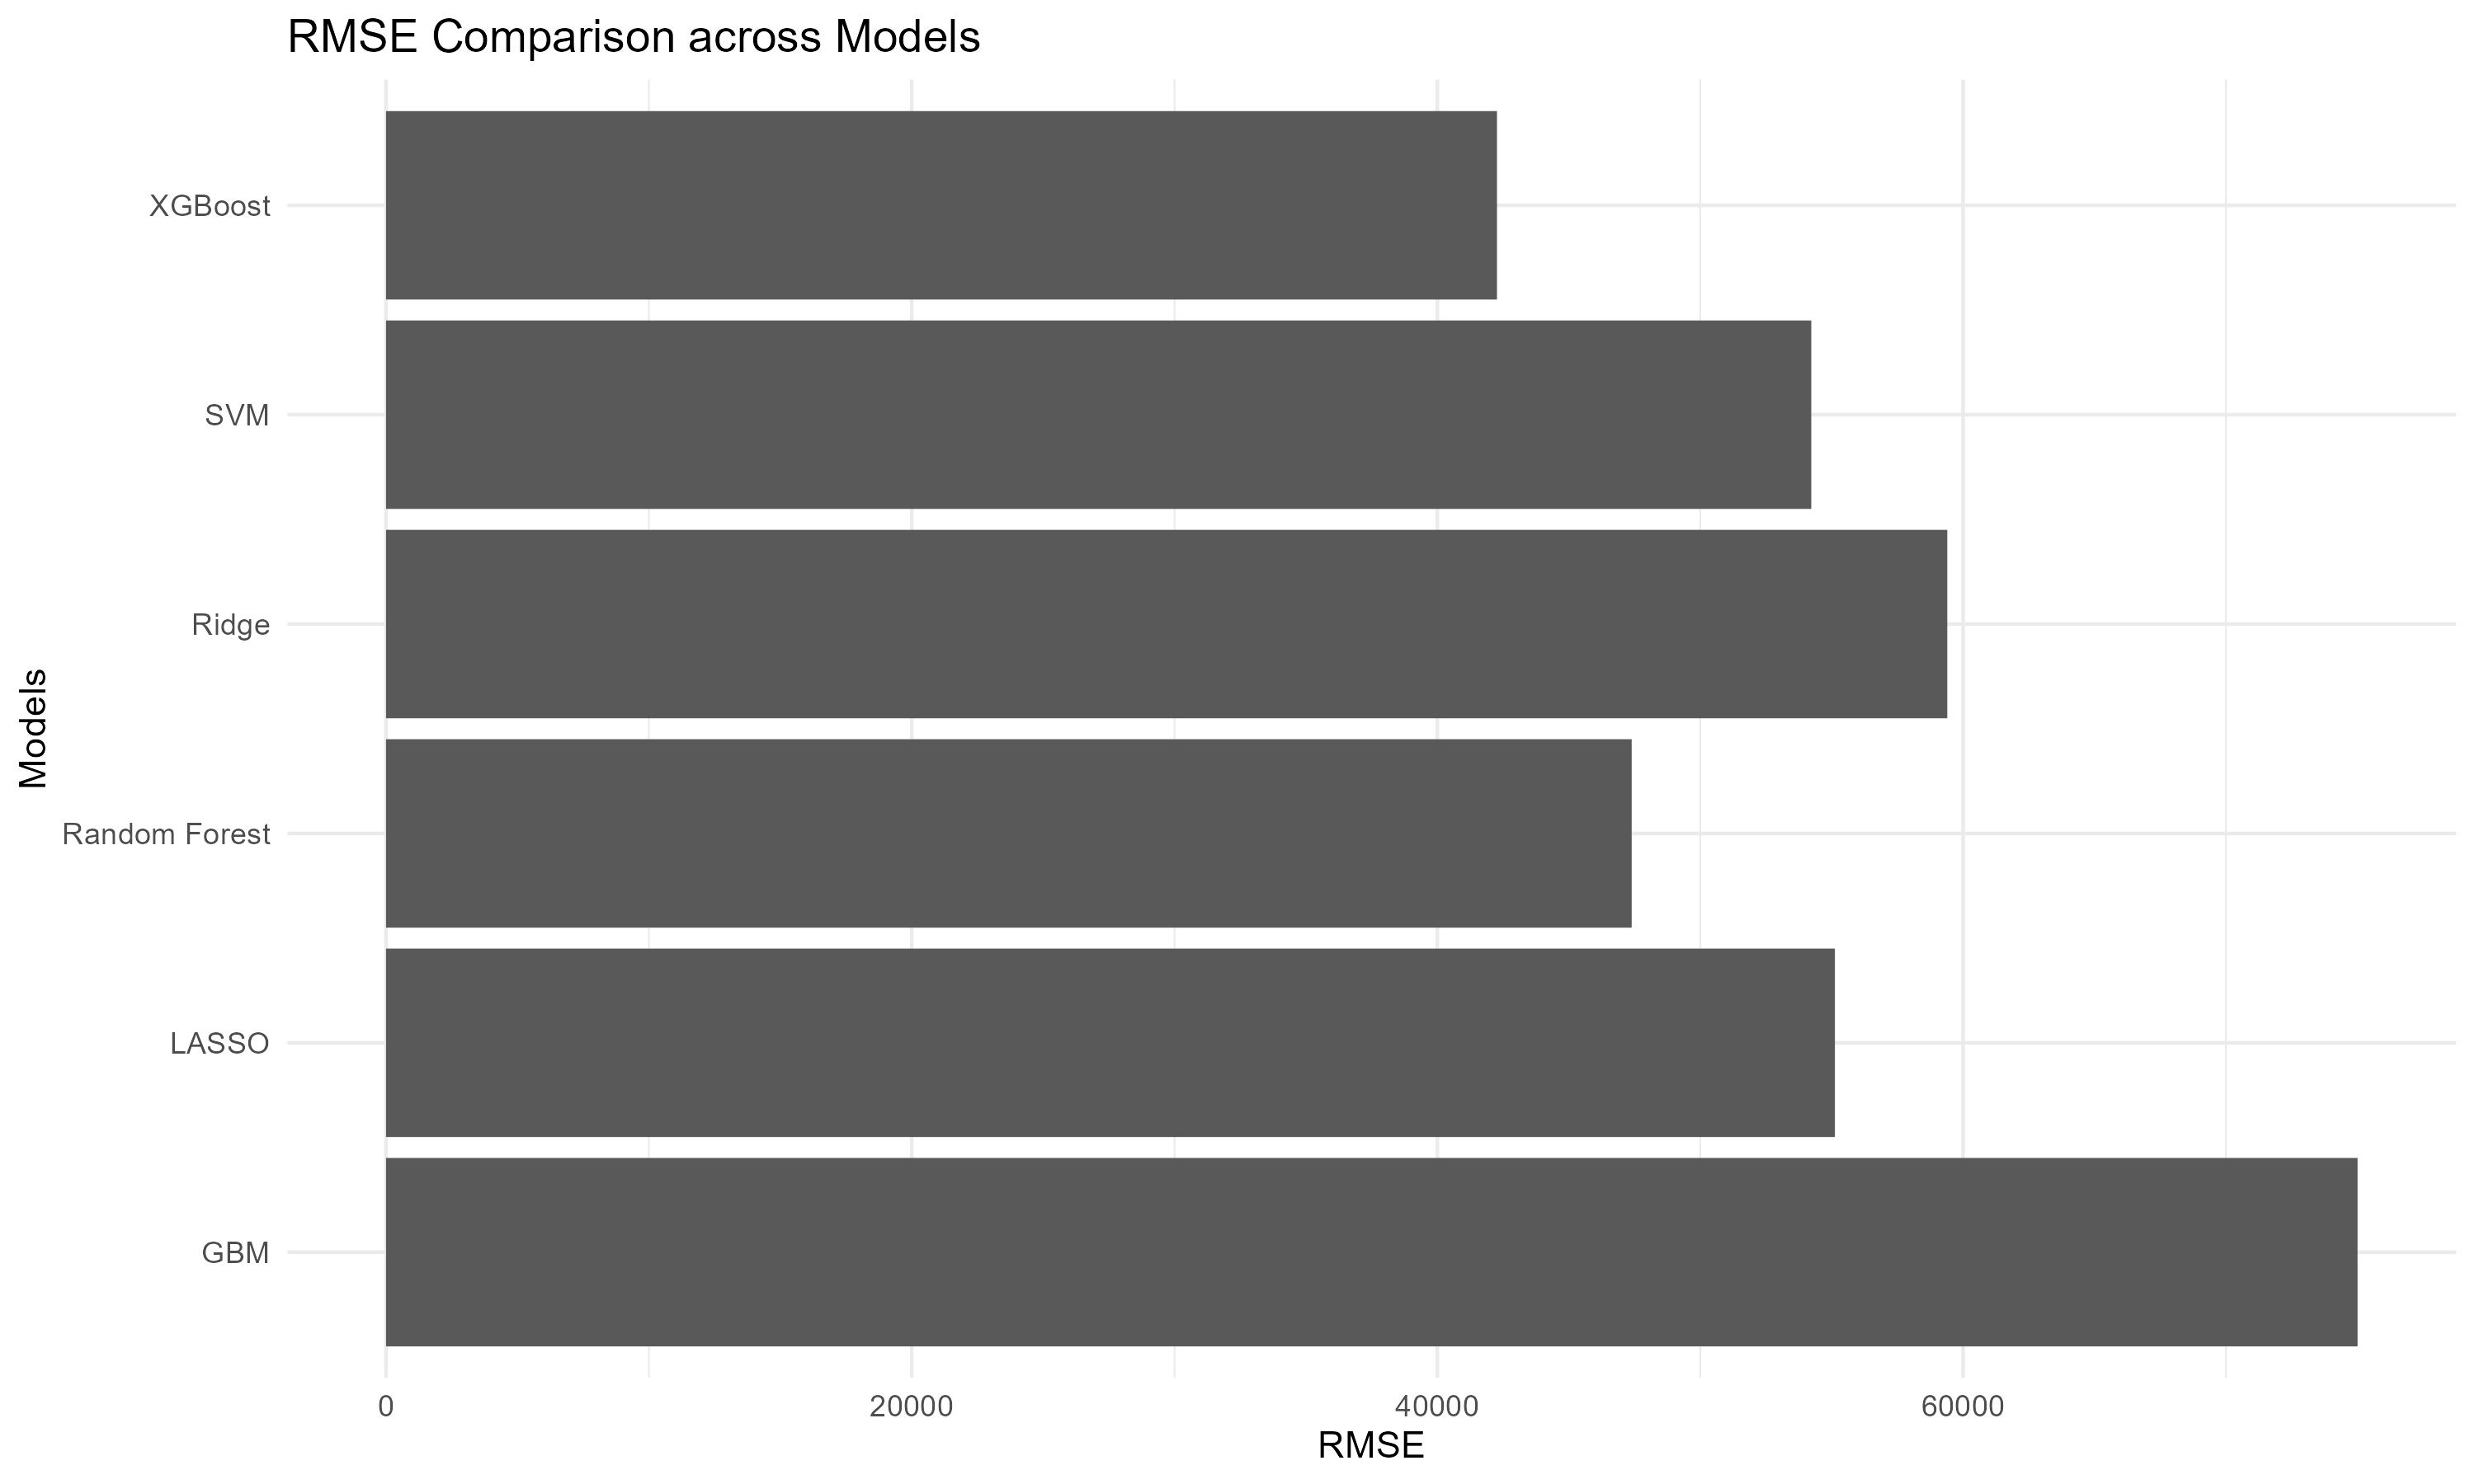
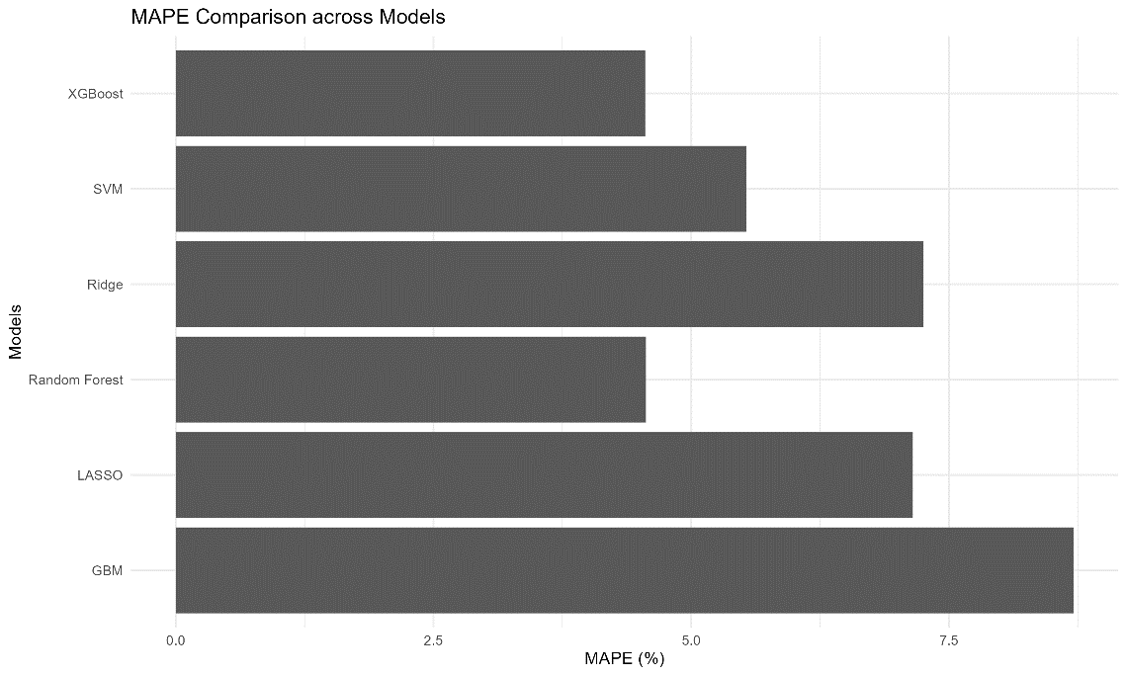
Results ( Performance metrics)
Insights on performance metrics
- XGBoost and Random forest are the best two performing model with MAPE less than 5 % and RMSE less than 50000

Slide 16
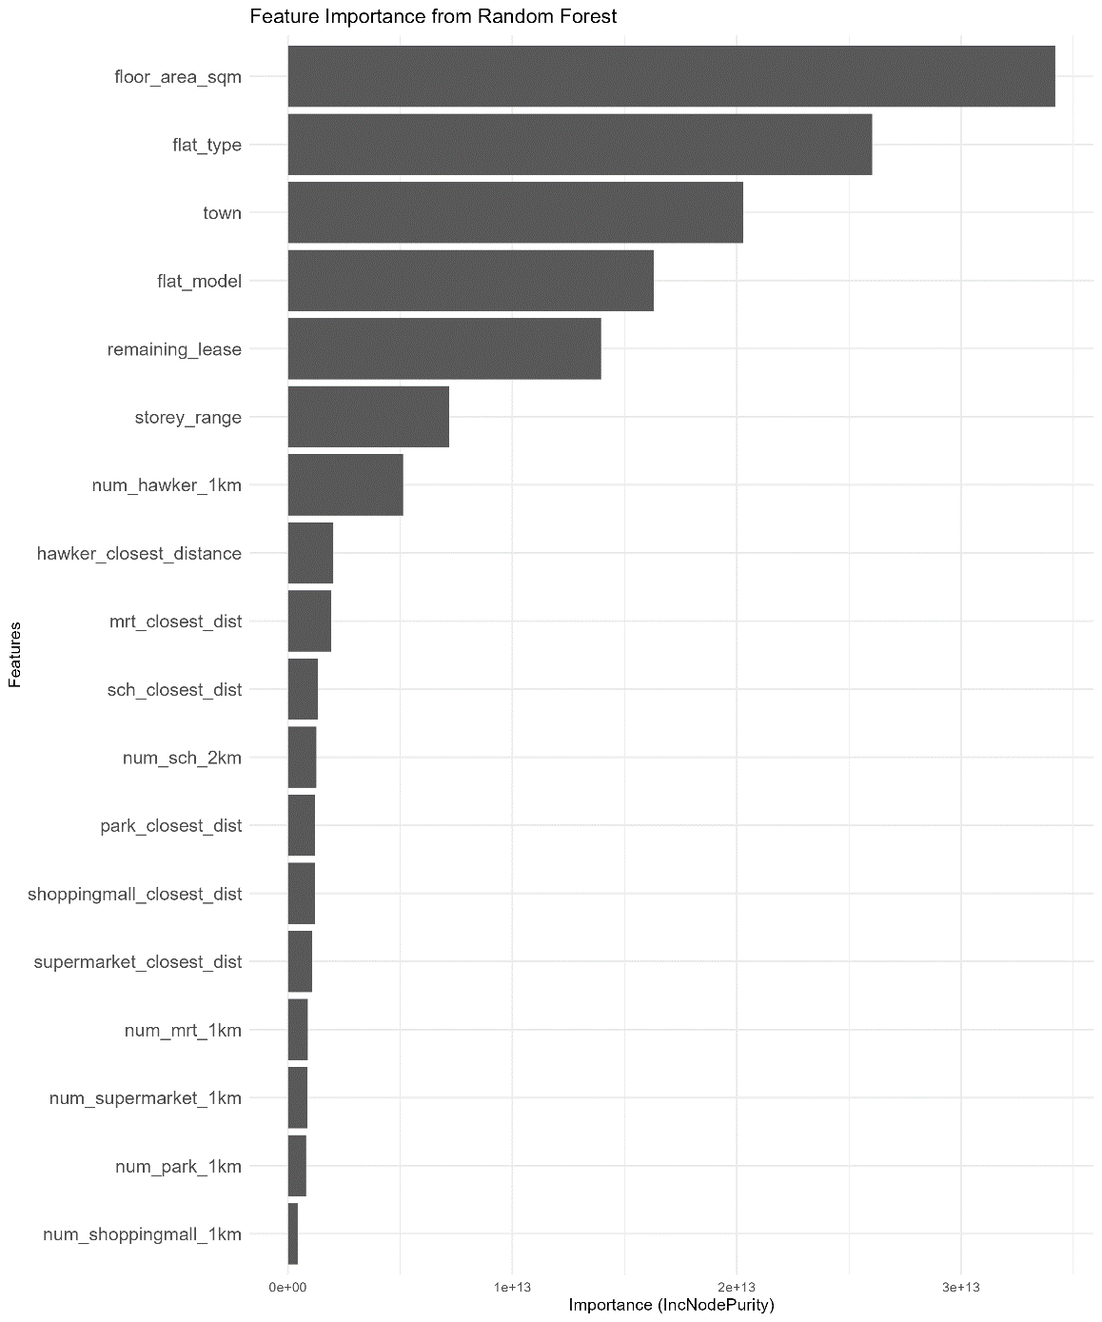
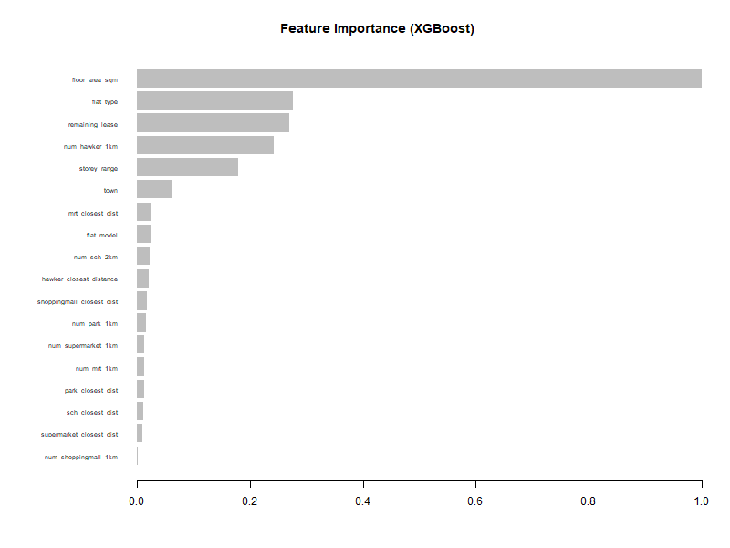
Results ( Feature importance)
Insights on Feature importance
- Both models identify 'floor area' and 'flat type' as top predictors.
- 'Town' is a critical factor in the Random Forest model.
- XGBoost highlights 'remaining lease' as unexpectedly significant.
- Agreement on key features affirms their reliability as universal predictors.

Slide 17
Demonstration of Shiny app

Slide 18
Conclusion
- Data analysis has revealed 'floor area' and 'flat type' as key price influencers.
- Random Forest and XGBoost models excel in price prediction.
-Geospatial analysis highlights the balanced amenity distribution.
-A dual toolset offers recommendations and predictions for housing decisions.
-Continuous evolution of the market necessitates ongoing model refinement.

Slide 19
Recommendation
Structured Housing Exploration
- Use the Recommendation System: Start with the recommendation system to get a curated list of properties based on user preferences.
- Make Informed Decisions: Use the resale price prediction tool for a detailed understanding of potential resale values to ensure sound investment decisions.
Keep Data Up-to-Date
Continual Updates & Training: Regularly update the housing data and retrain models to reflect the latest market trends for precise predictions.
Expand Data Sources
Incorporate Diverse Data: Improve prediction accuracy by including macroeconomic factors, infrastructural projects, and socio-demographic trends for a comprehensive market analysis.-

Slide 20
Thank You

