Slide 1
Photos for protocols

Slide 2
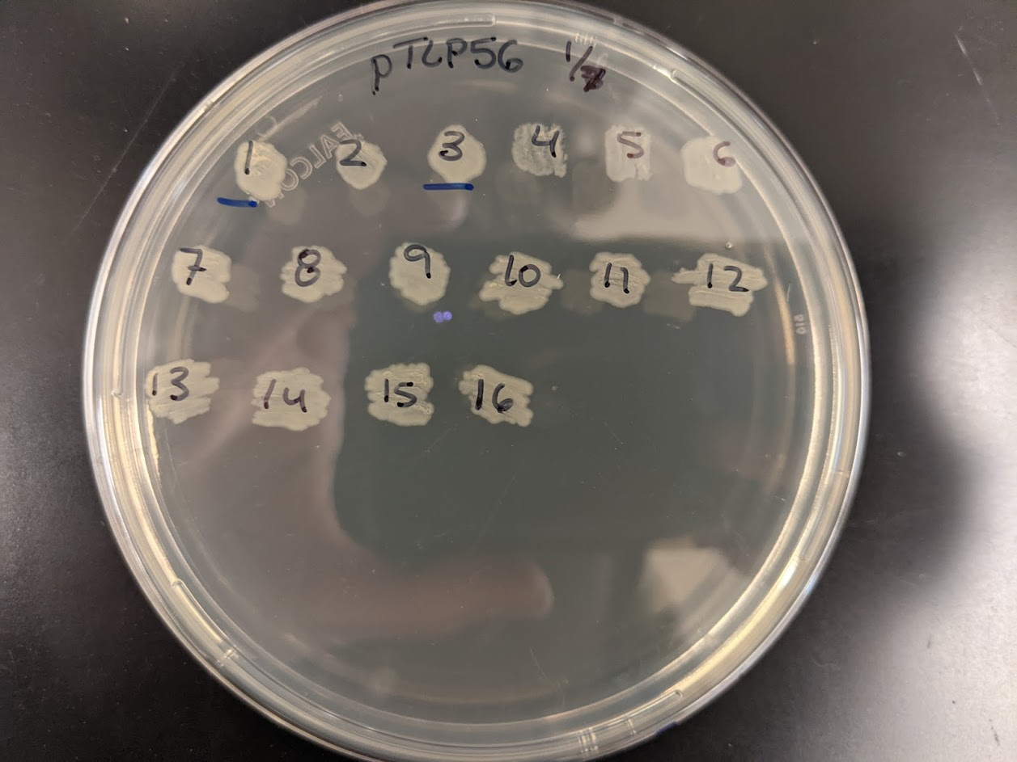

Slide 3
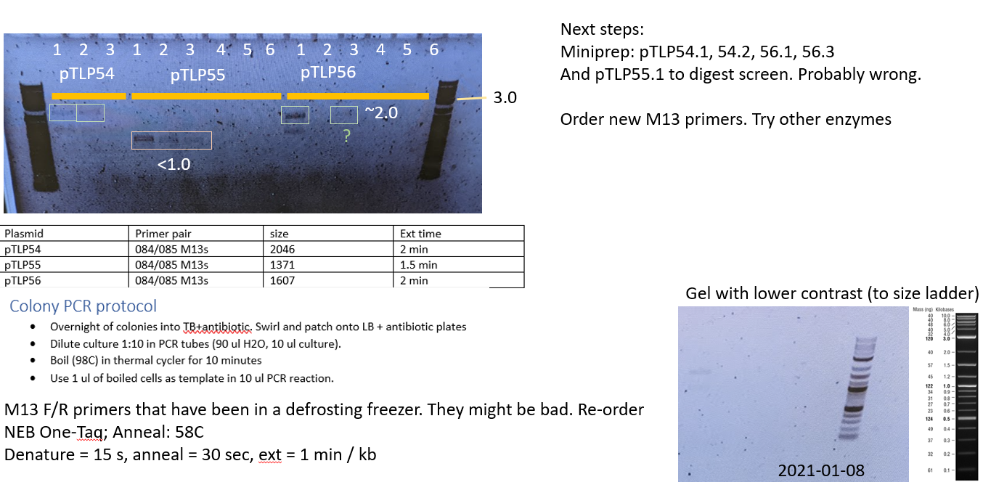

Slide 4
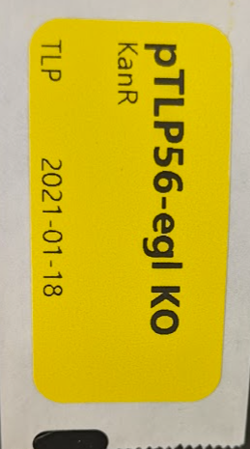
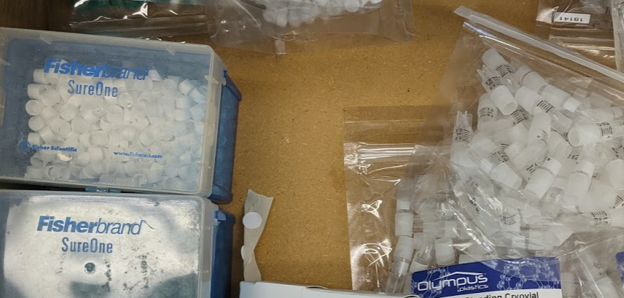
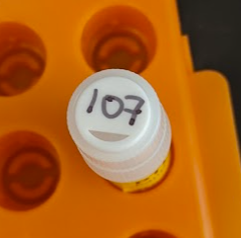
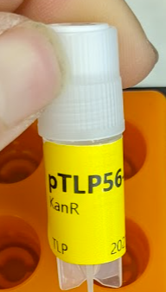
Labeling strains for strain list
Use Dymo printer to print a clear label on the cryo-labels. This should have enough information that someone will be confident they found the right strain.
+
=
Put a cap in the cryovial. Write the UCD# (Ralstonia/other isolates) or EC# (E. coli with plasmids/for cloning) on the lid.

