Slide 1

Tips & tricks for visual presentations
Tiffany Lowe-Power, PhD
@tlowepower

Slide 2
Use a white background
Why make your life hard? White is clean. White is the background of graphs. White has high contrast with black, so it should work even on the old projectors. White isn’t distracting. Use color judiciously to convey your data
Maybe use a black background.
DO NOT flip back and forth between white and black heavy slides. You’re going to make people wince. If you have fluorescence microscopy-heavy research, you probably want a dark theme. Jessie Uehling PhD gave a great black themed talk. When presenting graphs from papers, she inverted the colors in photoshop. It made the talk look retro 1990s, but it was a good trade-off of time saving (not re-making graphs) while still communicating well
(note, text heavy slides like this are bad for a normal presentation)

Slide 3
Most important presentation tip
reusing images / information / consistent formatting/ consistent color codes* for datasets is a great tool for teaching an audience new information. Try to use verbal and visual repetition to build up to complexity from material your audience will know
*If possible, consider color-blind friendly color palettes

Slide 4
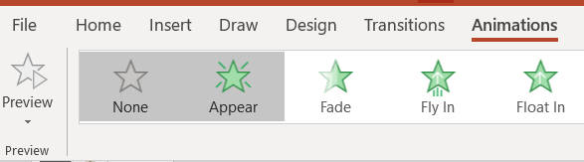
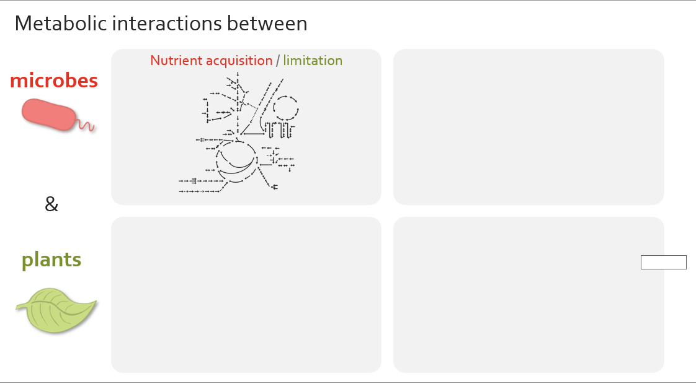
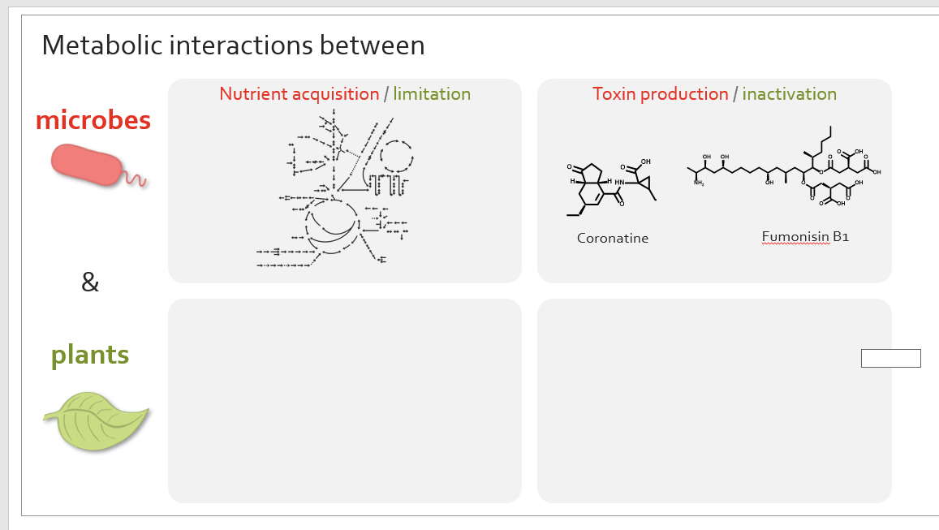
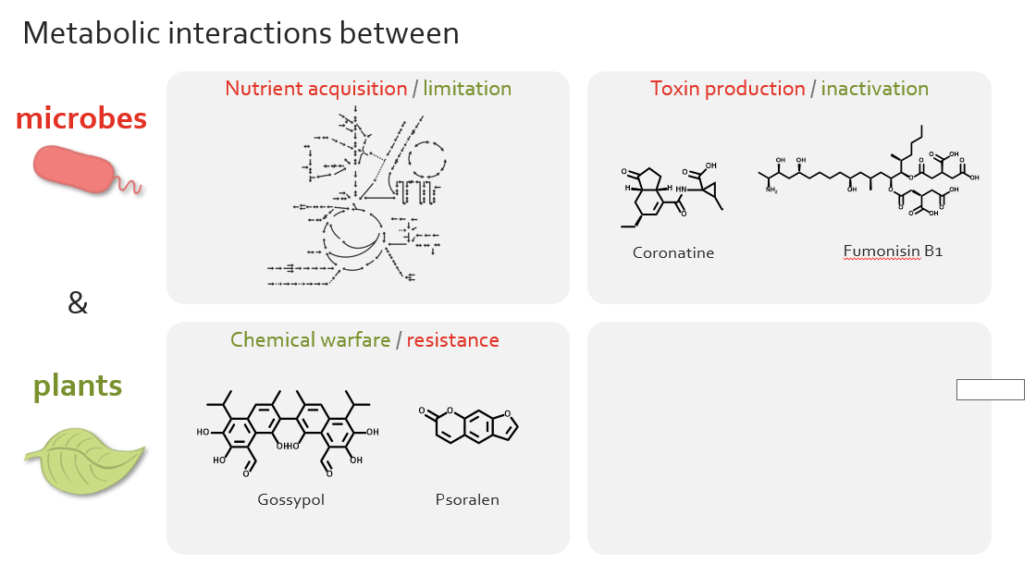
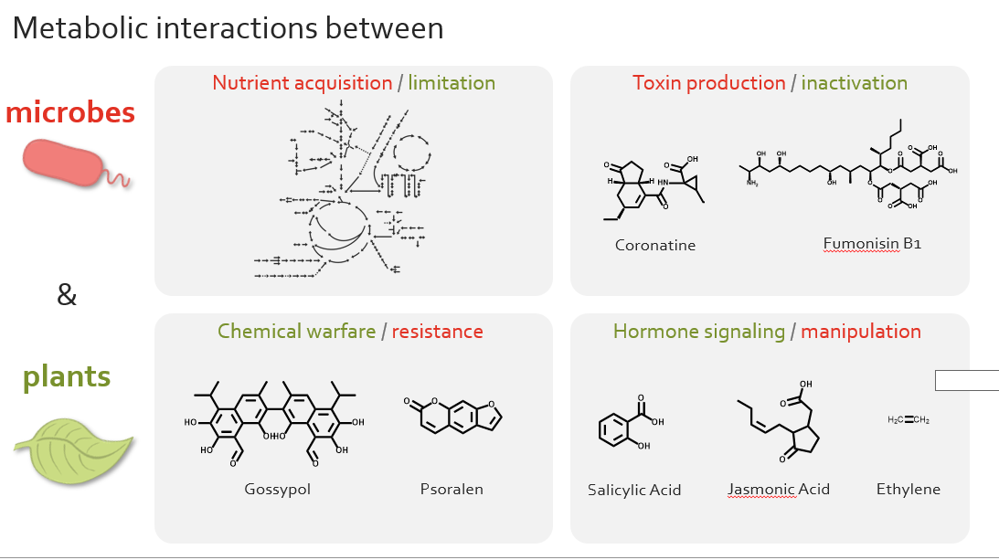
Use simple animations (appear) to build up to complex/busy slides

Slide 5
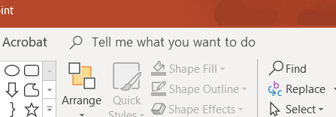
Surprisingly useful thing in ppt

Slide 6
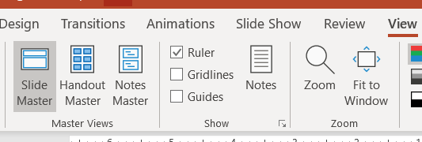
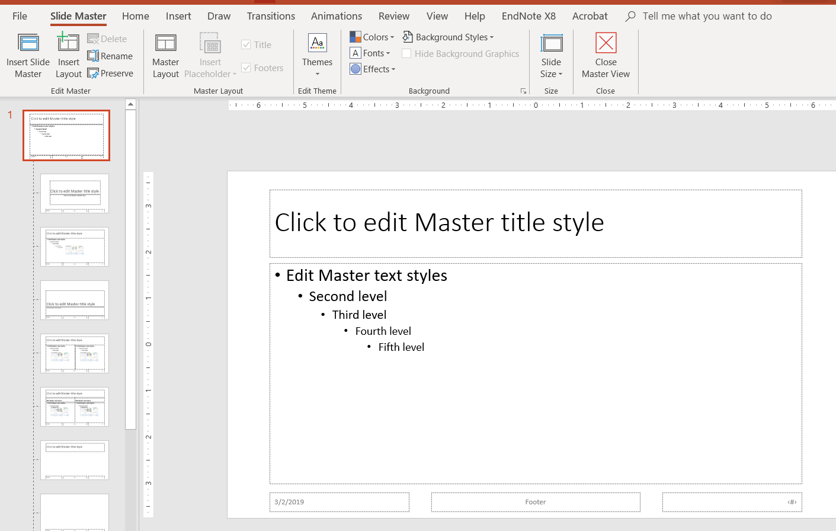
Slide Master: uniformly change some defaults in your ppt
This is how you can add background shapes to every slide. I personally like a simple embellishment like a thin black box. This box helps me place all my content away from the edges of slides. Since projectors are sometimes crooked, you want to keep your titles away from the top edge of slides.
I recommend investing in a slide style & using that for all your slides if possible (potentially improving it with different iterations of your talk)

Slide 7
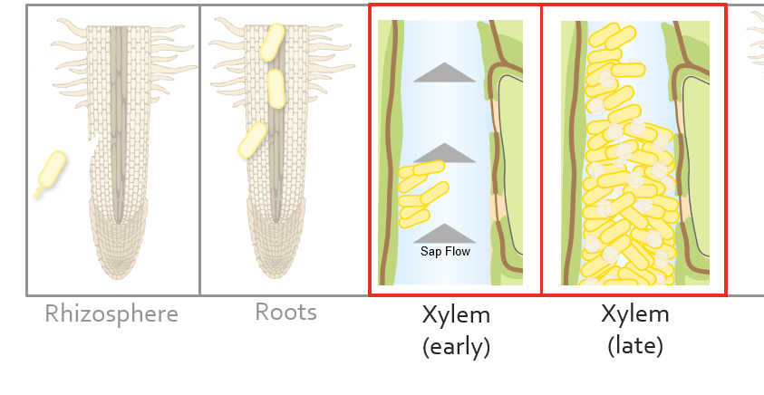
Highlighting information with semi-transparent white boxes

Slide 8
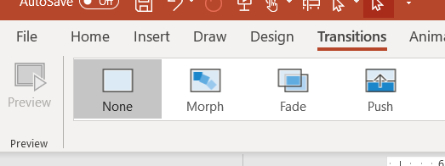
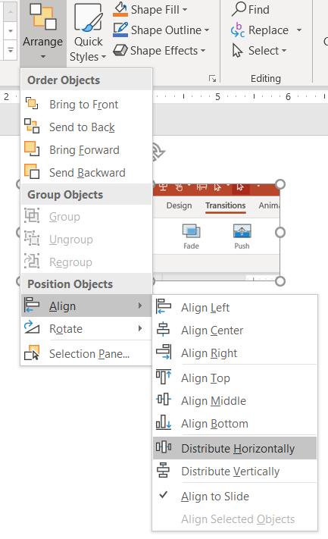
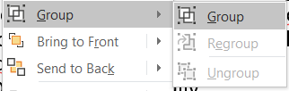
Using the “Morph” Transition
Step 1: Duplicate the slide that you want to ‘morph’
Step 2: Apply the morph transition
Step 3: On one of the duplicated slide, move things around. (In this chaos to ordered design, I started with the biochem map pathways (That had been drawn manually/carefully to summarize RNAseq data for a paper figure) & broke them up by Arrange > Align > Distribute horizontally.
Morph has a mind of it’s own. It either works or it doesn’t. If it moves objects in a “buggy” way, you can change how ppt morphs by grouping the “weird morphing” object to another. (select objects> right click> group)

Slide 9
Morph example
Glucose
Sucrose
Trehalose
Mannitol
Fructose
Ser
Galactose
Leu
Ile
Gluconate
SO₄⁻
Inositol
Palmitic Acid
Pectin
Lauric Acid
Phe
3-OH Butyrate
Galactarate
Glucarate
Acetoacetate
O-AcSer
Pyruvate
Taurine
NO₂⁻
β-Ala
Lys
Ethanolamine
Cys
Acetyl-CoA
Citrate
Asp
N₂
Ala
Malate
NO
Met
Urea
NO₃⁻
Succinate
NH₄⁺
Fumarate
Putrescine
His
2-Oxoglutarate
Glu
Gln
Orn
Pro
Succinyl-CoA
Salicylic Acid
GABA
PHB
Hydroxycinnamic
Acids
Val
Galacturonate
Notes:
But metabolism can be overwhelming to get a handle on.

Slide 10
Trehalose
Morph example
Sucrose
Glucose
Mannitol
Fructose
Inositol
Gluconate
Leu
Ile
Galactose
SO₄⁻
Ala
3-OH Butyrate
PHB
Taurine
Phe
Pyruvate
Ser
Acetoacetate
O-AcSer
Lauric Acid &
Salicylic Acid
Cys
Palmitic Acid
β-Ala
Ethanolamine
Acetyl-CoA
Met
Asp
Citrate
N₂
NO
NO₂⁻
NO₃⁻
Lys
Malate
Urea
NH₄⁺
Fumarate
Gln
His
2-Oxoglutarate
Glu
Orn
Pro
GABA
Succinate
Putrescine
Hydroxycinnamic
Acids
Succinyl-CoA
Val
Galactarate
Glucarate
Galacturonate
Pectin
Notes:
My work has illuminated key metabolic adaptations that Ralstonia uses to succeed in planta. Although many details remain to be filled in, we have developed a framework that is supported by transcriptomic, metabolomic, and genetic analyses. I don’t want you to focus on this

Slide 11
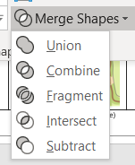
Drawing with Powerpoint shapes
Can be useful; can be frustrating (there’s not good undo... If I decide to use this, I create a lot of copy/paste in case I needed to edit things) . I had to add this to my “ribbon” because it was a ghost feature.
The better option is really to learn illustrator, export cartoons as svgs & convert them to ppt shapes if you need to animate them.

Slide 12
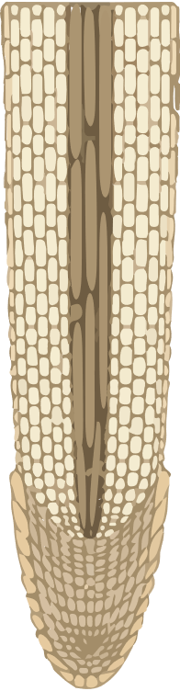
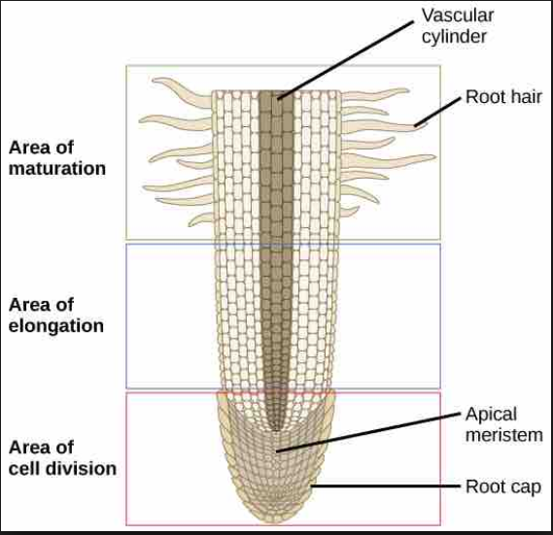
Illustrator tip:
Over the course of several years of presentations, I went from this textbook root drawing (from google images) to a modified root that more accurately represents xylem.
Step 1: removed the labels, boxes, etc. It took a while in illustrator after I used the “image trace” option
Step 2: Used” Expand” to be able to separately move features. This allowed me to make “xylem like” cell types
[missing link image lost]

Slide 13
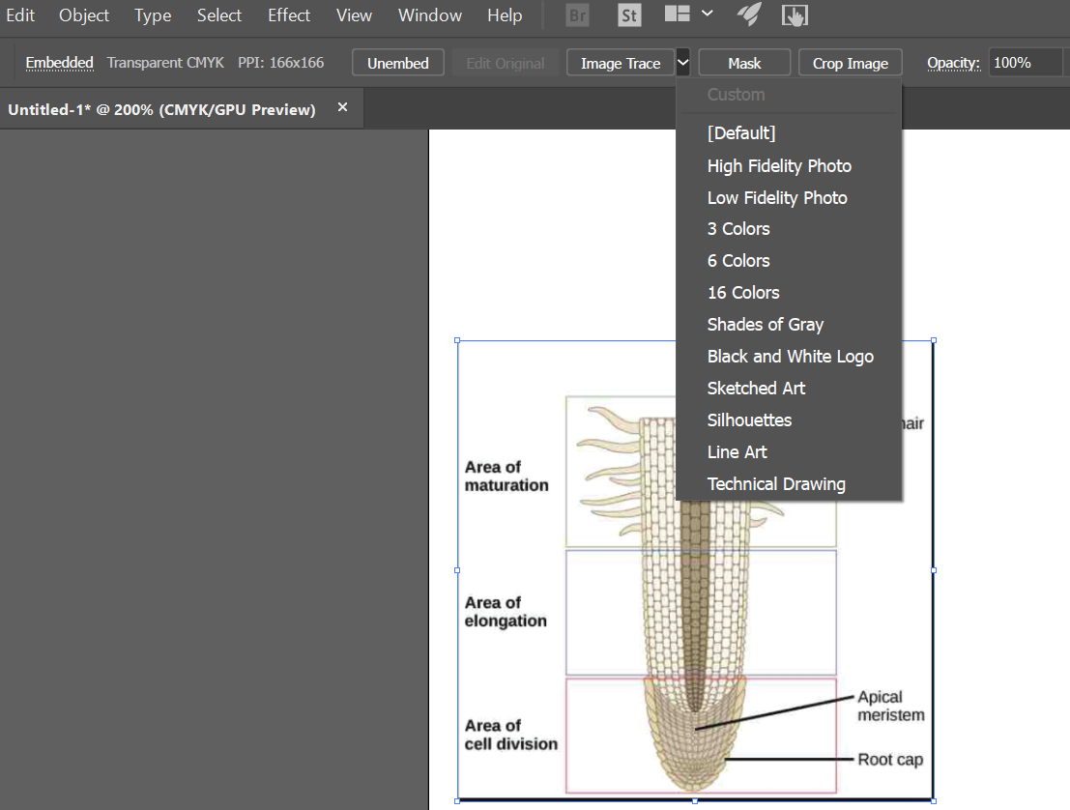
Illustrator: Image trace (there are probably better tutorials on google)
Purpose: Convert a bitmap/rasterized image (pixels) to a vector (image format that is infinitely scalable without pixel blur). This sometimes looks good.
Open rasterized image in illustrator (image with pixels e.g. png or jpeg. Hopefully not a jpeg, png is a higher fidelity file format for line art (graphs), cartoons, text. Jpeg is only good for photographs, fyi.)
Select object, which should open up Image Trace options.
Click the options & see how they work. Hit undo a lot.

Slide 14
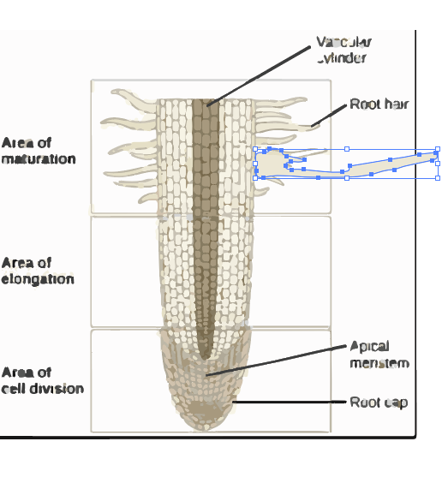
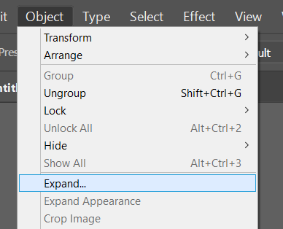
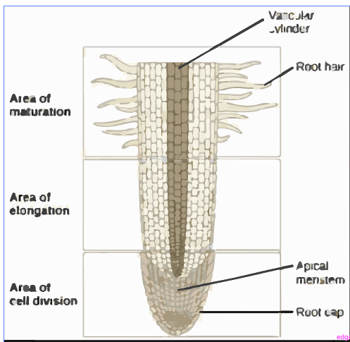
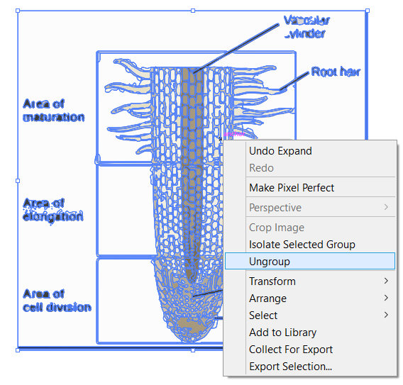
Illustrator: Expand (there are probably better tutorials on google)
Purpose: After you “traced”, expand will let you separately manipulate all the drawing parts separately
Now you can make large root hairs... Stretch cell types, delete cell types.

Slide 15
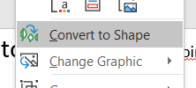
Illustrator/ppt tip (powerpoint can manipulate vectors! E.g. SVG format images)
SVG format
Converted to ppt shapes
Now you can manipulate the SVG components in powerpoint. Potentially useful for animations

Slide 16
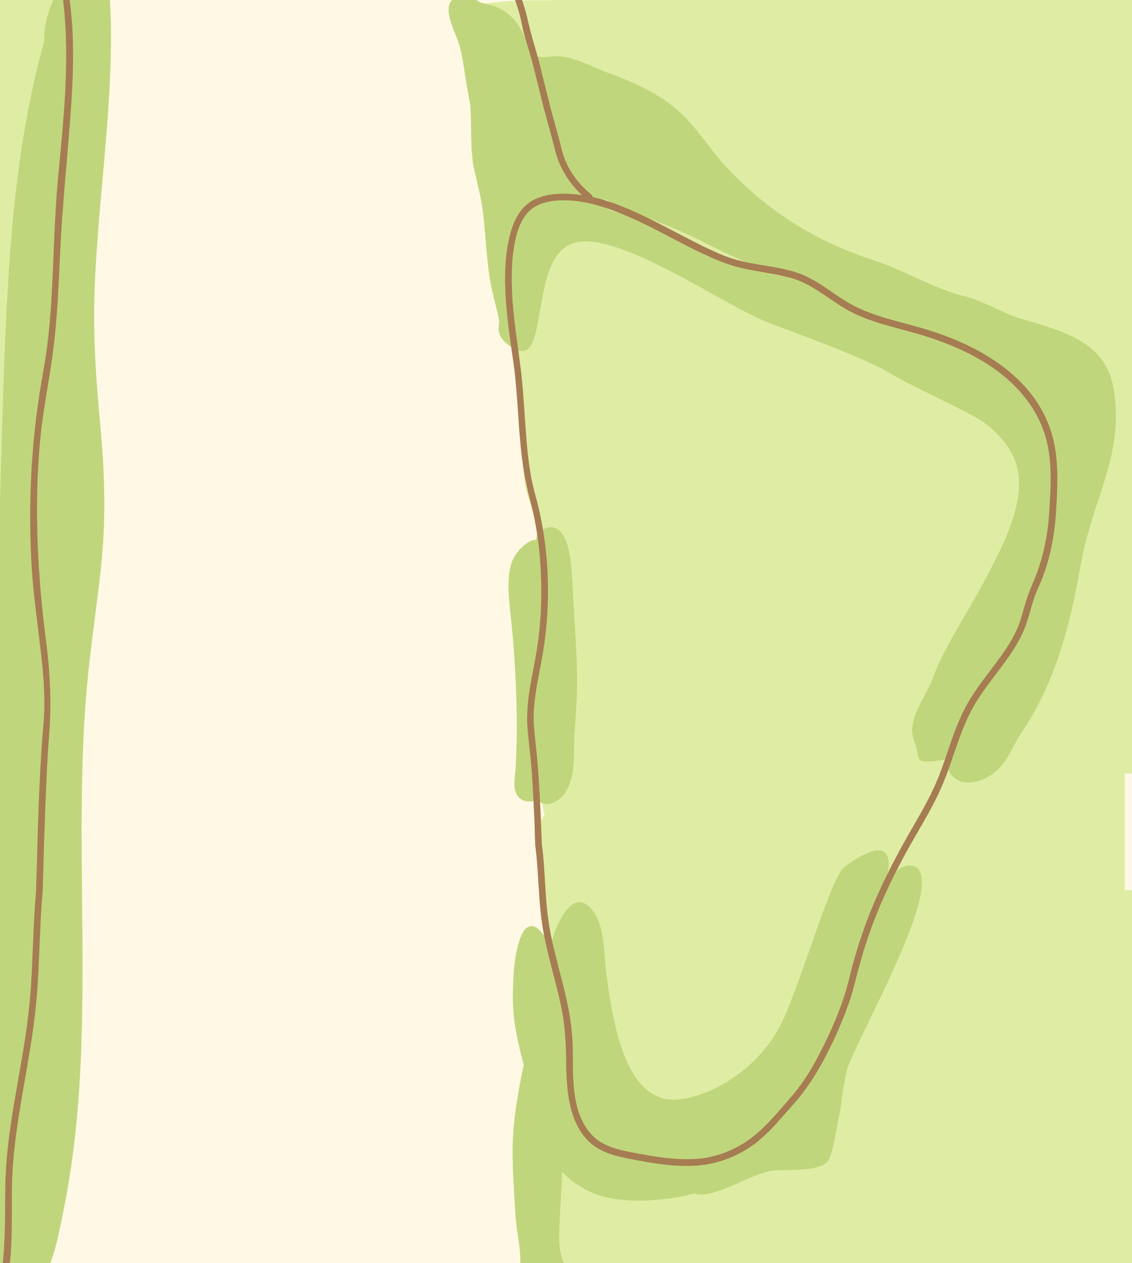
Illustrator / ppt compatibility
Illustrator can make nice looking cartoons. I’m very bad at Illustrator, but bacteria are easy to draw. At some point I traced a Ralstonia/xylem TEM photo from a 1990s paper.
I recycle this image to show xylem bacteria / plant interactions. Remember, recycling images / information is a great tool for teaching an audience new information.

Slide 17
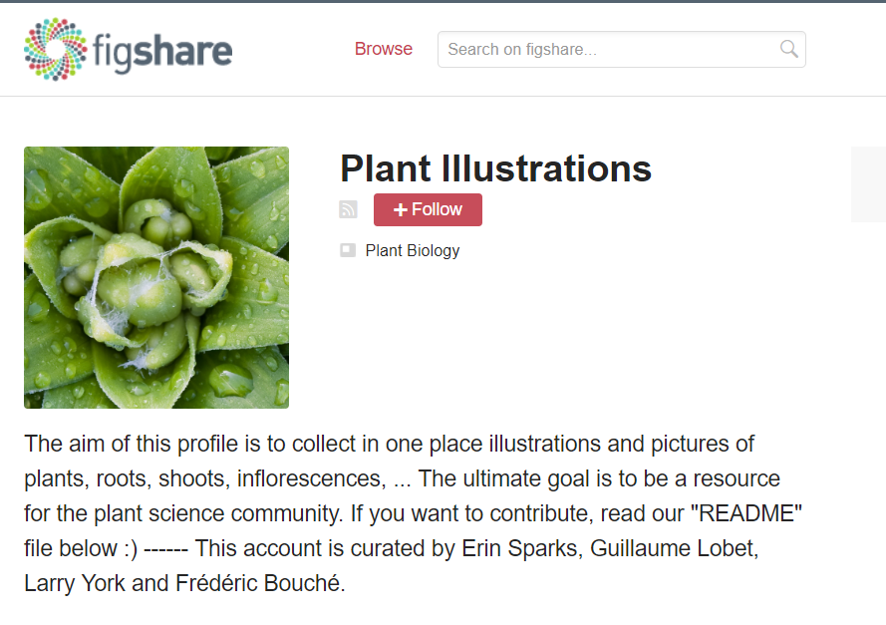
Great Resources for #plant #scicomm
https://figshare.com/authors/Plant_Illustrations/3773596
Also, google image search for “bacteria / petri dish / virus / etc” + SVG to find vectors

Slide 18
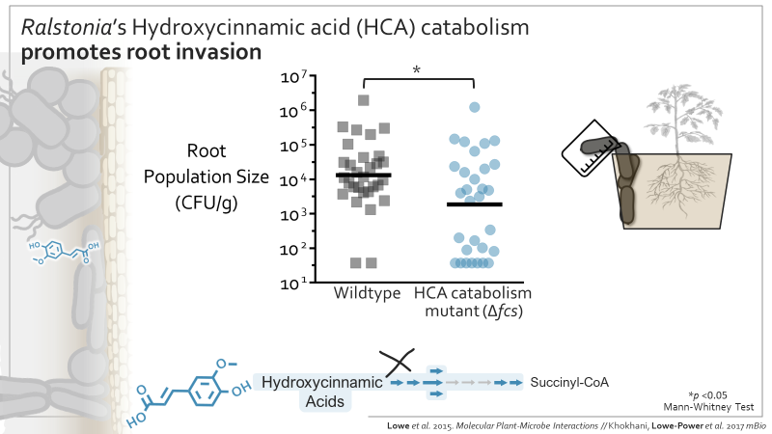
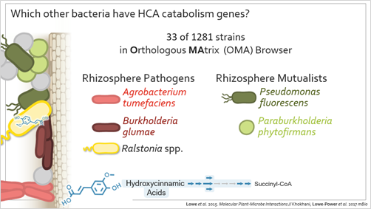
Design choices: Using color to highlight the information you want the audience to focus on
Important ‘data’ (a mutant of interest) highlighted in color. Neutral colors used elsewhere
Used colors to highlight pathogens (red colors = negative) and mutualists (green colors = positive)
(Also, Jason Lowe-Power thinks these slides are too busy. Oh well, it’s my style)

Slide 19
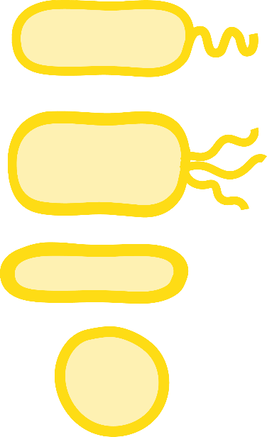

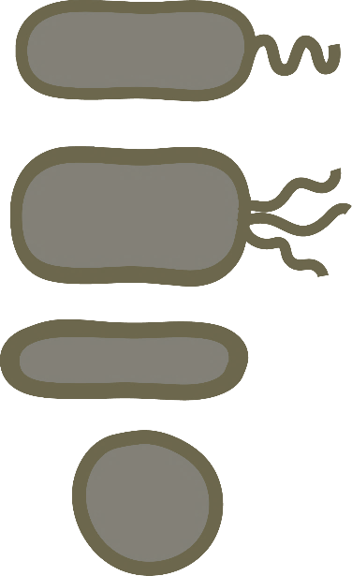

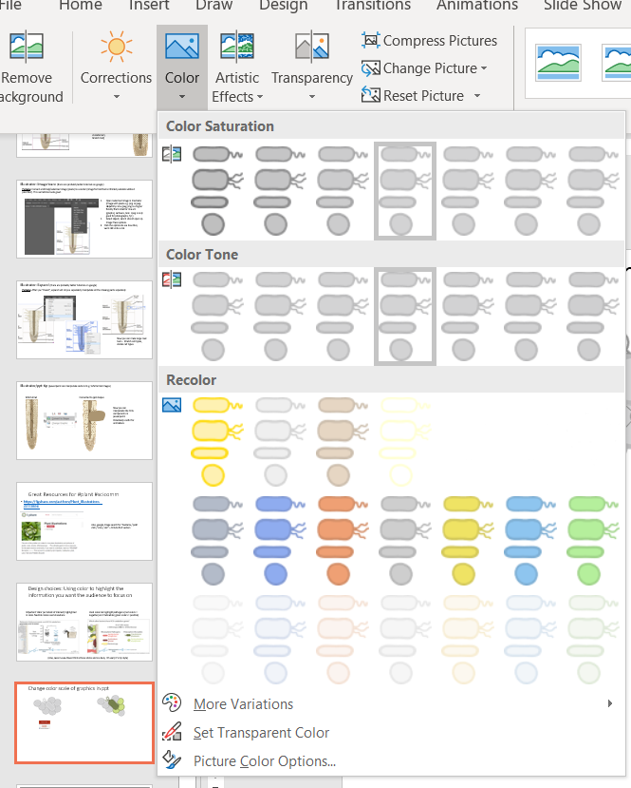

Change color scale of graphics in ppt
I think this works with .pngs, but not vectors...

Slide 20



Label graphs so audience can
understand them in < 5 or 10 sec.
If possible, rotate Y-axes so
audience doesn’t have to head tilt
Misc
Use cartoons to highlight methods
Making complex mutants? Try to first describe the genetic strategy with diagrams (metabolic pathway,
cartoons that show translational fusion). Include those diagrams on the slide to let audience refer back
to them as you show them your experimental data. Robyn Roberts, PhD did a fantastic job with this to walk through complex protein biochemistry, immunoprecipitations. Figure out what methods cartoons will communicate your data to an intelligent audience that doesn’t know your system like you do.

Slide 21
Misc
Don’t put new / important information in the bottom quarter of slides
Assume heads will block the bottom of the slides. Seminar rooms were often build in 1950.
This is an okay place to put “recycled” information if you can’t fit it somewhere better. It’s a good place to cite your sources.

Slide 22
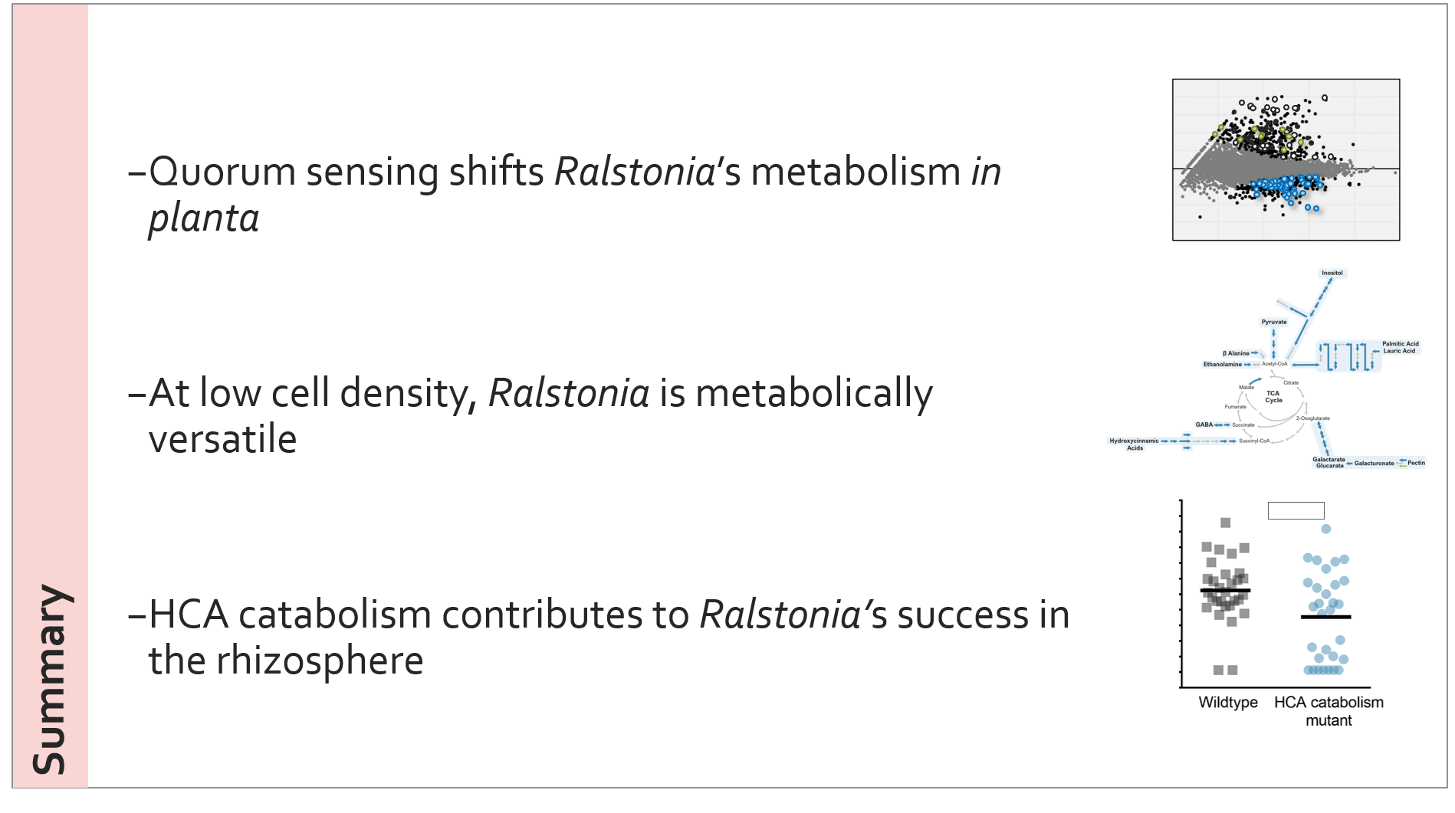
Recap your results & use tiny versions of the data as a visual reminder.
Specific outlines/talk road maps and summaries are essential for a > 30 min talk. Revisit them.
15 min talk should at least have a summary.
I learned this from Rick Lankau, PhD

Slide 23
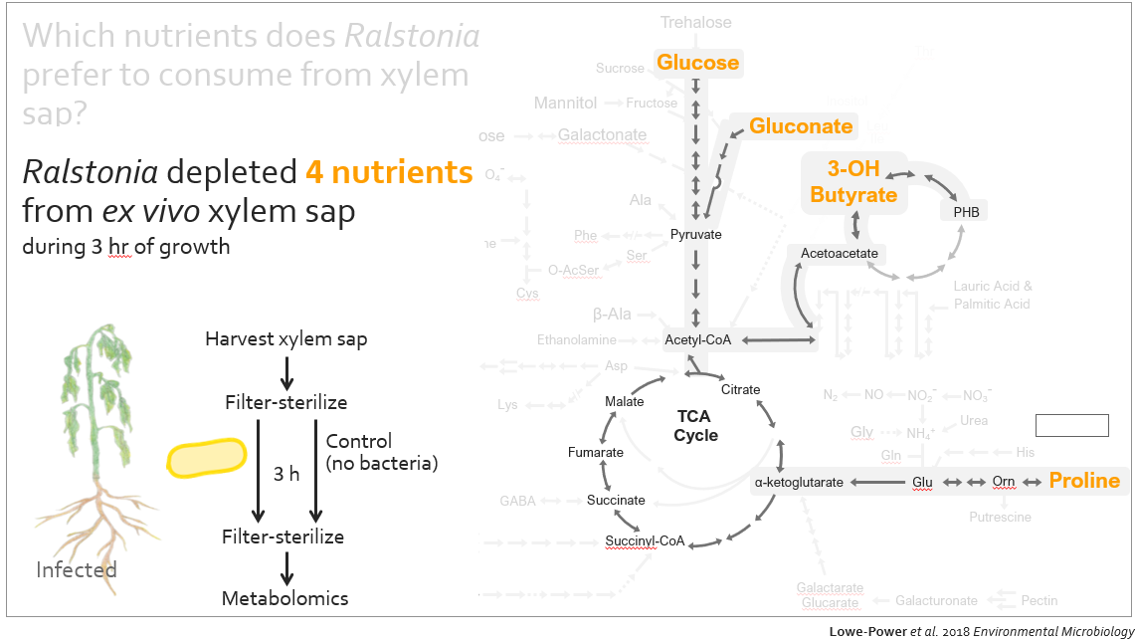
Misc
General advice: help your audience understand your conclusions without getting stuck in the weeds/details. Communicate your science with a goal of teaching. Don’t dumb it down, but do distill the most important points. Save the nitty gritty details for the paper.

Slide 24
Misc
When attending seminars/classes, pay attention both to the science and to the mechanisms of communicating science. What is effective and not effective?

