Slide 1
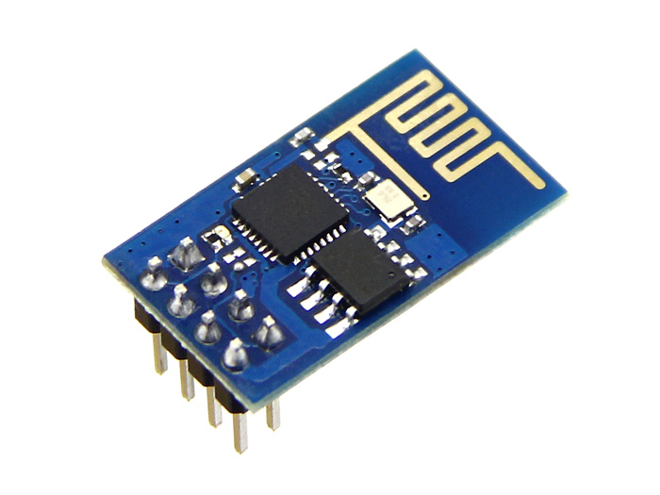
ESP8266 Sub $5 IOT Wifi
Hack Sonoma County
April 8, 2015

Slide 2
ESP8266 Hardware
80Mhz 32-bit SOC based on Tensilica Xtensa
3.3v at 225mA max, Standby <1mA, 12uA sleep.
802.11 b/g/n WIFI Station and/or Soft AP. Wifi direct.
16 GPIO, 3 PWM, ADC, UART, I2C, SPI
64K instruction RAM, 96K Data Ram.
Modules Availability: Amazon($7), Ebay($4), China($2.5)

Slide 3
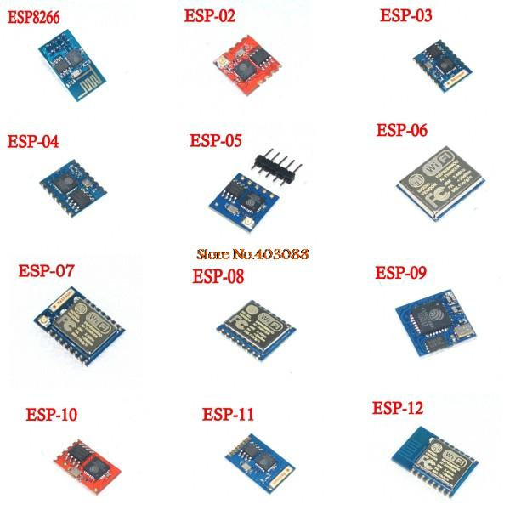
Current Modules

Slide 4
Programming Options
Current
AT Commands Via Serial Port
C (Espressif ESP8266 SDK)
Lua NodeMCU
ESP8266 Arduino (C based)
In Development
MicroPython

Slide 5
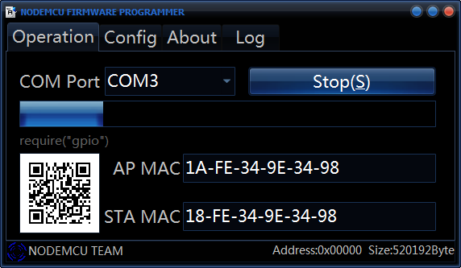
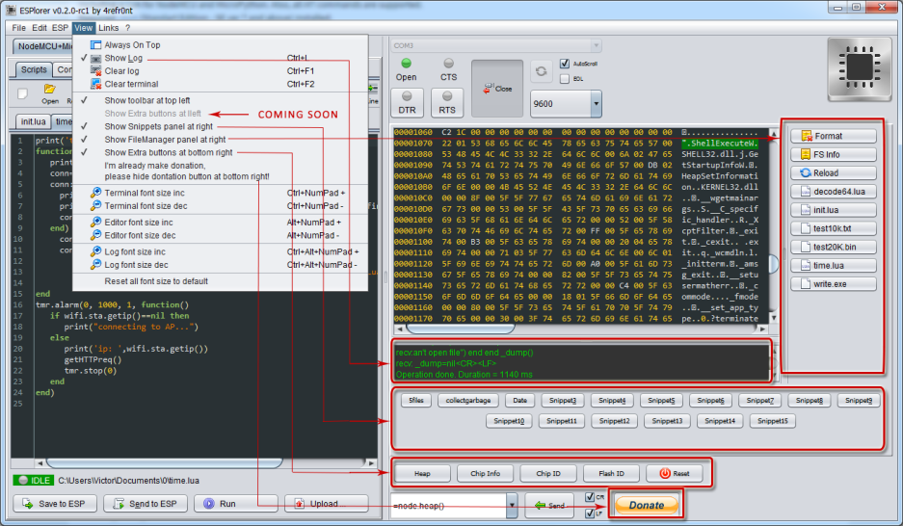
Lua NodeMCU
Use the NodeMCU Flasher or SDK loader to upgrade module to NodeMCU
ESPlorer IDE

Slide 6
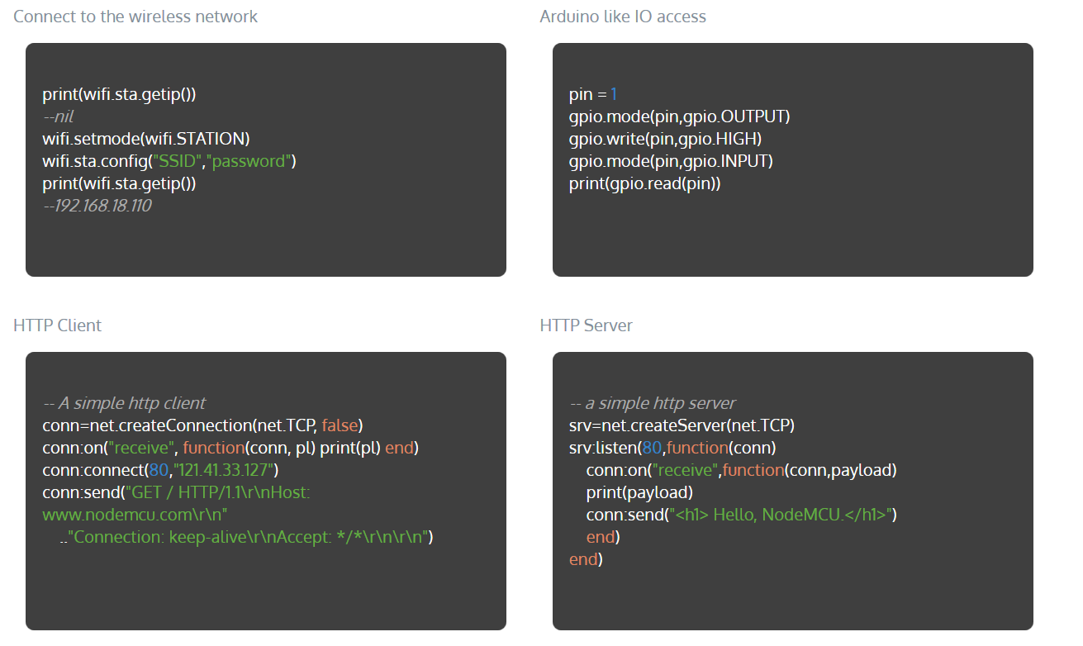
Examples

Slide 7
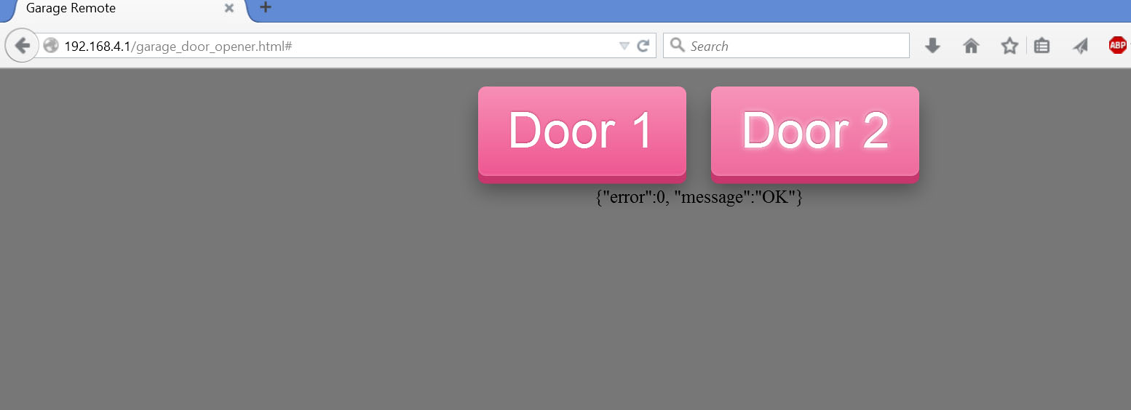
Demo

Slide 8
Resources
Forum and Community http://www.esp8266.com/
Espressif C SDK https://github.com/pfalcon/esp-open-sdk
FreeRTOS C SDK https://github.com/espressif/esp_iot_rtos_sdk
NodeMcu Firmware https://github.com/nodemcu/nodemcu-firmware
NodeMCU Docs http://www.nodemcu.com
ESPlorer IDE http://esp8266.ru/esplorer/
Arduino Compatible Dev System https://github.com/esp8266/Arduino
Example Source https://github.com/marcoskirsch/nodemcu-httpserver
This Demo https://github.com/lowerpower/esp8266-hsc-4-8-15

Slide 9
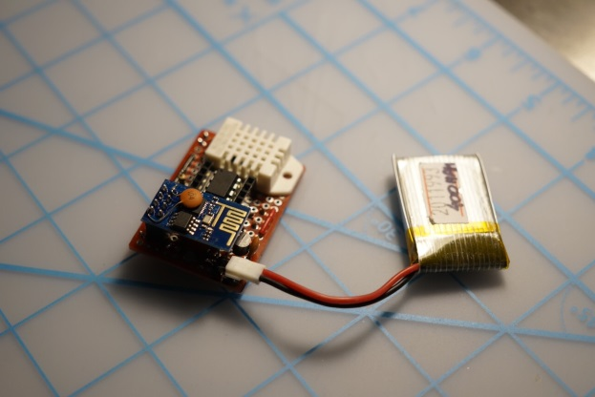
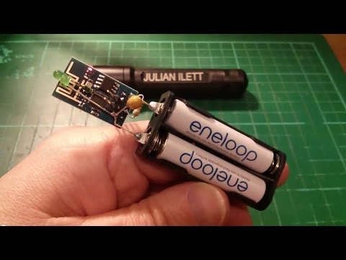
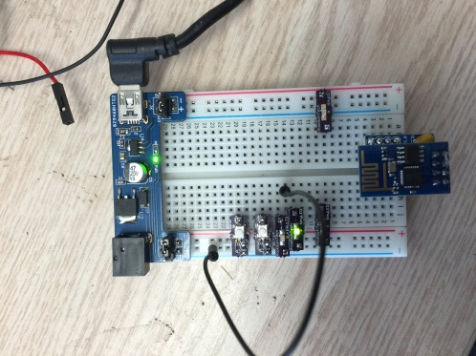
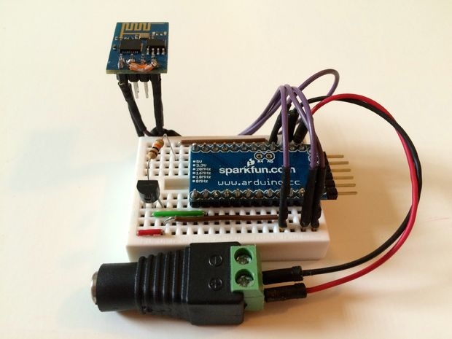
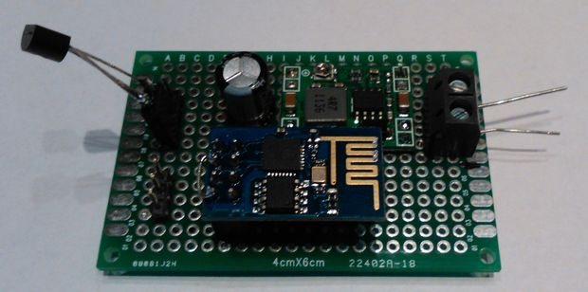
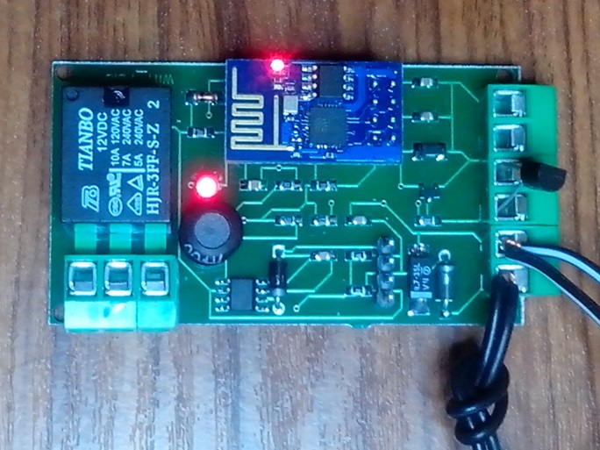
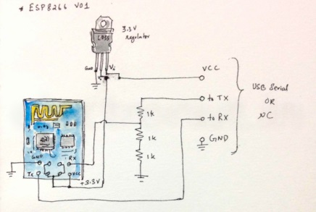
What Will You Make

Slide 10
Questions?

