Slide 1
Master Thesis Midterm Presentation
Bluetooth Low Energy (BLE) Device Classifier for HomeScout
Supervisor: Katharina Müller
Jie Liao
Notes:
Hello everyone. Sorry for the inconvenience that I have to do the presentation online because I’m currently not in Zurich. Welcome to the master thesis midterm presentation of Bluetooth low energy device classifier for HomeScout. My name is Jie Liao and my supervisor is Katharina. I’m really appreciated to have an opportunity to do the thesis at the group.

Slide 2
Outline
1 Introduction
2 Related Work
3 Motivation
4 Design
Notes:
So! My presentation today consists of four parts, including Introduction, related work, motivation and design.

Slide 3
1 Introduction
2 Related Work
3 Motivation
4 Design
Notes:
I will first introduce the background of this thesis.

Slide 4
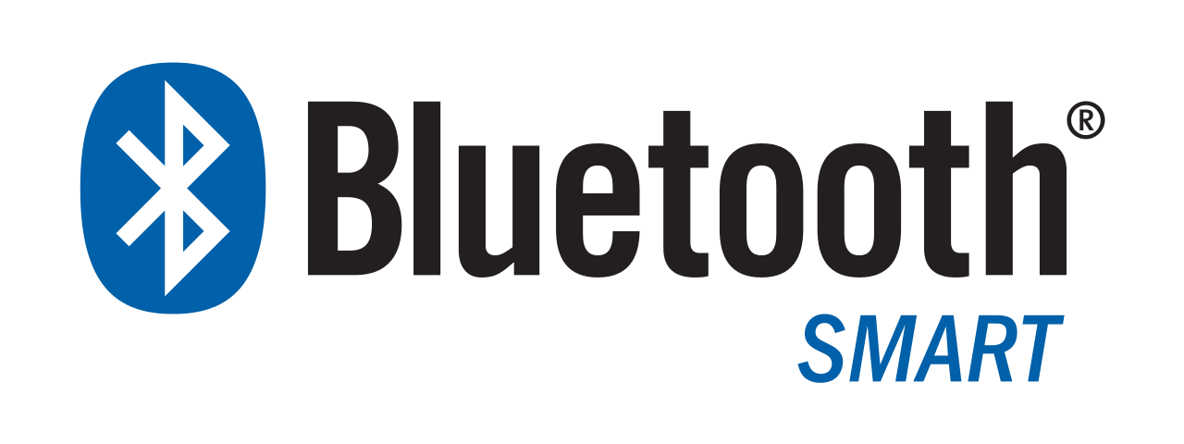
What is BLE?
A wireless protocol for connecting two devices.
A lightweight subset of classic Bluetooth.
Low power consumption
Introduced by Nokia; Became a part of the Bluetooth 4.0 core specification.
Notes:
The focus of this thesis is around Bluetooth Low Energy, or BLE. So, what exactly is BLE?
BLE is a power-efficient version of the classic Bluetooth technology, which is designed for short-range wireless communication between devices. It's the technology that connects your smartphone to your smartwatch, your wireless headphones, or even your home automation devices.
One of the key advantages of BLE is its low power consumption, which makes it ideal for devices that run on small, coin-cell batteries.

Slide 5
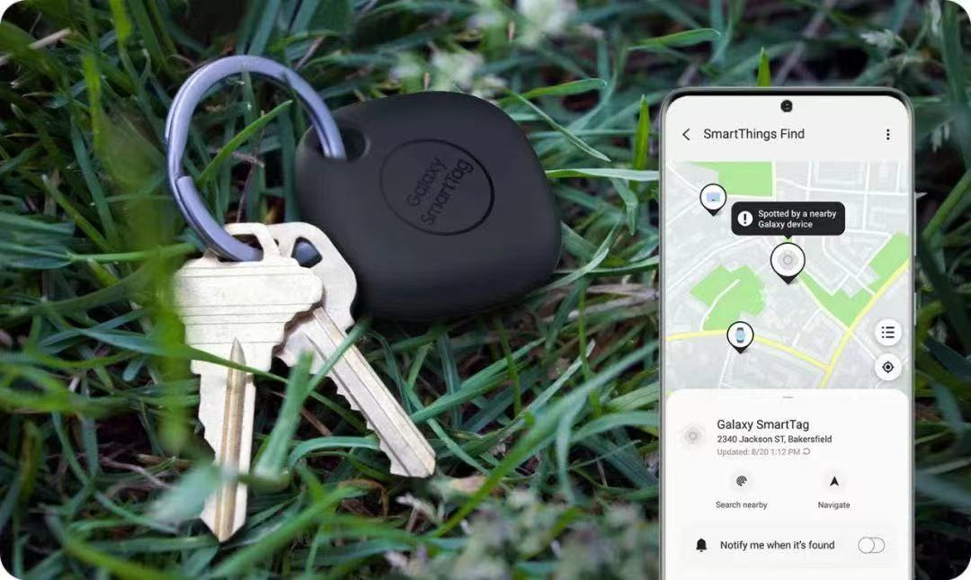
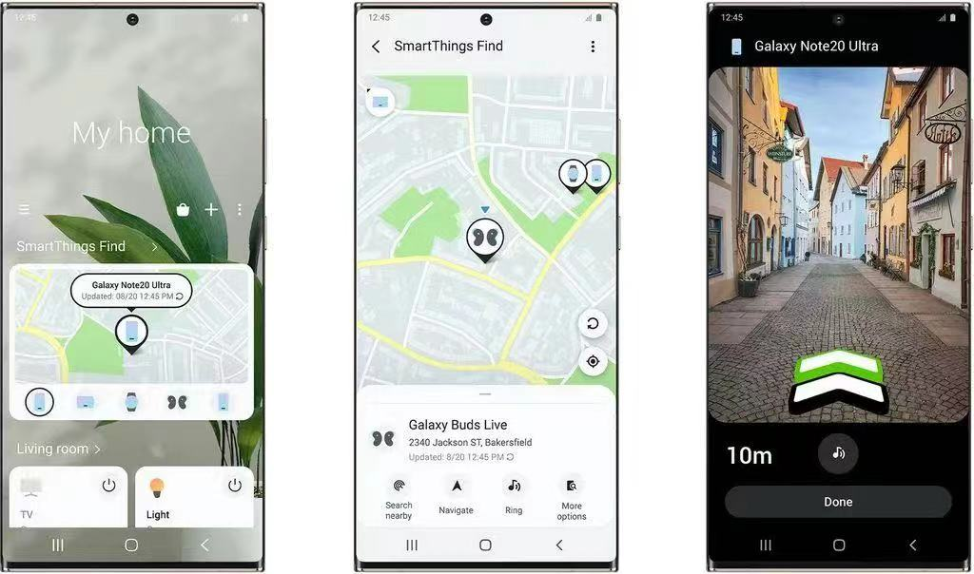
Introduction
Bluetooth Low Energy(BLE) Trackers
Notes:
Since the introduction of Airtags, BLE trackers has dominated the market of item trackers due to its energy saving advantage.
BLE trackers can help track and locate important items such as keys through crowdsourced finding networks. They can be very useful when we try to find a lost item.

Slide 6
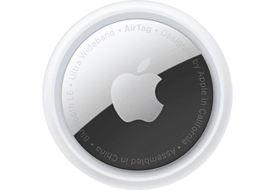
Introduction
Security and Privacy Issues
BLE tracker’s nature suits tracking people
Tracking ability exploited for malicious purposes
Countermeasure developed by Manufacturers
Problem of countermeasure
Easy to muffle the beeping noise
Airtags alerts when moving with unregistered users
8 hours to alert could be too late
Android users receive no equivalent protections
Notes:
While BLE trackers like Airtags has brought convenience to life,
they also pose security and privacy issues.
BLE tracker is typically small, easy to conceal and have a long battery life, which makes it perfectly suitable for tracking other people.
For example, malicious entities could potentially track the movements of an individual carrying an BLE tracker without their knowledge or consent. To solve these problems, device manufacturers like Apple have implemented security features in their products. Apple implements a safety measure to Airtags which makes a beeping noise when an unregistered AirTag is detected moving with a user after 8 hours. However, current countermeasure has some problems. First, it’s relatively easy to muffle the beeping noise with a cushion. Secondly, 8 hours could be too late to alert malicious activities. Thirdly, as of now, only iOS users are truly safeguarded by this measure. Google and Apple have pledged to collaborate on ensuring Android users receive equivalent protection, though progress on this front has been slow.

Slide 7
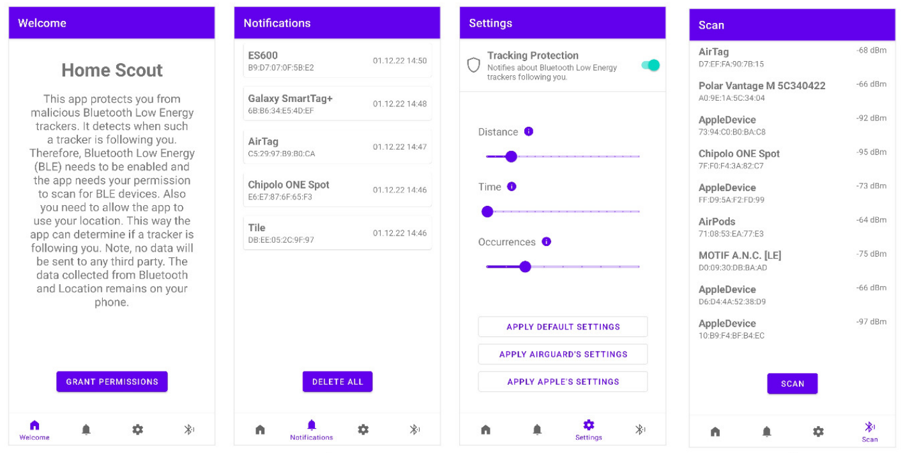
Introduction
HomeScout: an Android app used to detect stalking from BLE devices
Notes:
Thus, a number of third party applications have been developed to protect users from unwanted tracking, including HomeScout. HomeScout is an Android application used to detect stalking from BLE devices. It identifies malicious trackers that persistently appear in the user's vicinity and promptly alerts them. The parameters defining 'vicinity' and the frequency of 'persistent appearance' are adjustable, allowing users to customize the application according to their specific needs.

Slide 8
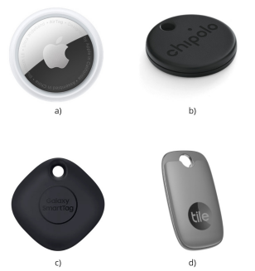
Introduction
Limitations of HomeScout
Detection of stalking events in HomeScout depends on the successful identification of tracker.
Identification of tracker in HomeScout supports only 4 devices including AirTag, Chipolo One Spot, Galaxy SmartTag+ and Tile.
3. HomeScout can only identify tracker and leave other types of BLE devices remain unknown.
Notes:
However, there are some limitations in HomeScout. Detection of stalking events in HomeScout depends on the successful identification of tracker. But Identification of tracker in HomeScout only supports 4 devices including AirTag, Chipolo One Spot, Galaxy SmartTag plus and Tile. HomeScout analyze these four devices on an individual basis and extract individual patterns to identify them. The problem is there is a huge market of item tracker and it’s impossible to analyze them all on an individual basis. Another limitation of HomeScout is that it only supports the identification of trackers, leaving many other types of BLE devices remain unknown in the application. Therefore, the classification capability of HomeScout is limited and needs to be enhanced.

Slide 9
1 Introduction
2 Related Work
3 Motivation
4 Design
Notes:
We will move on to related work of this thesis.

Slide 10
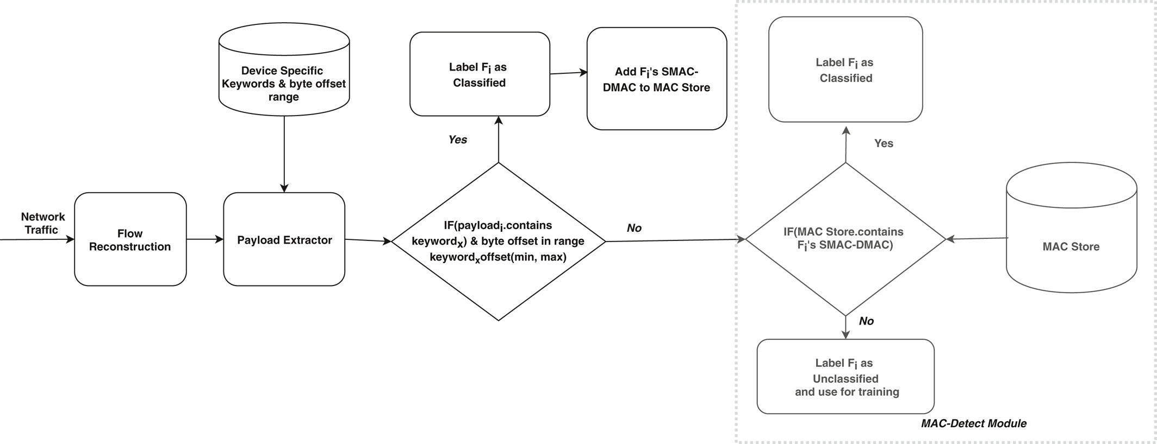
Related Work
IoT Hunter: IoT network traffic classification using device specific keywords
Notes:
IoTHunter is a Deep Packet Inspection based IoT traffic classifier that extracts unique keywords, such as domain names and device names, to identify flows belonging to a particular device. The system automates the keyword extraction process by using the frequency of occurrence of words belonging to flows of different devices. To enhance performance, IoTHunter combines device-specific keywords with the MAC address of the device for subsequent flow labeling.
The authors tested IoTHunter on a publicly available IoT dataset and demonstrated good classification accuracy across a range of IoT devices.

Slide 11
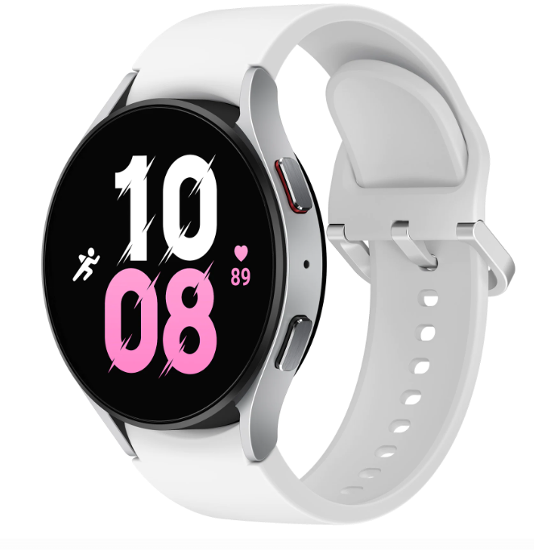
Identification of Wearable Devices with Bluetooth
Related Work
Focus on Bluetooth Classic protocol fingerprinting
Machine learning methods based
Use packet inter-arrival-time distributions as the fundamental wearable fingerprinting feature
Accuracy results show on average 98.5, 98.3 percent precision and recall for wearables using the Bluetooth classic protocol
Notes:
In Identification of Wearable Devices with Bluetooth, the authors propose a machine learning based fingerprinting method to identify wearable Bluetooth devices, such as smart watches. The key feature to feed into machine learning models is inter-arrival-time distributions of the Bluetooth packets. The results shows high precision and recall for identifying wearables using the Bluetooth classic protocol.

Slide 12
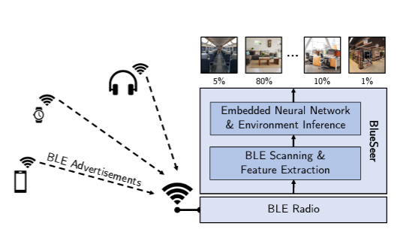
Related Work
Blueseer: A classification system that identify environment category via BLE Scans
Solely relies on BLE advertisement packets
Neural network based
Achieve up to 84% of accuracy in classifying 7 categories of environment – home, office, shopping, transport, nature, street, and restaurant.
Notes:
Blueseer is an AI-driven classifer that identify the category of environment. It scans BLE advertising packets and extracts features such as signal strength from them. The classification system of it is based on a two-layer dense neural network. It achieves an 84% of accuracy in differentiating between 7 categories of environment, including – home, office, shopping, transport, nature, street, and restaurant. The paper demonstrated the significant potential of leveraging BLE advertising packets for classification purpose.

Slide 13
Related Work
Summary of Related Work
 | Research Area | Data Source | Identification Algorithm | Classification Focus
IoT Hunter | IoT | IoT network flows | Deep Packet Inspection | Flow classification between IoT devices
Identification of Wearable Devices with Bluetooth | Bluetooth | Bluetooth classic packets | Machine learning | Inta-device classification between 7 smart watches
Blueseer | BLE | BLE advertising packets | Machine learning | Environment category
HomeScout | BLE | BLE advertising packets | Individual analysis | Identification of 4 BLE trackers
Notes:
To summarize recent studies, research area, data source, identification algorithm and classification focus of these papers will be discussed. IoT hunter focus on the IoT and take network flows of IoT devices as data source. They use deep packet inspection to classify between IoT device. In the second related work, they focus on Bluetooth classic protocol. The data source is Blutooth classic packets. The identification algorithm they used is machine learning method. They manage to classify between 7 smart watches. Blueseer also used machine learning in classification. They classify environment category by utilizing BLE advertising packets. The research area of it is BLE, which is the same with this thesis. HomeScout identify 4 BLE trackers by utilizing BLE advertising packets. It also focus on BLE protocol, but it doesn’t use a comprehensive method in classification.

Slide 14
1 Introduction
2 Related Work
3 Motivation
4 Design
Notes:
Let’s move on to the motivation part.

Slide 15
Motivation
Research Gap
 | Granularity of Research Area | Data Source | Identification Algorithm | Classification Ability
IoT Hunter | IoT | IoT network flows | Deep Packet Inspection | Flow classification between IoT devices
Identification of Wearable Devices with Bluetooth | Bluetooth | Bluetooth classic packets | Machine learning | Inta-device classification between 7 smart watches
Blueseer | BLE | BLE advertising packets | Machine learning | Environment category
HomeScout | BLE | BLE advertising packets | Individual analysis | Identification of 4 BLE trackers
Research Gap | BLE | BLE advertising packets | Comprehensive method | Classification of device category
Notes:
Upon reviewing the summary table of related work, it becomes apparent that there is a notable research gap in recent studies. Specifically, no work has been dedicated to the comprehensive classification of Bluetooth Low Energy (BLE) device categories. While HomeScout has also focused on this research area, its classification capabilities remain limited. Therefore, a study aimed at addressing this research gap, could be intriguing and valuable.

Slide 16
Motivation
Research Objectives
Develop a comprehensive classifier that can identify category of BLE device
Focus on utilizing BLE advertising packets
Integration into HomeScout
Notes:
Therefore, our research objectives is to develop a comprehensive classifier that can identify category of BLE device, which focus on utilizing BLE advertising packets. The implemented algorithm will finally integrated into HomeScout to enhance its classification capability.

Slide 17
1 Introduction
2 Related Work
3 Motivation
4 Design
Notes:
We will talk about overall design of the classification algorithm in the next part.

Slide 18
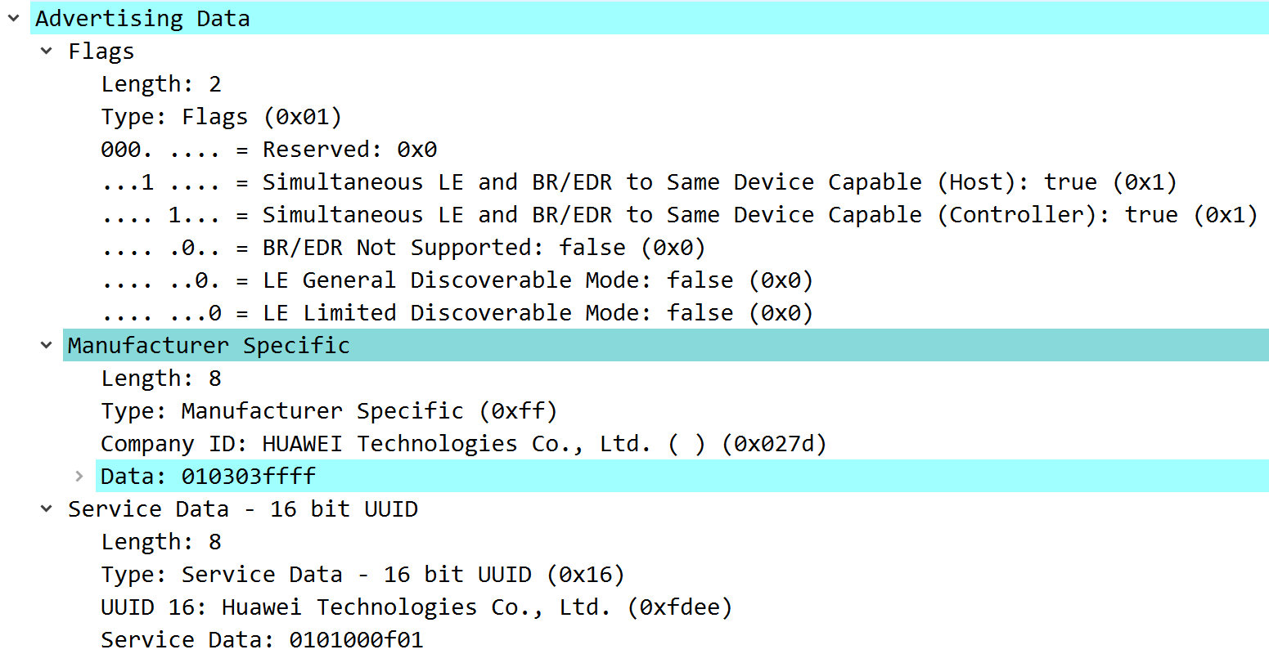
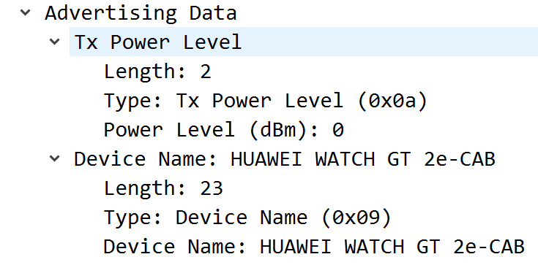
Design
Analysis of BLE advertising packets
Notes:
In this study, Wireshark is employed to capture BLE packets. These two screeshots are taken from captured BLE advertising packets of Huawei Smart Watch in Wireshark. From the screeshots, we can see that the payload of BLE advertising packets contains abundant information about device, such as device name, service data and manufacturer specific data. This makes BLE advertising packet an ideal data source for classification.

Slide 19
Design
Approach
Use machine learning based method and utilize BLE advertising packets to classify device category
Reason
Success of Blueseer
Capability of machine learning in recognizing complex pattern of data
Scalability of machine learning rather than manual coding rules in HomeScout
Notes:
The paper Blueseer successfully utilize machine learning method to identify the pattern of environment category in BLE advertising packets. Inspired by Blueseer, machine learning method will also be exploited in this work. The approach is to use machine learning models like random forest or neural network and take BLE advertising packets as inputs to classify device category. Another reason to choose machine learning based method is BLE advertising packets contain various pieces of information, which can have complex relationships that are difficult to model with traditional rule-based system. Machine learning models, on the other hand, are excellent at identifying patterns. Furthermore, there are countless types of BLE devices on the market, and new ones are being developed all the time. A machine learning model can be trained on a dataset of known devices, and then used to predict the type of new, unknown devices. This is much more scalable than manually coding rules for each type of device.

Slide 20
Roadmap
Research
Design
Implementation
Evaluation
01
02
03
04
Notes:
This is the roadmap of major work should be done in this thesis. The first step is to do the research work around how to identify category of BLE devices. The next step is to design the classification algorithm. The overall methodology has been designed so far. In next steps, a detailed prototype will be designed. After that, implementation and evaluation of models will be conducted.

Slide 21
Q&A
Thank you for your attention!
Notes:
Thank you for your attention. Do you have any question?

