Slide 1
Analog to Digital Conversion (ADC)

Slide 2
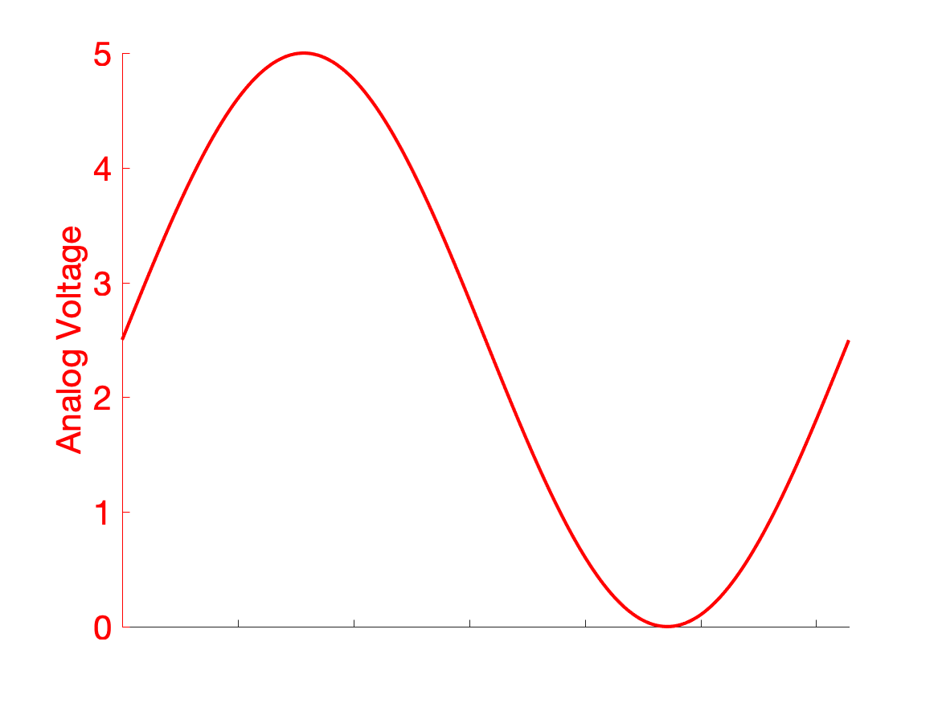
To do anything with this a voltage, even pass it to memory, we need to convert it from an analog voltage to a form
Analog signals are continuous
I.e. their resolution is infinite

Slide 3
We can’t really measure a signal to infinite resolution
Digitizing a signal means discretizing the continuous analog signal
We specify the resolution of this discretization in bits

Slide 4
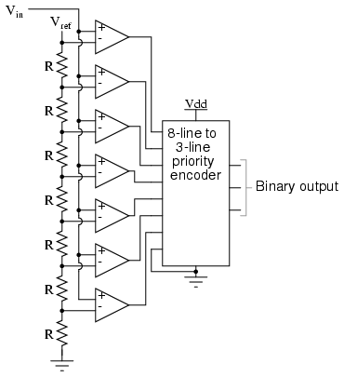
Here’s what a basic ADC looks like
An ADC takes an analog voltage as an input, and outputs a digital (binary) number

Slide 5
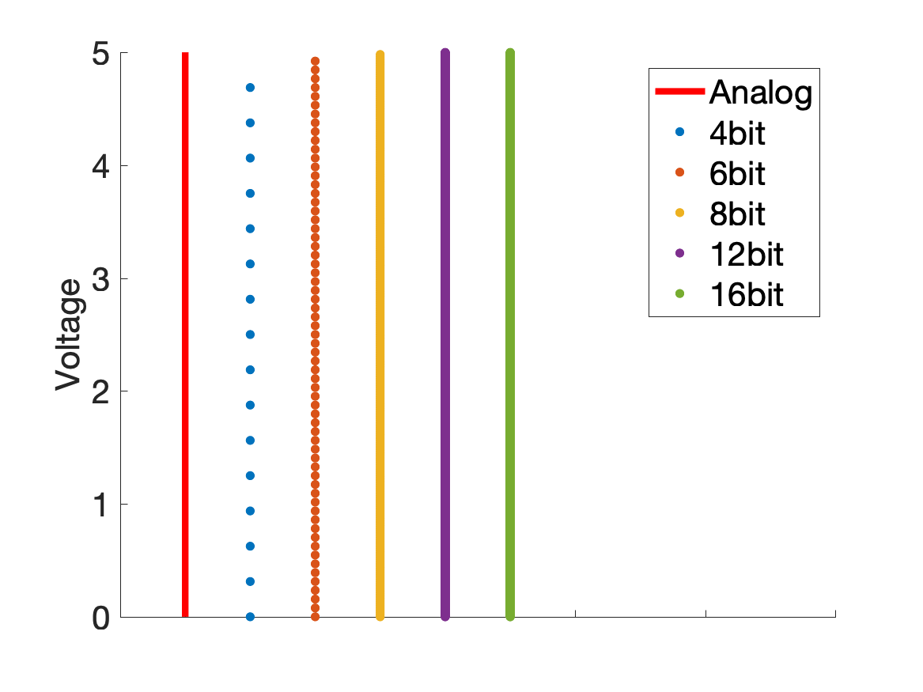
Our input voltage range is discretized to 2^(nbits)
If V_range is 5V, this 5V gets broken into…
2^4 = 16
2^8 = 256
2^12 = 4096
2^16 = 65536
… possible values

Slide 6
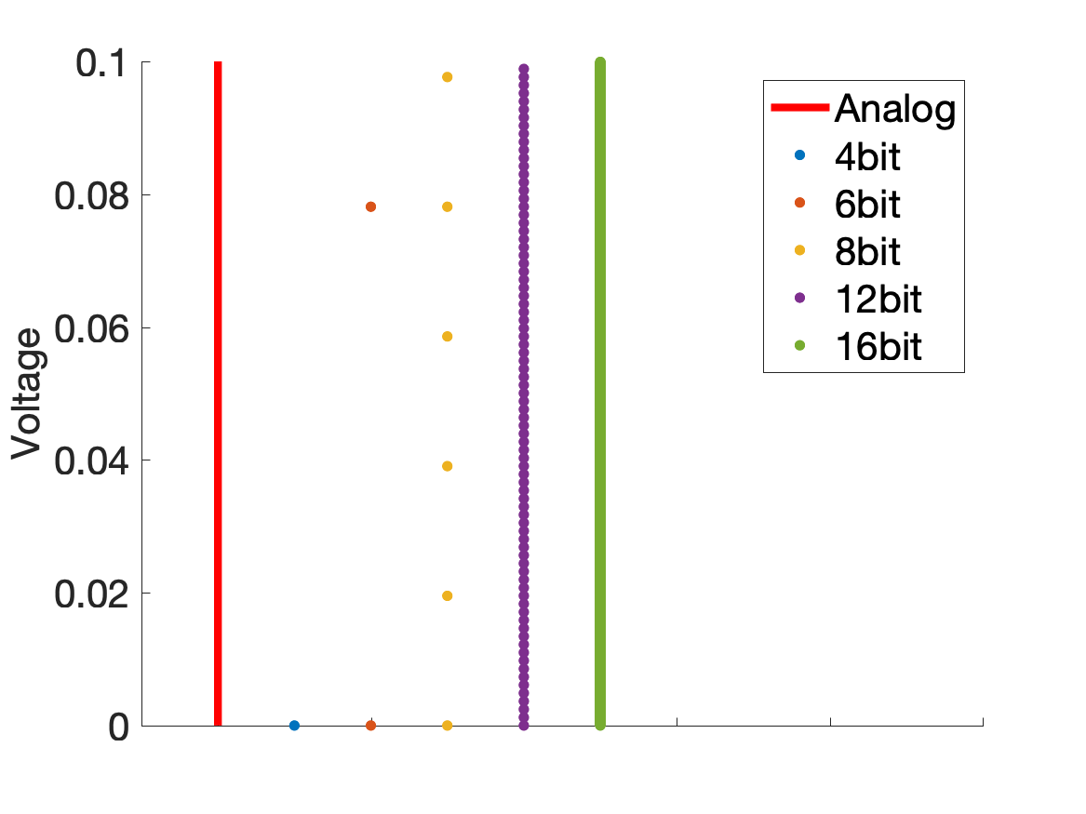
We have to zoom in pretty far to see the discretization at higher resolutions
16 bit still looks almost continuous

Slide 7
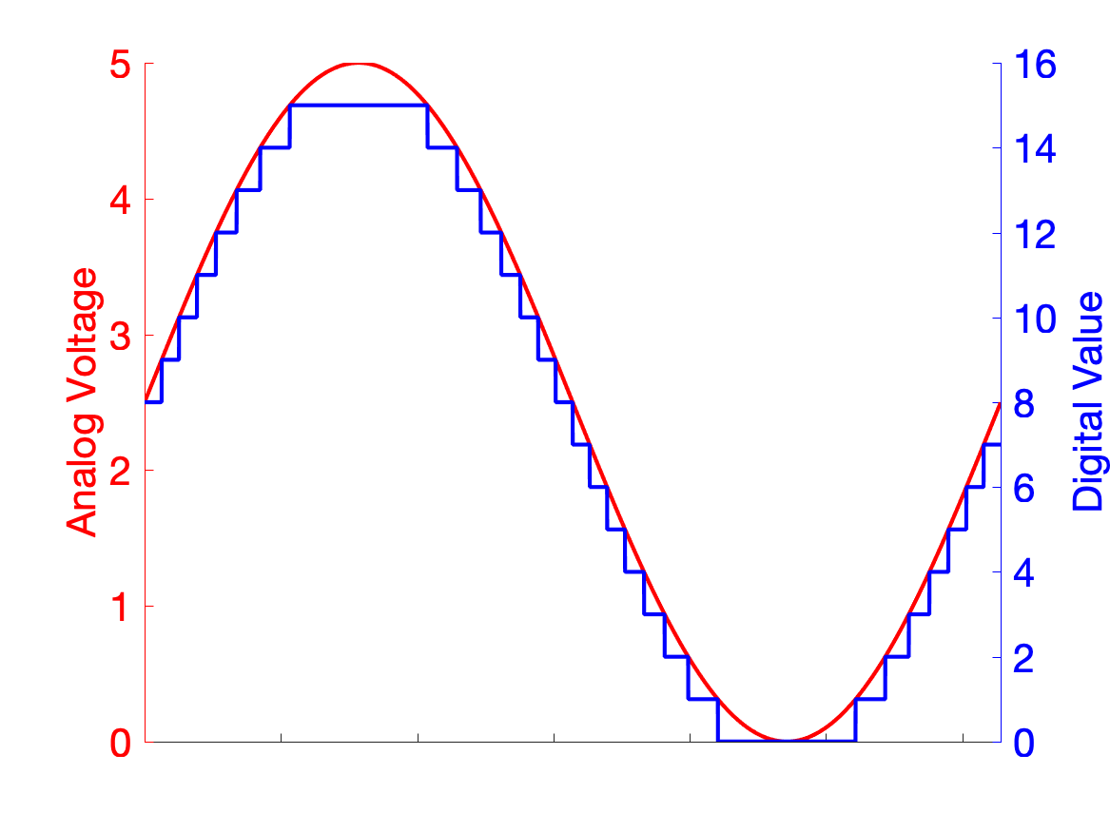
So the digital version of the analog waveform shows discretization
This discrete waveform is what our microcontroller ”sees”
This is a series of values that can be stored, communicated, manipulated, etc.

Slide 8
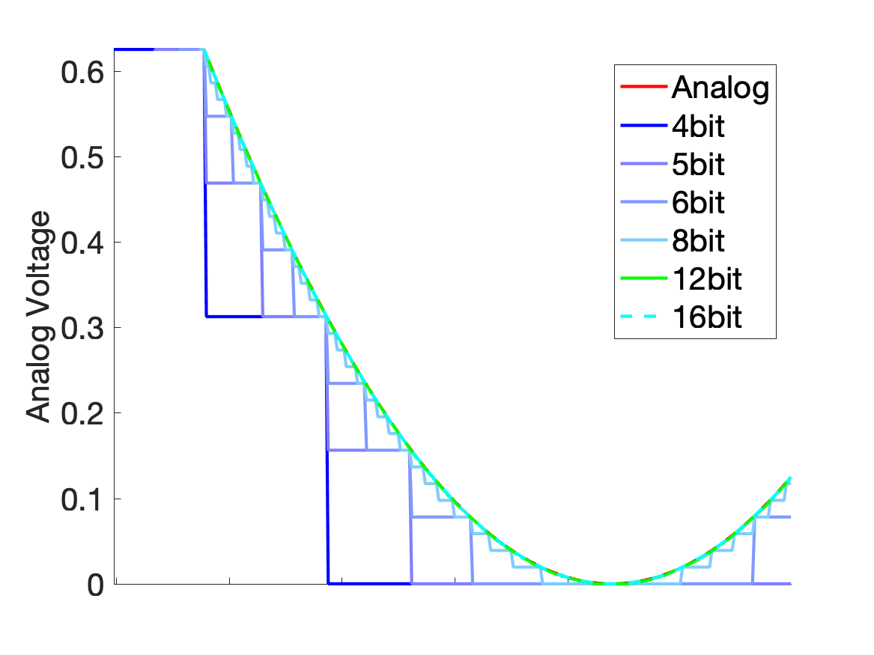
Increasing the resolution increases the appearance of continuity
The 12 and 16 bit waveforms are almost indistinguishable from analog, at this scale

