Slide 1
CMSC 508 – Database Theory Fall 2022
CMSC 508 Database Theory
Dr. John Leonard jdleonard@vcu.edu

Slide 2


CMSC 508 Database Theory
Recommended (optional) books:
Database System Concepts, Sixth Edition
A. Silberschatz, H. Korth, S. Sudarshan McGraw-Hill ISBN 978-0073523323
Database Management Systems, Third Edition
R. Ramakrishnan, J. Gehrke McGraw-Hill ISBN 978-0072465631

Slide 3
CMSC 508 Database Theory
Grading:
Homework & Classwork | (20 %)
Quizzes | (30 %)
Final project | (30 %)
Final exam | (20 %)
Cheating, plagiarism, or any other honor code offense will result in a grade of F in the course.

Slide 4
Course schedule overview
Database theory and design |  | Database programming and SQL
Design
Semester project design
SQL
Final Exam
Relational Algebra
Semester project implementation
Laptop required in class
Notes:
Open Schedule in Canvas to review

Slide 5

Course Format
Lecture materials are pre-recorded and posted in Canvas for each weekly module
You are to prepare before coming to class by watching videos / reading textbook chapters / reviewing lecture notes
Class meetings will be used to discuss topics / work on designs / practice problems / write queries in small groups and for quizzes
Semester project extends the learning by applying course topics and researching how to build a web application as part of a team.

Slide 6
CMSC 508 Database Theory
Major topics:
Data storage and representation
Entities and relations
Entity-Relationship model, diagrams, and design
Relational design
Functional dependencies
Normal forms and decomposition
Database programming and SQL
Queries. Subqueries. Functions. Views. Triggers. Indexes.

Slide 7
CMSC 508 Database Theory
Competencies:
Understand the concepts underlying databases design
Analyze problems to identify data requirements, types, and relations
Create E-R and relational designs from problem statements
Design structures and functions to store and process the information
Design and implement databases using SQL language
Query and manipulate data using SQL language
Translate a real-world problem into a implemented solution

Slide 8
CMSSC 508 Database Theory
Semester project:
Groups of 2 people
Idea: choose a real-world problem of general interest, design and implement solution
Problem must be approved by your professor
Phase 1: design a database model and its requisites
Phase 2: implement database solution, including SQL code to create a MySQL database, and all queries to access/manipulate data through a web interface
No languages restrictions for the interface - (C++/Java/Python/PHP)
Must use a relational database and SQL for data persistence
Will be evaluated according to the quality, functionality, security, and complexity of the database design and the solution

Slide 9
Read syllabus information and VCU policies:
VCU Email Policy
VCU Honor System: Upholding Academic Integrity
Student Conduct in the Classroom (respect, cheating)
Students with Disabilities
Statement on Military Short-Term Training or Deployment
Excused Absences for Students Representing the University
Campus Emergency Information
Important Dates (religious holidays, absences)
VCU Mobile
Class Registration Required for Attendance
Withdrawal from Classes (Please inform the instructor)

Slide 10
Homework and Quizzes
Homework aligned with quizzes – designed to help!
Homework submitted through Canvas and gradescope
Quizzes submitted through Canvas and gradescope
Practice makes perfect – see new “Submitting homework” in the Week 1 module.
EVERYONE must submit their POGIL individually. No sympathy later if you never submitted Homework 0!

Slide 11
REMINDER
Due dates arrive fast and furious
Quizzes are sometimes on Monday – much less prep!
Homework is sometimes due on Monday – in the next week!
LOOK AHEAD – WATCH THE OUTLINE
And … now back to our regularly scheduled programming …

Slide 12
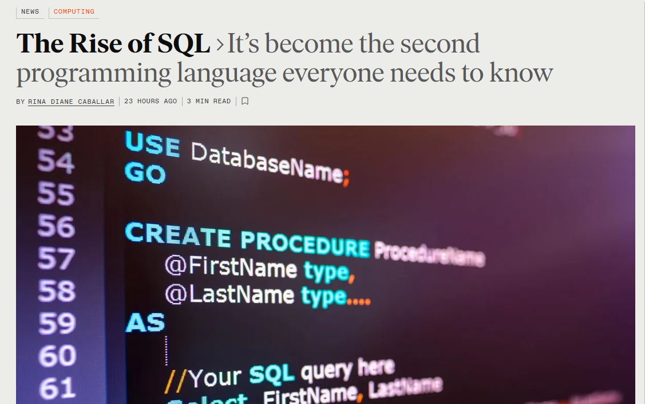
I’m glad you’re here!
https://spectrum.ieee.org/the-rise-of-sql

Slide 13
Intro to databases – Survey results!
Let’s review the survey …
https://docs.google.com/forms/d/1ziMIX_TptuLRwp7JOvwwpHqZ0o1Qll8XKNDwqFvAerQ/edit#responses
And the workbook …
https://docs.google.com/spreadsheets/d/120TXzq8jTPKwRDpT-Q74OiNvvgR6Zt07VEmNn_CVkvI/edit?resourcekey#gid=279755728

Slide 14
Today’s Activity
Introduction to Database Design POGIL Activity
Form a team of 4 people
Person with a laptop or tablet is the Reflector
Remaining person whose birthday is closest to January 1 is the Recorder – they get a copy of the activity
Reflector selects the Manager – they get a copy of the activity
Remaining person is the Presenter
Everyone is recorder … Everyone submit as HW 0!

