Slide 1
Week 2 – Lecture 2
CMSC 508 Database Theory
CMSC 508 – Database Theory
Chapter 7 from Database System Concepts, 6th Ed. by Silberschatz, Korth, Sudarshan, 2011 Chapters 2,3 from Database Management Systems, 3rd Ed. by Ramakrishnan, Gehrke, 2003
Notes:
The ER model is a way of modeling the needs of the database that is close to the user/enterprise. It’s a first step at understanding the user requirements and is easy for the end users to understand so it facilitates communication.
Importance of getting the data model right – can change physical design later, but to change the logical design would disrupt the way data is used.
The two major things to avoid are duplication and missing information.

Slide 2
Housekeeping
Homework 1 due Friday. Gradescope will be ready tomorrow. Submit electronically as PDF.
Additional timeslots for project approval meetings will be set up – I’m looking at Friday AM and PM blocks.
Quiz next Wednesday. VERY similar to Homework 1!
POGIL responses will be posted, too.
Zoom link for lectures is now available.
Questions?

Slide 3
Database design
CMSC 508 – Database Theory

Slide 4
Database Design
Logical design
Decide the specification of the database schema
Effective and efficient collection of relational schemas
What relations, attributes, constraints
What relationships are happening among data
What functionality is expected
Software design perspective
Analysis of requirements
Functional and nonfunctional analysis
Design synthesis
10
Notes:
DBAs are responsible for defining the logical and physical layers of the database, along with maintaining database security.

Slide 5
Database Design Phases
Formulation of information requirements and functional analysis
Definition of the problem and analysis of requisites
Conceptual data model: data modeling
Entity-relationship diagram
Entities: abstractions of objects
Relationships: association among entities
Logical data model: database schema logical design
DDL to specify the schema
Translation to relational schemas using normalization theory
Physical Database Design
Application & Security Design
Implementation. Translation to SQL through the DDL
Notes:
Requires interacting with various users of the system to discover their needs and document them as a formal specification. What are they currently doing to manage the data? What are common operations?
Formal specification is converted to a high-level view of the system that focuses on the entities (and their attributes), relationships between entities, any constraints that exist with either one, and the functional requirements – how will the system be used.

Slide 6
An example
Semester Project Team survey
Explore columns
How do we count projects?
How do we count people?
How do we count unused slots?
Conversion to data base …
Entities? Relations?
Normalizing

Slide 7
Normalization Theory
“Normalization” is the process of reorganizing the columns and tables of a relational database to minimize data redundancy and avoid inconsistencies
Normalization decomposes a table into smaller tables without losing information
Normalization is iterative, don’t expect perfection the first time through!
Normalization Theory provides simple tests to determine a “good design”
10
Notes:
Normalization provides guidelines for designing the relations in a database.
Key – a non-redundant attribute of set of attributes that uniquely identify each entity in a relation.

Slide 8
Entities, Relations and Degrees
CMSC 508 – Database Theory

Slide 9
Communicating Database Designs
Entity-relationship (E-R) model (Peter Chen 1976)
Developed to facilitate database design by allowing specification of a schema that represents the overall logical structure of a database
Maps the meanings & interactions of real-world problems → conceptual schema
Because of this usefulness, many database-design tools draw on concepts from the ER model
The ER model also has an associated diagrammatic representation, the ER diagram, which can express the overall logical structure of a database graphically
Notes:
It’s the first step in the design process.
Converts the natural language needs into a diagram that is less ambiguous and easily translated into a description of all the relations in the database and the relationships between them (Conceptual Schema)
New then select Software and the bottom right side is an ER diagram.

Slide 10
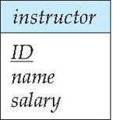
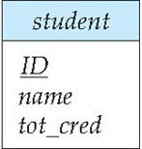
Entity Sets
Entity Sets are represented by their name and a set of attributes
Individual entities within an entity set are uniquely identified by a primary key
The primary key can be any set of attributes or generated IDs
Entity Sets are represented graphically as rectangles, listing the attributes. The primary key is underlined
Translation into tables:
instructor (ID, name, salary )
student (ID, name, tot_cred)
Notes:
Entity exists in the real world and can be described uniquely using a set of attributes.
The attributes will take on values within a specified domain. So, each tuple or row in an entity set is an entity with specific values for the attributes.

Slide 11
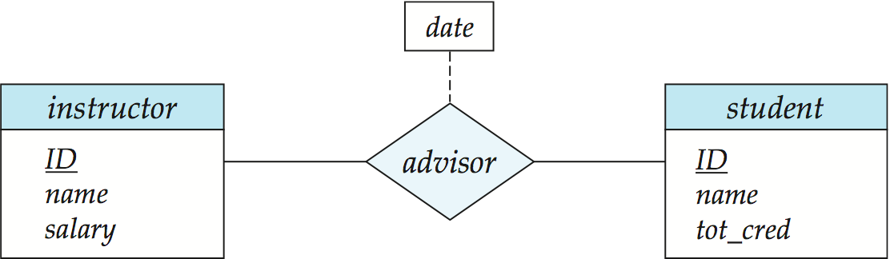
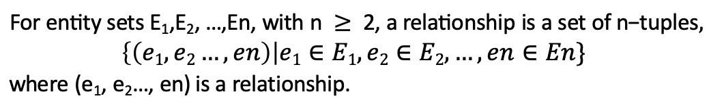
Relationship Sets
Relationships define associations / interactions among entities
Relationships are represented graphically as diamonds
Roles: meaning of entities in the relationship (noun/verb)
Relationships may generate new attributes due to the association (e.g. student takes a course, then earns a grade)
$$\text{For} \text{entity} \text{sets} \text{E}\text{1}\text{,}\text{E}\text{2}\text{, …,}\text{En}\text{, }\text{with} \text{n} ≥\text{ 2, }\text{a} \text{relationship} \text{is} \text{a} \text{set} \text{of} \text{n}\text{−}\text{tuples},$$
$$\left\{\left(e1,e2…, en\right)\right|e1∈E1,e2∈E2,…, en∈En\}$$
$\text{where}\text{ (}\text{e}\text{1}\text{, }\text{e}\text{2}\text{…, }\text{en}$) is a relationship.
Notes:
Attributes describe the relationship in some way – see notes. Depends on the data – the date could be when the relationship began when the instructor first became the advisor of the student or a documentation of all the dates that the advisor met with the student (depends on the context/needs of the system)
Note that the fact that n >= 2 does not mean that an Entity Set cannot be in a relationship with itself.
The formal definition means that the relationship consists of tuples from more than one entity set combined together into the relationship. The combination of Entity Sets basically defines the relationship.
We say that the Entity Sets participate in the relationship.

Slide 12
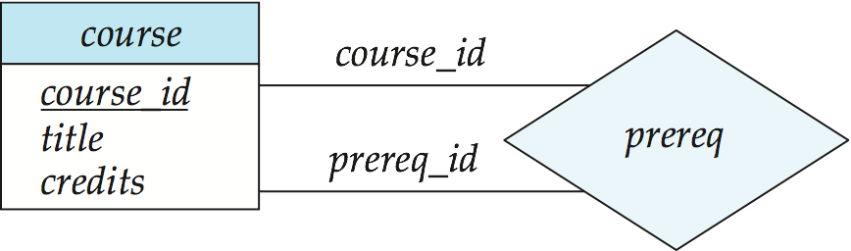
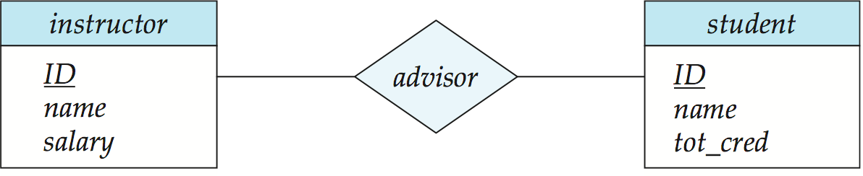
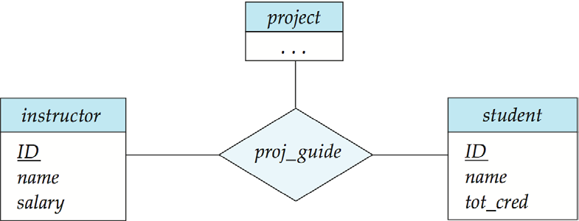
Degree of a Relationship
Unary
Roles
(recursive relationship)
Binary
Ternary, N-ary
Notes:
The Degree is the # of entities that participate in the relationship.
The role is the function that an entity has in the relationship. Mostly obvious, except in recursive relationships such as an employee relationship where some employees manage other employees. Here you might define roles as ”manages” and “managed by”

Slide 13
Practice
Design an E-R diagram for keeping track of a sports team. It should store the following:
matches played,
the scores in each match,
the players in each match,
individual player statistics for each match.
Model an attribute for a summary statistics – player_cnt as a derived attribute.
Model an attribute for the summary statistics, called season_avg, as a derived attribute.

Slide 14

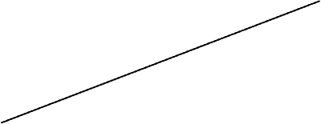
Practice from Last time
Design an E-R diagram for keeping track of a sports team. It should store the matches played, the scores in each match, the players in each match, and individual player statistics for each match. Model an attribute for the summary statistics, called season_avg, as a derived attribute.
Notes:
This is the problem from last time.

Slide 15
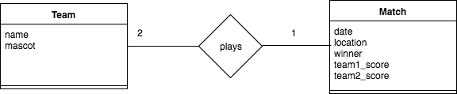
Practice
Design an E-R diagram for keeping track of a sports team. It should store the matches played, the scores in each match, the players in each match, and individual player statistics for each match. Model an attribute for the summary statistics, called season_avg, as a derived attribute.
()
Notes:
Examine the relationships:
two teams play a match and each team has a score in the match – this could be modeled as a recursive relationship, but Match has a lot of attributes, so better to have it as an Entity

Slide 16
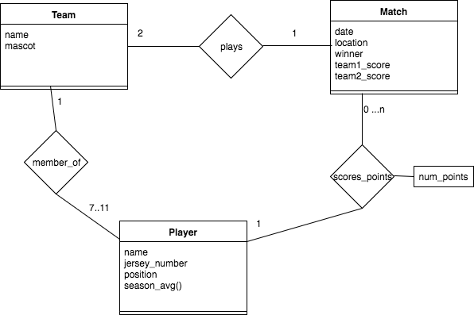
Practice
Design an E-R diagram for keeping track of a sports team. It should store the matches played, the scores in each match, the players in each match, and individual player statistics for each match. Model an attribute for the summary statistics, called season_avg, as a derived attribute.
()
…n
Notes:
Examine the relationships:
players are members of teams
to get the average stats for a single player, we need a relationship between player and match to capture the point earned by that player.
What’s missing in this diagram? Keys in the entities.

Slide 17
Learning Objectives
List the main steps in database design including the goal of each step.
Differentiate between entities / entity sets and relationships / relationship sets.
Design and draw an ER diagram that captures the information about a given data storage scenario.
Describe the cardinality and participation of entities in a relationship
Express multi-valued attributes correctly in an ER diagram.

Slide 18
Learning Objectives
Demonstrate the conversion of entity sets and relationship sets in an E-R diagram to relational schemas
Convert N-ary relationships to binary relational schemas
Derive the relational schemas for both specialization and aggregation based on a given E-R diagram

Slide 19
Weak Entities
CMSC 508 - Database Theory

Slide 20
Weak Entities
Some entities cannot exist by themselves in the real-world
A weak entity is one whose existence is dependent on another
identifying entity (strong)
The relationship associating the weak entity set with the identifying entity set is called the identifying relationship
Instead of associating a new primary key with a weak entity, the identifying entity along with an extra discriminator attributes are used to uniquely identify a weak entity
Notes:
For example, in the university database, a section cannot exist with out a course, but a course can have multiple sections. So section is a weak entity that depends on the course entity.
For insurance purposes, a dependent cannot exist without a primary insured person.

Slide 21
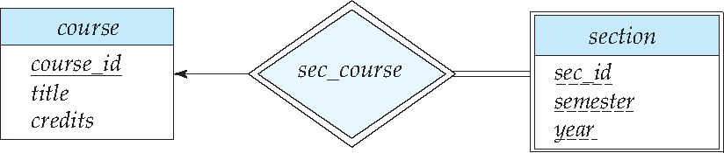
Weak Entities
A weak entity set is depicted via a double rectangle
The discriminator of a weak entity set is underlined with a dashed line
The identifying relationship connecting the weak entity to the identifying strong entity is depicted by a double diamond
Primary/foreign keys for section relation
section PK (course_id, sec_id, semester, year) FK (course_id)
*Arrow indicates that each section is related to a single course
*Double line indicates total participation of the section entity
Notes:
The arrow in this diagram is an alternative way to depict a one to many relationship. So a course can have multiple sections, but a section can be own by only one course.

Slide 22
Cardinality and participation
CMSC 508 – Database Theory

Slide 23
Cardinality and Participation
Express the number of elements in an entity to which another entity can be associated via a relationship
Connectivity types
One to one (1:1)
One to many (1:M)
Many to one (M:1)
Many to many (M:N)
Participation Constraint
Total: every entity in A participates in at least one relationship in B
Partial: only some entities in A participate in relationships in B
Notes:
See Key Constraints in notes.

Slide 24
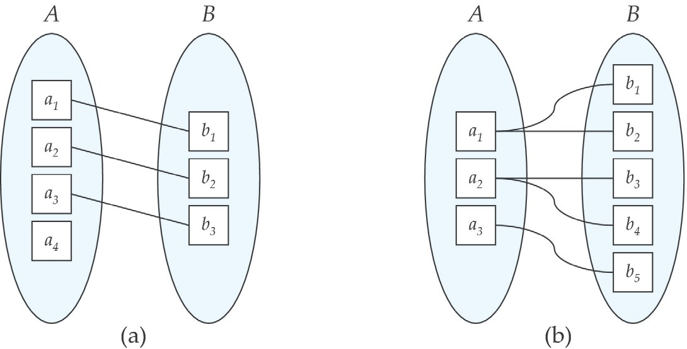
Cardinality Constraints
One to one
One to many
Partial participation of A
Total participation of A
Total participation of B
Total participation of B
8
Notes:
One to one: A is associated with AT MOST one entity in B, and B is associated with AT MOST one entity in A
One to many: A is associated with ZERO OR MORE entities in B, and B is associated with AT MOST one entity in A

Slide 25
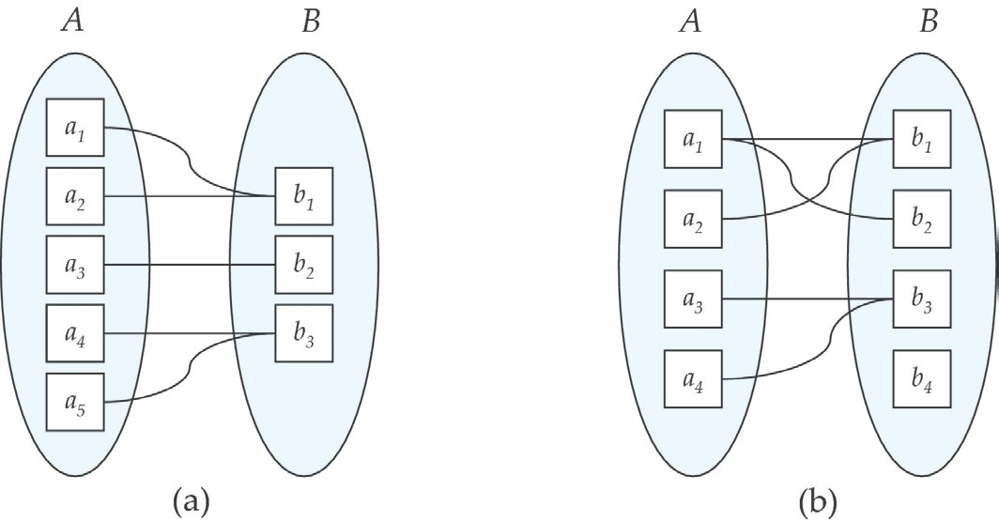
Cardinality Constraints
Many to one
Many to many
Total participation of A
Total participation of A
Total participation of B
Partial participation of B
Notes:
Many to one: A is associated with AT MOST one entity in B, and B is associated with ZERO OR MORE entities in A
Many to Many: A is associated with ZERO OR MORE entities in B, and B is associated with ZERO OR MORE entities in A

Slide 26
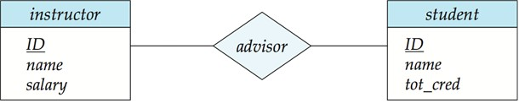
Cardinality Constraints
Minimum and maximum cardinality, shown in the form l…h or (l,h), where l is the minimum and h the maximum cardinality
A minimum value of 1 indicates total participation
A maximum value of 1 indicates that the entity participates in at most one relationship
A maximum value of * or n indicates no limit
A min/max value of C (integer) indicates a fixed value
1
N
0...*
1...1
Notes:
How are these constraints depicted in the diagram?
In the bottom diagram, the advisor student line is 1…1 meaning that the min an max cardinality is the same – a student has only 1 advisor so there is total participation because the min is 1 (not 0)
while the 0…1 for instructor advisor line means that an advisor can advise 0 or more students – a 1 to many relationship

Slide 27
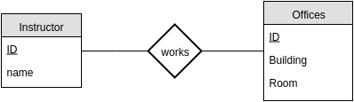
Cardinality Constraints
One to one relationship between instructor and offices (total)
1
1
One to one relationship between instructor and student (partial)
A student is associated with at most one instructor
An instructor advises one and only one student
1...1
0...1
Notes:
Point out the difference in the bottom diagram where student may not have an advisor.

Slide 28
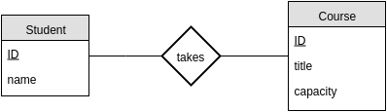
Cardinality Constraints
One to many
An instructor advises several (including 0) students
A student may be advised by at most one instructor
0...*
0...1
Many to many
o Students take 1 or more courses, courses may be empty
1...*
0...*

Slide 29
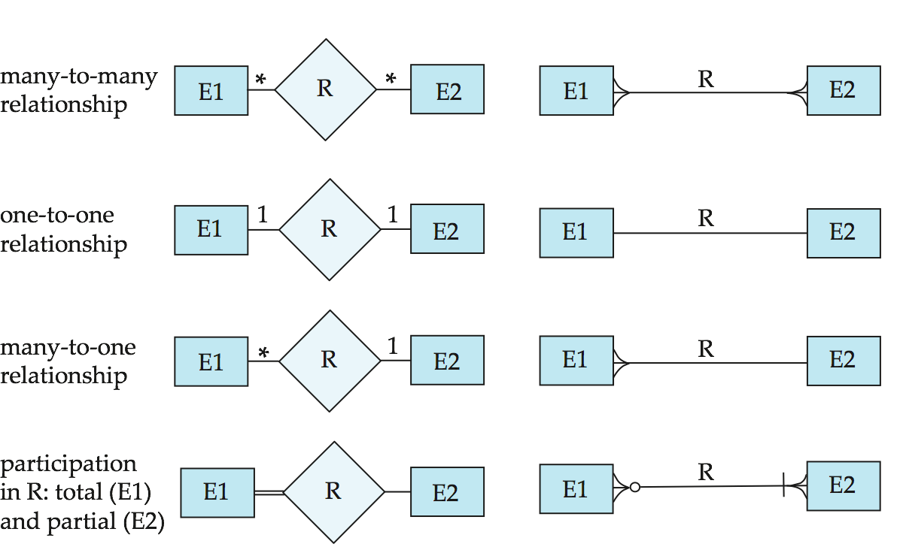
Alternative E-R notations
Chen
IDE1FX (Crow’s foot notation)
Notes:
No standard exists and different references will show them differently. Some might list the entity in a box with attributes as circle “balloons” surrounding it, for example.

Slide 30
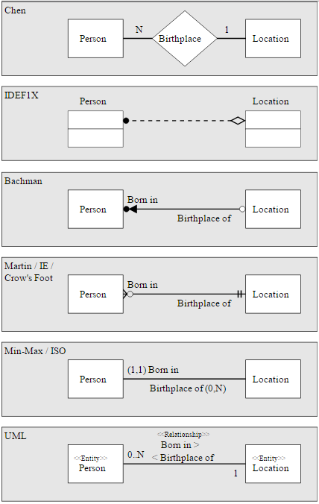
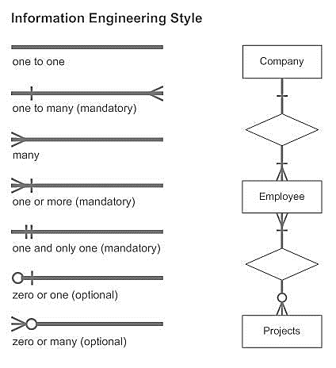
Notation
CMSC 508 Database Theory
Notes:
Try not to let the differences be an obstacle in the design process.

Slide 31
ER Diagramming
CMSC 508 – Database Theory

Slide 32
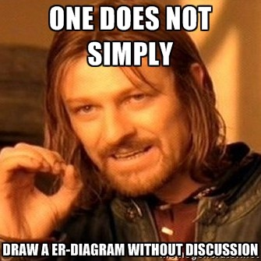
Database Design is not Accidental
Identify entities and their attributes
Identify relationships among entities
Analyze cardinalities and participation

Slide 33
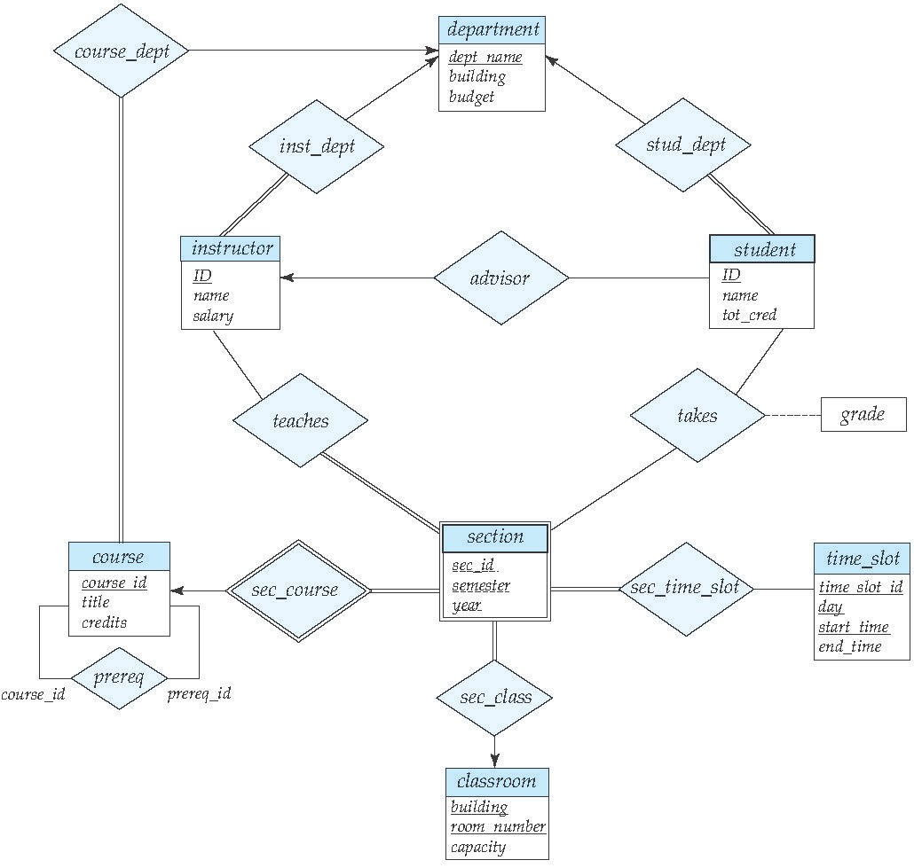
CMSC 508 Database Theory
E-R Diagram for a University Database
Notes:
What does it tell us?
See printout
*Arrow indicates that each section is related to a single course
*Double line indicates total participation of the section entity

Slide 34
Practice
Add to the University database design a way to record the grades that students get in the exams of different course offerings.
Notes:
Model exams as entities and use a ternary relationship with the existing database
Provide an alternative model using a binary relationship between student and section, allowing for a single relationship between a student and a section, but multiple exam scores can be entered for the student in the section

Slide 35
Complex attributes
CMSC 508 – Database Theory

Slide 36
Complex Attributes
Simple (atomic) and composite attributes (divisible)
Example: VCU eID vs name (First name + last name)
Single-valued and multi-valued attributes
Example multi-valued: phone_numbers
Derived attributes
Computed from other attributes
Example: age given the date of birth, GPA given grades
Domain
Set of allowed values for each attribute
Is null allowed?
Notes:
Attributes are the set of characteristics (data) for an entity in an entity set.
Attributes have a name and domain of values allowed for that attributes.
An attribute of an entity set is a function that maps from the entity set into a domain.
multi-valued attributes can be a set of values such as office and cell phone numbers.
Null can be not-applicable (I don’t own a phone) or it could be unknown (I don’t know Sally’s phone number) Which is it?

Slide 37
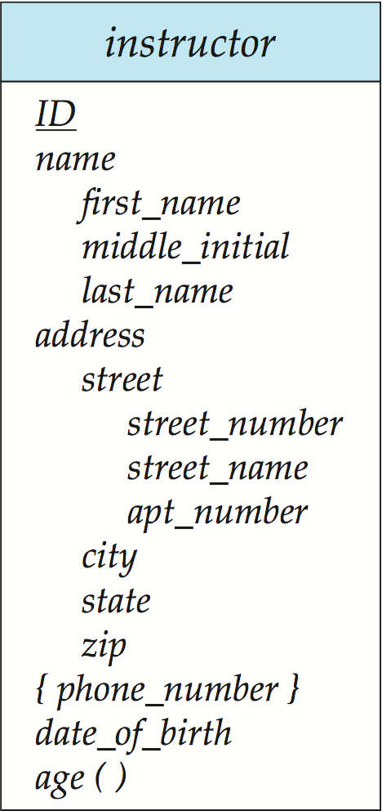
CMSC 508 Database Theory
Complex Attributes Notation
Composite attributes
Multi-valued attribute { }
Derived attribute ( )
20
Notes:
The name attribute is composed of the first_name, middle_name, and last_name; address and street are also composed of other attributes.
Multivalued attributes can have multiple values for the single entity – work phone and cell phone.
Age is a derived value. We don’t store it but rather calculate it when it’s needed in response to a query.

Slide 38
Composite Attributes
Composite attributes are flattened out by creating a separate attribute for each component
Example: name_first_name, name_last_name
Prefix omitted if there is no ambiguity (name_first_name could be first_name)
Table representation:
instructor (ID, first_name, middle_initial, last_name, street_number, street_name, apt_number, city, …)
Notes:
Composite attributes point out that the composite has { } and the derived is followed by ( )

Slide 39
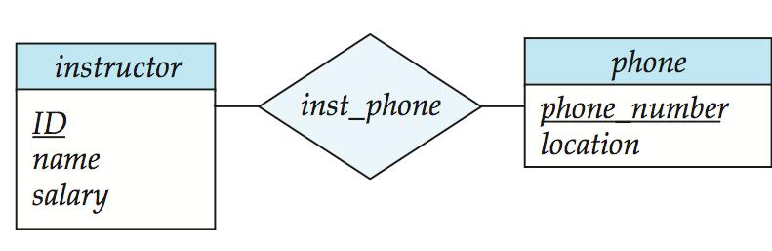
Multi-valued attributes
A multivalued attribute M of an entity E is represented by a separate schema EM
Schema EM has attributes corresponding to the primary key of E and an attribute corresponding to multivalued attribute M
Example: Multivalued attribute phone_number of instructor is represented by a schema:
inst_phone (Instructor.ID, phone_number, location)
Each value of the multivalued attribute maps to a separate tuple of the relation on schema EM
Notes:
Express a them with a relationship to a separate entity set

Slide 40
Relation schemas
CMSC 508 – Database Theory

Slide 41
Reduction to relation schemas
Entity sets and relationship sets can be expressed uniformly as relation schemas that represent the contents of the database
A database which conforms to an E-R diagram can be represented by a collection of schemas
For each entity set and relationship set there is a unique schema that is assigned the name of the corresponding set
Each schema has a number of columns corresponding to attributes which have unique names

Slide 42

Representing Relationship Sets
A strong entity set reduces to a schema with the same attributes student(ID, name, tot_cred)
A weak entity set becomes a table that includes a column for the primary key of the identifying strong entity set section ( course_id, sec_id, sem, year )
Notes:
Point out in the weak entity set example that the relational schema includes course_id

Slide 43
Representing Relationship Sets
A many-to-many relationship set is represented as a schema with attributes for the primary keys of the two participating entity sets, and any descriptive attributes of the relationship set.
Example: schema for relationship set advisor
advisor (instructor_ID, student_ID)
Notes:
The advisor relationship becomes a relationn schema that consists of the primary keys of each of the entity sets that participate in the relationship.
What if there are attributes on the relationship?

Slide 44
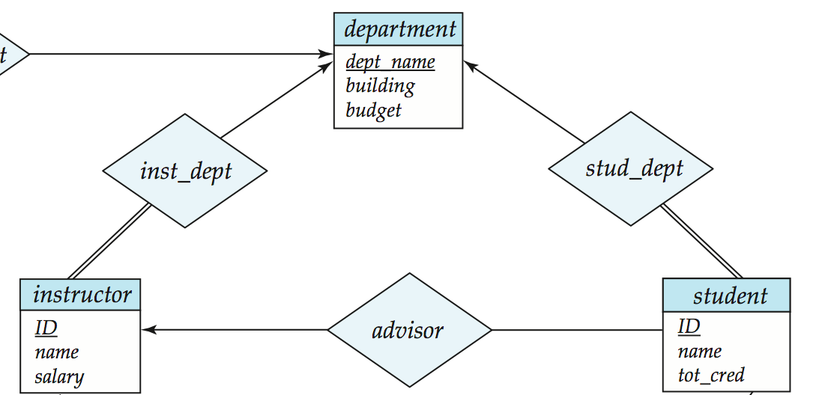
Redundancy of Schemas
Many-to-one and one-to-many relationship sets that are total on the many-side can be represented by adding an extra attribute to the “many” side, containing the primary key of the “one” side
Example: Instead of creating a schema for relationship set inst_dept, add an attribute dept_name to the schema arising from entity set instructor. instructor(ID, name, salary, dept_name)
Notes:
There will be an additional attribute in the instructor relation that refers to the department using a foreign key containing the dept_name.
However, If participation is partial on the “many” side, replacing a schema by an extra attribute in the “many” side could result in null values

Slide 45
Reducing N-ary relationships
CMSC 508 – Database Theory

Slide 46
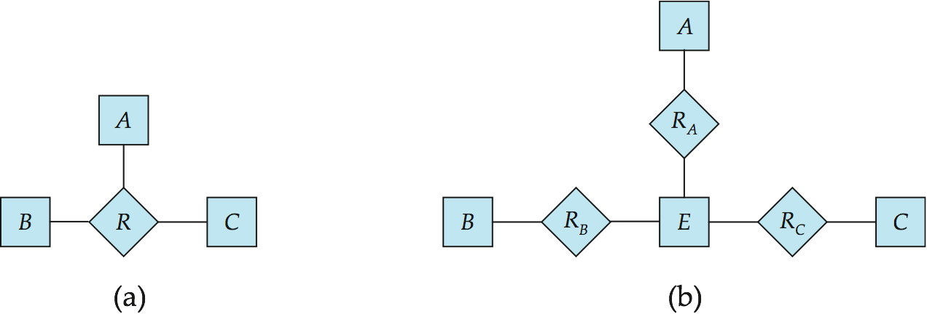
N-ary Relationships
Any non-binary relationship can be represented using binary relationships by creating an artificial entity set
Replace R between entity sets A, B and C by an entity set E, and three relationship sets: R_{A}, relating E and A, R_{B}, relating E and B, R_{C}, relating E and C
Create an identifying attribute for E and add any attributes of R to E
For each relationship (a_{i} , b_{i} , c_{i}) in R, create
1. a new entity e_{i} in the entity set E
2. add (e_{i} , a_{i} ) to R_{A}
3. add (e_{i} , b_{i} ) to R_{B}
4. add (e_{i} , c_{i} ) to R_{C}

Slide 47
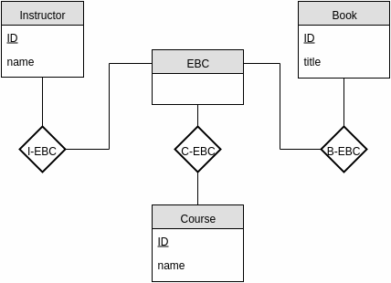
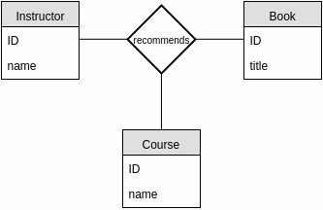
N-ary Relationships
instructor (instructor_id, name)
book (book_id, title)
course (course_id, name)
Ternary relationship
recommends (instructor_id, book_id, course)
DB designer
Notes:
Here the ternary relationship is removed and replaced with the artificial entity set EBC and the Instructor, Book, and Course now have binary relationships with this new entity.

Slide 48
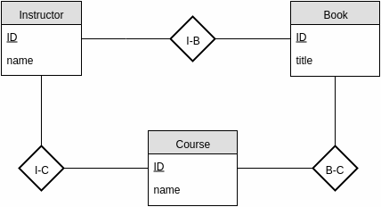
N-ary Relationships
Alternatively…
Instructor (instructor_id, name)
Book (book_id, title)
Course (course_id, name)
I-C (instructor_id,course_id)
I-B (instructor_id,book_id)
B-C (book_id,course_id)
Instructor (instructor_id, name)
Book (book_id, title)
Course (course_id, name)
recommends (instructor_id, book_id, course_id)
Notes:
Alternatively this can be used to replace the ternary relationship.
Lossless decomposition?
http://www.cci.drexel.edu/faculty/song/publications/p_JDB99.PDF

Slide 49
Specialization and Aggregation
CMSC 508 – Database Theory

Slide 50
Specialization
Top-down design process: sub-groupings within an entity set that are distinctive from other entities in the set
These sub-groupings become lower-level entity sets that have attributes or participate in relationships that do not apply to the higher-level entity set
Depicted by a triangle component labeled IS-A or a rounded arrow
Attribute inheritance – a lower-level entity set inherits all the attributes and relationship participation of the higher-level entity set to which it is linked
Notes:
Top down- start with the general entity and form specialized entity types based on speialized attributes or relationships specific to a class.
e.g., instructor “is a” person, student “is a” person, but attributes and relationships for instructor and student are different
Certain attributes apply to some, but not all, instances of an entity type
An instance of a subtype participates in a relationship unique to that relationship

Slide 51
Specialization
Overlapping: subclasses may have overlapping sets of entities
Disjoint: subclasses must have disjoint sets of entities
Overlapping: A student may also work for the university
Disjoint: A student must be either a graduate or undergrad
Notes:
Attributes are inherited. The double line from the superclass to the subclass indicates total participation. A student must be either a graduate or undergraduate
If we declare A ISA B, every A entity is also considered to be a B entity.
superclass is connected to a circle by a short line in this notation. Then each subclass connects to the circle.
In the circle, O denotes overlapping and D is for disjoint

Slide 52
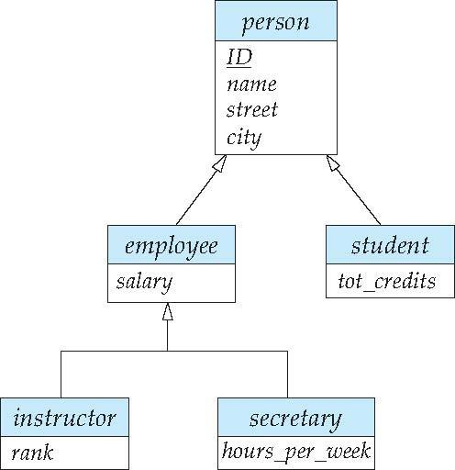
Specialization
Overlapping: subclasses may have overlapping sets of entities
Disjoint: subclasses must have disjoint sets of entities
Overlapping
An instructor cannot be secretary Disjoint
Students can be also employees
Notes:
Reasons for using ISA:
To add descriptive attributes specific to a subclass.
To identify entities that participate in a relationship. Here an instructor may have a relationship with sections, but a secretary does not.

Slide 53
Specialization
Representation of specialization using schemas (Method I)
Form a schema for the higher-level entity
Form a schema for each lower-level entity set, include primary key of higher-level entity set and local attributes
schema attributes
person student employee
ID, name, street, city
ID, tot_cred
ID, salary
Drawback: getting information about, an employee requires accessing two relations, the one corresponding to the low-level schema and the one corresponding to the high-level schema
Notes:
How does this get translated into a relational schema?

Slide 54
Specialization
Representation of specialization using schemas (Method II)
Form a schema for each entity set with all local and inherited attributes
schema attributes
person student employee
ID, name, street, city
ID, name, street, city, tot_cred
ID, name, street, city, salary
Drawback: name, street and city may be stored redundantly for
people who are both students and employees
Generalization
A bottom-up design process to combine a number of entity sets that share the same features into a higher-level entity set
Specialization and generalization are simple inversions of each other; they are represented in an E-R diagram in the same way
Notes:
Note that Generalization is very similar to Specialization, analogous to factoring out common attributes to place in a more general entity set.

Slide 55
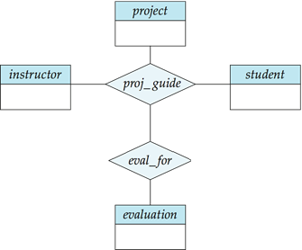
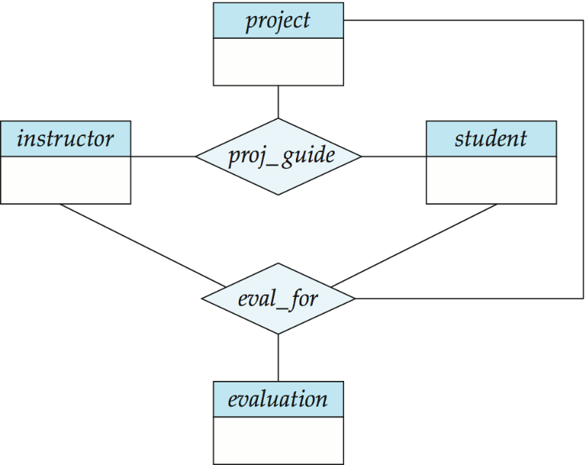
Aggregation
E-R model cannot express relationships between relationships
Suppose we want to record evaluations of a student by a guide on a project
E-R diagram with redundant relationships
Notes:
On the left, some instructor, student, project combinations may not have an associated evaluation.
On the right, there are redundant relationships because the eval_for entity sets (instructor, student, and project) are already represented in proj_guide.
Used when we have to model a relationship involving (entitity sets and) a relationship set.
Aggregation allows us to treat a relationship set as an entity set for purposes of participation in (other) relationships.

Slide 56
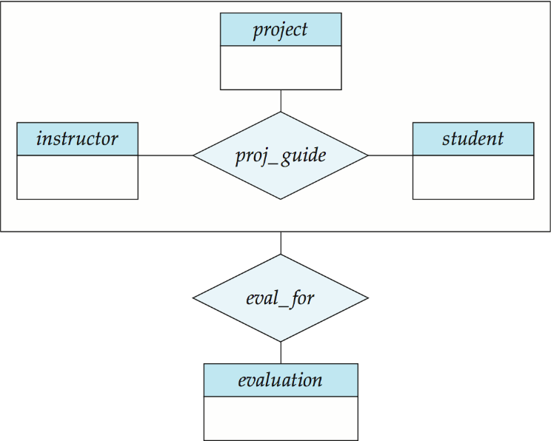
Aggregation
Eliminate this redundancy via aggregation without redundancy
Treat relationship as an abstract entity
Allows relationships between relationships
Abstraction of relationship into new entity
This diagram represents:
A student is guided by an instructor on a project
A student, instructor, project set may have an evaluation
Notes:
Aggregation vs. ternary relationship:
Monitors is a distinct relationship, with a descriptive attribute.

Slide 57
Aggregation
To represent aggregation, create a schema containing
Primary key of the aggregated relationship
The primary key of the associated entity set
Any descriptive attributes
eval_for (s_ID, project_id, i_ID, evaluation_id)
Notes:
The schema proj_guide is redundant.

Slide 58
The Art of database design
CMSC 508 – Database Theory

Slide 59
ER Diagram Design Decisions
The use of an attribute or entity set to represent an object
Concept is best expressed by an entity set or a relationship set
Ternary relationship versus a pair of binary relationships
The use of a strong or weak entity set
The use of specialization/generalization
The use of aggregation - treat the aggregate entity set as a single unit without concern for the details of its internal structure
Notes:
Should address be an attribute of Employees or an entity (connected to Employees by a relationship)?
Depends upon the use we want to make of address information, and the semantics of the data:
If we have several addresses per employee, address must be an entity (since attributes cannot be set-valued).
If the structure (city, street, etc.) is important, e.g., we want to retrieve employees in a given city, address must be modeled as an entity (since attribute values are atomic).

Slide 60
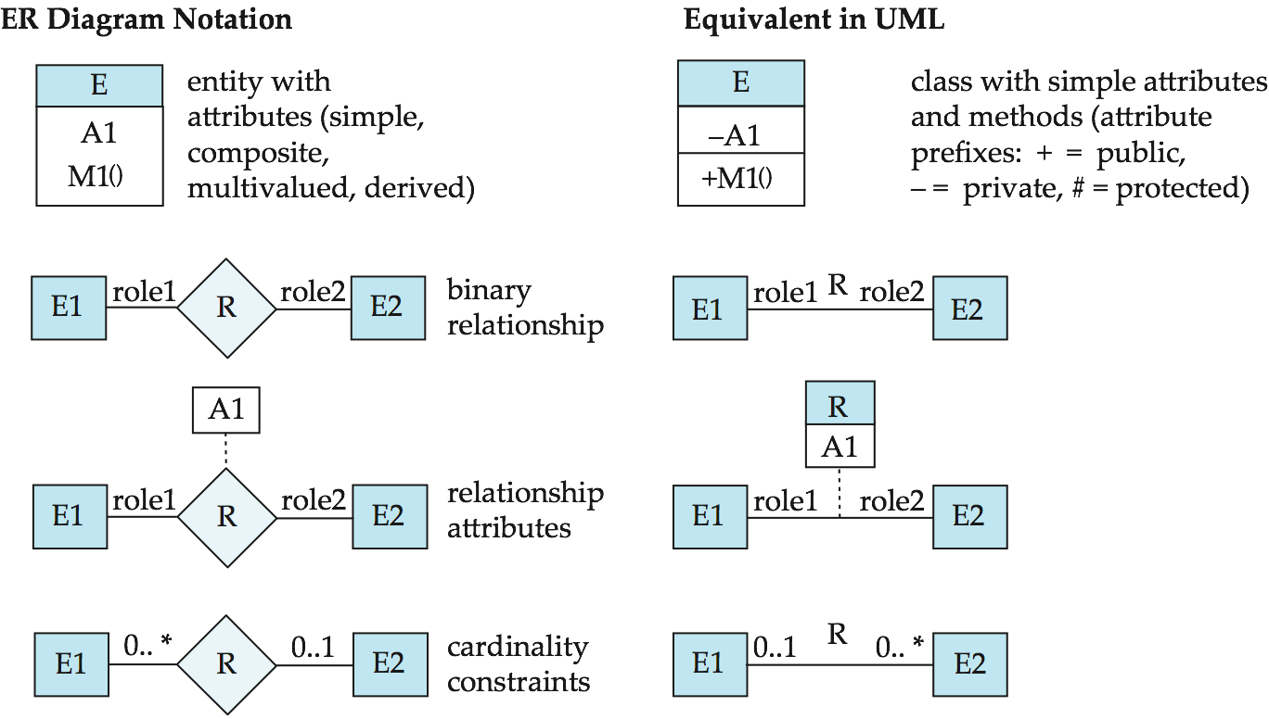
UML Diagrams
Notes:
UML: Unified Modeling Language
UML has many components to graphically model different aspects of an entire software system
UML Class Diagrams correspond to E-R Diagram, but several differences.

Slide 61
Summary
Minimize the redundancy of schemas
Transformation of N-ary relationships into multiple binary relationships
Concepts and objects may, in certain cases, be represented by entities, relationships, or attributes
Specialization and generalization define a relationship between a higher-level entity set and one or more lower-level entity sets
Aggregation is an abstraction in which relationship sets (along with their associated entity sets) are treated as higher-level entity sets, and can participate in relationships
Representation using UML diagrams

Slide 62
Summary
The entity-relationship (ER) data model is a widely used data model for database design
Unary, binary, ternary relationships
1:1, 1:M, M:1, M:N relationships
Mapping cardinalities express the number of entities to which another entity can be associated via a relationship set: total and partial
An entity set that does not have sufficient attributes to form a primary key is termed a weak entity set
Representation of composite and multi-valued attributes
Derived attributes are calculated from other attributes or entities

Slide 63
Review Terms
Specialization and generalization
Superclass and subclass
Attribute inheritance
Single and multiple inheritance
Condition-defined
User-defined membership
Disjoint
Overlapping
Generalization
Total and partial generalization
Aggregation
UML representation

Slide 64
CMSC 508 Database Theory
Review Terms
Entity-relationship data model
Entity and entity set
Attributes
Domain
Simple and composite attributes
Single-valued attributes
Multi-valued attributes
Null value
Derived attribute
Relationship and relationship set
Unary, Binary, Ternary relationship
Degree of relationship set
Role
Recursive relationship set
ER diagram
Mapping cardinality
One-to-one relationship
One-to-many relationship
Many-to-one relationship
Many-to-many relationship
Total participation
Partial participation
Weak entity
Strong entity
Discriminator attributes
Identifying relationship

Slide 65
Star Wars Practice
The rebel alliance destroyed the Star killer base and Kylo Ren is furious to rebuild the First Order database to track the enemies, droids, and ships. The database backup was described by a Storm trooper dropout as:
Every enemy in the galaxy is registered with their name, birthdate, and planet. We want to keep the family tree of the enemies, then we should be able to relate everyone with their father and mother (and to their grandfather, etc.). An enemy may own multiple droids, but every droid must have just one owner. Droids are identified by a unique serial number. Spaceships maybe either civil (passenger count) or military (cannon count), but they all have a name and speed (factor of light speed). Enemies may pilot none or just one ship, but every ship requires a minimum of one pilot and optionally a copilot.
Draw an ERD to represent the given problem. Remember to include the relationships, roles, cardinality, and participation.

